Slide 1








MAHARISHI UNIVERSITY OF INFORMATION TECHNOLOGY · NOIDA
DPS
Dual Disease Module
Diabetes + Cardiovascular
Gradient Boosting
DIAGNOSTIC PREDICTION SUITE
90.25% Accuracy / AUC 0.956
Machine Learning Powered Risk Screening for
Diabetes & Cardiovascular Disease
Random Forest
82.25% Accuracy / AUC 0.901
Ravada Siddharth · Arpit Kumar · Kanak Sharma
B.Tech CSE with Data Science | 6th Semester | Batch 2023–27
Minor Project · Academic Year 2026–27
Django Web App
AJAX · SQLite · Chart.js
UNDER THE SUPERVISION OF DR. KUSUM LATA MAM
DEPT. OF DATA SCIENCE AND ARTIFICIAL INTELLIGENCE
SMOTE Balanced
2,000 Samples per Model
Python 3.10+
Django 5.x
scikit-learn
Chart.js
SQLite

Slide 2

THE GLOBAL BURDEN OF PREVENTABLE CHRONIC DISEASE
537M+
~50%
17.9M
Adults with diabetes
globally (IDF 2025)
Cases undiagnosed
until complications arise
Deaths from CVD
per year (WHO)
THE PROBLEM
OUR SOLUTION
• Lab tests (HbA1c, fasting glucose) are costly
• ~50% diabetic cases missed by conventional screening
• Rural India lacks accessible diagnostic infrastructure
• CVD symptoms often unnoticed until severe
• Instant, low-cost prediagnostic web screening
• Dual-disease coverage (Diabetes + CVD) in one tool
• 90.25% accuracy · AUC 0.956 via ML + SMOTE
• Early intervention reduces complications by 58%

Slide 3

VERSION EVOLUTION
From single-model script → full-stack dual-disease web app
v1–v2 · OLD VERSION
v3.1 · DPS (CURRENT)
Single disease: Diabetes only
Random Forest — 768 samples, no SMOTE
8 raw features, no engineering
No web interface — Jupyter notebook
No result persistence or database
No visualisation charts
No PDF export
Class-imbalanced training data
Accuracy ~76–80% | AUC ~0.84
Dual disease: Diabetes + Cardiovascular
GradientBoosting + RandomForest, 2000 samples
11 features (3 engineered: GlucoseAge, BMIAge, InsulinGlucose)
Full Django 5.x web application (AJAX)
SQLite database — all predictions persisted
Radar · Feature Importance · Distribution charts
Branded PDF export via jsPDF
SMOTE balanced (1000 : 1000 per class)
Accuracy 90.25% / 82.25% | AUC 0.956 / 0.901

Slide 4


ML MODELS & DATASETS
TWO TRAINED CLASSIFIERS — TWO DISEASE MODULES
DIABETES MODULE
HEART DISEASE MODULE
Algorithm
Gradient Boosting Classifier
Algorithm
Random Forest Classifier
Dataset
Pima Indians — UCI ML Repo
Dataset
Synthetic — Framingham/Cleveland
Samples
2,000 (SMOTE — 1k : 1k)
Samples
2,000 (SMOTE+undersampling)
Features
8 raw + 3 engineered = 11
Features
13 clinical parameters
Engineered
GlucoseAge · BMIAge · InsulinGlucose
Key Features
Age · CP type · Thalach · Oldpeak · CA
n_estimators
250 | max_depth: 5 | lr: 0.08
n_estimators
300 | max_depth: 12 | balanced
Test Accuracy
90.25%
Test Accuracy
82.25%
ROC-AUC
0.9557
ROC-AUC
0.9007
Top Feature
GlucoseAge — 32.34% importance
Top Feature
ca (major vessels) — highest importance

Slide 5




SYSTEM ARCHITECTURE
Django MVT — 4-Layer Stack
Presentation Layer
1
index.html · Chart.js · jsPDF · Web Audio API · CSS Day/Night mode
▼
Application Layer
2
views.py · forms.py · urls.py · AJAX JsonResponse · Django ORM
▼
ML Service Layer
3
ml_service.py · GradientBoosting · RandomForest · StandardScaler
▼
Data Layer
4
SQLite3 · PredictionRecord model · JSONField · Auto-timestamp

Slide 6

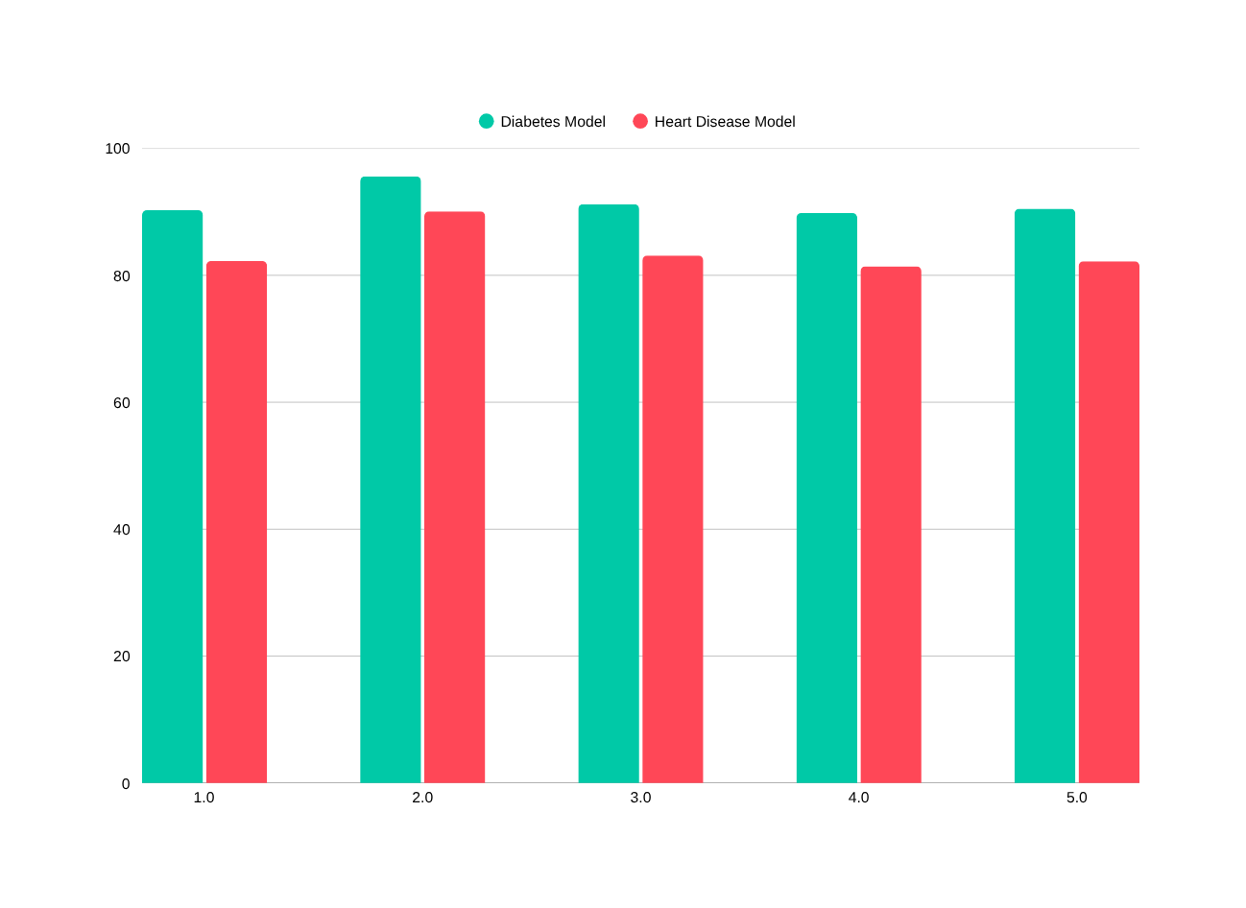
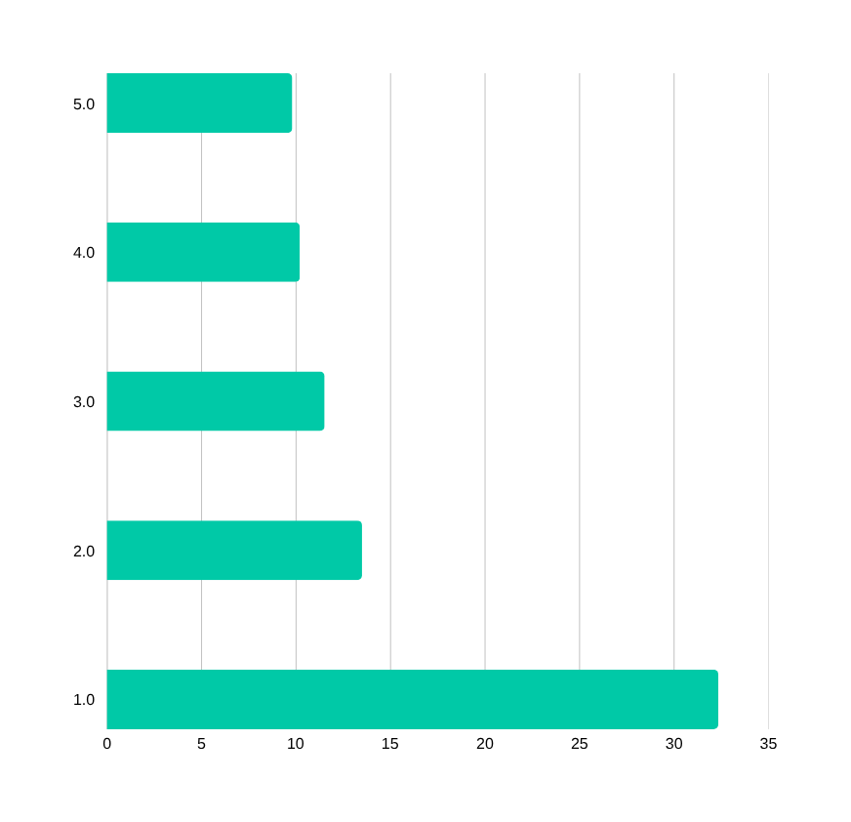
MODEL PERFORMANCE
Accuracy, ROC-AUC & Feature Importance
90.25%
0.9557
82.25%
0.9007
Diabetes Accuracy
Diabetes ROC-AUC
CVD Accuracy
CVD ROC-AUC
* Engineered features outperform raw inputs in feature importance ranking

Slide 7
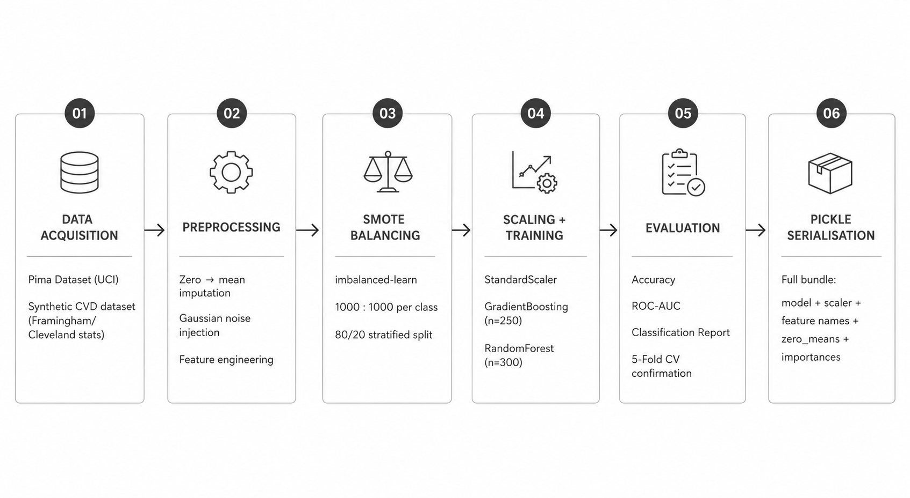
METHODOLOGY PIPELINE
End-to-end flow: data → trained model → live prediction

Slide 8
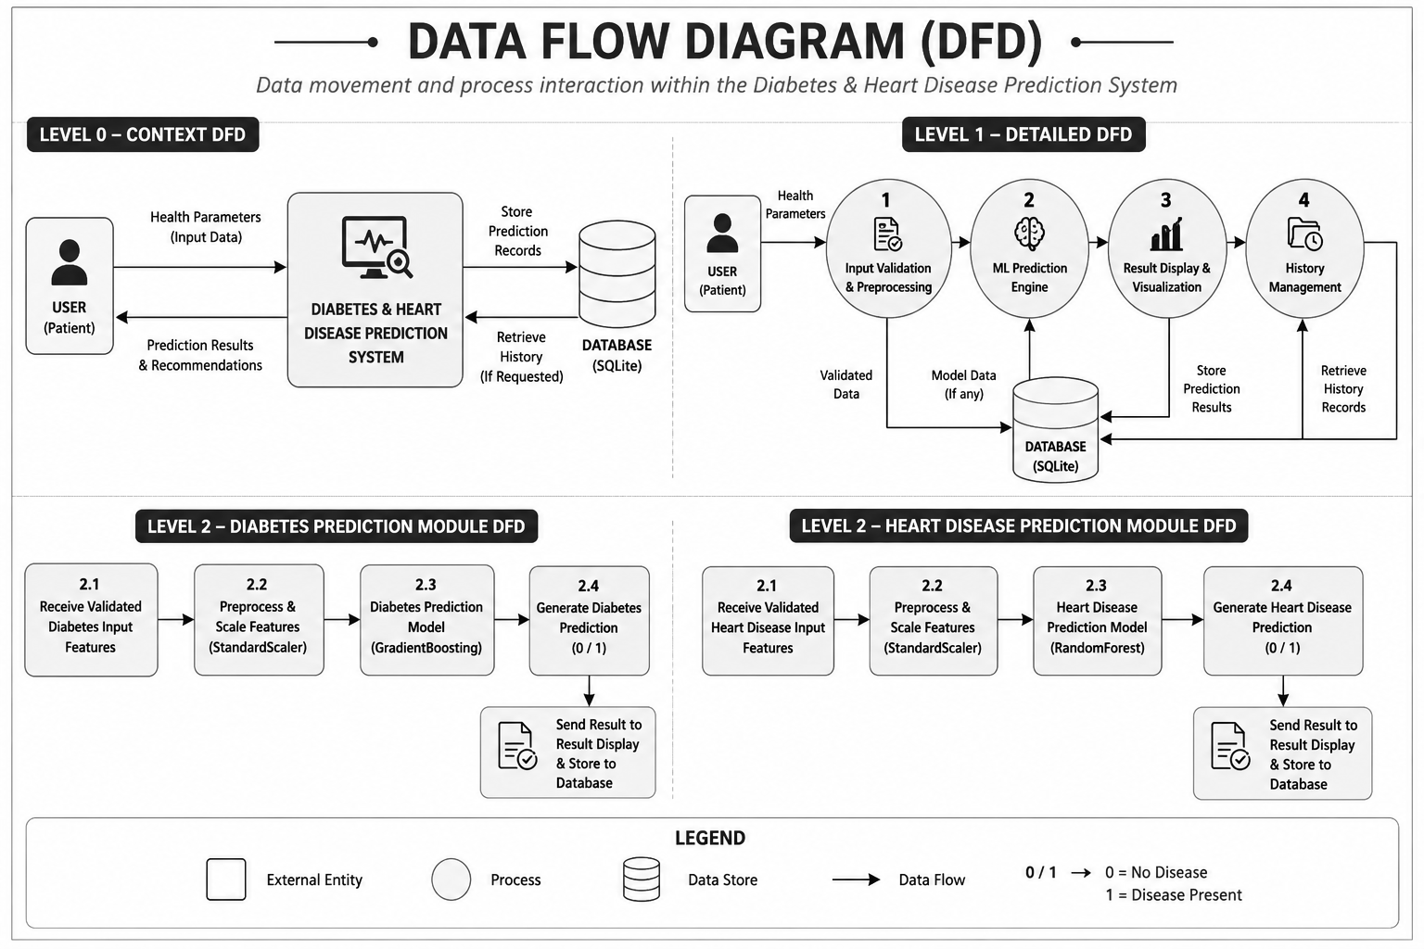
USER–SYSTEM DATA FLOW
Layer-wise structure of the proposed ML-based diagnostic system

Slide 9

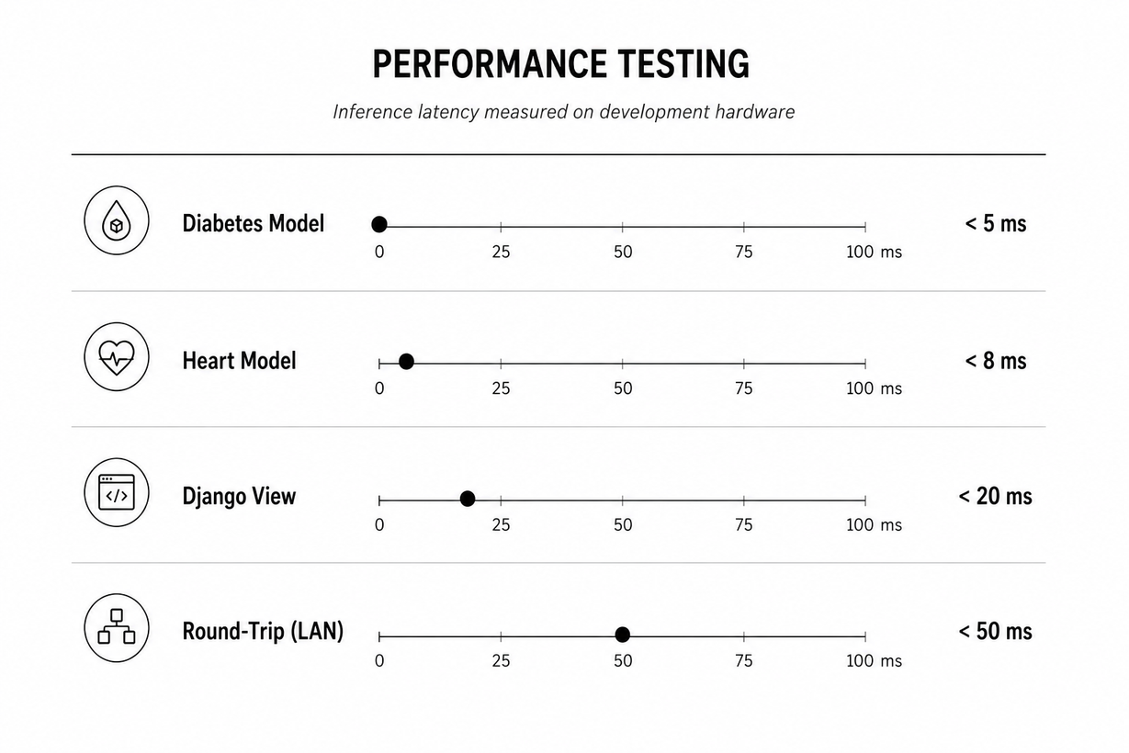
RESULTS & TESTING
Test cases, accuracy metrics & functional verification
Sample Functional Test Cases
Performance Testing
Test Case | Input | Result | Pass?
Low-risk diabetes | Glucose=85, BMI=22, Age=25 | < 30%, Low | ✔
High-risk diabetes | Glucose=200, BMI=40, Age=55 | > 60%, High | ✔
Zero imputation | Glucose=0 (missing value) | Replaced ~121 | ✔
Invalid input | Age = -5 | 400 error JSON | ✔
Low-risk CVD | Age=35, chol=160, CP=0 | < 30%, Low | ✔
High-risk CVD | Age=70, exang=1, ca=3 | > 60%, High | ✔
PDF export | Click Export after prediction | A4 PDF saved | ✔
History persistence | 9 sequential predictions | Last 8 shown | ✔
Avg. inference latency: Diabetes < 5 ms · Heart < 8 ms · Full round-trip < 50 ms (LAN)

Slide 10
Thank You
Questions & Discussion
Ravada Siddharth
Arpit Kumar
Kanak Sharma
ML Integration &
Data Pre-Processing
ML Engineer
& Data Analyst
Frontend dev
✦ 90.25% diabetes accuracy · AUC 0.9557
✦ 82.25% CVD accuracy · AUC 0.9007
✦ Full-stack Django web app — AJAX, SQLite, Chart.js, jsPDF
✦ SMOTE-balanced 2,000-sample datasets per model
github.com/Sidvortex/DPS · B.Tech CSE-DS, MUIT Noida · Batch 2023–27

