Slide 1
Hate Speech Detection
By Group 2: Still Processing…

Slide 2

Ready? If your view was correct, all strippers would be millionaires.
Reality: Strippers are dirt poor sociopaths.
Notes:
Caroline:

Slide 3
Introduction

Slide 4
Introduction
Hate Speech
“denial of the values of tolerance, inclusion, diversity and the very essence of the human rights norms and principles”
(UN, Cited May 2022)
“any form of non-acceptable language (profanity) or a targeted offence, which can be veiled or direct. This includes insults, threats, and posts containing profane language or swear words” (Zampieri et al., 2019a)
“when left unchecked, expressions of hatred can [. . . ] harm social cohesion, peace and development, as it lays the ground for conflicts and tensions, wide scale human rights violations, including atrocity crimes.”
(UN, Cited May 2022)
4
Notes:
Caroline:The growth and widespread availability of the internet and social media platforms allows people to interact with each other regardless of time or location (Hee et al., 2018). However, apart from friendly interactions, it also enables hate speech that could possibly reach a large crowd. The exact definition of hate speech differs from platform to platform and dataset to dataset (Fortuna and Nunes, 2018; MacAvaney et al., 2019). According to the UN, it entails “denial of the values of tolerance, inclusion, diversity and the very essence of the human rights norms and principles”(Cited May 2022). Although this happens online and not face-to-face, “when left unchecked, expressions of hatred can [. . . ] harm social cohesion, peace and development, as it lays the ground for conflicts and tensions, wide scale human rights violations, including atrocity crimes.” (UN, Cited May 2022) Accordingly, it is of importance to detect and eliminate harmful content.

Slide 5
Introduction
Traditional Model
Ensemble: SGD + LR + Nu-SVM + C-SVM
Neural Model
Majority vote: 5 RoBERTas
5
Notes:
Caroline:For the non-neural part of the task, we created an ensemble model using models based on an SGD classifier, a logistic regression classifier andtwo versions of SVM classifiers: a Nu-Support Vector Classifier and a C-Support Vector Classifier. All of the models were trained on features and preprocessed posts that were adjusted for the model, in addition all parameters and weights were optimised. For the neural part of the task, five RoBERTa models were given differently preprocessed posts as input and, using a majority vote, we aimed to return a final label. However, due to a coding error, the labelling was done by a single RoBERTa

Slide 6
Related Research

Slide 7
Related Research
Surface Level Features
Bag of Words: frequency dictionary
TF-IDF: term frequency-inverse document frequency
Word n-grams
Lose syntactic and semantic context
Character n-grams
Retrieve context
(Burnap and Williams, 2016)
Overcomes typing errors & spelling variations
(Schmidt and Wiegand, 2017; Fortuna and Nunes, 2018; Alorainy et al. 2018)
Range 1-5
(Alorainy et al., 2018; MacAvaney et al., 2019; Burnap and Williams, 2016)
7
Notes:
Caroline: Many features have already been explored when detecting hate speech. Amongst others, Schmidt and Wiegand (2017) and Alorainy (2018) claim that it is good to expand the textual, surface features with other features as well. This is an overview of the state-of-the-art features that inspired us and how we implemented them.
Bow = frequency dict
Bow: could lose context/syntactic meaning → character n grams could restore this + typing error spelling variation
Bag of Words (BoW) A common way to represent a text, is by creating a BoW, which entails generating a frequency dictionary based on the training data. This can be done by using either word or character n-grams. Whereas a BoW created on the basis of words loses the syntactic sequence and consequentially the semantic context, a BoW created on the basis of character n-grams partially overcomes this (Burnap and Williams, 2016). Next to that, character n-grams also overcome typing errors or spelling variation, a common characteristic of online writings (Schmidt and Wiegand, 2017; Fortuna and Nunes, 2018; Alorainy et al., 2018). Often, an n-gram range of 1-5 is used (Alorainy et al., 2018; MacAvaney et al., 2019; Burnap and Williams, 2016), this range was also explored in our models. Next to that, we explored word n-grams as well as character n-grams. 2 TF-IDF A variation on the ‘regular’ BoW is the term frequency-inverse document frequency (TFIDF). It differs from a BoW because it does not calculate just the frequency, but “the importance of a word in a document within a corpus and increases in proportion to the number of times that a word appears in the document” (Fortuna and Nunes, 2018). Just like a BoW, this can be built on either word or character n-grams. A TF-IDF based on character n-grams seems to be a recommended method for classifying hate speech (Markov and Daelemans, 2021; Alorainy et al., 2018; MacAvaney et al., 2019; Burnap and Williams, 2016). We explored both the regular BoW (using

Slide 8
Related Research
Surface Level Features
Capitalisation
(Burnap and Williams, 2016; MacAvaney et al., 2019)
Interpunction
(Alorainy et al., 2018; MacAvaney et al., 2019)
URL’s, @ mention, hashtags
(Davidson et al., 2017; Gambino and Pirrone, 2020)
Emojis
8
Notes:
Caroline: Other surface level features Apart from the text itself, there are other surface features relating to it, such as capitalisation (Burnap and Williams, 2016; MacAvaney et al., 2019), interpunction (Alorainy et al., 2018; MacAvaney et al., 2019), and the frequency of URL’s, @ mentions and hashtags (Davidson et al., 2017; Gambino and Pirrone, 2020). Because of that, the influence of casefolding, leaving out the punctuation or adding it as an extra feature, as well as the frequency of URL’s, mentions and hashtags were also explored. Lastly, there is another surface level feature typical for online texts, namely emojis. We wanted to make sure that our models took these into account as well. Accordingly, we used the demojize function from the emoji package to translate every emoji into its corresponding textual string.

Slide 9
Related Research
Linguistic Features
Parts-of-speech
(Markov and Daelemans, 2021; Alorainy et al., 2018)
Custom POS tagger
(Gambino and Pirrone, 2020)
Lemmatization
(Markov and Daelemans, 2021; Markov et al., 2021; Van Hee et al., 2018)
9
Notes:
Caroline:
Parts-of-speech (POS) Since tagging the partsof-speech of the words in a text can uncover the role of a word in its context (Fortuna and Nunes, 2018), using this linguistic feature has proved to be beneficial as well. Several researchers have either used POS in their representation of the text or as an additional feature (Markov and Daelemans, 2021; Alorainy et al., 2018). We opt for adding nltk’s universal tagset as an extra textual feature. Apart from translating every word to its corresponding POS, we added custom tags for URL’s, @ mentions and hashtags to incorporate these features as well, just as Gambino and Pirrone (2020) did.
Lemmatization Another feature that could possibly improve a model, is lemmatizing the words of a text. Just as with POS tagging, several researchers have either used lemmas in their representation of the text or as an additional feature (Markov and Daelemans, 2021; Markov et al., 2021; Hee et al., 2018). This could be beneficial because all variants of the same word get transformed into the same root form. This could lead to less sparse data. We explored whether our models improved by using lemmatized tweets or by adding them as an extra feature

Slide 10
Related Research
Semantic Feature
Semantic lexicon
(Alorainy et al., 2018; Markov and Daelemans, 2021)
Vader
(Hutto and Gilbert, 2014)
AFINN
(Arup Nielsen, 2011)
10
Notes:
Caroline:
Sentiment Lexicon Using a sentiment lexicon improves results as well (Alorainy et al., 2018; Markov and Daelemans, 2021). We will create extra feature columns using Vader, a lexicon and rule-based sentiment analysis library that returns a sentiment score between -1 (maximally negative) and 1 (maximally positive); and using the AFINN lexicon, which returns a similar score but in the range of -5 to 5. Vader proved to be highly accurate, even more than human annotators (Hutto and Gilbert, 2014). Next to that, AFINN proved to be very promising as well (Arup Nielsen, 2011). ˚ Both lexicons were created particularly for microblogs (such as tweets)

Slide 11
Related Research
Traditional Model
Stochastic Gradient Descent Model
(Sharif et al., 2020)
Logistic Regression Model
(Alorainy et al., 2018; Davidson et al., 2017)
Support Vector Machine
(Markov and Daelemans, 2021; Burnap and Williams, 2016; MacAvaney et al., 2019)
Neural Model
Hard voting: SVM + BERT + RoBERTa
Markov and Daelemans (2019)
11
Notes:
Caroline:
As already mentioned, our traditional model is an ensemble model based on an SGD classifier, a logistic regression classifier, and two SVM models. We opted for these models since they have proved to yield accurate results in the past. For instance, Markov and Daelemans (2021), Burnap and Williams (2016), and MacAvaney et al. (2019), used the SVM algorithm in their research and it obtained excellent results. Next to that, in researches by, amongst others, Alorainy et al. (2018) and Davidson et al. (2017), the logistic regression model yielded reliable results as well. Lastly, previous research has also shown that the SGD classifier is promising (Sharif et al., 2020), especially since the gradient of the loss is estimated each sample at a time. For the neural model we base our methodology on that of a 2021 paper on the improving of cross-domain hate speech detection by Markov and Daelemans. They brought our attention to the pretrained language model RoBERTa (Liu et al., 2019). Markov and Daelemans then combined this RoBERTa with other models through a hard majority-voting method. This inspired us to apply a hard majority vote to the results of 5 RoBERTas which each underwent a unique preprocessing of train and test data. At first the inclusion of Berts (Devlin et al., 2019) within the majority vote was also intended, however the top 5 RoBERTas all outperformed the very best Bert. Unfortunately, the majority vote’s result was not exported correctly. Instead, the result calculated by a single RoBERTa was wrongfully selected for the result exportation

Slide 12
Methodology
Notes:
Caroline: We trained our models on the Offensive Language Identification Dataset (OLID) (Zampieri et al., 2019a) and evaluated them on four more datasets, of which one was in-domain.

Slide 13
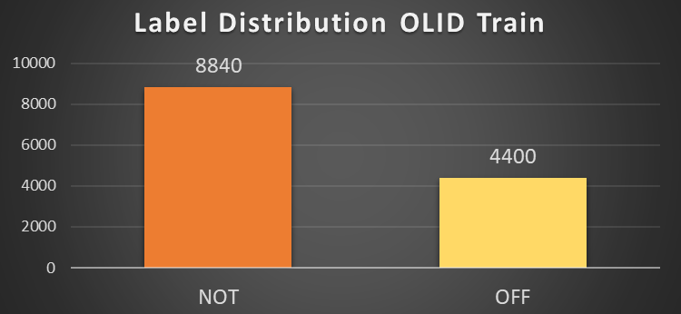
Methodology
OLID
English tweets
Two or three annotators
Offensive or not offensive
(Zampieri et al., 2019)
Train Data
13
Notes:
Caroline:
OLID The OLID training corpus consists of 13240 annotated English tweets and was created in the sphere of the OffensEval 2019 shared task organised at SemEval 2019 (Zampieri et al., 2019b). The task included differentiating offensive from non-offensive tweets, categorising offence types and identifying the target. Accordingly, the tweets are annotated hierarchically on those three levels by crowdsourced, experienced annotators. Every tweet was annotated by two annotators and in case of disagreement, a third annotator was called upon. Tweets were regarded offensive if they contained “any form of non-acceptable language (profanity) or a targeted offence, which can be veiled or direct. This includes insults, threats, and posts containing profane language or swear words” (Zampieri et al., 2019a). As stated before, we only focus on the more coarse grained classification, namely whether a tweet is offensive or not. Before fitting the models on the tweets, we normalised html specific characters and other nonutf8 encodings which were sometimes still present in the dataset. After that, during the training and optimization stage of our traditional models, we used 80% of this dataset as a training set and used the remaining 20% as a test set. In the training and optimization stage of our neural models, 20% of the training data was set apart as well as shuffled at the same random state for all 5 models. The statistics of this datase

Slide 14
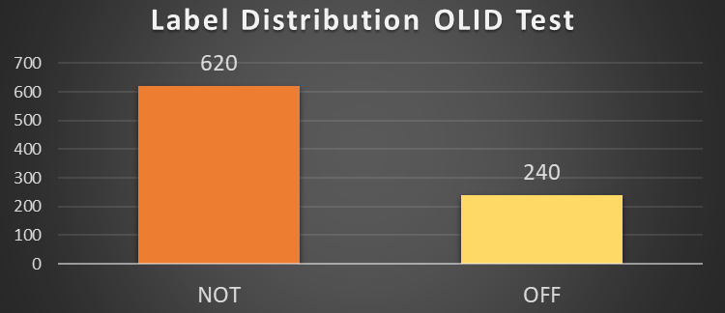
Methodology
OLID
English tweets
Two or three annotators
Offensive or not offensive
(Zampieri et al., 2019)
Test Data
14
Notes:
Caroline:
The first test set are the remaining 860 indomain tweets of the OLID corpus (Zampieri et al., 2019a). When evaluating our models on the test sets, all 13240 tweets were used for the training.

Slide 15
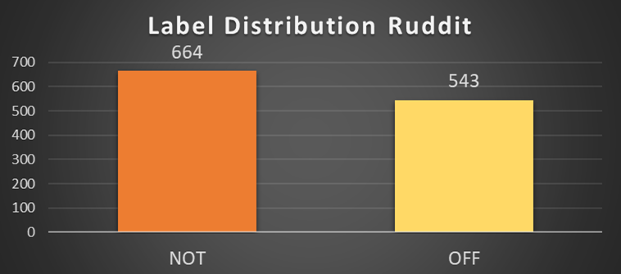
Methodology
Ruddit
English Reddit posts
Best-worst scaling
[-1, 1] → [-0.4, 0.4]
(Hada et al., 2021)
Test Data
15
Notes:
Caroline:
Ruddit The second test set is a sample of approximately 1200 English posts from the Ruddit dataset (Hada et al., 2021). This dataset consists of posts from several subreddits of Reddit. The posts were annotated by crowdsourced US annotators with a high approval rate. The posts all received a score from -1 (maximally supportive) to 1 (maximally offensive). This score was assigned by best-worst scaling. Every annotator was presented a four tuple of posts and had to rank them from maximally supportive to maximally offensive. Every four tuple was annotated by six annotators. For our research, posts that received a score lower than -0.4 were interpreted as not offensive and posts that received a score higher than 0.4 were interpreted as offensive. That way, borderline cases were excluded

Slide 16
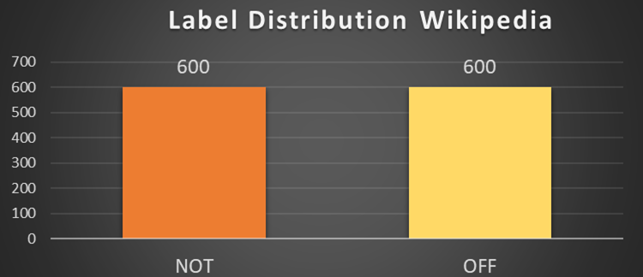
Methodology
Wikipedia
English Wikipedia comments
Manually annotated
Non-toxic, moderately offensive, severely offensive
(AI, 2018)
Test Data
16
Notes:
Caroline:
Wikipedia The third test dataset is a sample of English Wikipedia comments used in the first Jigsaw competition on Kaggle (AI, 2018). The teams had to predict probabilities for different types of (non-)toxic posts. The comments were manually annotated. The sample that we used contains nontoxic comments, moderately offensive comments and severely offensive comments.

Slide 17
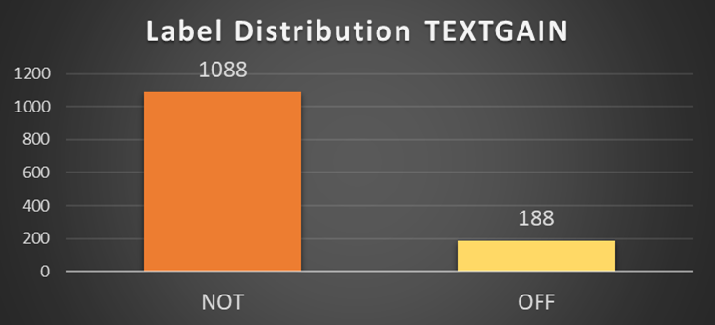
Methodology
TEXTGAIN
English football tweets
Manually labelled as offensive or not offensive
Test Data
17
Notes:
Caroline:
TEXTGAIN The fourth dataset was obtained from the AI company TEXTGAIN. It consists of English football tweets that have been manually labelled as offensive or not offensive. Once again, when loading in the test data, we normalised html specific characters and other non-utf8 encodings which were still be present in the dataset.

Slide 18
Methodology
Baselines
 | OLID | Ruddit | Wikipedia | Total | TEXTGAIN
Most Frequent Class | 0.28 | 0.31 | 0.33 | 0.30 | 0.46
SpaCy BoW-Model | 0.70 | 0.66 | 0.86 | 0.73 | 0.54
Bert | 0.81 | 0.70 | 0.90 | 0.81 | 0.47
HateBert | 0.82 | 0.68 | 0.91 | 0.81 | 0.48
18
Notes:
Morine:

Slide 19
Traditional
Classification

Slide 20
Traditional Classification
Ensemble Model
Stochastic Gradient Descent Model (SGD)
Logistic Regression Model (LR)
Linear Support Vector Machine 1 (SVM1)
Linear Support Vector Machine (SVM2)
Random state of 42
Class weights are balanced
20
Notes:
MORINE: balanced because of unequal class devision,

Slide 21
Traditional Classification
SGD Model
SGDClassifier(
random_state=42, class_weight='balanced’,
early_stopping=True, n_iter_no_change=3,
penalty='elasticnet’, loss='log'
alpha=0.001)
Count: Demojised tweet column
Tfidf: POS column (demojised tweets)
Count: Lemma column (demojised tweets)
Afinn
vaderSentiment: ‘pos’, ‘neg’ and ‘compound’
21
F1 score of 0.71
Notes:
MORINE:
Textual -> MaxAbsScaler()
Numeric ->MinMaxScaler()

Slide 22
Traditional Classification
LR Model
LogisticRegressionCV(
random_state=42, class_weight='balanced',
cv = 2, scoring='f1_macro’,
penalty = 'l1’, solver = 'saga’,
n_jobs=-1, verbose=2, multi_class='ovr')
Tfidf: Demojised tweet column (without hashtags)
Count: POS column (demojised tweets without punctuation)
Afinn
vaderSentiment: ‘neg’
22
F1 score of 0.71
Notes:
MORINE:
Textual -> MaxAbsScaler()
Numeric ->MinMaxScaler()

Slide 23
Traditional Classification
SVM1 Model
SVC(
random_state=42, class_weight='balanced’,
kernel='linear', C=0.1, verbose = 2,
probability=True)
Tfidf: Demojised tweet column (without punctuation)
Tfidf: POS column (basic tweets)
Afinn
vaderSentiment: ‘pos’ and ‘compound’
F1 score of 0.72
23
Notes:
MORINE:
Textual -> MaxAbsScaler()
Numeric ->MinMaxScaler()

Slide 24
Traditional Classification
SVM2 Model
NuSVC(
random_state=42, class_weight='balanced’,
probability=True,
verbose=2)
Tfidf: Demojised tweet column (without hashtags)
Tfidf: POS column (basic tweets)
Afinn
vaderSentiment: ‘pos’ and ‘compound’
24
Macro Average F1 score of 0.72
Notes:
MORINE:
Textual -> MaxAbsScaler()
Numeric ->MinMaxScaler()

Slide 25

Traditional Classification
Ensemble Model
VotingClassifier(
estimators=[
('sgd2', sgd_pipe2), ('log1', log_pipe1), ('svm1', svm_pipe), ('svm2', nu_svm_pipe)
],
verbose= 10, voting='soft’,
weights=[3, 3, 2, 3])
Soft Voting
Macro Average F1 score of 0.74
25
Notes:
MORINE:

Slide 26
Neural
Classification

Slide 27
Neural Classification
5 RoBERTa Models
Hard Majority Vote
27
Notes:
Siebe: For the neural model we base our methodology on that of a 2021 paper on the improving of cross-domain hate speech detection by Ilia Markov and Walter Daelemans (Markov et al., 2021). They brought our attention to the pretrained language model RoBERTa (Liu et al., 2019). Markov and Daelemans then combined this RoBERTa with other models through a hard majority-voting method (Markov et al., 2021). This inspired us to apply a hard majority vote to the results of 5 RoBERTas which each underwent a unique pre-processing of train and test data. At first the inclusion of BERTs (Devlin et al., 2019) within the majority vote was also intended, however the top 5 RoBERTas all outperformed the very best BERT.

Slide 28
Neural Classification
 | # @User | Tokenized | Emoji | Punctuation | Lemmatized
roberta_tweet | ✓ |  | ✓ | ✓
roberta_hashtag_tweet |  |  | ✓ | ✓
roberta_token_tweet |  | ✓ | ✓ | ✓
roberta_token_demojize |  | ✓ |  | ✓
roberta_lemma | ✓ |  | ✓ |  | ✓
28
Notes:
Siebe:

Slide 29
Neural Classification
RoBERTa
ClassificationModel(
'roberta’, 'roberta-base', num_labels=2,
args=model_args, use_cuda=True)
model_args.num_train_epochs=6
model_args.train_batch_size=64
model_args.learning_rate=1e-5
model_args.max_seq_length=128
Early Stopping
Pickle
29
Notes:
Siebe: Beyond the pre-processing, every RoBERTa model is the same; the model is a classification model from the simpletransformers library and is set to run a maximum of 6 epochs with a batch size of 64 and a learning rate of 1e-5. At first, we altered the max sequence length to the maximum length of a tweet with the idea to have the model be able to handle tweets of every size. Still we ended up using the default value of 128, because it garnered better results. In addition, an early stopping was included with a delta of 0.01 – the improvement over the best evaluation loss which is necessary for a checkpoint to be considered better – and a patience of 3. Through the use of evaluate_during_training (at 83 steps) these values seemed to result in an optimal decrease and stabilisation of training loss and validation loss after running the model on the roberta-base from huggingface.

Slide 30
Neural Classification
Majority Vote
 | twt | tok_tw | tok_d | lem | hsh | sum | mv
0 | 1 | 1 | 1 | 1 | 1 | 5 | 1
1 | 0 | 0 | 0 | 0 | 0 | 0 | 0
2 | 0 | 0 | 0 | 0 | 0 | 0 | 0
3 | 0 | 0 | 0 | 0 | 0 | 0 | 0
4 | 0 | 0 | 0 | 0 | 0 | 0 | 0
5 | 1 | 1 | 1 | 1 | 1 | 5 | 1
6 | 0 | 1 | 1 | 1 | 1 | 4 | 1
7 | 1 | 1 | 1 | 1 | 1 | 5 | 1
8 | 0 | 0 | 0 | 0 | 0 | 0 | 0
9 | 0 | 0 | 0 | 0 | 0 | 0 | 0
30
Notes:
Siebe: All 5 RoBERTas each return a prediction for each tweet: Offensive or non-offensive. Through the majority vote, this means a tweet is only labelled as offensive – or non-offensive – when 3 or more RoBERTas label it as such. In theory this sounds advantageous, since it allows us to apply 5 models instead of 1.
However, after getting the results through the OLID train and test data it was very important to consider whether the hard majority vote was actually worthwhile

Slide 31
Neural Classification
F1-scores for the best performing RoBERTas + Majority Vote
 | Accuracy | Macro Average
roberta_token_demojize | 0.82 | 0.80
roberta_token_tweet | 0.82 | 0.80
roberta_hashtag_tweet | 0.81 | 0.79
roberta_tweet | 0.81 | 0.79
roberta_lemma | 0.80 | 0.78
majority vote | 0.82 | 0.80
31
Notes:
Siebe:

Slide 32
Neural Classification
Precision and recall for the best performing RoBERTas + Majority Vote
 | Precision |  | Recall
 | OFF | NOT | OFF | NOT
roberta_token_demojize | 0.77 | 0.85 | 0.69 | 0.89
roberta_token_tweet | 0.75 | 0.85 | 0.71 | 0.87
roberta_hashtag_tweet | 0.70 | 0.87 | 0.77 | 0.83
roberta_tweet | 0.70 | 0.87 | 0.77 | 0.83
roberta_lemma | 0.69 | 0.87 | 0.76 | 0.82
majority vote | 0.73 | 0.86 | 0.74 | 0.86
32
Notes:
Siebe: as can be seen when comparing Table #A and Table #B, the RoBERTas with the highest macro average also had the lowest recall of offensive data. After the majority vote, however, while the macro average remains equally strong, the recall of offensive data increases. This happens at the cost of the recall of non-offensive data. However, less is lost than is gained through the recall of offensive data. Thus, we consider the majority vote to be worthwhile.

Slide 33
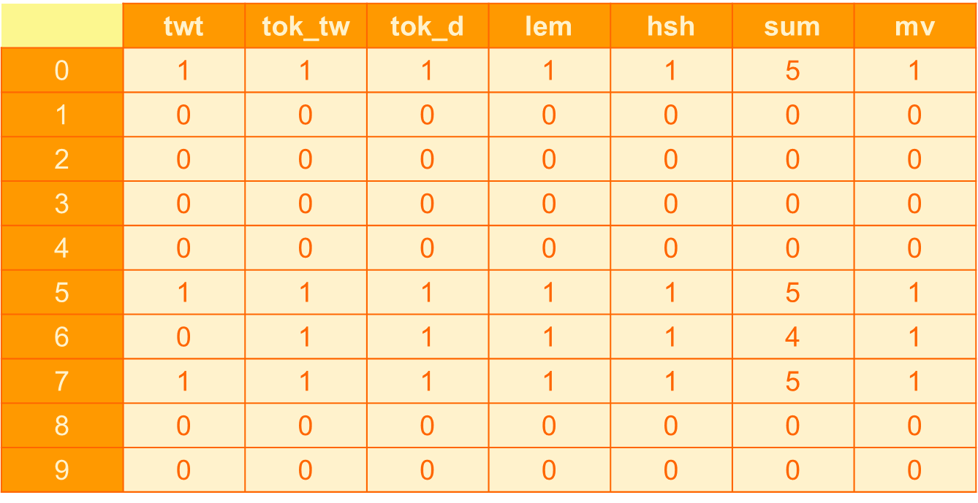
Neural Classification
Majority Vote
33
Notes:
Siebe: Normally, the column with all the labelling decided after the majority vote would then receive the appropriate namings (OFF and NON) and id-assignment, but through a coding error made by Siebe in the final stages of the project, this instead happened to the very first column in the majority vote dataframe. This column was roberta_tweet.
This means that the values assigned to ‘majority vote’ in Table #A and Table #B were determined when this error was not in place and still support our initial hypotheses, but that the results from our project onward do not reflect our original aspirations regarding the neural model.

Slide 34
Results and
Error Analysis
Notes:
Morine (en Siebe)

Slide 35
15 per cent offensive data
Results and Error Analysis
Results
 | Ruddit | OLID | Wikipedia | Total | TEXTGAIN
Traditional Ensemble | 0.661 | 0.753 | 0.874 | 0.76 | 0.434
Neural RoBERTa | 0.713 | 0.803 | 0.912 | 0.808 | 0.504
Clear division between offensive and non-offensive
Similar format to train data
35
Similar format to train data
Notes:
Morine:

Slide 36
Results and Error Analysis
Baselines
 | OLID | Ruddit | Wikipedia | Total | TEXTGAIN
Most Frequent Class | 0.28 | 0.31 | 0.33 | 0.30 | 0.46
SpaCy BoW-Model | 0.70 | 0.66 | 0.86 | 0.73 | 0.54
Bert | 0.81 | 0.70 | 0.90 | 0.81 | 0.47
HateBert | 0.82 | 0.68 | 0.91 | 0.81 | 0.48
Traditional Ensemble | 0.753 | 0.661 | 0.874 | 0.76 | 0.434
Neural RoBERTa | 0.803 | 0.713 | 0.912 | 0.808 | 0.504
36
Notes:
Morine:

Slide 37
Results and Error Analysis
Baselines
 | OLID | Ruddit | Wikipedia | Total | TEXTGAIN
Most Frequent Class | 0.28 | 0.31 | 0.33 | 0.30 | 0.46
SpaCy BoW-Model | 0.70 | 0.66 | 0.86 | 0.73 | 0.54
Bert | 0.81 | 0.70 | 0.90 | 0.81 | 0.47
HateBert | 0.82 | 0.68 | 0.91 | 0.81 | 0.48
Traditional Ensemble | 0.753 | 0.661 | 0.874 | 0.76 | 0.434
Neural RoBERTa | 0.803 | 0.713 | 0.912 | 0.808 | 0.504
37
Notes:
Siebe:

Slide 38
Discussion
Notes:
Morine (en Siebe): As mentioned before, every traditional model used in the ensemble had customised preprocessing steps. These ended up being the most optimal based on trial and error and the results of multiple grid searches. Some of these ‘optimal’ preprocessing steps are confirmed by related research while others are not.

Slide 39
Discussion
Vectorizers
Tweets, lemmas
POS
N-grams
Character n-grams
Word n-grams
….
Linguistic Features
POS
Lemmas
….
Sentiment Scores
Afinn
Vader
39
Notes:
Caroline: For example, in most cases the TfidfVectorizers were deemed the best vectorizer for most tweet columns and the lemma column which was to be expected, since this vectorizer is well suited for operations regarding text data with a large vocabulary as it gives a representation of the importance of each word or character in that document. Though the tweet column used in the stochastic gradient descent model seemed to be an exception.
For the POS columns, the tfidf vectorizer initially seemed less useful since there is a limited amount of tags which all carry a similar meaning. Therefore, the CountVectorizer was often used to vectorize these columns, though in some models a TfidfVectorizer did seem to yield better results. The POS column’s additional information to the models seemed to make them perform better.
According to research done by Schmidt and Wiegand, Fortuna and Nunes, Alorainy et al. we expected character n-grams to outperform word n-grams, but this was only sometimes the case (page(s)).
The sentiment scores (vaderSentiment and Afinn) also added value to each model though different vaderSentiment scores had different impacts on all the models.
Other preprocessing trial and error since related research made conflicting choices in their regard. This seemed to be the best modus operandi.

Slide 40
Conclusion
Notes:
Morine: The models we made performed surprisingly well, even if one wasn’t our preferred choice. While there is still room for improvement, like adjusting the neural majority vote to weigh in all models in a similar way, we can say we are proud of the results we obtained. An overall conclusion we came to was that a long process of trial and error is needed to figure out what works best for each model and that more preprocessing does not always lead to better results. It’s hard to say if there will ever be a neural or traditional model that can perfectly detect hate speech, though it seems unlikely since humans have not found an objective way of discerning hate speech themselves.

Slide 41


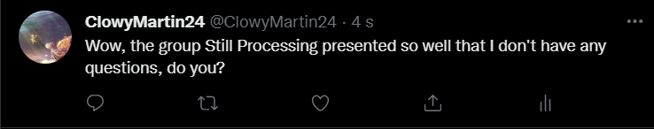
NLP_Student42 @NLP_Student42 ∙ 4 s
41
Notes:
Morine:

Slide 42
Works Cited
Anna Schmidt and Michael Wiegand. 2017. A survey on hate speech detection using natural language processing. Proceedings of the Fifth International Workshop on Natural Language Processing for Social Media, pages 1–10.
Clayton Hutto and Eric Gilbert. 2014. Vader: A parsimonious rule-based model for sentiment analysis of social media text. Proceedings of the international AAAI conference on web and social media, 8(1):216–225.
Clayton Hutto. Cited May 2022. Vader-sentiment-analysis. https://github.com/cjhutto/vaderSentiment.
Cynthia Van Hee, Gilles Jacobs, Chris Emmery, Bart Desmet, Els Lefever, Ben Verhoeven, Guy De Pauw, Walter Daelemans, and Veronique Hoste. 2018. Automatic detection of cyberbullying in social media text. PLoS ONE, 13(10):e0203794.
Finn Arup Nielsen. 2011. A new anew: Evaluation ˚ of a word list for sentiment analysis in microblogs. Proceedings of the ESWC2011 Workshop on ’Making Sense of Microposts’: Big things come in small packages, pages 93–98.
42
Giuseppe Gambino and Roberto Pirrone. 2020. Chilab@ haspeede 2: Enhancing hate speech detection with part-of-speech tagging. EVALITA Evaluation of NLP and Speech Tools for Italian-December 17th, 2020, pages 165–170
Notes:
Works Cited…

Slide 43
Works Cited
Ilia Markov, Nikola Ljubesiˇ c, Darja Fi ´ ser, and Wal- ˇ ter Daelemans. 2021. Exploring stylometric and emotion-based features for multilingual crossdomain hate speech detection. Proceedings of the Eleventh Workshop on Computational Approaches to Subjectivity, Sentiment and Social Media Analysis, pages 1–11.
Ilia Markov and Walter Daelemans. 2021. Improving cross-domain hate speech detection by reducing the false positive rate. Proceedings of the Fourth Workshop on NLP for Internet Freedom: Censorship, Disinformation, and Propaganda, pages 17– 22.
Jacob Devlin, Ming-Wei Chang, Kenton Lee, and Kristina Toutanova. 2019. Bert: Pre-training of deep bidirectional transformers for language understanding. Proceedings of the 2019 Conference of the North American Chapter of the Association for Computational Linguistics: Human Language Technologies, pages 4171–4186.
Jigsaw/Conversation AI. 2018. Toxic comment classification challenge. https://www.kaggle.com/competitions/jigsawtoxic-comment-classification-challenge/overview.
Marcos Zampieri, Shervin Malmasi, Preslav Nakov, Sara Rosenthal, Noura Farra, and Ritesh Kumar. 2019a. Predicting the type and target of offensive posts in social media. Proceedings of the 2019 Conference of the North American Chapter of the Association for Computational Linguistics: Human Language Technologies, pages 1415–1420.
43

Slide 44
Works Cited
Marcos Zampieri, Shervin Malmasi, Preslav Nakov, Sara Rosenthal, Noura Farra, and Ritesh Kumar. 2019b. SemEval-2019 Task 6: Identifying and Categorizing Offensive Language in Social Media (OffensEval). In Proceedings of The 13th International Workshop on Semantic Evaluation (SemEval).
Omar Sharif, Mohammed Moshiul Hoque, A. S. M. Kayes, and Raza Nowrozy et al. 2020. Detecting suspicious texts using machine learning techniques. Applied Sciences, 10(6527):1–360.
Paula Fortuna and Sergio Nunes. 2018. A survey on ´ automatic detection of hate speech in text. ACM Computing Surveys, 51(4):85:1–85:30.
Pete Burnap and Matthew L Williams. 2016. Us and them: identifying cyber hate on twitter across multiple protected characteristics. EPJ Data Science, 5(11):1–15.
Rishav Hada, Sohi Sudhir, Pushkar Mishra, Helen Yannakoudakis, Saif M. Mohammad, and Ekaterina Shutova. 2021. Ruddit: Norms of offensiveness for english reddit comments. Proceedings of the 59th Annual Meeting of the Association for Computational Linguistics and the 11th International Joint Conference on Natural Language Processing, pages 2700–2717.
44
Sean MacAvaney, Hao-Ren Yao, Eugene Yang, Katina Russell, Nazli Goharian, and Ophir Frieder. 2019. Hate speech detection: Challenges and solutions. PLoS ONE, 14(8):e0221152.

Slide 45
Works Cited
Tommaso Caselli, Valerio Basile, Jelena Mitrovic, and Michael Granitzer. 2020. Hatebert: Retraining bert for abusive language detection in english. Proceedings of the Fifth Workshop on Online Abuse and Harms, pages 17–25.
Thomas Davidson, Dana Warmsley, Michael Macy, and Ingmar Weber. 2017. Automated hate speech detection and the problem of offensive language. Proceedings of the International AAAI Conference on Web and Social Media, 11(1):1–4.
UN. Cited May 2022. Impact and prevention: Why tackle hate speech? https://www.un.org/en/hatespeech/impact-and-prevention/why-tackle-hatespeech.
Wafa Alorainy, Pete Burnap, Han Liu, and Matthew Williams. 2018. The enemy among us: Detecting hate speech with threats based ’othering’ language embeddings. ArXiv, page 1801.07495.
Yinhan Liu, Myle Ott, Naman Goyal, Jingfei Du, Mandar Joshi, Danqi Chen, Omer Levy, Mike Lewis, Luke Zettlemoyer, and Veselin Stoyanov. 2019. Roberta: A robustly optimized bert pretraining approach. ArXiv, page abs/1907.11692.
45

