Slide 1
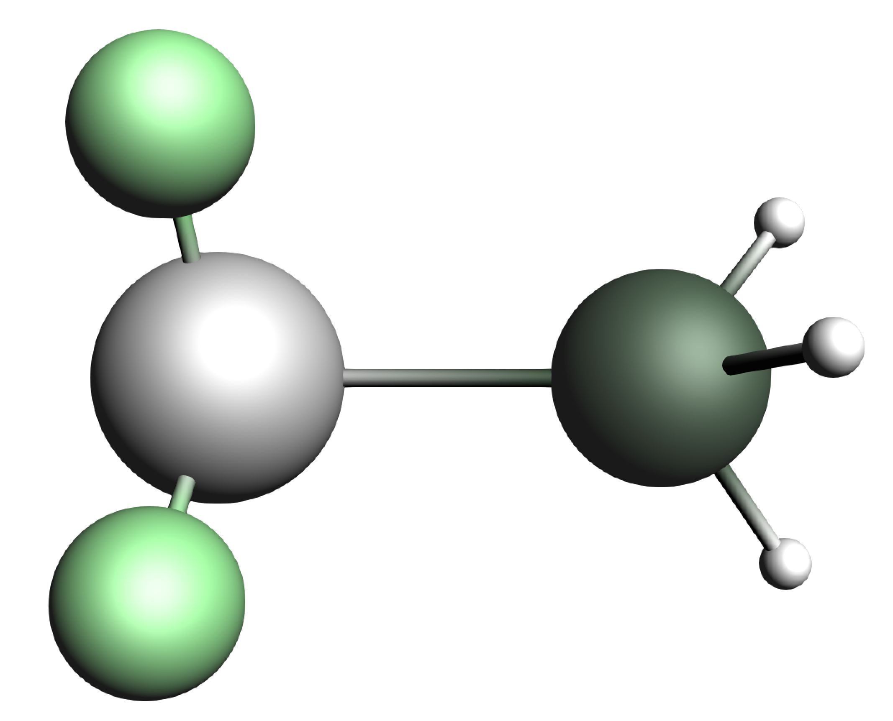
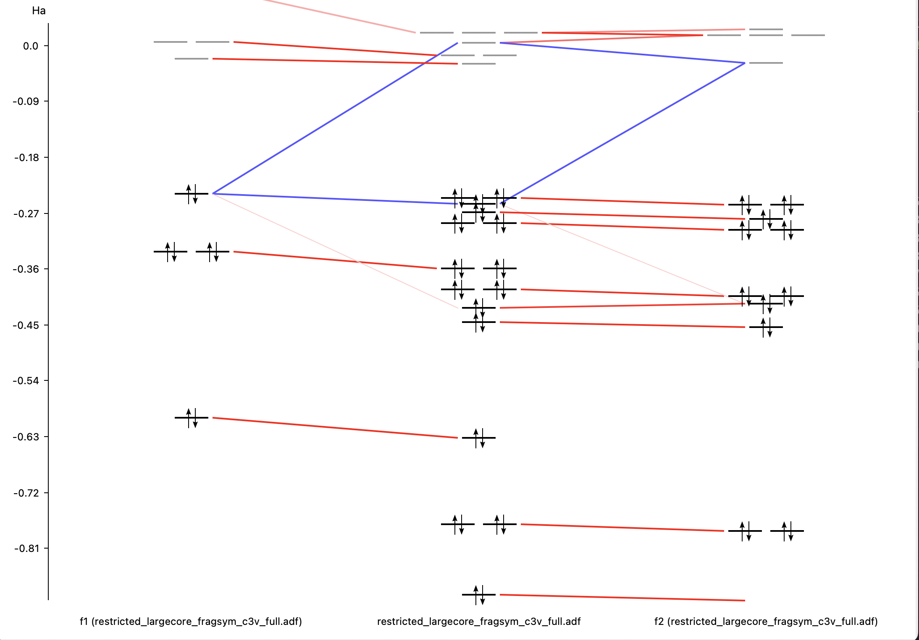
Fragment Calculation
orb_analysis output
SFOs information
calc_analyzer class
SFOs overlap matrix
MOs information

