Slide 1
Game of Classification
Deep Learning on Game of Thrones Screenshots
Machine Learning II
Group 5
Michael Siebel

Slide 2
Purpose
Game of Thrones was HBO’s most popular TV series
It made HBO substantial profits
But, it was also the most pirated show in history
My goal:
To create a copyright detection algorithm
Classify screenshots of Game of Thrones against a variety of other TV shows from another genre
A common issue television networks face is improper distribution of their intellectual property

Slide 3
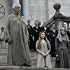
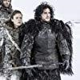
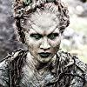

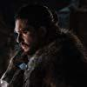
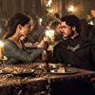
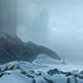

Challenge
Game of Thrones is known for having a very high number of characters & sets
The model should not try to classify faces
Instead, general aesthetic
Attributes of importance:
High production values
Color treated
Costume drama
Outdoor/rustic castles sets

Slide 4
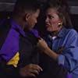

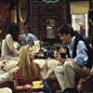
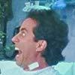
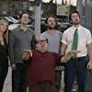

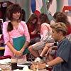
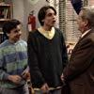
Comparison Group
All other shows are sitcoms
13 sitcoms, 1989-Today
Again, many characters & sets
Has sitcom aesthetic
Attributes
Lower production values
Colorful/not color treated
Modern clothes/locations
Indoor sets

Slide 5
Data
Webscrapped all photos from the Internet Movie Database (IMDB.com)
All are screenshots (no BTS or promos)
Images were thumbnails
Only 100x100 pixels
Pre-cropped photos
Focus more on faces
Backgrounds can be hidden
Somewhat imbalanced data
Images
Total: 13,535
Game of Thrones: 3,883
Sitcom: 9,653
Game of Thrones comprises ~30% total data

Slide 6
Modeling
Modeling with a Convolutional Neural Network (CNN)
Key attributes relate to RGB values
Image filters capture general aesthetic better than Multilayer Perceptron (MLP)
Solving binary classification problem
Splitting data into training (70%), testing (15%), and validation (15%)
Training on a Binary Cross Entropy loss (BCELoss) function
Evaluating testing data on several models based on F1 scores
Evaluating final validation models based on F1 scores
Coding is all done in Pytorch

Slide 7
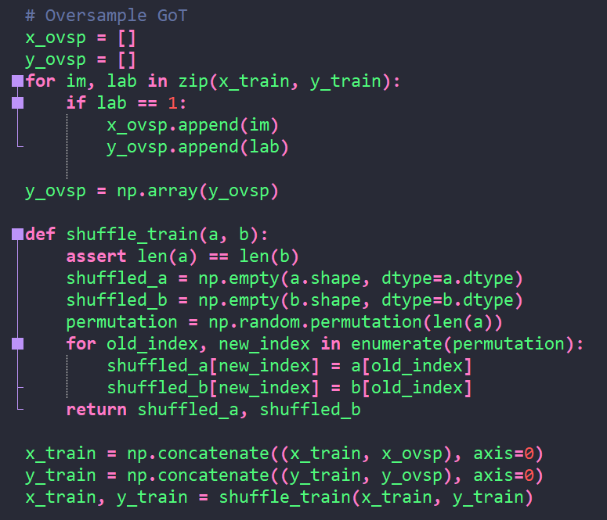
Data Augmentation
Oversampled Game of Thrones
Only on the training set
Doubled images
Shuffled into main training
More balanced
Went from 29% to 44% of images
Labels | 0 Sitcom | 1 Game of Thrones
Pre-Oversampling | 6763 | 2711
Post-Oversampling | 6763 | 5422

Slide 8
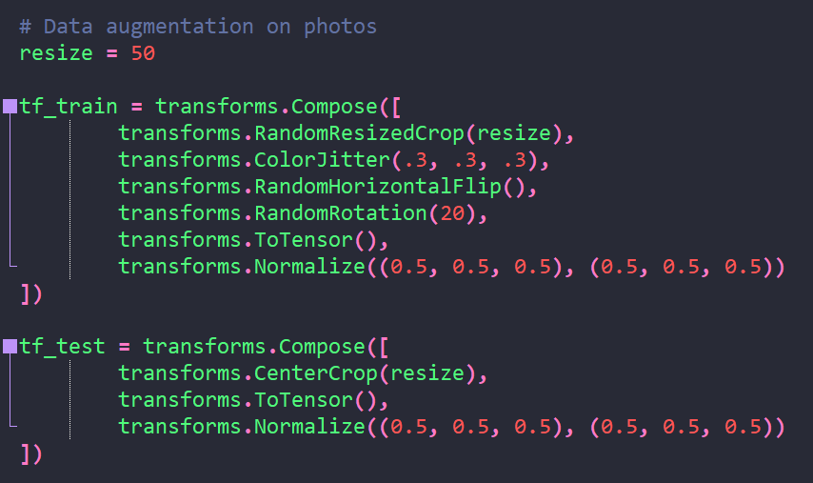
Data Augmentation
Resized images to half their size
On training:
Used proportional color jitter
Random flips and rotation
Normalized
On testing:
Center crop
Normalized
Avoided randomized transformations

Slide 9
Parameters and Network Architecture
Began with 5 convolutional layers
Batch normalization on each layer
0.2 dropouts after layer 3, layer 5, and fully connected layer
Oversampled (doubled) Game of Thrones
Used only 25 epochs
Evaluated best learning rate based on F1 score on test dataset

Slide 10

Parameters and Network Architecture
Updated epochs to 300
Best learning rate became smaller
F1 scores did not necessarily improve
Over predicting Game of Thrones
Oversampling is working too well
Confusion Matrix | Predicted Sitcom | Predicted Game of Thrones
Actual Sitcom | 701 | 725
Actual Game of Thrones | 290 | 314

Slide 11
Final Model Architecture
Updated epochs to 500
Updated learning rate to 1e-8
After attempting a learning rate of 1e-7
Received similar F1-score but more true positives with the lower rate
Increased dropouts to 5x
 | Input | Output | Activation | Batch Normalization | Pooling | Dropout
Convolutional Layer 1 | 3 | 16 | ReLU | 2D | Max Pooling
Convolutional Layer 2 | 16 | 32 | ReLU | 2D | Max Pooling | 0.2
Convolutional Layer 3 | 32 | 64 | ReLU | 2D | Max Pooling | 0.2
Convolutional Layer 4 | 64 | 128 | ReLU | 2D | Max Pooling | 0.2
Convolutional Layer5 | 128 | 256 | ReLU | 2D | Max Pooling | 0.2
Fully Connected Layer | 256 | 128 | ReLU | 1D |  | 0.2
Output layer | 128 | 1 | Sigmoid

Slide 12
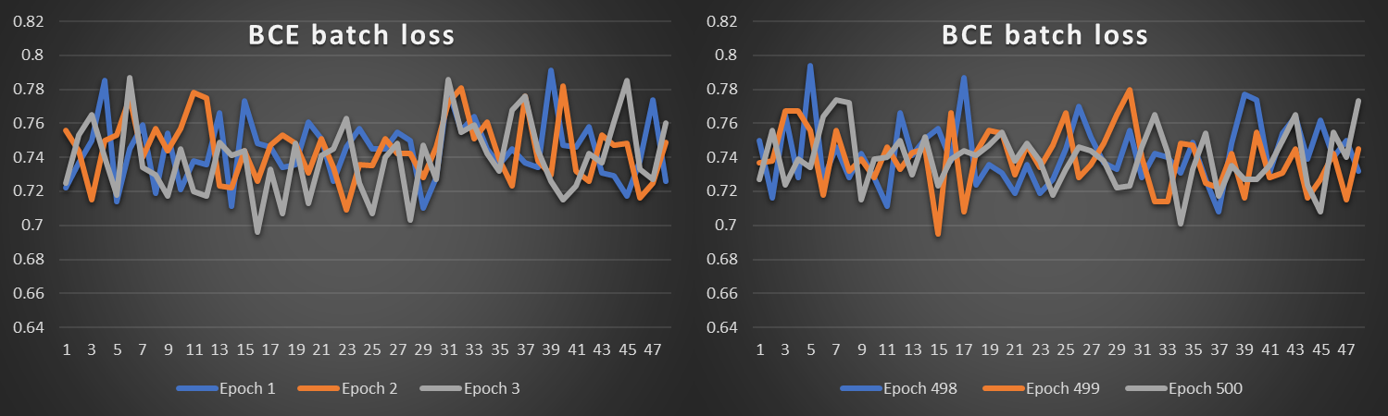
Main Model Performance
Ran on validation dataset
Achieved F1-score of 0.39
Achieved accuracy of 0.44
Greatly over predicted
Loss function did not improve over epochs
dasfsdafsd
Sitcom
Game of Thrones
Prediction
Confusion Matrix | Predicted Sitcom | Predicted Game of Thrones
Actual Sitcom | 533 | 930
Actual Game of Thrones | 202 | 366
Actual

Slide 13
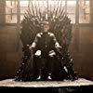

Alternative Models
Experimented on the main model by
Removing oversampling
Reducing to 3 convolutional layers
Running a MLP version
Surprisingly, the MLP version had similar classification scores as the main model
Achieved same F1-Score
Received slightly less true positives (342)
No Oversampling F1-Score 0.29 Accuracy 0.60
Three Layers F1-Score 0.35 Accuracy 0.53
MLP Version F1-Score 0.39 Accuracy 0.47

Slide 14
Conclusion
Learning rate was the most tuned hyper-parameter
Did not do enough
Epochs helped very little
Allowed lower learning rates Did not lower the loss metrics much
Oversampling only slightly helped
Improved precision, lowered recall
CNN surprisingly was not much better than MLP
Image size was manageable by MLP
Full sized versions would not be
Layers make a difference
Three layers performed much worse
Small images, though, can only have so many pooling layers

Slide 15
Next Steps
Image quality was likely too weak for the complex analysis of which CNN’s are capable
Would need to get full-size images for better analysis
The loss function may be at issue
Need to better investigate why the loss metrics did not diminish greatly
Ensemble algorithms are likely necessary
…Or simply try classifying the Simpsons

