Slide 1
R Community of Interest: Lunch & Learn
Parallel Processing

Slide 2

What is parallel processing?
Subfield of High Performance Computing (HPC)
Works a little differently for
Personal computers (PC)
Servers
Super computers
With PCs, the tools are
CPUs are the tools
All is run locally

Slide 3

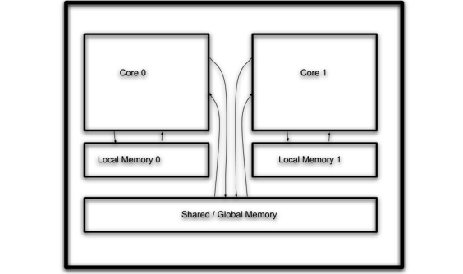
What is parallel processing?
Parallelized on threads
CPU is the central processing unit
A multicore CPU has at least 2 cores; most have 4
Each core contains 2 logical processors also known as threads
Thread
Thread
Thread
Thread

Slide 4
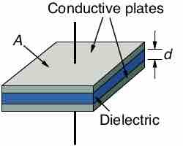
Science lesson
Energy
A processor (core) requires electrons for energy
Energy runs transistors which perform the calculations
More transistors means more calculations
Power
Power is expended forcing electrons onto a processor
Power converts into thermal energy (i.e., heat)
Too much heat, and the processor is fried
Limits to
processing power

Slide 5
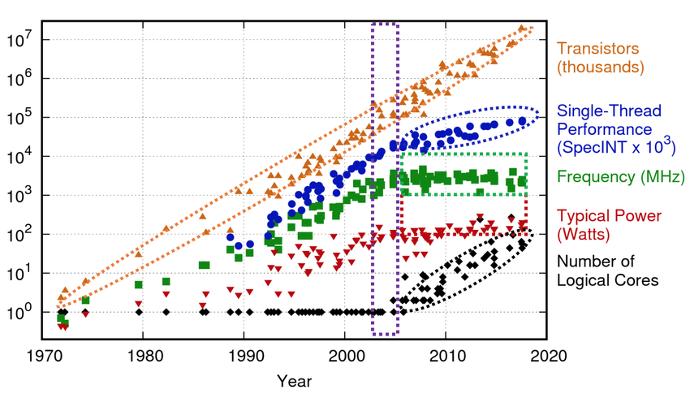
History lesson Moore's law: The number of transistors on a chips doubles every 2 years. In the end, it was more like every 18 months.
Intel's Pentium D

Slide 6
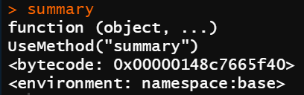
Automatic and Manual Parallelization
Your computer know how to parallel across programs
Open a browser and open R
Defaults to different threads
Within programs, parallelization is more difficult
The browser will with tabs
R often does not know how to parallelize until you tell it
Many base commands call C scripts which will parallelize a task
Otherwise, you need to do it yourself

Slide 7
What is parallelizable?
Parallelizable
Number of iterations known upon entry and does not change
Each iteration independent of all others
No data dependence
Not Parallelizable
Conditional loops (while loops)
Iterations dependent upon each other
Data dependence

Slide 8
Strong scaling
For example:
Dial every number in the phonebook
Flip a coin a trillion times
Monte Carlo Simulations
Adding more workers (threads) speeds up the time to complete the task. The amount of work for each workers is inversely proportional to the number of workers.
How: Minimize the communication necessary between tasks

Slide 9
Weak scaling
For example:
Fibonacci's Series
1 2 3 5 8 13 21 34
Gradient boosted algorithms
Time series
Adding more workers does not reduce the time to arrive at a solution…
Illustration:
One woman can produce a baby in nine months
Nine women can only produce nine babies in nine months
However, nine women cannot produce a baby in one month

Slide 10
FMG Examples?

Slide 11
Now let’s turn to coding

