Slide 1
Harry Potter and the Script Classification
Michael Siebel

Slide 2
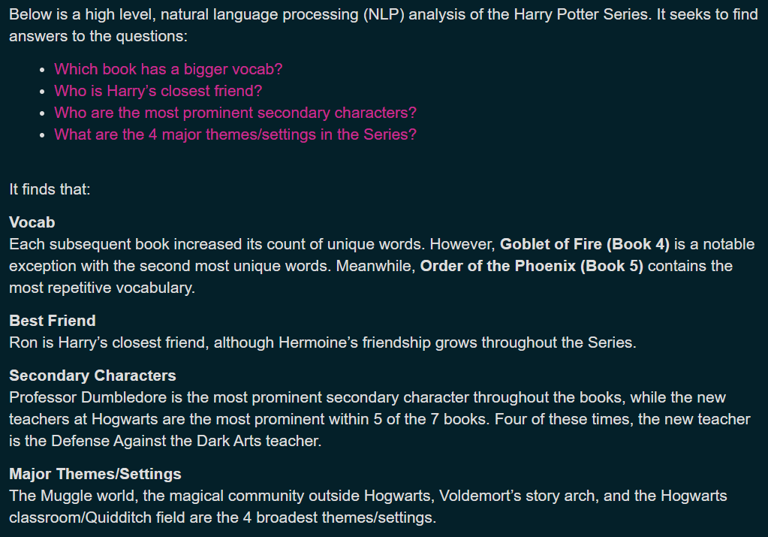
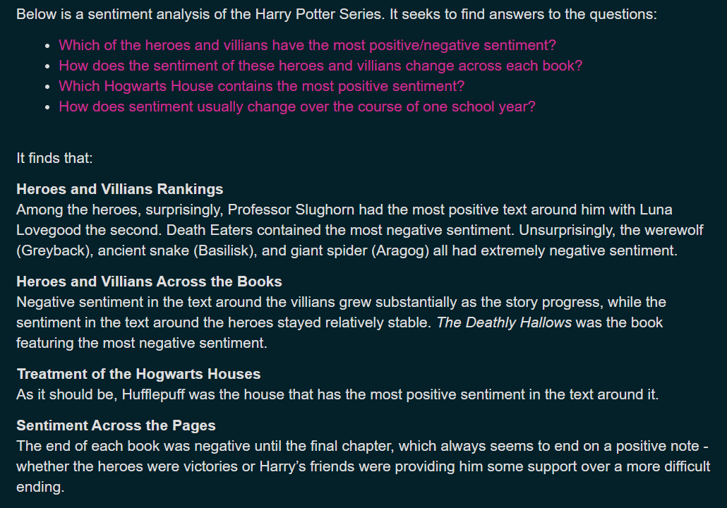
Prior work
Used basic NLP techniques
Sentiment analysis

Slide 3
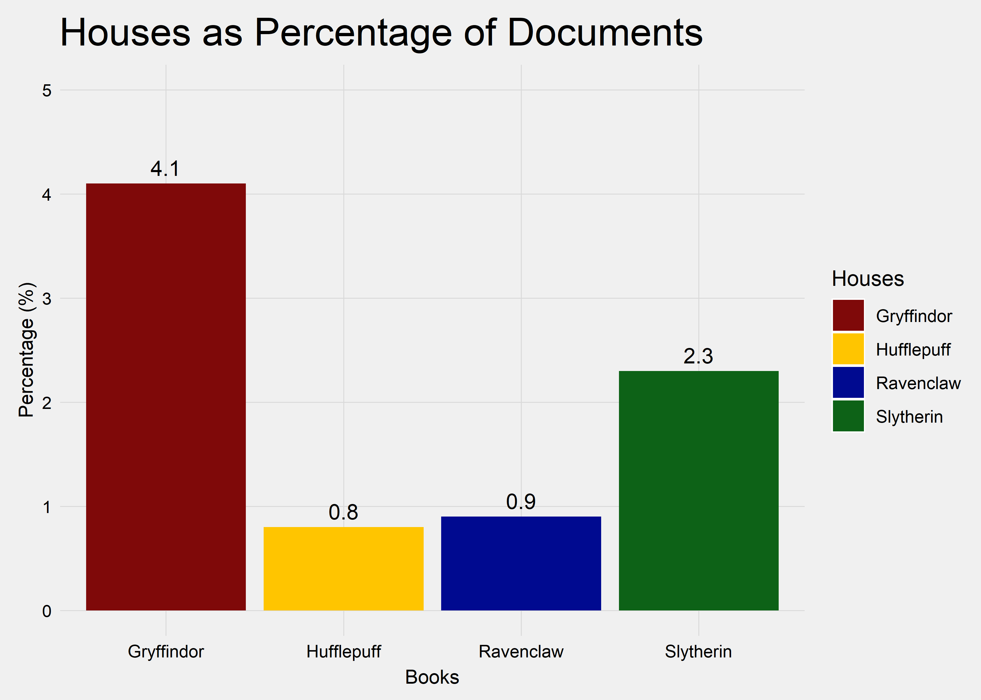
Hufflepuff is the least mentioned

Slide 4
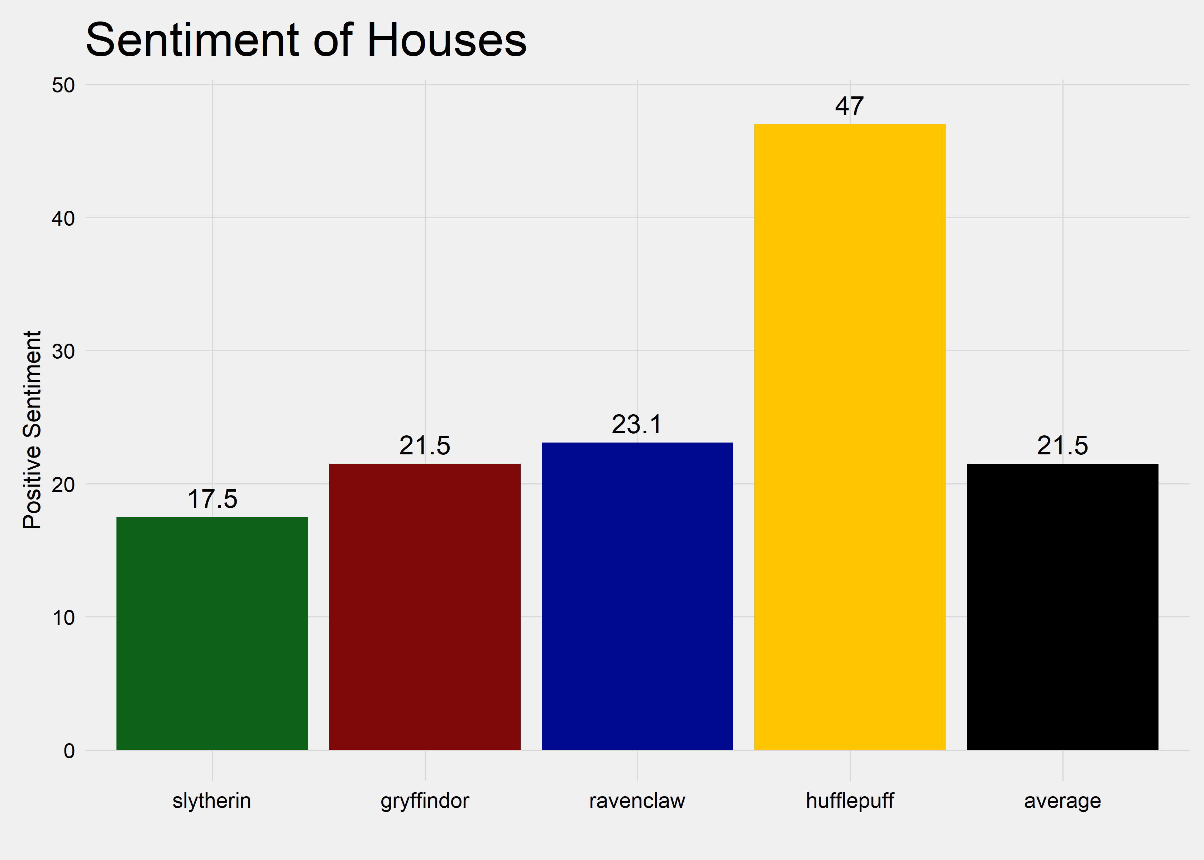
…But is mentioned in the most positive light

Slide 5
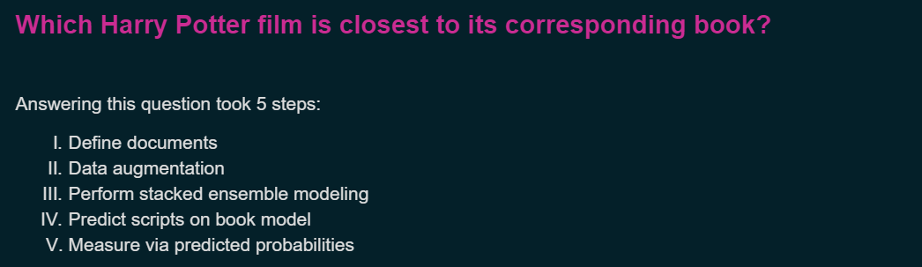
Current Work

Slide 6
Stacked Ensembling
Final Predictions
K-Nearest Neighbors
Topic Model
BoW TF
BoW TF-IDF
Word Embeddings

Slide 7
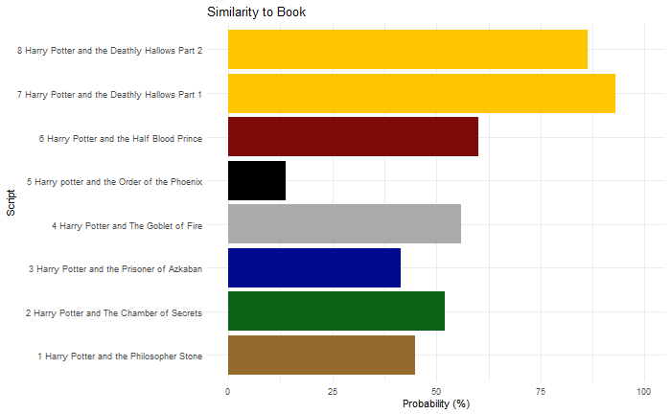
Similarity to Book

Slide 8
Backup Slides
(Not in presentation)

Slide 10
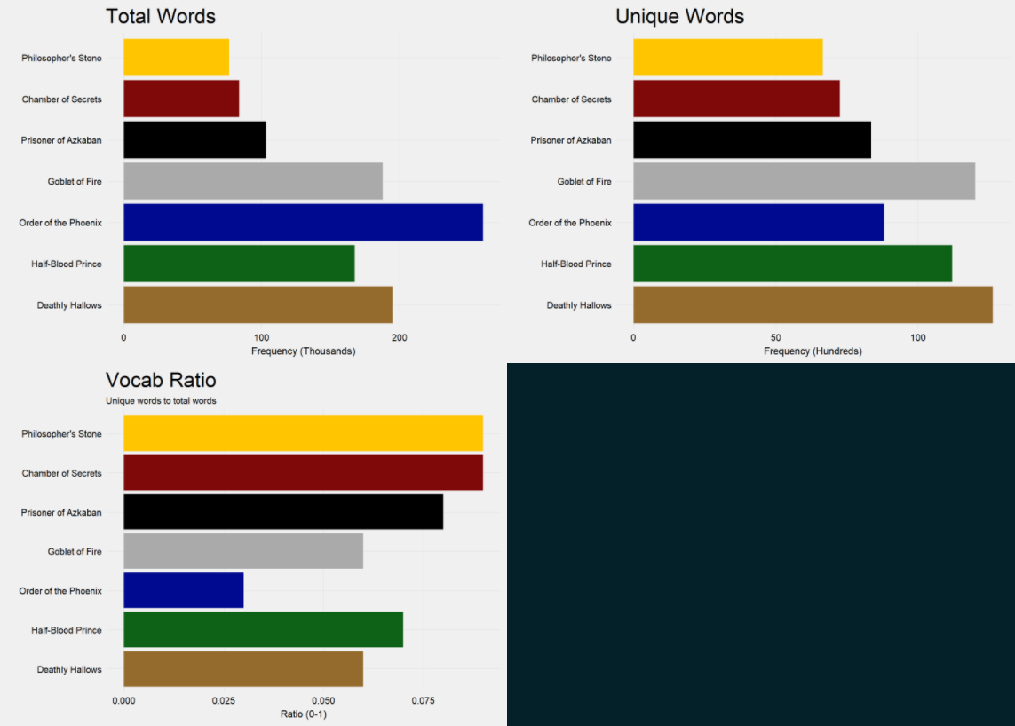
Basics

Slide 12
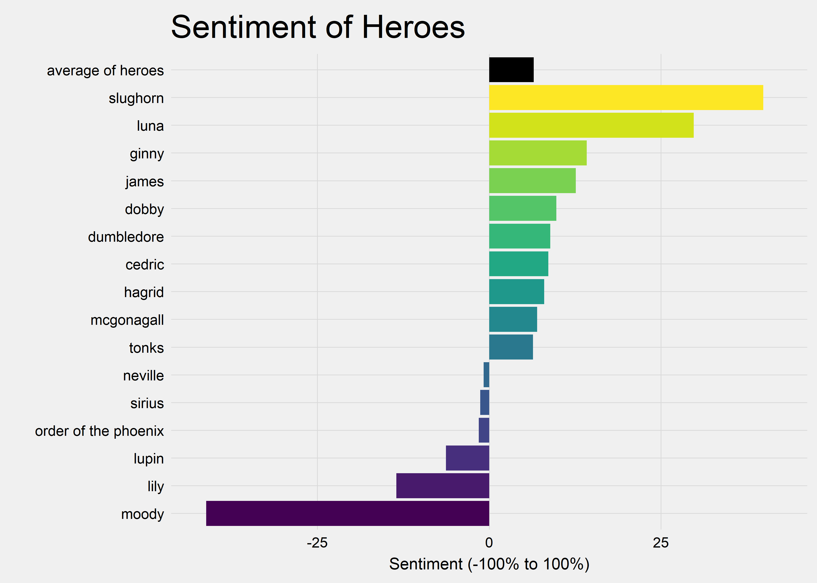
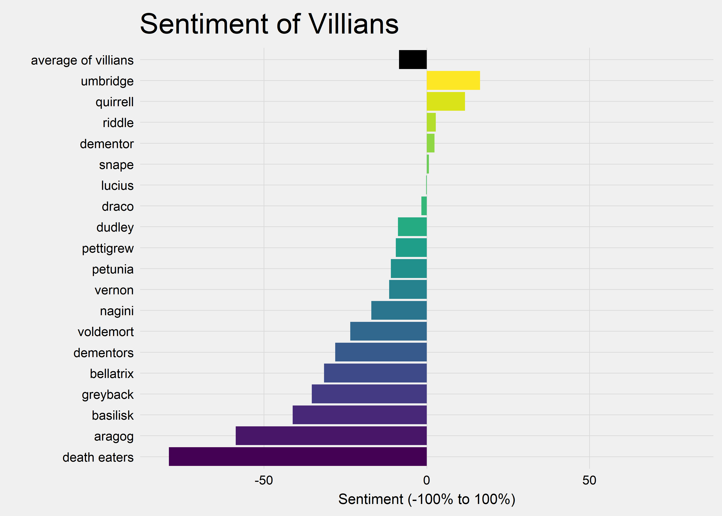
Sentiment

Slide 13
