Slide 1
Harry Potter and the Script Classification
Michael Siebel

Slide 2
Prior work
Used basic NLP techniques
Which book has a bigger vocab?
Who is Harry’s closest friend?
Who are the most prominent secondary characters?
What are the 4 major themes/settings in the Series?
Sentiment analysis
Which of the heroes and villians have the most positive/negative sentiment?
How does the sentiment of these heroes and villians change across each book?
Which Hogwarts House contains the most positive sentiment?
How does sentiment usually change over the course of one school year?

Slide 3
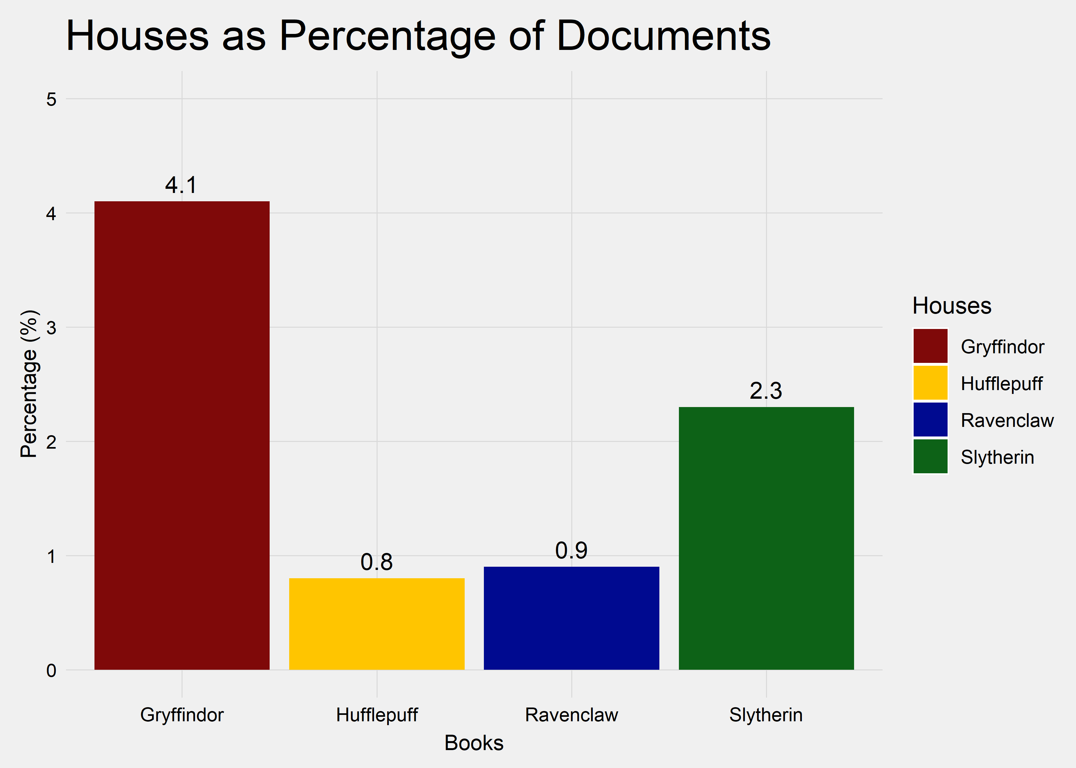
Hufflepuff is the least mentioned

Slide 4
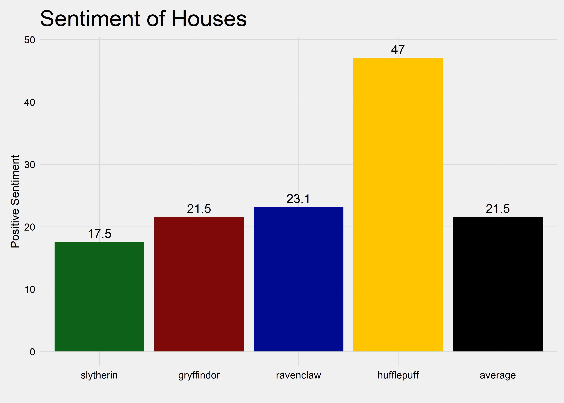
…But is mentioned in the most positive light

Slide 5
Current Work
Which Harry Potter film is closest to its corresponding book? Answering this question took 5 steps:
Define documents
Data augmentation
Perform stacked ensemble modeling
Predict scripts on book model
Measure via predicted probabilities

Slide 6
Stacked Ensembling
Final Predictions
K-Nearest Neighbors
Topic Model
BoW TF
BoW TF-IDF
Word Embeddings

Slide 7
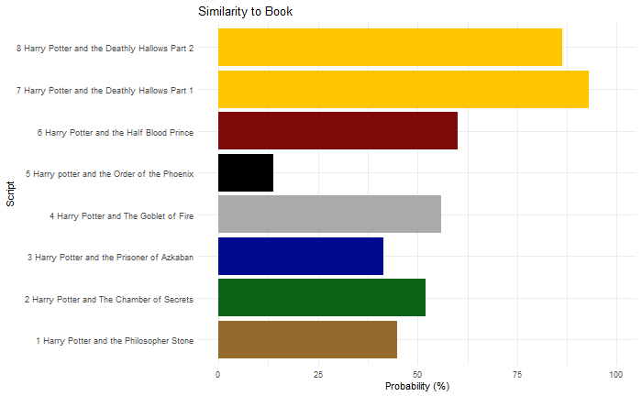
Similarity to Book

Slide 8
Backup Slides
(Not in presentation)

Slide 9
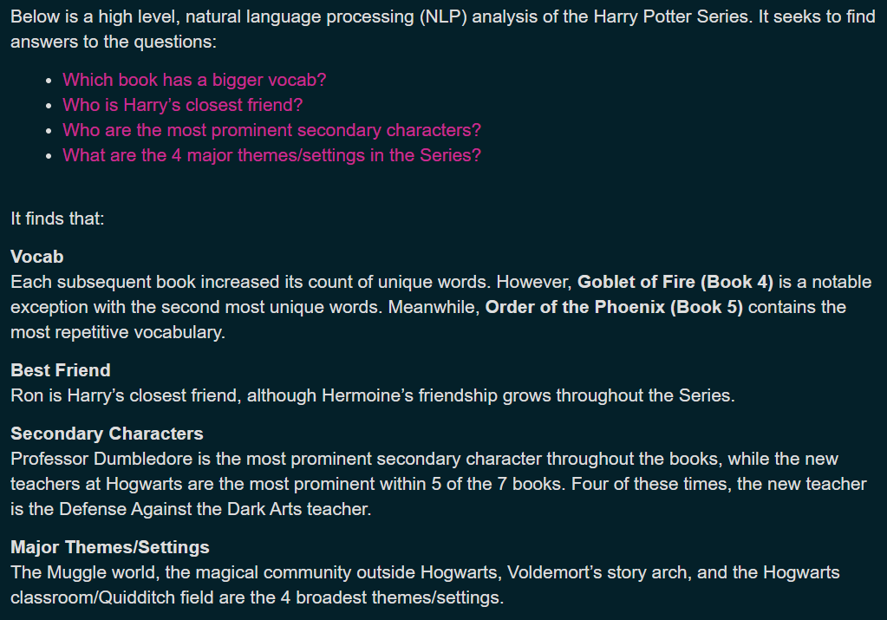

Slide 10
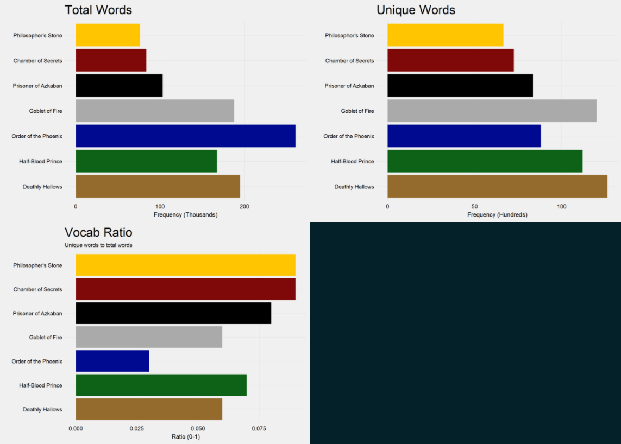
Basics

Slide 11
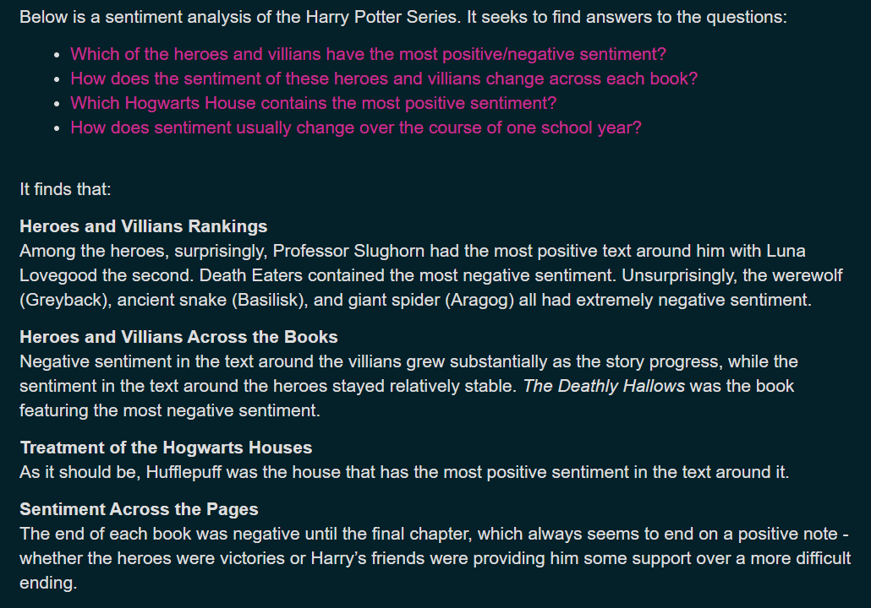

Slide 12
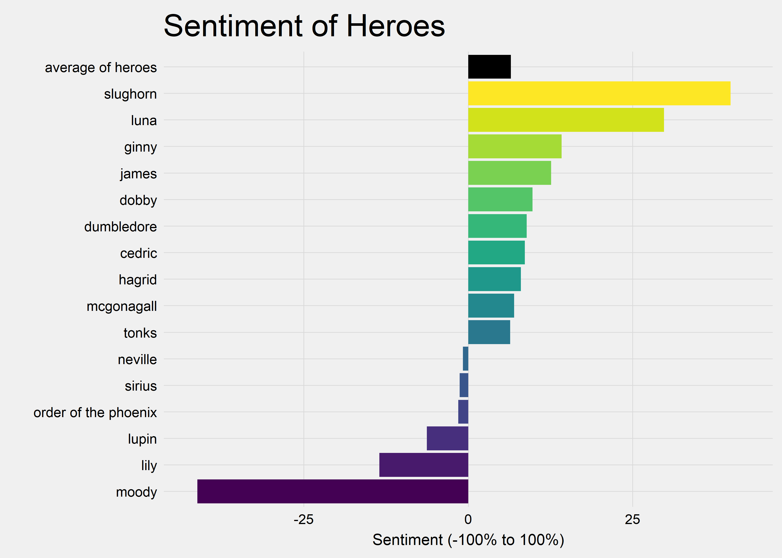
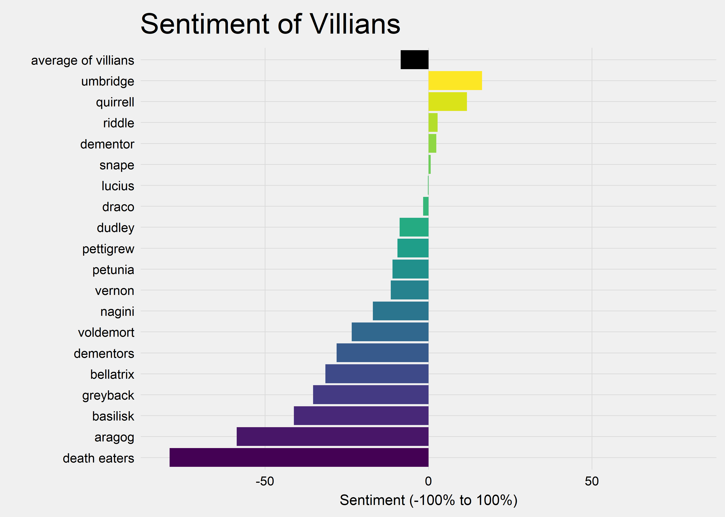
Sentiment

Slide 13
