Slide 1
Objects

Slide 2
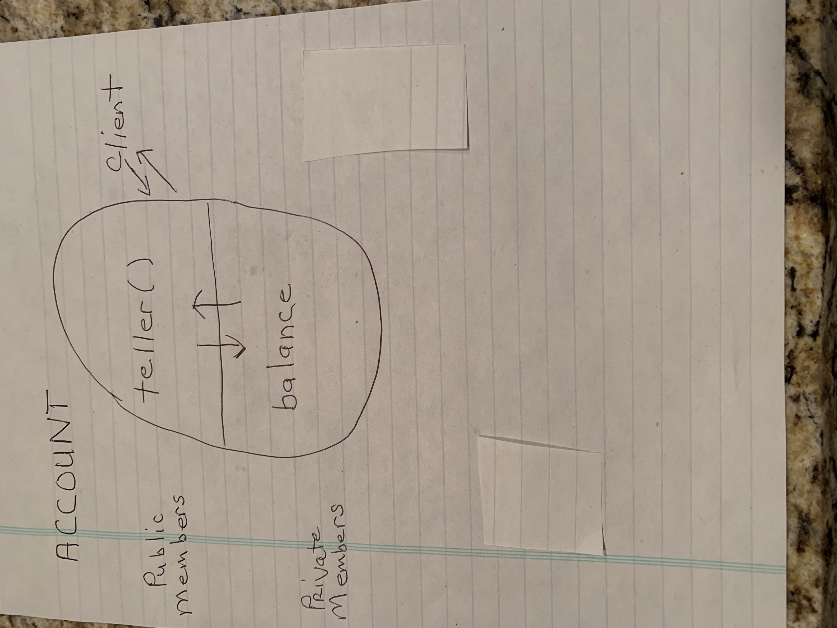
Account

