Slide 1




Introduction to NextPlay
Predicting NBA Success with Data
Siegfried Nacion
Data Scientist, Brooklyn College
SiegfriedAnthonyNacion@gmail.com

Slide 2
Agenda
• Project Introduction
• Customer Identification & Questions (PR-FAQ Process)
• Workflow Outline
• Scraping
• EDA Findings
• Machine Learning Example
• Product Demo

Slide 3
NextPlay’s Mission: To have an accurate outlook on the upcoming generation of the NBA

Slide 4
Customer Questions
1. Who is the customer?
2. What is the customer’s problem?
3. What are/is the customer benefit[s]?

Slide 5

Who are my customers?

Slide 6
• NBA front offices
• ESPN analysts
• Sportsbook companies and players

Slide 7
What is the customer problem or opportunity?
Today
NBA front offices, ESPN Analysts, Sportsbook Players
have to
actively scout NBA prospects in college
when
they want to instantly and accurately see how well a prospect is going to play when they get drafted

Slide 8
What is/are the customer benefit[s]?
Customer will predict a college player’s first four years in the NBA

Slide 9
Fictitious Customer Testimonial
“As the Knicks’ President, a majority of our draft picks end up not performing as well as we’d like them to,” said Leon Rose. “Our front offices have been mainly using a mix of analytical and scouting methods to decide who we draft on a yearly basis. With NextPlay, I can see a college player’s initial career trajectory in a click of a button. This way, our front office is able to more efficiently focus their time on how to draft accordingly.”

Slide 10






Project Diagram
Analysis Scripts
Algo Selection
Model Eval.
Visualizations
Training & Testing Sets
Data Preparation
Review & Revise
Model Creation
Research Conclusion
EDA
Exploratory Data Analysis

Slide 11


Scraping
Data Source:
Scraping module:

Slide 12
EDA Questions
• What are the average stats for players in the top 5 conferences?
• Are there differences in stats across conferences (e.g., average points, assists)?
• How many players transitioned to the NBA from each conference?

Slide 13
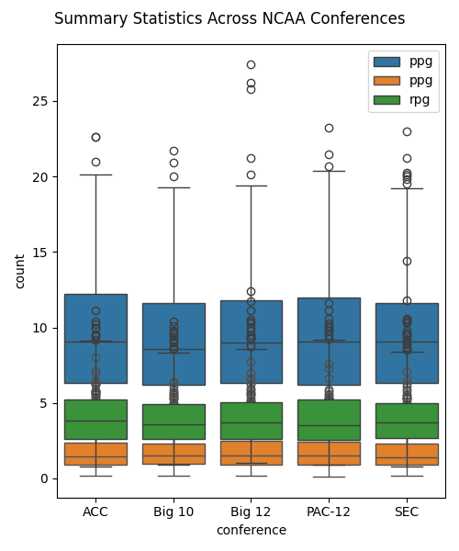
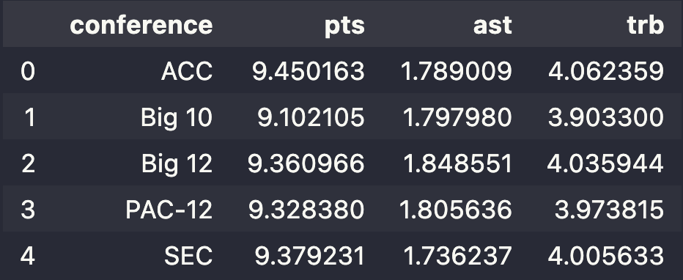
EDA Findings

Slide 14
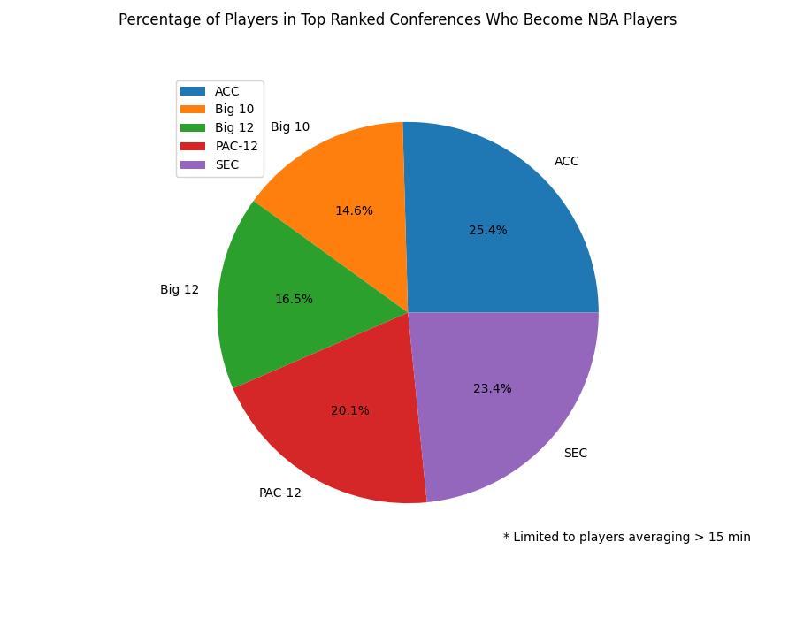
EDA Findings

Slide 15
EDA Findings
• No big difference in statistics between each conference
• All 5 conferences have a tendency to score over assist and rebound
• SEC, PAC-12, ACC favorites for NBA prospects

Slide 16
Model Creation

Slide 17
What is Machine Learning?
Per Google:
“The use and development of computer systems that are able to learn and adapt without following explicit instructions, by using algorithms and statistical models to analyze and draw inferences from patterns in data.”

Slide 18

Teaching a machine how to think using examples instead of rules.

Slide 19
How NextPlay Uses Machine Learning
Input: College basketball stats like points, assists, rebounds, free throws, steals, blocks, etc.
Output: Predicted NBA stats for the first 4 years, including points, assists, and rebounds, plus an impact score that ranks players into tiers (Elite, High Impact, Medium Impact , Low Impact).

Slide 20
Impact Classification
Low Impact
Medium Impact
AJ Green
Zabian Dowdell
CJ Wilcox
Yuta Watanabe
Bojan Bogdanović
Yogi Ferrell
Aaron Brooks
Wayne Ellington
High Impact
Elite
Aaron Gordon
Zach Lavine
Al Jefferson
Willie Cauley-Stein
LeBron James
Donovan Mitchell
Kyrie Irving
Carmelo Anthony

Slide 21
Impact Classification Formula
Impact Score =
PPG + APG + DRB + (0.5 × ORB) + FG + FT + STL + (0.5 × BLK) − TOV − FGA − FTA

Slide 22
K-Means Clustering
Allow the data to decide which players are in which tier

Slide 23
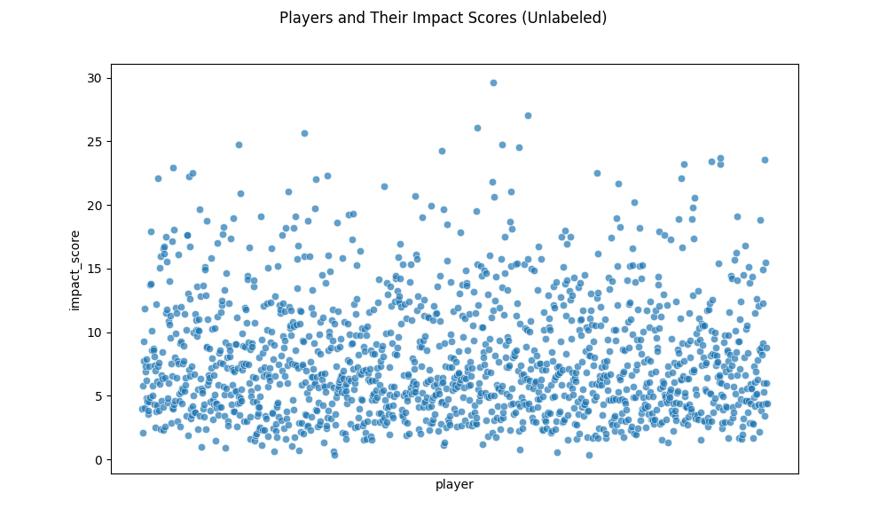
Impact Classification

Slide 24
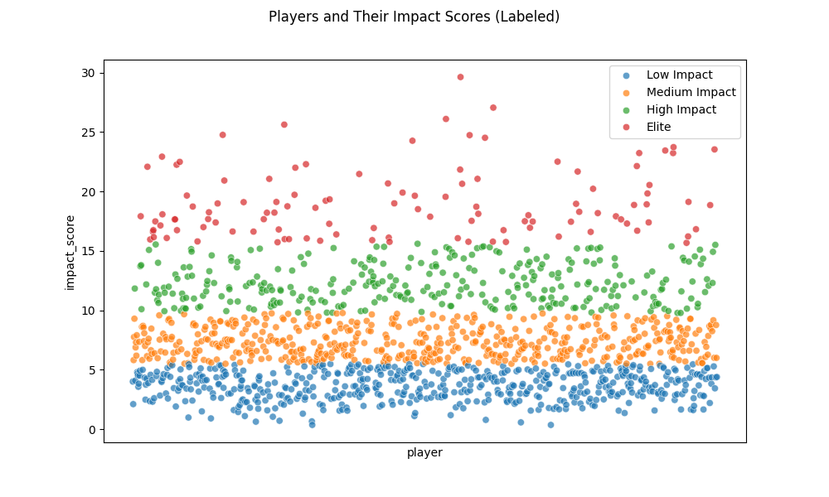
Impact Classification

Slide 25
NextPlay

Slide 26
Introduction to NextPlay
Predicting NBA Success with Data
Siegfried Nacion
Data Scientist, Brooklyn College
SiegfriedAnthonyNacion@gmail.com

