Slide 1

Dream Job
Functional walkthrough and technical architecture · v2
An AI-assisted job discovery and application platform: profile in, ranked and explained opportunities out, every message reviewed and sent by the job seeker. Version 2 refreshes every screenshot, diagram and count, and covers the screens added since the first edition.
Prepared for Stephane van der Aa | Live application walkthrough, system architecture and the full source catalogue · September 2026
Dream Job · Functional walkthrough and technical architecture · v2
1

Slide 2
OVERVIEW
What this deck contains
A working tour of the platform, the architecture behind it, and the complete list of external sources it can read.
• Part 1 · A functional walkthrough: a screenshot of every working screen — including Browser session, Apply browser, Networking and Mail setup, which the first edition did not cover — with what each screen is for and how the job seeker uses it.
• Part 2 · Technical architecture: the layered system, the five chokepoints, the campaign pipeline end to end, the adapter contract, the path of one LLM call and one outbound request, and the data model.
• Part 3 · Data sources: every registered adapter — 29 today — grouped by type, with coverage, access method, terms status and whether it needs the language model.
• Throughout: diagrams and figures are generated from the code, and every count in this deck was measured from the working tree.
• The principle throughout: nothing is sent or applied on its own; the job seeker is the last line of defence and the only sender.
Dream Job · Functional walkthrough and technical architecture · v2
2

Slide 3
OVERVIEW · WHAT CHANGED
What is new in version 2
Every figure below was re-measured from the current codebase; screens added since the first edition are listed on the right.
Metric | v1 | v2 (measured)
Python modules | 172 | 227 (120,881 lines)
JS/JSX modules | 113 | 140 (43,932 lines)
API routes | 301 | 422 over 22 routers
Database tables | 71 | 88 (49 private, 38 shared)
Indexes | 144 | 158
Migrations | 34 | 43
Tests | 1,725 | 2,055 passing of 2,061 (114 files)
Adapters | 29 | 29 (4 need acknowledgement)
Prompt templates | 24 | 24
• New screens: Browser session, Apply browser, Networking and export, Mail setup, and the per-screen Help drawer.
• New depth within screens: Profile tabs (Sections, Skills, Evidence, Personas, Privacy), Composite (Online findings, Enrichment), Campaign (Plan review, Live dashboard, Re-run a stage), Company (Profile, Financials, Market and timing, Values and culture).
• New depth continued: Contacts (Browse all, Introduction routes, My network, Objections and retention), Dream-job intelligence (Gaps, Stepping stones, Fit across the market, Values conflicts, LinkedIn profile), Administration (nine tabs).
• Refreshed diagrams: all 20 generated figures and every screenshot in this deck come from the current system.
Dream Job · Functional walkthrough and technical architecture · v2
3

Slide 4
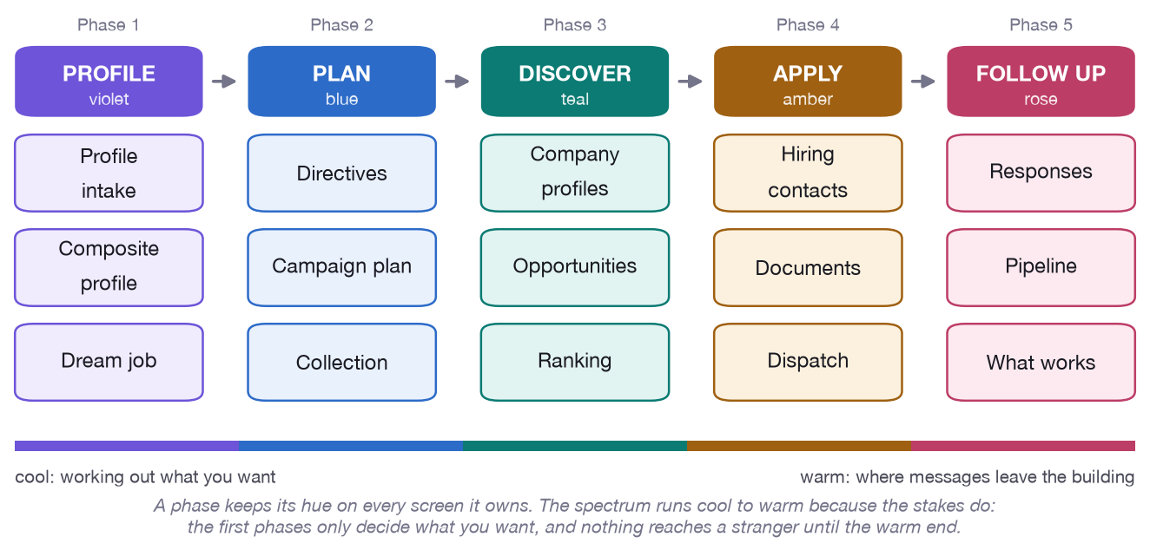
OVERVIEW
The product in one picture
• Profile — import the facts about you and describe the job you want.
• Plan — bound the search with structured directives and review the plan.
• Discover — collect, profile, analyse and rank the market.
• Apply — write, check and dispatch applications you approve.
• Follow up — read the outcomes and redirect the next search.
The five phases of the journey. Each phase owns a colour that follows it through every screen of the application.
Dream Job · Functional walkthrough and technical architecture · v2
4

Slide 5
PART 1
A functional walkthrough
Every screen, in the order a job seeker meets it. The screenshots are taken from the running application with real data.
Dream Job · Functional walkthrough and technical architecture · v2
5

Slide 6
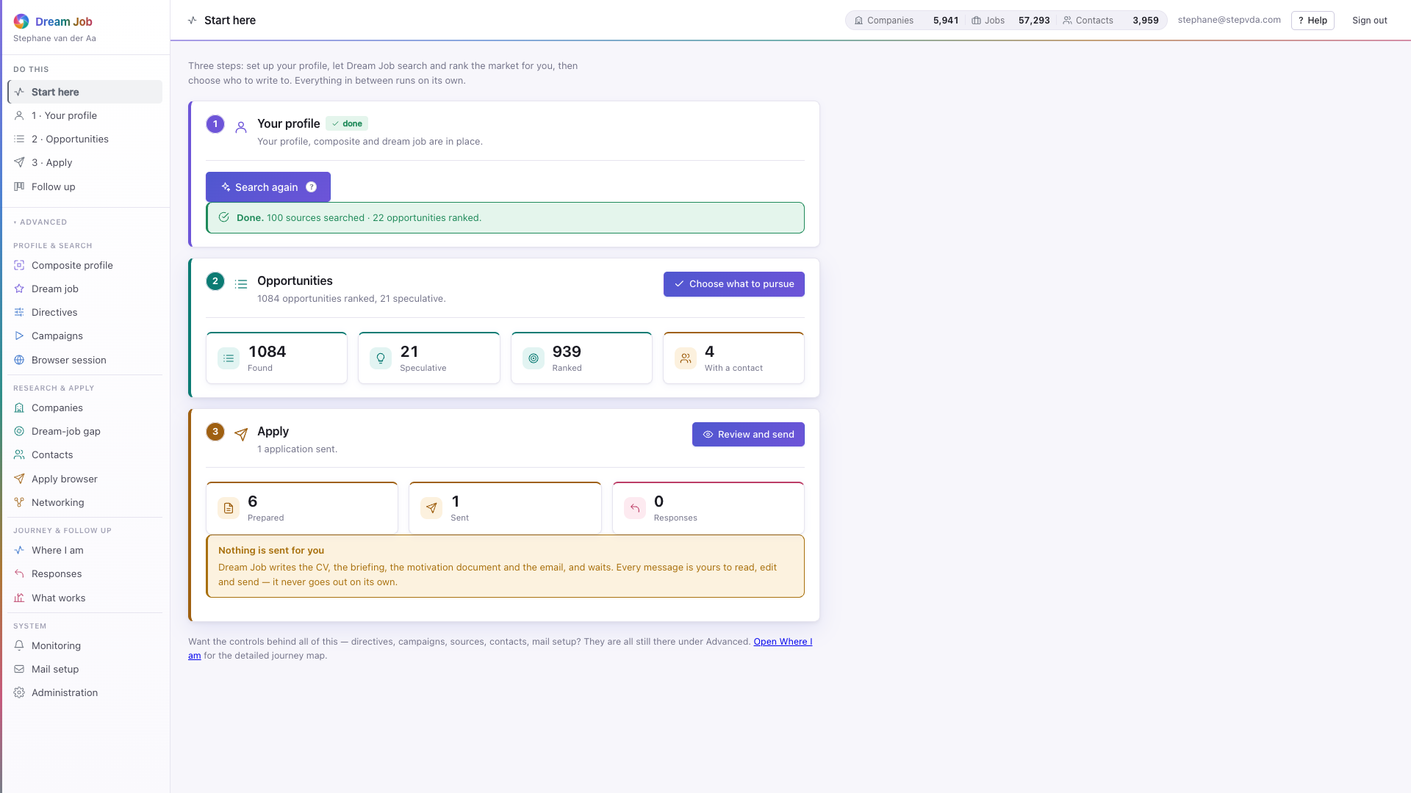
PART 1 · START HERE
Start here
Three steps and nothing else: set up your profile, let Dream Job search and rank the market, then choose who to write to. Everything in between runs on its own.
• The whole search runs in the background; the page can be closed.
• Live counts on today's data: 1,084 opportunities found, 21 speculative, 939 ranked, 4 with a contact.
• Nothing is ever sent on its own — every message waits for approval.
• A speculative opening is labelled everywhere so an email never claims a vacancy exists.
home · three steps, one action each
Dream Job · Functional walkthrough and technical architecture · v2
6

Slide 7
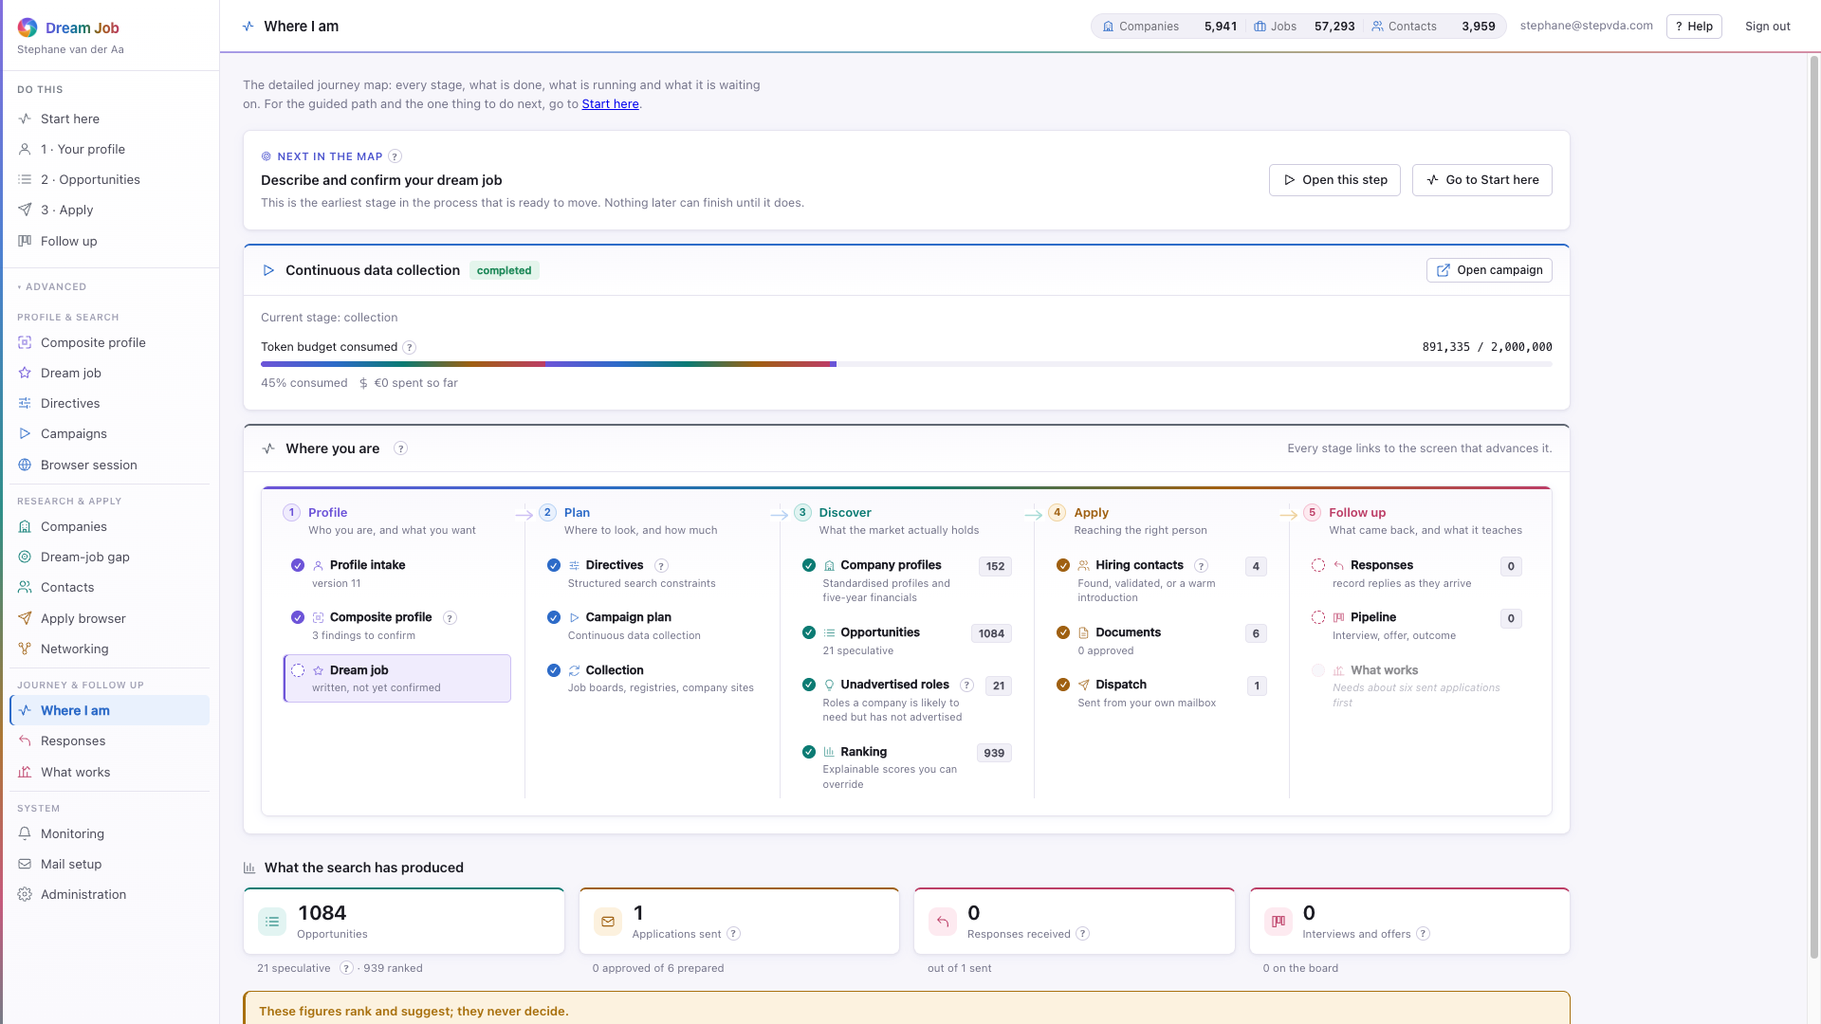
PART 1 · SYSTEM
Where I am — the full journey map
The whole process on one screen: what is done, what is running, what is blocked, and what the next useful move is. Every stage links to the screen that advances it.
• A green mark is finished, a pulsing one is running, a dotted one is waiting on an earlier stage.
• Headline counts are links to the screens their numbers come from.
• While a campaign runs, its token budget and cost refresh every few seconds.
• A blocked stage says what it needs, so the next move is never a guess.
overview · the journey map over the live campaign
Dream Job · Functional walkthrough and technical architecture · v2
7

Slide 8
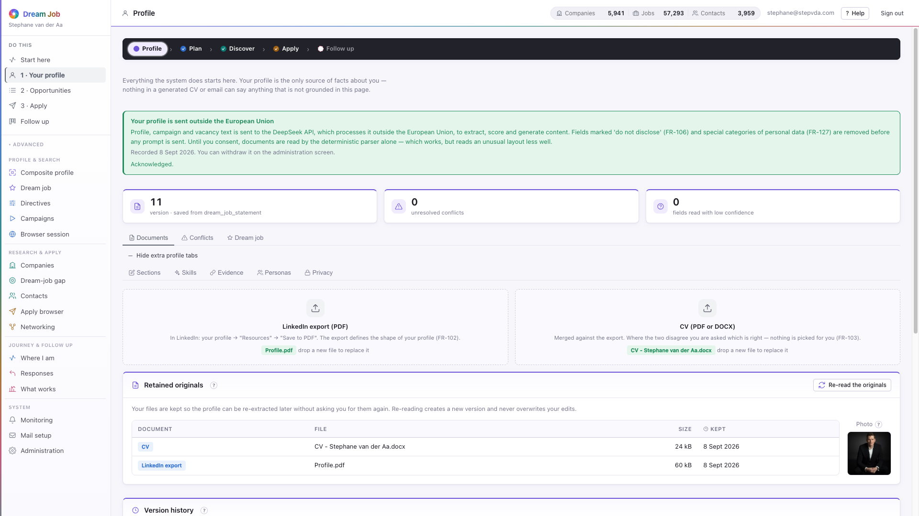
PART 1 · PROFILE
Your profile
Everything the system does starts here. The profile is the only source of facts about the job seeker; nothing in a generated CV or email can say anything not grounded in this page.
• Import the LinkedIn export and the CV; the two are merged, and conflicts are surfaced, not silently resolved (FR-102/103).
• This account holds 22 saved versions; every save is a new version and campaigns record which version they used.
• Five extra tabs sit one click away: Sections, Skills, Evidence, Personas and Privacy.
• Fields marked 'do not disclose' are stripped before anything reaches the AI provider (FR-106).
profile · Documents — the two uploads
Dream Job · Functional walkthrough and technical architecture · v2
8

Slide 9
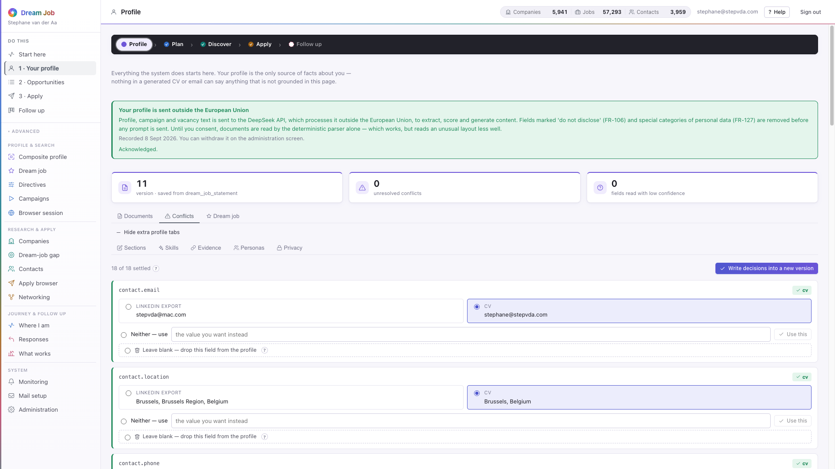
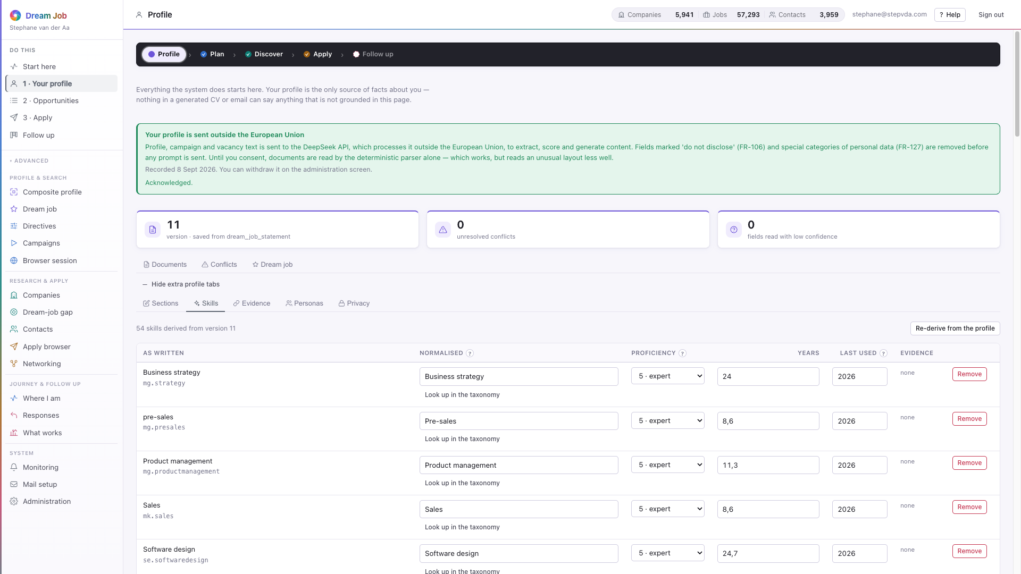
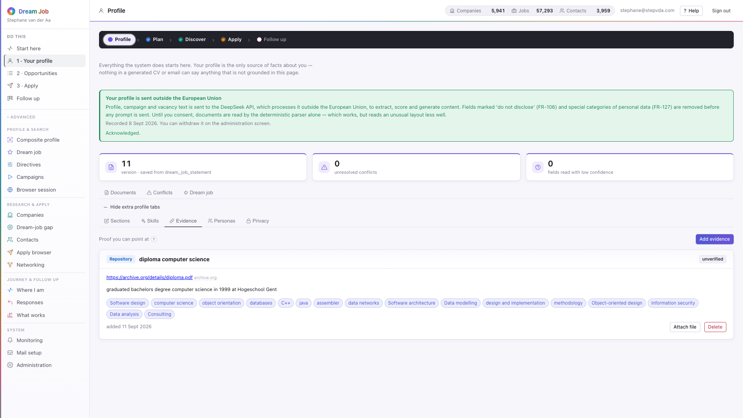
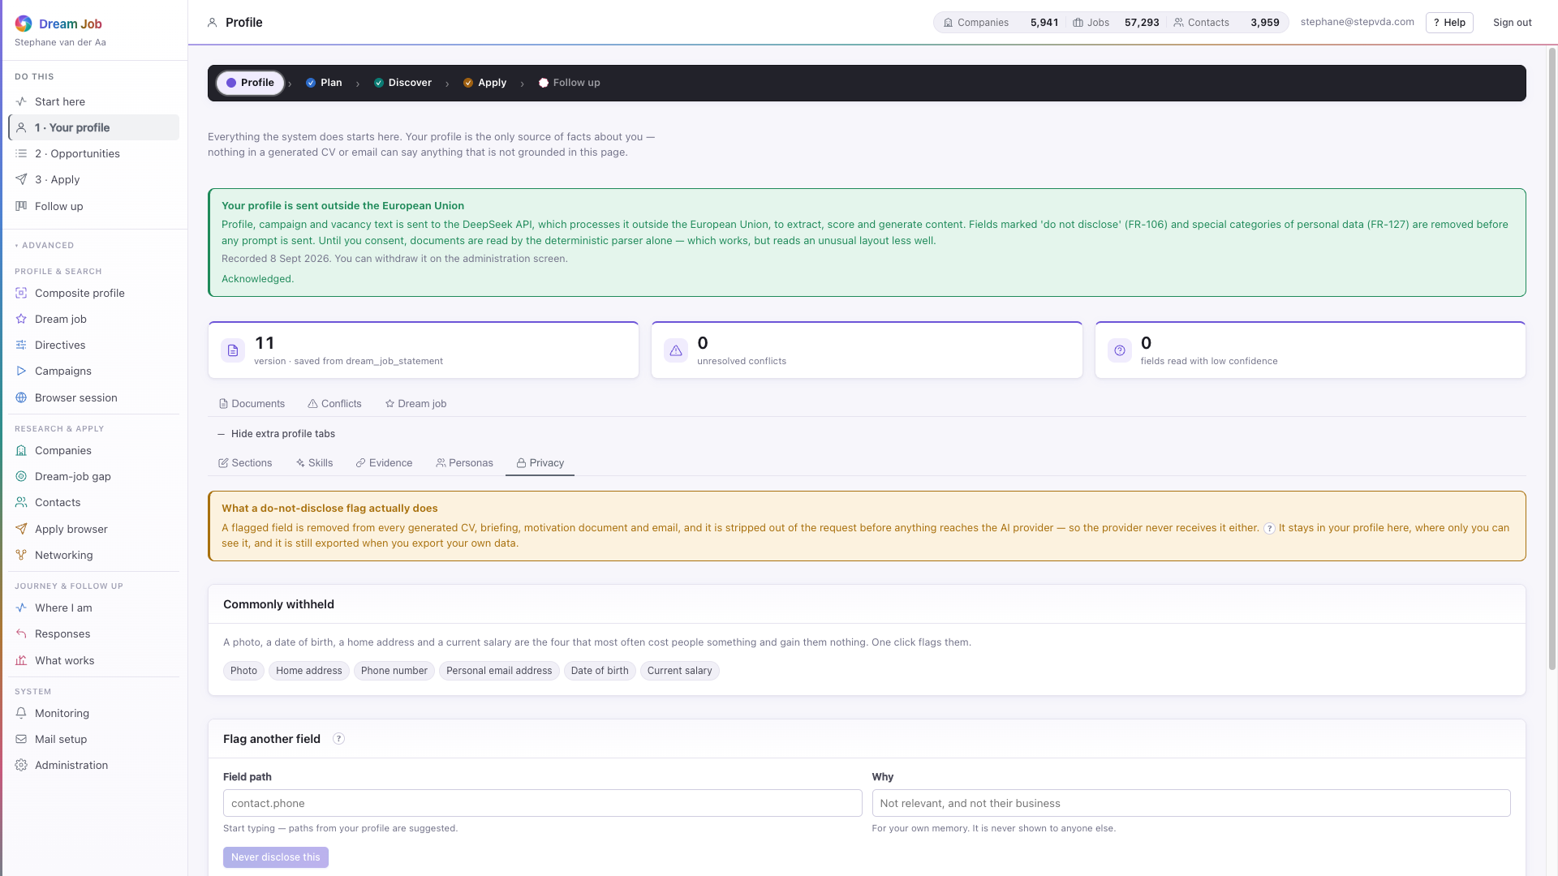
PART 1 · PROFILE
Resolving the disagreements
The merge is honest about what it could not decide: every conflict is shown with both values side by side and stays open until the job seeker chooses.
profile · Conflicts — contested values, resolved by hand
profile · Skills — the normalised, canonical skill taxonomy
profile · Evidence — statements kept with their provenance
profile · Privacy — fields marked do not disclose
Dream Job · Functional walkthrough and technical architecture · v2
9

Slide 10
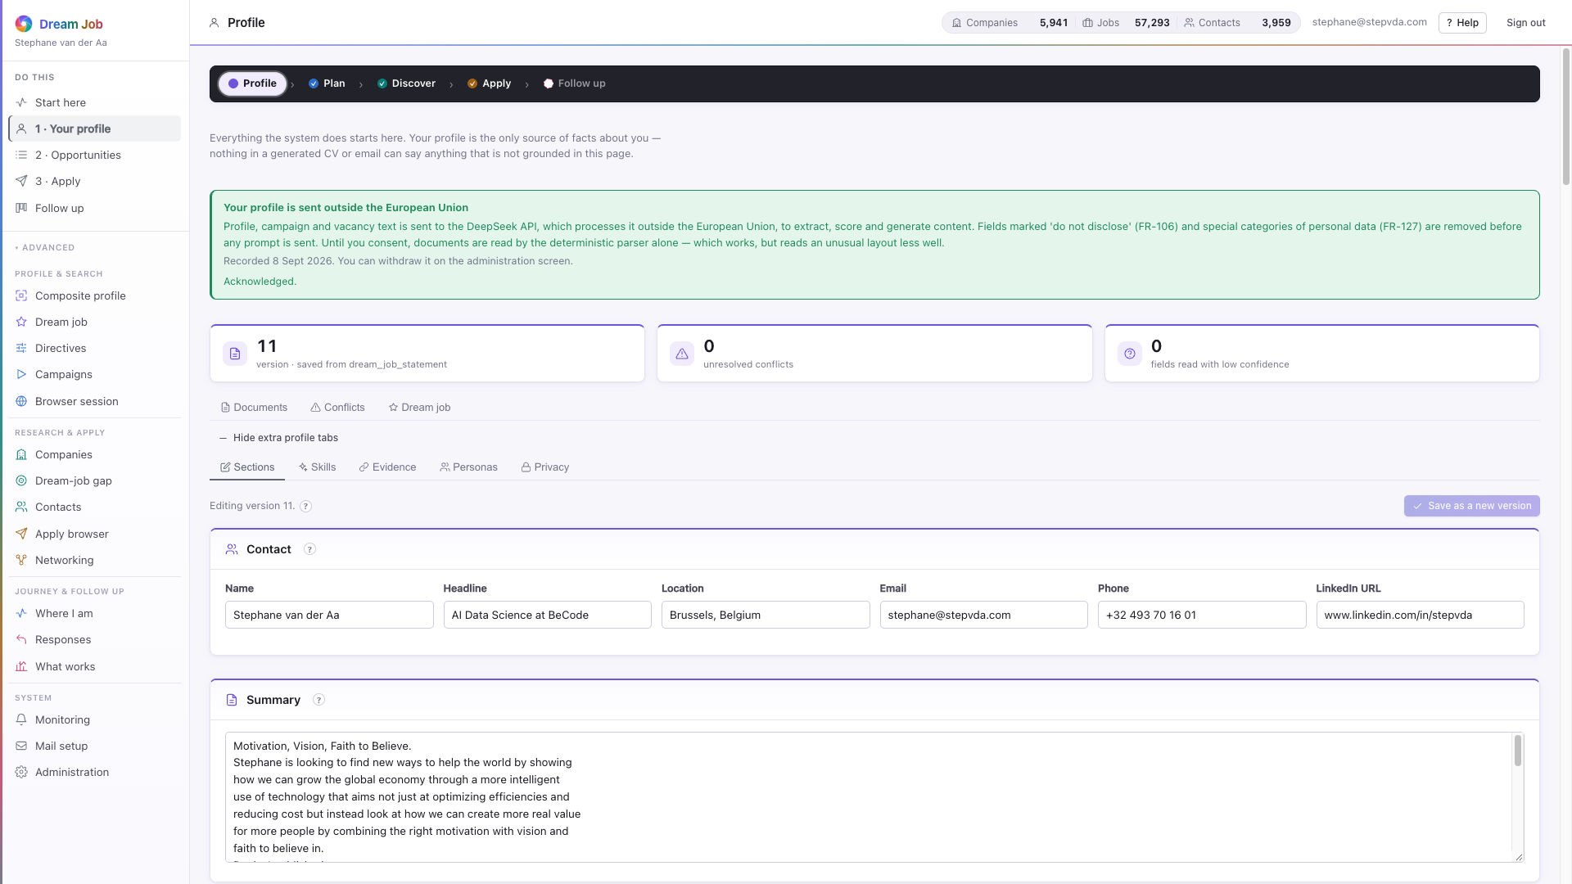
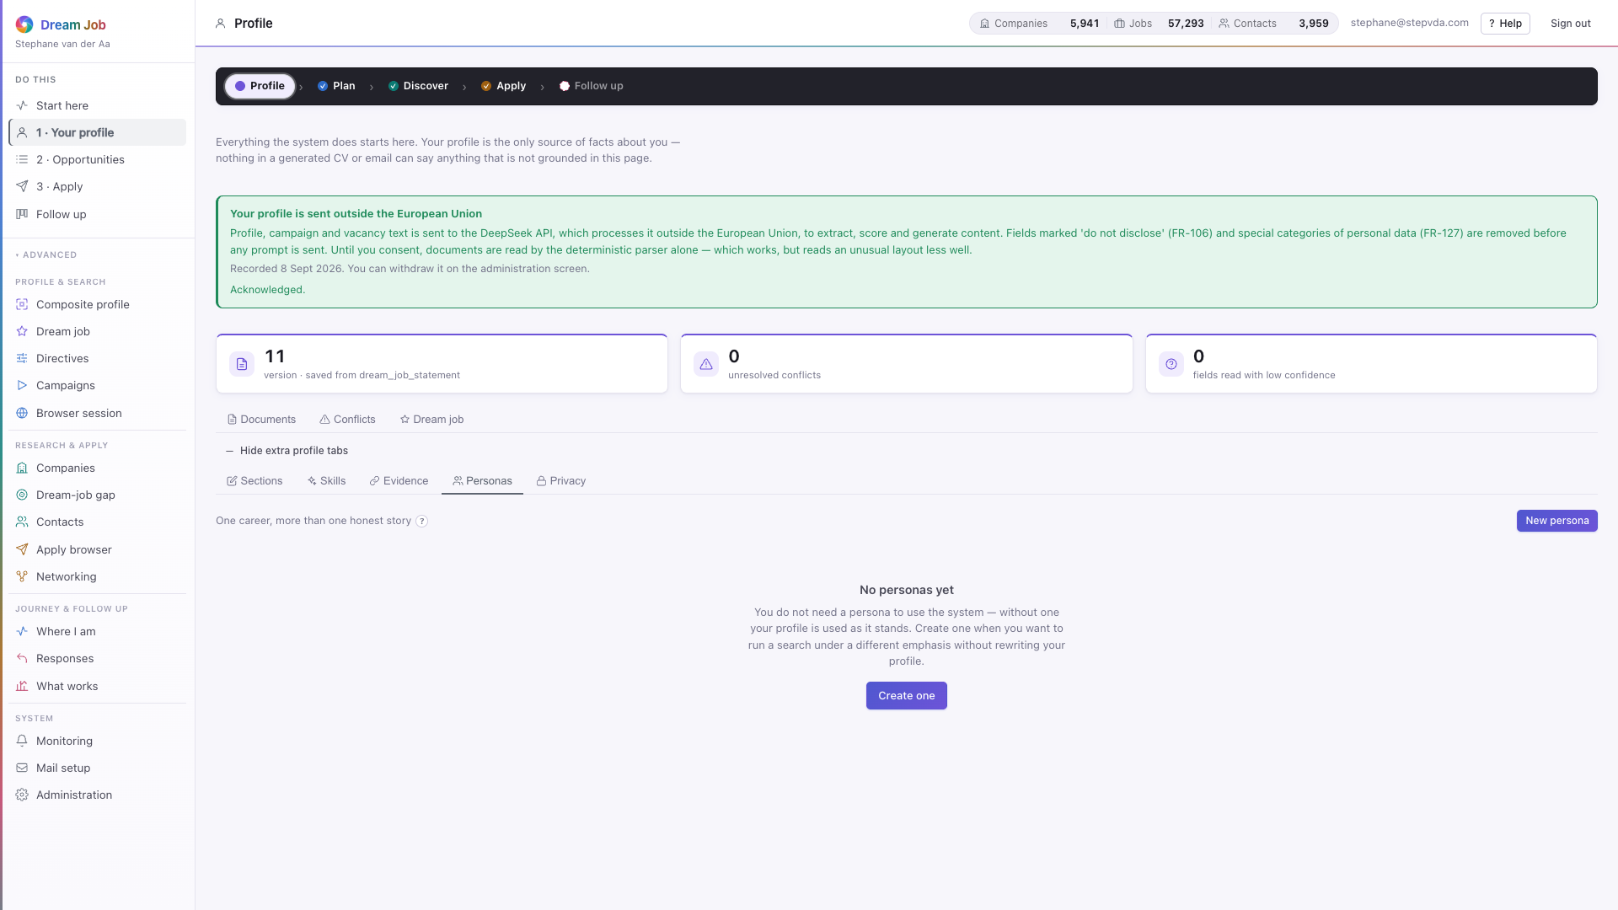
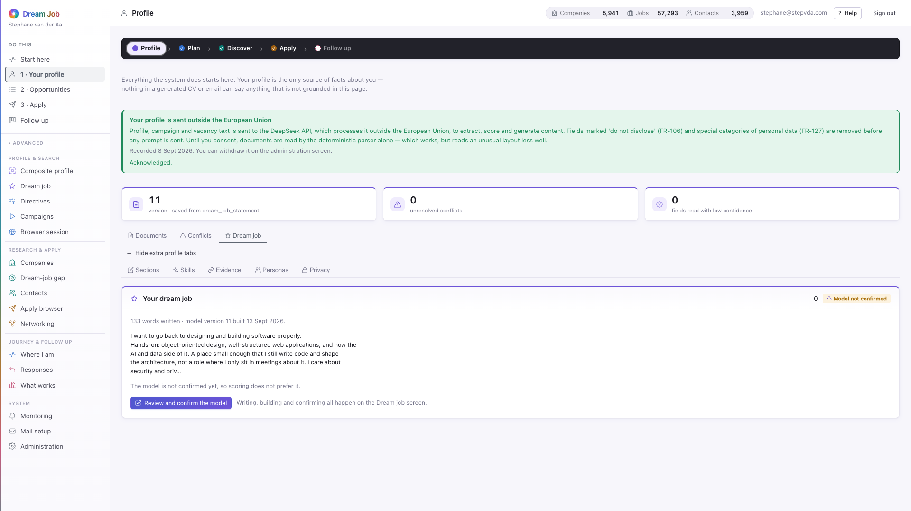

PART 1 · PROFILE
The rest of the profile workspace
Personas let one profile serve more than one kind of application; sections show the structured profile the model actually reads.
profile · Sections — the structured profile
profile · Personas — one profile, more than one angle
profile · Dream job tab — a summary with a link to the editor
profile · the default view, with version and conflict counters
Dream Job · Functional walkthrough and technical architecture · v2
10

Slide 11
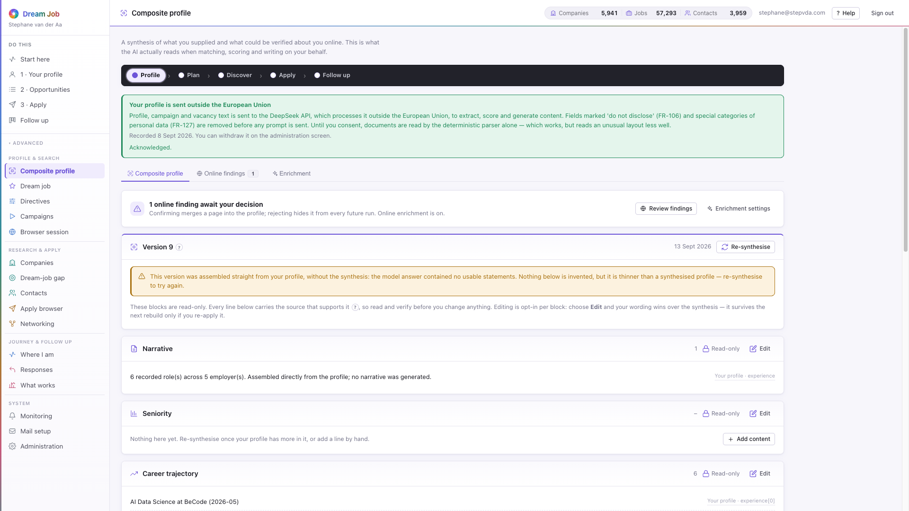
PART 1 · PROFILE
Composite profile
A synthesis of what the job seeker supplied and what could be verified online. This is what the model actually reads when matching, scoring and writing.
• Every statement carries its source and a confidence.
• Ten blocks from narrative and career trajectory to constraints and inferred preferences.
• Online findings are queued for confirm or reject; a rejection is permanent (FR-124).
• Enrichment can be switched off; the profile is then built from documents alone.
composite · the traceable synthesis
Dream Job · Functional walkthrough and technical architecture · v2
11

Slide 12
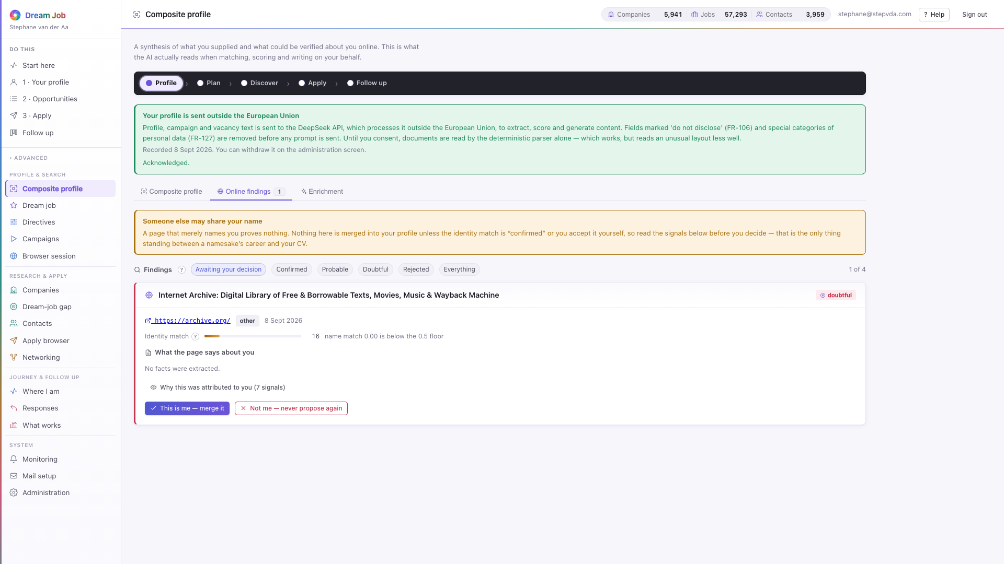
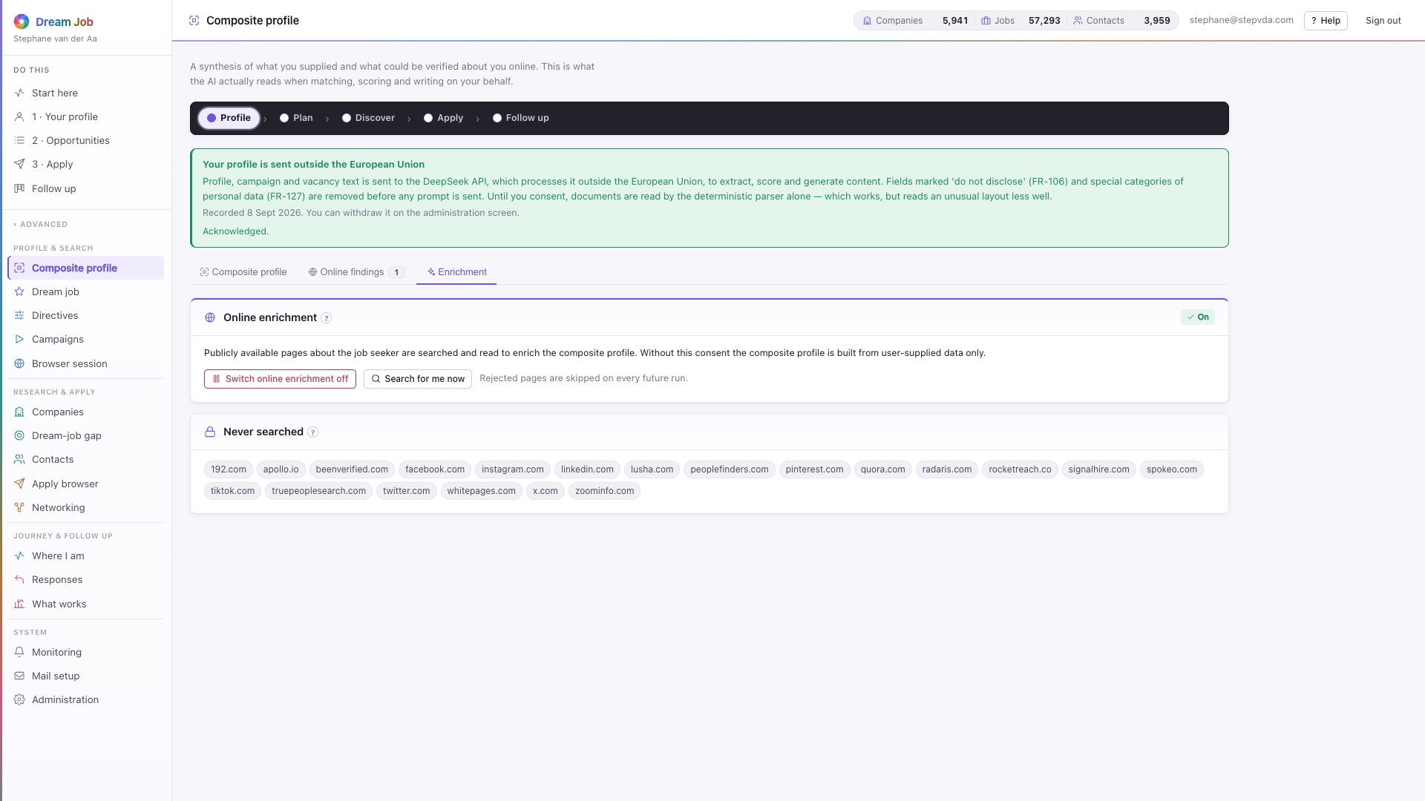
PART 1 · PROFILE
Online findings and enrichment
Identity matching folds name variants, employer overlap, cross-links, location, timeline and photo similarity; only confirmed findings merge (RK-02).
composite · Online findings — confirm or reject, permanently
composite · Enrichment — switch it off, exclude domains
composite · the composite in context
the same discipline as profile conflicts
Dream Job · Functional walkthrough and technical architecture · v2
12

Slide 13
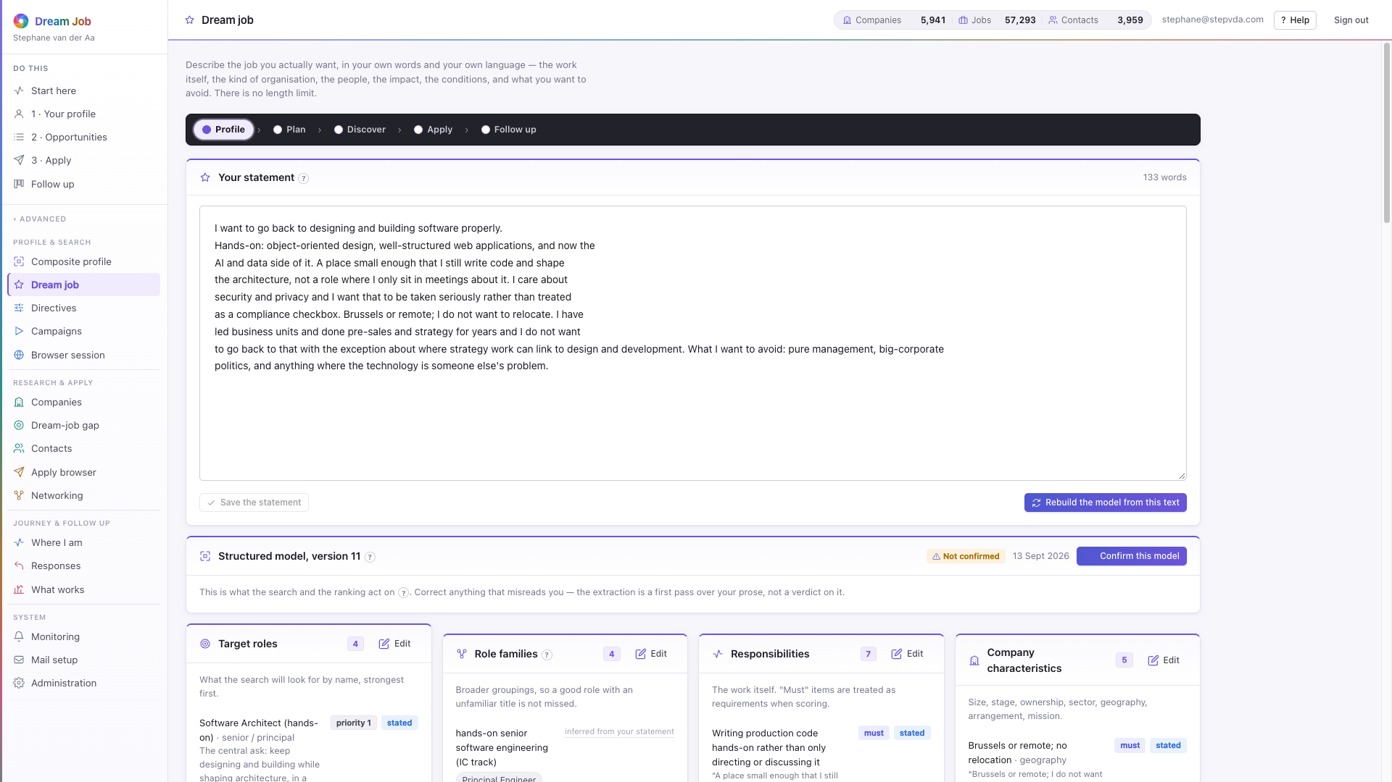
PART 1 · PROFILE
Dream job
Describe the job you actually want, in your own words and language. The model reads it for nuance — target roles, responsibilities, values and deal-breakers.
• Deal-breakers filter more decisively than preferences; they become directive defaults.
• The structured model is used for matching; the prose is not.
• The screen flags when the statement and the model have drifted apart.
• Nothing acts on the model until the job seeker confirms it (FR-128).
dream job · statement plus structured model
Dream Job · Functional walkthrough and technical architecture · v2
13

Slide 14
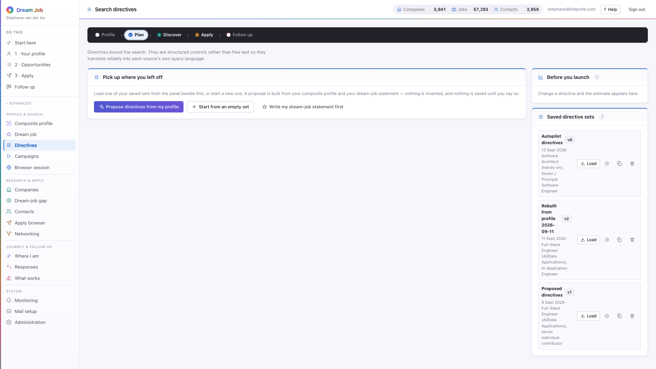
PART 1 · PLAN
Search directives
Directives bound the search. They are structured controls rather than free text, so they translate reliably into each source's own query language.
• Five groups: job content, company type, location, work arrangement and compensation.
• Values pre-filled from the composite profile are suggestions, not facts.
• Discretion mode excludes the current employer and its group entities from every search and message (FR-385).
• The estimate beside the form says how many sources and pages the settings imply.
directives · structured controls and a live estimate
Dream Job · Functional walkthrough and technical architecture · v2
14

Slide 15
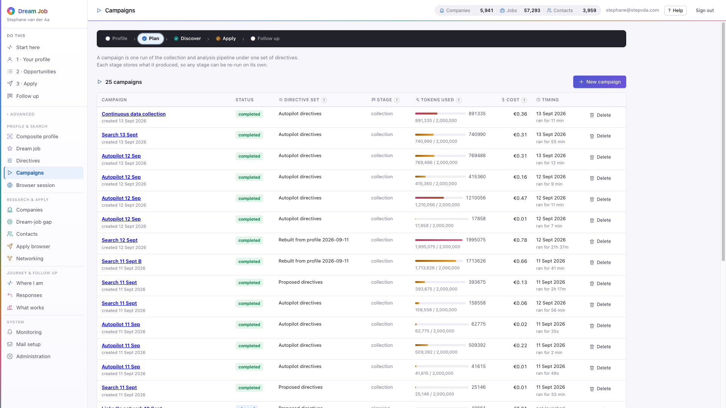
PART 1 · PLAN
Campaigns
A campaign is one run of the collection and analysis pipeline under one set of directives. Every stage stores what it produced and can be re-run on its own.
• The plan is reviewed before launch: sources, queries, expected volume, duration and cost.
• The planner checks the shared knowledge base first and collects only what is missing or stale (FR-342/343).
• Pause, resume or cancel at any point; a crash loses at most the page in flight (NFR-401).
• The token budget caps AI spend and degrades gracefully near the limit.
campaigns · the ledger of runs
Dream Job · Functional walkthrough and technical architecture · v2
15

Slide 16
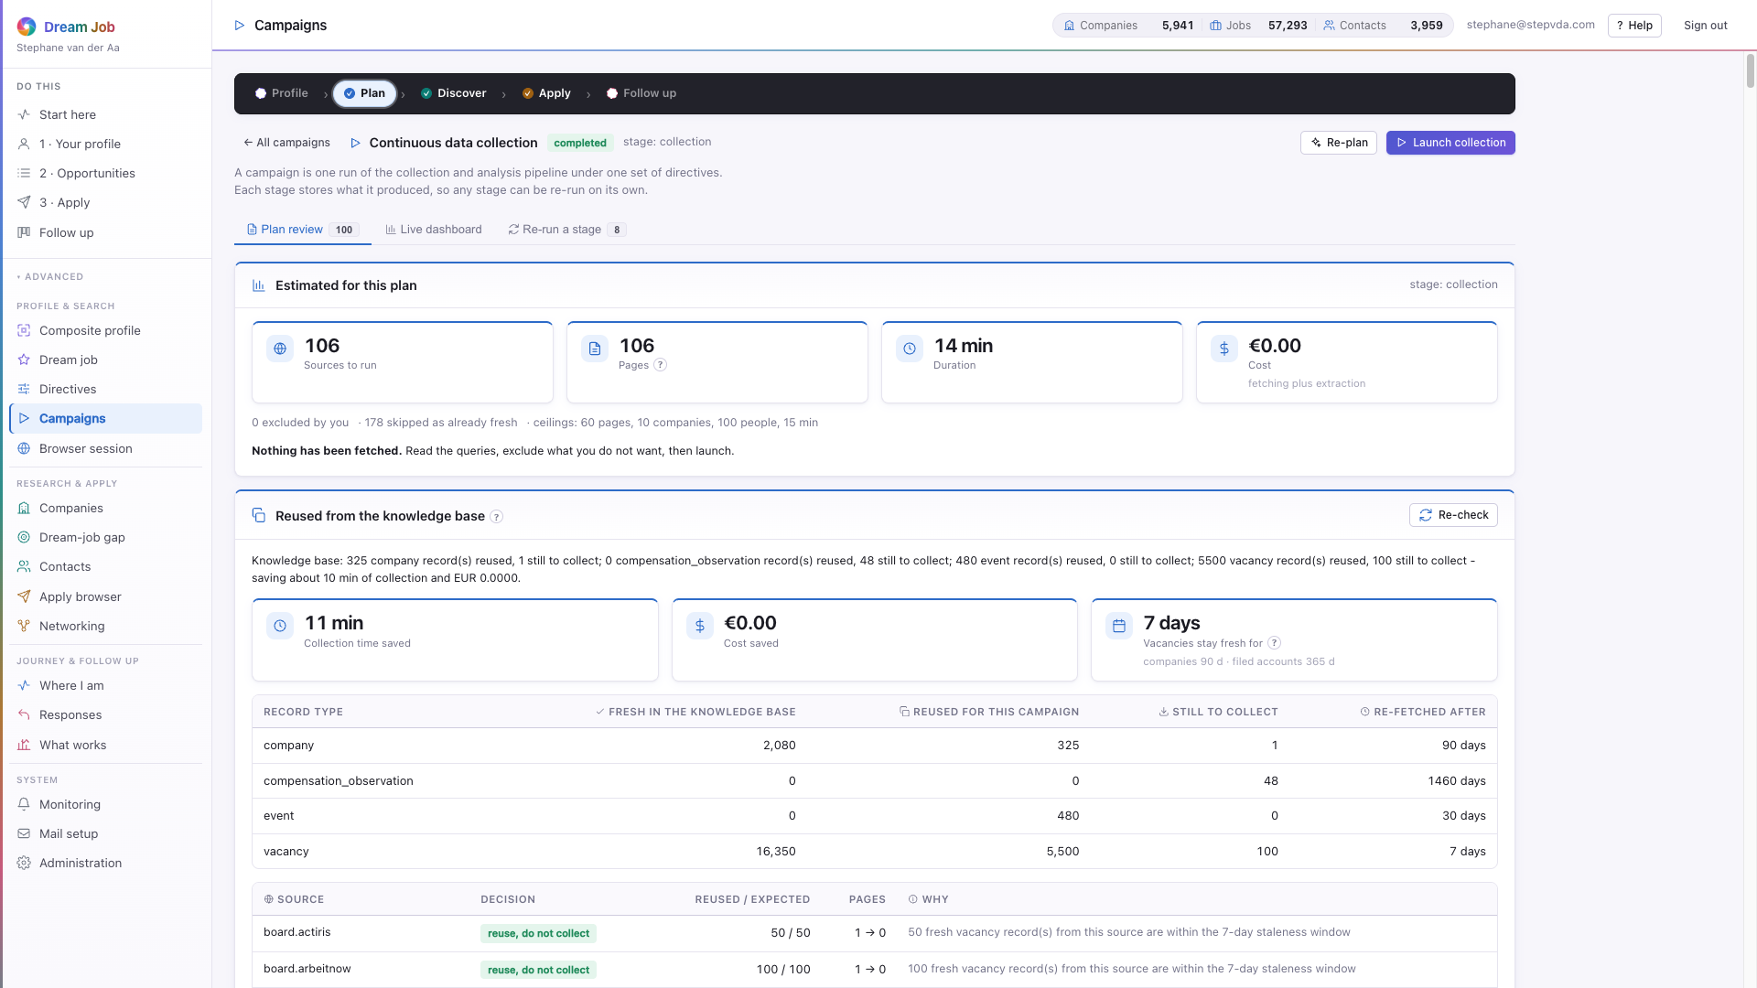
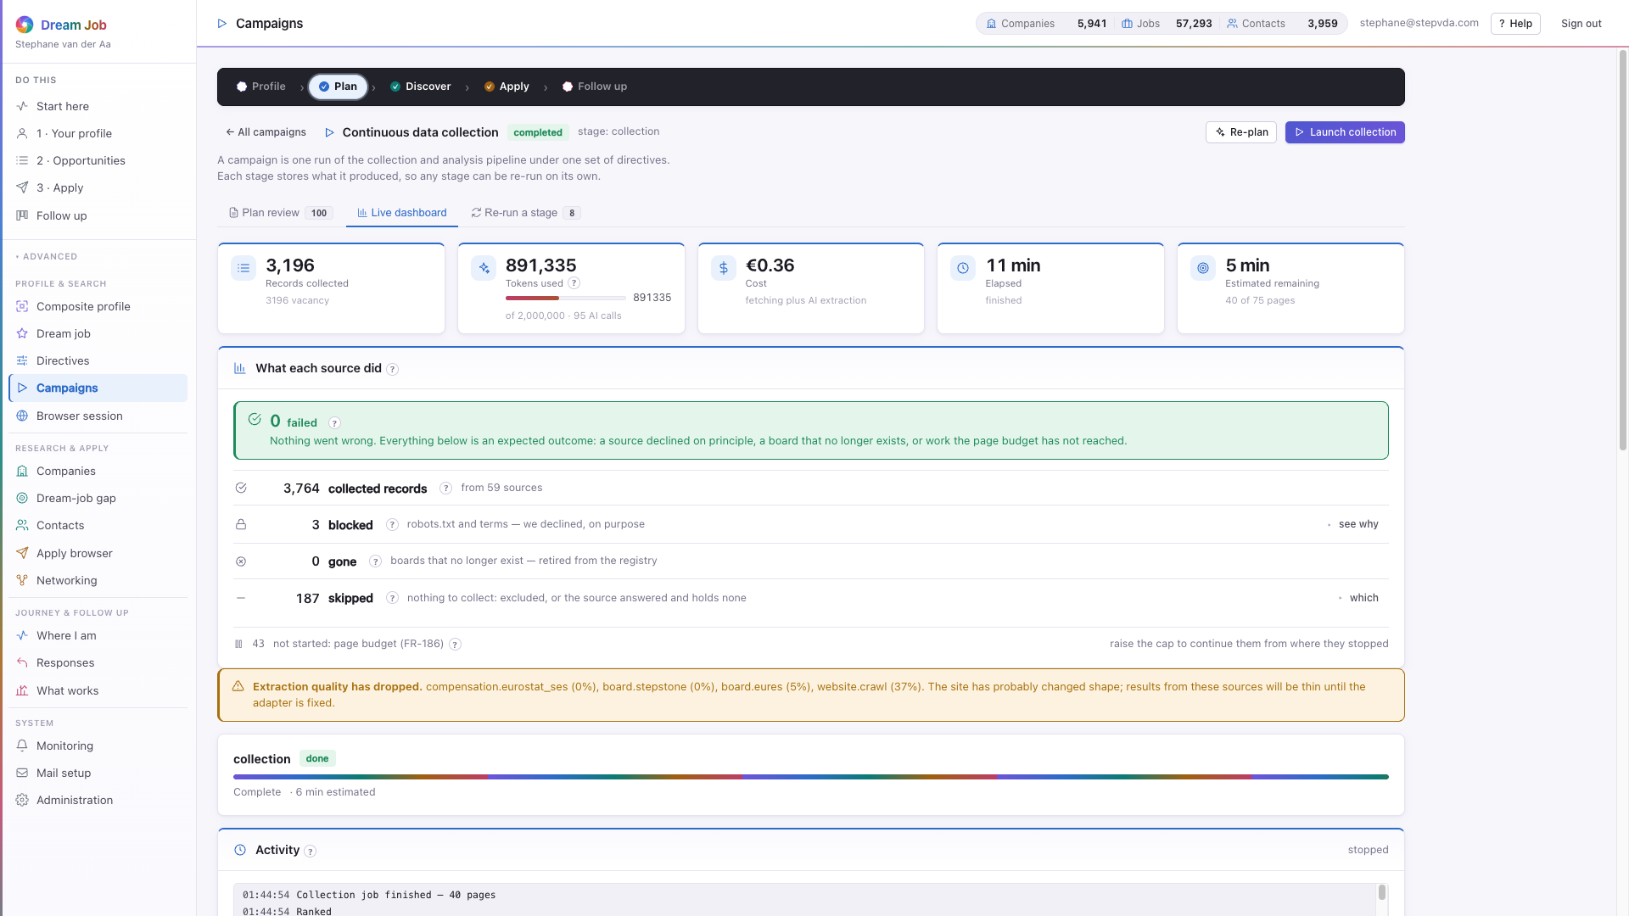
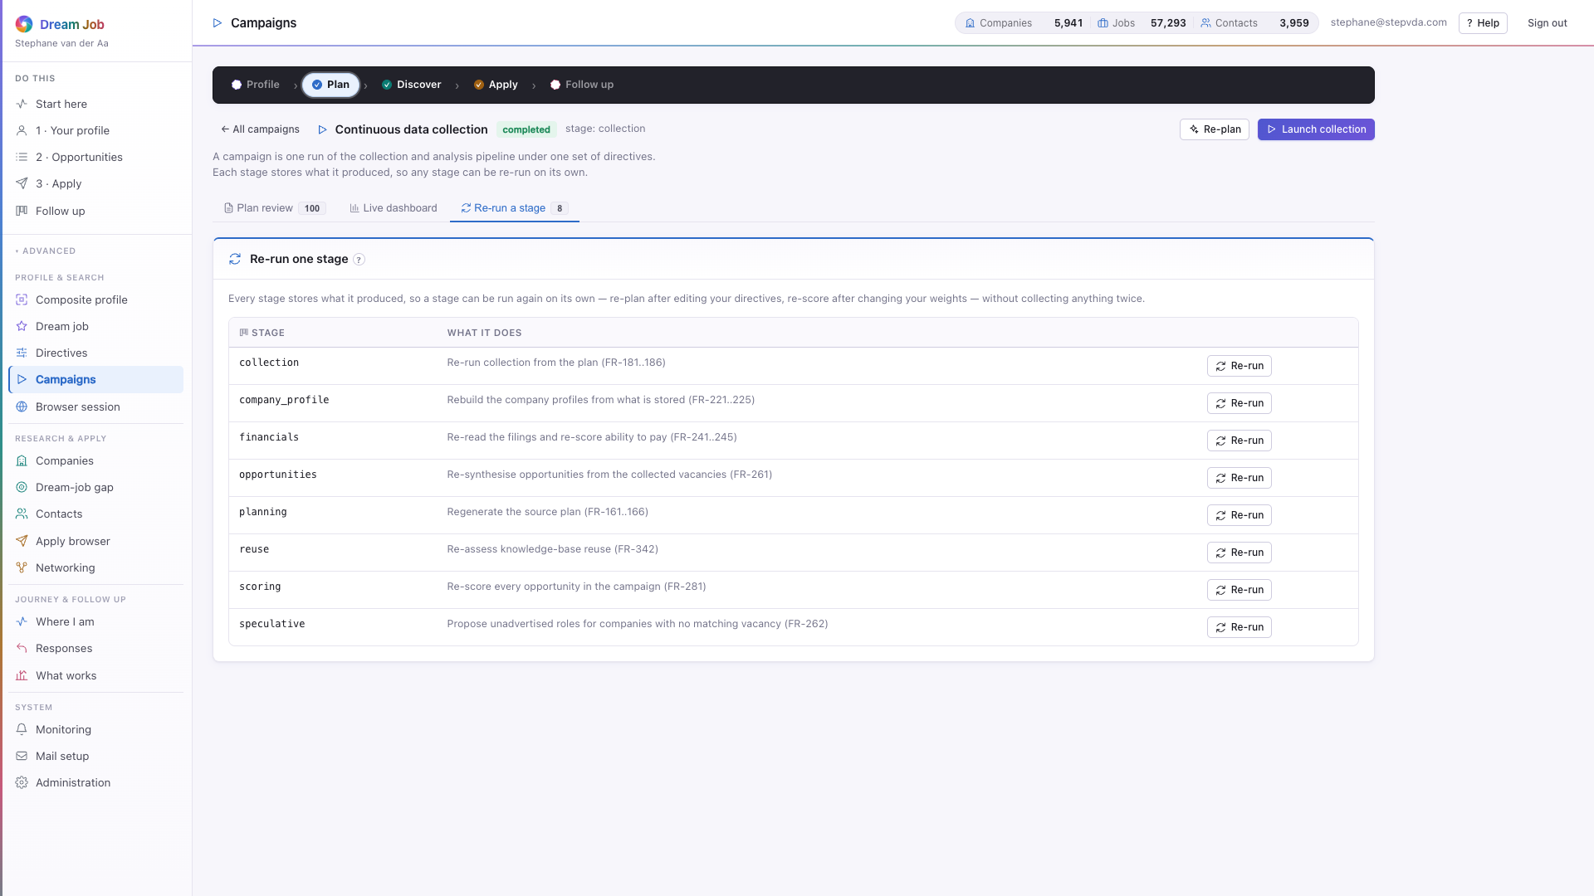
PART 1 · PLAN
Inside a campaign
Every stage persists its own artefacts; the plan is a human gate before collection, and the dashboard is the live view of what each adapter is doing.
campaign · Plan review — sources, queries, cost, reuse
campaign · Live dashboard — per-adapter progress, tokens, cost
campaign · Re-run a stage — one stage, without the rest (NFR-603)
campaign · the campaign header and state actions
Dream Job · Functional walkthrough and technical architecture · v2
16

Slide 17
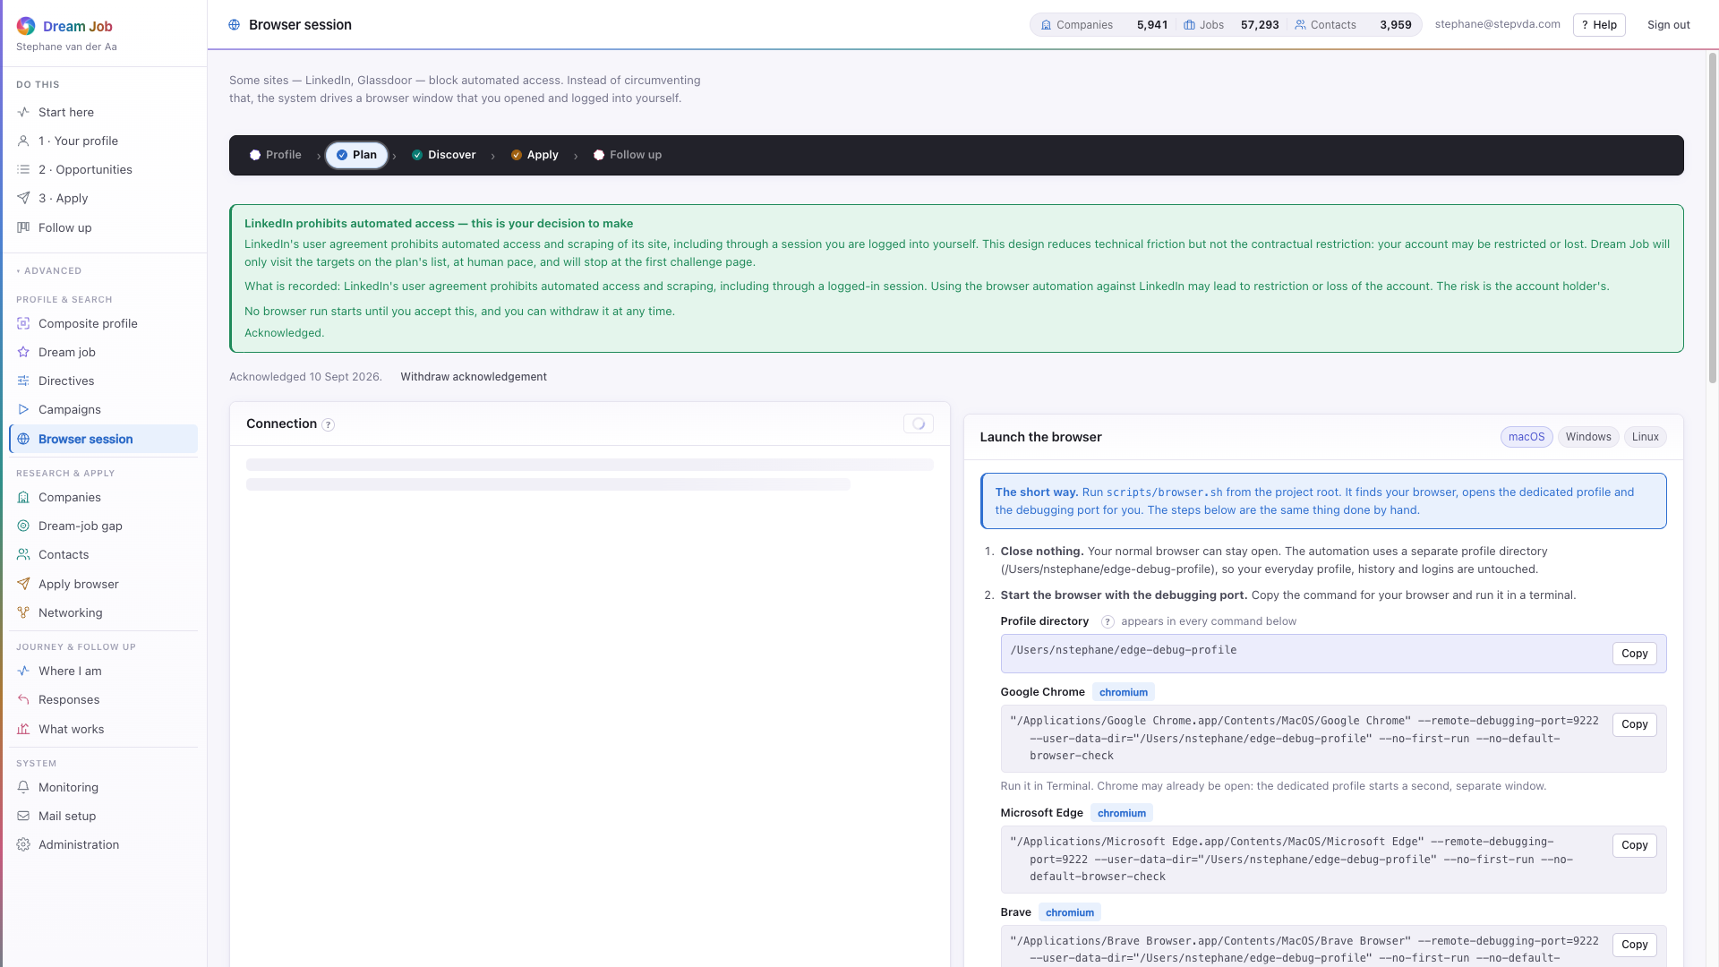
PART 1 · PLAN
Browser session
The control surface for browser-assisted collection. Dream Job attaches to a browser you already signed in to; it never holds a third-party password (FR-201/202).
• Connection panel reports whether a browser is attached and which sites are signed in.
• Launch instructions per operating system; the session is attach-only.
• Human pacing, a duration contract and immediate stop on a challenge (CR-401).
• Retention and purge keep browser-collected data on a short leash (NFR-303/344).
browser · connection, pacing and terms acknowledgement
Dream Job · Functional walkthrough and technical architecture · v2
17

Slide 18
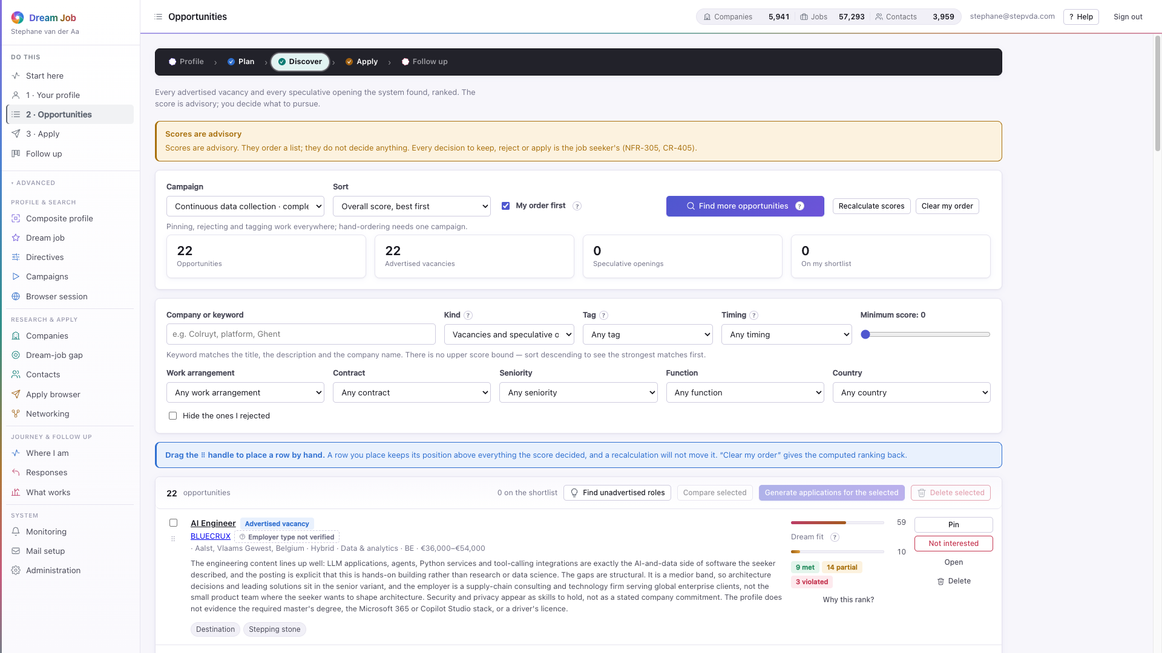
PART 1 · DISCOVER
Opportunities
Every advertised vacancy and every speculative opening the system found, ranked. The score is advisory; the job seeker decides what to pursue.
• Filter and sort by kind, arrangement, seniority, country, score floor or keyword.
• 'Why this rank?' opens the seven sub-scores and the dream-job criteria behind them.
• Manual ordering overrides the computed ranking and survives recalculation (FR-284).
• Rejection reasons feed back into the weights, which is why a reason is required.
opportunities · the ranked list, filtered and sortable
Dream Job · Functional walkthrough and technical architecture · v2
18

Slide 19
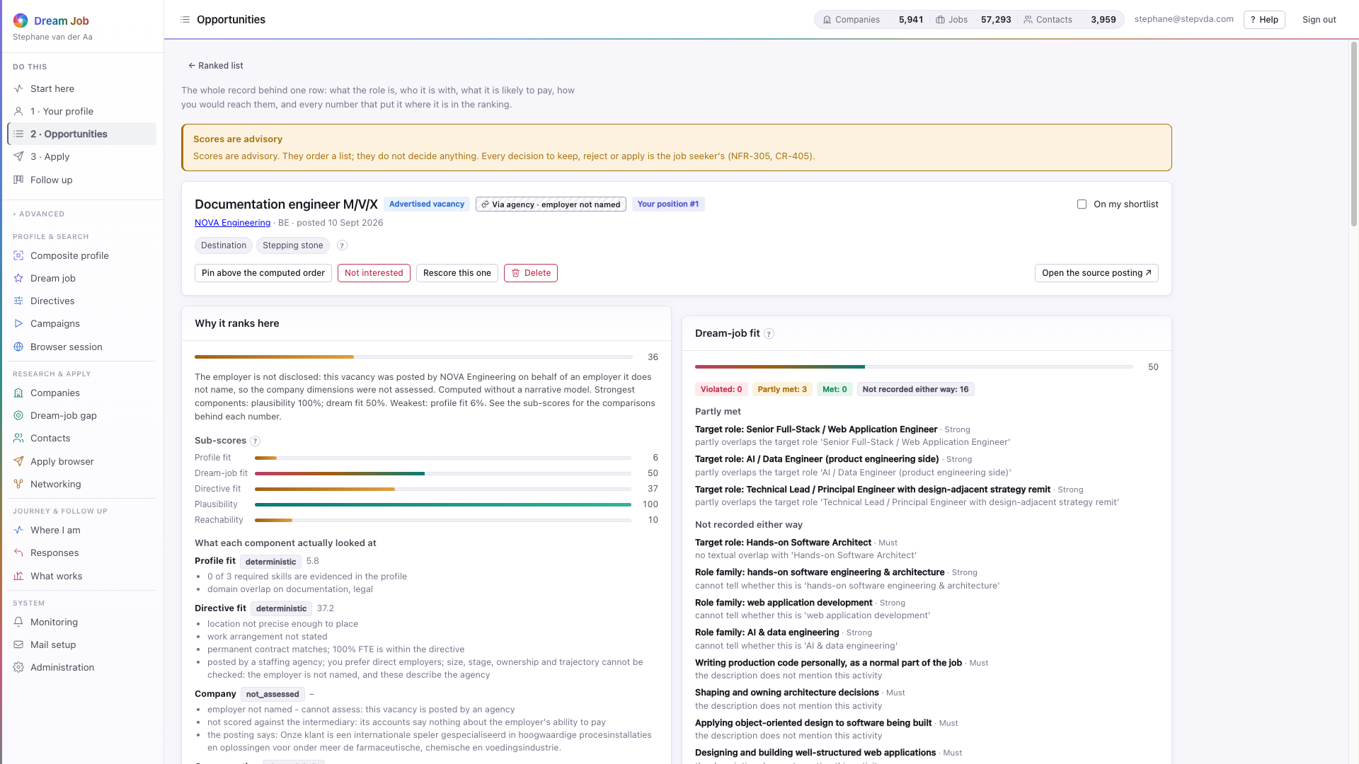
PART 1 · DISCOVER
Why a role ranks where it does
The detail screen turns the score into an argument: seven sub-scores, the dream-job criteria, the compensation estimate and its sources, and the route to a person.
• Sub-scores: profile fit, dream-job fit, directive fit, company, compensation, plausibility, reachability.
• Dream-job fit shows met, partly met and violated criteria, not a single number.
• A speculative opening explains why the system thinks the role exists (FR-263).
• 'Prepare an application for this role' is the bridge into Apply.
opportunity detail · the full explanation
Dream Job · Functional walkthrough and technical architecture · v2
19

Slide 20
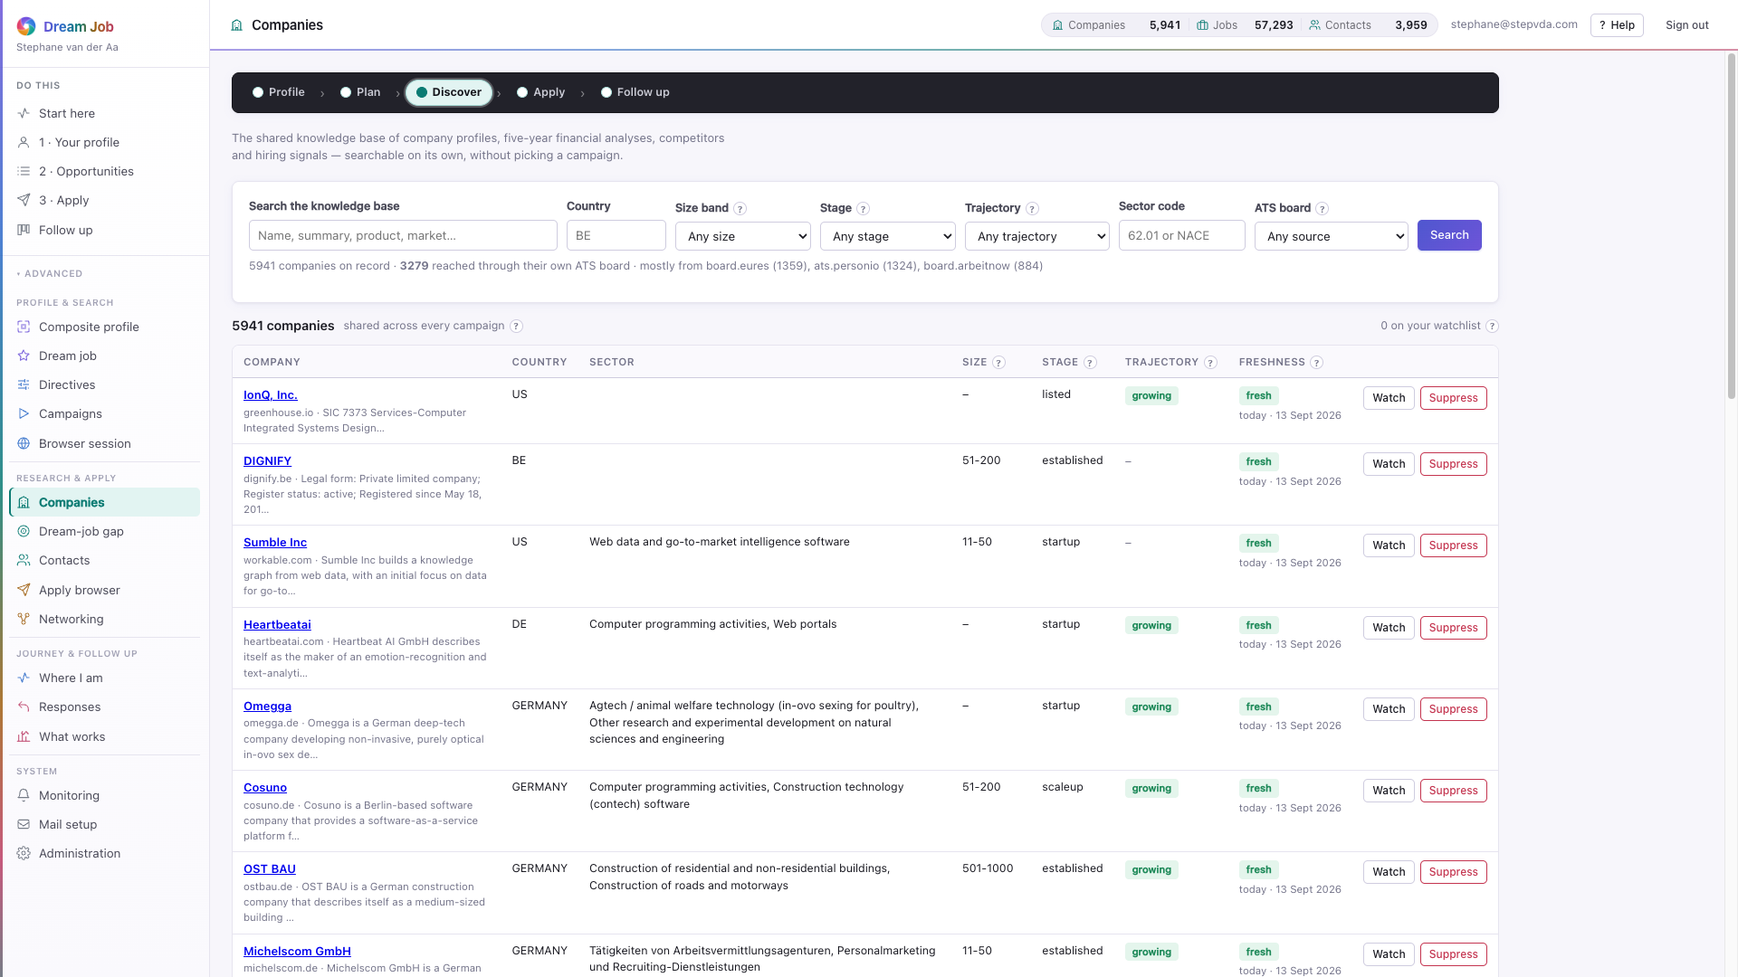
PART 1 · DISCOVER
Companies and the knowledge base
The shared knowledge base: company profiles, five-year financial analyses, competitors and hiring signals — searchable without picking a campaign.
• Company research is shared across job seekers and reused while fresh, so a second search costs nothing.
• Freshness is shown before the figures: a stale row describes the company as it was.
• Suppression and watch controls, plus an employer-kind verdict for who is hiring.
• The inventory today holds 5,941 companies and 57,293 vacancies.
companies · the shared inventory
Dream Job · Functional walkthrough and technical architecture · v2
20

Slide 21
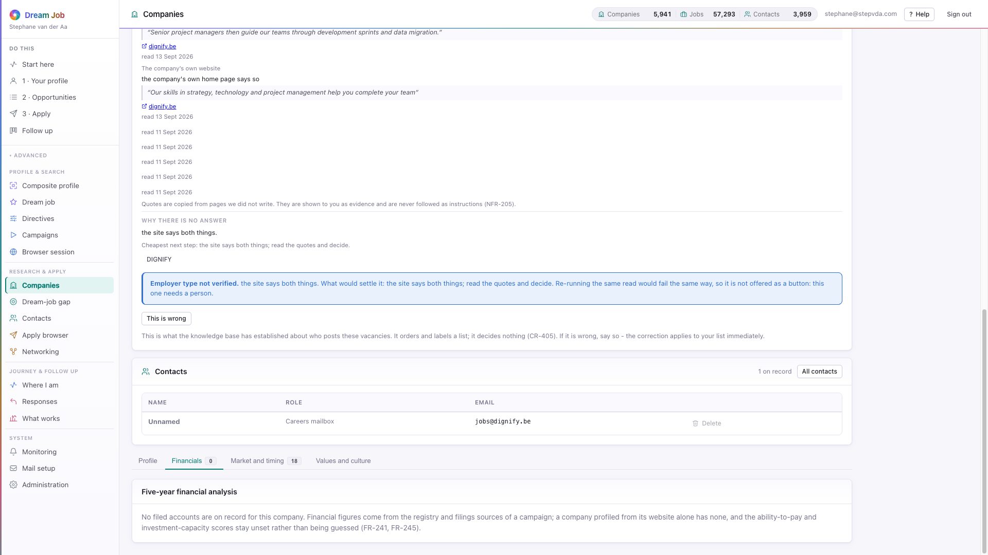
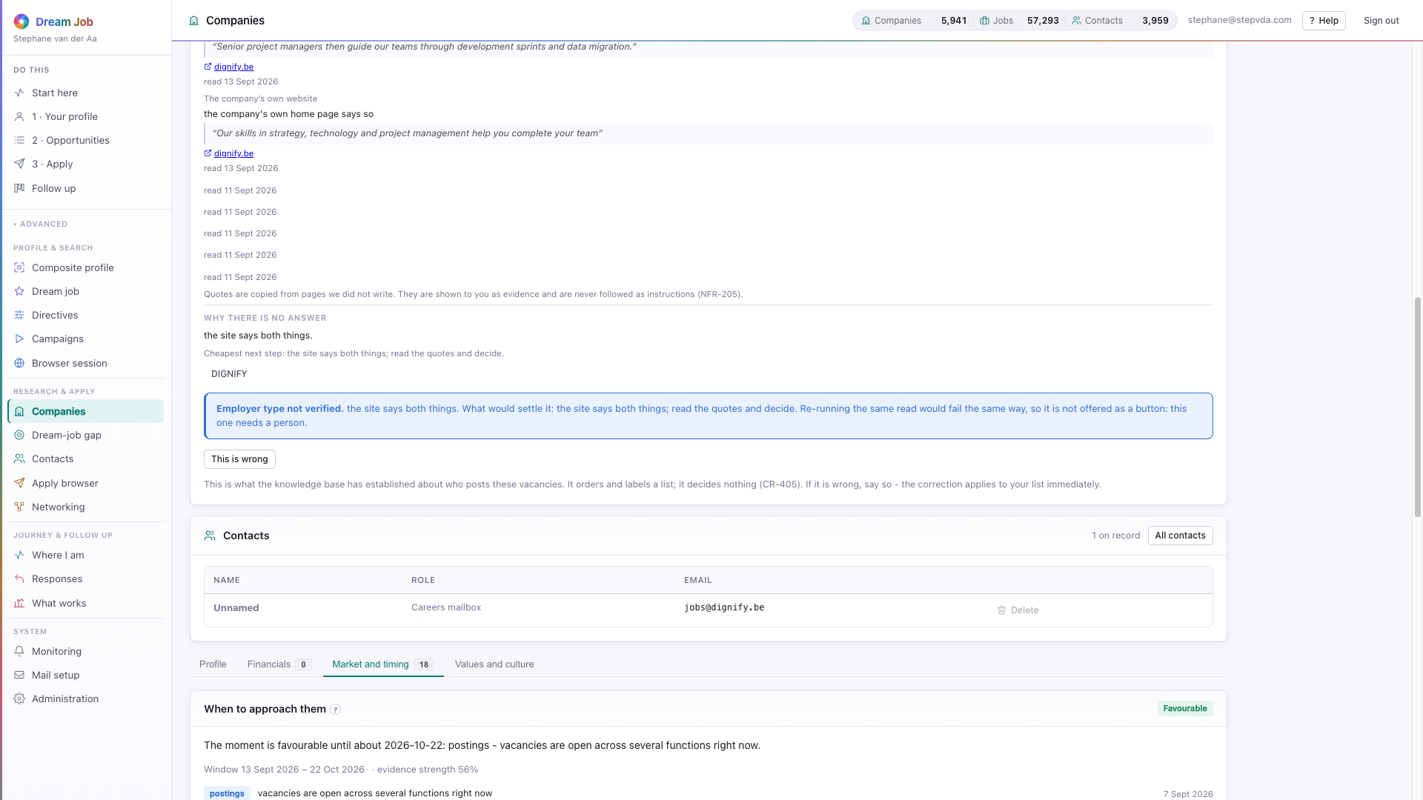
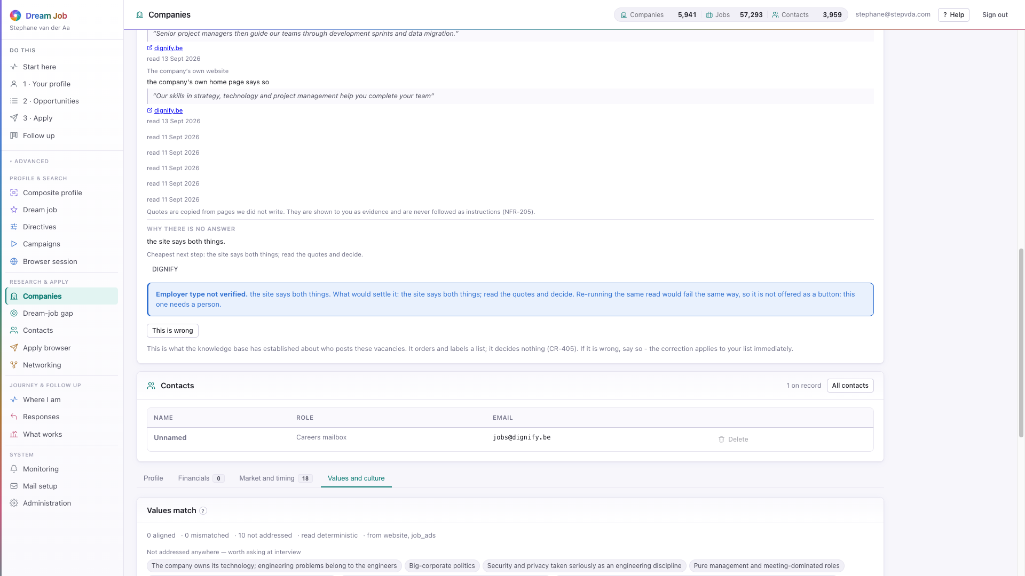
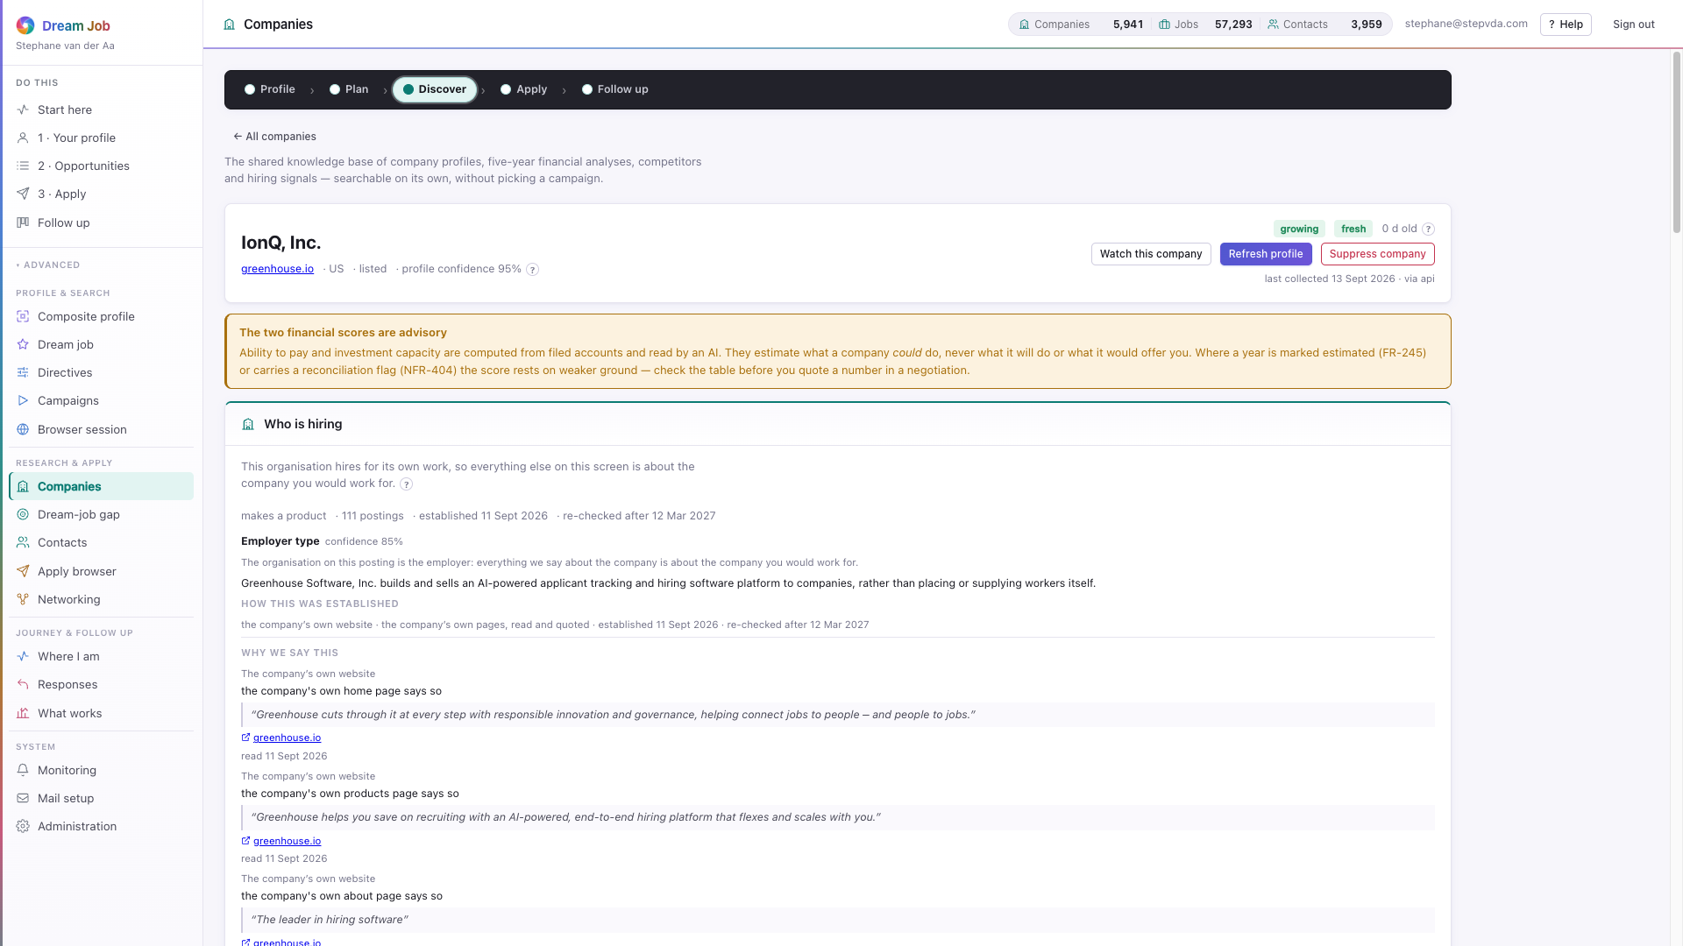
PART 1 · DISCOVER
Inside a company
Five years of filed figures become two advisory scores that cite their inputs; market timing, peers and values are separate tabs.
company · Financials — five-year analysis and two scores
company · Market and timing — signals and peers to adopt
company · Values and culture — what the company says about itself
company · the header: trajectory, freshness, watch and suppress
Dream Job · Functional walkthrough and technical architecture · v2
21

Slide 22
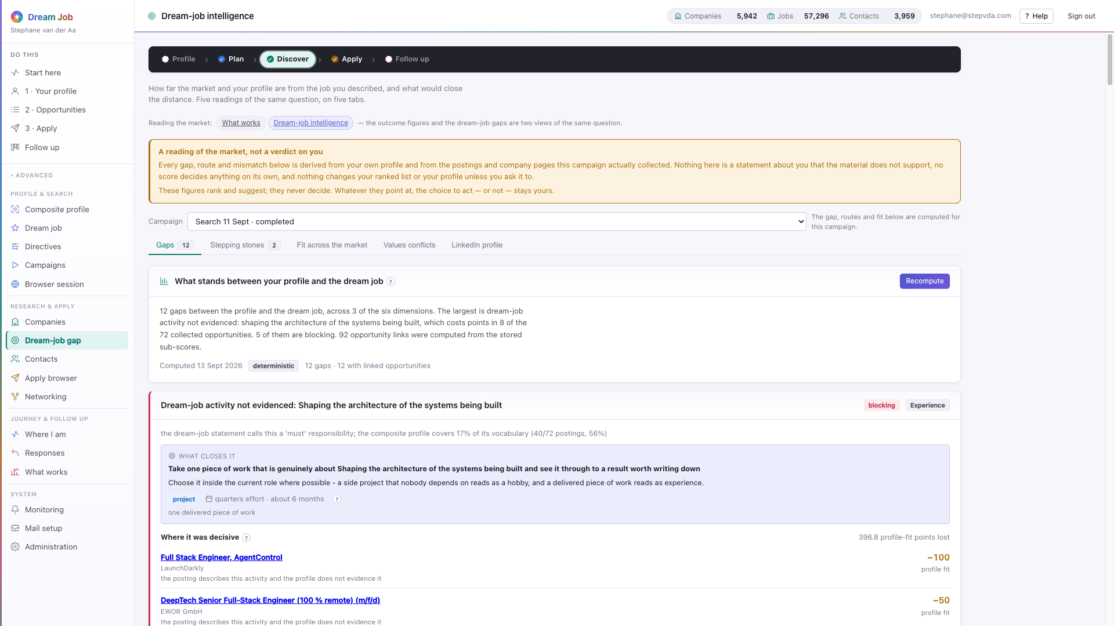
PART 1 · DISCOVER
Dream-job intelligence — the gaps
How far the market and your profile are from the job you described, and what would close the distance. Gap analysis and paths work without the language model.
• Gaps are computed against the structured dream-job model, with a threshold the job seeker controls.
• Each gap says what closes it and where it was decisive on the ranked list.
• The reading is stored; recompute is explicit, nothing recalculates behind your back.
• The numbers are deterministic; a model only sharpens the wording (CR-405).
intelligence · Gaps and what closes them
Dream Job · Functional walkthrough and technical architecture · v2
22

Slide 23
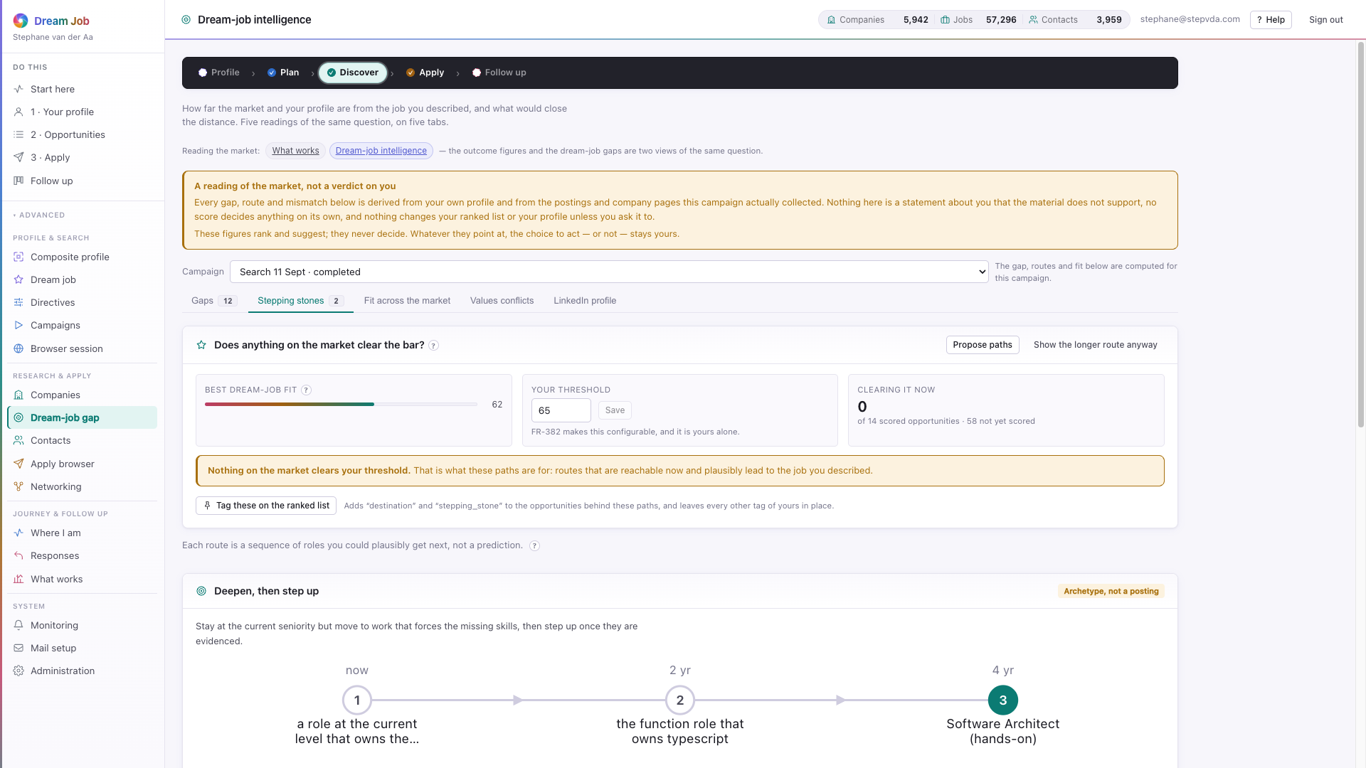
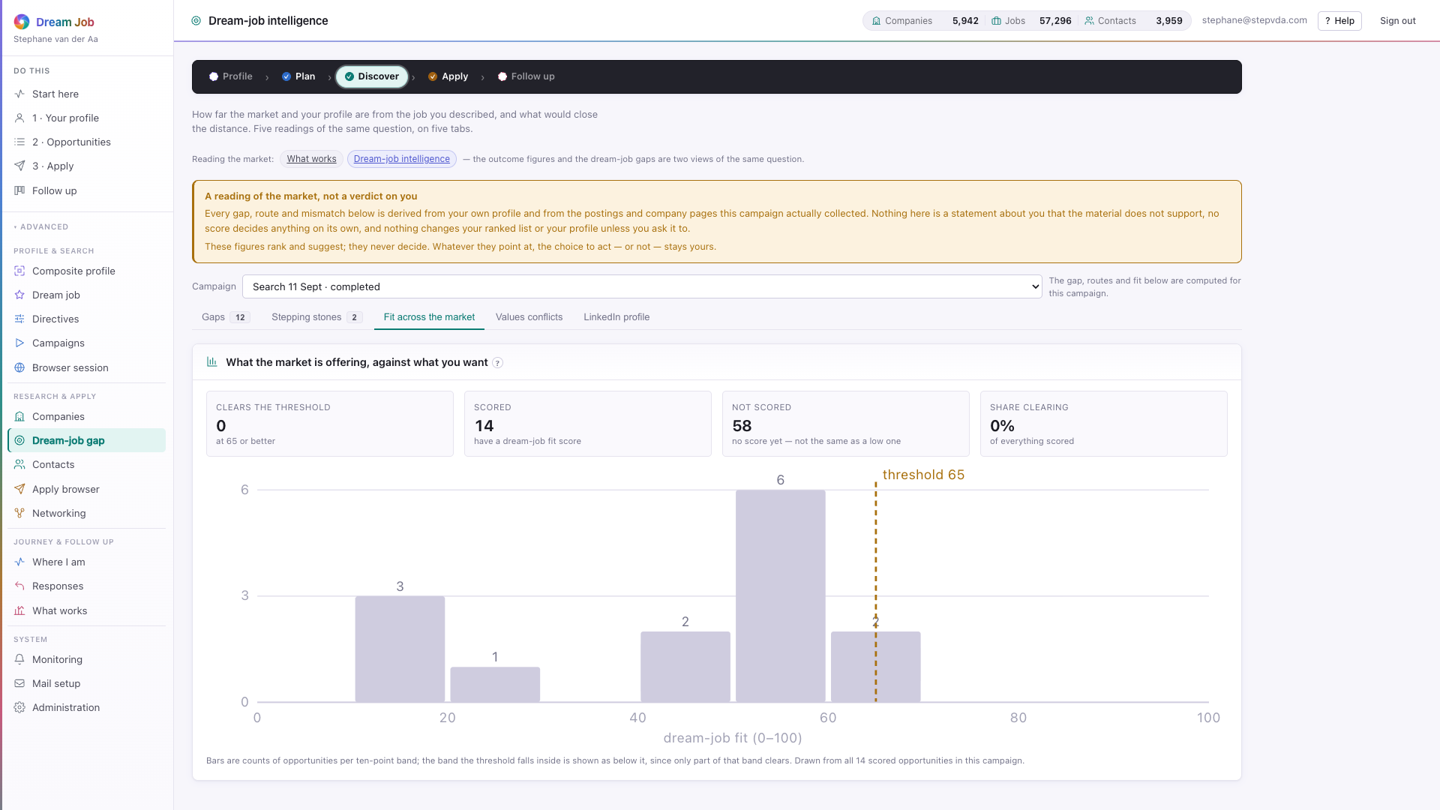
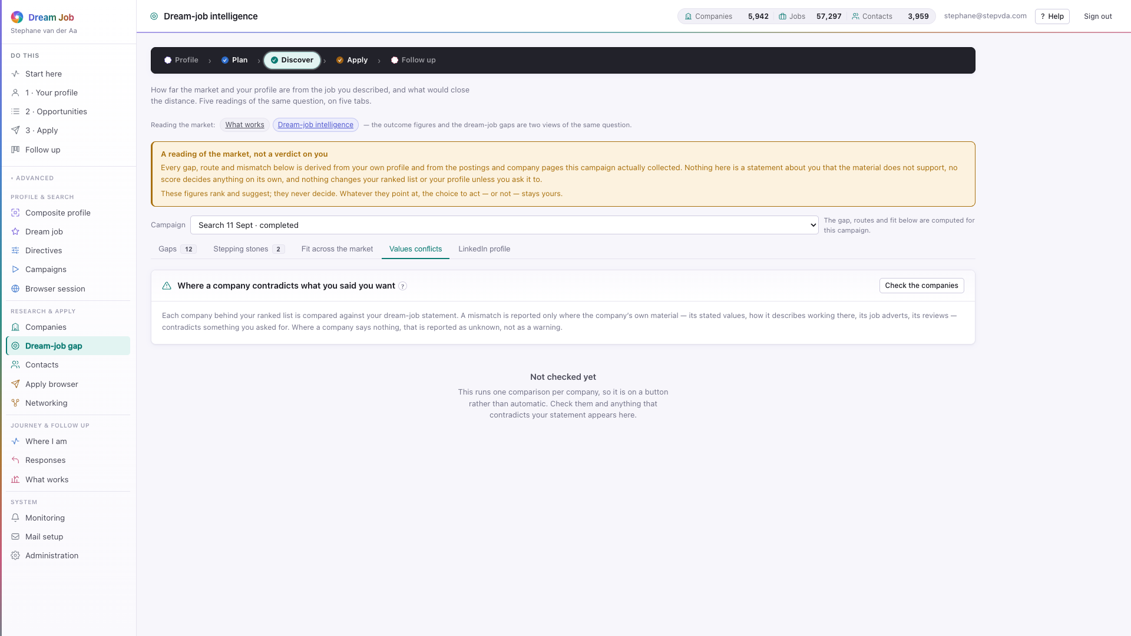
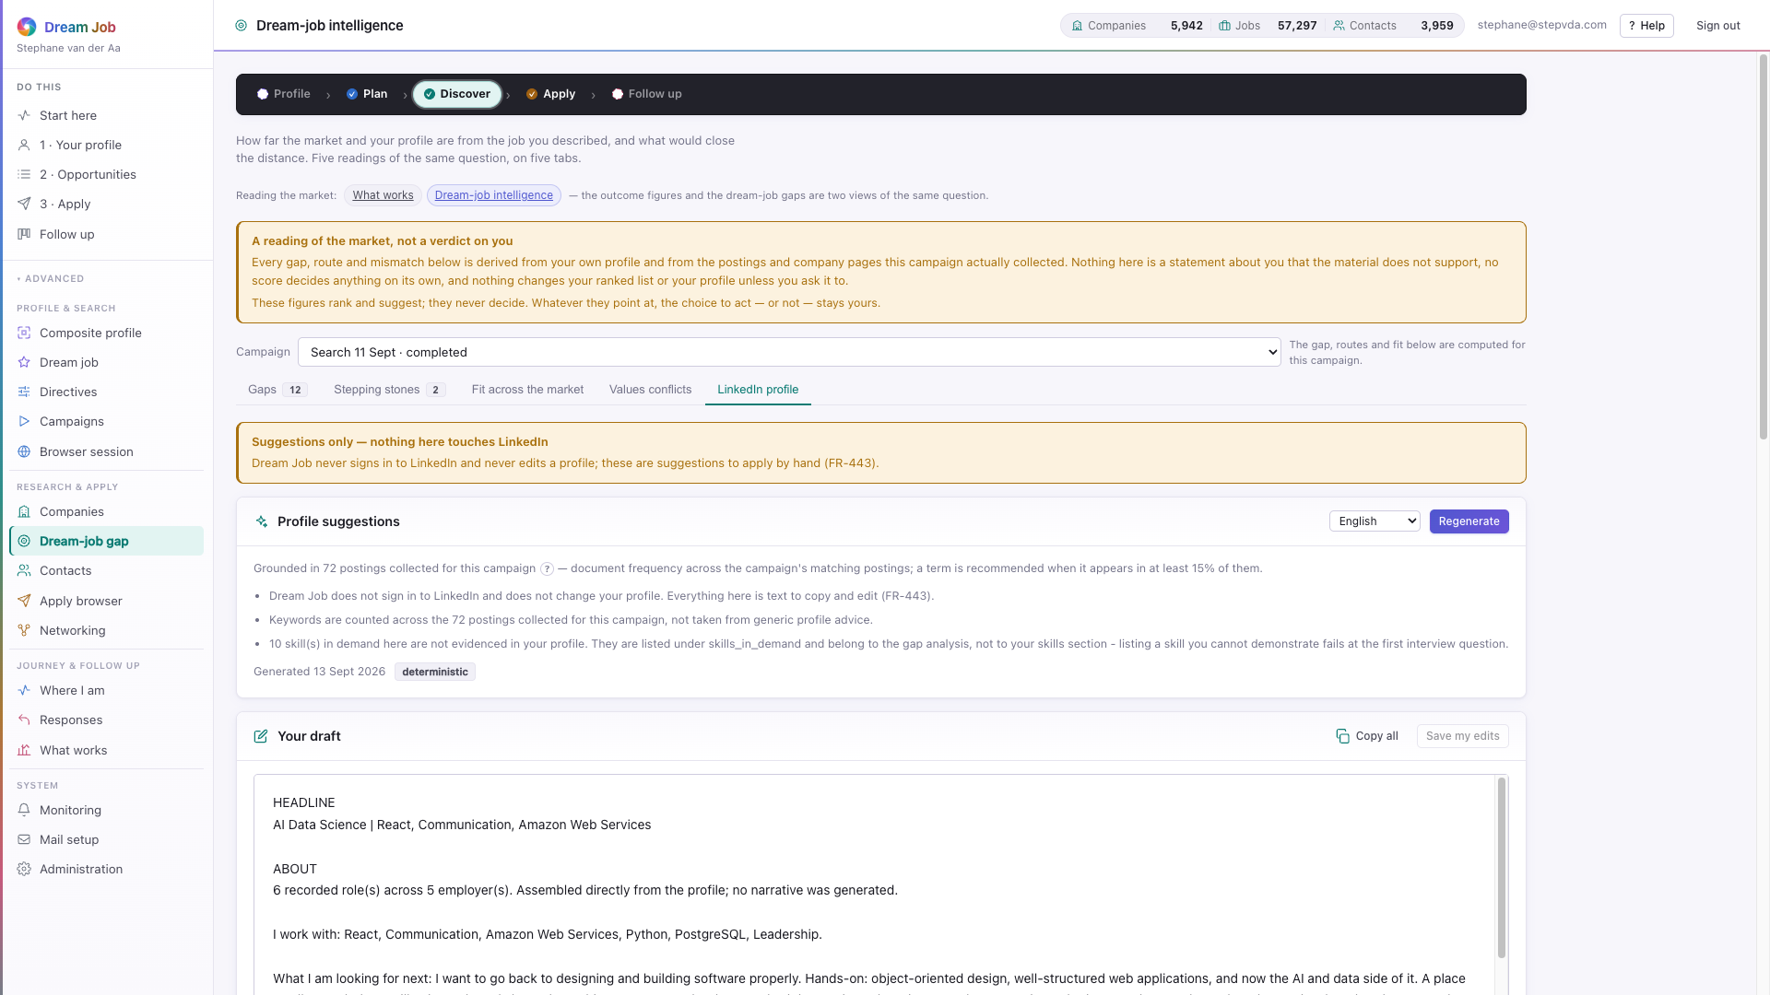
PART 1 · DISCOVER
Stepping stones, fit and values
When nothing clears the dream-job threshold, the system proposes two or three sequences of roles that lead there — and shows how much of the market clears it at all.
intelligence · Stepping stones — routes to the dream job
intelligence · Fit across the market — the distribution and threshold
intelligence · Values conflicts — where a company contradicts you
intelligence · LinkedIn profile — suggestions you copy by hand
Dream Job · Functional walkthrough and technical architecture · v2
23

Slide 24
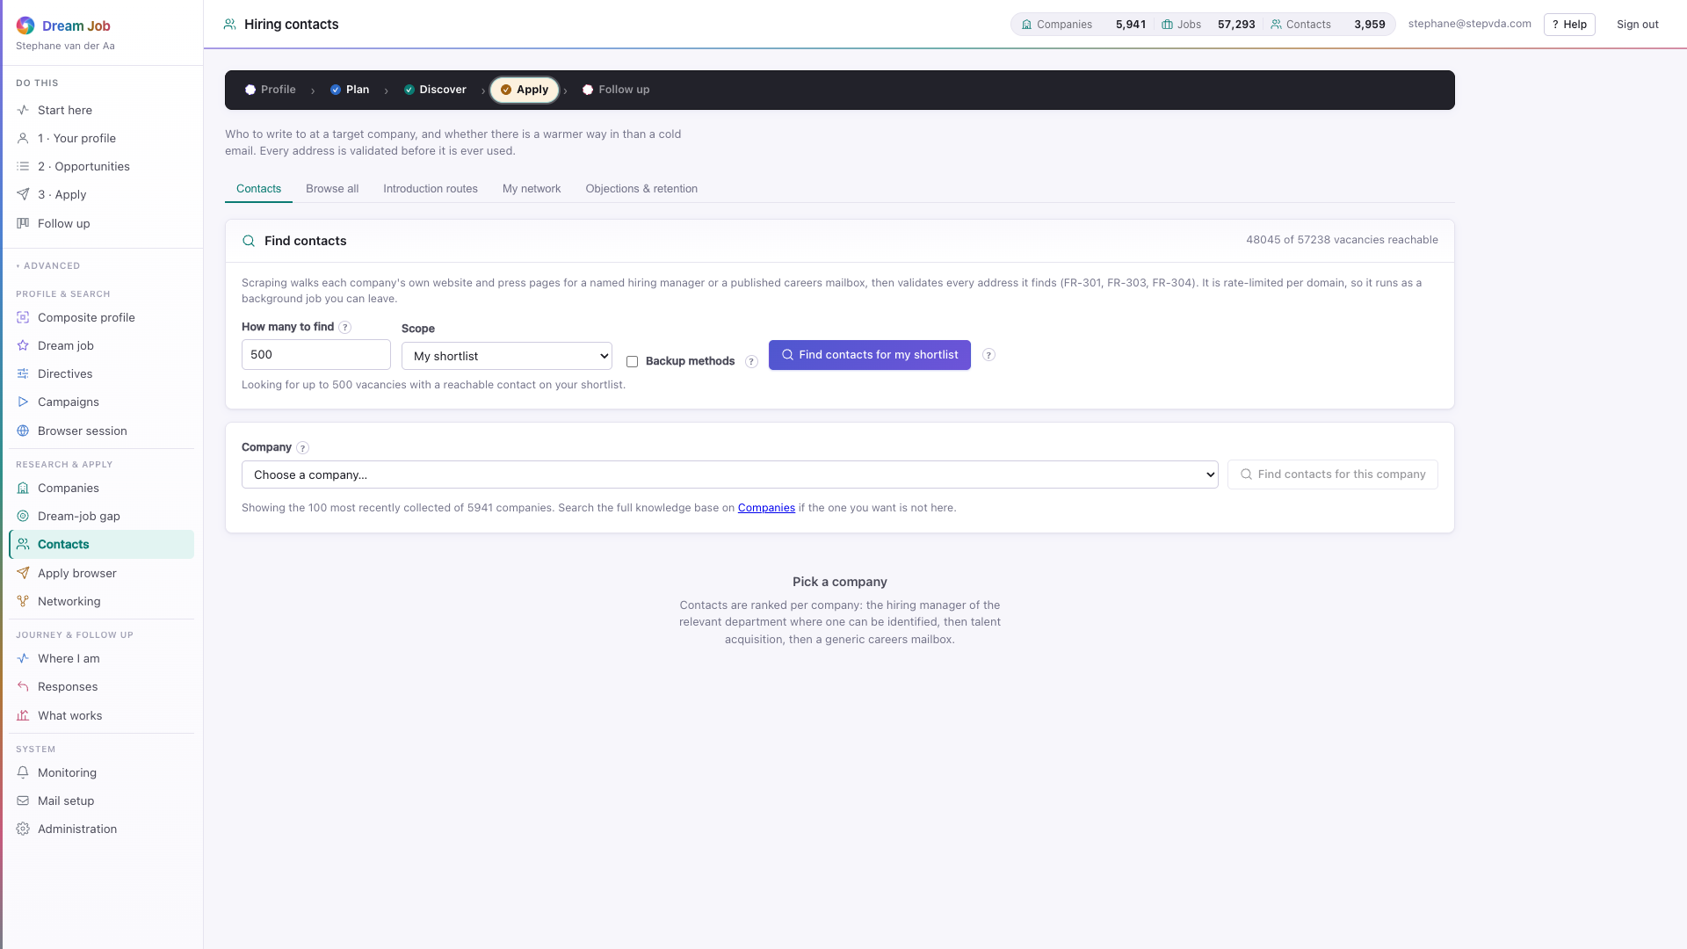
PART 1 · APPLY
Hiring contacts
The people behind the opportunities, found by walking a ladder of sources and validated rather than guessed.
• A company showing 'unreachable' is a real finding: nothing survived the ladder.
• Contacts are shared unless collected by browser automation, then restricted (NFR-302/303).
• An objection blocks the address permanently for everyone on the installation.
• The knowledge base holds 3,959 contacts today.
contacts · the ranked ladder for a company
Dream Job · Functional walkthrough and technical architecture · v2
24

Slide 25
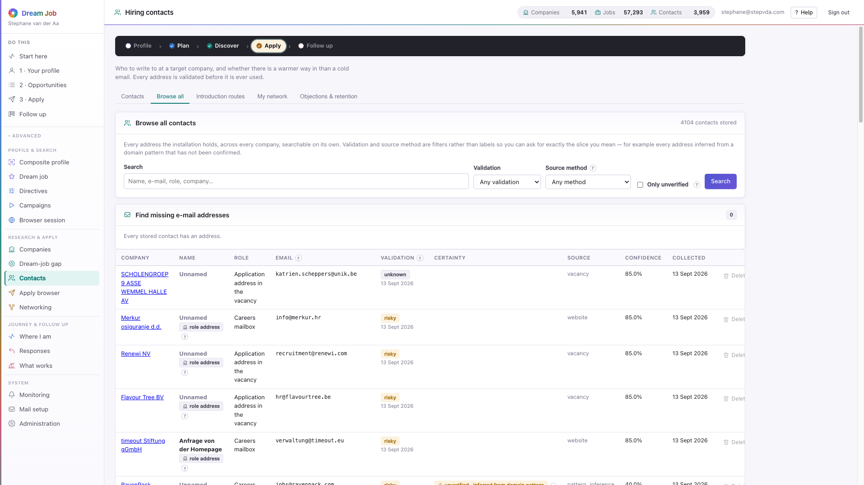
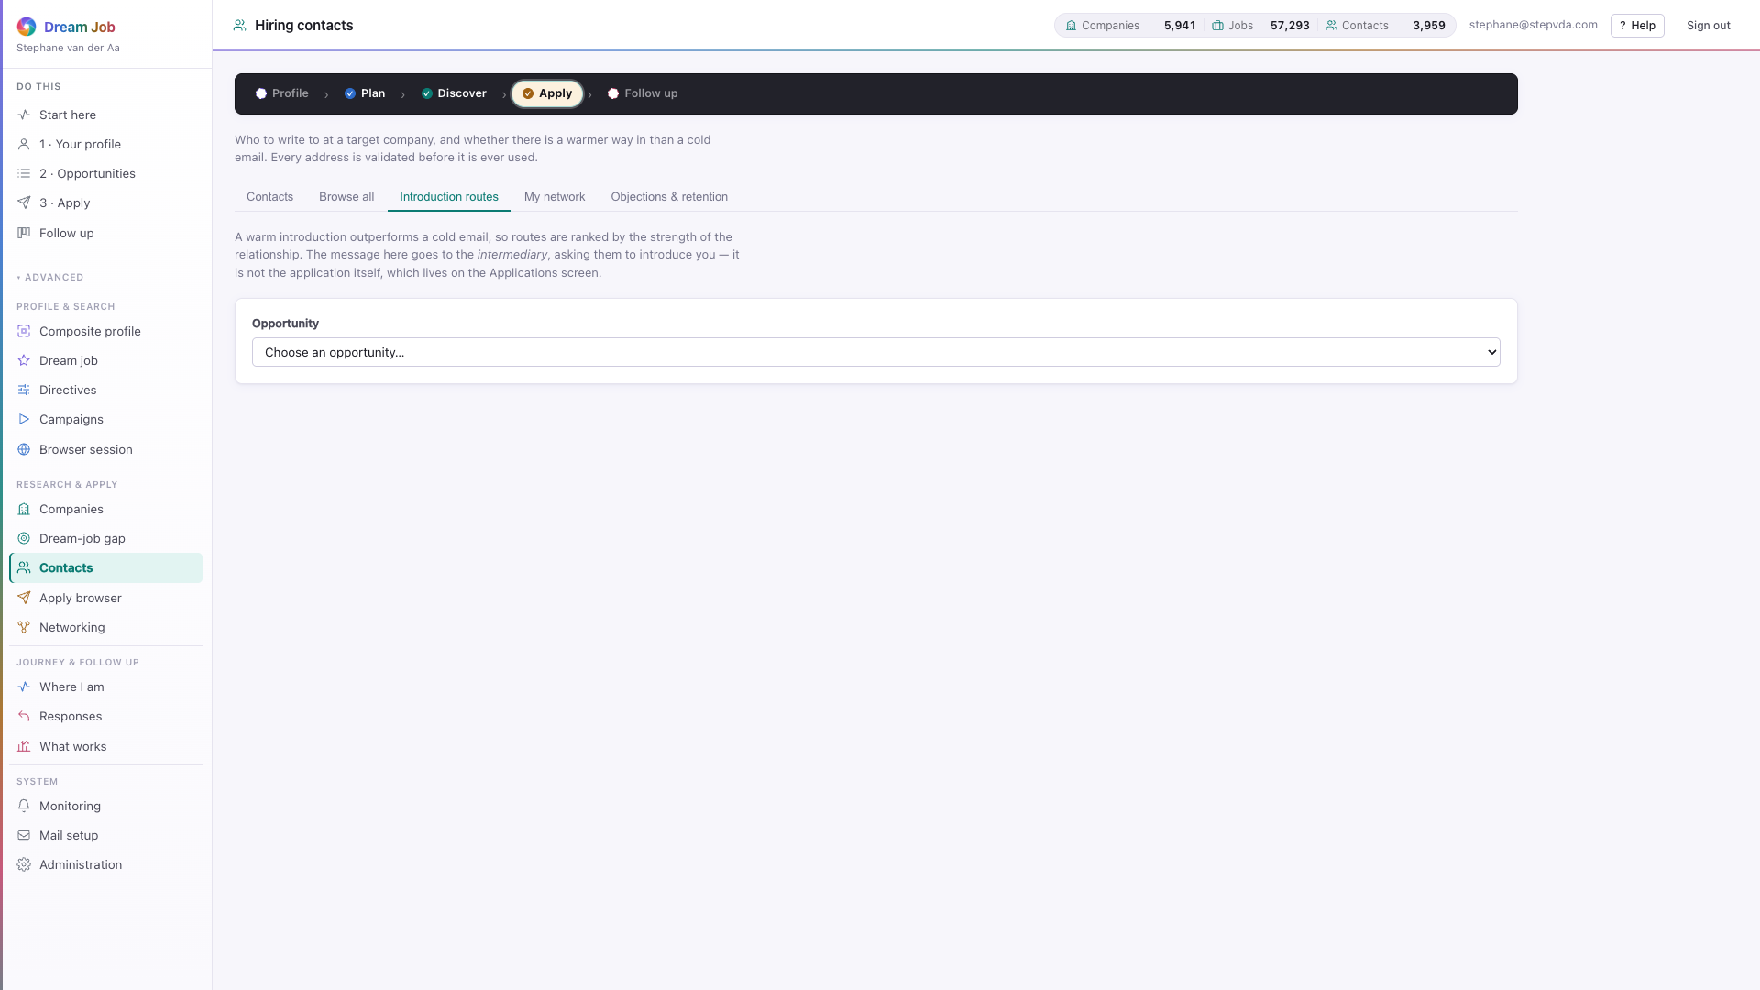
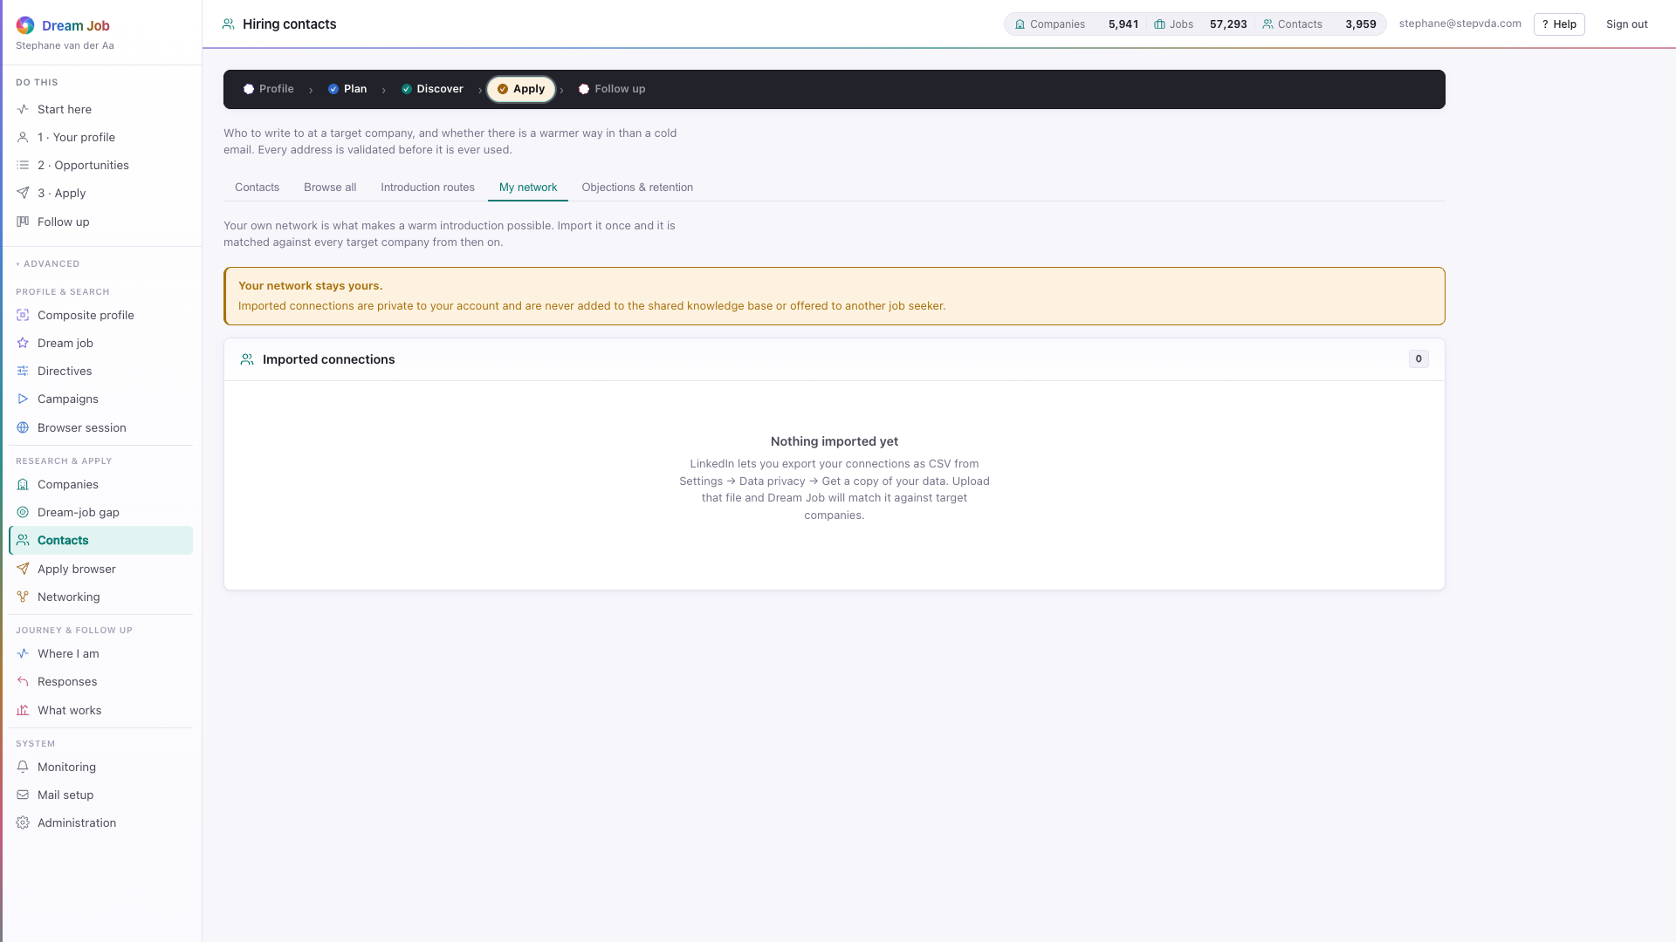
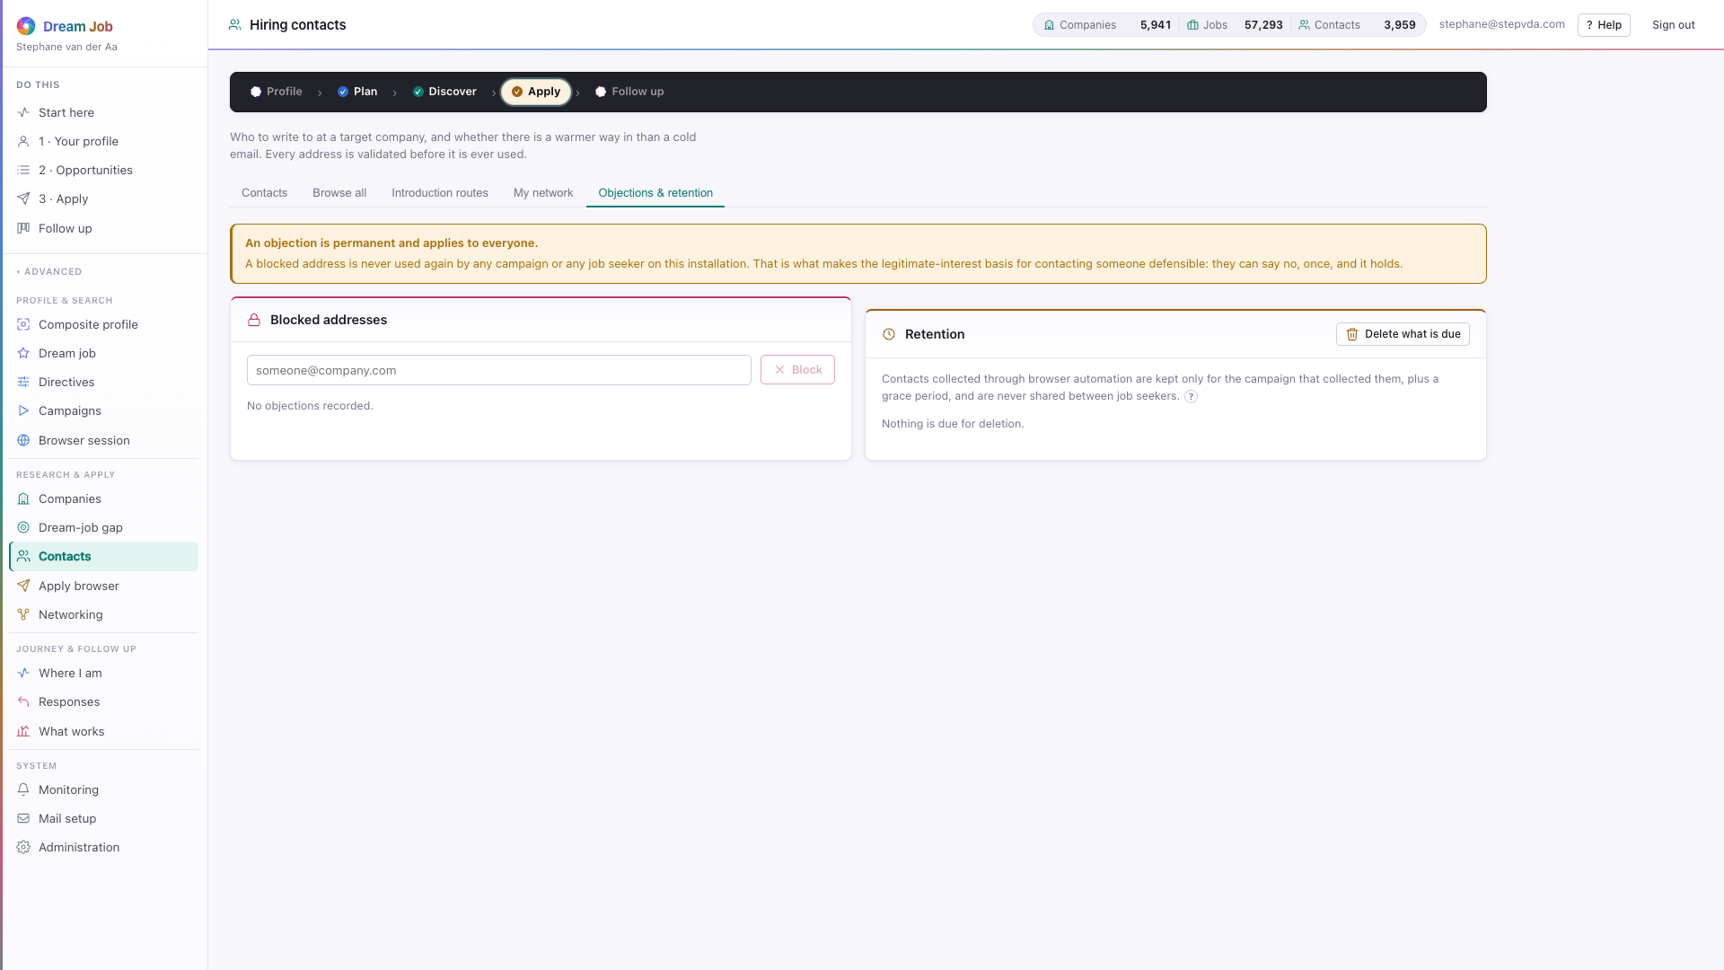
PART 1 · APPLY
Contact discovery at scale
Browse every contact, find missing addresses, walk warm introduction routes, import your network and honour objections and retention.
contacts · Browse all — filters and the missing-email panel
contacts · Introduction routes — warm paths into a company
contacts · My network — import your own connections
contacts · Objections and retention — the privacy sweep
Dream Job · Functional walkthrough and technical architecture · v2
25

Slide 26
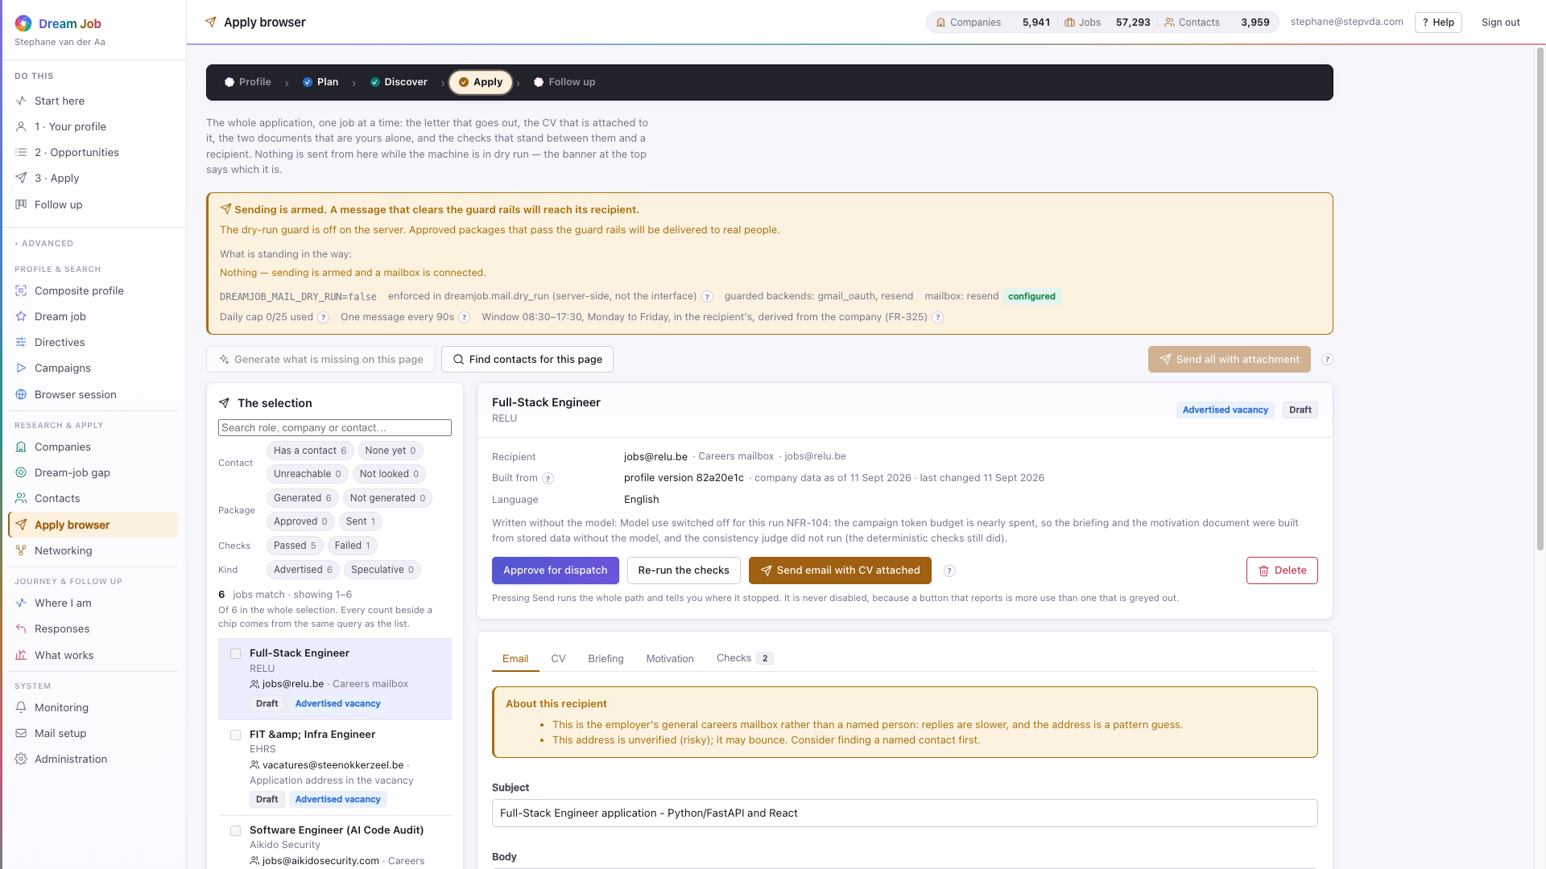
PART 1 · APPLY
Applications and the Apply browser
The generated CV, briefing, motivation document and email for each shortlisted role — all for the job seeker to read, edit and approve.
• A consistency check catches invented employers, dates and titles (FR-322).
• A leak scan refuses briefing and motivation as attachments (NFR-206).
• Approving authorises dispatch but sends nothing; messages go from the seeker's own mailbox.
• The job seeker is the last line of defence for anything technically true and still wrong for the audience.
apply browser · the email, with every review tab
Dream Job · Functional walkthrough and technical architecture · v2
26

Slide 27
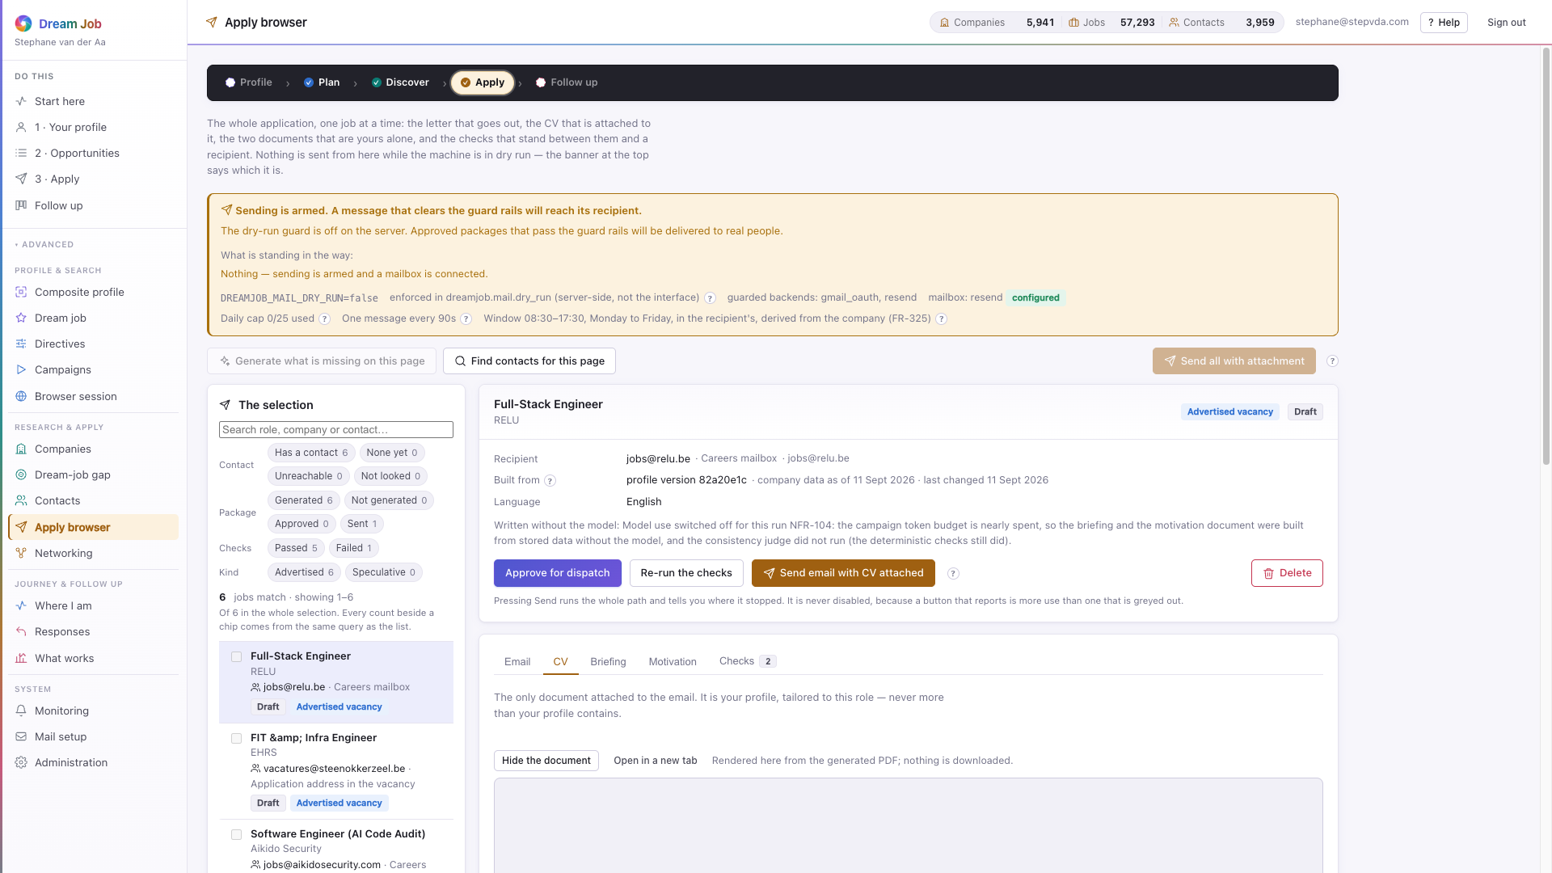
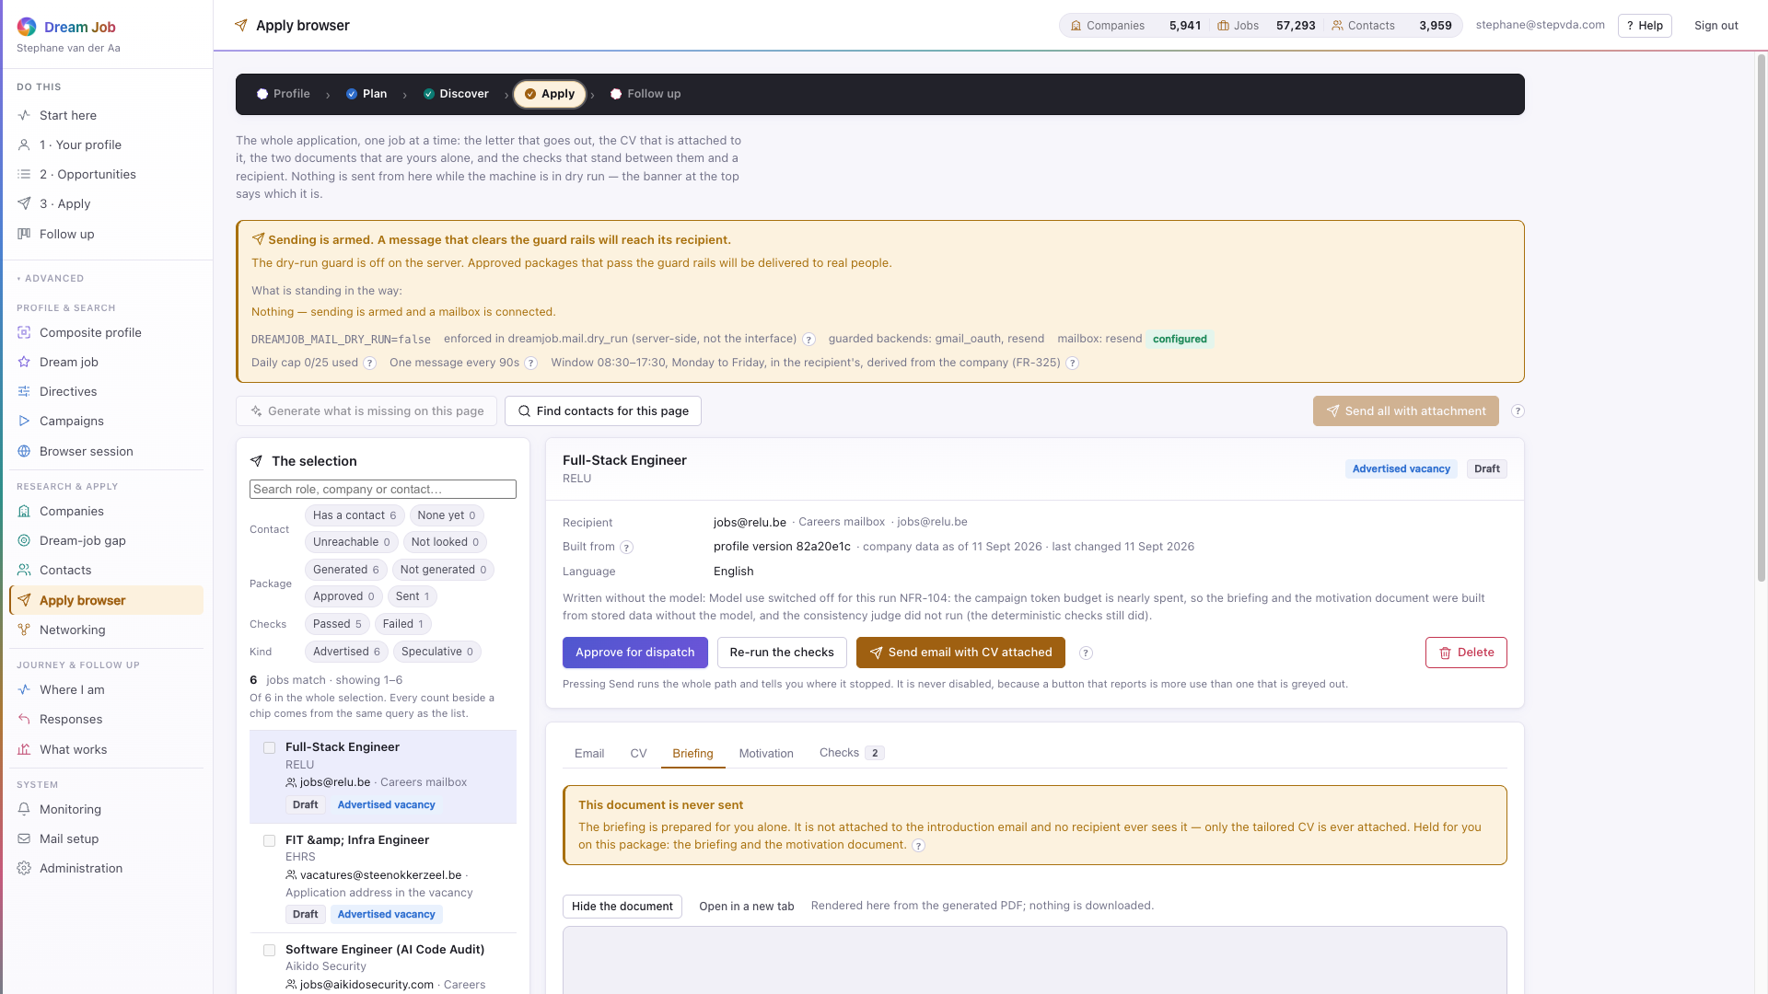

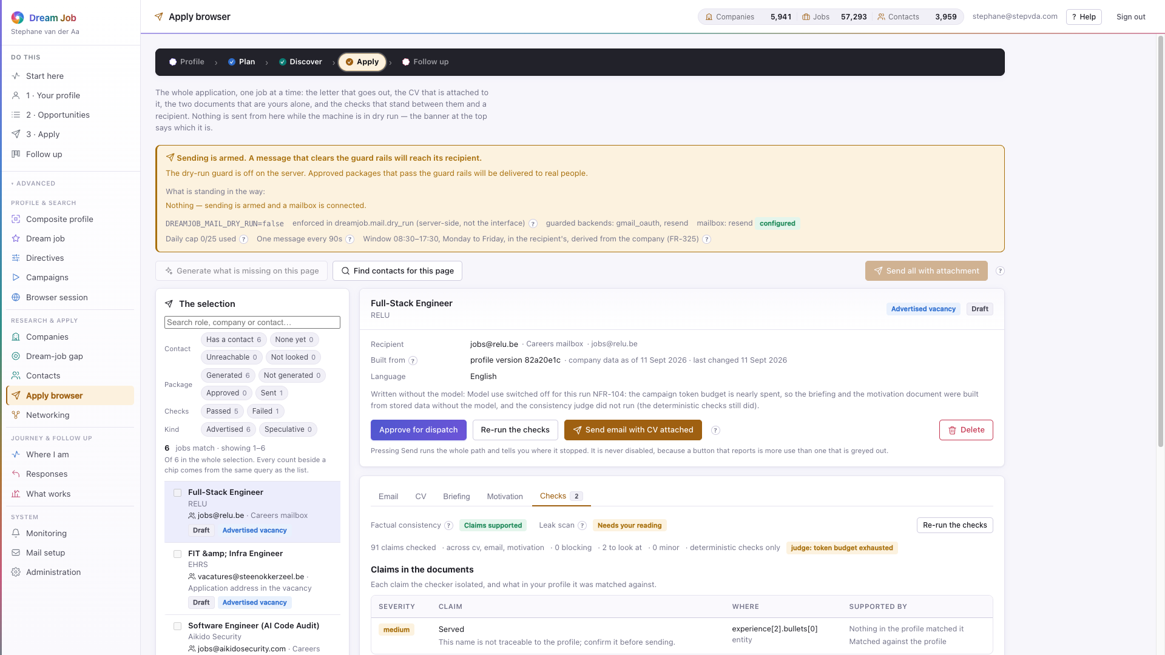
PART 1 · APPLY
The four artefacts, and the checks before dispatch
CV, briefing, motivation and email are generated together; the briefing and motivation never leave the machine, and the checks gate the send.
apply · CV — grounded in the profile, nothing untraceable
apply · Briefing — for the job seeker, never attached
apply · Motivation — the longer statement, never attached
apply · Checks — consistency and leak scan before dispatch
Dream Job · Functional walkthrough and technical architecture · v2
27

Slide 28
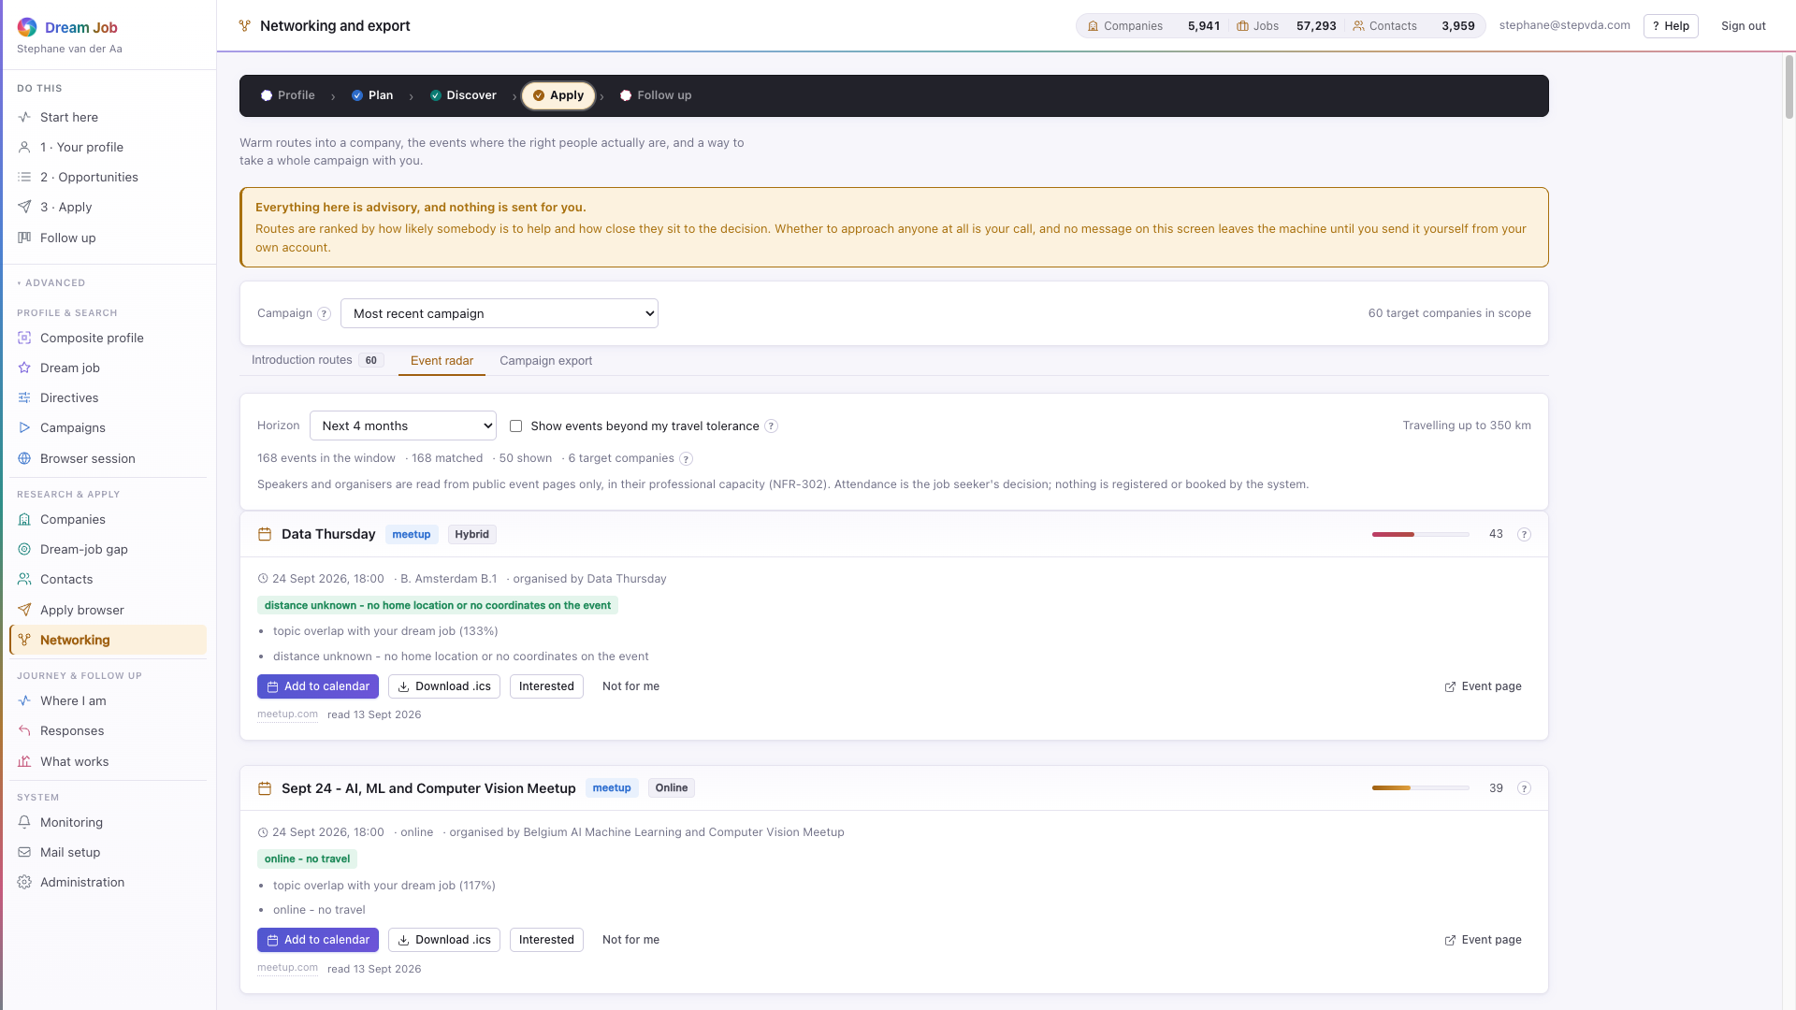
PART 1 · APPLY
Networking and export
Warm introduction routes, an event radar with calendar export, and a self-contained campaign package for a coach — built from one structure, redacted like the LLM path.
• Introduction routes are ranked by strength and relevance (FR-461).
• Events come with a match meter, calendar links and an .ics download (FR-462).
• The export is a PDF bundle plus machine-readable JSON, and it refuses outright if it could reach another seeker's data (FR-463).
• Discretion mode is honoured on every response (FR-385).
networking · Event radar and the export builder
Dream Job · Functional walkthrough and technical architecture · v2
28

Slide 29
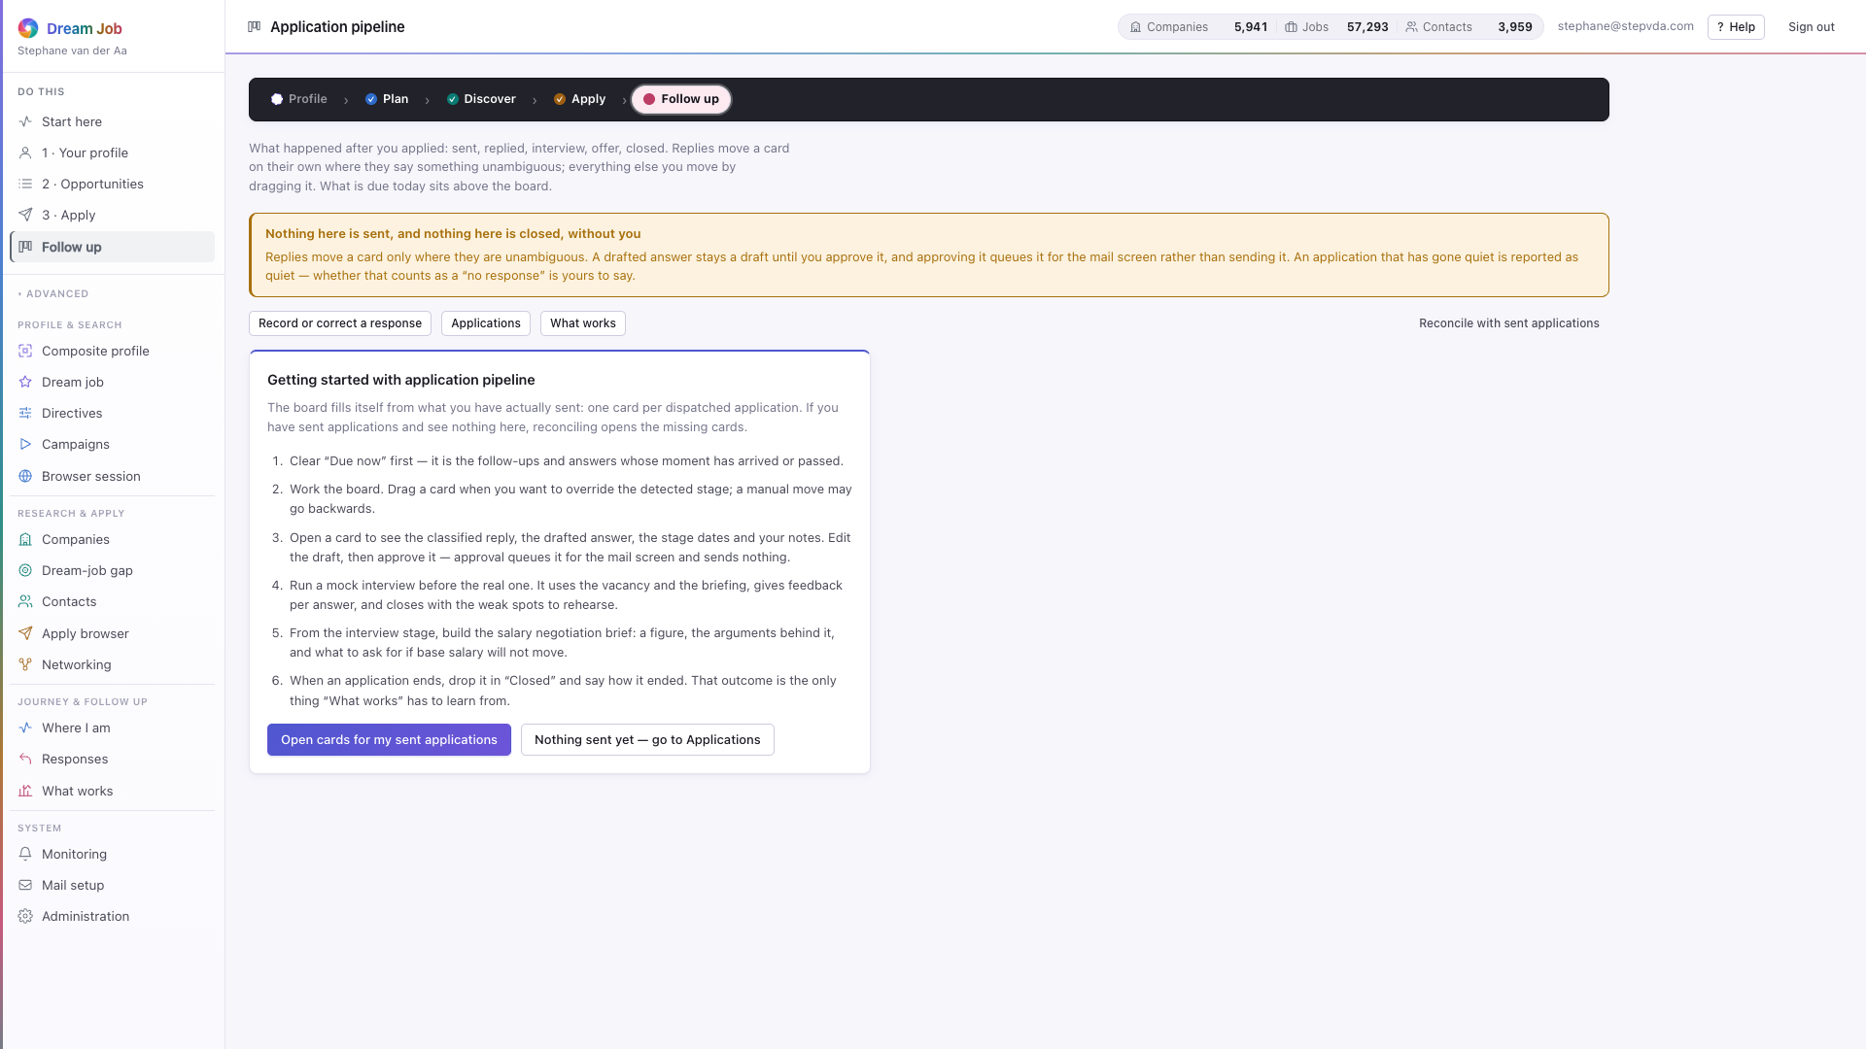
PART 1 · FOLLOW UP
Application pipeline
Every authorised application and its stage, from sent to reply, interview and outcome, on one board.
• Open a card for the classified reply, the drafted answer and the stage dates.
• Approving a draft queues it for the mail screen; it still sends nothing.
• Outcomes feed back into generation defaults and scoring weights.
• The negotiation brief and a mock interview sit on the same card.
pipeline · the five-stage board
Dream Job · Functional walkthrough and technical architecture · v2
29

Slide 30
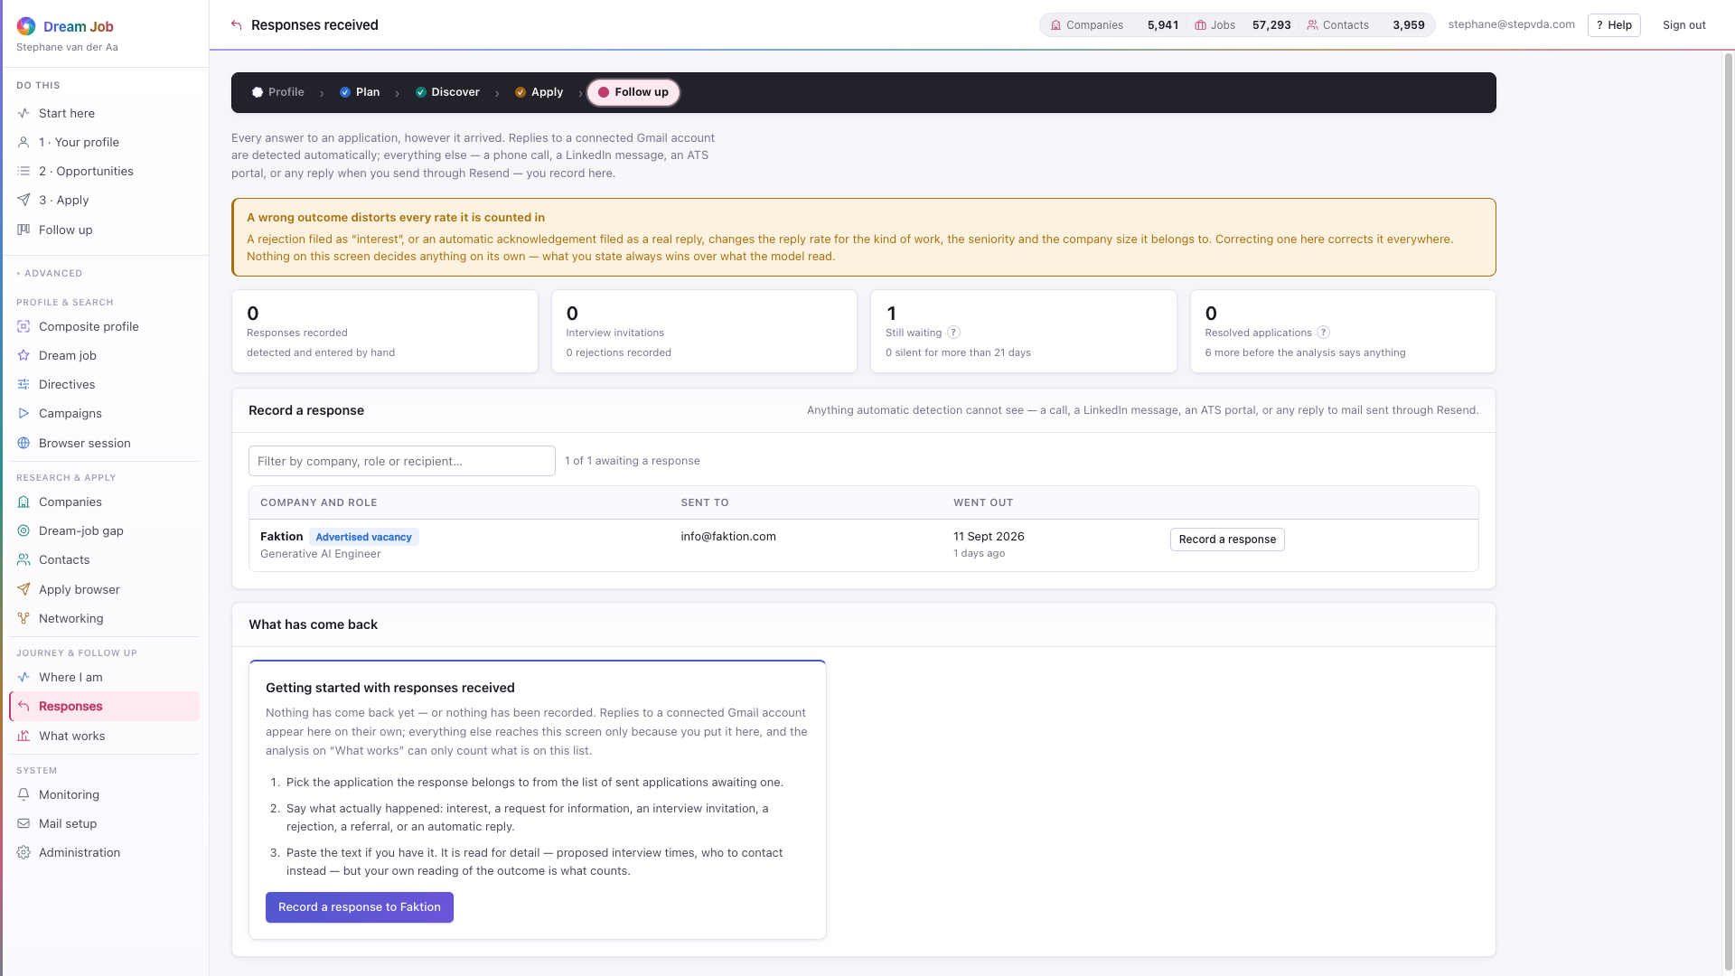
PART 1 · FOLLOW UP
Responses received
Every answer to an application, however it arrived: detected automatically from Gmail, or recorded by hand for a call, a portal or a LinkedIn message.
• Recording rejections matters as much as good news; both feed the pattern analysis.
• An application counts as answered or as silence, and nothing in between until 21 days pass.
• Recording a response moves the card on the pipeline board automatically.
• A wrong outcome is correctable, because it distorts every rate it is counted in.
responses · record, correct and review
Dream Job · Functional walkthrough and technical architecture · v2
30

Slide 31
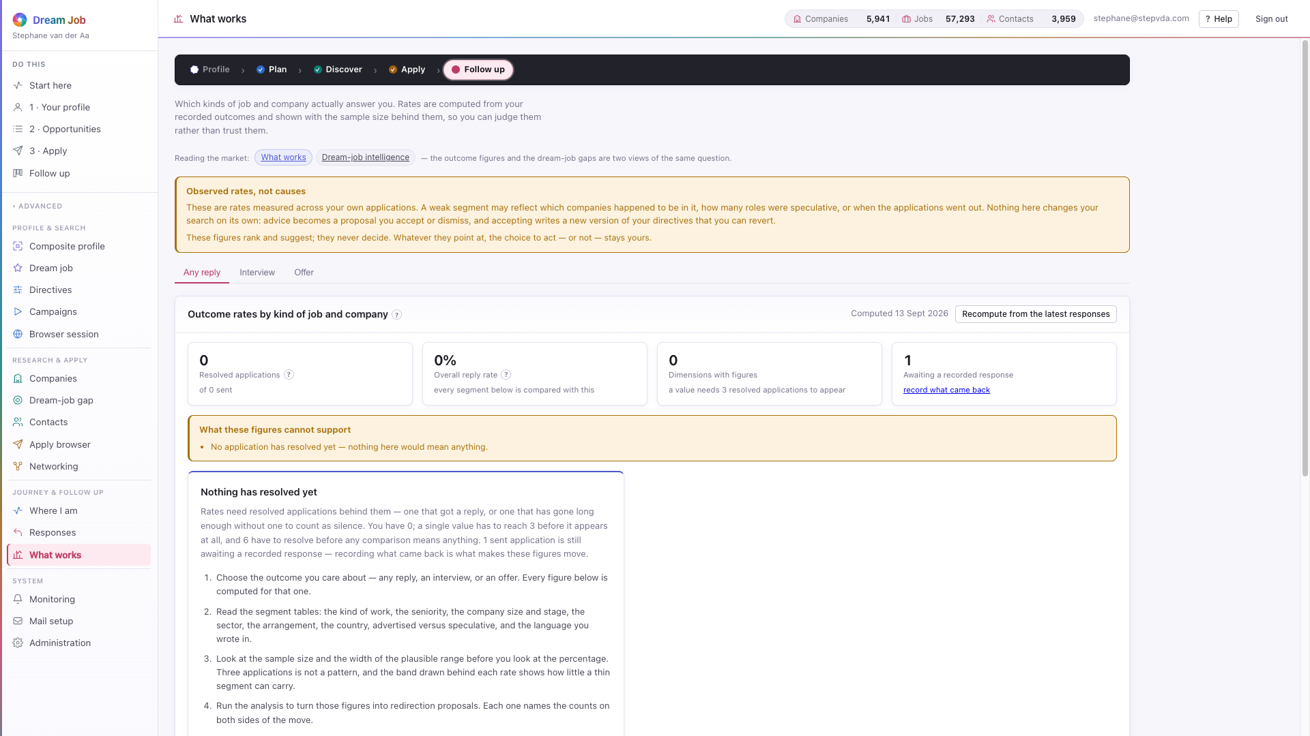
PART 1 · FOLLOW UP
What works, and where to redirect
Which kinds of job and company actually answer, computed from recorded outcomes and always shown with the sample size behind them.
• Rates are drawn with a plausible range, so a thin segment cannot look decisive.
• Advice needs roughly six resolved applications before it will say anything.
• Applying a proposal creates a new directive version — it never overwrites (FR-285).
• The data does not get to overrule the dream job; it only shows what the mismatch costs.
insights · outcome rates with Wilson intervals
Dream Job · Functional walkthrough and technical architecture · v2
31

Slide 32
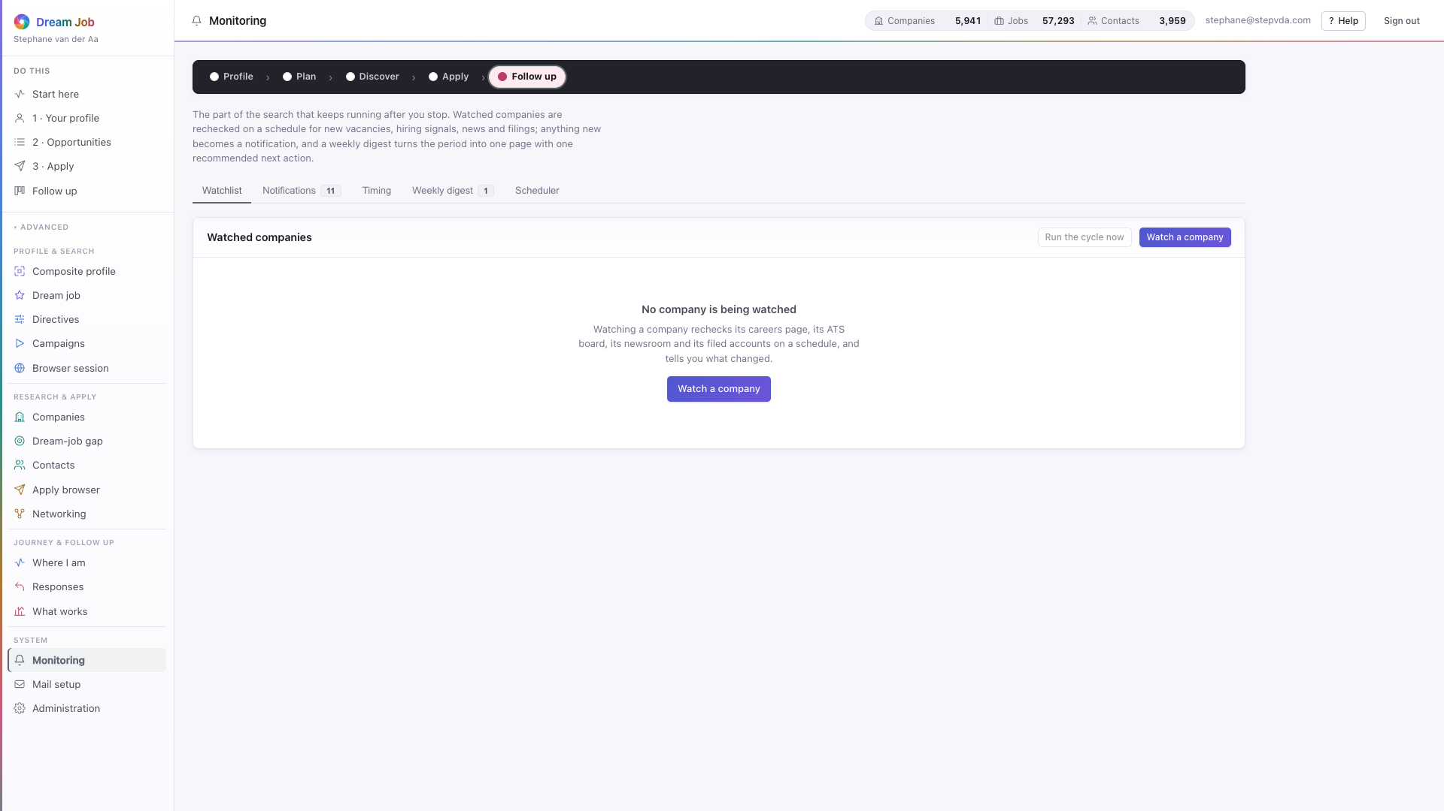
PART 1 · SYSTEM
Monitoring
The operational surface: campaign health, token spend, extraction rates and the audit trail, plus the scheduled re-checks of watched companies.
• Extraction-rate monitoring surfaces adapter breakage (NFR-403).
• Every LLM call, egress request and score is audited with its provenance.
• Watched companies are rechecked on a schedule, and what changed becomes one weekly digest (FR-401/403).
• Notifications, timing windows and the scheduler are all on this screen.
monitoring · watchlist, digests and the scheduler
Dream Job · Functional walkthrough and technical architecture · v2
32

Slide 33
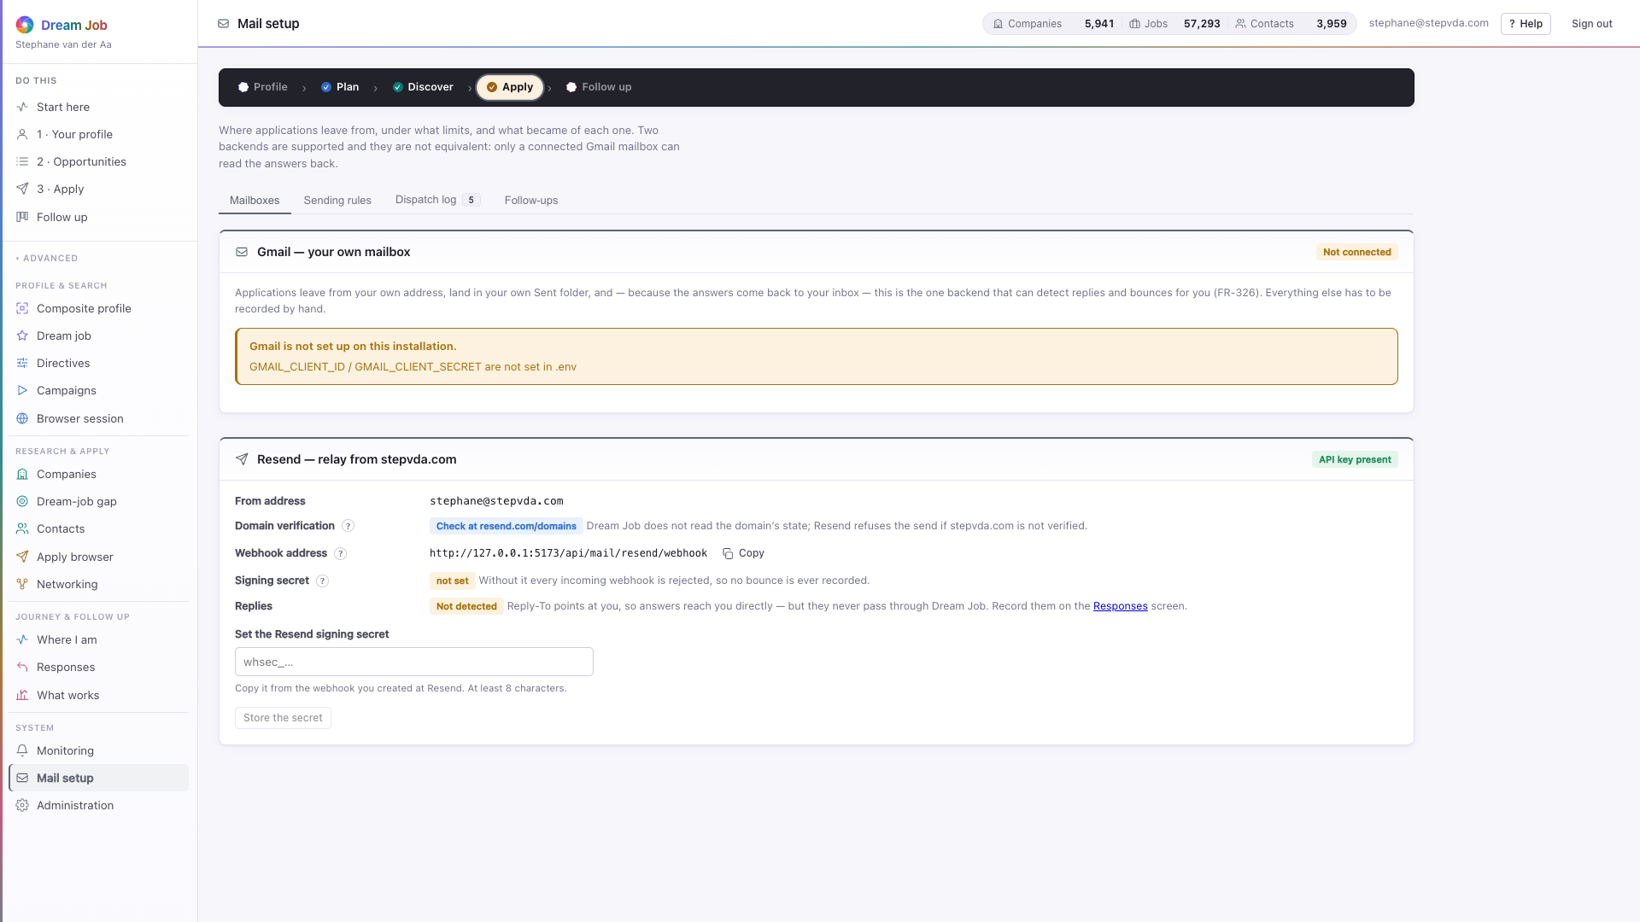
PART 1 · SYSTEM
Mail setup
Two ways to send from the seeker's own identity — Gmail OAuth or a Resend relay — behind one dispatcher that holds every guard rail.
• Gmail and Resend both satisfy 'send from your own mailbox' (FR-325).
• Sending rules, windows and a daily cap protect sender reputation (NFR-702).
• The dispatch log records everything sent, down to the message id; replies are detected.
• Follow-ups become due on a schedule and are drafted, then approved, never auto-sent (FR-327).
mail setup · mailboxes, rules, log and follow-ups
Dream Job · Functional walkthrough and technical architecture · v2
33

Slide 34
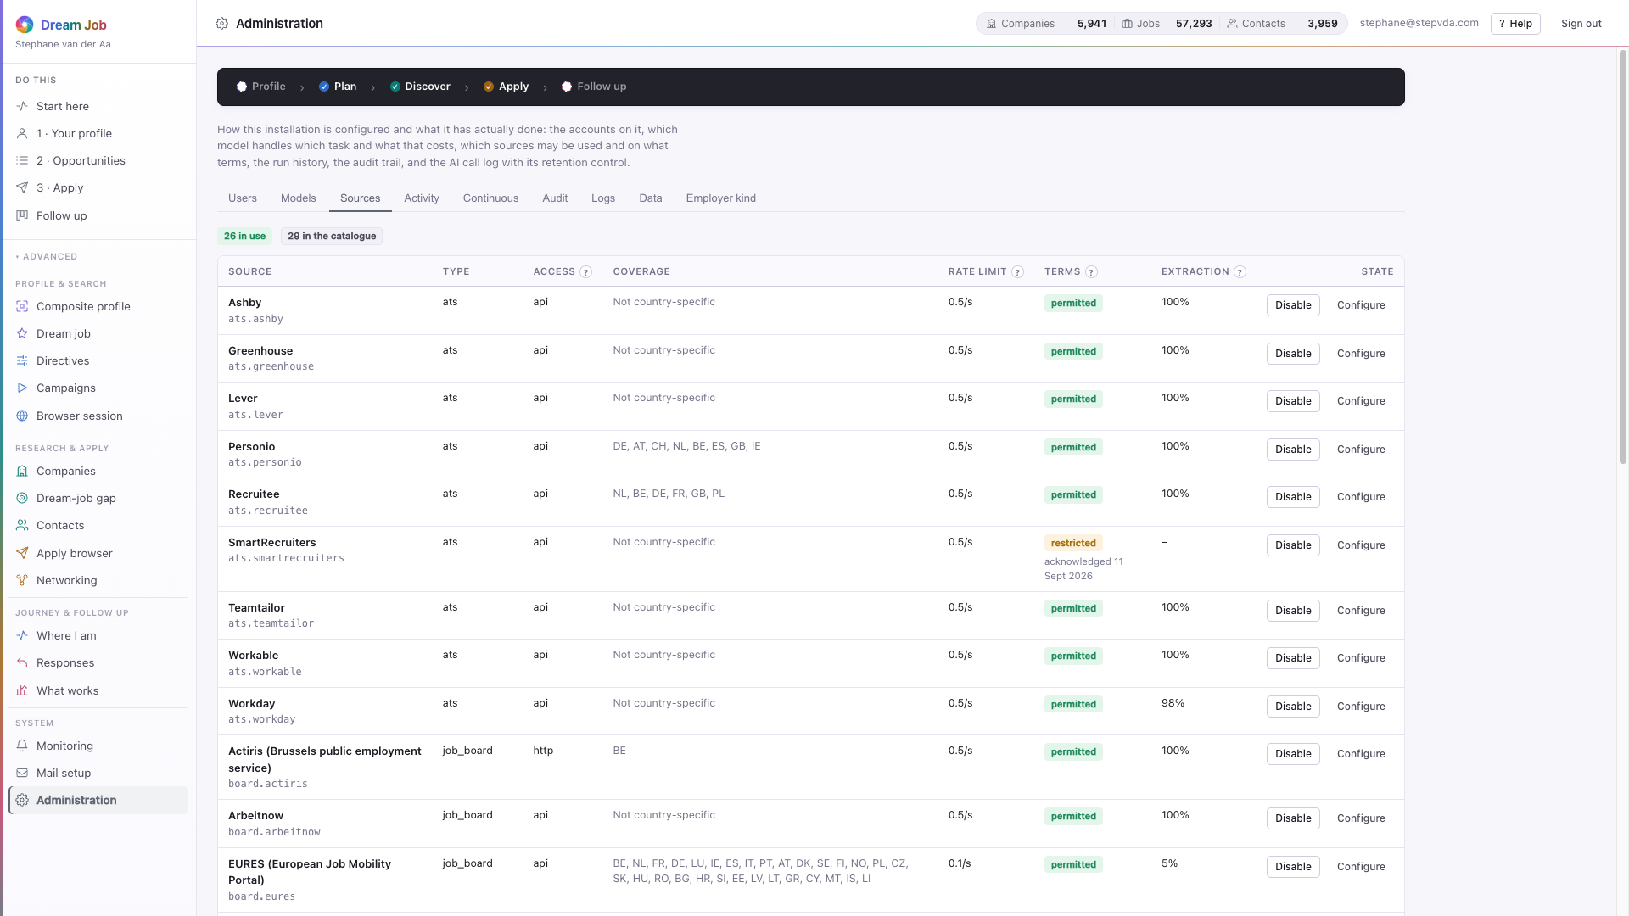
PART 1 · SYSTEM
Administration
The installation-level controls: the source catalogue and its terms acknowledgements, the server logs, model routing and the data-rights tools.
• Nine tabs: Users, Models, Sources, Activity, Continuous, Audit, Logs, Data, Employer kind.
• Sources that require acknowledgement stay disabled until an administrator confirms their terms (IR-101).
• Model routing chooses the provider per task and can point at a local endpoint for private data (FR-362, NFR-306).
• Two actions cannot be undone: the redaction sweep and erasing a job seeker; erasing leaves the shared market data standing (FR-108).
administration · the source catalogue and its terms
Dream Job · Functional walkthrough and technical architecture · v2
34

Slide 35
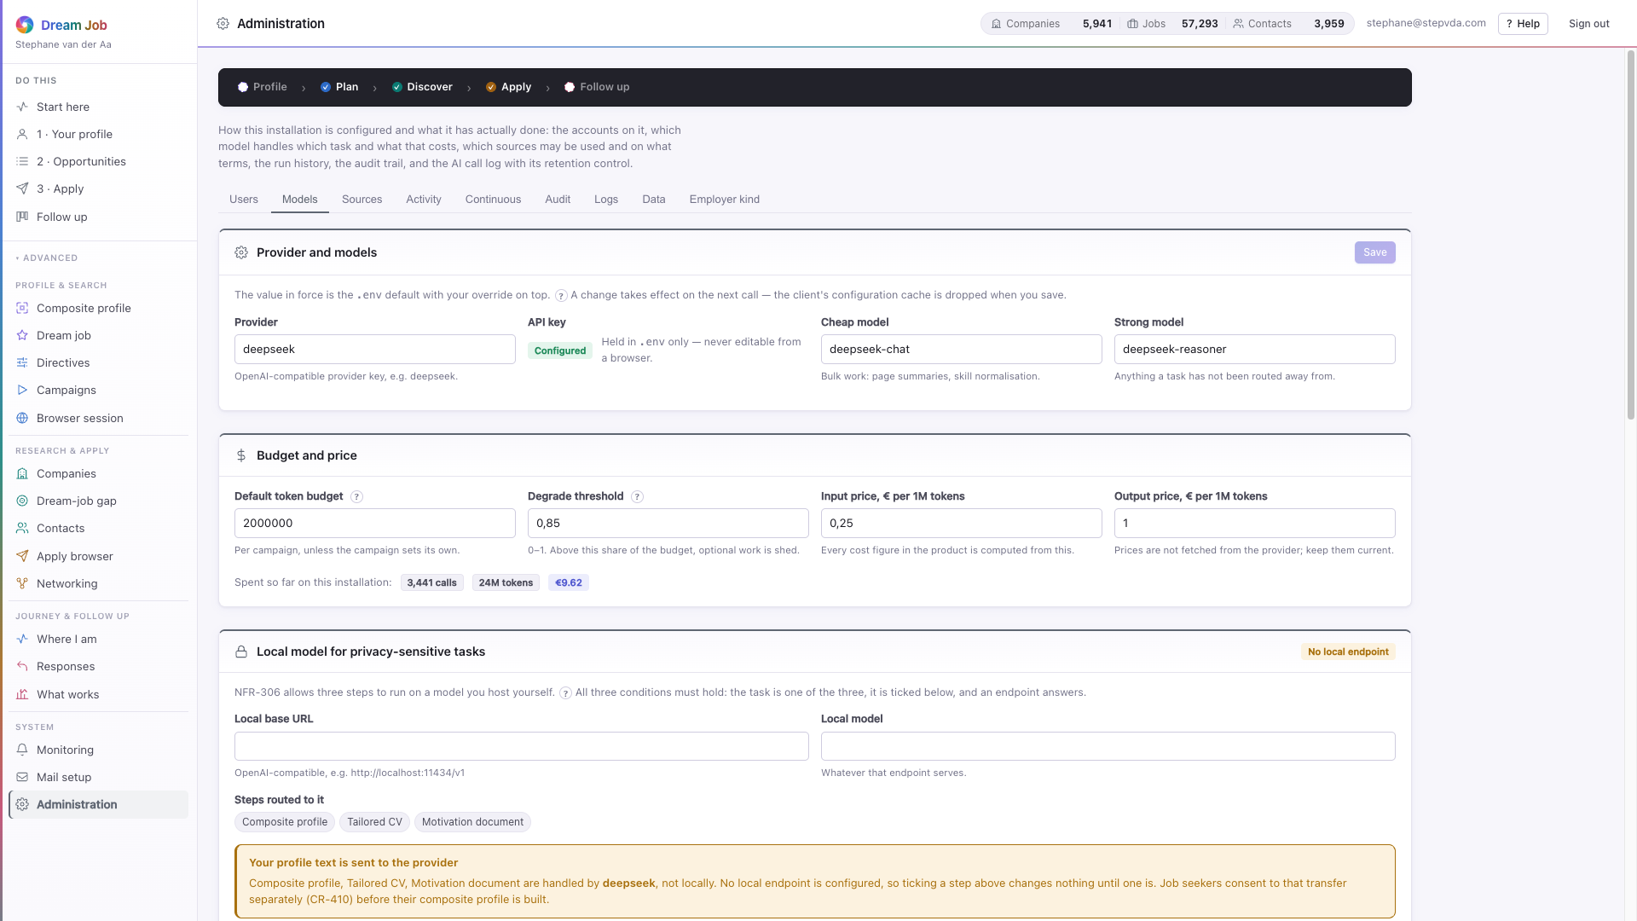



PART 1 · SYSTEM
Administration, the other eight tabs
Activity and Continuous show what the installation has collected; Models controls spend and routing; Data holds the irreversible actions.
admin · Models — provider, routing, budget and usage
admin · Activity — corpus, traffic and cost counters
admin · Data — retention, redaction and erasure
admin · Users — accounts, admin role and password resets
Dream Job · Functional walkthrough and technical architecture · v2
35

Slide 36

PART 1 · SYSTEM
Help, everywhere
Every screen explains itself: inline '?' tips drawn from a 142-term glossary, a per-screen drawer with purpose, steps and cautions, and first-run guidance that works before any data exists.
• Press ? anywhere to open the drawer for the screen you are on.
• The drawer carries purpose, how to work through it, worth knowing, and a caution where reliance is risky.
• Inline tips resolve from the same glossary, so a term means the same thing everywhere.
• Help is static and offline: it works before a profile exists.
help drawer · opened with the ? key on any screen
Dream Job · Functional walkthrough and technical architecture · v2
36

Slide 37
PART 2
Technical architecture
The layered system, the five chokepoints that make its requirements enforceable, and the path one campaign takes through the pipeline.
Dream Job · Functional walkthrough and technical architecture · v2
37

Slide 38

ARCHITECTURE · SHAPE
The shape of the system
A React single-page application over a FastAPI API, a pipeline of stages, and five services — LLMClient, EgressClient, SourceAdapter, JobRunner and crypto — over a repository layer and SQLite.
422 routes over 88 tables · 227 Python modules, 140 JS modules · 2,061 tests.
Dream Job · Functional walkthrough and technical architecture · v2
38

Slide 39

ARCHITECTURE · CHOKEPOINTS
The five chokepoints
The architecture funnels five concerns through exactly one module each, which is what makes the requirements below them enforceable rather than aspirational.
• Every SQL statement — db/repositories/*, db/connection.py: portability and isolation (CR-408, FR-344).
• Every outbound HTTP request — egress/client.py: robots, pacing and raw capture (FR-182/183).
• Every LLM call — llm/client.py: budget, injection defence, redaction, routing, audit.
• Every external source — adapters/base.py: one file per source, terms status (NFR-601, IR-101).
• Every long-running task — jobs/runner.py: pause, cancel, resume (FR-185, NFR-401).
Dream Job · Functional walkthrough and technical architecture · v2
39

Slide 40

ARCHITECTURE · DATAFLOW
The path of one campaign
From directives to redirection advice. The middle of the flow reads and writes the shared knowledge base; replies stay private to one job seeker.
• Plan: directives and the composite profile become a priced, per-source plan with a human gate before collection (FR-161..166).
• Reuse: the planner asks the knowledge base what is fresh enough and collects only the rest (FR-342/343).
• Collect: the plan runs through the adapters and EgressClient into raw documents and knowledge-base rows (FR-181..186).
• Analyse and rank: companies, filings, opportunities, compensation and seven sub-scores produce the advisory ranking (FR-221..285).
• Apply and learn: contacts, documents, dispatch, replies and redirection advice that becomes the next directives (FR-301..285).
Dream Job · Functional walkthrough and technical architecture · v2
40

Slide 41
ARCHITECTURE · STAGES
One campaign, stage by stage
Every stage persists its own artefacts and can be re-run on its own (NFR-603). The user-facing pipeline is the five phases: Profile, Plan, Discover, Apply, Follow up.
Stage | What it produces | Requirements
Plan | Campaign plan: sources, queries, cost | FR-161..166
Reuse | What the knowledge base already has, fresh enough | FR-342/343
Collect | Raw documents through the adapters and egress | FR-181..185
Profile | Shared company profiles | FR-221..225
Financials | Five-year analysis, ability to pay, investment capacity | FR-241..246
Enrich | Hiring signals, employer kind, domains | FR-201..207
Synthesise | Opportunities, including speculative openings | FR-261/262
Price | Compensation estimate against the stated minimum | FR-264
Score | Seven sub-scores and the ranked list | FR-281..285
Contacts | Hiring contacts, validated and ranked | FR-302..306
Generate | CV, briefing, motivation and email | FR-321..324
Dispatch | Send, approved and from your own mailbox | FR-325..327
Learn | Replies, outcomes and redirection advice | FR-285, FR-425
Dream Job · Functional walkthrough and technical architecture · v2
41

Slide 42

ARCHITECTURE · SOURCES
The adapter contract
One contract — plan, fetch, parse, normalise — and every source is one subclass and one decorator (NFR-601).
• plan: directives, composite profile and caps become this source's own query form, priced and paced.
• fetch: every request goes through EgressClient — robots, rate limit, cache and raw capture.
• parse: JSON-LD first, then deterministic selectors, then LLM extraction, in that order.
• normalise: knowledge-base columns carrying a confidence and a provenance record (NFR-402).
Dream Job · Functional walkthrough and technical architecture · v2
42

Slide 43

ARCHITECTURE · LLM
The path of one LLM call
Every call in the system takes this path, because llm/client.py is the only module that speaks to a model.
• Redact, route, fence: do-not-disclose fields stripped, a model chosen per task, scraped text quarantined (CR-410, NFR-205).
• Check the budget pre-flight, then shed optional work rather than stop mid-campaign (NFR-104).
• Validate the response before any of it is used; injection defence is at the boundary.
• Debit and audit: tokens, cost, latency, model and prompt version recorded (FR-364).
Dream Job · Functional walkthrough and technical architecture · v2
43

Slide 44

ARCHITECTURE · EGRESS
One outbound request, end to end
No other module opens an HTTP connection. Cache, robots.txt, pacing, fetch, capture, parse — every response kept under its content hash (FR-183).
• A cache hit never reaches the network.
• robots.txt is parsed per domain; a disallow raises rather than being ignored.
• A 429 or 503 backs off exponentially under one retry policy (IR-102).
• Raw bodies are stored on disk so an extractor can be re-run on the page it originally saw.
Dream Job · Functional walkthrough and technical architecture · v2
44

Slide 45

ARCHITECTURE · DATA
One database, three scopes
49 private tables carry a job_seeker_id; 38 shared tables carry none; the migration ledger is the third. FR-344 is the invariant: no shared row links back to a job seeker.
• Private: profile versions, campaigns, opportunities, applications, replies.
• Shared: companies, vacancies, financial years, signals, competitors, events.
• Restricted: contact straddles the boundary — browser-collected rows are private to the campaign that made them (NFR-303).
• Two FTS5 virtual tables index companies and vacancies; a usable_contact view encodes the objection rule at the database.
• Erasing a job seeker deletes the private rows and leaves the shared market data standing (FR-108).
Dream Job · Functional walkthrough and technical architecture · v2
45

Slide 46

ARCHITECTURE · JOBS
Every long task is resumable
A job runner is the single home for long tasks: jobs are pauseable, cancellable and restart-safe, and they never run on the request loop.
• Jobs run on their own threads with per-unit checkpoints (FR-185, NFR-401/502).
• A paused job resumes where it stopped, not from the beginning.
• All job threads use the bulk write lane, so requests never queue behind a campaign (NFR-102).
• Job outcomes, progress and errors are persisted and surfaced on screen.
Dream Job · Functional walkthrough and technical architecture · v2
46

Slide 47

ARCHITECTURE · CODEBASE
The codebase, measured
The pipeline is the centre of gravity; the interface and the tests are the next two largest bodies of work. Numbers are measured, not estimated.
2,061 tests collected across 114 files; tests are 34% of the backend's lines.
Dream Job · Functional walkthrough and technical architecture · v2
47

Slide 48

ARCHITECTURE · FRONTEND
What the interface costs
Route-level code splitting keeps the first paint small; the heaviest screen loads only when it is opened.
• Before splitting the bundle was 858 kB; the shared entry is now 312 kB, 105 kB over the wire.
• 33 lazy chunks: a screen's code downloads when the route is opened (NFR-101).
• Every phase hue meets WCAG AA for small text, on white and on its own tint, in both themes.
• The screenshots in Part 1 are the running application, not mock-ups.
Dream Job · Functional walkthrough and technical architecture · v2
48

Slide 49

QUALITY · COVERAGE
Requirement coverage
156 of 157 requirements in the specification are cited in the implementation — 99.4%; the one not cited is the DPIA (NFR-304), a document rather than code.
Must 103/104, Should 44/44, Could 9/9. The line is not cited is NFR-304.
Dream Job · Functional walkthrough and technical architecture · v2
49

Slide 50

QUALITY · SCORING
Seven sub-scores, one explained rank
Every rank is a weighted mean over seven named sub-scores; the weights are visible, editable and learned from outcomes, and the score orders a list rather than making a decision.
• Profile fit 0.22, dream-job fit 0.22, directive fit 0.18, company 0.14, compensation 0.10, plausibility 0.08, reachability 0.06.
• Deterministic pre-rank of the whole corpus, then LLM scoring of the top 500 by default.
• The dream-job meter uses must/strong/nice importance and met/partial/violated status.
• Scores are advisory (NFR-305); manual order and pins win over the computed rank.
Dream Job · Functional walkthrough and technical architecture · v2
50

Slide 51

QUALITY · LEARNING
Learning it refuses to overstate
Outcome rates are shown with a Wilson interval and the sample size, and the system will not advise below six resolved applications.
• Every rate carries its interval and its n, so a thin segment cannot look decisive.
• Advice needs roughly six resolved applications before it speaks (FDD 9.3).
• Applying a proposal writes a new directive-set version; nothing is auto-applied (NFR-305).
• Rejections are data too: they feed the same segmentation as interviews.
Dream Job · Functional walkthrough and technical architecture · v2
51

Slide 52

ARCHITECTURE · FINANCIALS
Two advisory scores from filed accounts
Five years of filed figures are reduced to ability to pay and investment capacity — weighted, coverage-shaded, and never claiming more than the evidence supports.
• Ability to pay: cost per FTE 0.35, EBIT margin 0.25, equity/assets 0.20, current ratio 0.20.
• Investment capacity: revenue CAGR 0.22, cash runway 0.22, headcount CAGR 0.18, EBITDA margin 0.18, debt/equity 0.12, capex/revenue 0.08.
• Components that cannot be computed are not invented; the score is shaded toward 0.5 for the missing coverage.
• Both scores are advisory and cite the figures they rest on (NFR-305, RK-06).
A profile built from secondary signals rather than filings can never score above 55 (FR-245).
Dream Job · Functional walkthrough and technical architecture · v2
52

Slide 53
PART 3
Data sources
Every adapter registered in the codebase — 29 today — what each one covers, how it is reached, and whether it needs consent.
Dream Job · Functional walkthrough and technical architecture · v2
53

Slide 54
DATA SOURCES · OVERVIEW
The source catalogue at a glance
29 adapters register themselves at import time. 4 require an explicit terms acknowledgement before they can be enabled (IR-101).
Group | Count | Consent | Access
Applicant tracking systems | 9 | 1 require acknowledgement | API, API, API…
Job boards and public employment services | 9 | 2 require acknowledgement | HTTP, API, API…
Company registries | 5 | — | API, HTTP, API…
Directories | 1 | — | API
News and signals | 1 | — | HTTP
Conferences and events | 2 | 1 require acknowledgement | HTTP, HTTP
Company websites | 1 | — | HTTP
Compensation benchmarks | 1 | — | API
Nothing is collected from a source whose terms are not acknowledged; the planner selects from this catalogue using the coverage each adapter declares (FR-161/164).
Dream Job · Functional walkthrough and technical architecture · v2
54

Slide 55
DATA SOURCES · ATS
Applicant tracking systems
Structured job feeds hosted by the employer's own recruiting system. Machine-readable, so collection costs no tokens.
Source | Type | Access | Terms | Acknowledgement | Enabled
Ashby | Applicant tracking systems | API | permitted | — | yes
Greenhouse | Applicant tracking systems | API | permitted | — | yes
Lever | Applicant tracking systems | API | permitted | — | yes
Personio | Applicant tracking systems | API | permitted | — | yes
Recruitee | Applicant tracking systems | API | permitted | — | yes
SmartRecruiters | Applicant tracking systems | API | restricted | required | yes
Teamtailor | Applicant tracking systems | API | permitted | — | yes
Workable | Applicant tracking systems | API | permitted | — | yes
Workday | Applicant tracking systems | API | permitted | — | yes
Dream Job · Functional walkthrough and technical architecture · v2
55

Slide 56
DATA SOURCES · JOB BOARDS
Job boards and public employment services
Advertised vacancies across Belgium, the Netherlands, the EU and globally. Terms status decides whether a source is enabled by default.
Source | Type | Access | Terms | Acknowledgement | Enabled
Actiris (Brussels public employment service) | Job boards and public employment services | HTTP | permitted | — | yes
Arbeitnow | Job boards and public employment services | API | permitted | — | yes
EURES (European Job Mobility Portal) | Job boards and public employment services | API | permitted | — | yes
Generic HTML job board | Job boards and public employment services | HTTP | permitted | — | catalogue only
Indeed | Job boards and public employment services | HTTP | prohibited | required | yes
Jobat.be | Job boards and public employment services | HTTP | restricted | — | yes
StepStone | Job boards and public employment services | HTTP | restricted | required | yes
VDAB (Vind een job) | Job boards and public employment services | HTTP | restricted | — | catalogue only
Welcome to the Jungle | Job boards and public employment services | API | restricted | — | catalogue only
Dream Job · Functional walkthrough and technical architecture · v2
56

Slide 57
DATA SOURCES · REGISTRIES AND MORE
Registries, directories, news, events, websites, compensation
The non-vacancy sources: statutory filings that price a company, news and events that signal hiring, the company's own site, and the pay benchmark.
Source | Type | Access | Terms | Acknowledgement | Enabled
Companies House (UK) | Company registries | API | permitted | — | yes
KBO/BCE (Belgian enterprise register) | Company registries | HTTP | permitted | — | yes
KvK Handelsregister (NL) | Company registries | API | permitted | — | yes
NBB Central Balance Sheet Office | Company registries | API | permitted | — | yes
SEC EDGAR (US) | Company registries | API | permitted | — | yes
OpenCorporates | Directories | API | permitted | — | yes
Company newsroom / RSS | News and signals | HTTP | permitted | — | yes
Conference sites and community calendars | Conferences and events | HTTP | permitted | — | yes
Meetup and Eventbrite (public listings) | Conferences and events | HTTP | restricted | required | yes
Company website | Company websites | HTTP | permitted | — | yes
Eurostat Structure of Earnings Survey | Compensation benchmarks | API | permitted | — | yes
Dream Job · Functional walkthrough and technical architecture · v2
57

Slide 58
DATA SOURCES · COVERAGE
What the catalogue implies
The catalogue is not a fixed list: the planner selects from it using the coverage metadata each adapter declares (FR-161/164).
• Coverage is declared per adapter, so a Belgian search runs the registries and boards that cover Belgium and skips the rest.
• Terms status is first-class: SmartRecruiters, Indeed, StepStone and Meetup/Eventbrite require acknowledgement before they are enabled (IR-101).
• Adapters that return machine-readable payloads set llm_fallback = false, so the structured forms are read deterministically at zero token cost.
• Every source is reached through EgressClient, so robots.txt, pacing and raw capture apply no matter which adapter asked.
• The shared knowledge base is reused while fresh, so a second search over the same companies costs little or nothing (FR-342).
Dream Job · Functional walkthrough and technical architecture · v2
58

Slide 59
SUMMARY
The system in five sentences
Profile in, ranked and explained opportunities out, every message reviewed and sent by the job seeker.
• Profile in: a LinkedIn export, a CV and a description of the job actually wanted, merged into one composite profile with every conflict surfaced.
• Plan and collect: structured directives become a per-source plan, reviewed and priced before anything runs, then executed through 29 registered adapters behind one contract.
• Analyse and rank: company profiles, five years of filings and seven sub-scores produce an explained, advisory ranking of advertised and speculative opportunities.
• Apply with consent at every gate: generated documents are checked, approved by the job seeker, and sent from the seeker's own mailbox — nothing leaves on its own.
• Follow up and learn: replies, outcomes and negotiation are captured; redirection advice becomes the next directive version, which the seeker accepts or dismisses.
Dream Job · Functional walkthrough and technical architecture · v2
59

Slide 60
Dream Job · v2
Every screen, every diagram and every count in this deck was taken from the running system in September 2026.
227 Python modules · 140 JS modules · 422 API routes · 88 tables · 29 adapters · 2,055 tests passing
Dream Job · Functional walkthrough and technical architecture · v2
60

