Slide 1
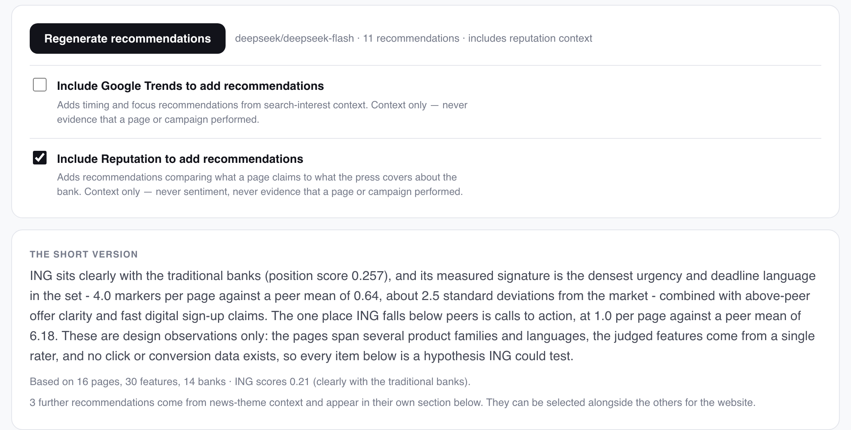



A recommendation system on top of the measurement
One model call over the finished analysis
Reads report.json only — the same numbers the charts are drawn from. This run turned 30 measured features across 14 banks into 11 ordered changes.
Ordered by priority, not by confidence
3 high, 6 medium, 2 low. The order is the argument: what the measurement most supports acting on first.
Two contexts, both opt-in and both marked
The panel as the team sees it: one button, two opt-in contexts, and the run it produced.
Search interest for timing, and news themes for reputation (3 of the 11 here). Context is never allowed to stand as evidence that a page performed.
It writes what to change. It does not re-derive a single number — that direction is one-way by design.
Banking Campaigns Comparator · ING DACI / Customer AI · September 2026
1
Notes:
The recommendation layer is the only place in the project where a model is allowed to opine. Everything upstream measures; this interprets.

Slide 2
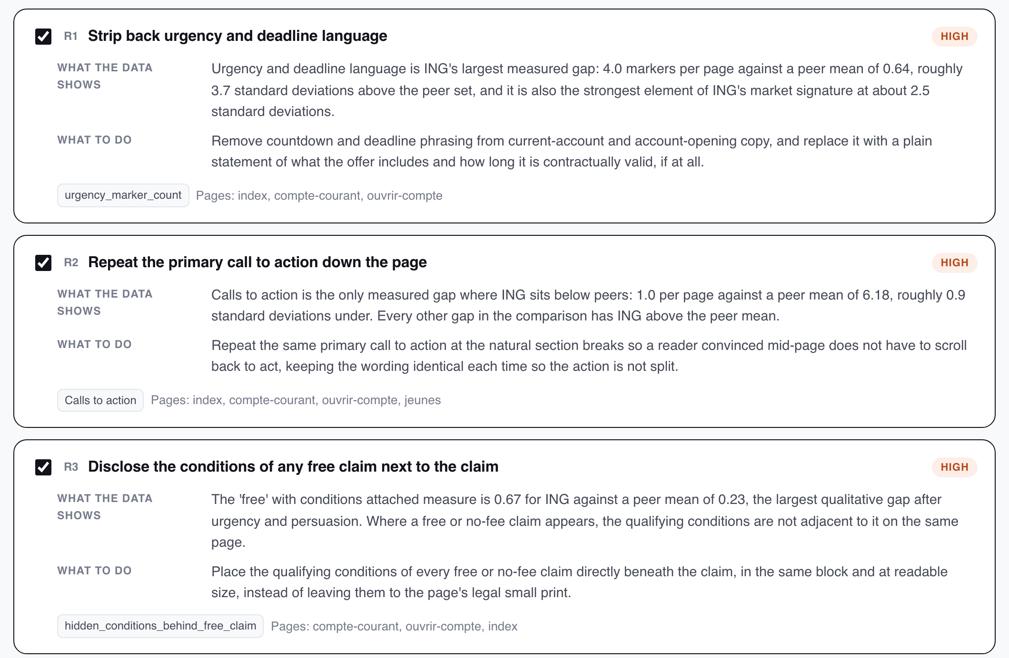
Every recommendation carries the evidence it was argued from
Finding and action, kept apart
What the data shows sits above what to do. A reader can reject our suggested action and still keep the measured finding.
Named features, checked before release
Each card names the measured features it was argued from and the pages it applies to. Those ids are verified against the report — an invented one never leaves the module.
No figure the analysis did not produce
The prompt receives only numbers already in the report, and the output is not trusted to add any.
Three of the eleven, as the team reviews them.
Banking Campaigns Comparator · ING DACI / Customer AI · September 2026
2
Notes:
Separating finding from action matters: a reader can reject our suggested action and still keep the measured finding.

Slide 3
What it concluded about ING
4.0
1.0
0.67
urgency markers per page
call to action per page
‘free’ claims with conditions elsewhere
against a peer mean of 0.64 — about 3.7 standard deviations above the set, and ING's strongest measured signature.
against a peer mean of 6.18. The only measured gap where ING sits below its peers rather than above.
against a peer mean of 0.23 — the qualifying conditions are not adjacent to the claim they qualify.
The three it ranked highest
Strip back urgency and deadline language
urgency_marker_count
Repeat the primary call to action down the page
cta_count
Disclose the conditions of any free claim next to the claim
hidden_conditions_behind_free_claim
Design observations, not performance findings. The pages span several product families and languages, the judged features come from a single rater, and no click or conversion data exists — so every item is a hypothesis ING could test.
Banking Campaigns Comparator · ING DACI / Customer AI · September 2026
3
Notes:
The caveat is not decoration. Without outcome data these are differences, not faults.

Slide 4
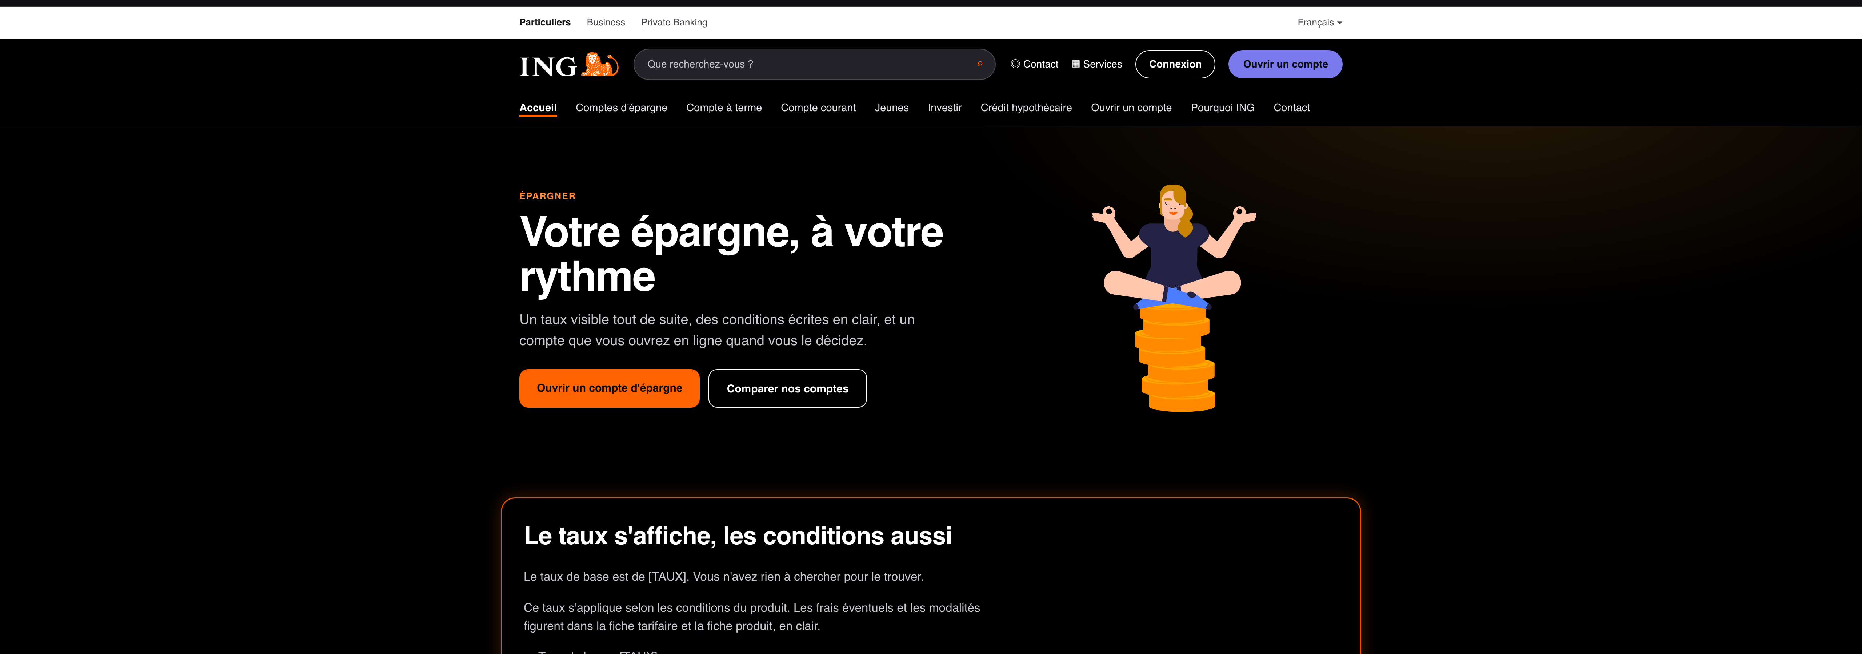


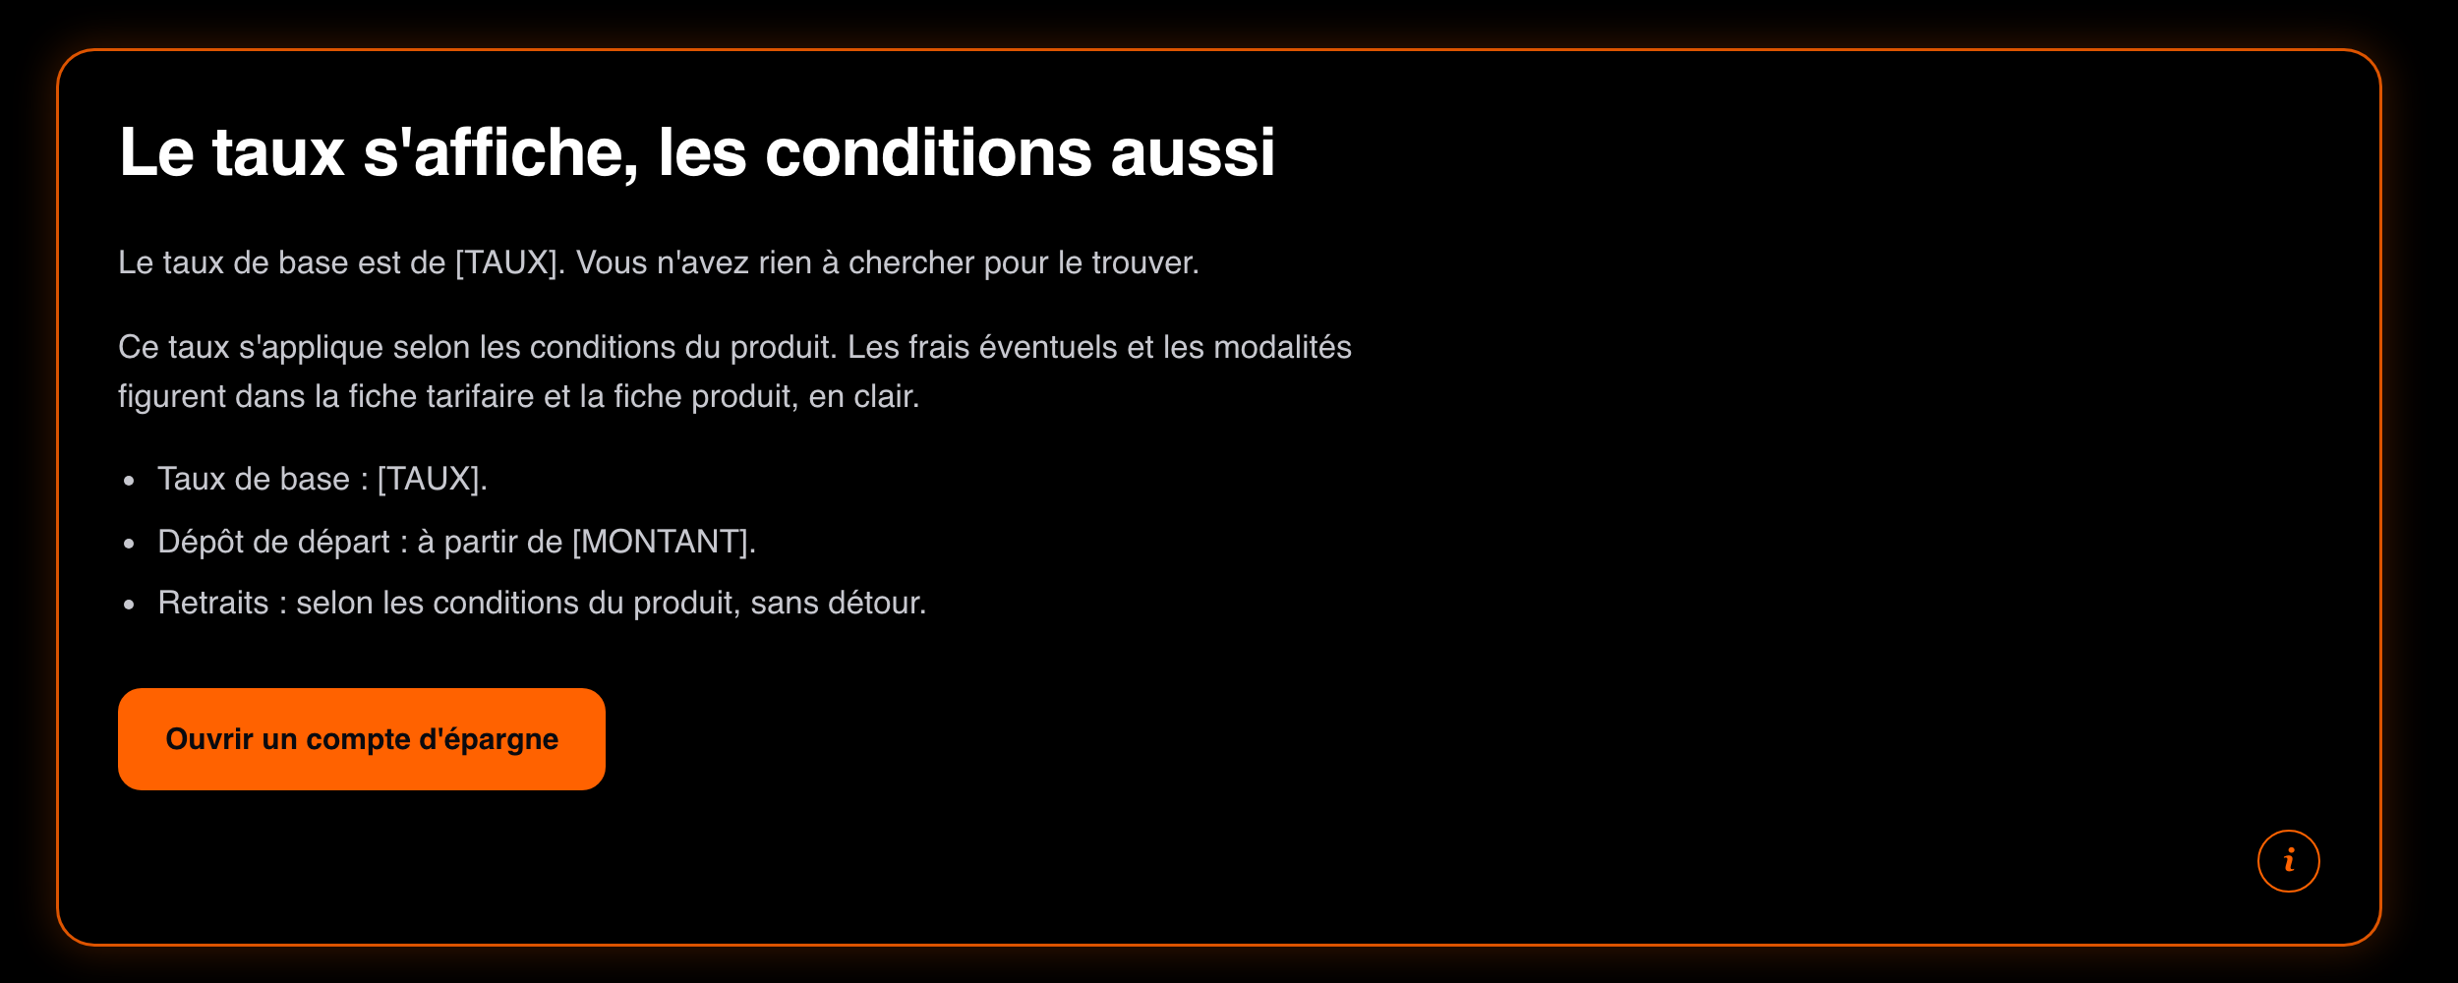
From a list of changes to a site you can actually look at
The team chooses what gets built
Every recommendation is a checkbox. Nothing reaches the generator that a person did not tick.
Ten ING-styled pages, in fr-BE or nl-BE
Home, savings, term account, current account, youth, investing, mortgage, opening, why ING, contact.
Each section can name its own source
In explained mode, the orange blocks say which recommendation produced that section and why — so the site is auditable, not just persuasive.
This is what makes the analysis arguable: a stakeholder can look at the change rather than read about it.
Generated, never published: rates and amounts stay as [TAUX] and [MONTANT] placeholders.
Banking Campaigns Comparator · ING DACI / Customer AI · September 2026
4
Notes:
The site is a demonstration of the recommendations, not a proposal for production copy.

Slide 5
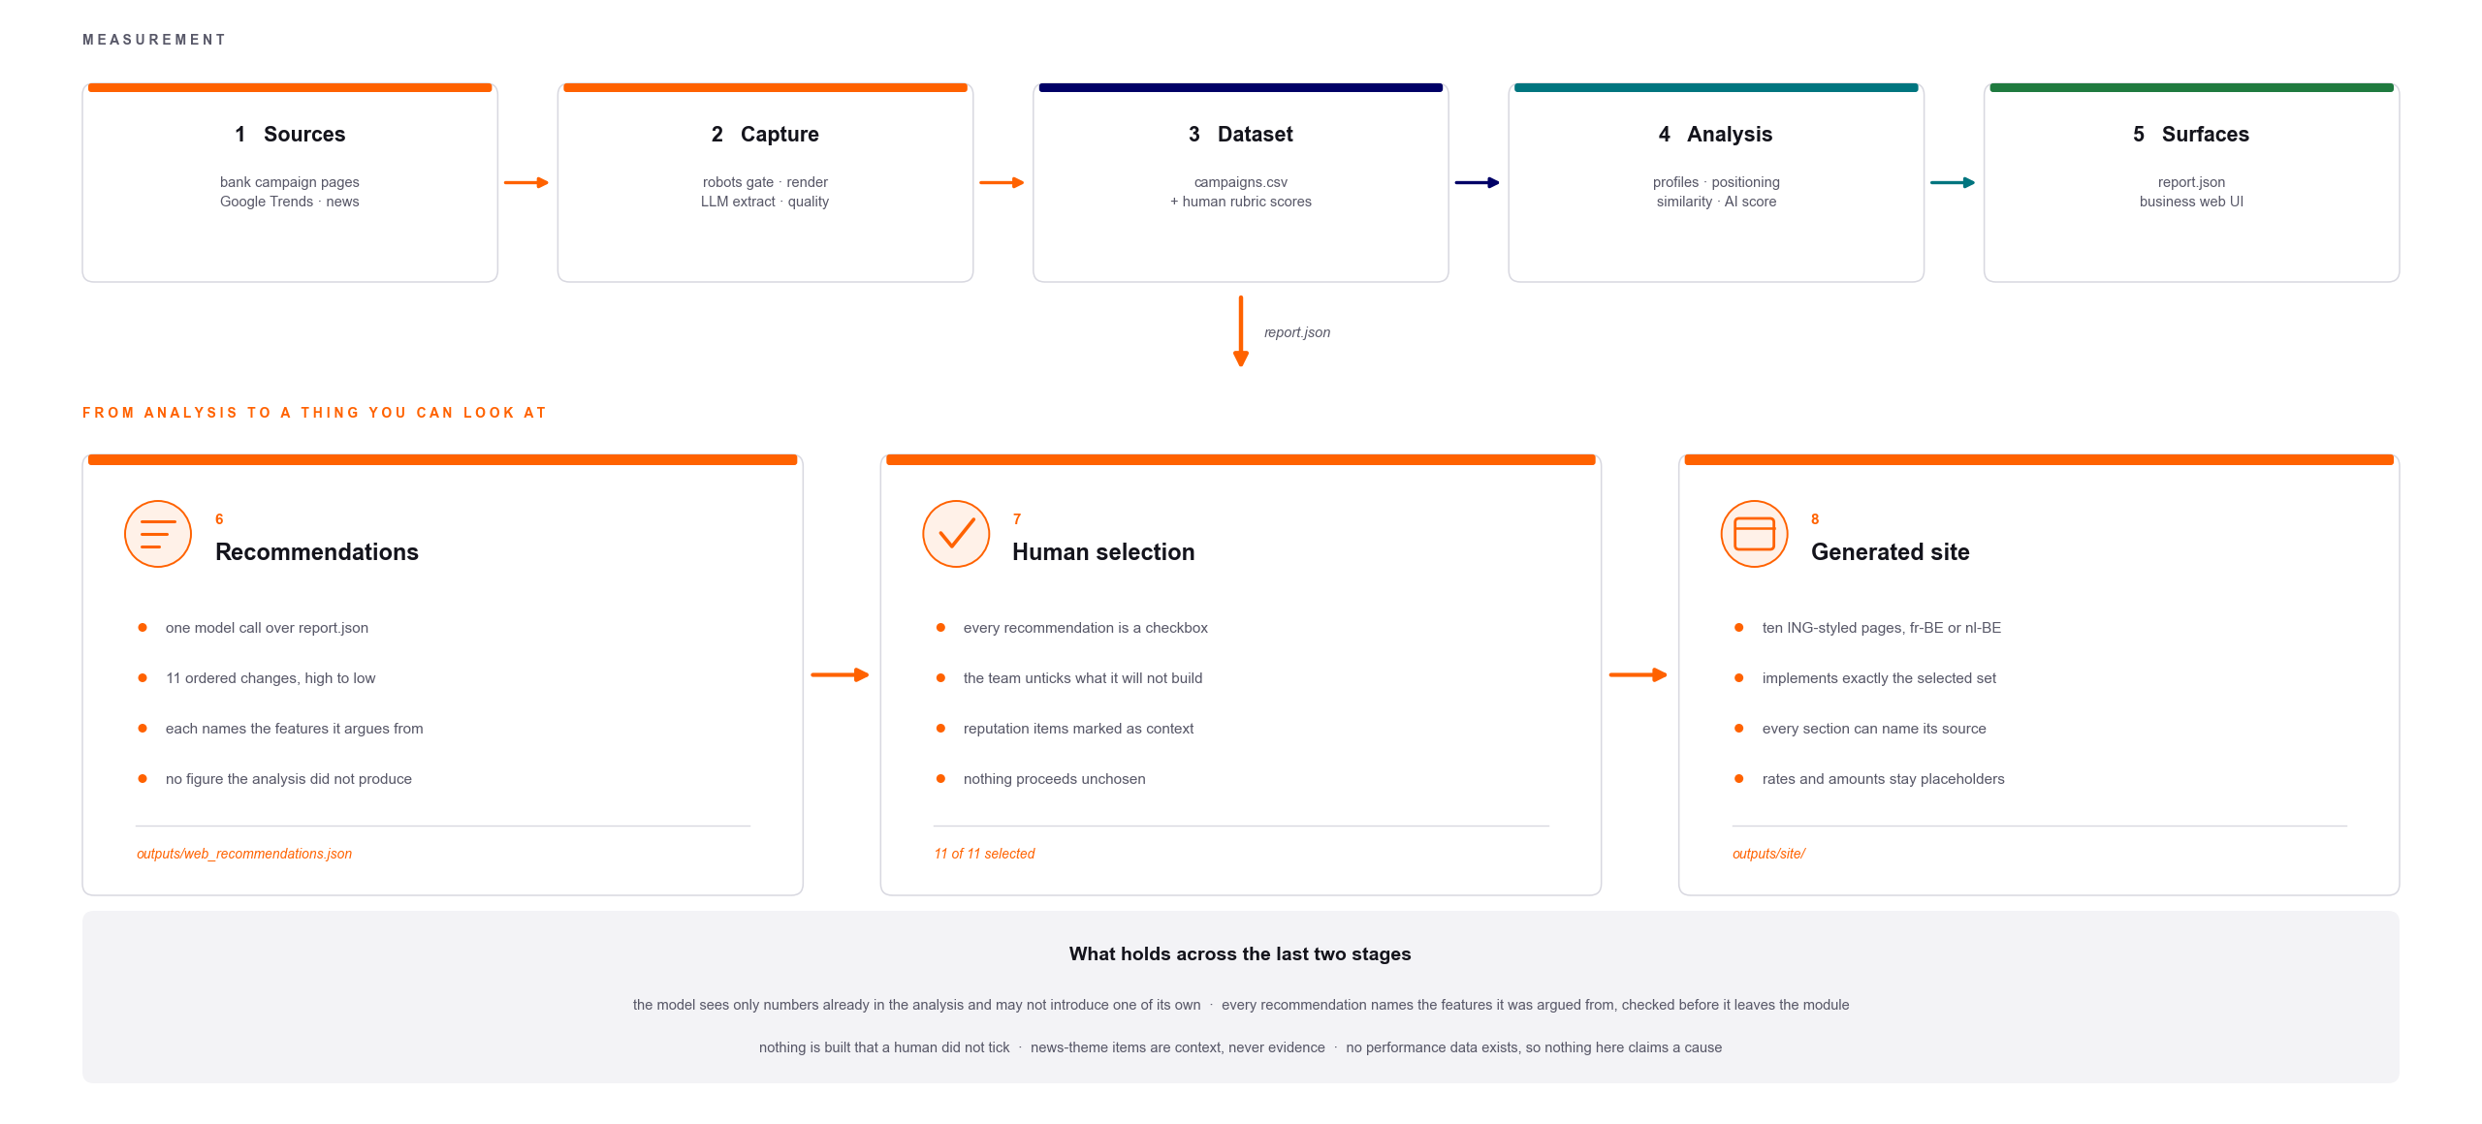
The complete pipeline
Stages 1–5 are the measurement half shown in the main deck. Stages 6–8 are this one.
Banking Campaigns Comparator · ING DACI / Customer AI · September 2026
5
Notes:
Stages 1-5 are the measurement half shown in the main deck. Stages 6-8 are this deck.

