Slide 1
Banking Campaigns Comparator
How Belgian banks communicate similar products differently,
and what ING can learn from it.
Two-week proof of concept for ING DACI / Customer AI
Siegried (marketing framework) · Dan (collection, extraction) · Stephane (analysis, GenAI)
14 – 25 September 2026 · 11 banks · 13 current-account pages · 104 features

Slide 2
The brief, and the constraint that shapes everything
• Compare how Belgian banks communicate comparable products
Campaign pages only: the open web, one language, one product family at a time.
• Turn that comparison into advice ING can act on
Measured differences, argued from named features — not opinion dressed as data.
• The hard constraint: no performance data exists
No clicks, no conversions, no sales. So nothing here may claim that a design choice caused an outcome.
• Therefore every recommendation is a hypothesis to test
The project's value is a defensible, repeatable measurement — and an honest statement of its limits.
This single constraint drives the guardrails you will see on every slide that follows.
Banking Campaigns Comparator · ING DACI / Customer AI · September 2026
2

Slide 3
What we built, end to end
• A measurement pipeline: 11 banks, 13 current-account pages, 104 declared features, one frozen contract.
• A scoring workflow: automatic extraction, model-assisted extraction, and a human rubric for the 13 judgement features.
• An analysis library: positioning, similarity, category comparison, AI score, cross-sell, plus generated limitations.
• Two business surfaces: a React web UI (Analysis, Trends, Reputation, Recommendations) and a Streamlit dashboard.
• Two optional signals, both fenced off from the performance claim: search interest, and news themes.
• A generated ING website: ten pages built from the selected recommendations, in ING's house style.
Each of those pieces is the next few slides; the pipeline diagram overleaf is the map.
Banking Campaigns Comparator · ING DACI / Customer AI · September 2026
3

Slide 4
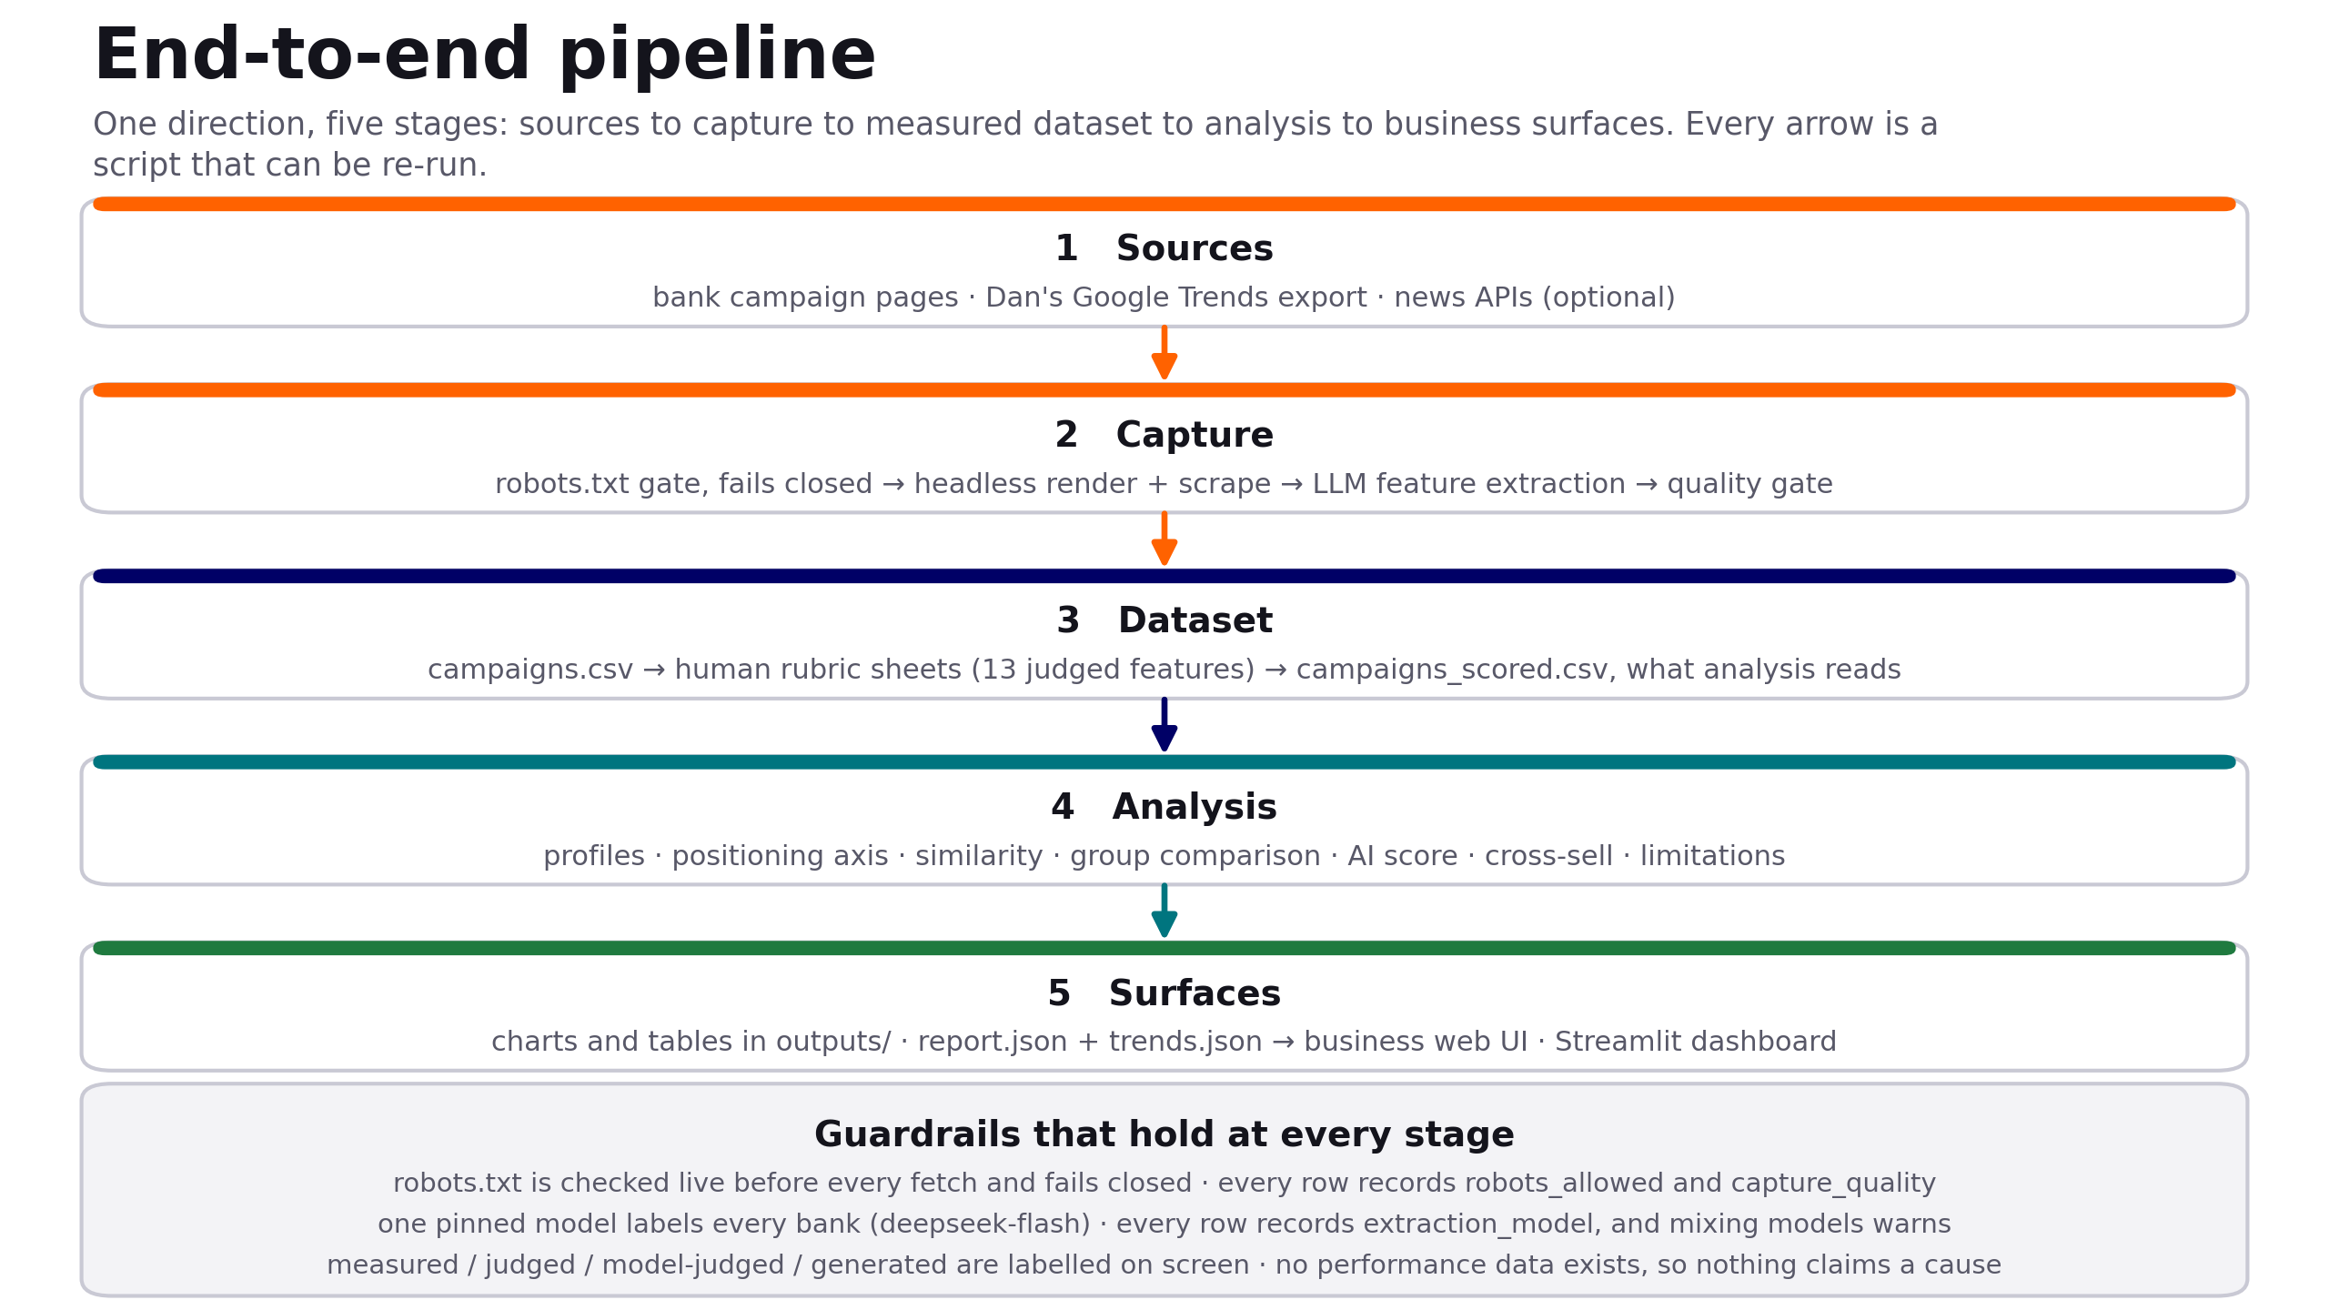
The pipeline, end to end
One direction, five stages. Every arrow is a script that can be re-run; the guardrail band holds at every stage.
Banking Campaigns Comparator · ING DACI / Customer AI · September 2026
4

Slide 5
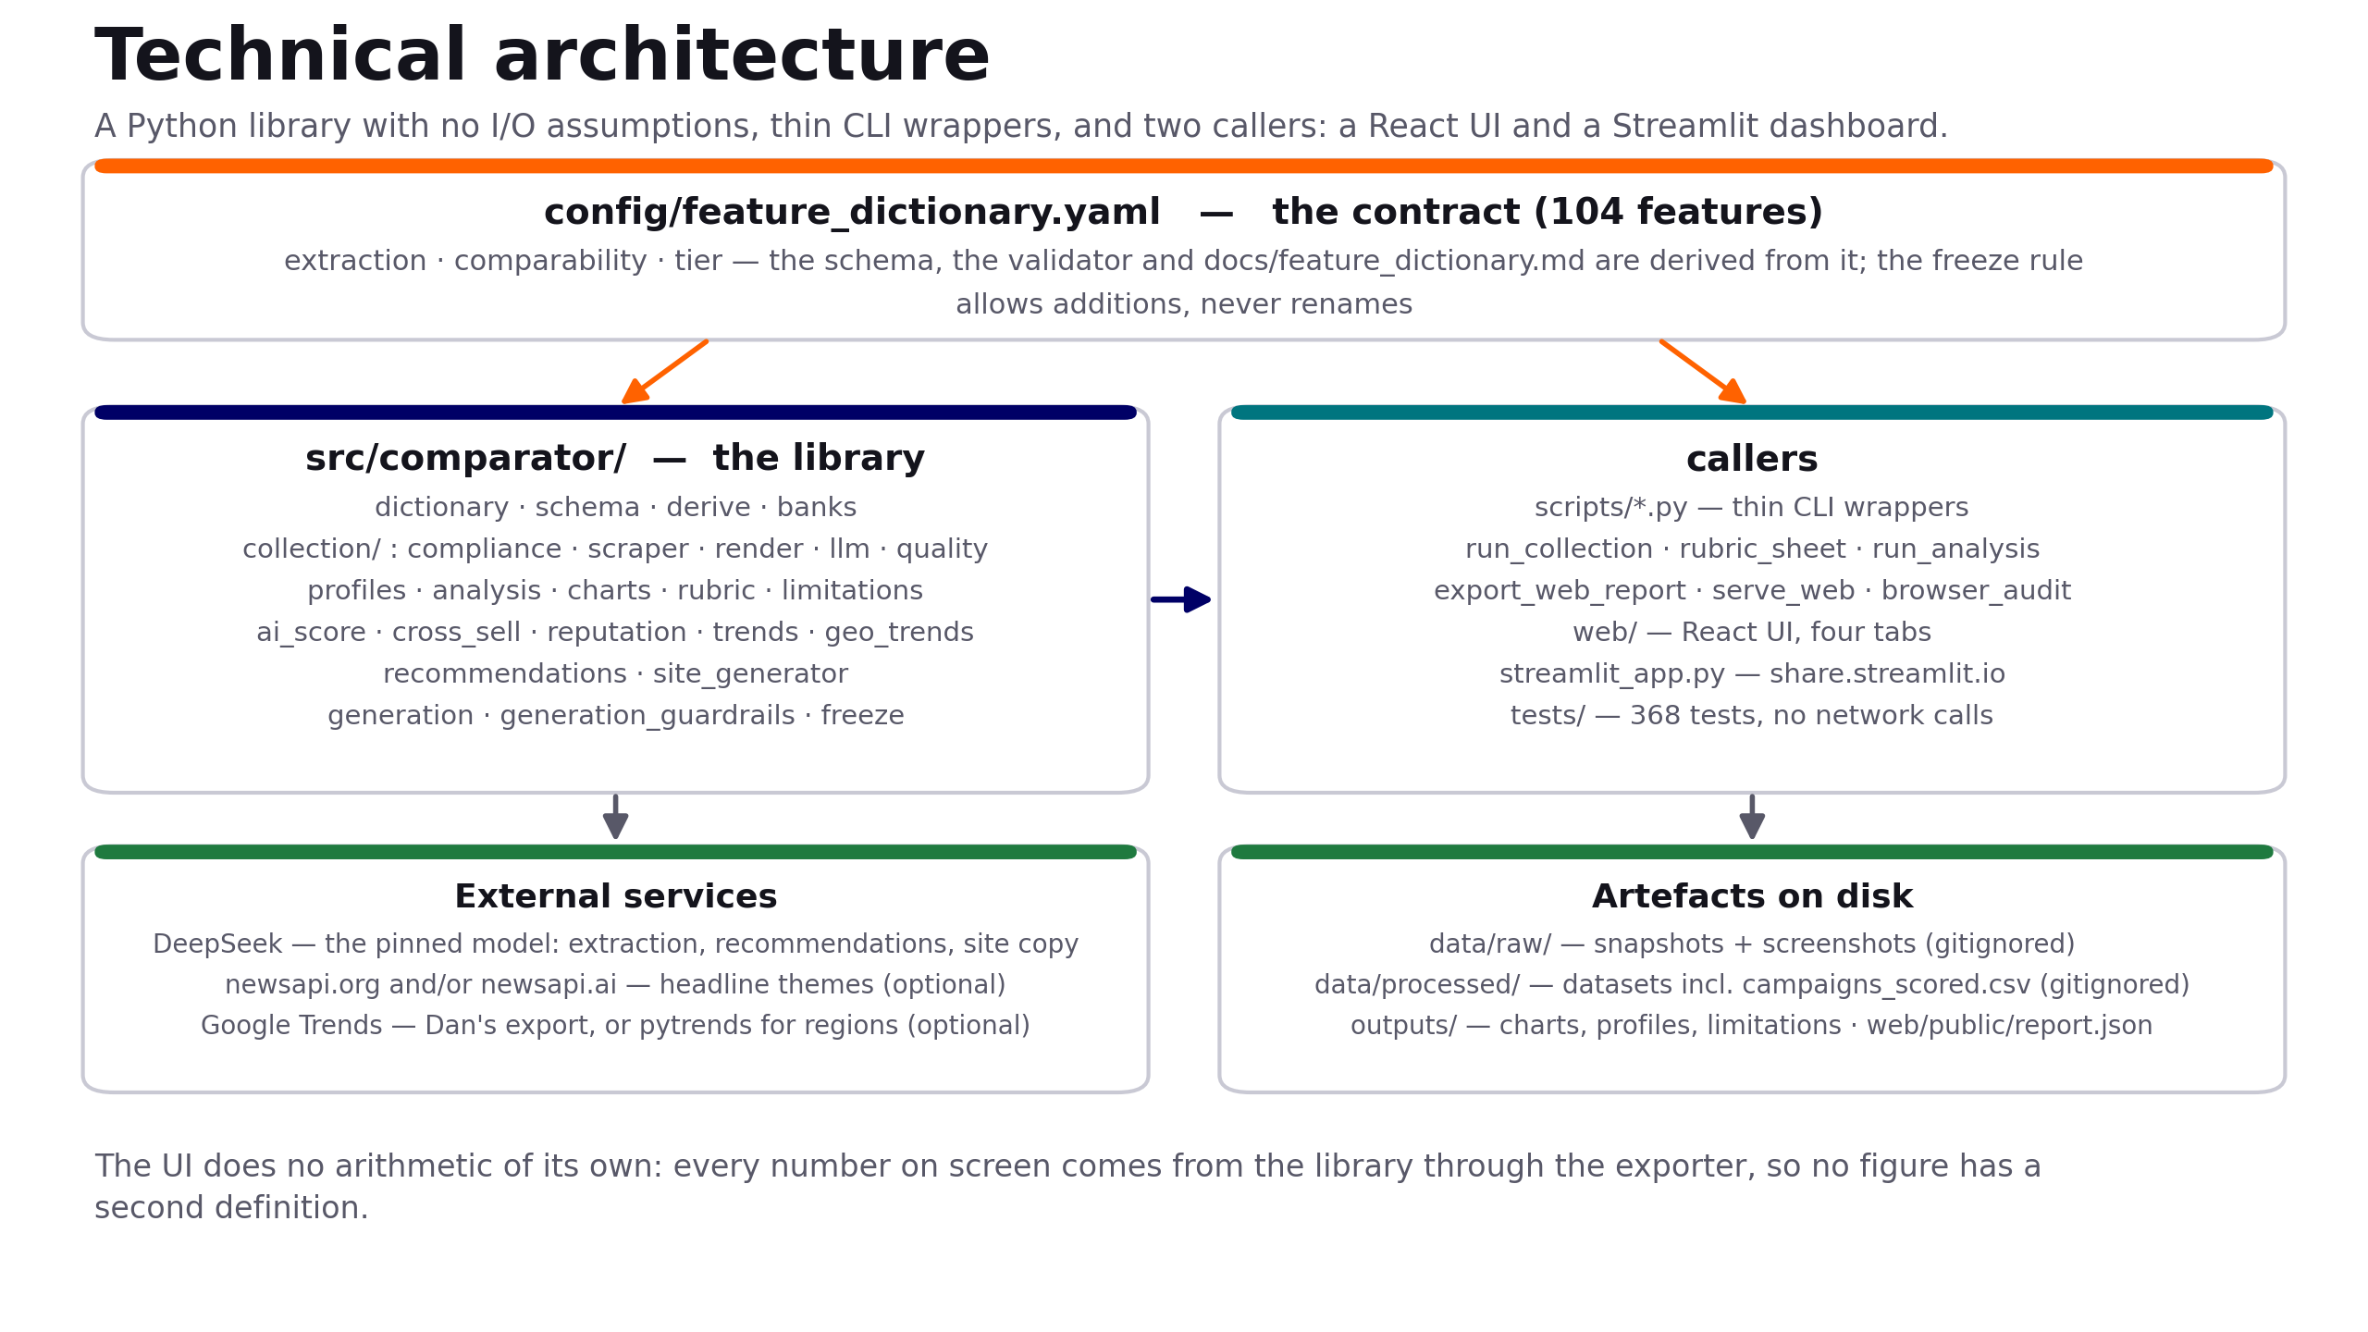
Technical architecture
A library with no I/O assumptions, thin CLI wrappers, and two callers — so no figure has a second definition.
Banking Campaigns Comparator · ING DACI / Customer AI · September 2026
5

Slide 6
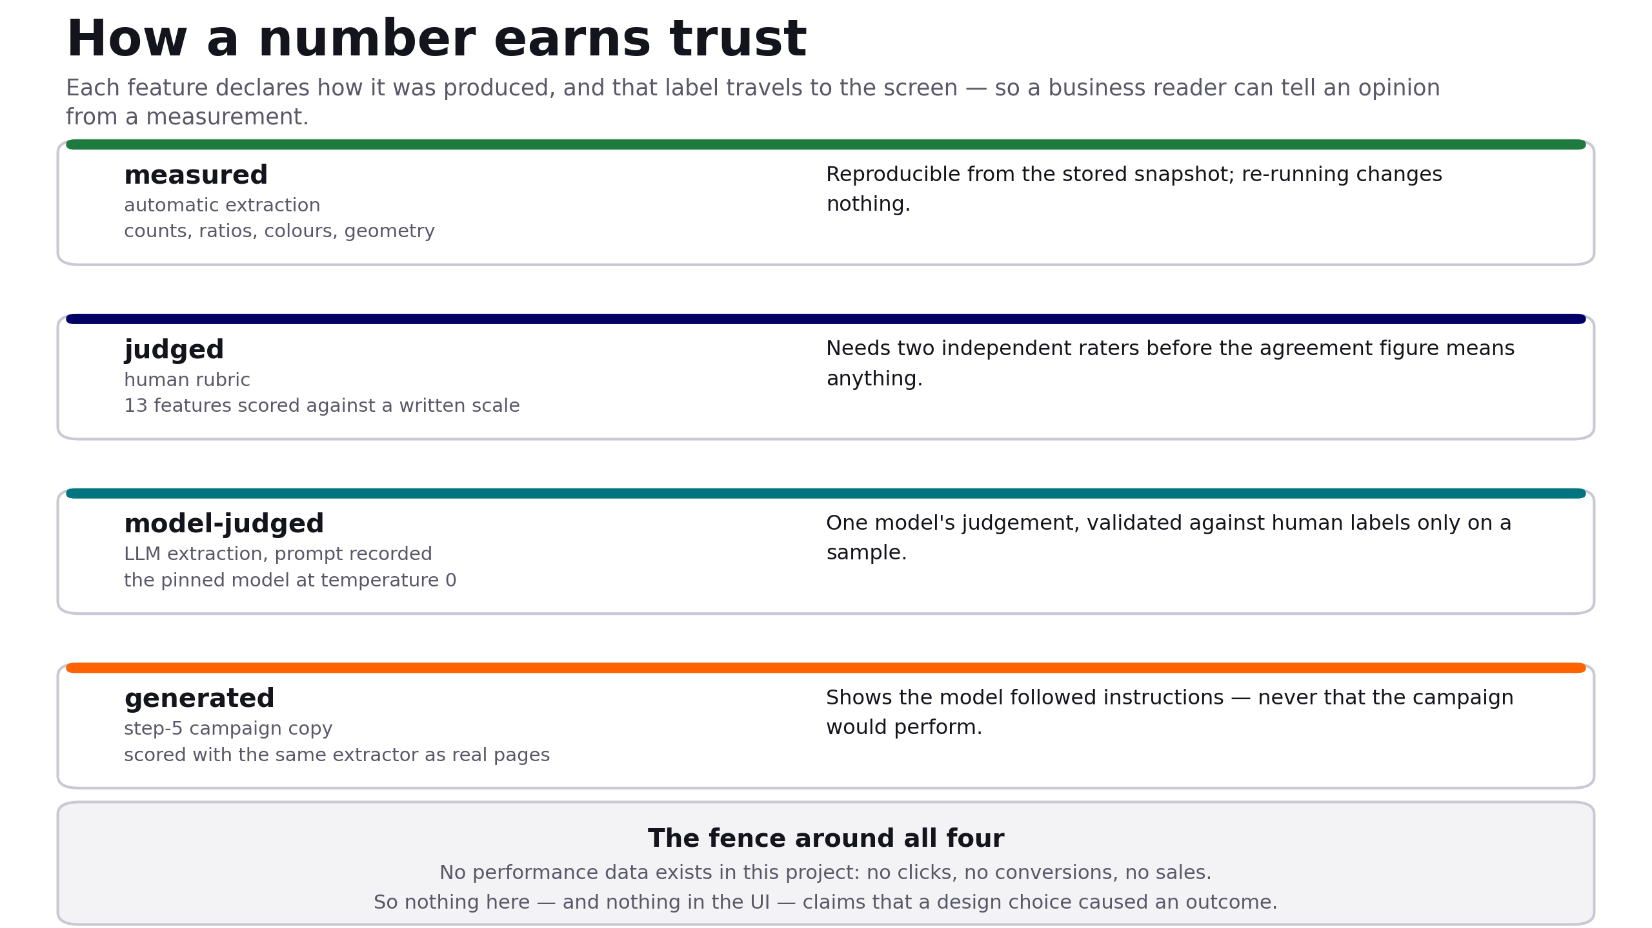
How a number earns trust
Each feature declares how it was produced, and that label travels all the way to the screen.
Banking Campaigns Comparator · ING DACI / Customer AI · September 2026
6

Slide 7
The feature dictionary is the contract
• 104 features, each declaring three things
how it was extracted (automatic / rubric / model-assisted / derived), how it may be compared, and whether it is core or extended.
• Everything else is derived from it
The dataset schema, the validator and the published feature dictionary are generated from the same YAML, so they cannot drift apart.
• The freeze rule: add, never rename
After the Day 2 freeze, columns may be added; renames and removals need all three of us, because analysis code depends on them.
• Two checks, deliberately different
A byte-equality test catches an accidental edit; the semantic freeze check catches a rename that happens to keep the bytes matching.
• It grew twice, legitimately
3 features added after the freeze, and the bank list extended to 12 values — both additions, both recorded.
Banking Campaigns Comparator · ING DACI / Customer AI · September 2026
7

Slide 8
Collection and compliance
• robots.txt is checked live before every fetch, and fails closed
If robots.txt cannot be read, the URL is treated as not allowed. Every row carries robots_allowed; the validator refuses a row where it is false.
• Pages are rendered, not just downloaded
A headless browser reads the page as a visitor sees it, which also fills the geometry features — page height, above-fold elements, image area.
• A quality gate judges the capture, not just the numbers
Two early captures passed every range check while being an empty JavaScript shell and a maintenance notice. capture_quality now travels with the row.
• When a site will not serve us, a person saves the page
BNP Paribas Fortis blocks automated traffic (HTTP 503) and Revolut's headless render is refused; the importer takes a browser-saved page, re-checks robots, and marks it manual_capture.
Banking Campaigns Comparator · ING DACI / Customer AI · September 2026
8

Slide 9
The dataset behind this analysis
• 13 pages, 11 banks, 25 comparable features, nothing excluded
Argenta · Belfius · Beobank · bunq · Crelan · Hellobank · ING · KBC · N26 · Revolut · Vdk
• Collected in Belgian French, for comparability
Word counts and readability are within-language features; mixing languages would silently drop eight of them from every comparison.
• Split for like-for-like comparison
7 traditional banks and 3 challengers, compared one product family at a time — a mortgage page and a current-account page differ because the products differ.
• The dataset is not in git; the contract is
Snapshots and datasets are gitignored — reproducible from the stored HTML, but never mistaken for committed truth.
A snapshot is the honest shape for a finding: true for one dataset, one capture date, one scope.
Banking Campaigns Comparator · ING DACI / Customer AI · September 2026
9

Slide 10
Rubric scoring: people, plus a model as a third rater
• 13 features are judgements, not measurements
Clarity of the offer, layout archetype, AIDA coverage, persuasion levers — scored against a written scale, one sheet per rater.
• Siegried has scored all 23 pages; Stephane now has 9
Stephane's were proposed by a vision model over the screenshots and adopted, and the sheet's notes column says so. Dan is still at 0/23.
• Agreement is measurable for all 13 features, over 9 to 10 pages
The module flags three as below its 60% bar — persuasion levers 0.14, accent locations 0.33, text-image layout 0.56 — and says to tighten the wording before trusting them in a finding.
• The model still writes to its own sheet, never a pre-filled one
A pre-filled sheet gets rubber-stamped, and the agreement figure would then measure how persuasive the model was, not how well two people agree.
Banking Campaigns Comparator · ING DACI / Customer AI · September 2026
10

Slide 11
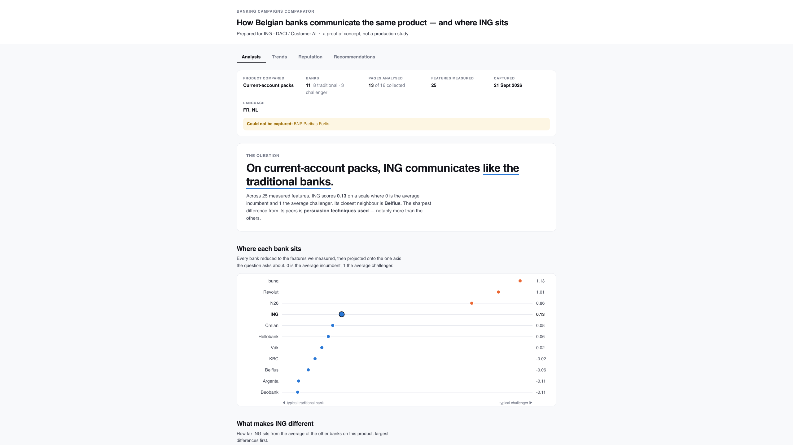
The Analysis tab
Scope, focus and the verdict above the first number — the reader cannot see a figure without seeing what it covers.
Banking Campaigns Comparator · ING DACI / Customer AI · September 2026
11

Slide 12
What the analysis found
• ING sits with the traditional banks, not the challengers
Traditional↔challenger positioning score 0.131 on the current dataset.
• Where ING is furthest above its peers
Figures quoted: 25.5 vs peers 12.1 (+1.61 SD) · Targeting students: 1.0 vs 0.3 (+1.53 SD) · Clarity of the offer: 5.0 vs 3.8 (+1.30 SD, rubric-sourced).
• Where ING is below
Calls to action: 3.0 vs peers 13.75 (-0.95 SD), and no comparison table where peers average 0.4.
• What separates the two groups
People present (d = -2.71, traditional higher), subscription framing and showing a rate (both d = +2.71, challenger higher), share of page that is imagery (d = +2.10).
• Read as description, not proof
With eleven banks these are descriptive effect sizes, not significance tests — and the rubric-sourced ones moved when the second sheet was folded in, which is the point of measuring agreement.
Banking Campaigns Comparator · ING DACI / Customer AI · September 2026
12

Slide 13
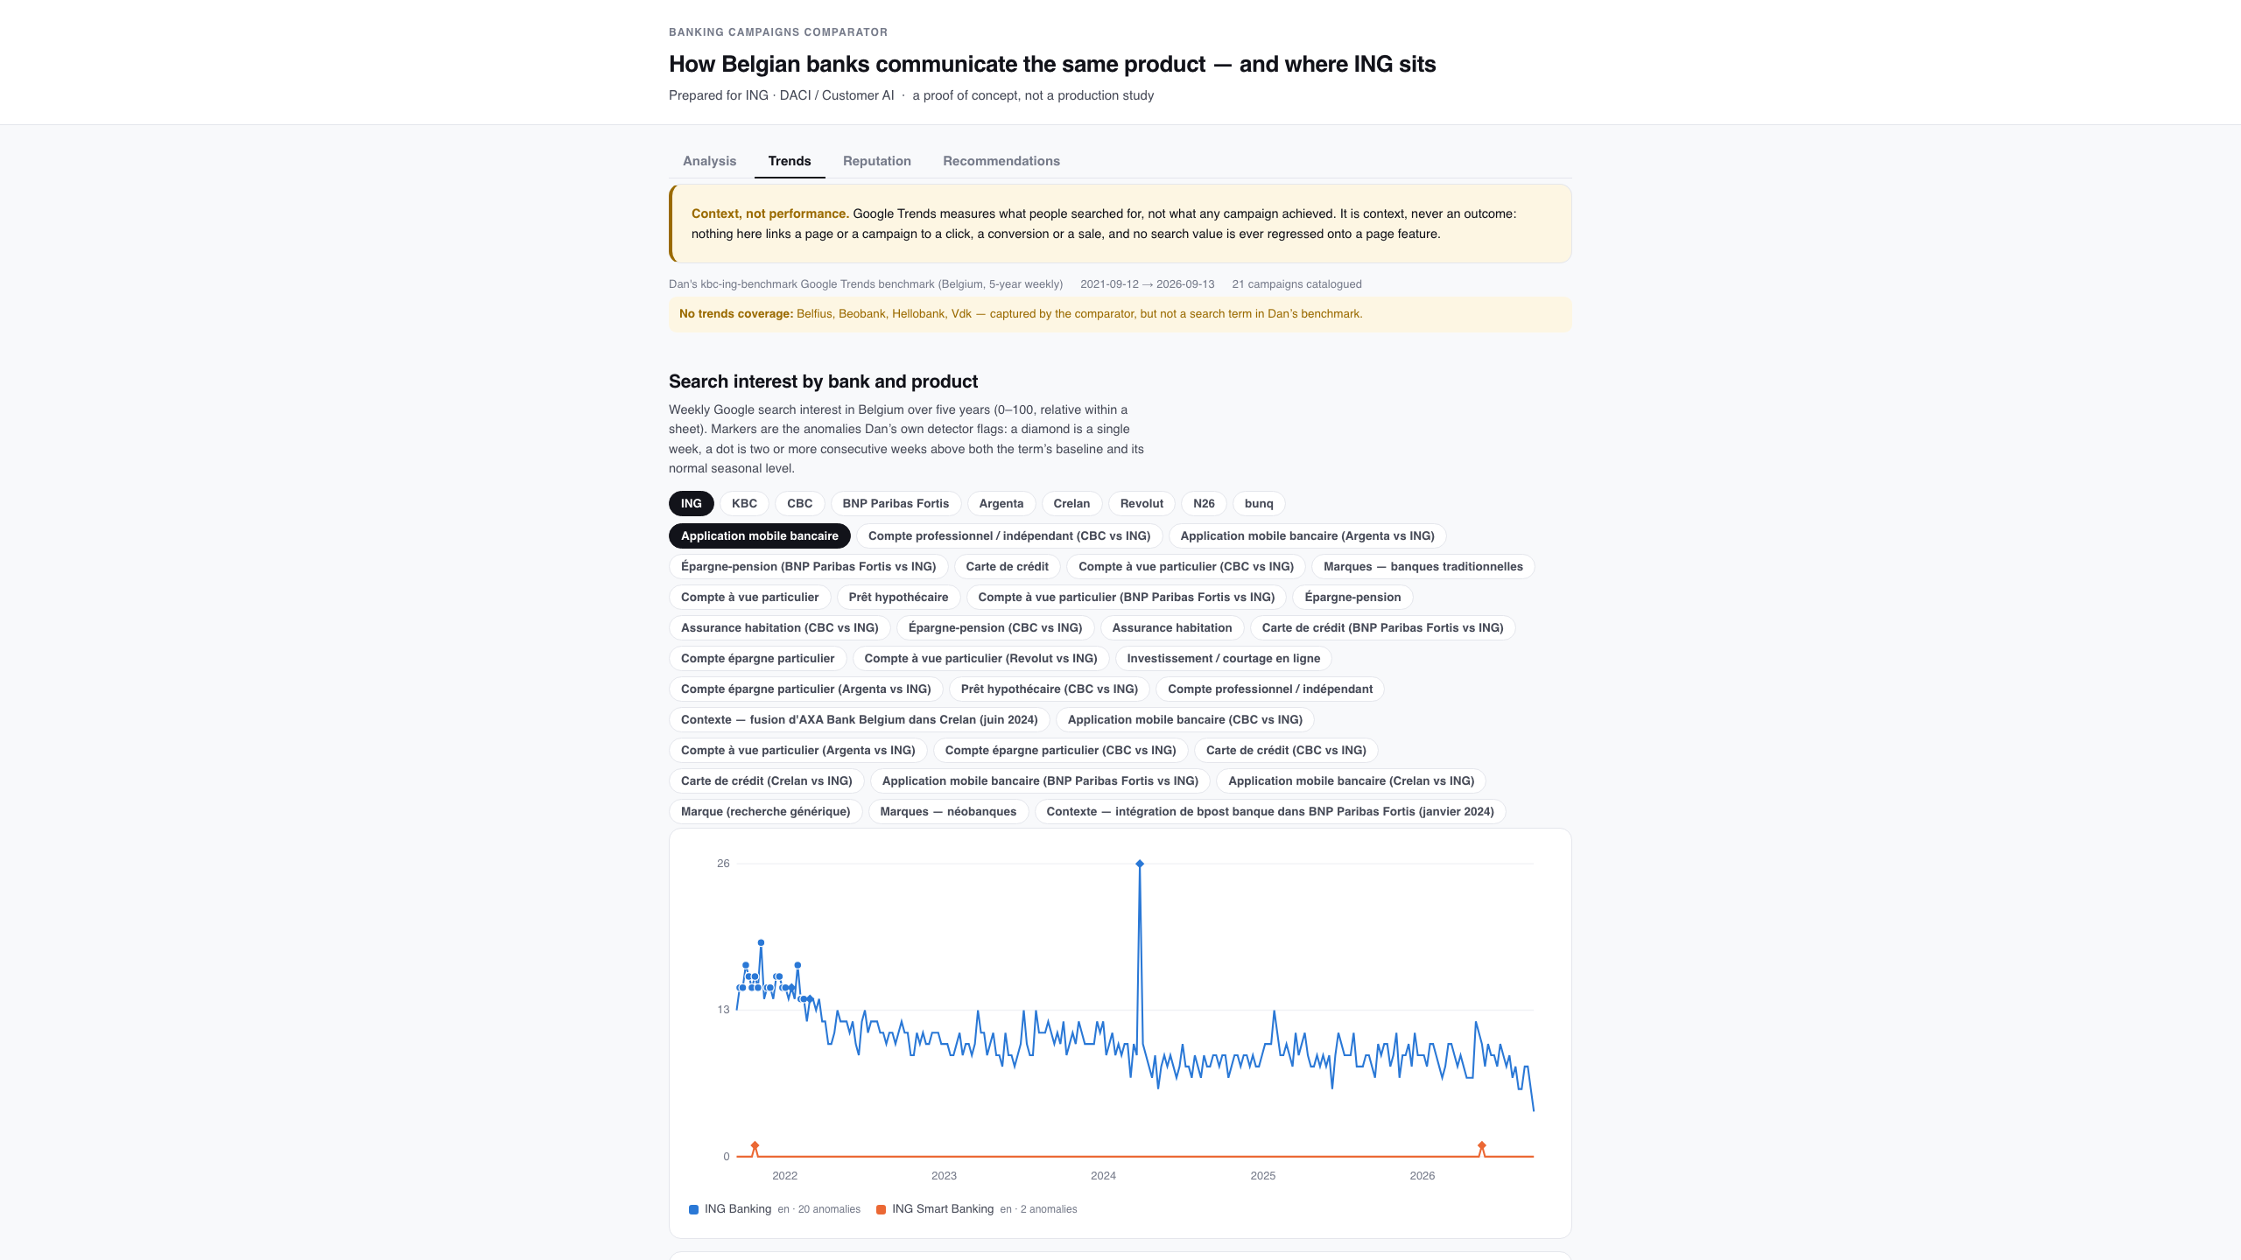
The Trends tab: search interest as context
Five years of weekly search interest per bank and product, Dan's flagged spikes, and the campaigns matched to them.
Banking Campaigns Comparator · ING DACI / Customer AI · September 2026
13

Slide 14
Trends: a guardrail with teeth
• It measures what people searched for — never what a campaign achieved.
• The module refuses to emit a per-page number, because a per-page column would end up regressed against page features and called performance.
• The tab carries the sentence itself, so no view can drop the caveat.
• Recommendations may use a slice of it for timing and focus — those are marked as trends-based, kept in their own group, and forbidden from citing a page feature as evidence.
• Absent Dan's export, the tab shows an empty state and nothing else is affected.
Banking Campaigns Comparator · ING DACI / Customer AI · September 2026
14

Slide 15
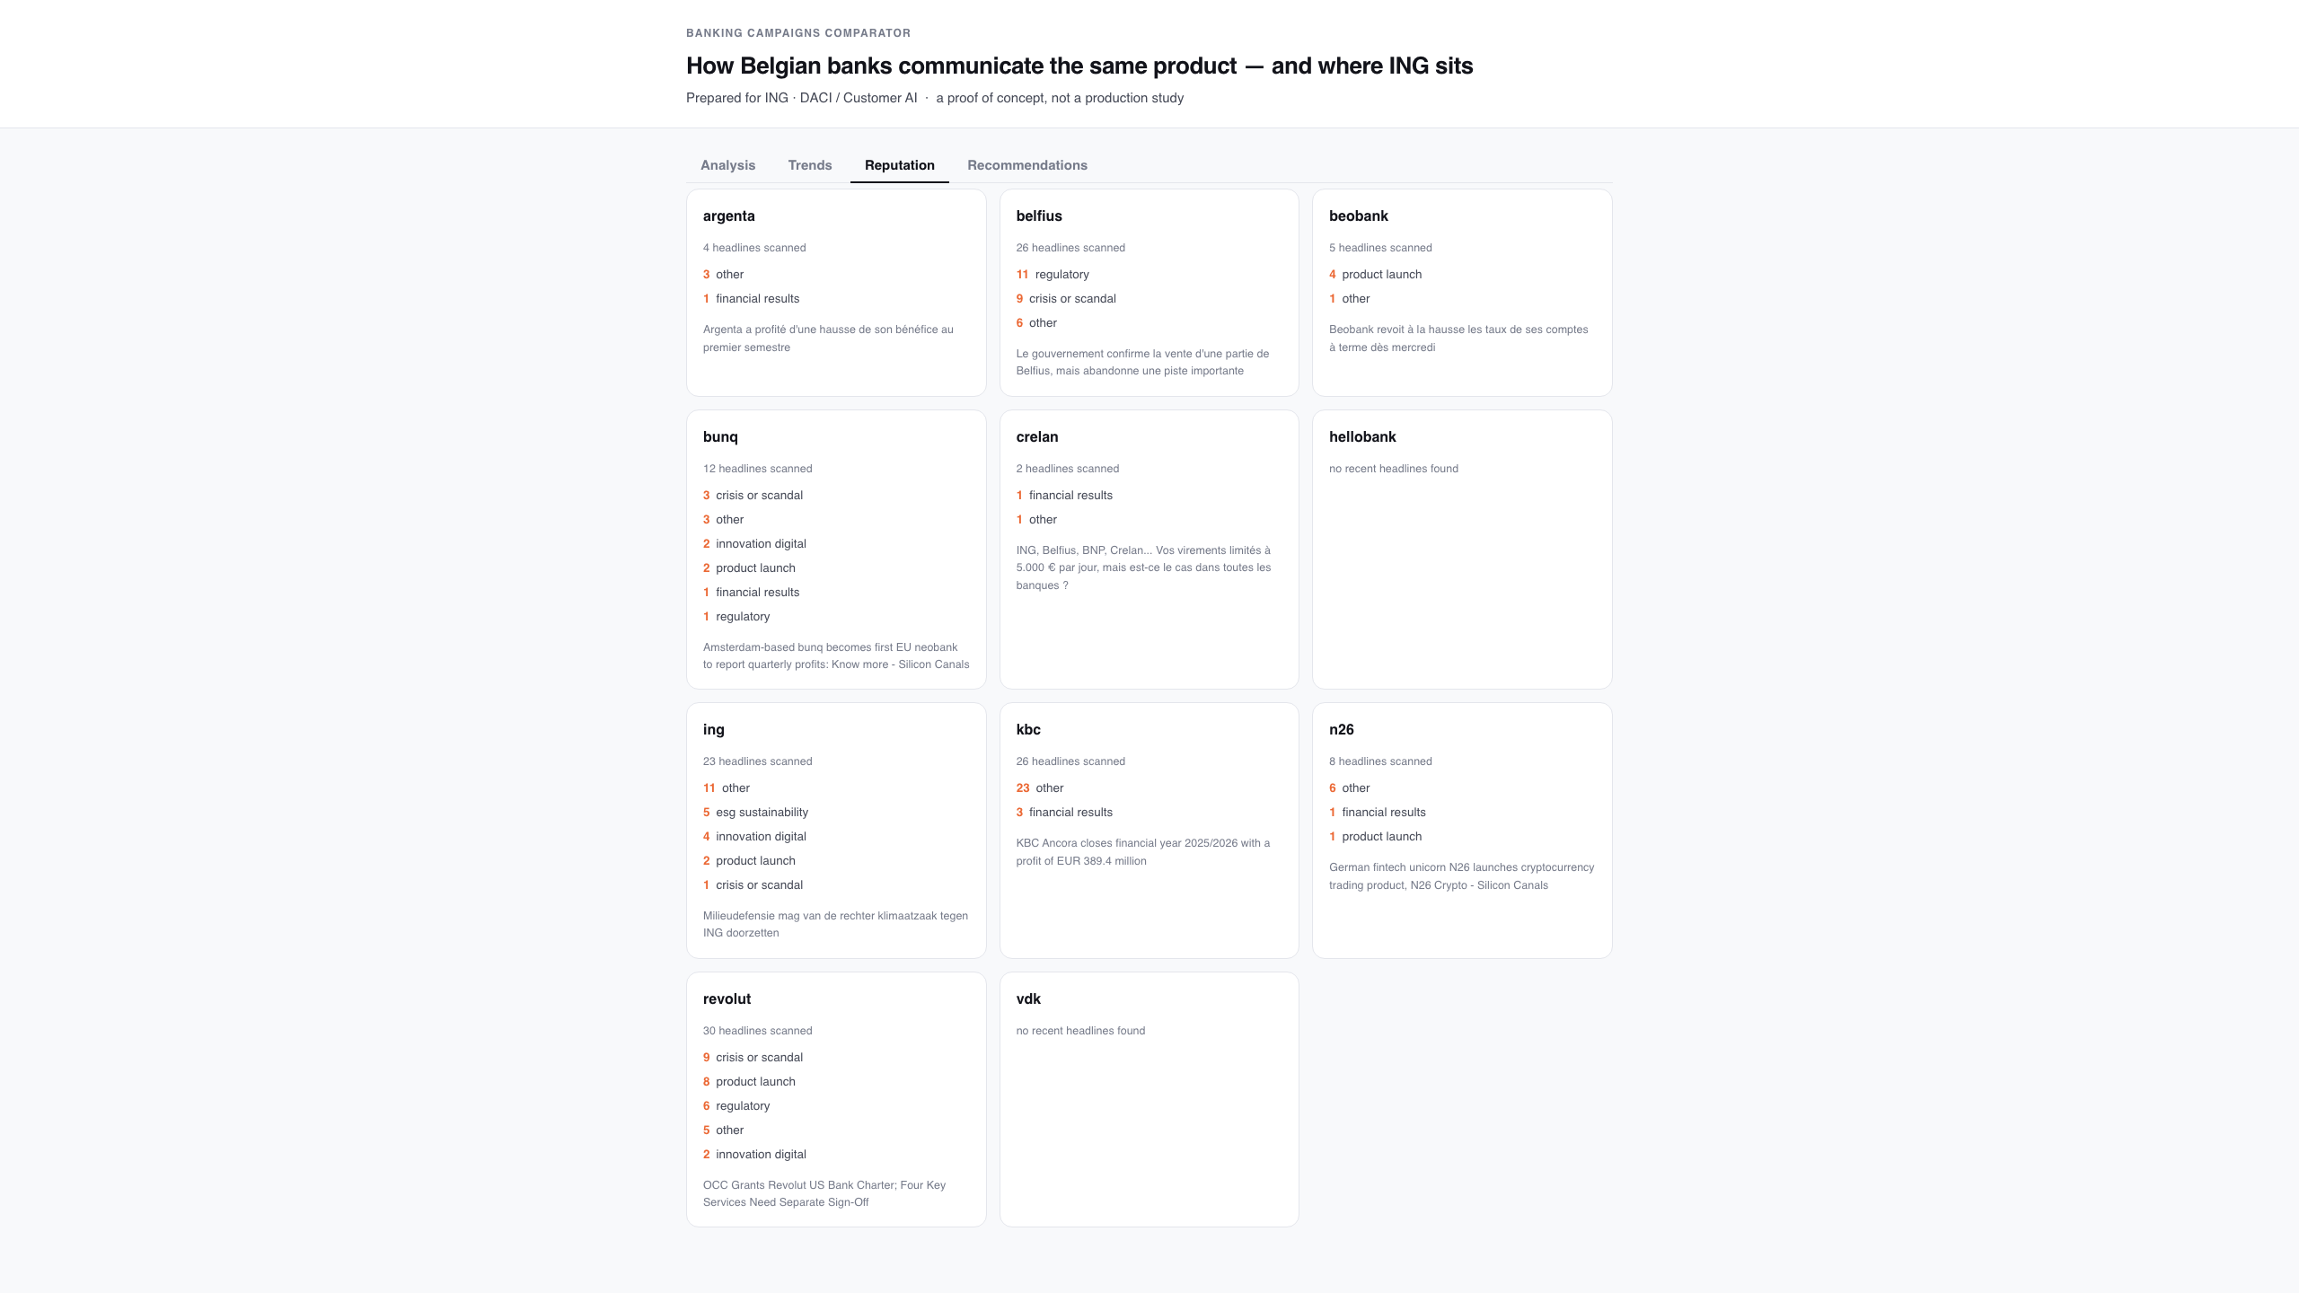
The Reputation tab: what each bank is in the news about
Headline themes — innovation, crisis, results — counted, never scored for sentiment. Two news providers are merged, in three languages.
Banking Campaigns Comparator · ING DACI / Customer AI · September 2026
15

Slide 16
Reputation: themes, not sentiment
• Sentiment scoring was out of scope; themes turn the brief's own 'reputation, innovations, crises' framing into a closed, countable list.
• Two similarly named providers are supported at once (newsapi.org and newsapi.ai); headlines from both are merged and de-duplicated.
• Every provider is queried in English, French and Dutch — Belgian bank news is mostly not in English.
• The module degrades to 'not configured' when no key is present, rather than inventing a number for a bank it has no data on.
• Themes are context about the bank, never evidence about the page.
Banking Campaigns Comparator · ING DACI / Customer AI · September 2026
16

Slide 17
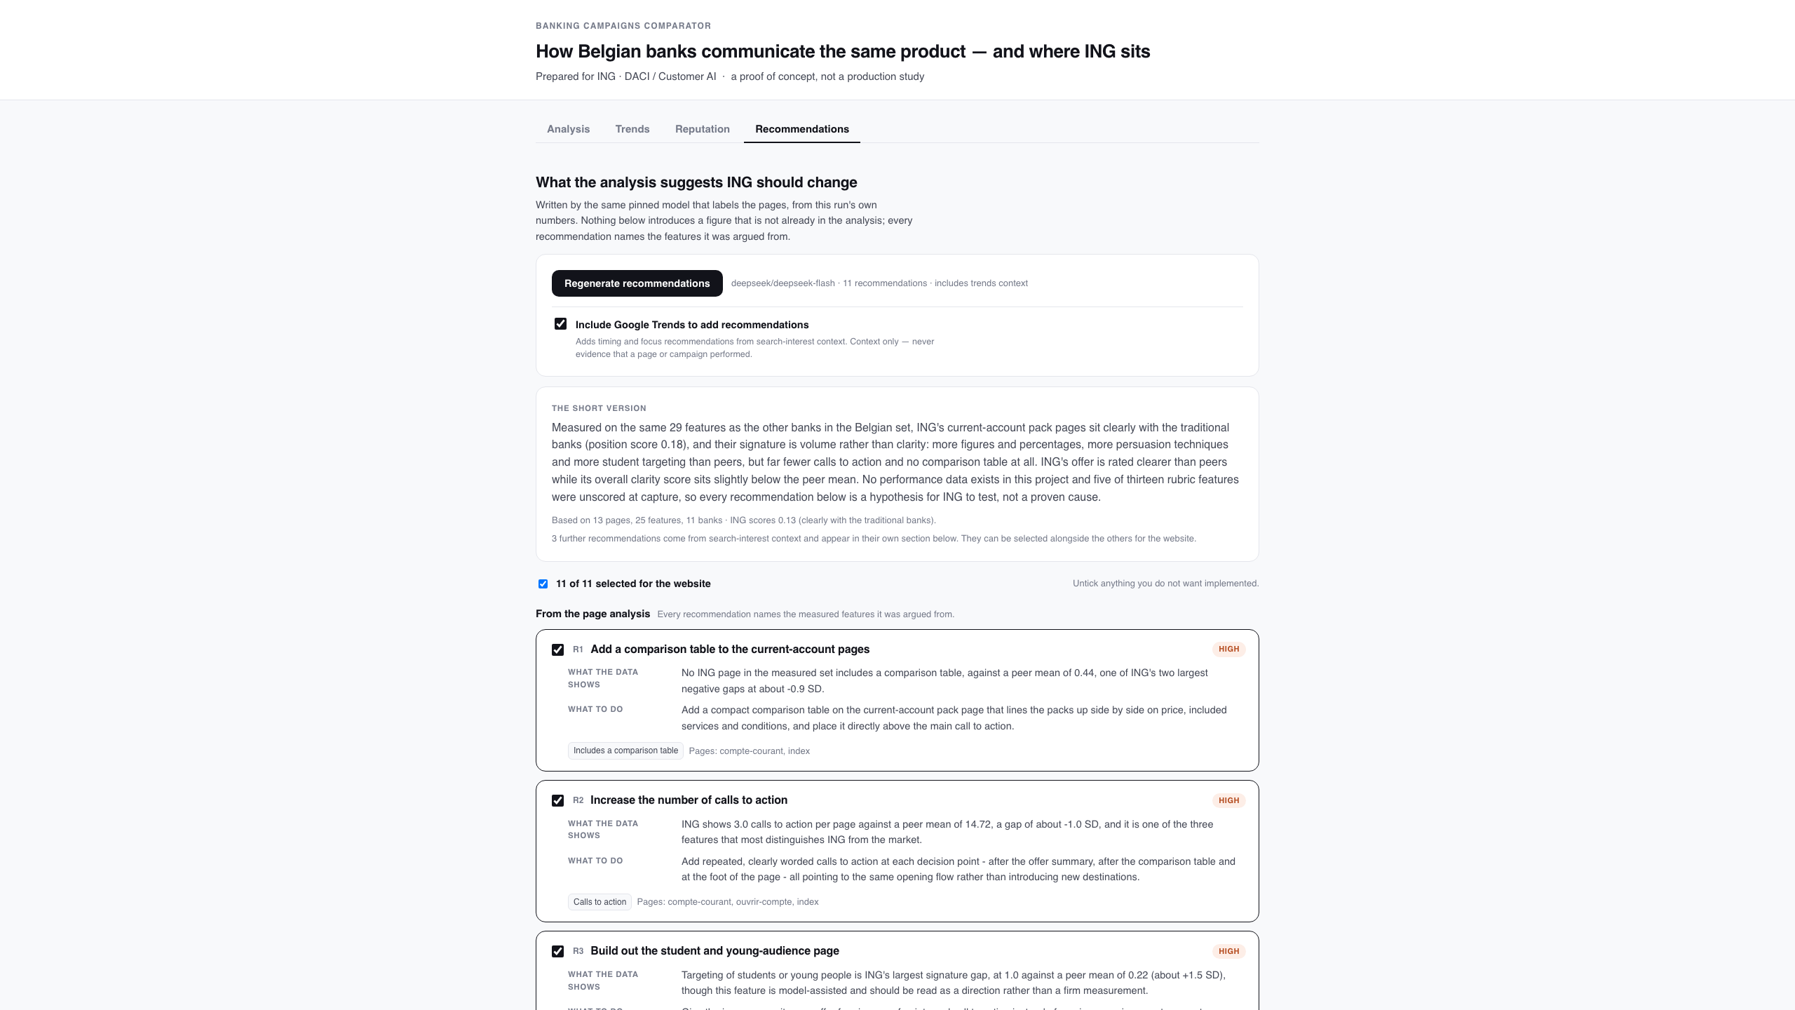
The Recommendations tab
The one place a model is allowed to opine: advice grounded in this run's numbers, each item shown next to the features it was argued from, and selectable.
Banking Campaigns Comparator · ING DACI / Customer AI · September 2026
17

Slide 18
Recommendations, and how they stay honest
• Every recommendation names the measured features it was argued from; an invented feature id is dropped before the list is shown.
• A second, opt-in group can be added from search-interest context.
• Those carry basis='trends' and a market context, render in their own visually separated group, and may not cite a page feature as evidence.
• A reader ticks the ones worth building; only the ticked subset reaches the site builder.
• Nothing here re-runs collection or analysis — it reads one report and writes advice.
Banking Campaigns Comparator · ING DACI / Customer AI · September 2026
18

Slide 19
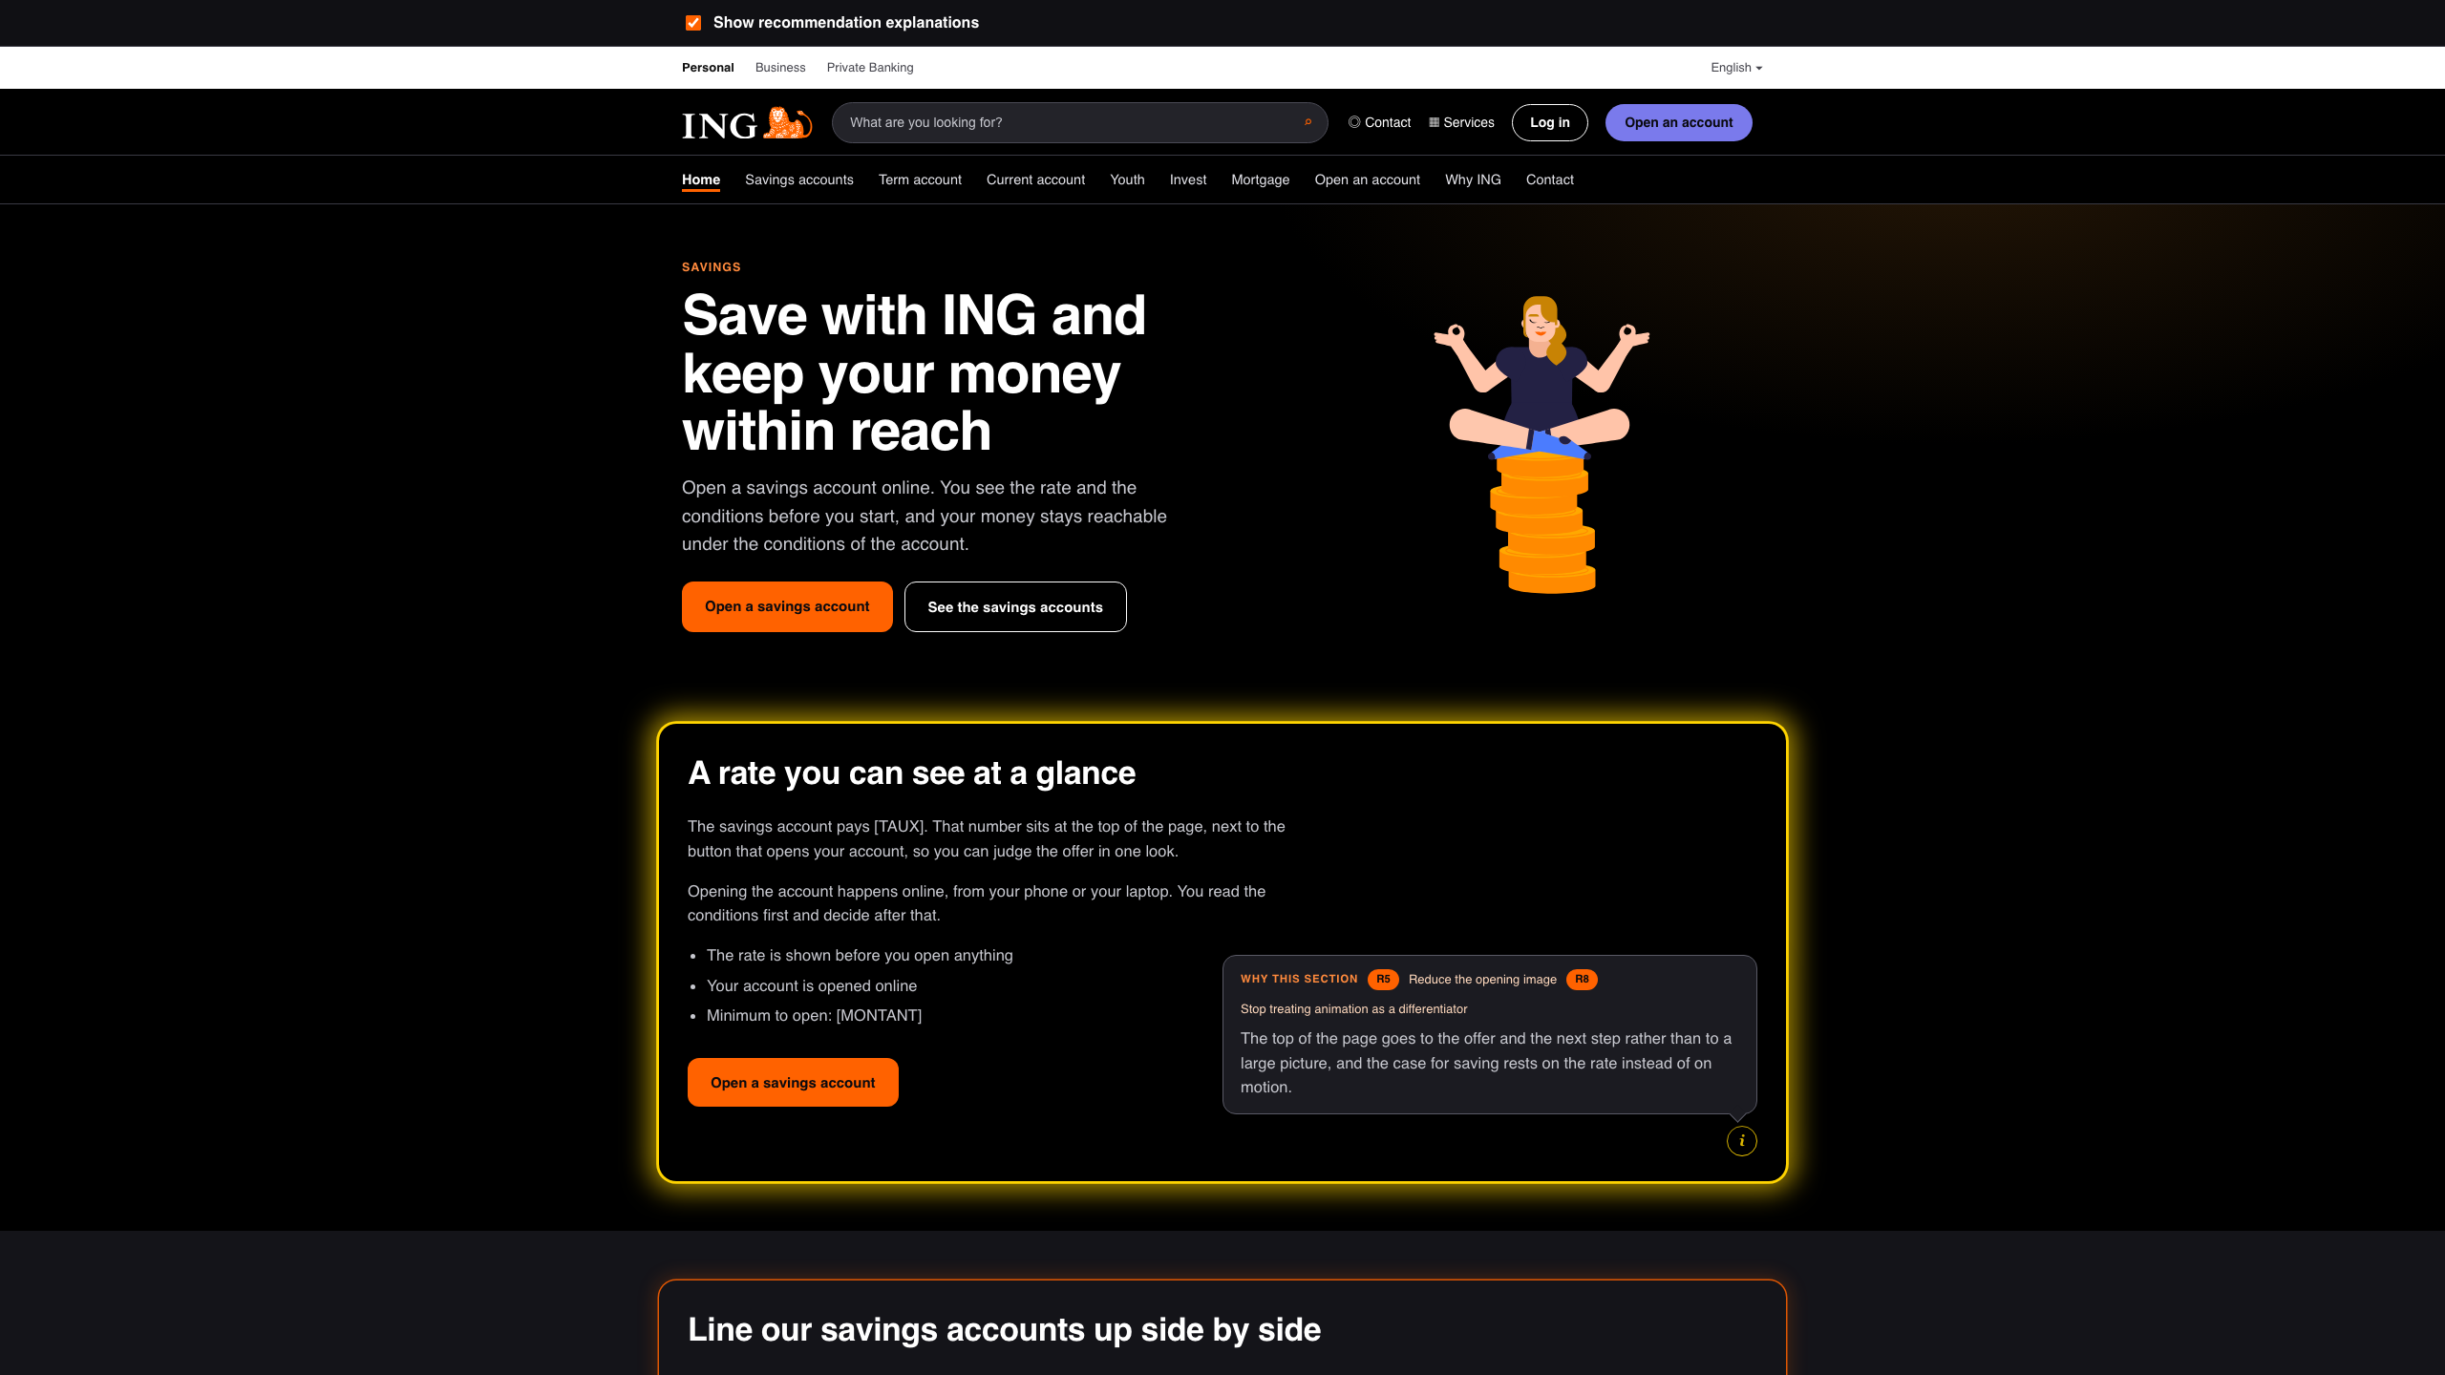
The generated ING website, with explanations on
Each section that implements a recommendation is boxed; the (i) button opens the reasoning above it, and that section's glow switches to a slow yellow flicker.
Banking Campaigns Comparator · ING DACI / Customer AI · September 2026
19

Slide 20
Explanation mode: showing the work
• Tick 'Explain each section' and every generated section that acts on a recommendation is boxed, with an (i) button and a one-sentence rationale in the page language.
• Yellow flicker while an explanation is open — deliberately not ING orange, so the explanation state cannot be mistaken for the brand treatment.
• A switch above the site turns the whole layer off, and the choice is remembered across the ten pages — so the same site can be shown as a normal site.
• Every page gets at least one box; pages no recommendation targets borrow the site-wide advice that applies.
• The first explained run produced copy about the recommendations themselves, so the page prompt now forbids meta copy and confines 'why' to the rationale.
Banking Campaigns Comparator · ING DACI / Customer AI · September 2026
20

Slide 21
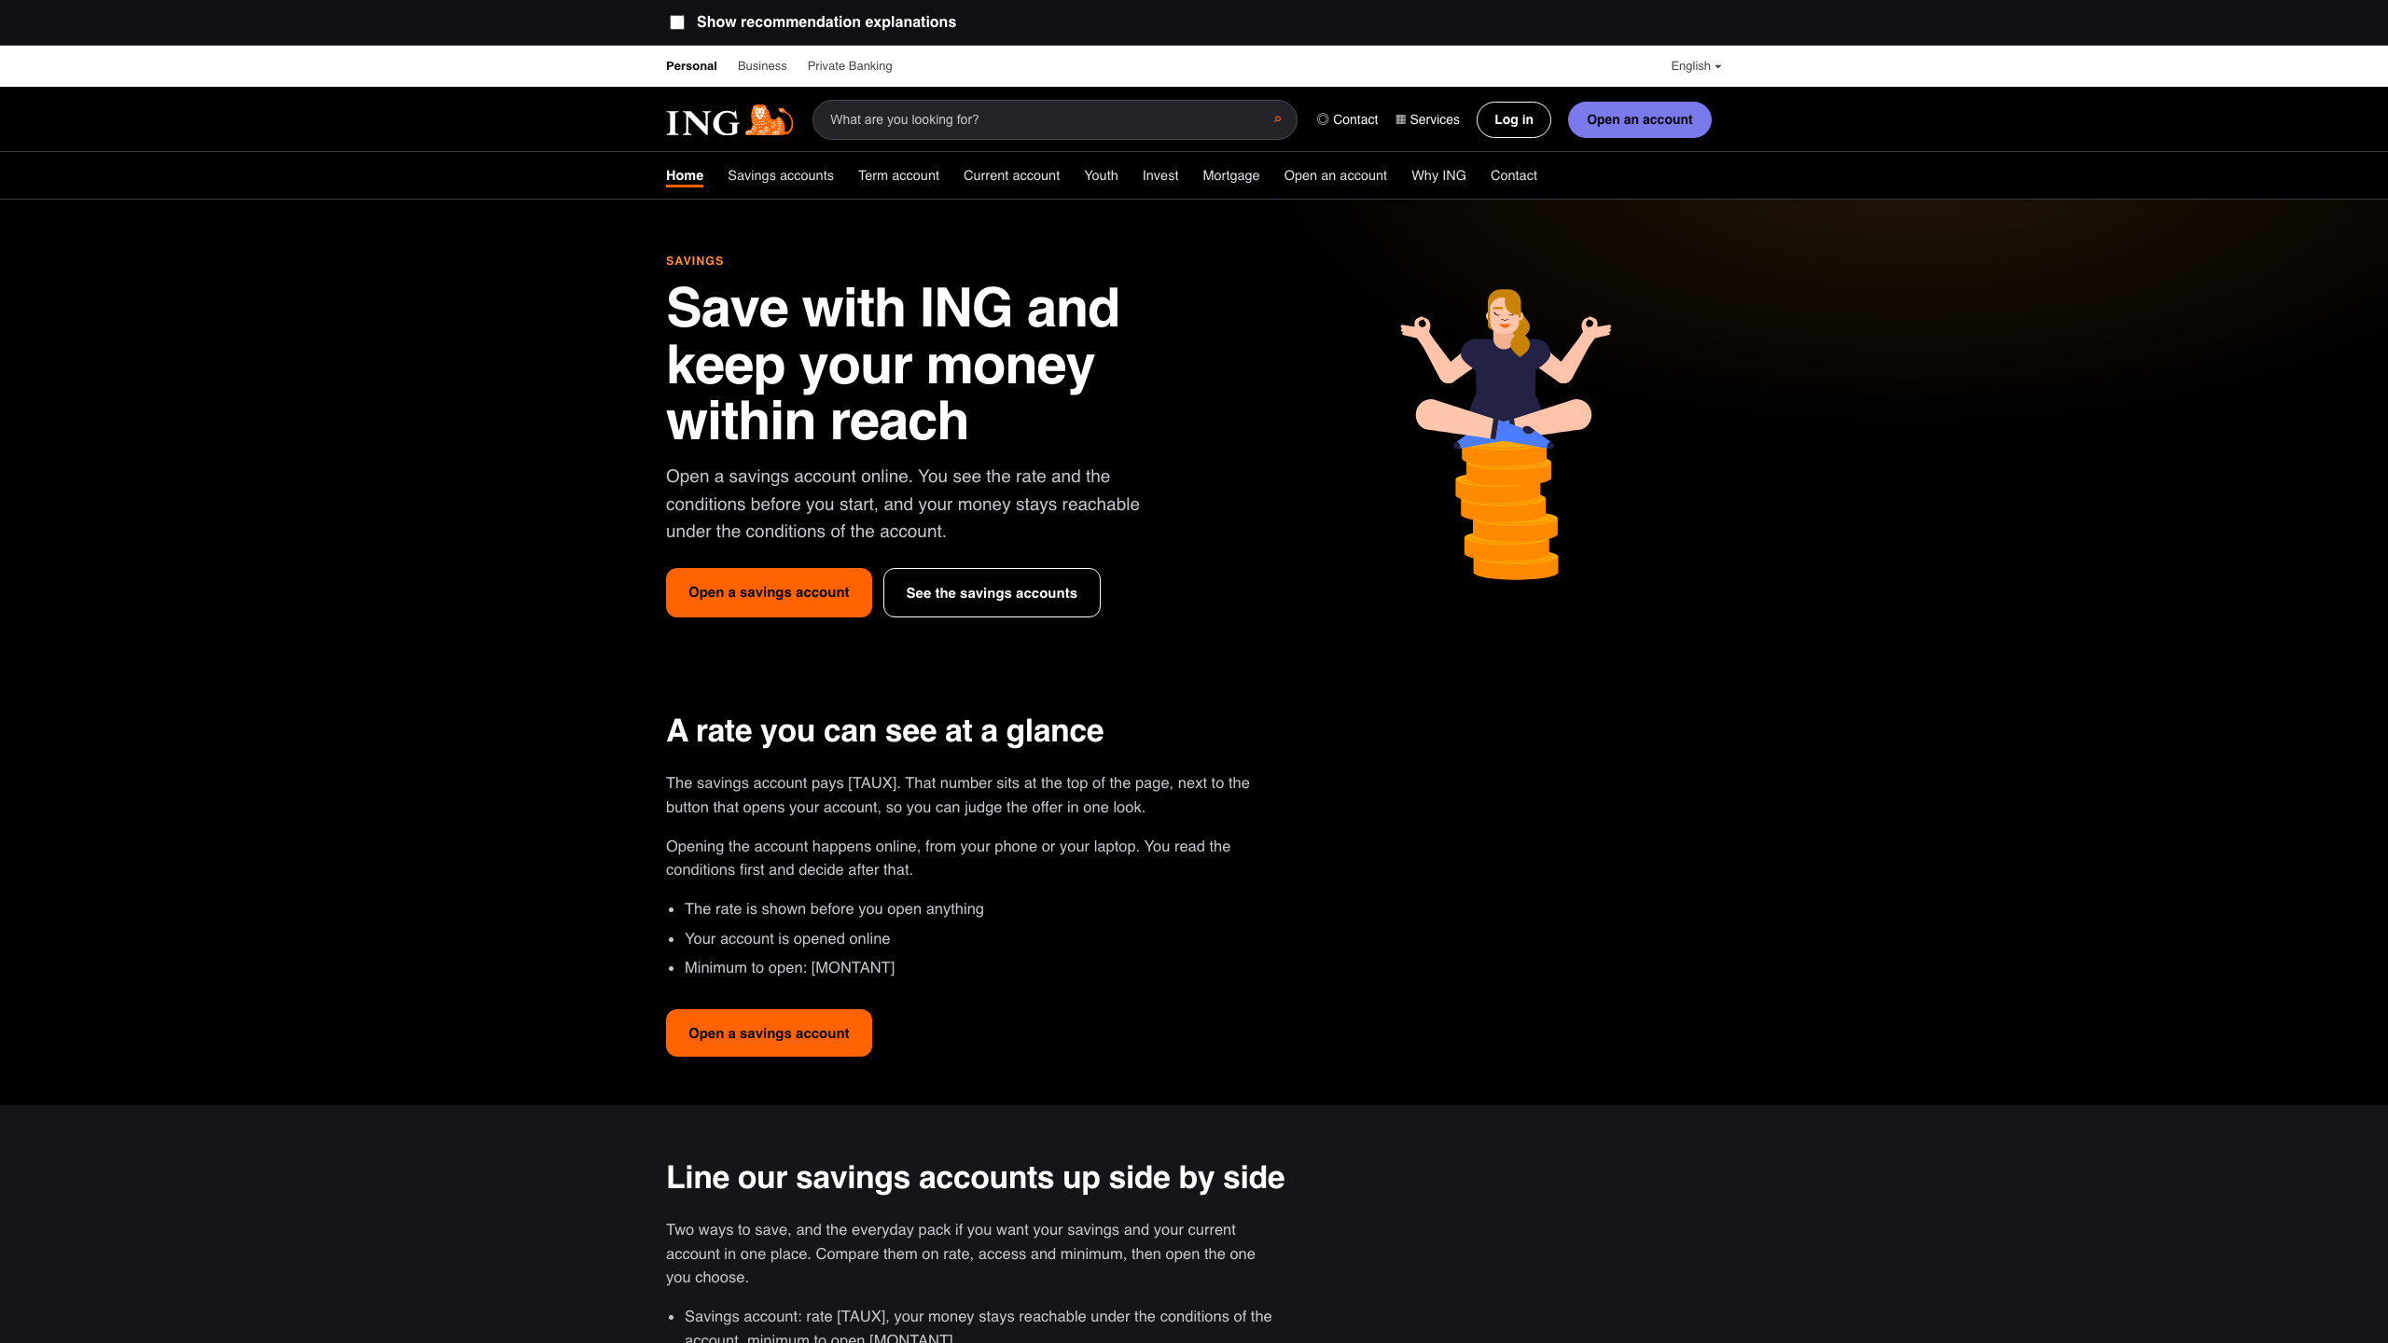
The same site, explanations off
One checkbox above the site hides every box, balloon and rationale — the identical pages, shown as a normal site.
Banking Campaigns Comparator · ING DACI / Customer AI · September 2026
21

Slide 22
What this cannot support
• No performance data exists here
Nothing links a design choice to a click, a conversion or a sale. Every recommendation is a hypothesis ING could test.
• Small groups, by design
Three challengers against seven traditional banks, and most banks contribute a single page — so a group mean is an anecdote and an effect size describes separation, not significance.
• The judgement features are thinner than they look
Siegried covers all 23 pages, Stephane's 9 were machine-proposed and adopted, Dan's are empty — and three of the 13 features fall below the agreement bar, so anything resting on persuasion levers or accent placement is a hypothesis.
• Search interest is context, and covers part of the market
It measures what people searched for, not what a campaign achieved, and the pages captured are today's pages.
• Only the open web is covered
Social, in-app and email banners are out of scope — and may be where a bank's real communication happens.
outputs/limitations.md is regenerated from the dataset on every run, so these cannot quietly go stale.
Banking Campaigns Comparator · ING DACI / Customer AI · September 2026
22

Slide 23
Roadmap
• 1. Finish the rubric properly
Dan's sheet, the 14 pages whose screenshots are missing, and a genuinely independent second human — an adopted machine sheet measures the model, not agreement.
• 2. Recover the two blocked pages
BNP Paribas Fortis and Revolut via the manual-capture path, so the challenger side is not carried by two banks.
• 3. Re-run and re-export
rubric_sheet.py merge → run_analysis.py → export_web_report.py, then re-verify the narrative's figures.
• 4. Decide on outputs/ in git
It is regenerated on every run yet tracked, so each analysis leaves a large binary diff.
• 5. Then, if the team wants it
More product families (savings, mortgage) compared the same way, and a wider bank set.
Banking Campaigns Comparator · ING DACI / Customer AI · September 2026
23

Slide 24
Measure one way. Label the trust. Claim only what the data supports.
The pipeline, the contract and the guardrails are in the repository:
README.md · docs/design.md · docs/pipeline.md · web/README.md · docs/decisions.md

