Slide 1


Supervisor meeting
1st Year Project
UvA/VU BSc
Physics & Astronomy
J.A. Dijksman & C. Nellist
j.a.dijksman@uva.nl & c.nellist@uva.nl

Slide 2
Thank you
For being a Project supervisor
Supervision done by research group staff/PhD/Postdocs = you!
Clara & Joshua coordinate.
Handle student organization and communication
Point of contact for scientific groups
In charge of teaching / assessment strategy
We alternate the main contact. This year it's Clara.

Slide 3

Student contact established?
You can proactively reach out to students via email. These have been sent to you.
The students have been added in groups to Canvas.
We will add your contact information on Canvas.
We can directly add you to the group if you wish to use this as a way to communicate with your group(s).
They are available from June 2 onwards

Slide 4

Project Goals
Make experimental research activities in Amsterdam more visible to students
Better align astronomy & physics practicum training methods
Integrate academic skills training (AVT) with practicum
Stimulate “ownership” of projects while working in a team

Slide 5
What are students going to do in your Project?
Possible activities
Confront the students with a simple experiment and let them describe/rationalize observations.
Repeat experiment from a PhD student/postdoc at slightly different settings
Perform data analysis on a (new) data set with (new) code and perform some systematic study
Build a necessary component in a slightly different way
Prepare a sample in a different way (if sample prep is reasonably involved)
In all these tasks, the ideas is to spark creativity, curiosity, ownership.

Slide 6

Background knowledge
(AVT - academische vaardigheden training - Joëlle Kessels / Chaokang Tai / Donna Sandtke)
Build on
P1: Latex writing / Overleaf
P2: Argumentation skills
P3: Presentation skills (duo)
P4: Poster
Integrate with:
P5: Literature search - based on selection of topic for P6
Add to:
P6: Team work skills - provide training for entire group

Slide 7

Project Timeline
Mid April: student teams assigned
End April: students read literature
Students do research from June 2 - 19
Poster presentations: Thu June 25
From 2-24 is ~17 days, of which:
Research: ~ 10 days full time
Poster + animation ~ 5 days full time

Slide 8
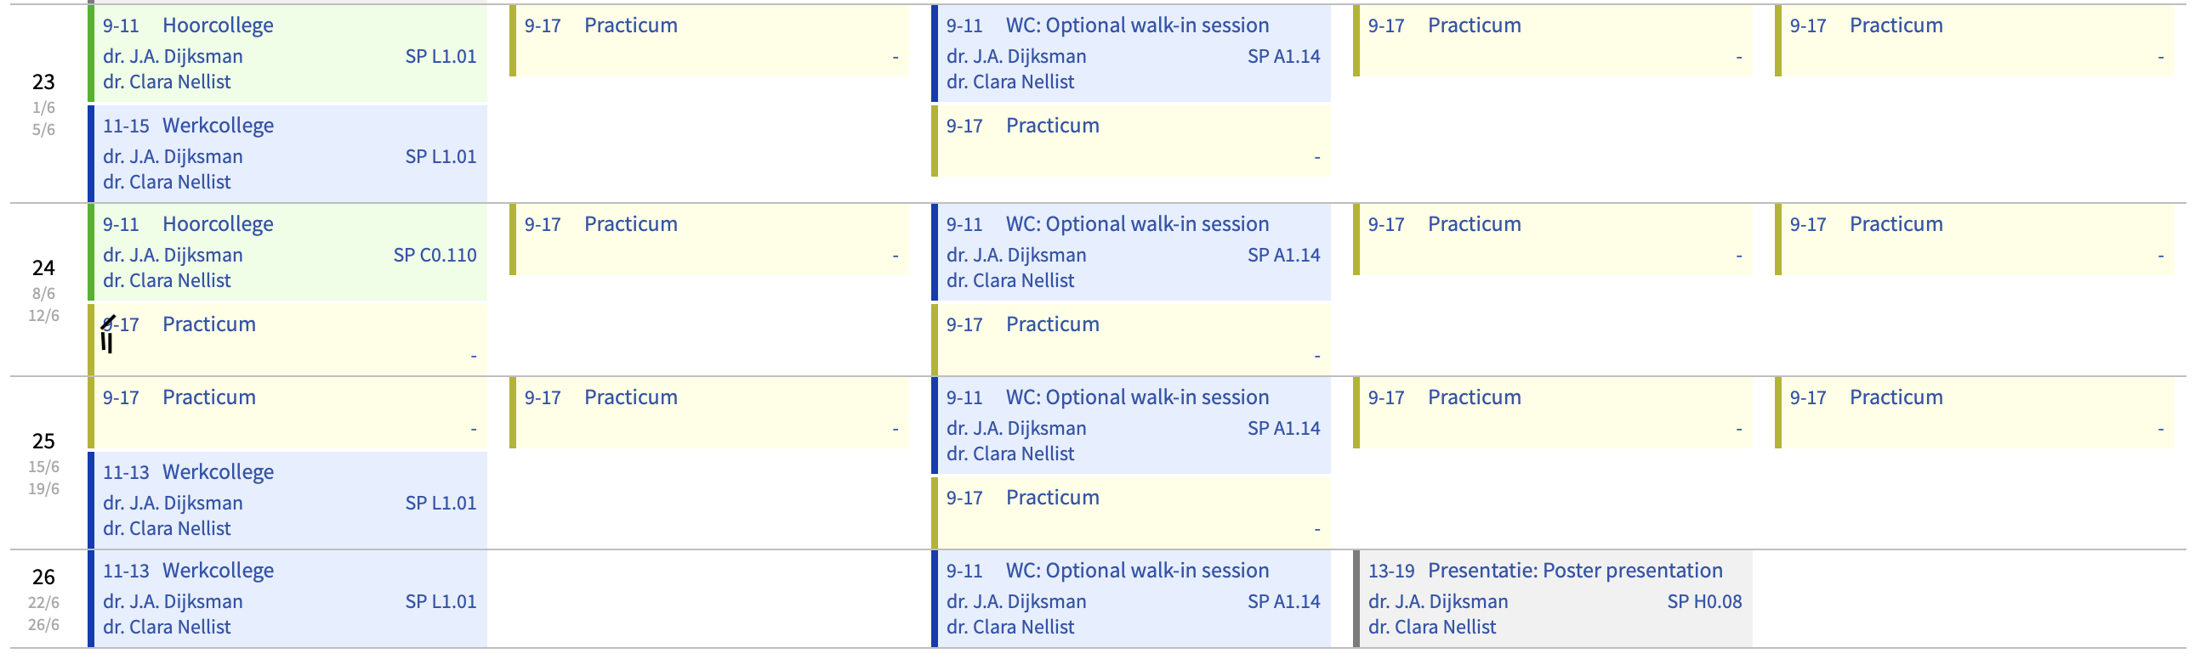
Project Timeline in June
Monday
Tuesday
Wednesday
Thursday
Friday
Week

Slide 9
Project Timeline in June
Monday
Tuesday
Wednesday
Thursday
Friday
Week
Yellow space is all available for you

Slide 10
Project Timeline in June
Monday
Tuesday
Wednesday
Thursday
Friday
Week
Walk-in support session
UvA/VU locations
Help with teamwork issues, animations, etc

Slide 11
Project Timeline in June
Monday
Tuesday
Wednesday
Thursday
Friday
Peer feedback on poster/animation will take place in the morning here.
Online or UvA/VU locations
Not enforced, but we want them to complete it.
Week

Slide 12
Please note: a few students may have resits
We hope it shouldn't disrupt scheduling during working hours. But please be mindful that some students will be juggling this extra workload.
Ask them to inform you and their teammates if this is the case.
They should ensure to still contribute fully to their team.
Include their efforts to minimise disruption as positive teamwork.

Slide 13
What students should learn: Assessment
Ownership (30%)
An essential (scientific/professional) skill
Team Work (20%)
Common lab journal, use of Github, structured meetings
Attitude (10%)
Displays interest and engages socially in research group
Poster (30%)
Layout is effective, concise, convincing. Discussion is adding value.
Short animation (10%)
Concise & clear message that adds value, use of Manim
Scientific skills
Presentation

Slide 14
What students should learn: Assessment
Graded by the Supervisor
Ownership (30%)
An essential (scientific/professional) skill
Team Work (20%)
Common lab journal, use of Github, structured meetings
Attitude (10%)
Displays interest and engages socially in research group
Poster (30%)
Layout is effective, concise, convincing. Discussion is adding value.
Short animation (10%)
Concise & clear message that adds value, use of Manim
Scientific skills
Presentation

Slide 15
What students should learn: Assessment
Graded by Clara/Joshua
Ownership (30%)
An essential (scientific/professional) skill
Team Work (20%)
Common lab journal, use of Github, structured meetings
Attitude (10%)
Displays interest and engages socially in research group
Poster (30%)
Layout is effective, concise, convincing. Discussion is adding value.
Short animation (10%)
Concise & clear message that adds value, use of Manim
Scientific skills
Presentation

Slide 16
What students should learn: Assessment
Graded by Jury
Ownership (30%)
An essential (scientific/professional) skill
Team Work (20%)
Common lab journal, use of Github, structured meetings
Attitude (10%)
Displays interest and engages socially in research group
Poster (30%)
Layout is effective, concise, convincing. Discussion is adding value.
Short animation (10%)
Concise & clear message that adds value, use of Manim
Scientific skills
Presentation

Slide 17
What students should learn: Assessment
Personal Grade
Ownership (30%)
An essential (scientific/professional) skill
Team Work (20%)
Common lab journal, use of Github, structured meetings
Attitude (10%)
Displays interest and engages socially in research group
Poster (30%)
Layout is effective, concise, convincing. Discussion is adding value.
Short animation (10%)
Concise & clear message that adds value, use of Manim
Scientific skills
Presentation

Slide 18
What students should learn: Assessment
Team Grade
Ownership (30%)
An essential (scientific/professional) skill
Team Work (20%)
Common lab journal, use of Github, structured meetings
Attitude (10%)
Displays interest and engages socially in research group
Poster (30%)
Layout is effective, concise, convincing. Discussion is adding value.
Short animation (10%)
Concise & clear message that adds value, use of Manim
Scientific skills
Presentation

Slide 19
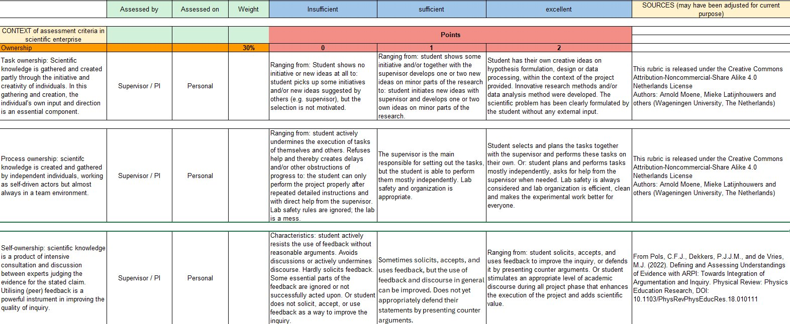
Clear rubric for assessment: Ownership

Slide 20


Training on Teamwork
Part of lecture/exercises on June 1
How to run meetings
How to collaborate digitally
Platforms to make teamwork concrete and visible
Github (supported by Clara/Joshua)
… as you prefer (supported by you)
We provide templates

Slide 21
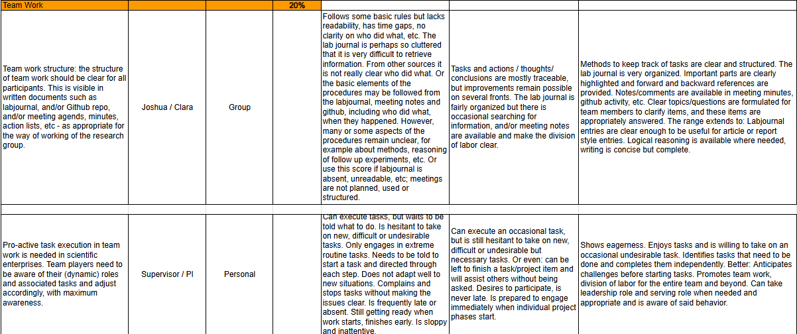
Clear rubric for assessment: Teamwork

Slide 22

Training on Poster Making & Animations
Poster training
Already received training in AVT
Please feel free to share good examples with your group
Animation training
Provided by us in week 24
(Monday June 8, 9-11)
Animations will be added to the poster via QR code

Slide 23

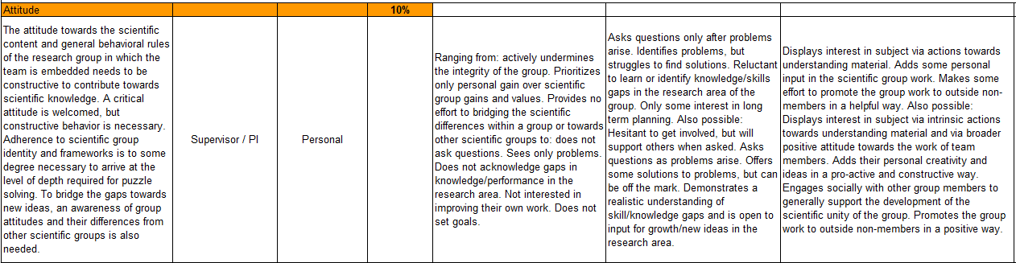
Clear rubric for assessment
Attitude

Slide 24


Intermediate feedback is key!
Mid-June
Provide “tops” & “tips” based on rubrics
Optional: provide comments via form
Encourage students to read rubrics!

Slide 25
Lab access WZI / VU
Via secretariats VU/UvA
VU secretariat knows the names, but not room numbers
UvA secretariat: we can send them a list if needed (but don't know room#)
AMOLF/ARCNL/NIKHEF/AMCA: please arrange yourself :)

Slide 26

Assessment Support Meetings
Optional online support meeting, Zoom
Held 23rd/24th June (times to be confirmed)
Final assessments due June 26th midnight
Easy survey offered to make grading simple!

Slide 27

How to get in touch with us if you have any Qs
Joshua: j.a.dijksman@uva.nl
Clara: clara.nellist@cern.ch

Slide 28

The end

Slide 29

Backup

Slide 30
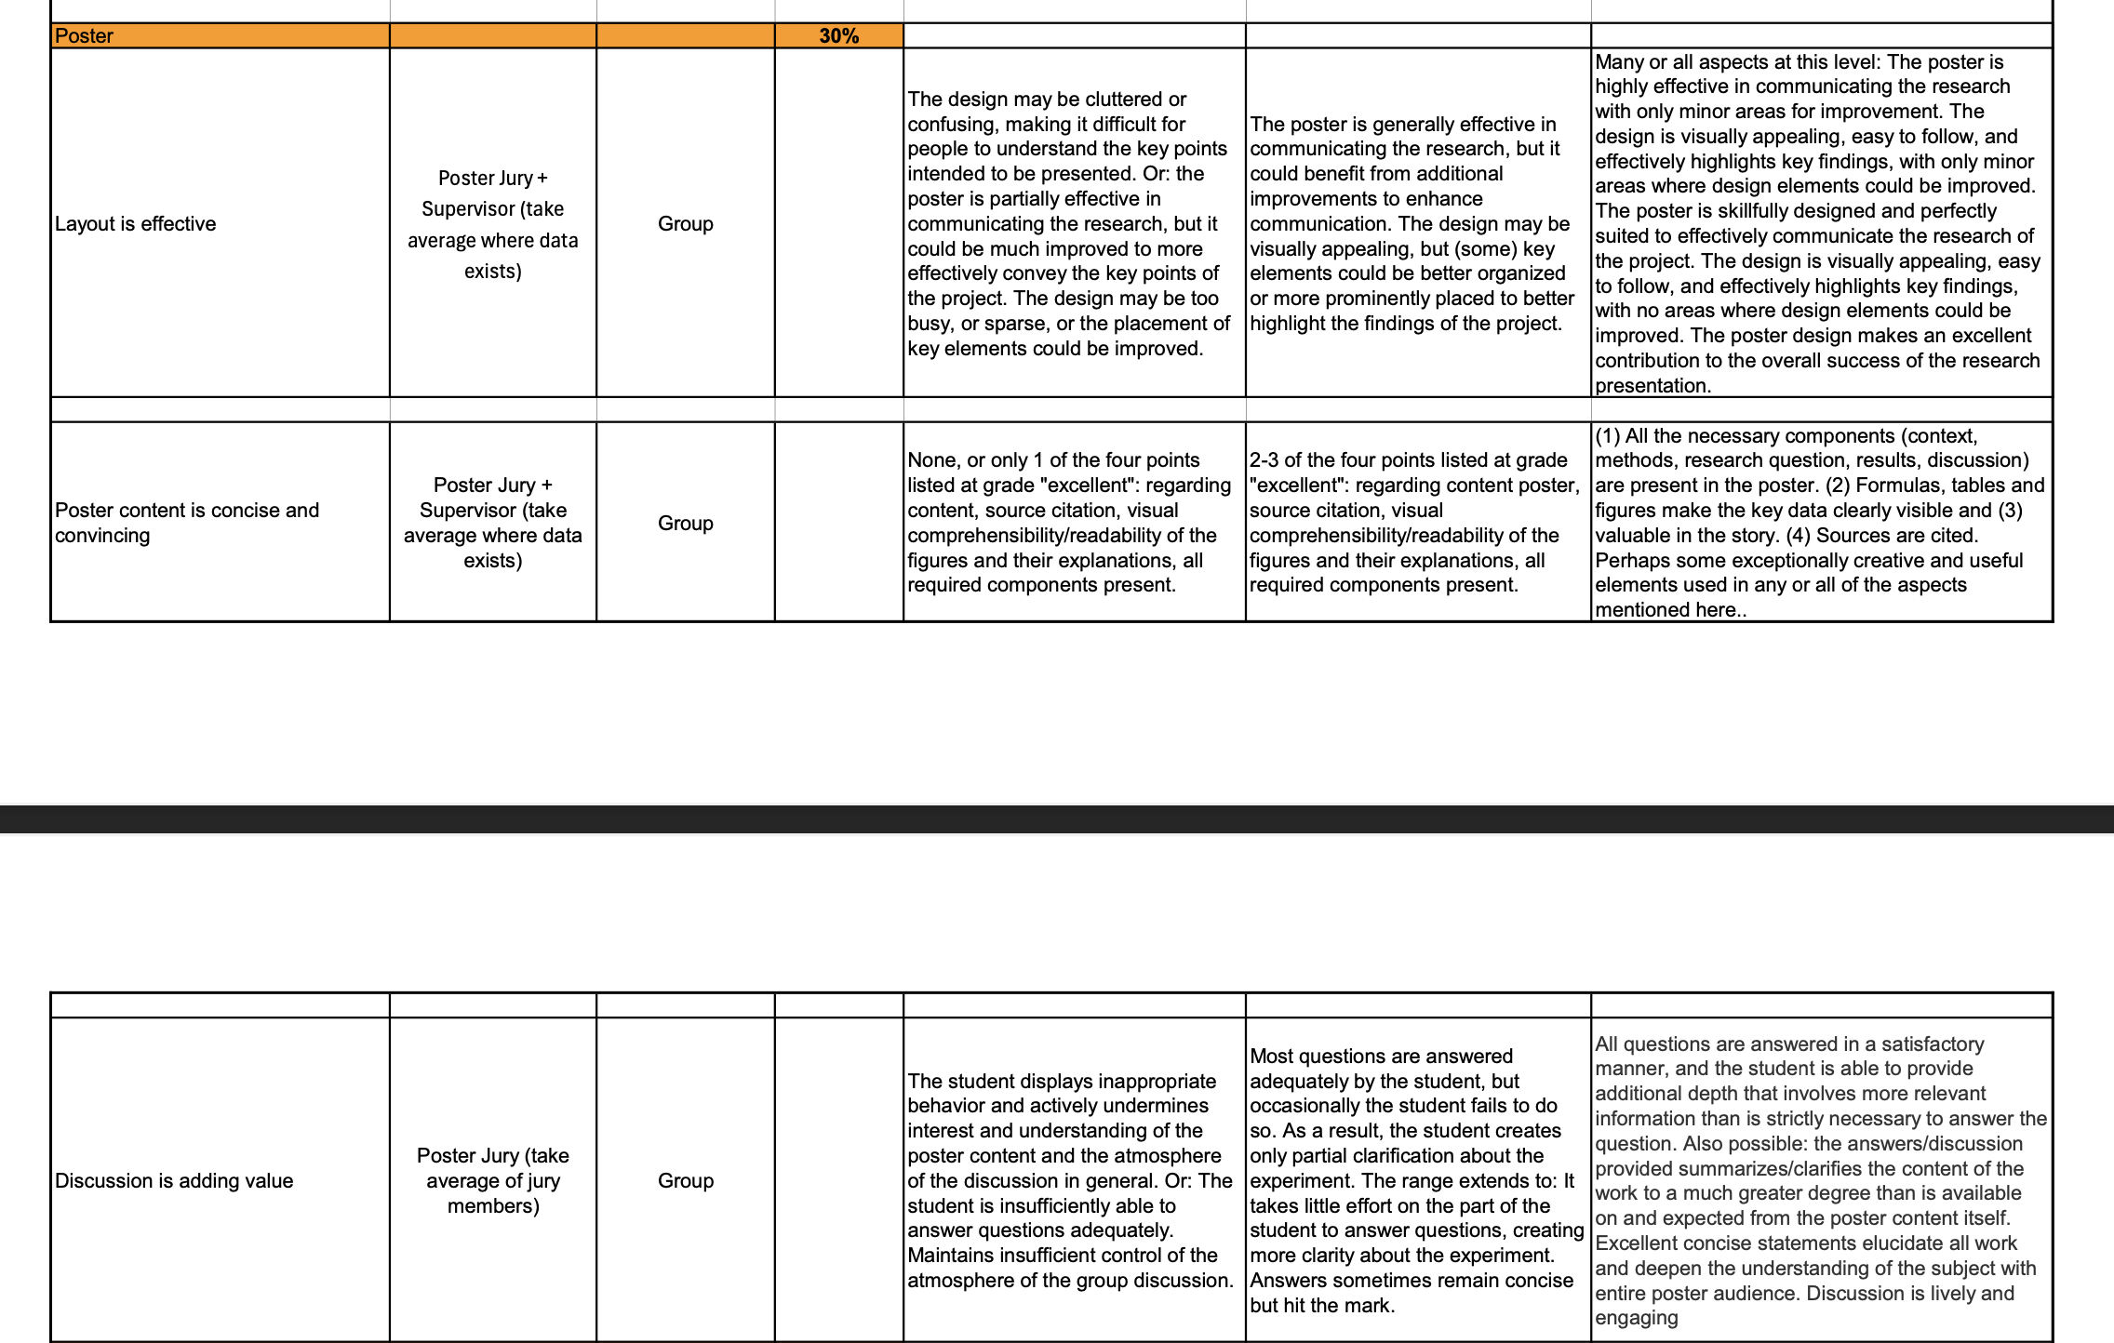
Clear rubric for assessment: Poster

Slide 31
Clear rubric for assessment: Animation

