Slide 1
UVM Testbench Architecture
- Neeraj Pandey

Slide 2
Agenda
Why UVM?
Introduction of UVM
UVM Base Classes
UVM TB Architecture
Sequence_item, Sequence
Sequencer, Driver, Monitor
Agent
Scoreboard
Environment
Test
Interface and DUT
Top
Demonstration of debug using wave and tracker files

Slide 3
Why UVM??
System Verilog is a Design and Verification language, whereas UVM is a verification methodology built using System Verilog.
Before UVM: Before UVM, engineers used System Verilog to write testbenches.
System Verilog provides features such as:
          Classes and objects
          Inheritance and polymorphism
          Randomization and constraints
          Interfaces and modports
          Mailboxes and semaphores
          Assertions and functional coverage
SV Testbench Link: https://www.youtube.com/watch?v=9ygbJ_rjZHU&t=357s

Slide 4
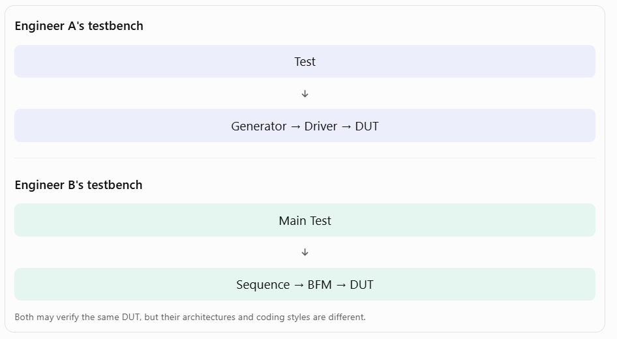
Why UVM??
Problems:
      No standard architecture
      Code reusability:.
      Maintenance:
      Scalability:
      Team collaboration:
SV Testbench Link: https://www.youtube.com/watch?v=9ygbJ_rjZHU&t=357s

Slide 5
What is UVM??
UVM stands for Universal Verification Methodology.
The Universal Verification Methodology (UVM) consists of class libraries needed for the development of well constructed, reusable System Verilog based Verification environment.
The UVM standard, reference implementation, and user guides can be accessed through the official Accellera website. : https://www.accellera.org/downloads/standards/uvm
Key Characteristics:
  Modular: Pre-built base classes (drivers, monitors, scoreboards) accelerate development.
  Reusable: Verification IP (VIP) can be shared across projects and organizations.
  Configurable: Factory patterns and config_db enable flexible testbench adaptation.
  Industry-Adopted: Supported by all major EDA vendors (Siemens EDA, Synopsys, Cadence, Aldec)

Slide 6
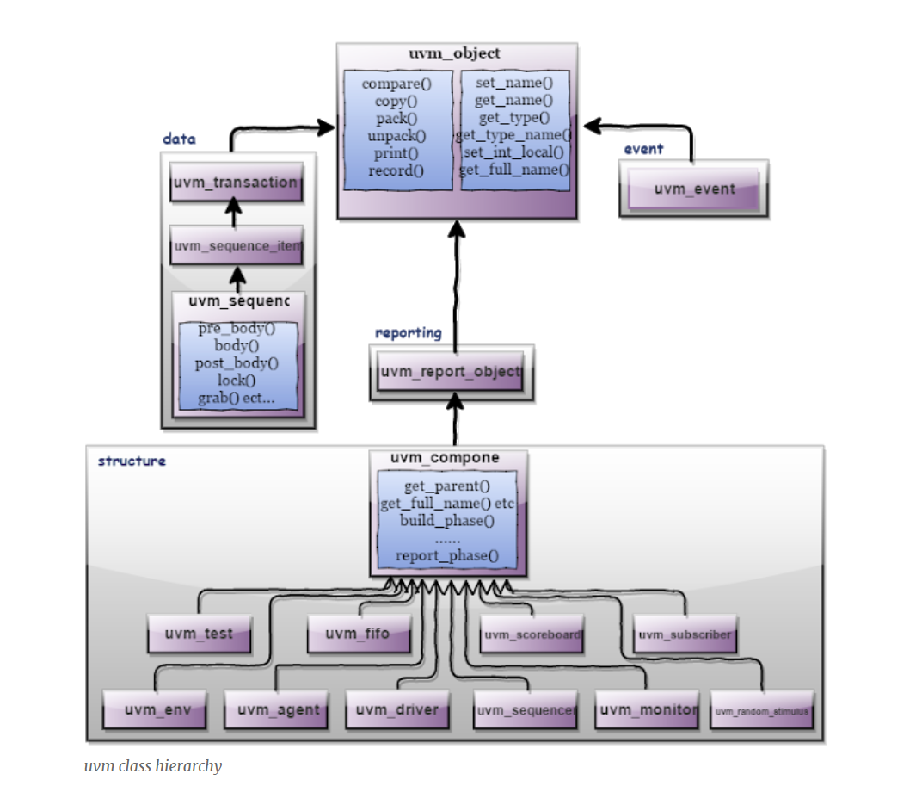
UVM Base classes
uvm_void : src/base/uvm_misc.svh
uvm_object: src/base/uvm_object.svh Core class based operational methods (create, copy, clone, compare, print, record, etc..), instance identification fields (name, type name, unique id, etc.) and random seeding were defined in it.
uvm_transaction: src/base/uvm_transaction.svh Used in stimulus generation and analysis.
uvm_component: src/base/uvm_component.svh Uvm_objects are transient and uvm_component is quasi-static.

Slide 7
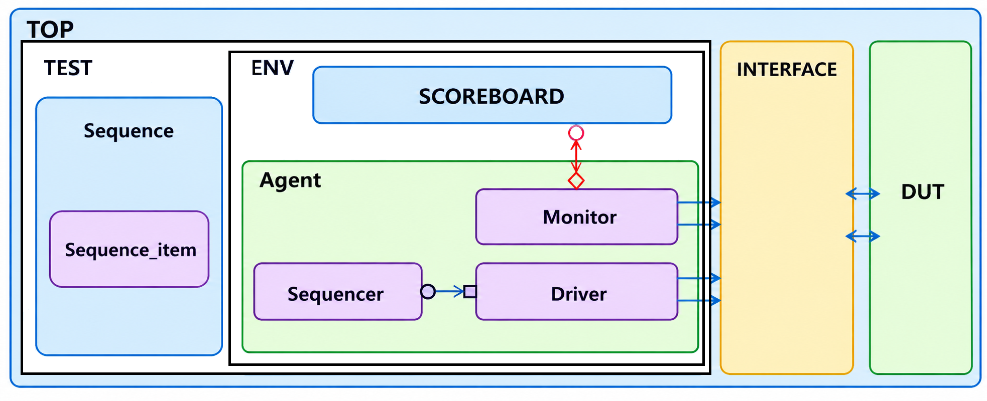
UVM TB

Slide 8
Phases
build : Used to construct the testbench components
Connect: Used to connect TLM ports of components
end of elaboration: Used to make any final adjustments to the structure,
start of simulation: Used for printing testbench topology or configuration information
run (reset, configure, main. shutdown): Used for stimulus generation, driving, monitoring, and checking
Extract: Used to retrieve and process information from scoreboards and functional coverage monitors
Check: Used to check that the DUT behaved correctly and to identify any errors that may have occurred during the execution of the test bench
Report: Used to display the results of the simulation
Final: Used to complete any other outstanding actions that the test bench has not already completed

Slide 9
Sequence_item
The sequence-item is written by extending the uvm_sequence_item, uvm_sequence_item inherits from the uvm_object via the uvm_transaction class. therefore uvm_sequence_item is of an object type.
The sequence-item consist of data fields required for generating the stimulus.
In order to generate the stimulus, the sequence items are randomized in sequences.
Therefore data properties in sequence items should generally be declared as rand and can have constraints defined.

Slide 10
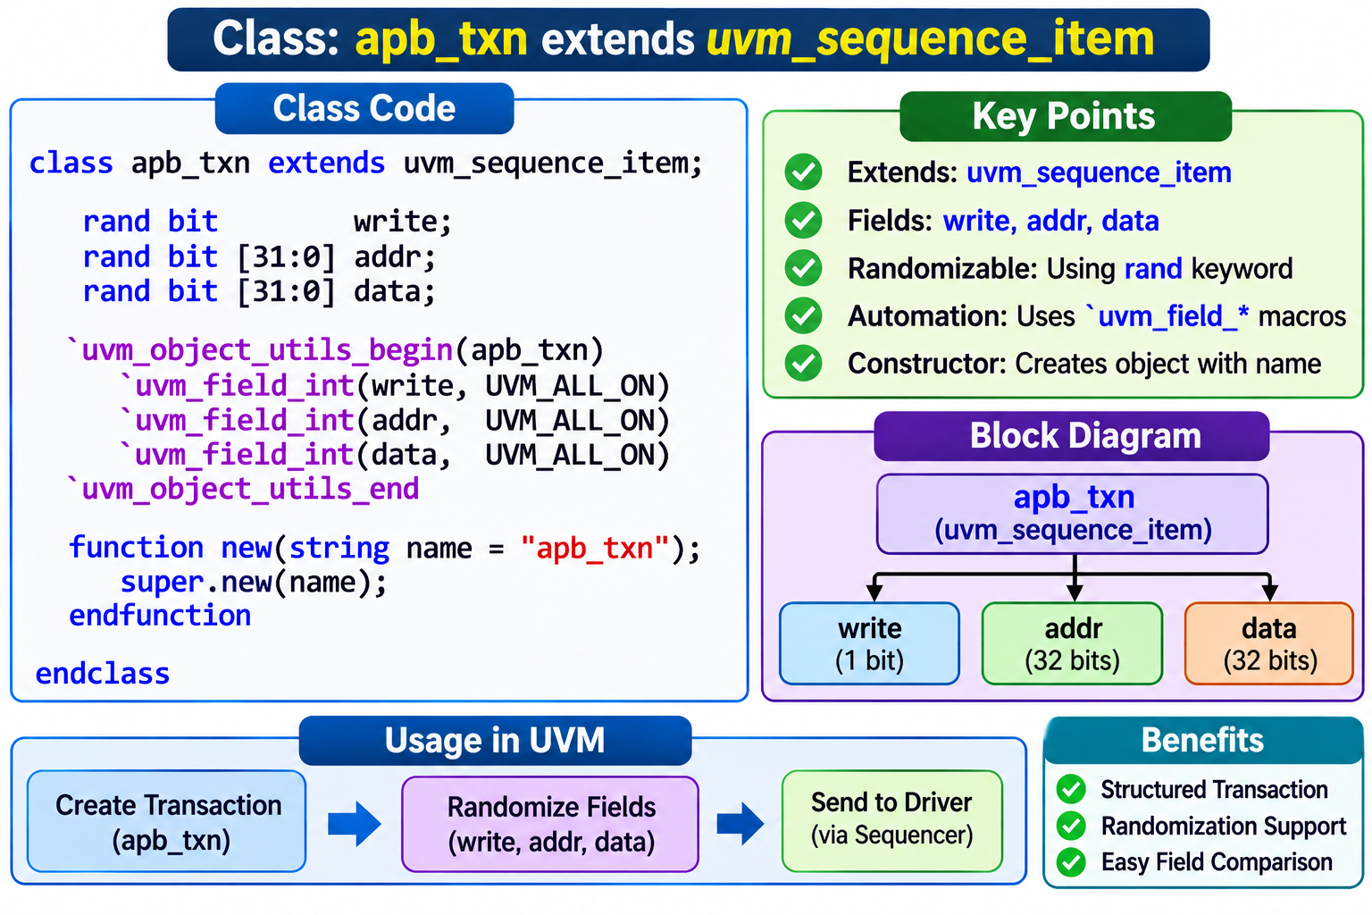
Sequence_item

Slide 11
Sequence
A sequence generates a series of sequence_item’s.
Sends it to the driver via sequencer.
Sequence is written by extending the uvm_sequence.
the sequence has handle req and rsp of sequence_item class.
Body Method.

Slide 12
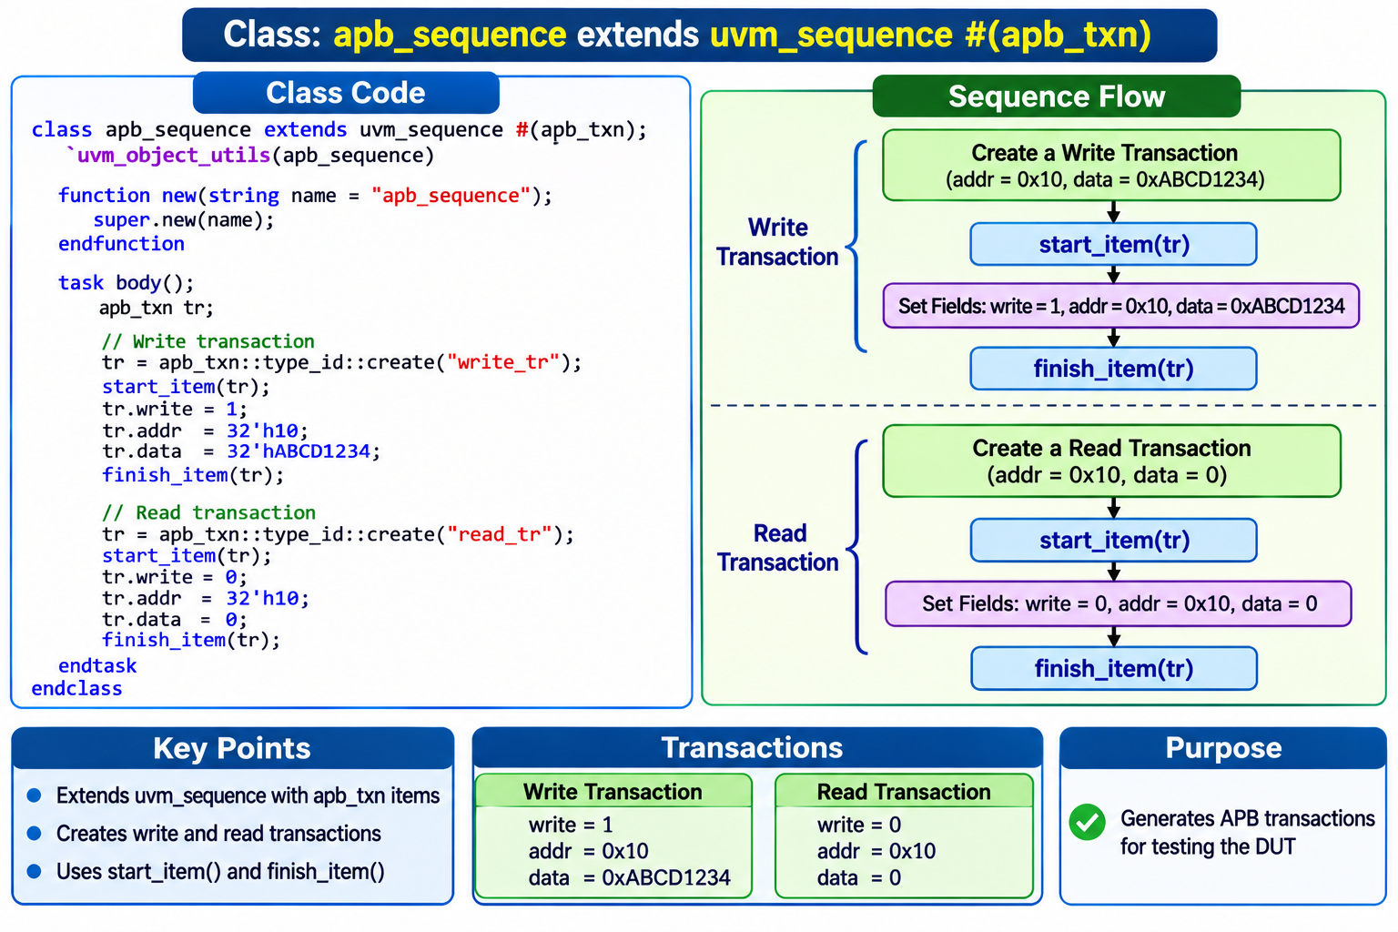
Sequence

Slide 13
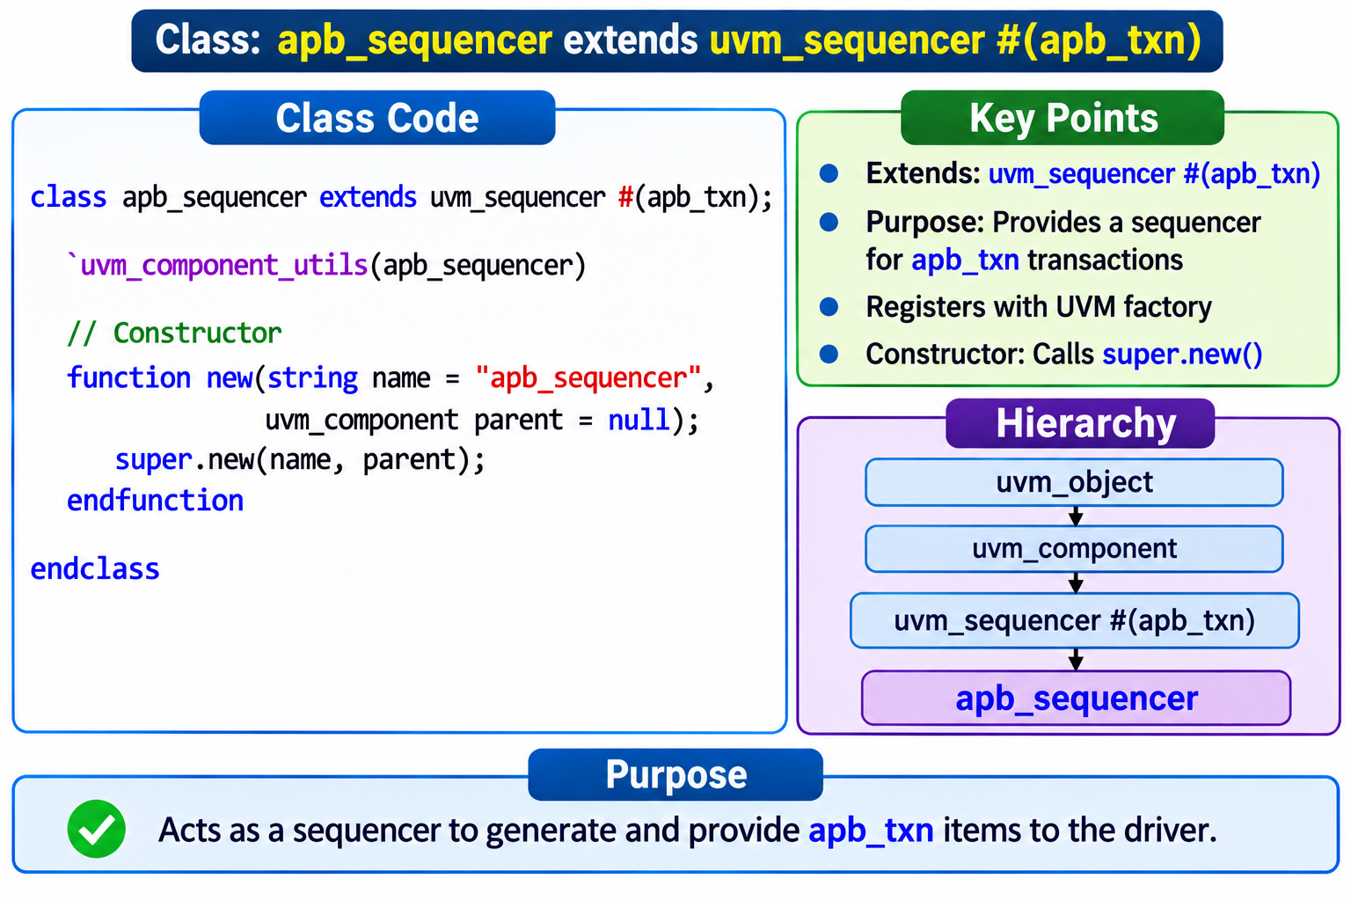
Sequencer
Sequencer is written by extending the uvm_sequencer.
The sequencer controls the flow of request and response sequence items between sequences and the driver.
Sequencer and driver uses TLM Interface to communicate transactions.

Slide 14
Driver
A driver is written by extending the uvm_driver.
uvm_driver is inherited from uvm_component.
TLM port (seq_item_port) are defined for communication between sequencer and driver.
The uvm_driver is a parameterized class and it is parameterized with the type of the request sequence_item and the type of the response sequence_item.

Slide 15
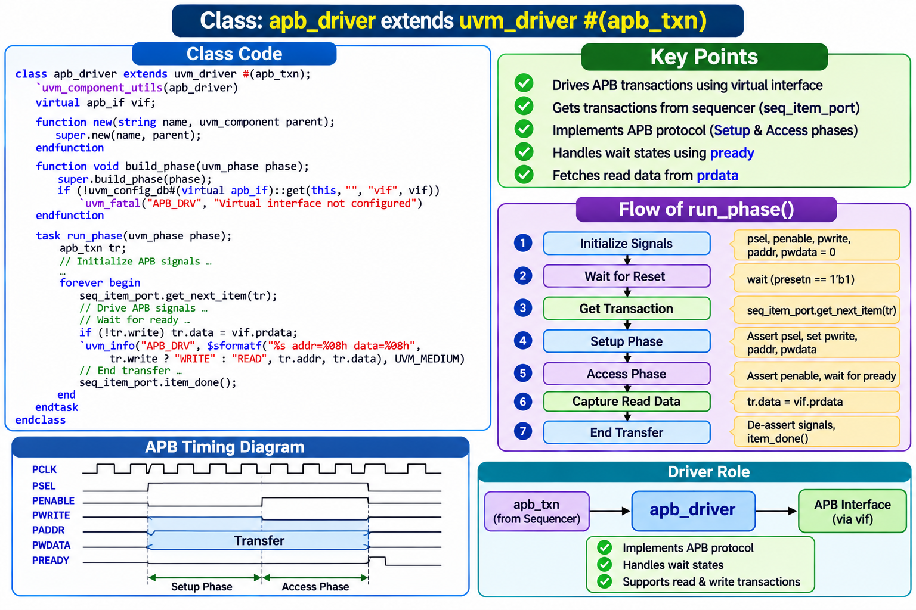
Driver

Slide 16
Agent
a user-defined agent is extended from uvm_agent, uvm_agent is inherited by uvm_component.
  An agent typically contains a driver, a sequencer, and a monitor.
  Agents can be configured either active or passive.
  Active agent: Active agents generate stimulus and drive to DUT.
  Passive agents sample DUT signals but do not drive them.
  An agent can be configured as ACTIVE/PASSIVE by using a set config method, the default agent will be ACTIVE. the set config can be done in the env or test.
set_config_int("path_to_agent", "is_active", UVM_ACTIVE);
set_config_int("path_to_agent", "is_active", UVM_PASSIVE);
Notes:
An active agent shall consists of all the three components driver, sequencer, and monitor.
A passive agent consists of only the monitor.

Slide 17
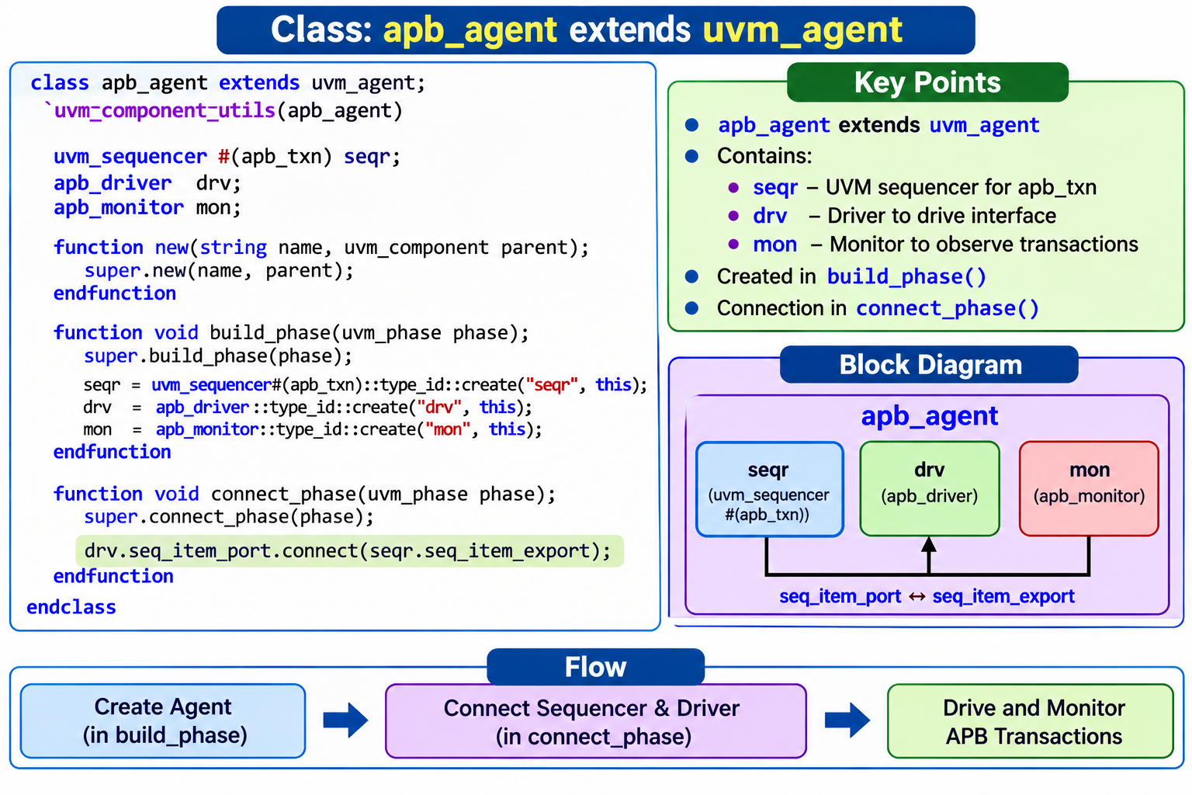
Agent

Slide 18
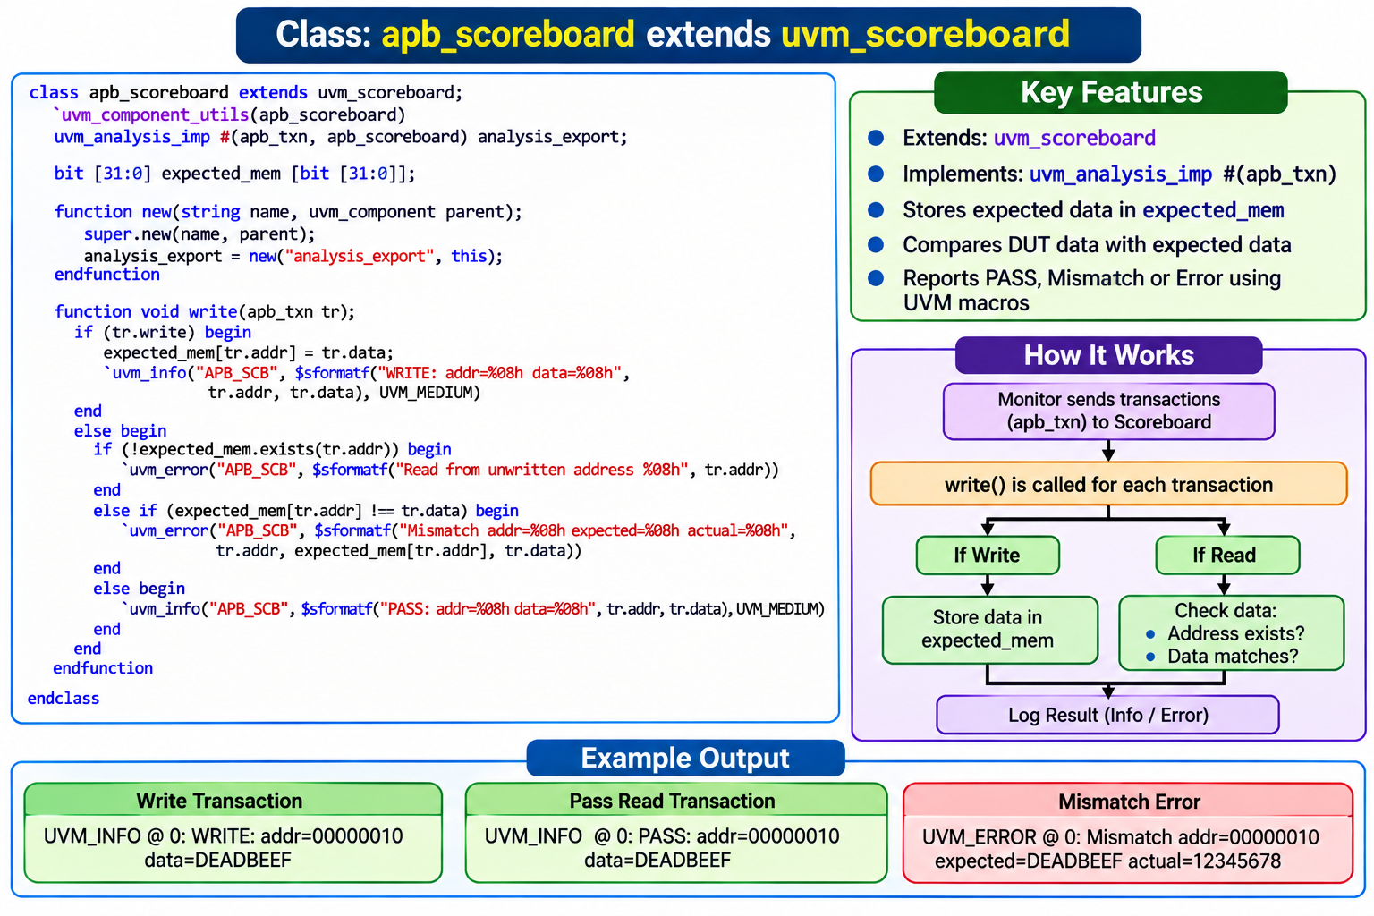
Scoreboard
The user-defined scoreboard is extended from uvm_scoreboard, uvm_scoreboard is inherited by uvm_component.
The scoreboard will check the correctness of the DUT by comparing the DUT output with the expected values

Slide 19
ENV
The user-defined environment is derived from uvm_env, uvm_env is inherited from uvm_component. The environment is the container class:
  It contains one or more agents.
  Components such as the scoreboard,
  top-level monitor
  Checker.

Slide 20
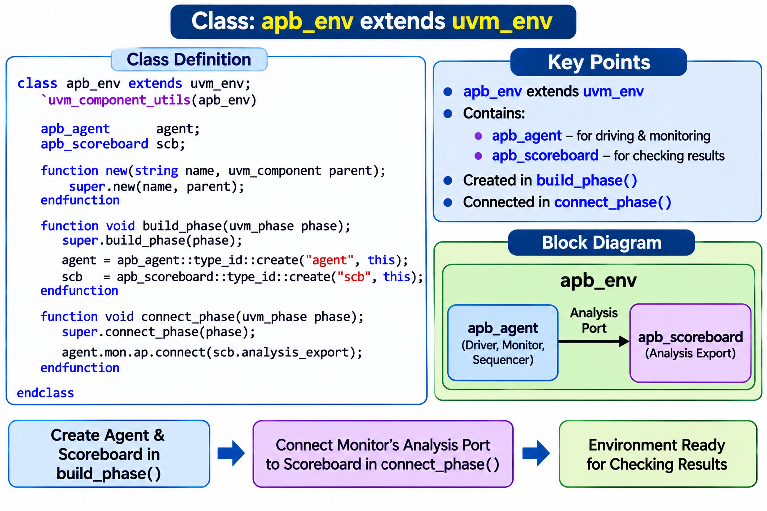
ENV

Slide 21
TEST
The user-defined test is derived from uvm_test, uvm_test is inherited from uvm_component.
  The test defines the test scenario for the testbench
  test class contains the environment, configuration properties, class overrides etc
  A sequence/sequences are created and started in the test
  The UVM testbench is activated when the run_test() method is called, the global run_test() task should be specified inside an initial block.
  There can be many user-defined test cases. Among multiple test cases, a particular test case can be selected and execute on two methods,
  1. by specifying the test name as an argument to run_test();
  example: run_test(“apb_test");
  2. by providing the UVM_TESTNAME command line argument
  example: <SIMULATION_COMMANDS> +UVM_TESTNAME=apb_test

Slide 22
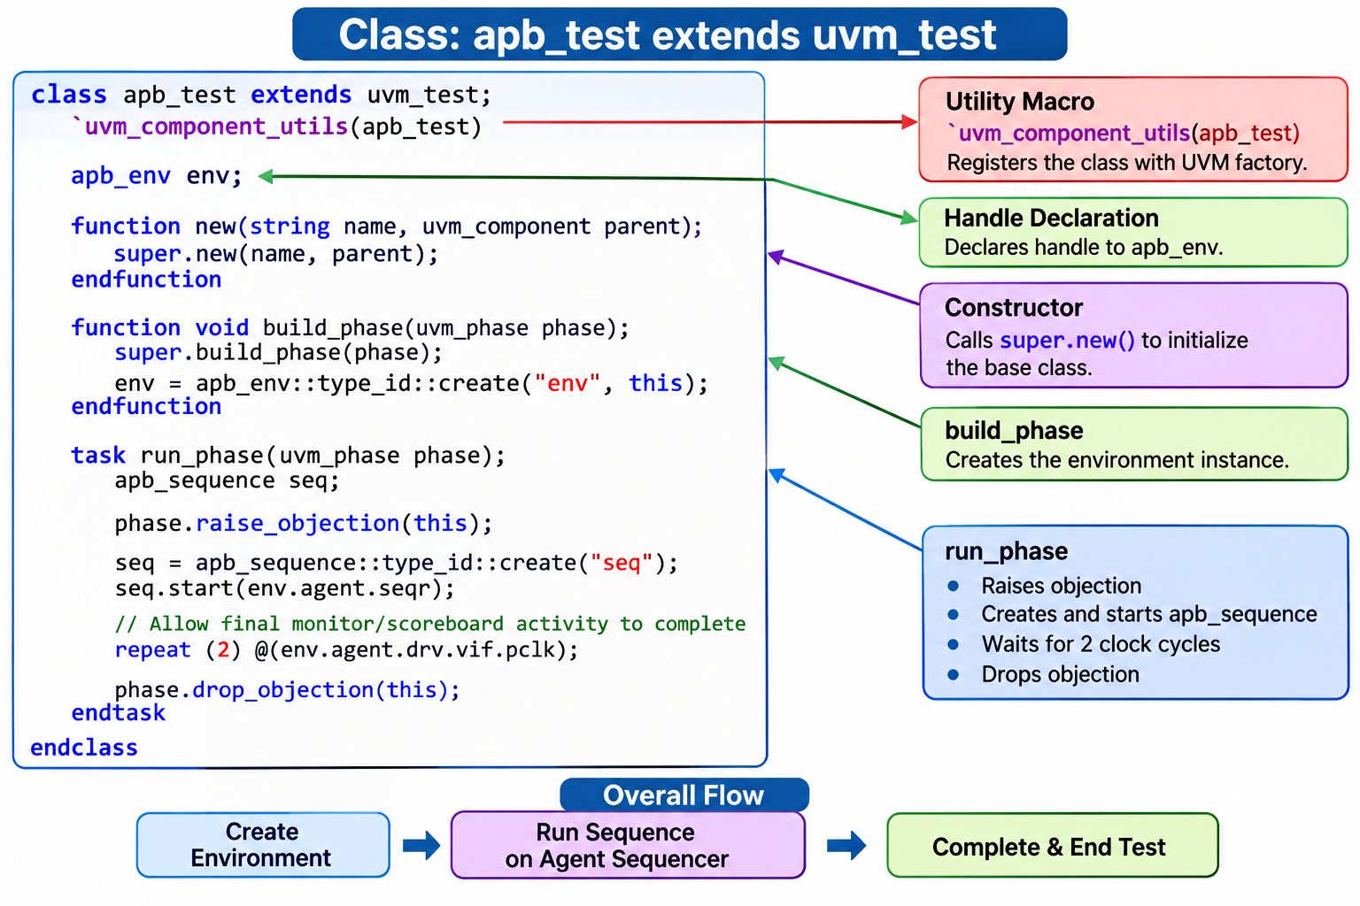
TEST

Slide 23
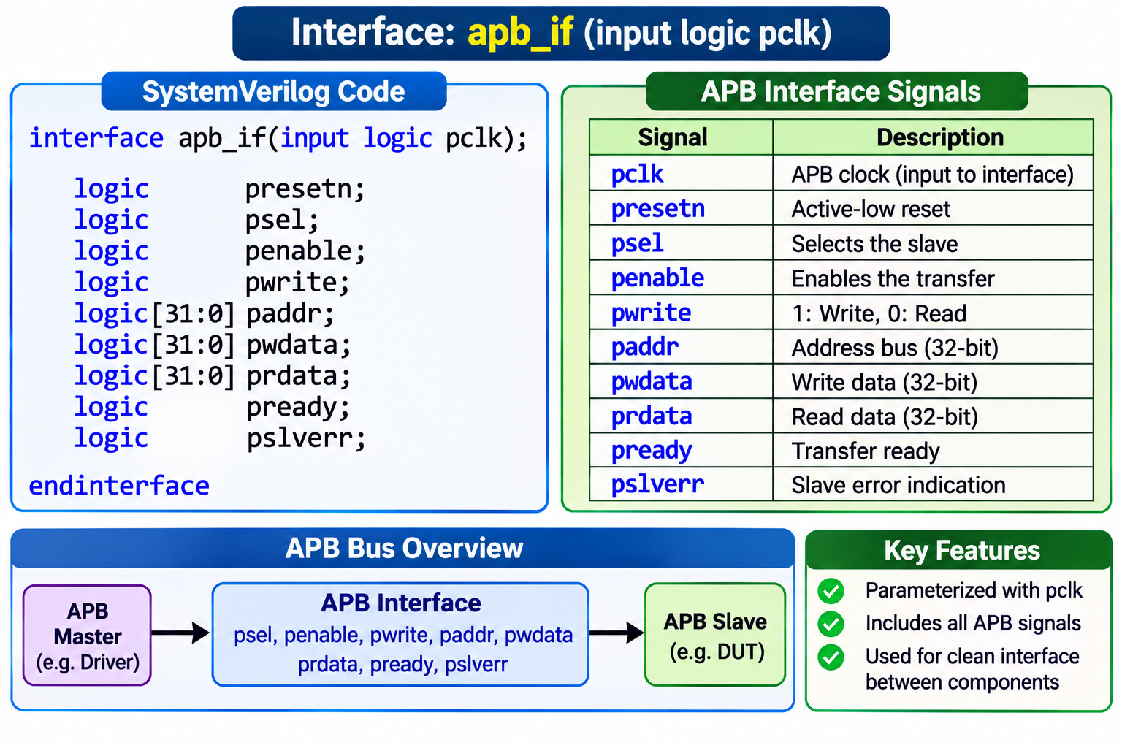
Interface

Slide 24
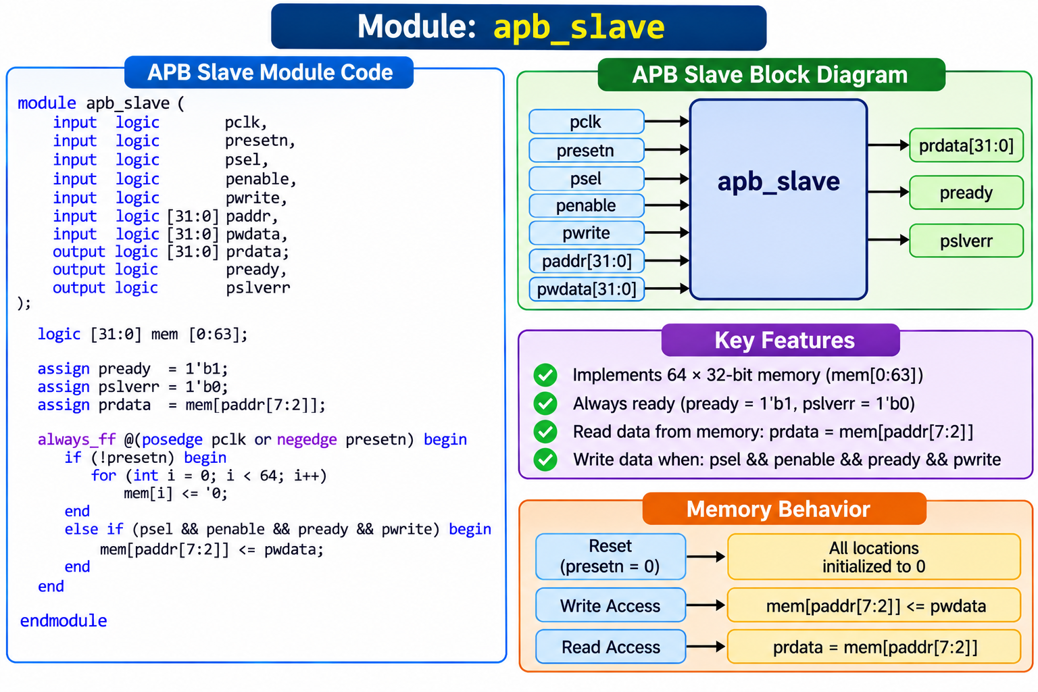
DUT

Slide 25
TOP
Testbench top is the module, it connects the DUT and Verification environment components.
TOP
TEST
INTERFACE
DUT

Slide 26
TOP
Typical Testbench_top contains,
  DUT instance
  interface instance
  run_test() method
  virtual interface set config_db
  clock and reset generation logic
  wave dump logic

Slide 27
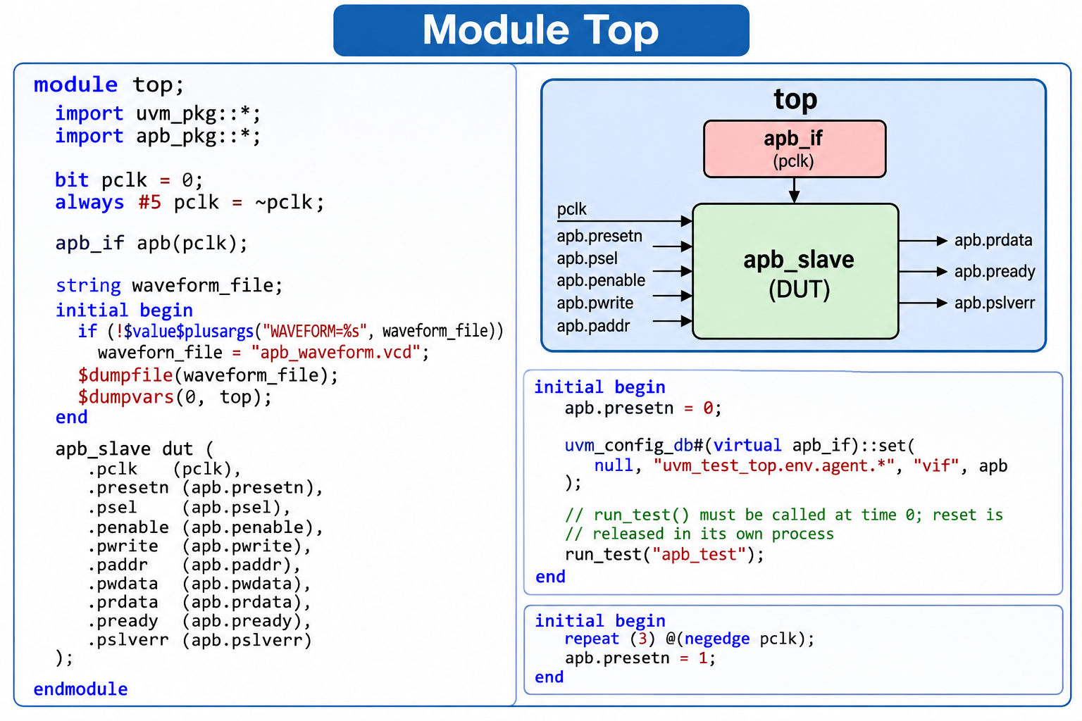
TOP

Slide 28
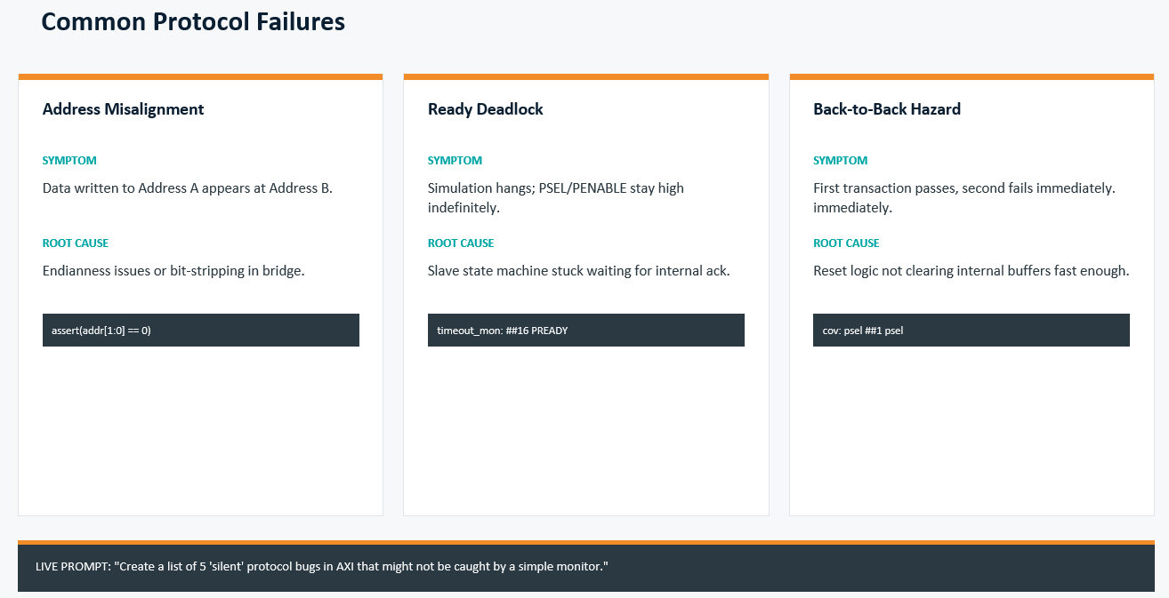
Common Protocol Failure

Slide 29
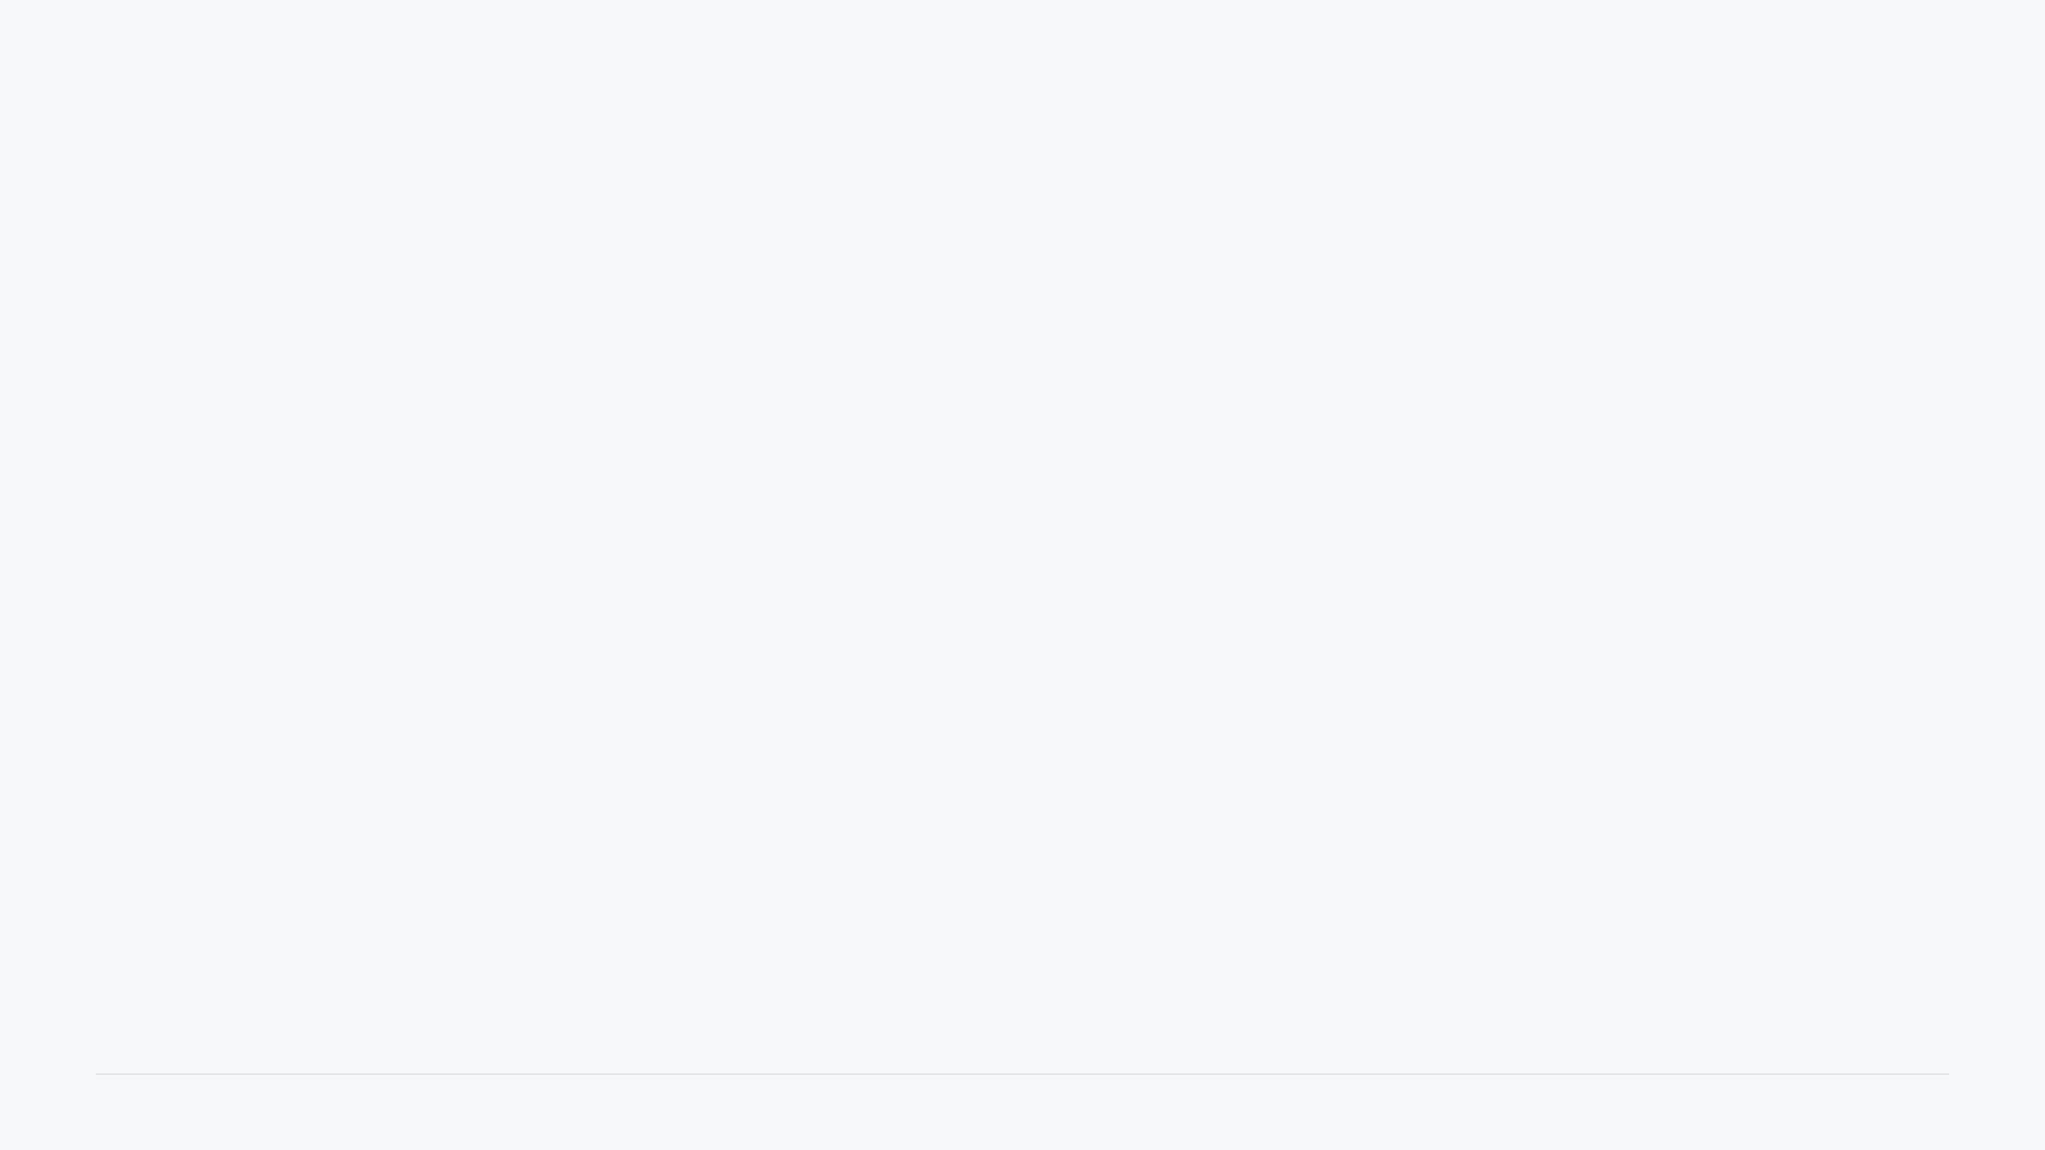
Student AI Challenge: Try it Yourself
1. Randomized Traffic
2. Coverage Planning
"Write a UVM sequence that generates 10 APB transactions with randomized addresses, but ensures all addresses are 4-byte aligned."
"Create a covergroup for an APB interface that monitors all possible combinations of PADDR[31:28] and PWRITE."
STUDENT HINT
STUDENT HINT
Look for `bins` and `cross` keywords. Expect a matrix-style coverage summary.
Check if the AI uses `constraint` or a `for` loop. Alignment is usually `addr[1:0] == 0`.
3. Protocol Converter
4. Debugging Assistant
"Explain how to convert a 'Valid-Ready' handshake into an APB transfer. What signals map to what?"
"I see a 'UVM_ERROR: Mismatch' in my scoreboard. The expected data is 0x0 but I got 0xXZ. What are the most likely causes?"
STUDENT HINT
The AI should discuss buffering and stall cycles. Valid+Ready maps roughly to PSEL+PREADY.
STUDENT HINT
Expect mention of uninitialized memory, reset issues, or sampling clock edges.

Slide 30
Paper Tutorial: Lab Exercises
Questions 1 to 3: Architecture & Protocol
1
A UVM Testbench needs to verify a Dual-Port RAM. One port is for Write-only (Master A) and one is for Read-only (Master B).
Draw the UVM Block Diagram showing Agents, Scoreboard, and the DUT.
2
In an APB transfer, the Slave misses a PREADY cycle, causing PREADY to be 'X' during PENABLE.
Sketch the Waveform for this failing scenario and mark the exact cycle where the error occurs.
3
You are writing a Monitor for a protocol that has a 4-cycle latency between 'Request' and 'Response'.
Write the pseudo-code for the `run_phase` loop that would capture these as a single transaction object.

Slide 31
Paper Tutorial: Lab Exercises
Questions 4 to 5: Debug & Methodology
4
A Scoreboard mismatch occurs ONLY when the APB Slave is accessed at the maximum frequency. In the waveform, you see data changing exactly on the sampling edge of PCLK.
✎ Is this a Setup/Hold violation or a TB Sampling issue? Explain your reasoning.
5
You are given a Tracker file that shows "WR 0x1000 0xAAAA" at 100ns followed by "RD 0x1000 0x0000" at 150ns. The expected data was 0xAAAA.
✎ List 3 specific things you would search for in the waveform to debug this.

Slide 32
Questions ?

