Slide 1
Communication Protocols
Amit Tanwar
(Architect)

Slide 2
Agenda
Need for on‑chip communication protocols
Role of buses in SoC architectures
Handshake mechanisms (request–acknowledge, valid–ready)
Overview of AMBA protocols (APB, AHB‑Lite, AXI4‑Lite)
Introduction to serial protocols (SPI, I2C), protocol timing

Slide 3
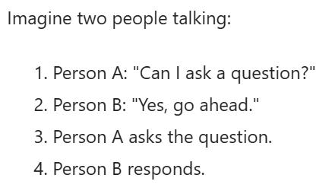
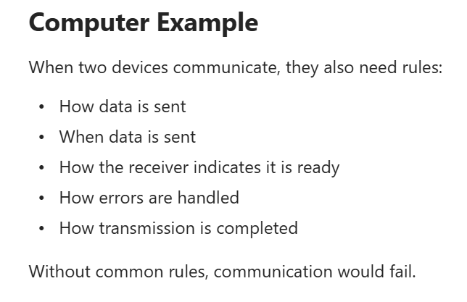
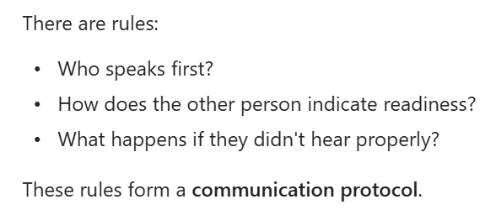
What Is Communication Protocol

Slide 4
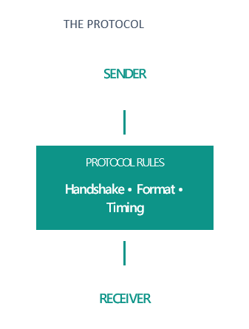
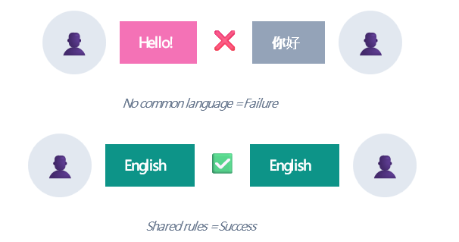
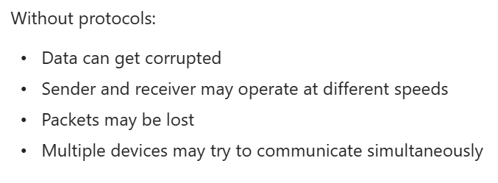
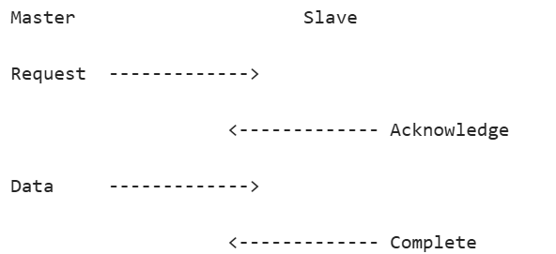
Why Do We Need Protocol

Slide 5
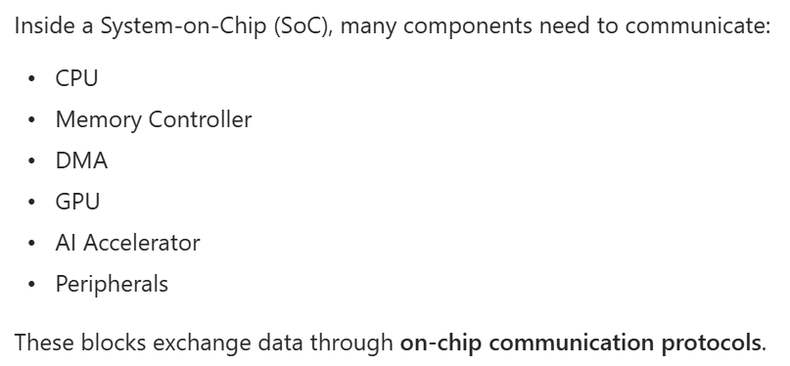
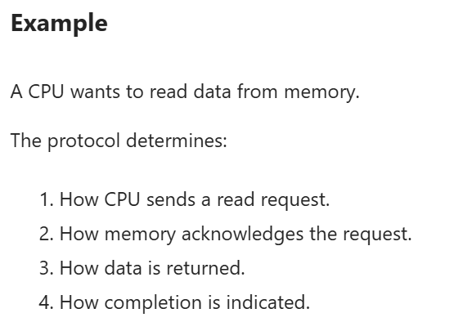
In SoC Context

Slide 6
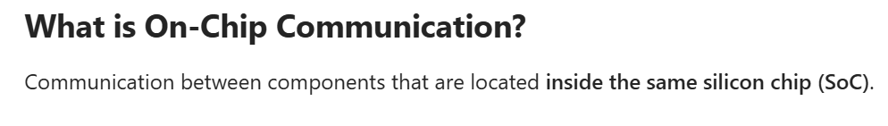
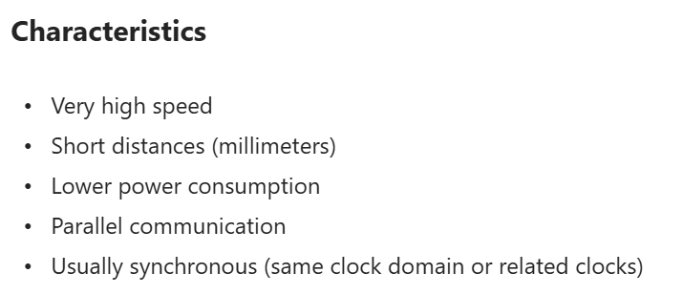
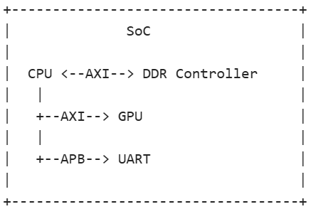
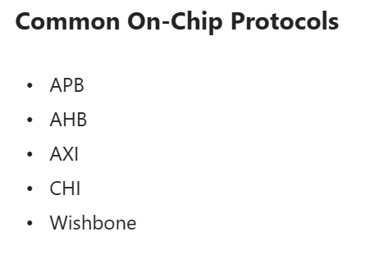
On-Chip vs Off-Chip Communication

Slide 7
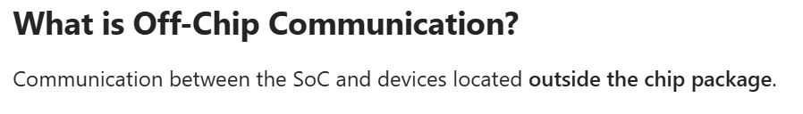
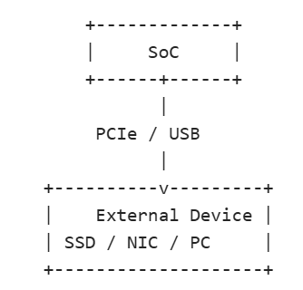
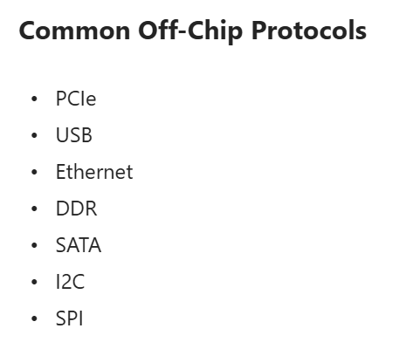
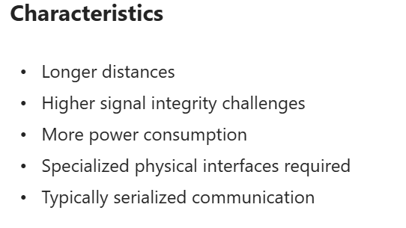
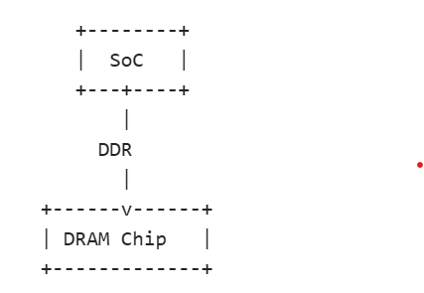
On-Chip vs Off-Chip Communication

Slide 8
Complete Portfolio
networking
Ethernet 800G/1600G, MacSec
Flex-E, BaseT, UEC, UALink1/2, Infiniband
SoC essentials
CHI, ACE5, AXI5, AHB, APB
CXS, TileLink, JTAG, UART
SMBus, SPI/xSPI, I2C/I3C/I2S
AMBA®
Ethernet
Serial
PCIe®
high-perf compute
PCIe5/6/7/Gen8 interconnect
CCIX, CXL 2.0/3.0/3.1/3.2/4.0
USB
UCIe
human interface
USB4, USB3.2, PD, SoundWire
HDMI2.1a, DP2.0, DPI, SFPDP
Protocol Portfolio
3DIC/chiplet
UCIe 1.1/2.0/3.0, C2C, HBM2E/3/4
Custom Solutions & Services
Display
Storage
automotive net
10M-10G T1 Auto Ethernet, TSN/AVB
CAN/LIN, Flexray, MIPI CSI/DSI
Auto
Flash
high-perf storage
CXL2/3/4, NVMe, UAS, SAS, SATA, AHCI,
UFS4, eMMC, SD, ONFI, Flash/SSD stds
MIPI
DDR
mil-aero verticals
PCI, JESD204, SRIO, Mil-Std
SpaceWire, SpaceFibre, 1553b
MilAero
memory models
DDR5, LPDDR5/6, GDDR6/7, DFI
RDIMM5, LRDIMM5, MRDIMM5, HBM4

Slide 9
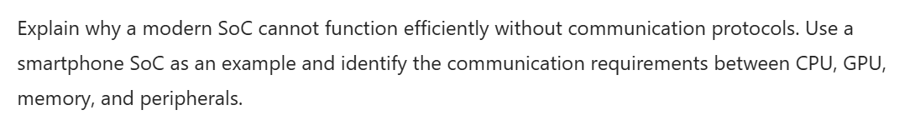
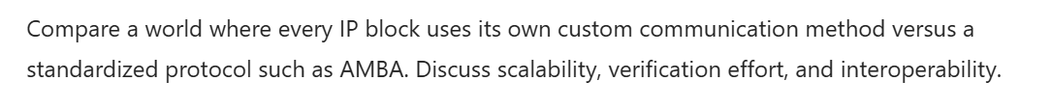
Try AI Prompts

Slide 10
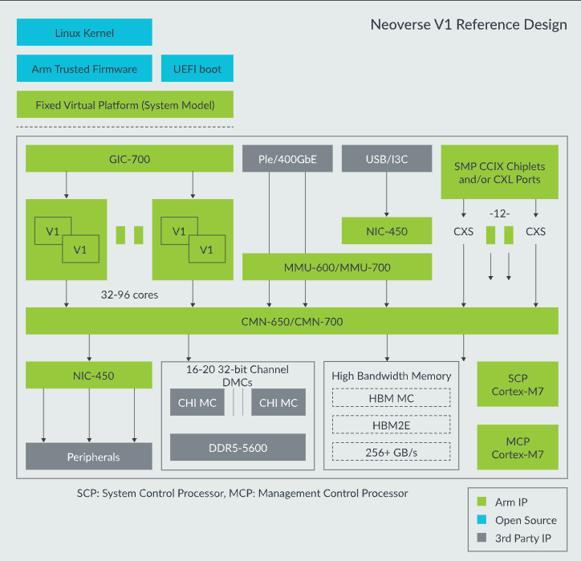
Role Of Buses in SoC Architecture

Slide 11
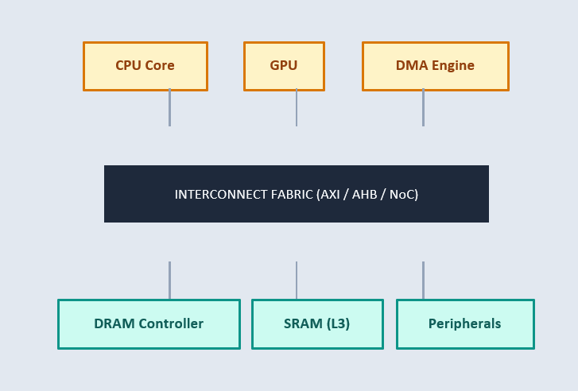
Role Of Buses In SoC Architecture

Slide 12
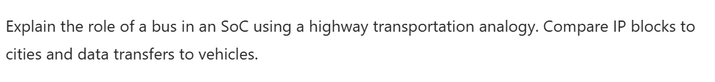
Try AI Prompts

Slide 13
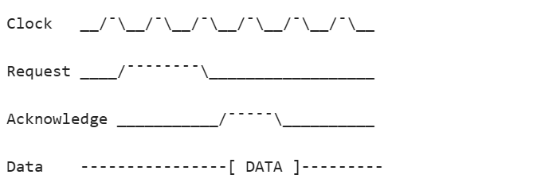
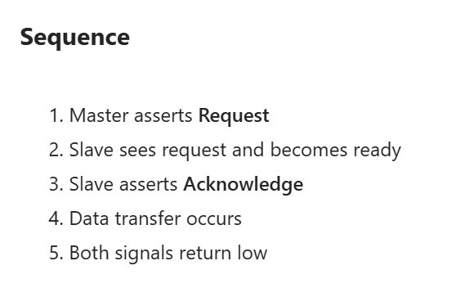
Basic Handshake Mechanism

Slide 14
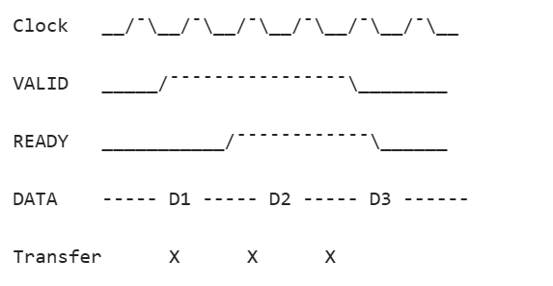
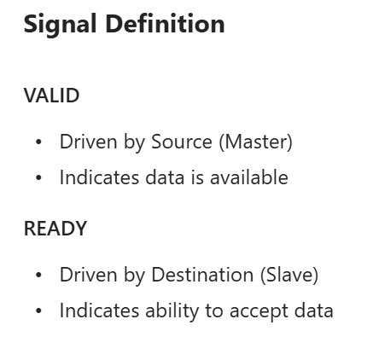
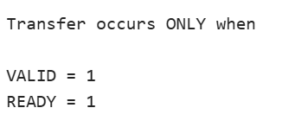
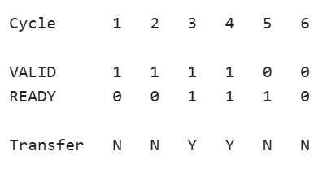

AXI Valid-Ready Handshake

Slide 15
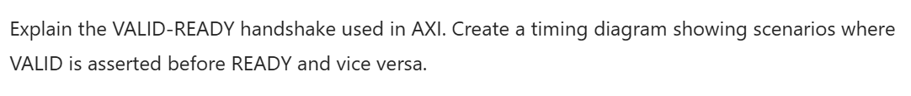
Try AI Prompts

Slide 16
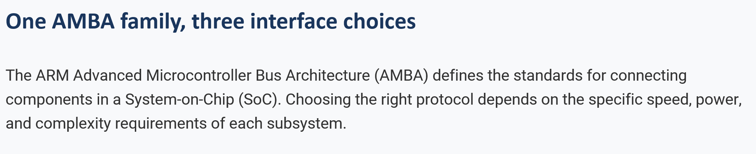
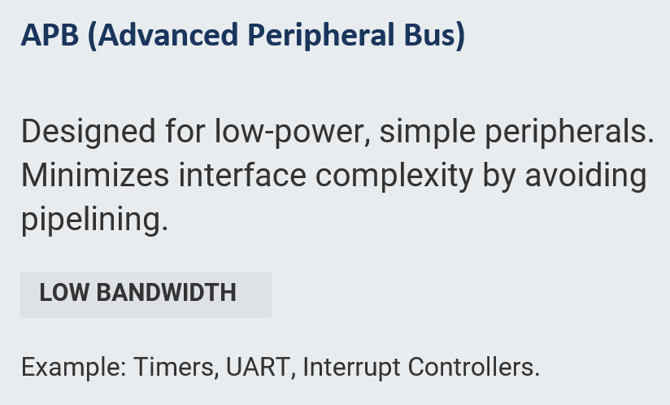
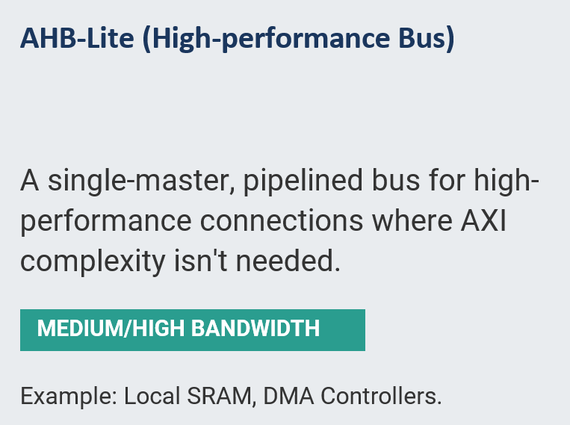
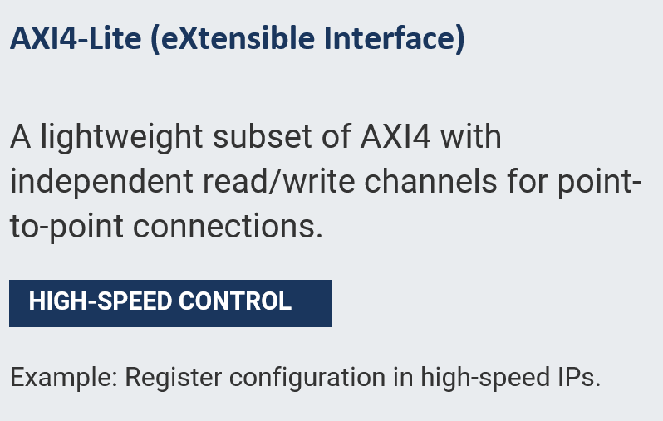
AMBA (APB, AHB‑Lite, AXI4‑Lite)

Slide 17
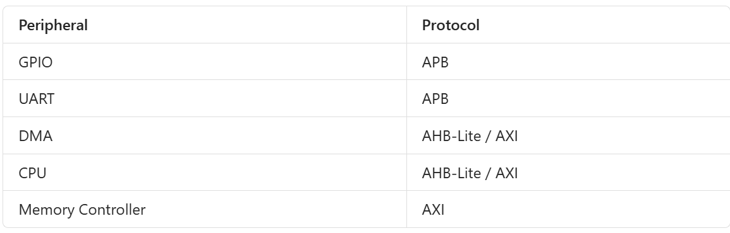
Use Case

Slide 18
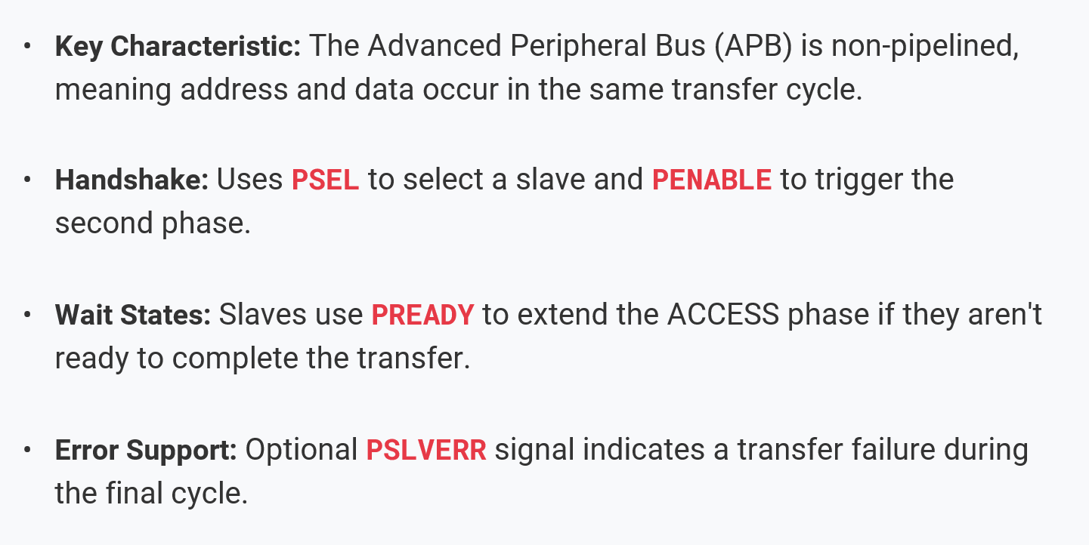
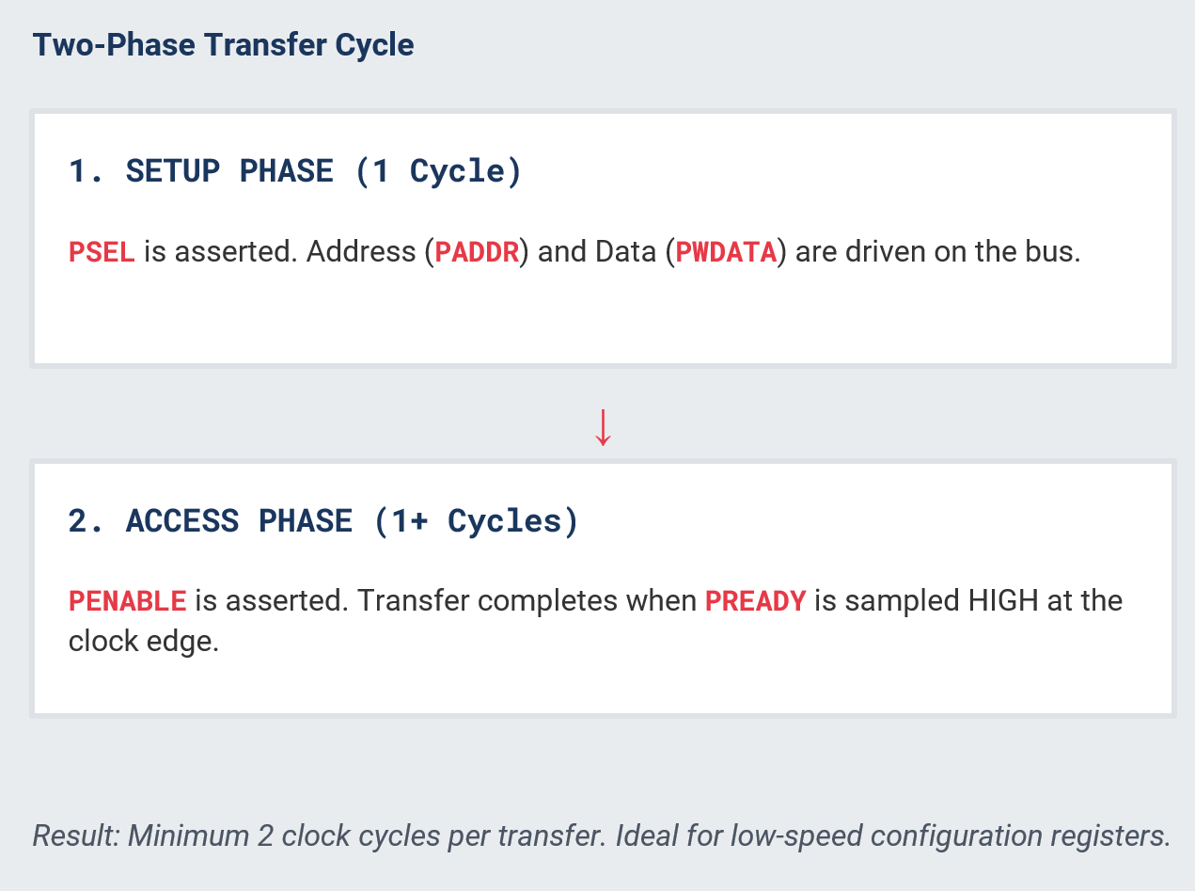
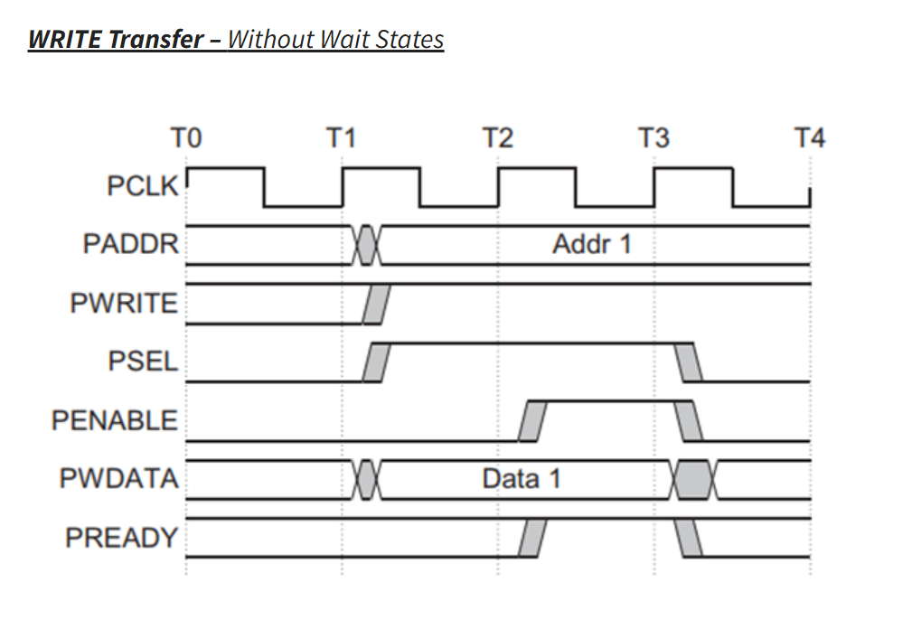
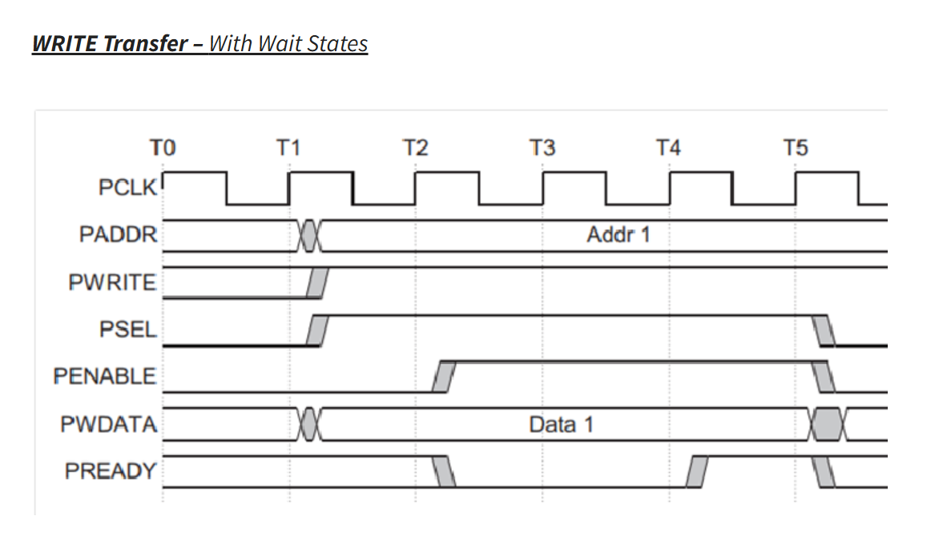
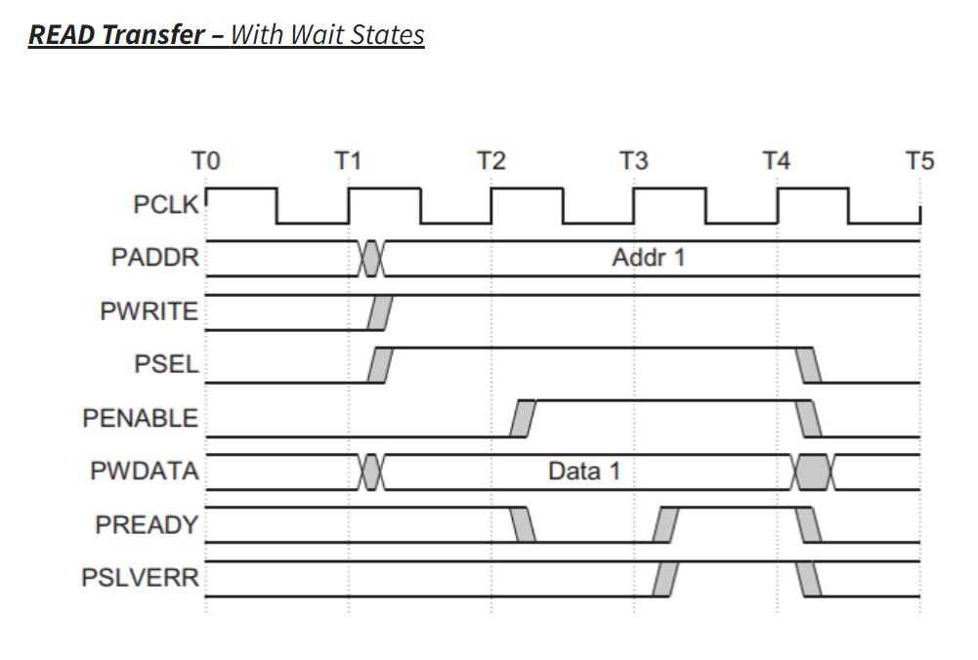
APB (Simple Peripheral Access)

Slide 19
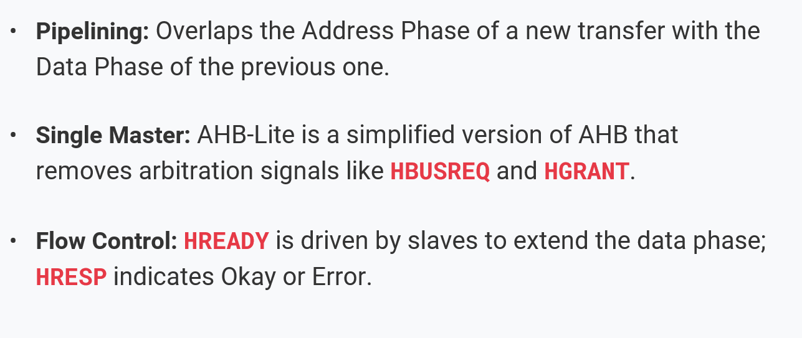
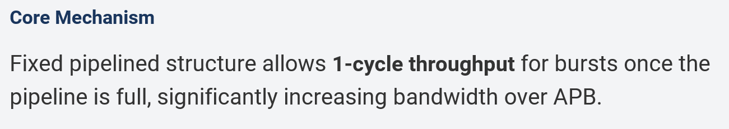
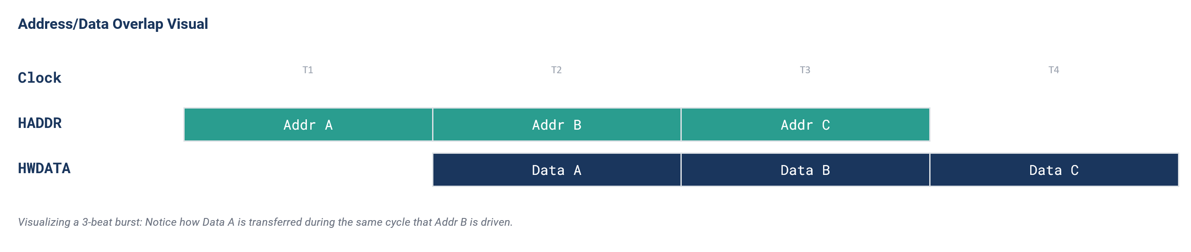
AHB-Lite (pipelined Transfer)

Slide 20
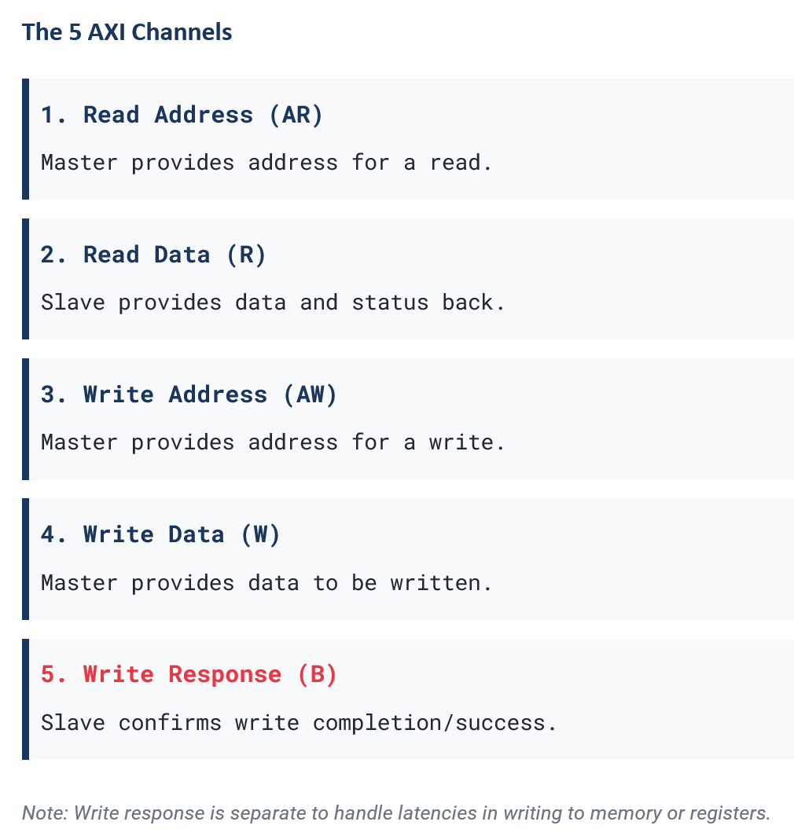
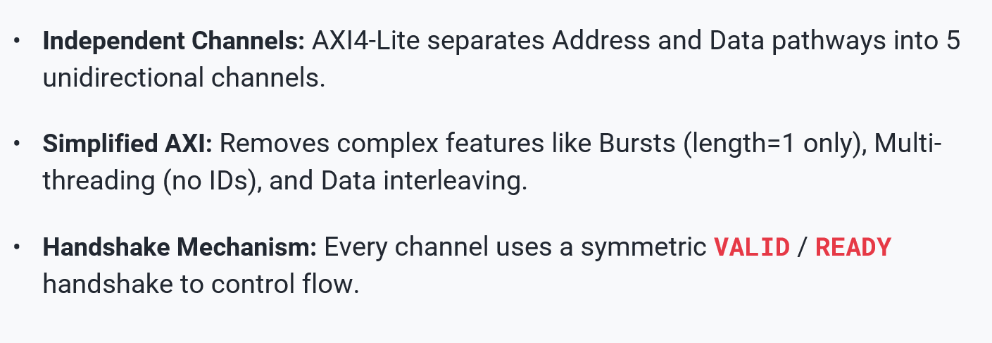

AXI4-Lite (Five Handshake Channels)

Slide 21
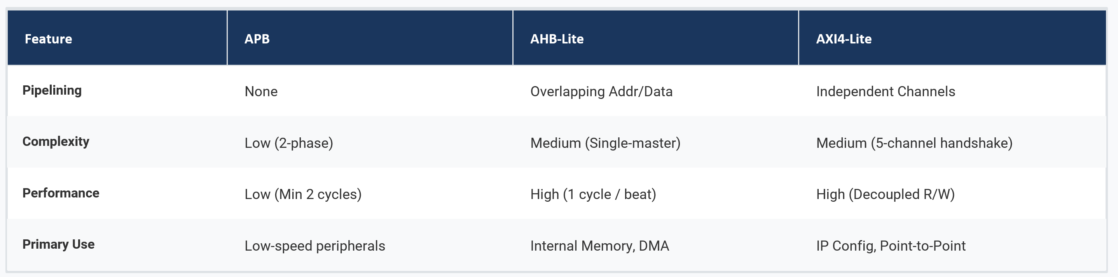
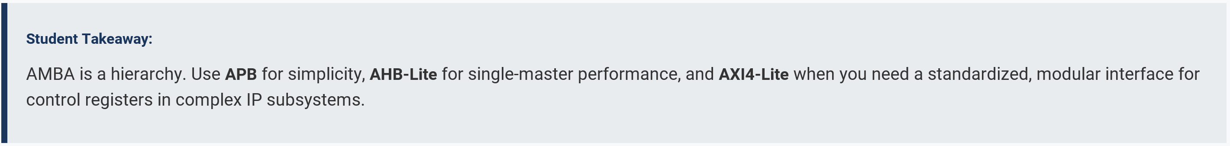
Choose By Job – Not By Name

Slide 22
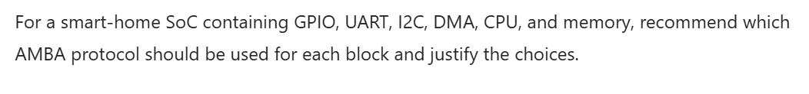
Try AI Prompts

Slide 23
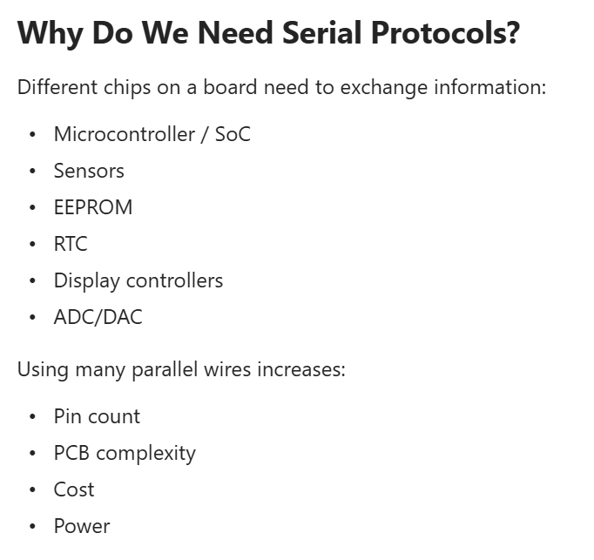
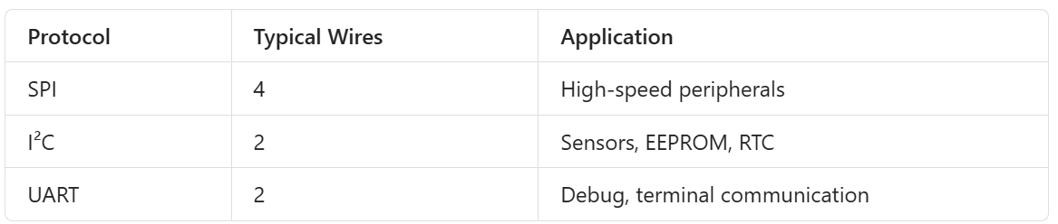
Serial Protocols: SPI and I2C

Slide 24


Serial Protocols: SPI and I2C

Slide 25







Protocol Timing

Slide 26




SPI Vs I2C
Notes:
What if there is no local copy and i is used directly

Slide 27


Try AI Prompts

Slide 28
Questions ?

