Slide 1
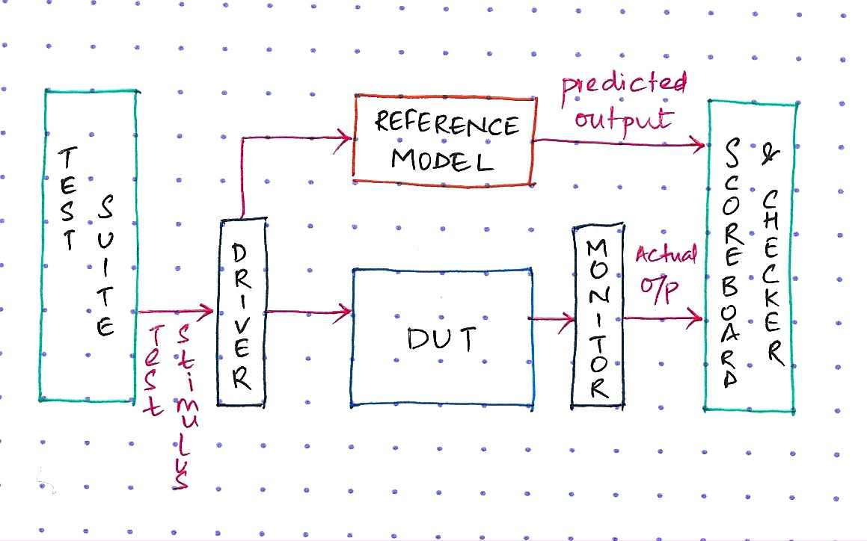
From Specification to Stimulus
How a verification engineer turns a document into a test
Siemens-DTU Verification Training Program | Week 5
Prajwal Matukumalli - Verification Engineer, Siemens DISW EDA
9 September 2026
Restricted | (c) Siemens 2026 | Prajwal Matukumalli | DISW EDA | 2026-09-09

Slide 2
Today: Eight Ideas, One FIFO
1. Specification analysis
2. Functional requirements vs corner cases
3. Verification plan and test plan
4. Types of testing
5. Directed testing
6. Constrained-random testing
7. Stimulus generation
8. rand and randc
The same journey, every project:
spec in, working test out.
Spec
Requirements
Plans
Test Types
Stimulus
Random
Every one of these, applied to the same 8x8 synchronous FIFO.
Restricted | (c) Siemens 2026 | Prajwal Matukumalli | DISW EDA | 2026-09-09
Notes:
This deck is a tour, not a deep dive - we covered why verification matters last week. Today is mechanics, applied consistently to one running example: an 8-bit-wide, 8-deep synchronous FIFO. Point at the chevron strip - the same six dots track our position in the top-right corner from slide 3 onward.

Slide 3
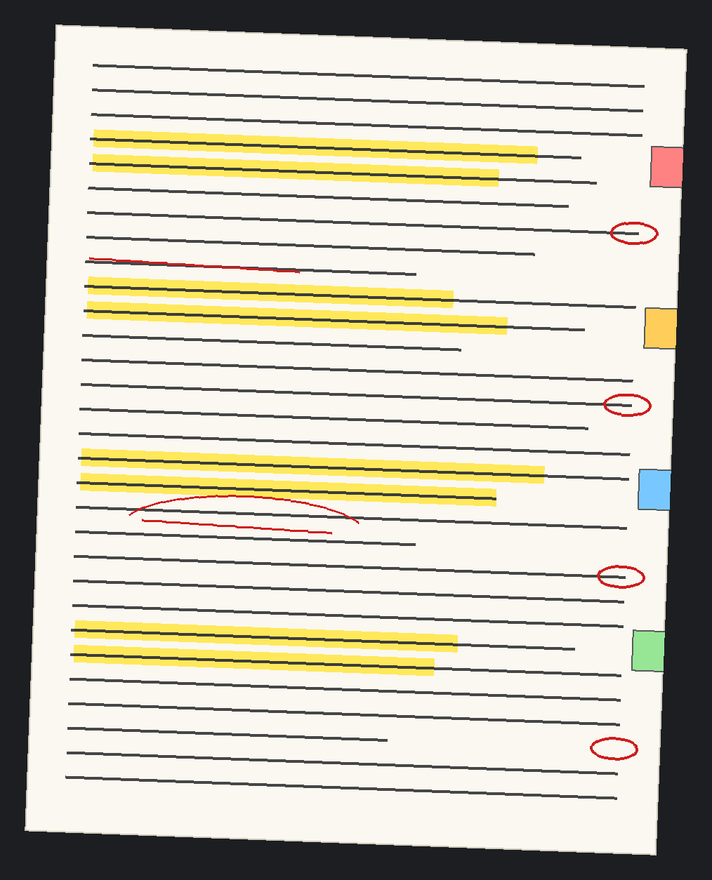
Specification Analysis - Five Moves
Reading, decomposing and interrogating a spec before you write any test code.
READ | The whole spec. Twice. Never skim.
MAP | Every interface: inputs, outputs, protocols
LIST | Every behavior the spec claims
MARK | Every boundary and every error condition
ASK | Every ambiguity - take it to the designer
Steps 1-4 are homework. Step 5 is engineering - it is the step that saves the project.
Restricted | (c) Siemens 2026 | Prajwal Matukumalli | DISW EDA | 2026-09-09
Notes:
Walk through READ-MAP-LIST-MARK-ASK using the photo as a prop: this is what a marked-up spec physically looks like - highlighter for claims, red pen for questions, flags for sections to revisit. Emphasise that step 5, asking the designer, is the one junior engineers skip and it is the one that prevents wasted verification cycles later.

Slide 4
SPEC-FIFO-001 - Synchronous FIFO
Parameters: 8-bit data - 8 entries deep - single clock - active-high sync reset
data_in[7:0]
SYNC FIFO
depth 8 - width 8
wr_en
data_out[7:0]
clk | in 1
rst | in 1
wr_en | in 1
rd_en | in 1
data_in | in 8
data_out | out 8
full | out 1
empty | out 1
• wr_en=1, full=0 -> data_in stored on rising clk
• rd_en=1, empty=0 -> data_out shows oldest entry
• Ordering is strictly first-in, first-out
• Reset clears all entries: empty=1, full=0
rd_en
full
clk
rst
empty
write ptr
This spec is deliberately incomplete. Finding the holes is your job today.
0
1
2
3
4
5
6
7
read ptr
slots 0-2 occupied - slots 3-7 free - pointers wrap at slot 7 -> 0
Restricted | (c) Siemens 2026 | Prajwal Matukumalli | DISW EDA | 2026-09-09
Notes:
This is our running example for the entire session. Walk the block diagram left to right: five control/data inputs, three status/data outputs. Then walk the slot row: three entries already written (petrol), five free (white), write pointer at slot 3, read pointer at slot 0. Ask: what happens when write pointer reaches slot 7 and wr_en is still 1? That seeds CC-05 later. The spec is incomplete on purpose - it does not say what happens on simultaneous read/write, exploited on slide 6.

Slide 5
Turning Sentences Into Testable Requirements
A functional requirement is a clear, testable statement covering ONE behaviour.
Prose (ambiguous)
"data_in is written when wr_en=1 and full=0"
-> FR-01: wr_en=1, full=0 -> data_in stored at next rising edge
Requirement (testable)
"FIFO ordering is first-in-first-out"
-> FR-03: Data is read out in exactly the order it was written
"Reset clears all entries"
-> FR-04: After rst=1 for one cycle, empty=1, full=0, ptrs at zero
Test (executable)
If you cannot write a test for it, it is not a requirement yet.
Ambiguity in, executable check out
Restricted | (c) Siemens 2026 | Prajwal Matukumalli | DISW EDA | 2026-09-09
Notes:
Show the mechanical transformation: prose is compressed into ONE testable statement per requirement. FR-02 (read) is left as a class exercise. A requirement which cannot be phrased as a pass/fail check is not finished yet - it is still prose.

Slide 6
Requirements vs Corner Cases
FUNCTIONAL REQUIREMENTS
CORNER CASES
The design doing its job
The design pushed to its limits
• FR-01 Write succeeds when not full
• FR-02 Read succeeds when not empty
• FR-03 Ordering preserved
• FR-04 Reset clears the FIFO
• CC-01 Write attempted when full
• CC-02 Read attempted when empty
• CC-03 Read+write same cycle, 1 entry
• CC-04 Reset asserted mid-write
• CC-05 Pointer wrap after 1000 cycles
CC-01
wr_en = 1
full = 1
Bugs live in the overlap.
Corner cases come from two places: boundaries and simultaneous events.
Restricted | (c) Siemens 2026 | Prajwal Matukumalli | DISW EDA | 2026-09-09
Notes:
Corner cases are not random extra tests - they are systematically derived from two sources: values at boundaries (full, empty, wrap) and events that collide in the same clock cycle. The Venn diagram makes CC-01 concrete: it lives exactly where wr_en=1 intersects full=1. Ask students which circles would produce CC-02.

Slide 7
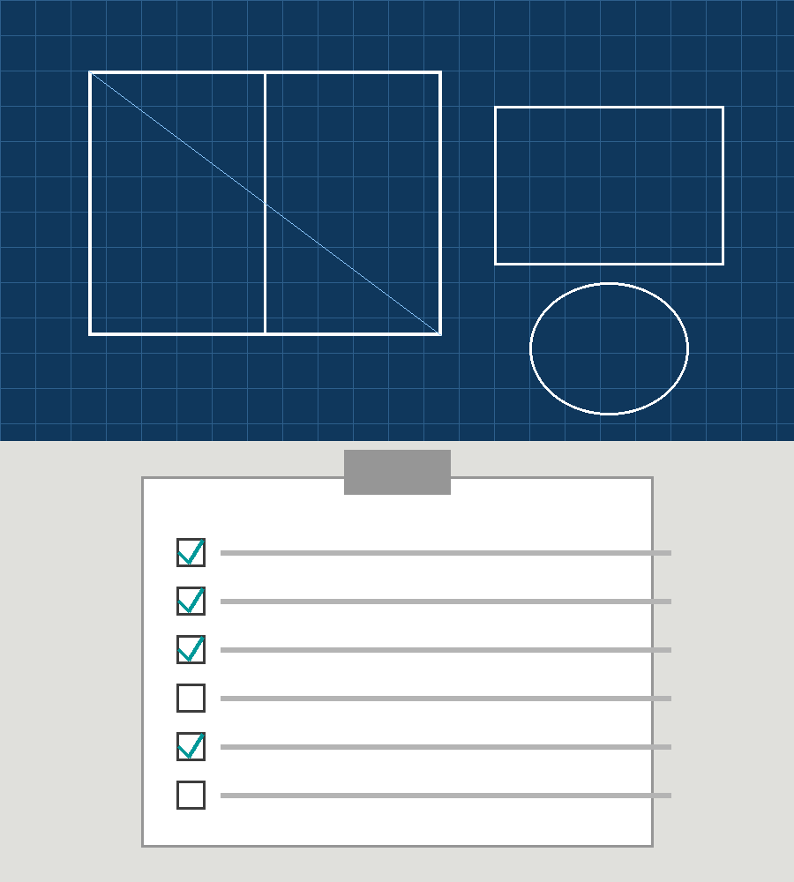
Verification Plan vs Test Plan
Verification plan: "We will test the braking system."
Test plan: "Brake at 60 km/h dry. Brake at 120 km/h wet, ABS off. Brake on ice at 40 km/h, loaded."
STRATEGY
 | Verification Plan | Test Plan
Level | Strategic - what and how | Tactical - specific cases
Granularity | Feature-level | Test-case-level
Author | Verification lead | Verification engineer
Changes | Rarely, after signoff | Constantly
Size | A thin booklet | A thick binder
ORDERS
Written BEFORE any testbench code - and updated forever after.
Restricted | (c) Siemens 2026 | Prajwal Matukumalli | DISW EDA | 2026-09-09
Notes:
The braking-system analogy is the whole slide. The verification plan says WHAT and HOW at a feature level and rarely changes. The test plan is the tactical binder of individual test cases and changes daily as bugs are found. Both are written before a line of testbench code exists.

Slide 8
The FIFO Plans - Feature to Test
VERIFICATION PLAN - FEATURES
F1 Write F2 Read F3 Ordering F4 Full flag F5 Empty flag
F6 Reset F7 Write-when-full F8 Read-when-empty
F9 Simultaneous R/W F10 Pointer wrap
Approach: F1-F6 directed. F7-F10 constrained-random.
Signoff: 100% functional coverage, >95% code coverage, zero open bugs.
REQUIREMENT
FEATURE
TEST
FR-03
F3
T03
TEST PLAN - EXTRACT
CC-04
F9
T09
ID | Feat. | Description | Type
T03 | F3 | Write 8, read 8, check order | Directed
T04 | F4 | Write 8, check full flag | Directed
T07 | F7 | Assert wr_en while full=1 | Directed
T09 | F9 | Random R/W mix, 500 cycles | CR
T10 | F10 | 100 W/R, force wrap | CR
Every test traces back to a line in the spec. No orphan tests.
Restricted | (c) Siemens 2026 | Prajwal Matukumalli | DISW EDA | 2026-09-09
Notes:
This slide connects everything: verification-plan features roll up from requirements, and each feature is covered by one or more concrete tests in the test plan. Point at the traceability diagram: FR-03 to F3 to T03 is a directed path; CC-04 to F9 to T09 is a constrained-random path. If a test cannot be traced back to a feature and a requirement, it should not exist.

Slide 9
Two Ways to Make Stimulus
DIRECTED - a human writes each case by hand
RANDOM - a tool generates cases automatically
Unconstrained: legal-looking noise, almost useless
Constrained: random inside rules you define
Testing Approaches
Directed
Random
Unconstrained
Constrained
Real projects use both. Directed covers what you know. Constrained-random finds what you don't.
Restricted | (c) Siemens 2026 | Prajwal Matukumalli | DISW EDA | 2026-09-09
Notes:
This is a signpost slide - deliberately sparse. Directed and random are the two ways to make stimulus. Random splits again into unconstrained (mostly useless noise) and constrained (random inside rules). The greyed-out unconstrained box and the crossed-out mark make the recommended path visually obvious. The next four slides expand each branch.

Slide 10
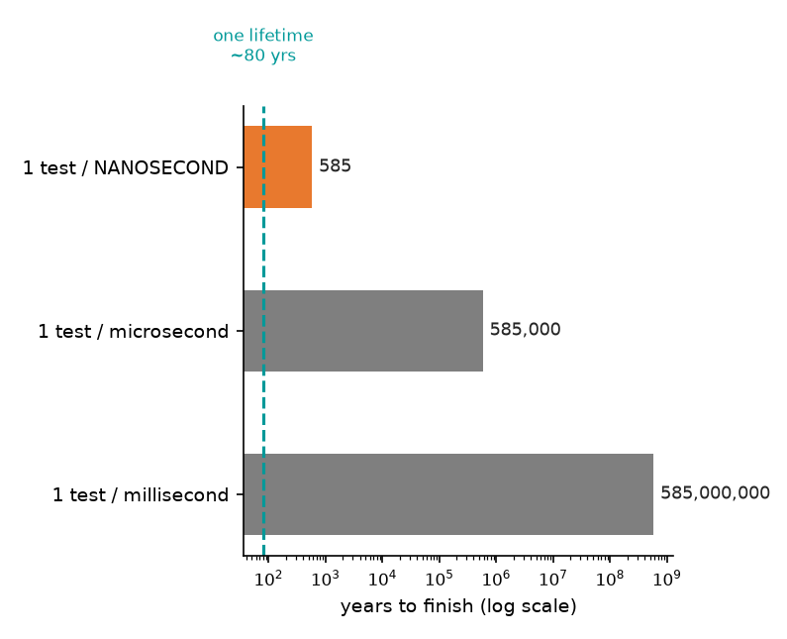
Directed Testing - You Write Every Case
// T03: Write 8 values, read 8, verify order
// 1. reset the FIFO
// 2. write data_in = 0,10,20,30,40,50,60,70
// 3. check full == 1
// 4. read 8 values, expect 0,10,...,70 in order
// 5. check empty == 1
How many directed tests cover every 8-byte sequence?
2^64 = 1.8 x 10^19
1 test per millisecond | 585 million years
1 test per microsecond | 585 thousand years
1 test per NANOSECOND | 585 years
Even at a billion tests per second, you finish 585 years from now.
Directed-only is not slow. It is impossible.
Restricted | (c) Siemens 2026 | Prajwal Matukumalli | DISW EDA | 2026-09-09
Notes:
The scalability wall: directed testing enumerates cases one at a time. For an 8-byte FIFO payload space of 2^64 sequences, even at one test per nanosecond it takes 585 years. The log-scale chart is itself a teaching point - linear axes cannot show this range meaningfully. This motivates constrained-random on the next slide.

Slide 11
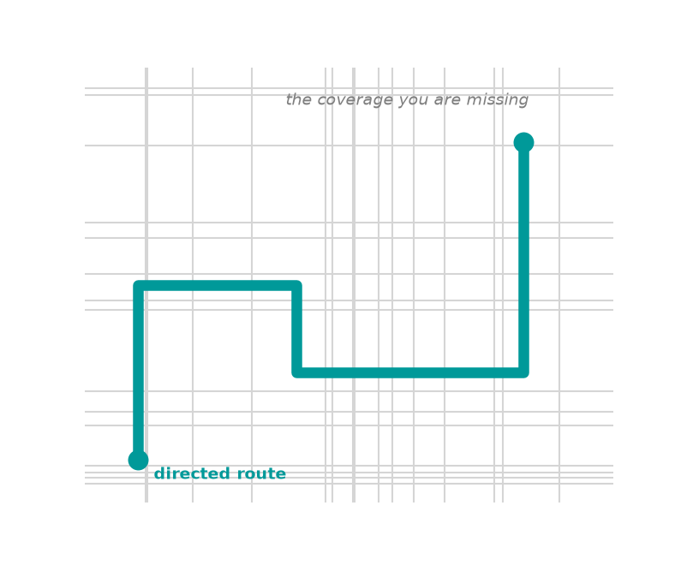
Constrained-Random - Let the Tool Explore
The tool generates stimulus randomly, but only inside rules you write.
Why constrain it?
• Pure random is mostly illegal or uninteresting stimulus
• Constraints keep it legal and aim at interesting territory
Directed
Driving the same route to work daily. You know it perfectly, never see anything else.
Constrained-random
Exploring the city with one rule: stay inside the limits. You find roads you never knew existed.
The catch: you cannot predict the input, so you cannot hand-write the expected output. Constrained-random REQUIRES a self-checking testbench - a scoreboard. That is next week.
Restricted | (c) Siemens 2026 | Prajwal Matukumalli | DISW EDA | 2026-09-09
Notes:
The city-driving analogy is the anchor. Constrained-random trades predictability for coverage: you cannot hand-write expected results for stimulus you did not choose, so a scoreboard becomes mandatory - this is the bridge into next week's testbench-architecture session.

Slide 12
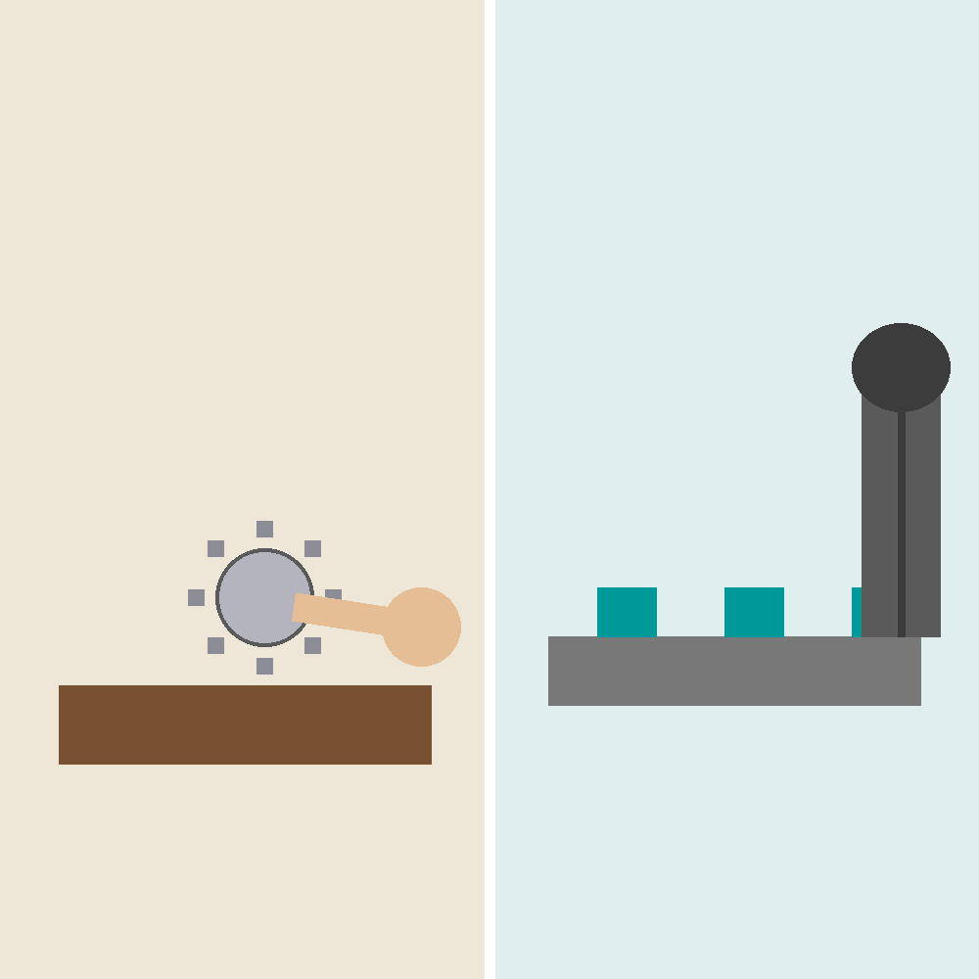
Directed vs Constrained-Random
Aspect | Directed | Constrained-Random
Who makes stimulus | You | The constraint solver
Finds | Bugs you thought of | Bugs you didn't
Debug | Easy, deterministic | Harder, needs seed replay
Self-checking | Optional | Mandatory
Scales to SoC | No | Yes
Typical usage mix | ~20% of tests | ~80% of tests
GOLDEN RULE - Start directed to build confidence. Move to constrained-random to build coverage.
Directed - one at a time, total control.
Constrained-random - thousands, automatic checker.
Restricted | (c) Siemens 2026 | Prajwal Matukumalli | DISW EDA | 2026-09-09
Notes:
Six dimensions of comparison, tinted petrol for directed and orange for constrained-random. The golden rule is the single takeaway: sequence matters - directed first for confidence, then constrained-random for breadth. Most mature projects run roughly an 80/20 split toward random.

Slide 13
Stimulus Generation in SystemVerilog
Creating the inputs applied to the DUT to exercise its behaviour.
• Hardcoded values - directed tests
• Randomised values - constrained-random <- today
• File-driven values
• UVM sequences - a later session
2^24 possible stimulus values
CONSTRAINTS
class FifoTransaction;
rand bit [7:0] data;
rand bit wr_en;
rand bit rd_en;
// don't waste a cycle doing nothing
constraint activity_c { wr_en || rd_en; }
// aim at the boundaries, where bugs hide
constraint data_c { data inside {[8'h00:8'h0F], [8'hF0:8'hFF]}; }
endclass
legal AND
interesting
Wide input space, narrowed by constraints to legal and interesting stimulus
FifoTransaction txn = new();
if (!txn.randomize()) $fatal(1, "Randomization failed");
ALWAYS check the return value of randomize(). A silent failure gives you a test that tests nothing.
Restricted | (c) Siemens 2026 | Prajwal Matukumalli | DISW EDA | 2026-09-09
Notes:
Walk the class through the constraint class line by line: two rand fields plus a control bit, an activity constraint that forbids doing nothing, and a data constraint that biases the generator toward the boundary byte ranges where bugs cluster. Stress the randomize() return-value check - this is the single most common rookie mistake in constrained-random code.

Slide 14
rand and randc
rand bit [2:0] addr;
// uniform, repeats allowed
randc bit [2:0] addr;
// permutation, no repeats until all seen
rand - 8 draws
randc - 8 draws
 | rand | randc
Distribution | Uniform, repeats OK | Permutation, no repeats
Analogy | Rolling a die | Shuffling a deck
Sample run | 3,7,3,1,7,0,3,5 | 3,7,1,0,5,2,6,4
Best for | Data, addresses | Exhausting a small set
4
3
6
1
8
5
7
2
0
1
2
3
4
5
6
7
0
1
2
3
4
5
6
7
some values repeated,
three values never appeared
every value exactly once,
then reshuffle
Why randc? To hit all 8 opcodes, rand needs ~22 draws on average. randc guarantees it in exactly 8.
IEEE 1800 only guarantees randc support up to 8 bits (256 values). Keep randc small - randc bit [15:0] will bring the solver to its knees.
Restricted | (c) Siemens 2026 | Prajwal Matukumalli | DISW EDA | 2026-09-09
Notes:
This is the exam-answer slide. rand with a uniform distribution can repeat values and skip others - the left number line shows 3 and 7 appearing multiple times while 2, 4 and 6 never appear across 8 draws. randc guarantees a full permutation before any repeat - the right number line shows every value hit exactly once. Use randc only on small fields: IEEE 1800 only mandates support up to 8 bits.

Slide 15
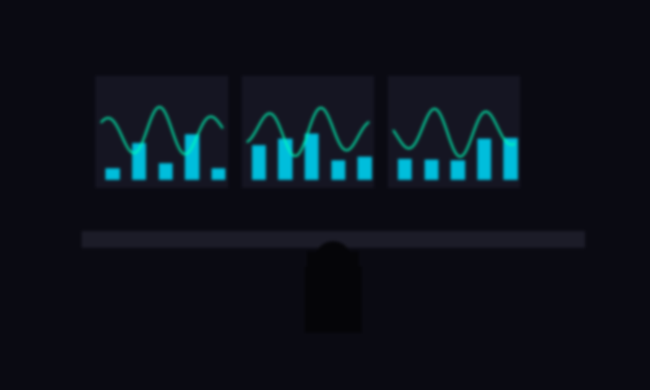
That's the Toolkit
Spec analysis
Requirements
Corner cases
Verification plan
Test plan
Directed
Constrained-random
rand / randc
TUTORIAL
5 problems. Separate PDF on the portal.
Due 16 September 2026, 23:59 IST.
Discuss with peers: yes. Use AI to understand: yes.
Use AI to write your answers: no.
NEXT WEEK
Building the FIFO testbench for real - driver, monitor, scoreboard.
First functional coverage. First step towards UVM.
This is where you're headed.
Write a constrained-random FIFO testbench on edaplayground.com.
It does not need to compile. Bring what you have.
Restricted | (c) Siemens 2026 | Prajwal Matukumalli | DISW EDA | 2026-09-09
Notes:
Close by compressing the whole session into one flow: spec analysis through rand/randc, all applied to the same FIFO. Point at the tutorial box - AI may help you understand a concept but the write-up must be the student's own reasoning. The single call to action: open edaplayground.com and attempt a constrained-random FIFO testbench before next week, even if it does not compile.

