Slide 1
Professional English
LIU Limin
IT School 信息工程学院
Tel： 13819251469
Email：frankliu_sg@qq.com
L1

Slide 2
Rules of The Class（课堂纪律)
Don’t disturb others in the classroom （课上不许影响他人听课）

Slide 3
Results（成绩计算）
Test 40%
Others 60%
  Attendance rate
    -4/ Absence; -1/Late
  Showing on class
    +X/good showing
  Assignments

Slide 4
About Computer
What is a computer?
  a calculating (such as addition, subtraction, multiplication and division) machine
  a general-purpose device that can be programmed to carry out a set of arithmetic or logical operations automatically
What is a computer system?
  Hardware + Software

Slide 5
Different Computer Systems
General Computer Systems
  A computer system is for general applications, such as calculation, office, entertainment, and so on.
Embedded Systems
  A computer system is for control, measurement, management, and so on.

Slide 6
Classes of Computers in Application
Personal computers
  General purpose, variety of software
  Subject to cost/performance tradeoff
Server computers
  Network based
  High capacity, performance, reliability
  Range from small servers to building sized

Slide 7
Supercomputers
  High-end scientific and engineering calculations
  Highest capability but represent a small fraction of the overall computer market
Embedded computers
  Hidden as components of systems
  Stringent power/performance/cost constraints

Slide 8
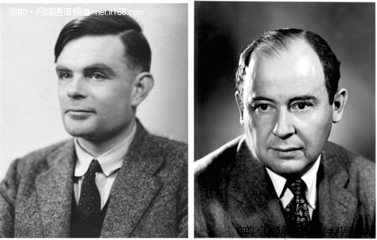
Turing and Neumann
Alan Turing, 1912-1954, British, father of computer science and artificial intelligence
Von Neumann, 1903-1957, US (Hungarian), father of modern computer

Slide 9
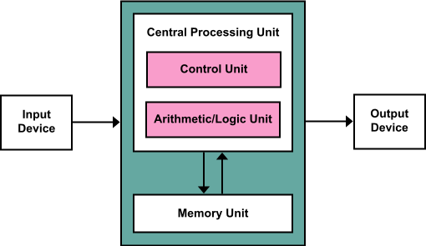
Von Neumann Architecture, 1945
To set up a computer with I/O, CPU and memory based on program storage and binary operation

Slide 10
Concept of microcomputer
Microcomputer
  A computer is built with microprocessor.
Microprocessor
  A device to be integrated CPU on one chip.
  The first commercial microprocessor: Intel 4004, 4-bit, 1971
  Popular 8-bit microprocessor: Intel 8080 (1974) and Z80 (1976)

Slide 11
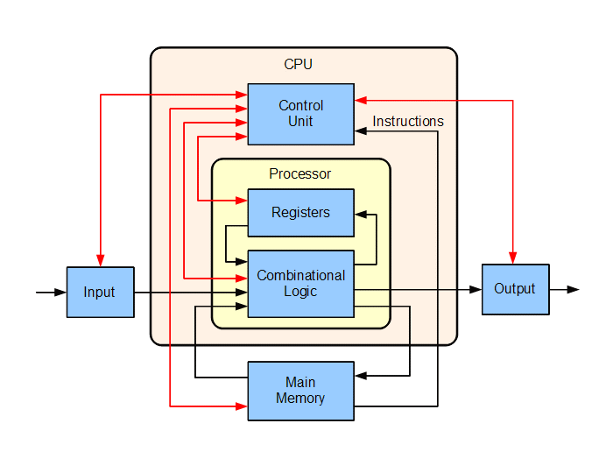
Organization of Microcomputer

Slide 12
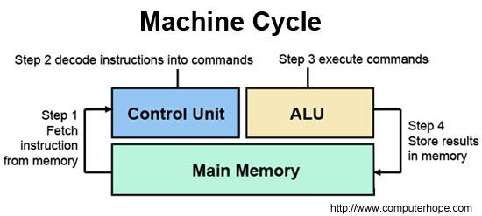
CPU – Central Processing Unit
In the CPU, the primary components are the ALU (Arithmetic Logic Unit) that performs mathematical, logical, and decision operations and the CU (Control Unit) that directs all of the processors operations.

Slide 13
Memory
1.Various memory
Paper storage:
  paper tape, punched cards
Optical storage：
  CD（Compacted Disk）,DVD
Magnetic storage：
  hard disks, floppy discs, magnetic tape
Semiconductor storage：
  ROM（Read Only Memory）、Flash Memory
  RAM（Random Access Memory）

Slide 14
2.Semiconductor memory
Non-volatile memory: keep information after power off
  PROM
  EPROM，OTP ROM (erasing with UV- UltraViolet)
  EEPROM
  Flash Memory
Volatile memory： loose information after power off
  SRAM（Static RAM）
  DRAM（Dynamic RAM）

Slide 15
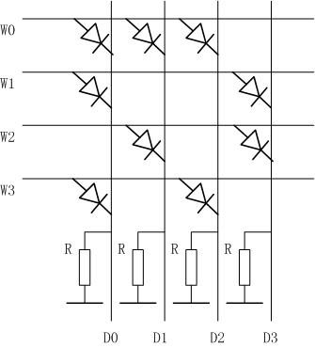
ROM-Read Only Memory
PROM
  programmable ROM

Slide 16
EPROM, EEPROM, Flash Memory
  When the floating without electrons filled，the transistor switch turns on with positive voltage D-S and G-S.
  When the floating with electrons filled，the transistor switch will be always off, although positive voltage D-S and G-S.
S
G
D
MOS Transistor
D
N
N
G
P
S
Insulated-gate
Floating gate

Slide 17
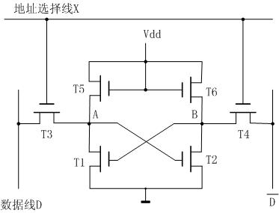
RAM – Random Access Memory
SRAM unit

Slide 18
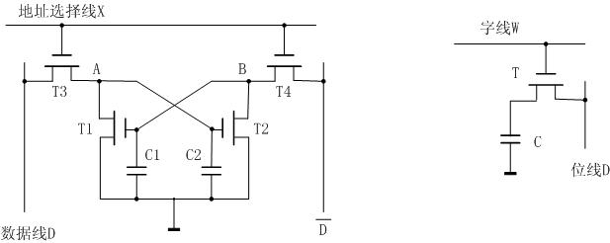
DRAM unit
DRAM-1
DRAM-2

Slide 19
Input/Output devices
Input devices:
  Keyboard, Mouse
  Scanner
  Camera, Microphone
  Touch screen, Writing board
  Joystick, Joypad and so on
Output devices：
  LCD
  Printer
  Plotter
  Projector
  Audio and so on

Slide 20
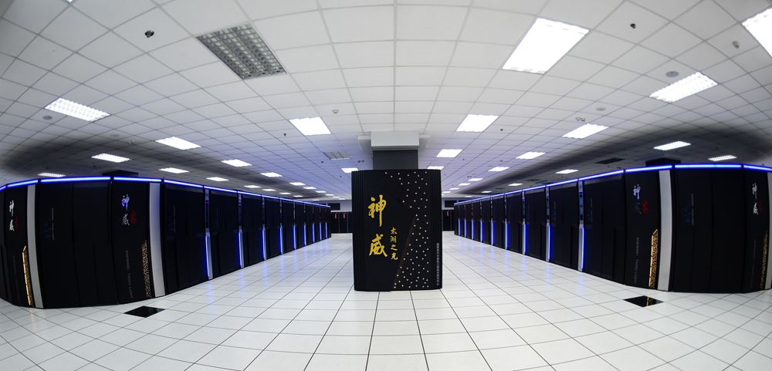

Slide 21
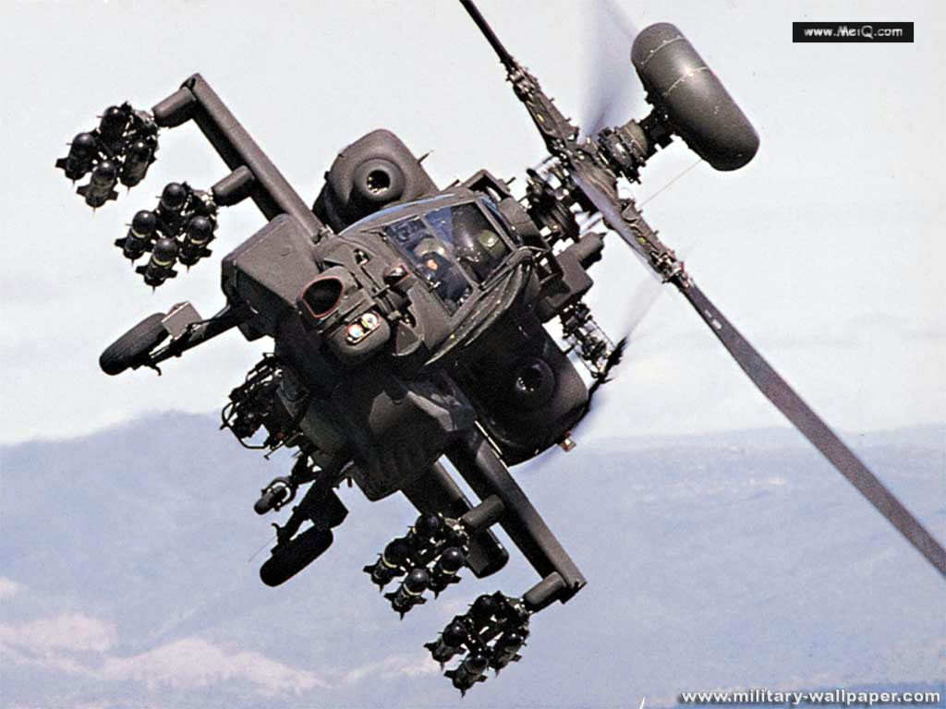

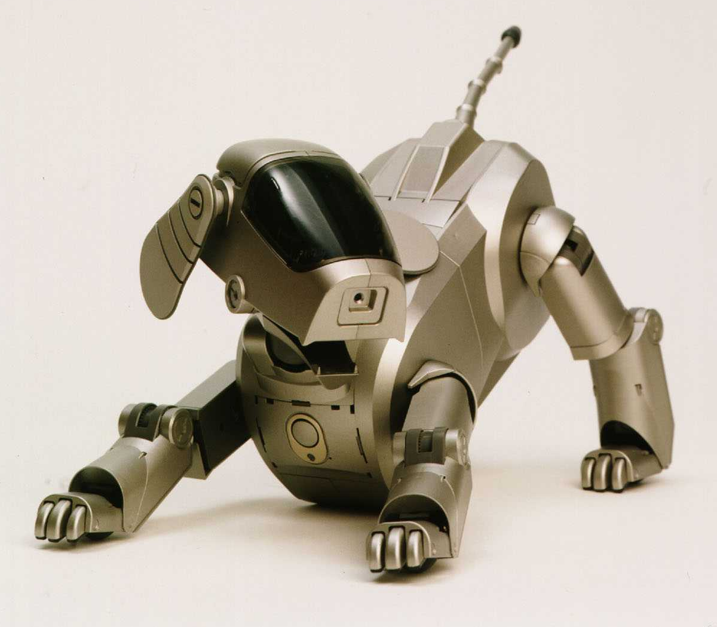
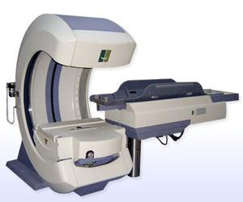
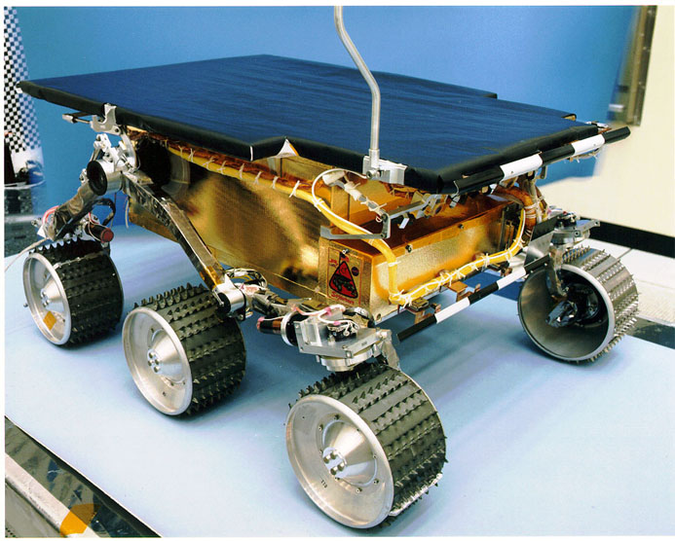
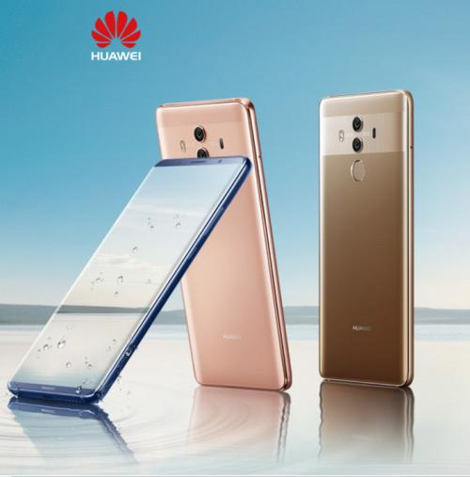

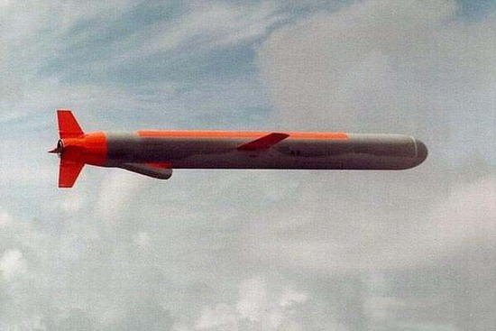
robotic dog
Apache helicopter
Ferrari
Lunar
rover
Gamma knife
Huawei
High speed train
Cruise Missile: Red Bird

Slide 22
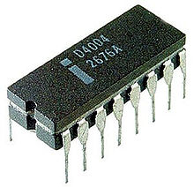
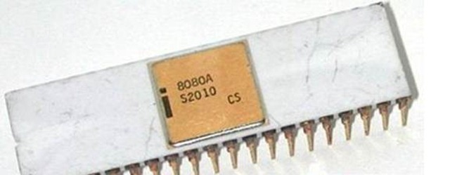

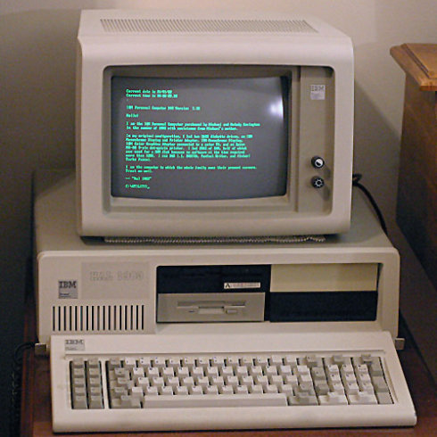
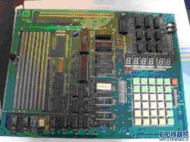

Slide 23
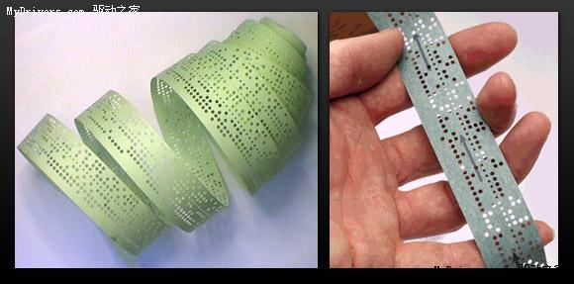
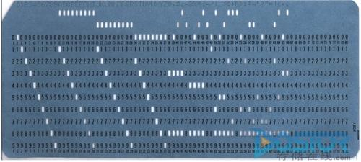

Slide 24
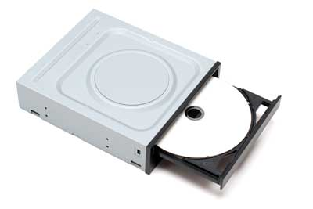
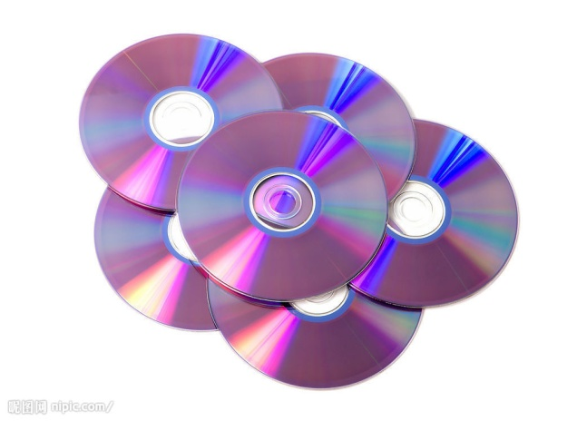
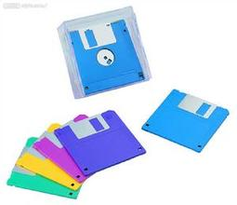
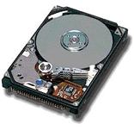
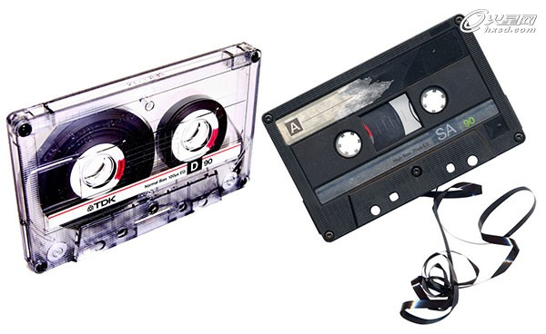

Slide 25
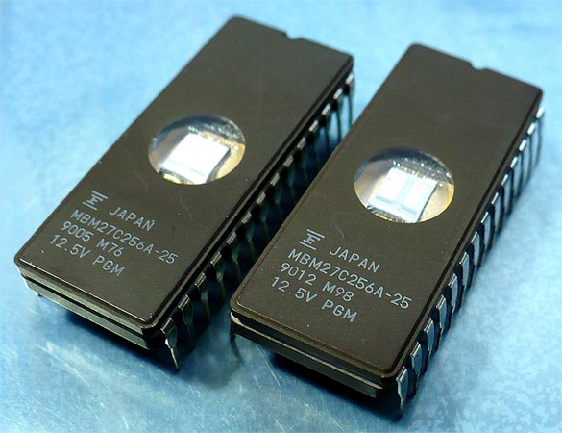
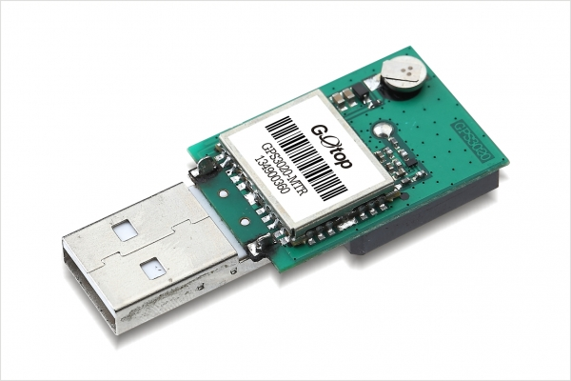
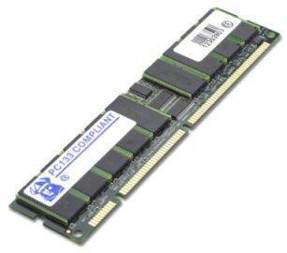
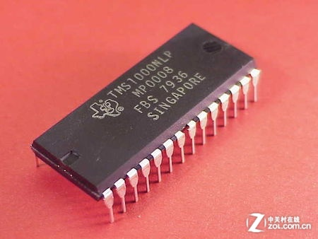

Slide 26
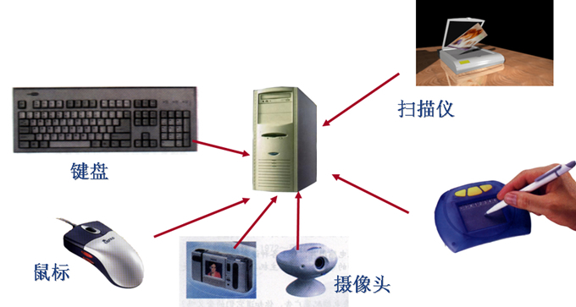
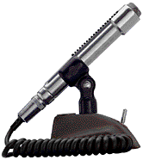
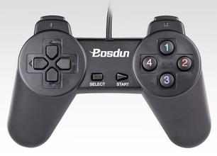

Slide 27
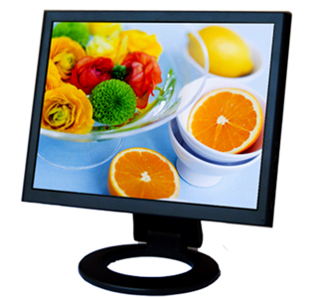
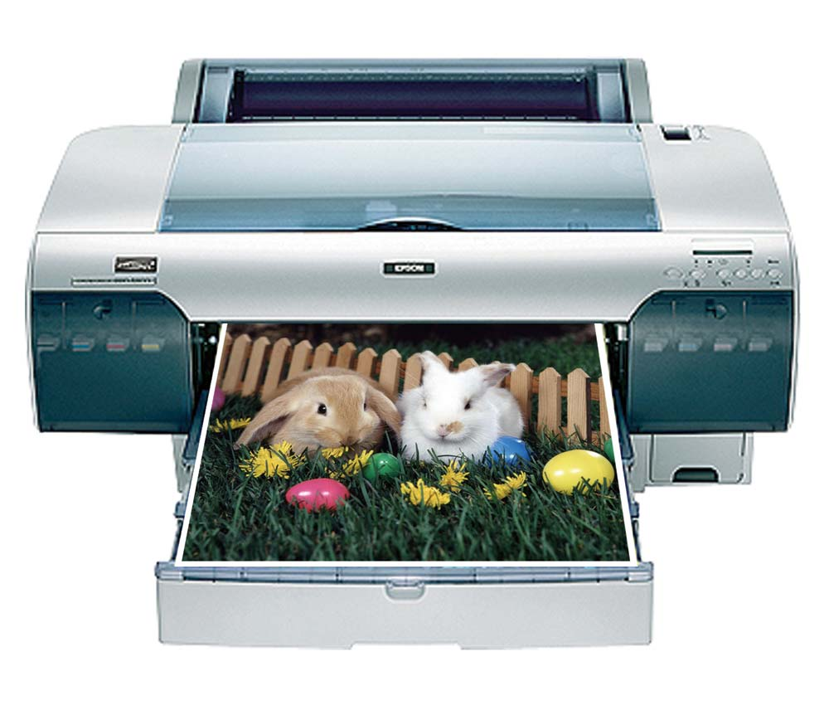
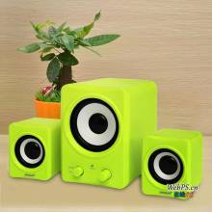
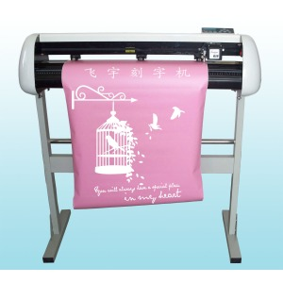

Slide 28
Moore’s Law
  Moore's law refers to an observation made by Intel co-founder Gordon Moore (1929-) in 1965, as an engineer of Fairchild Semiconductor.
Moore’s law is with different version.
  To increase performance or to decrease cost for microprocessors may be doubled in 18 months.
  The performance of computers with one US dollar may be doubled in 18 months.

Slide 29

CISC
CISC, Complex Instruction Set Computer
  Instruction number for a computer > 200
  Intel (Integrated Electronics) X86
x86 instruction set

Slide 30
RISC
RISC, Reduced Instruction Set Computer
  Instruction number for a computer < 100
  MIPS (Microprocessor without Interlocked Piped Stages)
  ARM (Advanced RISC Machines)

Slide 31
Microcontroller
Definition
  MCU: Micro-Controller Unit
  An unit with application control function on a single chip.
  NOTE: It contains a processor, RAM, ROM, clock, register, and I/O control unit.

Slide 32
Basic Organization of MCU
memory
（ROM、RAM）
interfaces
（I/O、LCD、AD/DA）
Bus Control
CPU
Clock/Reset
data、address bus
registers
（GFR、SFR）
functional modules
（timers、interupt）

Slide 33
The Lasted Progresses of Computer
Deep Learning
Cloud Computing
Big Data

