Slide 1

Data analysis of Sale Data
Sierra Michael, Junior

Slide 2
Analysis Question:
For each product, which fiscal quarter has, on average, the highest amount of sales?

Slide 3
Product 1

Slide 4
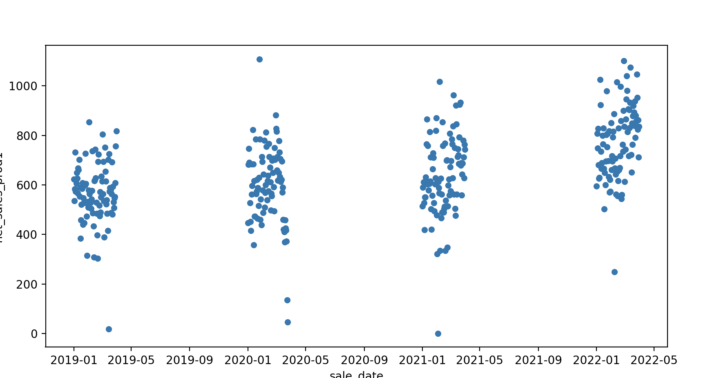
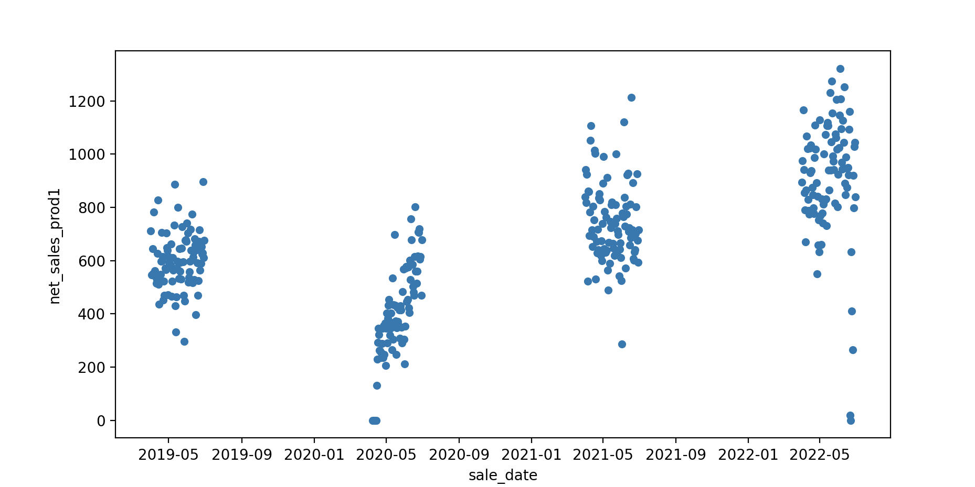
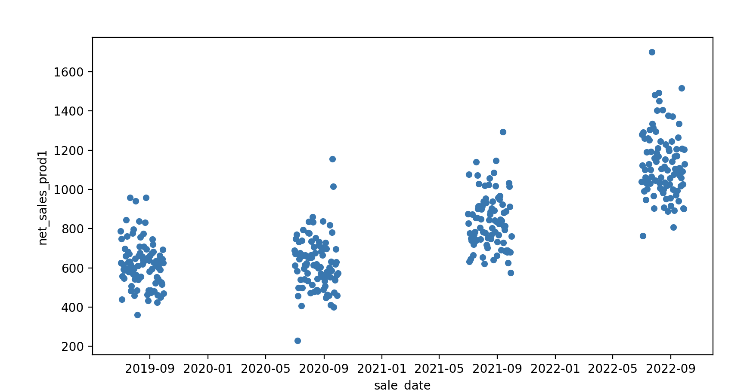
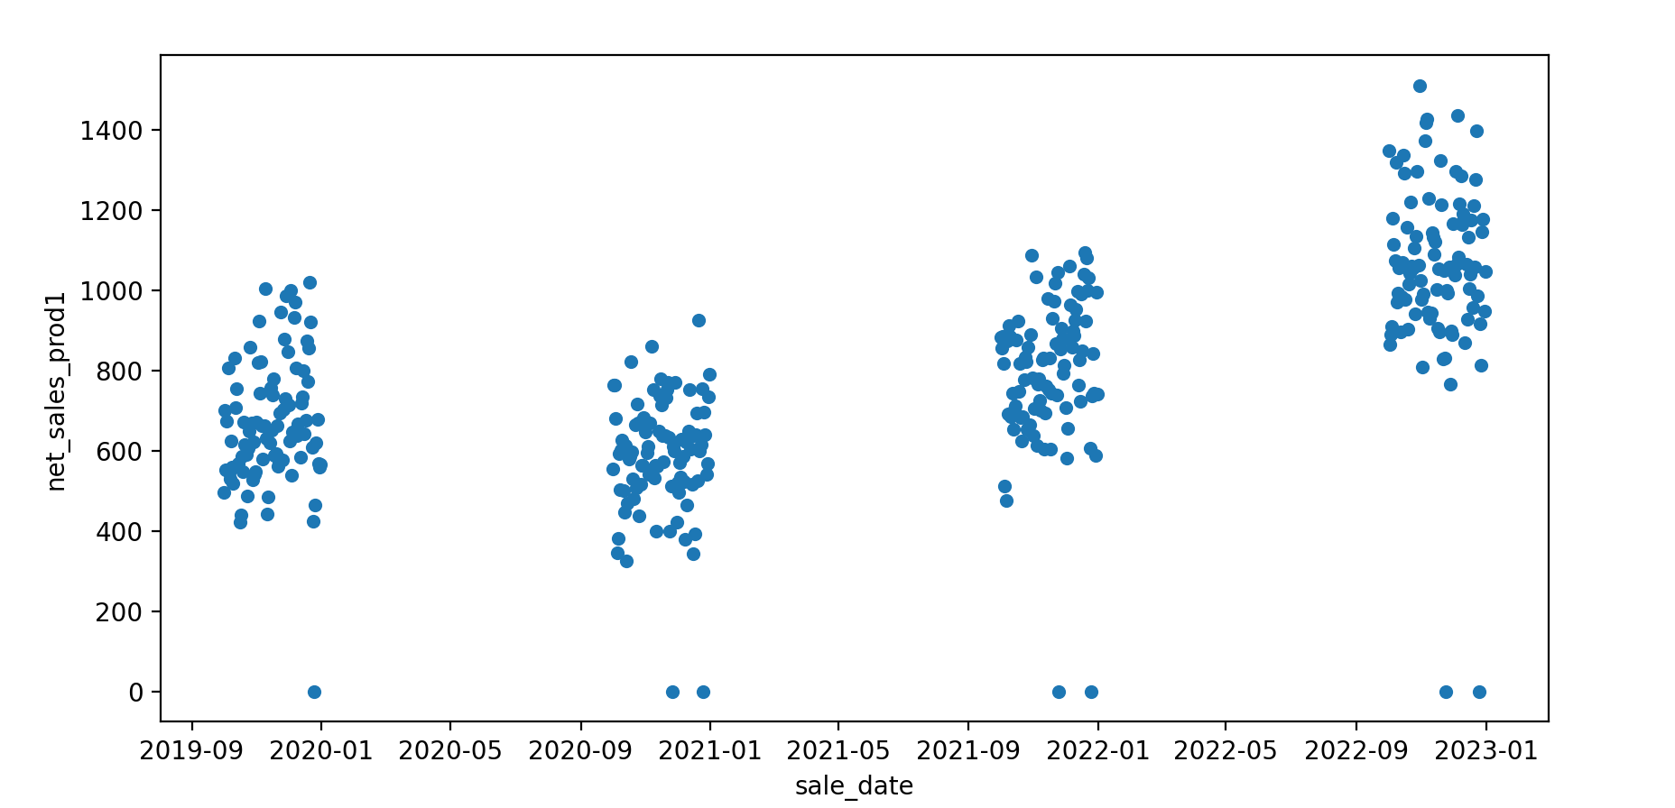

Product 1 Overall
Mean: 645.37
Std Dev: 167.07
Mean: 667.24
Std Dev: 255.24
Quarter 1
Quarter 2
Quarter 3
Quarter 4
Mean: 802.46
Std Dev: 249.72
Mean: 777.55
Std Dev: 254.67

Slide 5
Product 1 Results
Percentages of average sales:
Quarter 1: 22.31%
Quarter 2: 23.07%
Quarter 3: 27.74%
Quarter 4: 26.88%
Highest number of sales in 3rd and 4th quarters
July 1st to December 31st
Lowest in 1st and 2nd quarters
Jan 1st to June 30th
Peak sales during 3rd quarter from July 1st to Sep 30th

Slide 6
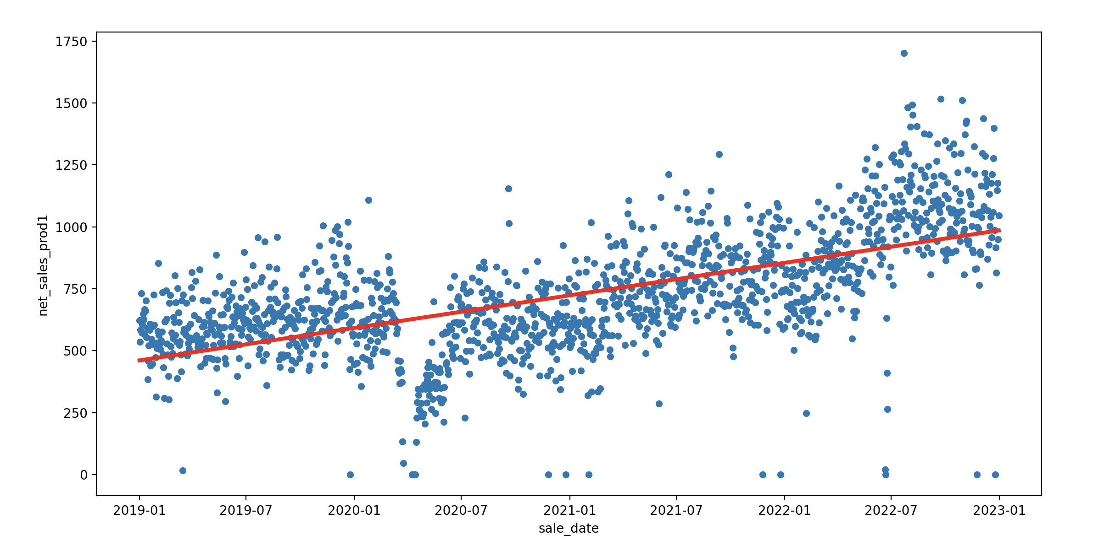
Linear Regression Model
P Value =1.19e-155
Standard Error=1.38e-16
$$Y=\left(4.15e−15\right)∗X −5969.67$$

Slide 7
Product 2

Slide 8
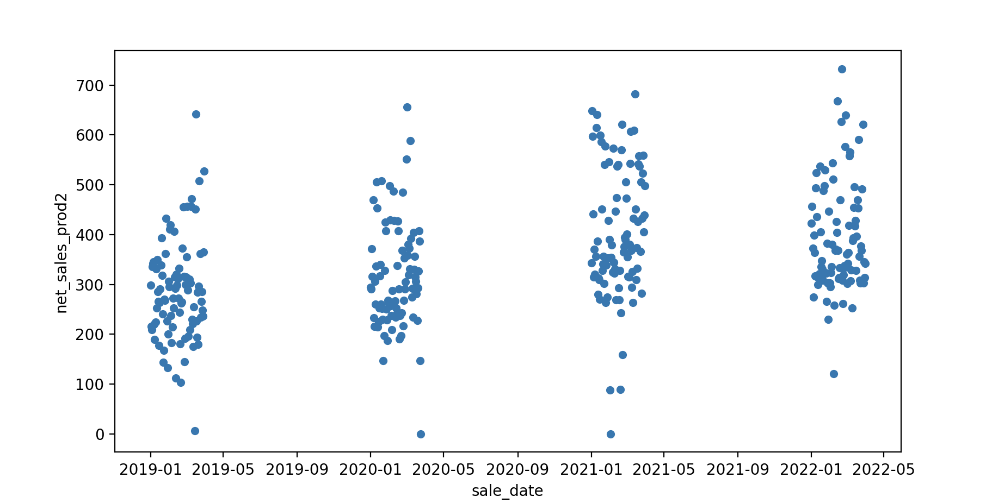
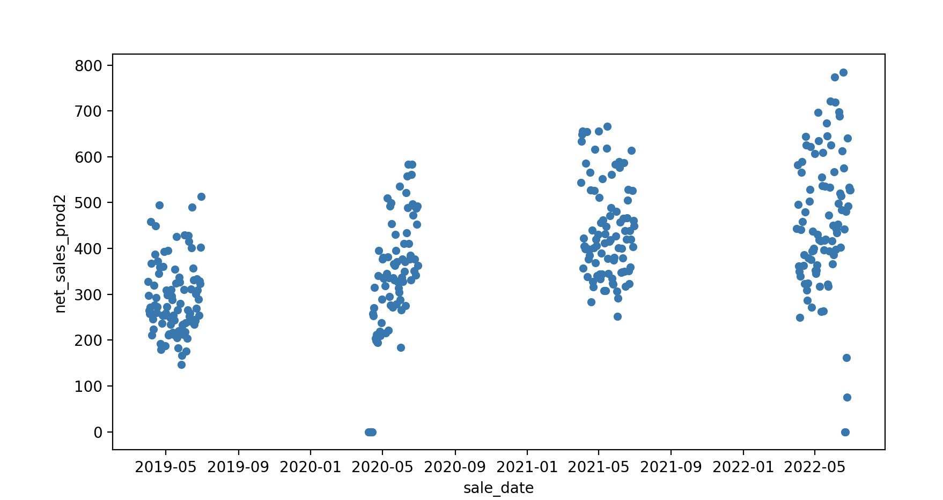
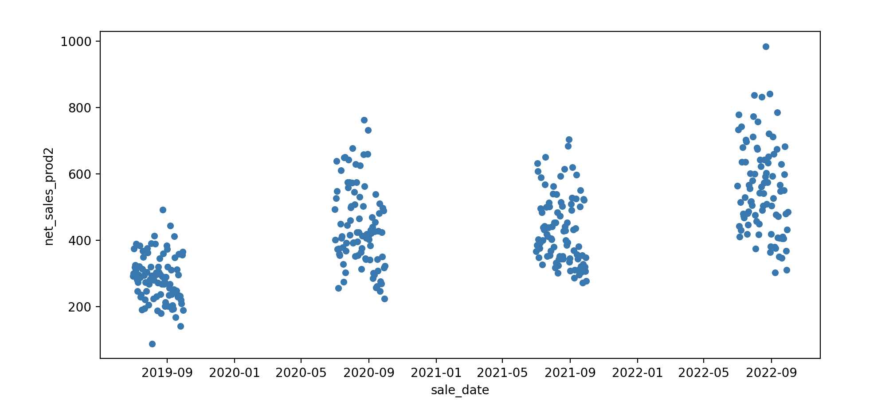
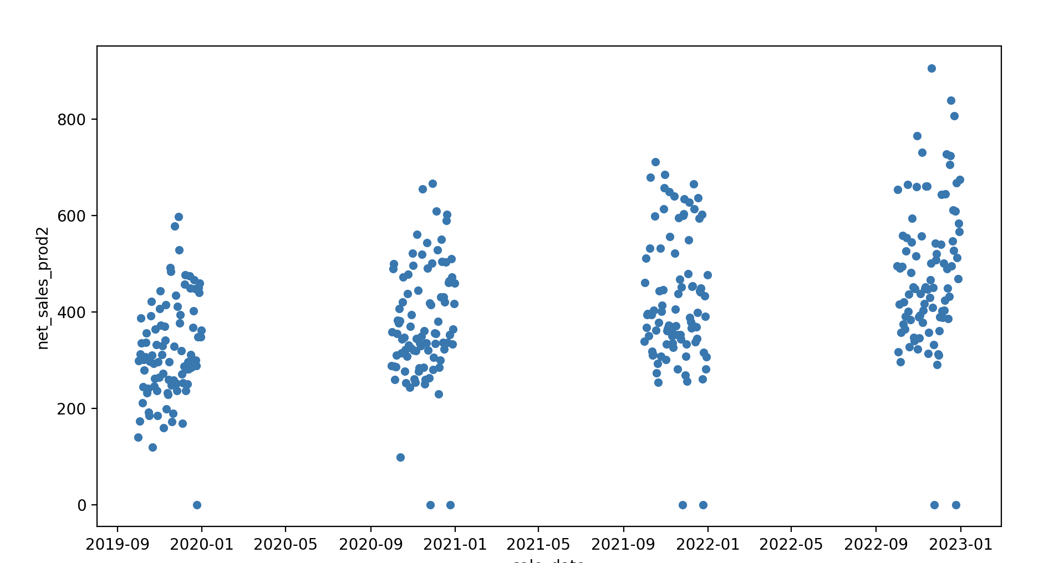
Mean: 350.31
Std Dev: 123.07
Mean: 379.79
Std Dev: 140.60
Quarter 1
Quarter 2
Product 2 Overall
Quarter 3
Quarter 4
Mean: 427.30
Std Dev: 145.97
Mean: 399.48
Std Dev: 142.04

Slide 9
Product 2 Results
Percentages of average sales:
Quarter 1: 22.51%
Quarter 2: 24.39%
Quarter 3: 27.44%
Quarter 4: 25.66%
Highest number of sales in 3rd and 4th quarters
July 1st to December 31st
Lowest in 1st and 2nd quarters
Jan 1st to June 30th
Peak sales during 3rd quarter from July 1st to Sep 30th

Slide 10
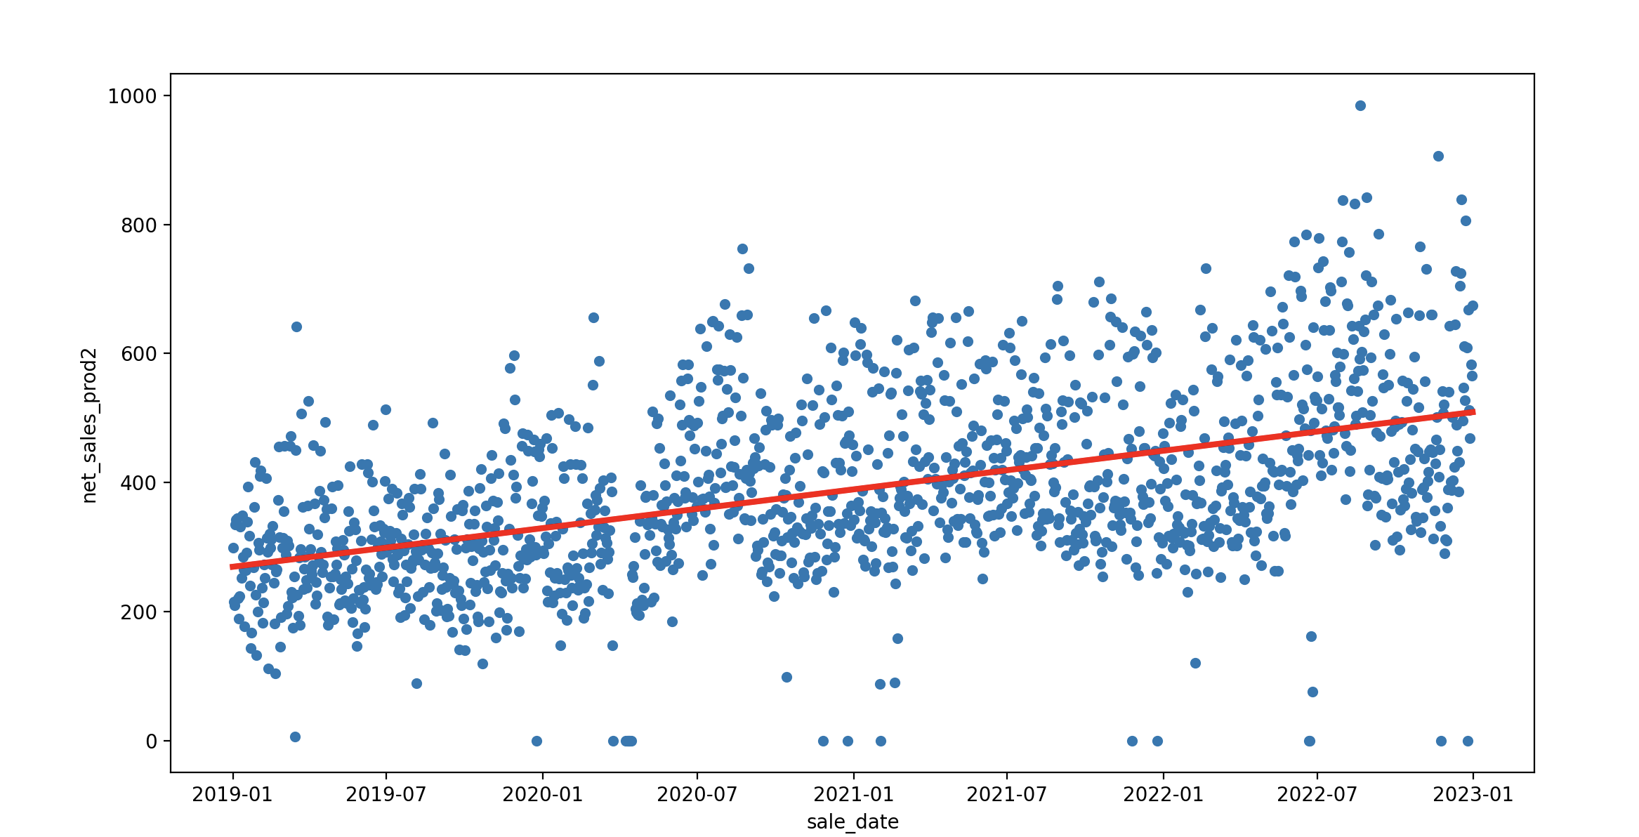
Linear Regression Model
P value= 2.77e-89
Standard Error=8.83e-17
$$Y=\left(1.89e−15\right)∗X −2668.49$$

Slide 11
Things to Consider
Product 1: Quarter 2 has the highest standard deviation
Product 2: Quarter 4 has the highest standard deviation
This indicates that data is spread out for both those quarters
Outliers in the data

Slide 12
Outside Factors
Covid-19 lockdown started Thursday, March 19th 2020
Can see a drop in sales for both products during this time
Affected quarter 1 and quarter 2 sales in 2020 as well as overall averages for both quarters
Other possible economic factors, like the current recession, could have affected sales as well

Slide 13
Further Research
Find out why sales are higher in 3rd and 4th quarters
Research factors to increase sales during quarters 1 and 2
Predict future sales for each product
Find factors causing Product 2 lower sales compared to Product 1

