Slide 1
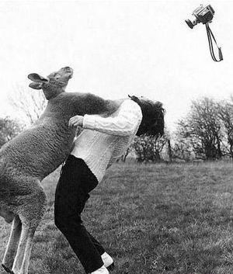
Team Killer Kangaroos
RBE 1001
Final Project
You
Jeffrey Tolbert, Karina Naras, and Sierra Palmer

Slide 2

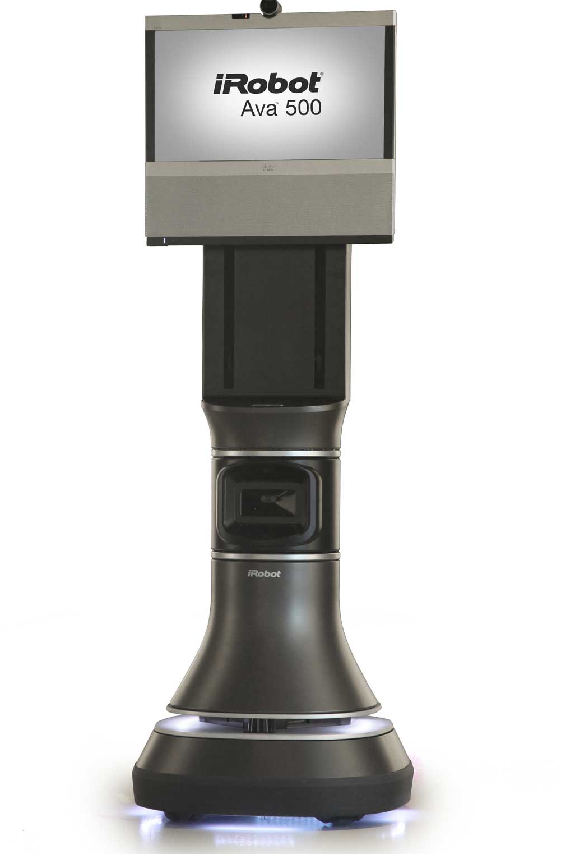
Say hello to the Ava Mobile Robotics Platform
Intent of Ava
Unique compared to other robots
Sensors
Ava Interface
Role of 3rd party developers

Slide 3
Intent of Ava
Modular smart robot movement base
Used for various tasks
Self-driving telepresence for simple use remotely
Allows use in areas such as hallways
No meeting scheduling; stop by offices using Ava

Slide 4
Unique Design Characteristics
Self-driving
Adjustable height for display
Modular for other applications other than telepresence

Slide 5
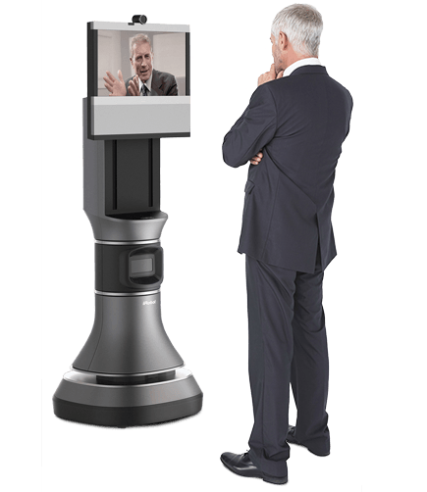
Sensors
LIDAR (light detection and ranging)
Sonar
Touch Sensors
Adjustable platform height by users
Remotely adjustable

Slide 6
Ava Interface
Maps surrounding area by one drive-by
telepresence-specific
Telepresence mode allows user to click on destination
Connects to iPad, Android, and laptop
repurpose for app development

Slide 7
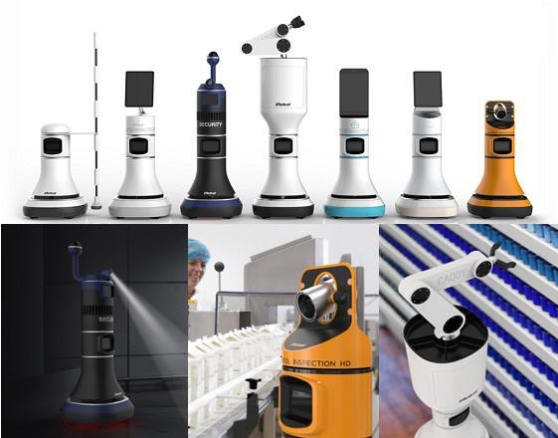
Role of 3rd Party Developers
Develop new top modules to connect to base
Develop app software to use sensors or navigation

Slide 8
What did we find out about Ava?
Used to create a more involved telepresence robot
Self-driving, modular robot
Uses multiple sensors to accomplish tasks
Interface allows for development and better navigation
Allows for development of new modules & software

Slide 9
Questions?

