Slide 1
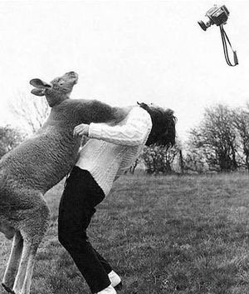
Team Killer Kangaroos
RBE 1001
Final Project
You
Jeffrey Tolbert, Karina Naras, and Sierra Palmer

Slide 2

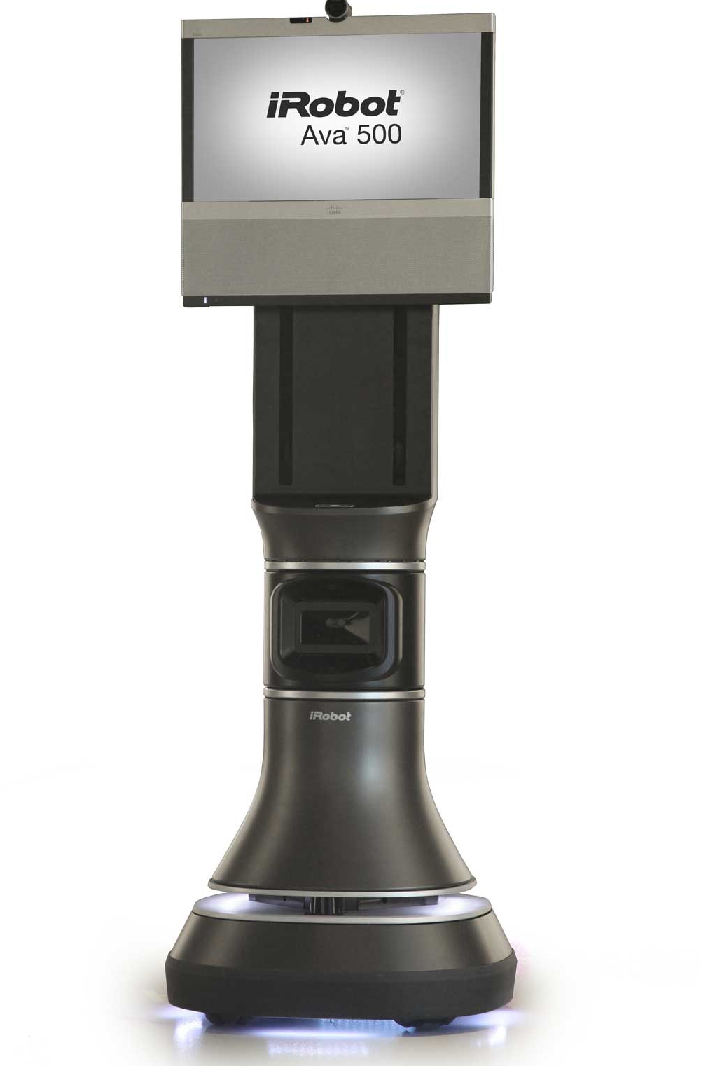
Say hello to the Ava Mobile Robotics Platform
Intent of Ava
Uniqueness compared to other robots
Sensors
Ava Interface
Role of 3rd party developers

Slide 3
Intent of Ava
Modular smart robot movement base
  Used for various tasks
Self-driving telepresence for simple use remotely
  Allows use in areas such as hallways
  No meeting scheduling; stop by offices using Ava

Slide 4
Unique Design Characteristics
Self-driving
Modular for other applications other than telepresence
Adjustable height of display

Slide 5
Sensors
LIDAR
Sonar
Touch Sensors
  Adjustable platform height by users
    Remotely adjustable

Slide 6
Ava Interface
Maps surrounding area by one drive-by
  telepresence-specific
Telepresence mode allows user to click on destination
Connects to iPad, Android, and laptop
  repurpose for app development

Slide 7
Role of 3rd Party Developers
Develop new top modules to connect to base
Develop app software to use sensors or navigation

Slide 8
What did we find out about Ava?
Used to create a more involved telepresence robot
Self-driving, modular robot
Uses multiple sensors to accomplish tasks
Interface allows for development and better navigation
Allows for development of new modules & software

Slide 9
Questions?

