Slide 1

Movie Ticket Reservation System
Members:
VIPUL GUPTA – 2k16/CO/360
YASH GARG – 2k16/CO/366
VU DUY DU – 2k16/CO/364
DBMS PROJECT
Notes:
It is using the background from https://dribbble.com/shots/1588545--Freebie-7-Low-Poly-Backgrounds-svg-png
Template modified by fppt.com

Slide 2

Introduction
Movie Ticket Reservation System is a Database system that allows client to book ticket for the movies. This system contains all the relationship among data of a movie theater. Users access the data and select an interested movie for a ticket.

Slide 3
Movie Ticket Booking System Entities and Their Attributes
To store all the needed information for a reservation, we use TICKET.
Ticket entity:
Ticket number (ticket_no)
Show Date (show_date)
Price (price)

Slide 4
Movie Ticket Booking System Entities and Their Attributes
Each movie will be shown in a different times and in different language which are stored in a particular SHOW.
Show entity:
Starting time (st_time)
Ending time (end_time)
Language (language)

Slide 5
Movie Ticket Booking System Entities and Their Attributes
Movie entity has the data of a movie.
Movie entity:
Movie ID (m_id)
Movie Name (m_name)
Release Date (release_date)
Director (director)
Actors (actors)

Slide 6
Movie Ticket Booking System Entities and Their Attributes
To store the information of a Theater.
Theater entity:
Theater ID (tid)
Theater Name (tname)
Location (location)
Number of Seat (no_of_seat)

Slide 7
Movie Ticket Booking System Entities and Their Attributes
Each seat has its own id, and only can be selected once for each ticket.
Seat entity:
Seat ID (Seat_id)
Seat name (seat_name)

Slide 8
Movie Ticket Booking System Entities and Their Attributes
Admin Information is recorded to tell which Admin works on which theater.
Admin entity:
Admin ID (admin_id)
Password (password)

Slide 9
Movie Ticket Booking System Entities and Their Attributes
Some movie tickets have discount.
Discount entity:
Offer ID (offer_id)
Movie Name (m_name)
Price (price)

Slide 10
Movie Ticket Booking System Entities and Their Attributes
Customer information is recorded in the system so that next time when he/she logins, system will use that already existed information to make a new reservation.
Customer entity:
Customer name (c_name)
Customer ID (cid)
Password (password)
Email ID (email_id)
Phone Number (phone_no)

Slide 11
Movie Ticket Booking System Entities and Their Attributes
Booking is a relationship between Ticket and Customer. When a customer book a new ticket, his ID and the ticket ID will be recorded. New ticket ID is generated.
Booking Relationship:
Booking Date (booking_date)

Slide 12
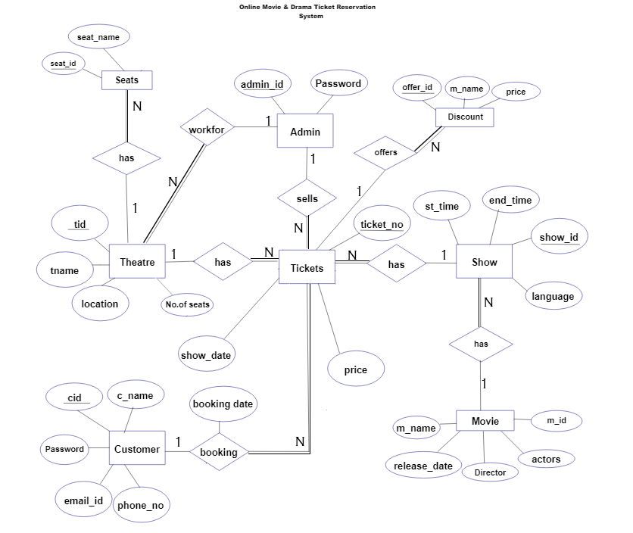
ENTITY RELATIONSHIP
MODEL OF A TICKET
RESERVATION SYSTEM

Slide 13
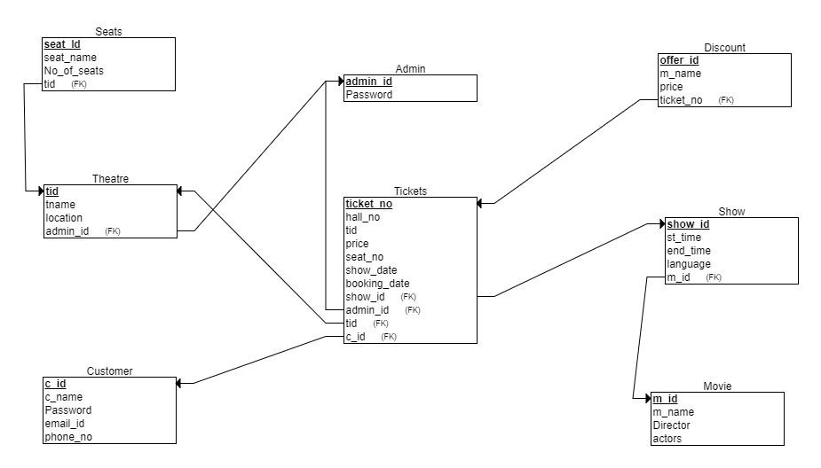
RELATIONAL MODEL OF A TICKET RESERVATION SYSTEM

