Slide 1
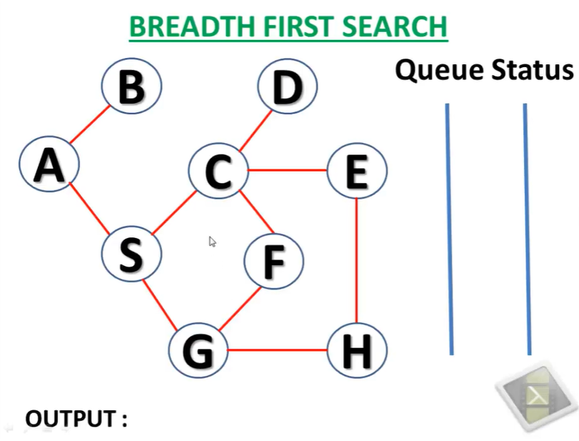

Slide 2
A
A

Slide 3
A
Deque A
B
S
A, B, S

Slide 4
B
Deque B
S
A, B, S

Slide 5
S
Deque S
C
G
A, B, S, C, G

Slide 6
C
Deque C
G
D
E
F
A, B, S, C, G, D, E, F

Slide 7
G
Deque G
D
E
F
H
A, B, S, C, G, D, E, F, H

Slide 8
D
Deque all the nodes in stack which has no child.
E
F
H
A, B, S, C, G, D, E, F, H

Slide 9
