Slide 1
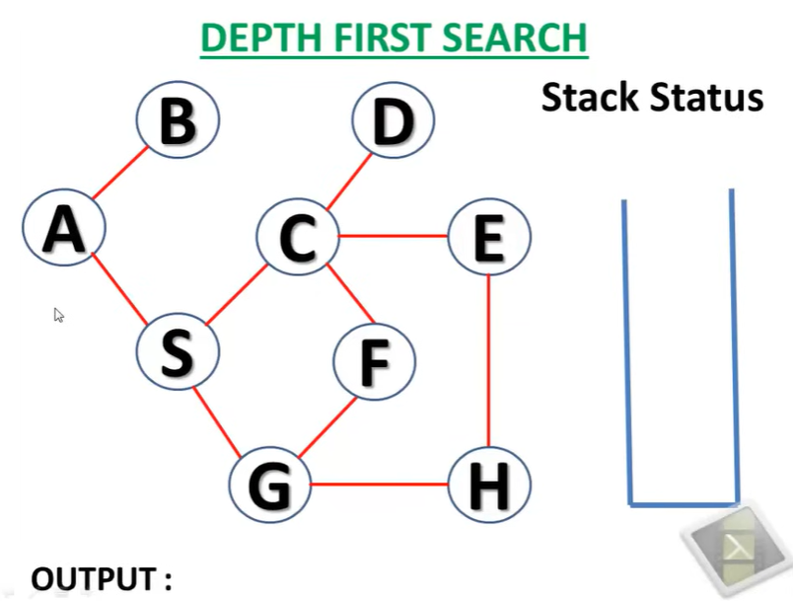

Slide 2
A
A

Slide 3
B
A
A, B

Slide 4
B
B has no child to visit
A
A, B

Slide 5
S
A
A, B, S

Slide 6
C
S
A
A, B, S, C

Slide 7
D
C
S
A
A, B, S, C, D

Slide 8
D
D has no child to visit
C
S
A
A, B, S, C, D

Slide 9
E
C
S
A
A, B, S, C, D, E

Slide 10
H
E
C
S
A
A, B, S, C, D, E, H

Slide 11
G
H
E
C
S
A
A, B, S, C, D, E, H, G

Slide 12
F
G
H
E
C
S
A
A, B, S, C, D, E, H, G, F

Slide 13
F
G
H
All nodes in stack has no child to visit.
E
C
S
A
A, B, S, C, D, E, H, G, F

Slide 14
