Slide 1
Predicting No-Shows of Customers for Hotel Chain
Yeo Siew Ping

Slide 2
Content
Problem Statement
Exploratory Data Analysis
Model Training and Selection
1
2
4

Slide 3
Problem Statement
To predict the No-Show of customers to help a hotel chain to formulate policies to reduce expenses incurred due to No-Shows.
Supervised binary classification model (0 for show , 1 for no-show)

Slide 4
Exploratory Data Analysis
From bivariate analysis :
Majority of the no show cases are from Changi hotel branch.
No shows are the highest during the arrival months of May to August and this seems to be in line with the summer season of the year.
A significant number of no shows were visitors from China.
Large majority of no shows are from visitors who booked the room at the hotel for the first time and from those who booked a king sized room

Slide 5
Exploratory Data Analysis
One of the hypotheses made → The lower the room price, the higher the tendency for customers to do a no-show
Assumptions made:
Customers have paid a deposit for the room booking through the respective booking platforms
Lower room price → lower booking deposit

Slide 6
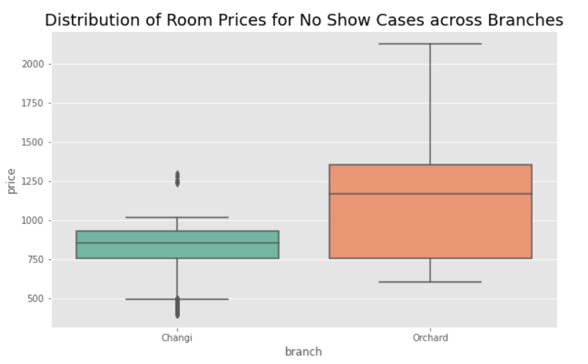
Exploratory Data Analysis
Based on the bivariate analysis of the features, noshow cases are higher for the Changi branch
Room prices are indeed lower for Changi branch – lower accesibility

Slide 7
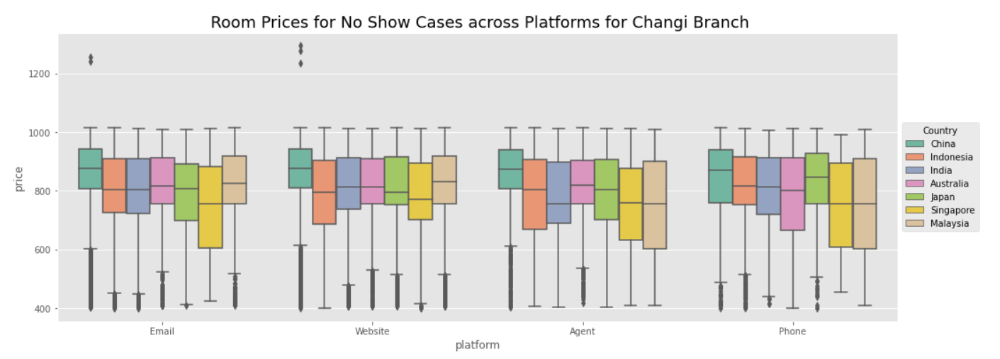
Exploratory Data Analysis
Prices are quite consistent across platforms for each country
Customers from China paid the highest compared to other customers, but yet highest no-show cases

Slide 8
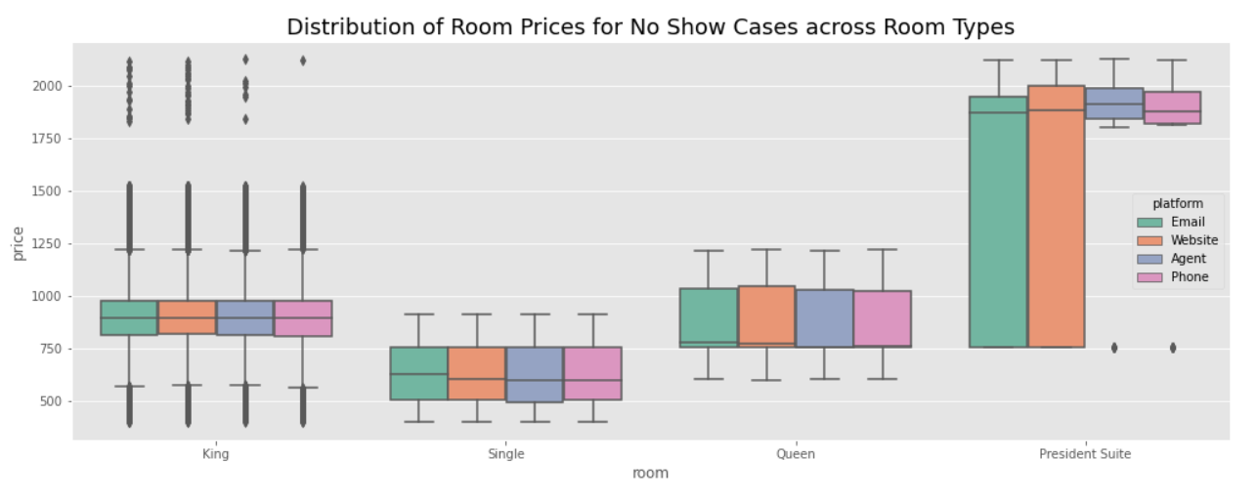
Exploratory Data Analysis
Room prices are also consistent across platforms for different room types
King-sized rooms have highest no-shows but yet one of the more expensive rooms

Slide 9
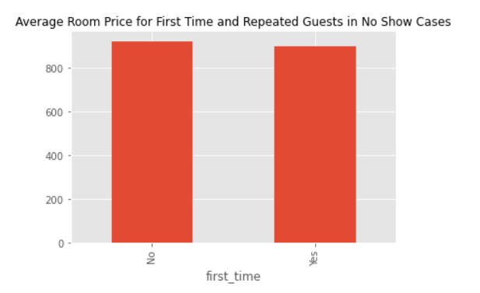
Exploratory Data Analysis
Bivariate analysis → first time customers have higher no-shows
No significant difference in room prices
Room prices might not have much influence on no shows

Slide 10
Model Training and Selection
Dataset is moderately imbalanced → SMOTE and class weights adjustment
Data cleaning, Get dummies and frequency encoding, feature scaling
Algorithms explored: Logistic Regression, K Nearest Neighbours, Naives Bayes, Random Forest, XGBoost
Metrics used:
F1-score - harmonic mean of precision and recall
AUC score - area under the ROC curve → performance of a classification model at all classification thresholds

Slide 11
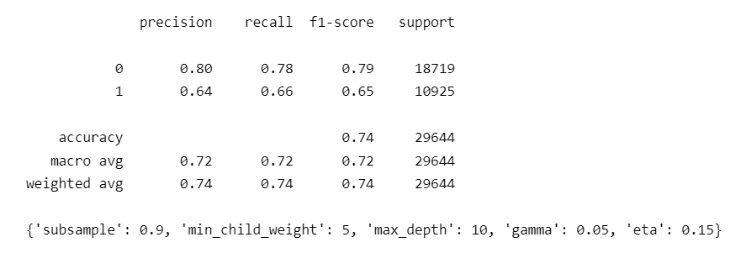
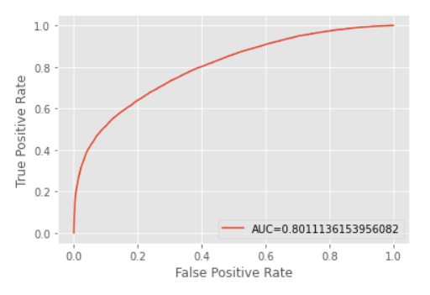
Model Training and Selection
Best model based on F1-score and AUC score – XGBoost model with class weights adjustment
Cross validation is done for every model training process to prevent model over-fitting
Hyper-parameter tuning is done for XGBoost model

Slide 12
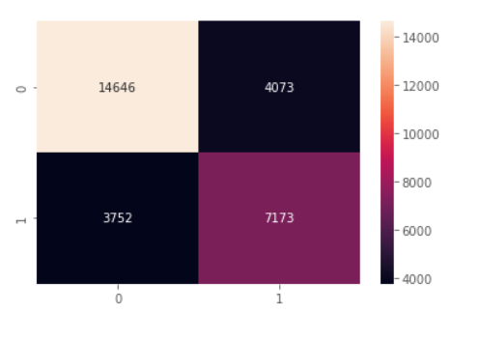
Model Training and Selection
At probability threshold of 0.5 , 13% false negatives 14% false positives
Need to consider business impacts of false positives (Type I error) and false negatives (Type II error) to assess if model is suitable
Business cost of Type I error → revenue loss from promotions/discounts given , man-hours to follow up with potential no-shows
Business cost of Type II error → loss of revenue from no-shows
Probability thresholds can be adjusted accordingly
Real cost ratio can be used for class weights adjustment

Slide 13
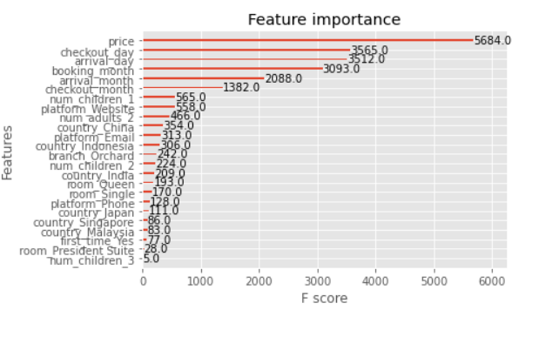
Model Training and Selection
Price is one of the most important feature in model training process → opposite from EDA results
Top features include time features → major influence when analyzed together with time features , time-sensitive

