Slide 1
Name: Sifa Yusuf Kazi
Role: Data Analyst Intern
Tool Used: Power BI
Dataset Used: Superstore Sales Dataset (Kaggle)
Project Type: Sales & Profit Analysis Dashboard
Date: 15/12/25

Slide 2
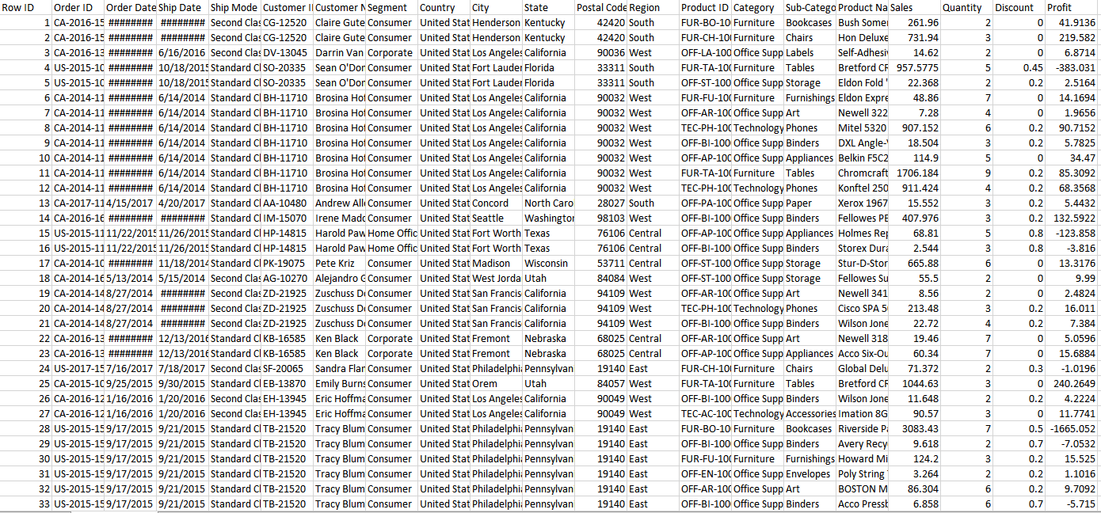

Slide 3
Slide 1 — Dashboard Overview
Dashboard Title: Sales & Profit Analysis Dashboard
Objective:
To design an interactive dashboard for business stakeholders that provides a clear overview of sales performance, profit trends, growth percentage, and order analysis using interactive visuals and filters.
This dashboard helps decision-makers understand business performance at a glance.

Slide 4
Slide 2 — Dashboard KPIs
This dashboard highlights the following KPIs:
Total Sales: 142.45K
Total Profit: 10.86K
Sales Growth: 59.49%
Total Orders: 641
These KPIs help understand the overall business performance and growth.

Slide 5
Slide 3— Visuals Included
The dashboard includes the following visuals:
Line Chart – Sum of Sales by Year
Shows sales trends over time.
Bar Chart – Profit by Category
Compares profit across Technology, Furniture, and Office Supplies.
Tree Map – Sales by Sub-Category
Highlights contribution of each sub-category to total sales.
Table – Sales Details
Displays detailed sales and profit information.
Column Chart – Profit by Category
Compares profit across Technology, Furniture, and Office Supplies.
Donut Chart – Profit by Region
Shows percentage contribution of profit from each region (West, East, South, Central).

Slide 6
Slide 4 — Filters (Slicers) Used
The dashboard is fully interactive using slicers:
Region: Central, East, South, West
Category: Furniture, Office Supplies, Technology
Order Date: Year and Month
These slicers allow users to filter and analyze data dynamically based on business needs.

Slide 7
Slide 5 — Dashboard Pages Explanation
Page 1: Sales Overview
Displays KPIs (Sales, Profit, Growth %, Orders)
Shows overall sales trend
Category-wise sales
Region-wise profit distribution
High-level business summary
Page 2: Sales Analysis
Category-wise profit comparison
Sub-category performance analysis
Detailed sales table
Deeper insights for decision-making

Slide 8
Slide 6 — Key Insights
Key insights derived from the dashboard:
Sales show strong growth in recent years.
Technology category generates the highest sales and profit.
Certain regions contribute more to overall profit.
Some sub-categories perform significantly better than others.
Furniture category shows lower profit compared to other categories.

Slide 9
Slide 7 — Conclusion
This dashboard provides a clear overview of sales performance, profit trends, and category-wise analysis.
Interactive visuals and filters allow users to explore data easily and identify key business insights.
Overall, the dashboard supports informed and data-driven decision-making for business growth.

Slide 10
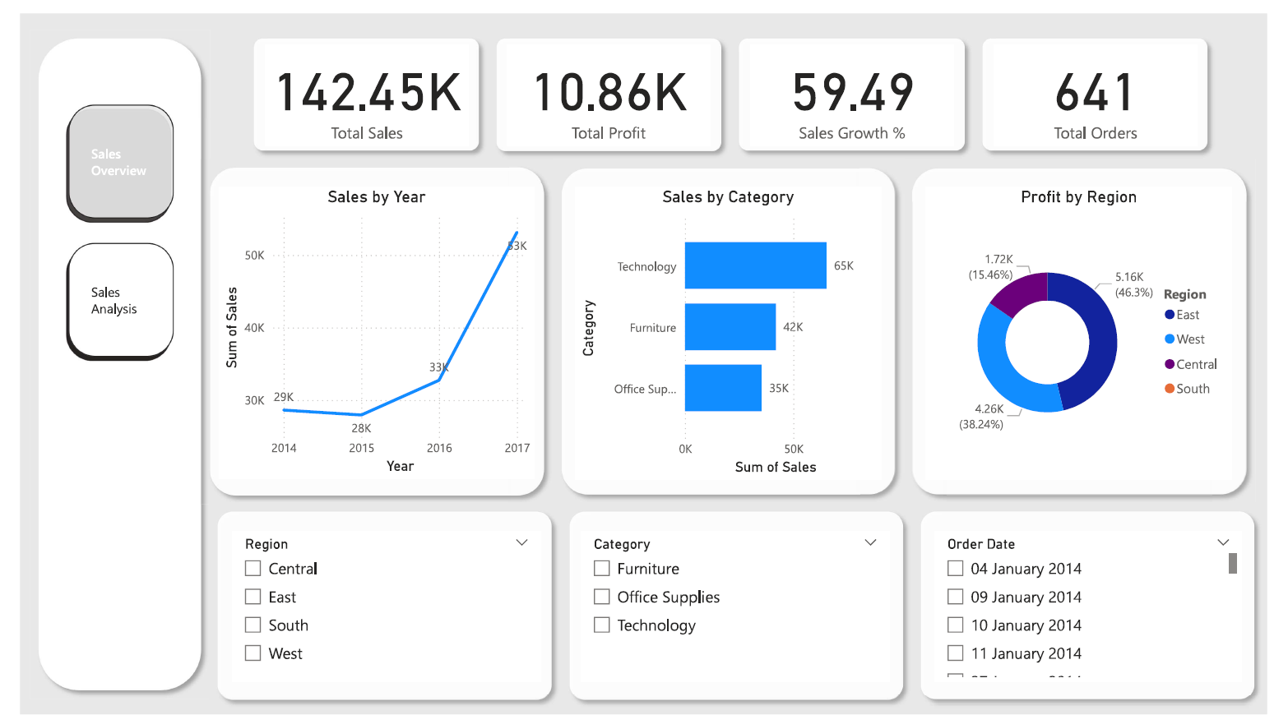

Slide 11
