Slide 1

OpenShift
Source-to-Image

Slide 2


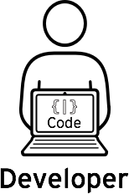



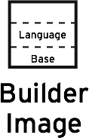
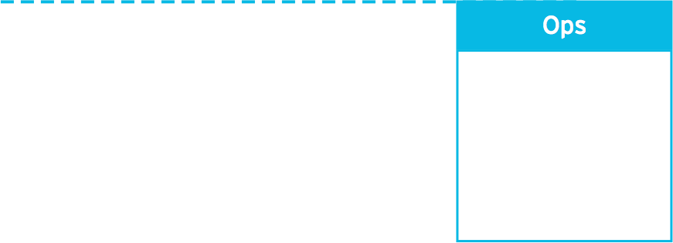

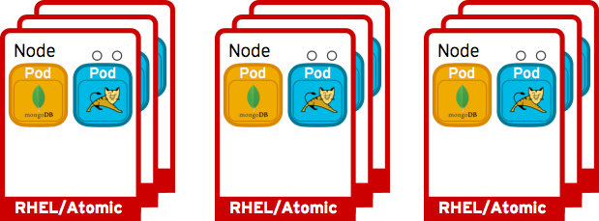
Source 2 Image Walk Through
Can configure triggers for automated deployments, builds, and more.
Code
Build
Can configure different deployment strategies like A/B, Rolling upgrade, Automated base updates, and more.
Deploy

Slide 3
Source 2 Image Walk Through
Can configure triggers for automated deployments, builds, and more.
Code
Developers can leverage existing development tools and then access the OpenShift Web, CLI or IDE interfaces to create new application services and push source code via GIT. OpenShift can also accept binary deployments or be fully integrated with a customer’s existing CI/CD environment.

Slide 4
Source 2 Image Walk Through
Can configure triggers for automated deployments, builds, and more.
Build
OpenShift automates the Docker image build process with Source-to-Image (S2I). S2I combines source code with a corresponding Builder image from the integrated Docker registry. Builds can also be triggered manually or automatically by setting a Git webhook.

Slide 5
Source 2 Image Walk Through
Can configure triggers for automated deployments, builds, and more.
Deploy
OpenShift automates the deployment of application containers across multiple Node hosts via the Kubernetes scheduler. Users can automatically trigger deployments on application changes and do rollbacks, configure A/B deployments & other custom deployment types.
Can configure different deployment strategies like A/B, Rolling upgrade, Automated base updates, and more.

