Slide 1

Proposal: Airbnb Pricing Prediction
Team 8:
Peiqi Chen
Sifan Zhu
Rohan Chaudhary
Ashley Mercado

Slide 2

The Problem
We aim to use the Airbnb dataset to predict the log pricing of each individual listing with the given variables in the data.
(Target Variable: log price)
We found this important because it gives us a look into how each of the variables affects the price
Users
Hosts
Company

Slide 3

Data Source & Dataset Description
We chose Kaggle because the dataset met all of the requirements and the entire team agreed upon it
Our dataset contains:
29 columns
74,111 rows
The different types of variables that are included are:
Categorical variables
Numerical variables
Booleans
Dataset Link: https://www.kaggle.com/datasets/stevezhenghp/airbnb-price-prediction

Slide 4
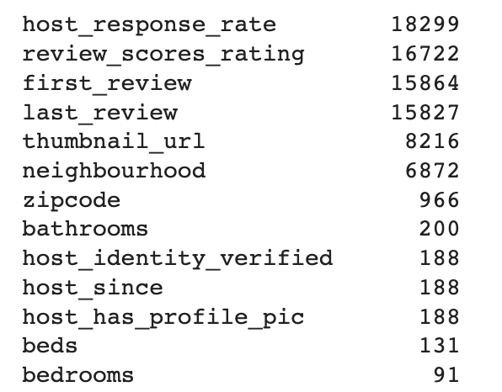
Data Exploration and Cleaning
data.isna().sum().sort_values(ascending = False)
No duplicate Values present
High number of Missing values in certain columns
Recognizing redundant columns
Handling Numeric missing values
Random Forest to predict and handle categorical missing values
Pairplot to identify relationships

Slide 5
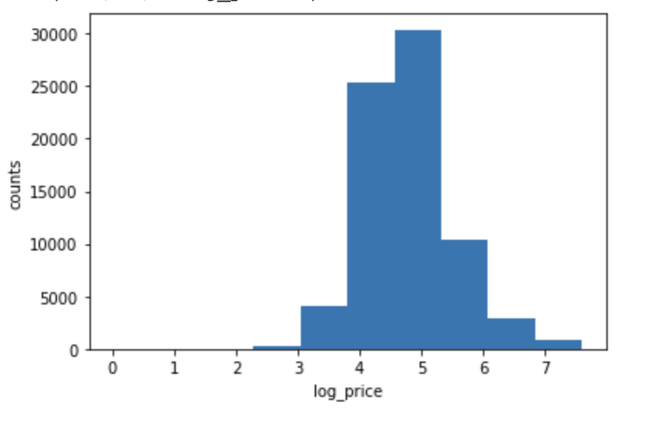
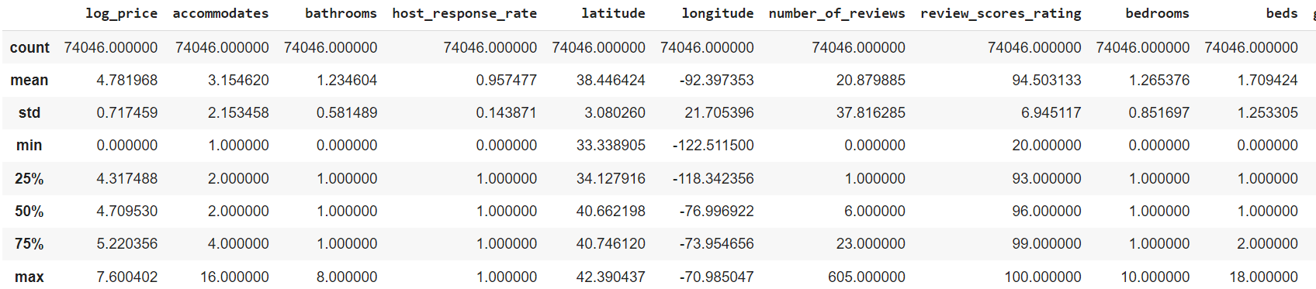
Data Loading and Summary Statistics
We calculated the Summary Statistics for the entire Airbnb dataset, however below we only provided 10 variables as a quick summarization

Slide 6
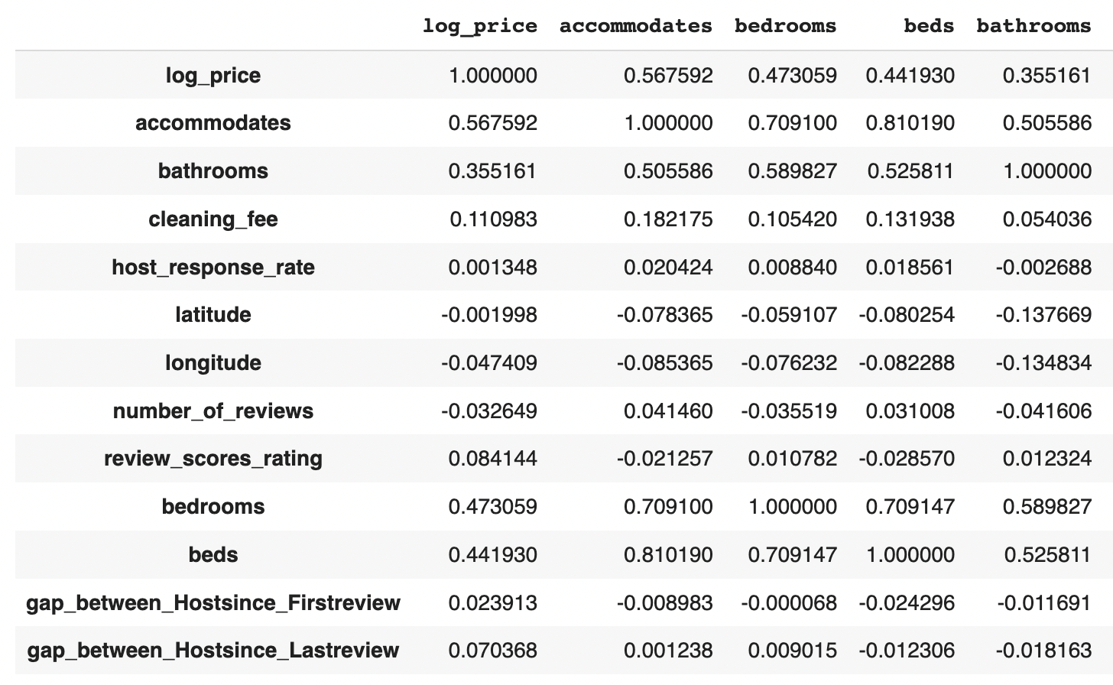
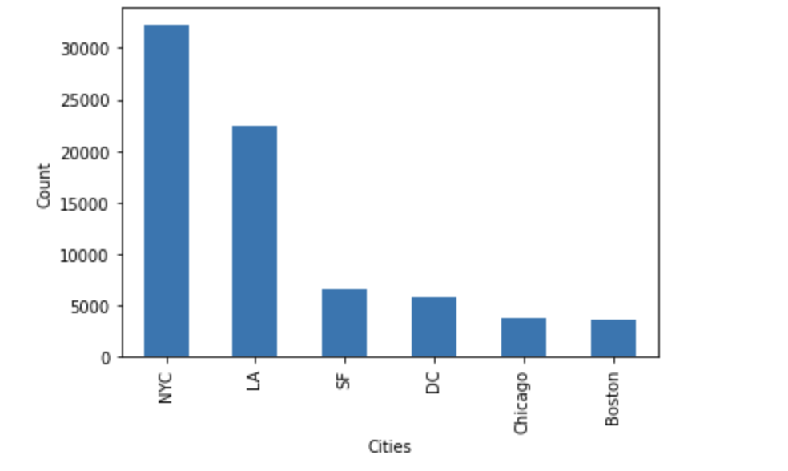
Data Exploration and Cleaning
Correlation matrix to identify potential patterns
Analyzing values of categorical variables like city, property_type, amenities, accommodates

Slide 7
Results and Potential Implications
Use a linear regression model to predict the pricing for each listing, through columns transformation and regularization (Lasso or Ridge)to improve model performance.
Evaluate model performance using metrics like MSE, RMSE and R-squared.
Results will have valuable implications for users, hosts and Airbnb company
Users save money and get comparable prices
Hosts make money by setting a price that gets more bookings
Company increases revenue and targets customers

Slide 8
Thank You!

