Slide 1


SYSTEMATIC LITERATURE REVIEW
Semantic Caching for LLM Inference
A Systematic Literature Review — 87 records screened to 66 papers
Kaniz Reza Mithila
Khaled Mahmood Sifat
Redwan Ahmed
ID: 2022-3-60-052
ID: 2022-3-60-217
ID: 2022-3-60-155

Slide 2


The Problem
LLM inference recomputes everything, every time
Repeated Query
•LLM inference is computationally expensive — every query recomputes from scratch
•Semantic caching is the field's proposed fix: reuse a stored response for a similar new query
•It is frequently marketed as a green-computing technique
Cache Hit
Recompute from
Scratch
Semantic caching decides reuse by meaning, not exact text match

Slide 3
THE GAP & OUR CONTRIBUTION
No review has consolidated this literature — until now
•No published review consolidates this fast-growing literature
•This review: systematic search, five databases, three rounds, 87 candidate records
87
84
66
5
records identified
screened
papers included
clusters
We also found something the field has not measured.

Slide 4
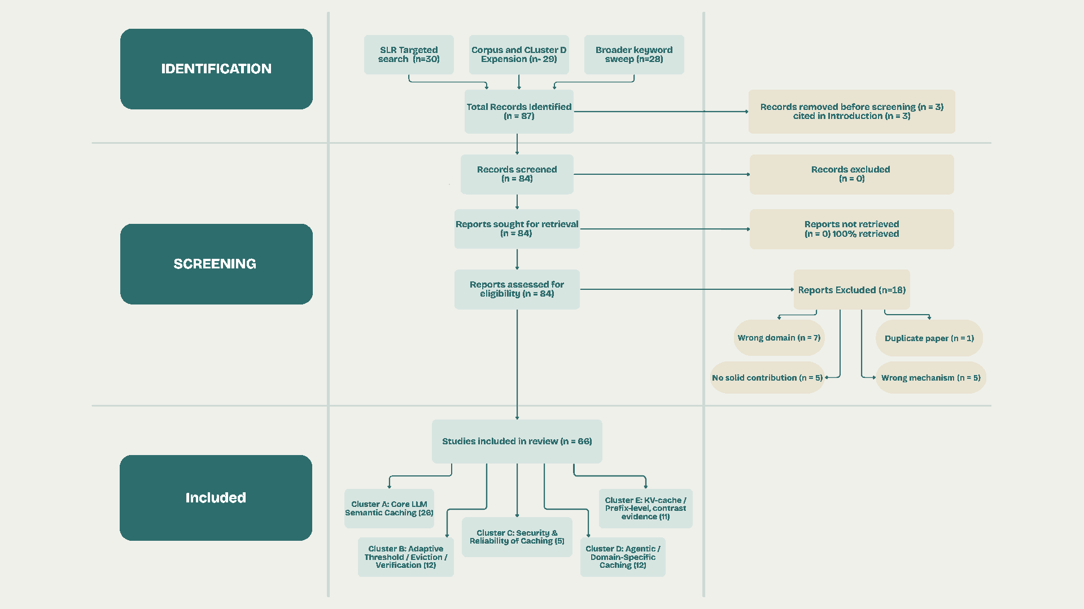
METHODOLOGY
Three
search
rounds,
full-text screening,
five cluster

Slide 5
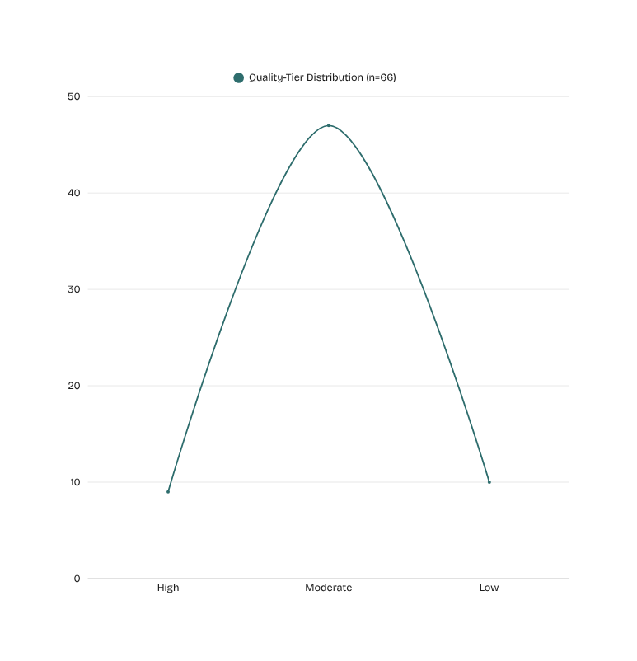
QUALITY ASSESSMENT
Quality matters as much as inclusion
•A four-dimension rubric scored every included paper: venue rigor, evaluation depth, reproducibility, limitation transparency
Low tier stays in the corpus.
It just carries less weight.

Slide 6
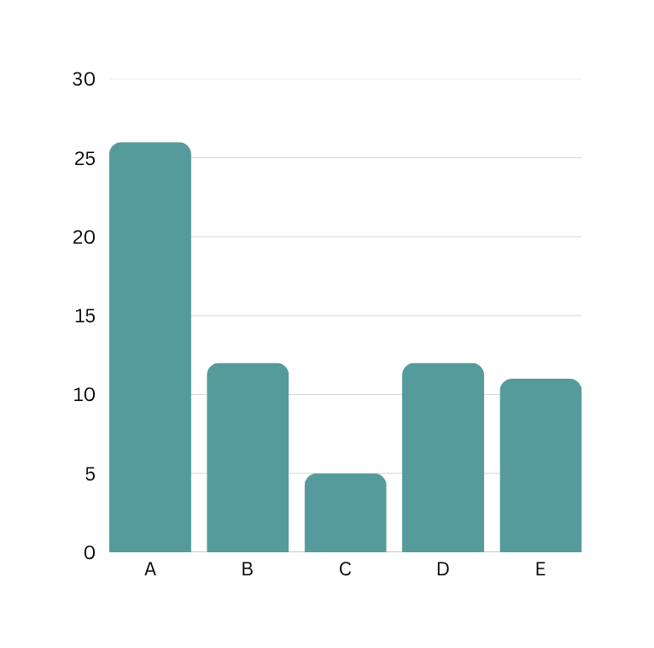
Five Clusters
TAXONOMY
A-Core LLM Semantic Caching
B -Adaptive Threshold / Eviction / Verification
C -Security & Reliability of Caching
D -Agentic / Domain-Specific Caching
E -KV-Cache / Prefix-Level Caching (contrast evidence — not core)
Cluster E is kept separate on purpose — it reuses internal model state within a single generation, a structurally different mechanism from cross-query semantic caching. It is retained as contrast evidence, not core evidence.

Slide 7
CROSS-CUTTING SYNTHESIS
Five Patterns That Recur
P 1
P 2
P 3
The similarity threshold is unreliable
Caching stays blind to context
Each fix improves one thing and leaves the next
P 4
P 5
Reliability fixes add unmeasured cost
Cached results going stale is understudied

Slide 8
THE GAP
THE CENTRAL FINDING
Not one paper in this corpus measures the energy cost of semantic caching against the inference it replaces
18 papers report comparable results. 0 report an energy figure.

Slide 9

OPEN QUESTIONS FOR THE FIELD
Three Open Questions
Under what workload and threshold conditions does query-level semantic caching produce a net energy saving, once embedding generation, vector search, and verification overhead are included in the accounting — not only the inference calls the cache avoids?
1
Is there a minimum cache hit rate below which semantic caching costs more energy than always performing direct inference?
2
3
Does a high cache hit rate reliably imply high net energy savings, or can the two diverge?
8

Slide 10
LIMITATIONS
We want to be upfront about our own limits
LIMITATIONS
Screening done without a second independent reviewer
Search strategy reconstructed from screening records, not a preserved query log
Four papers with an unconfirmed venue

Slide 11
CONCLUSION
What we built — A 66-paper corpus across five clusters, with a four-dimension quality rubric applied to every paper
What we found — Five recurring patterns — no single paper states any of them alone
What we're proposing — Three open questions the field has left unanswered on energy cost
Not one paper in this corpus measures whether semantic caching actually saves energy.
That's the gap we're leaving the field with.
CEO & Founder
Co - Founder
Marketing Manager

Slide 12
Thank You

