Slide 1
PLA
Asnuva Tanvin

Slide 2
PLA
Suppose, you want to design a combinational circuit that converts a 12 bit card code to a 6 bit alphanumeric code.
The input contains 12 lines designated by 0,1,2,.....,10,11
The size of the combinational circuit must be 4096 X 6 since there are 12 inputs and 6 outputs. (2¹²=4096)
But suppose there are only 47 valid card codes.
That means 4049 don’t care conditions!!!
The remaining 4049 combinations are not used and thus wasted.
PLA is a type of LSI component that can solve this problem.

Slide 3
PLA
PLA does not provide full decoding of the variables and does not generate all minterms.
Programmable Logic Array(PLA) is a fixed architecture logic device with programmable AND gates followed by programmable OR gates.
The AND and OR gates inside the PLA are initially fabricated with fuses among them.
The specific Boolean functions are implemented in sum of products form by blowing appropriate fuses and leaving the desired connections.

Slide 4
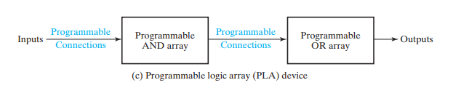
PLA
A Programmable Logic Array (PLA) is a digital electronic device used to implement combinational logic circuits. It consists of a grid of programmable AND and OR gates, where the inputs to the AND gates are programmable, and their outputs are fed into OR gates. By programming the connections within the array, various logical functions can be implemented, making it highly versatile for a range of applications.

Slide 5
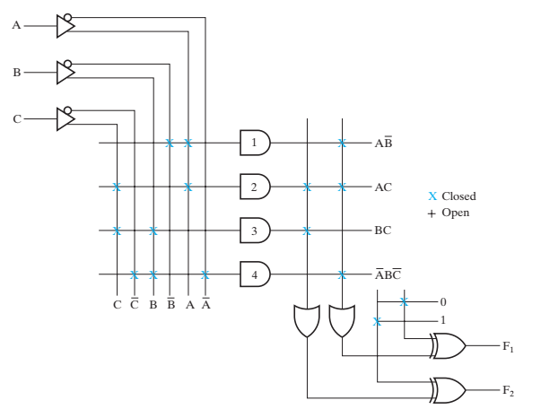

Implement boolean function with PLA-1
Y ⊕ 1 = ~Y
Y ⊕ 0 =Y⊕

Slide 6
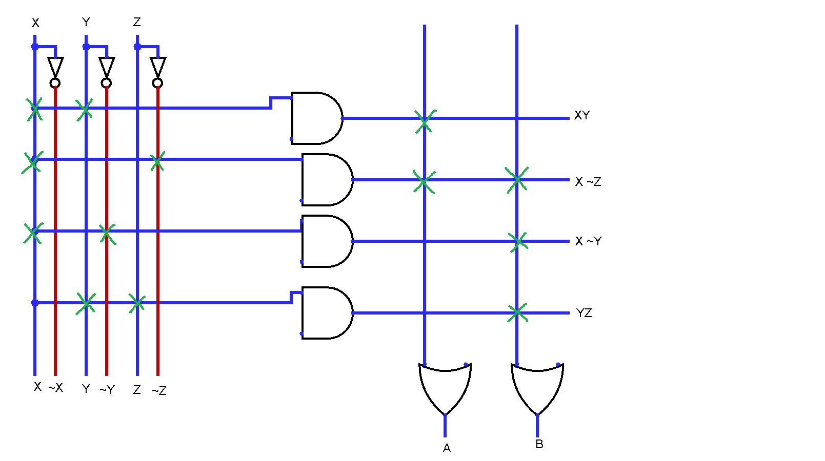
Implement boolean function with PLA-2
Can you find expressions for A and B ?

Slide 7
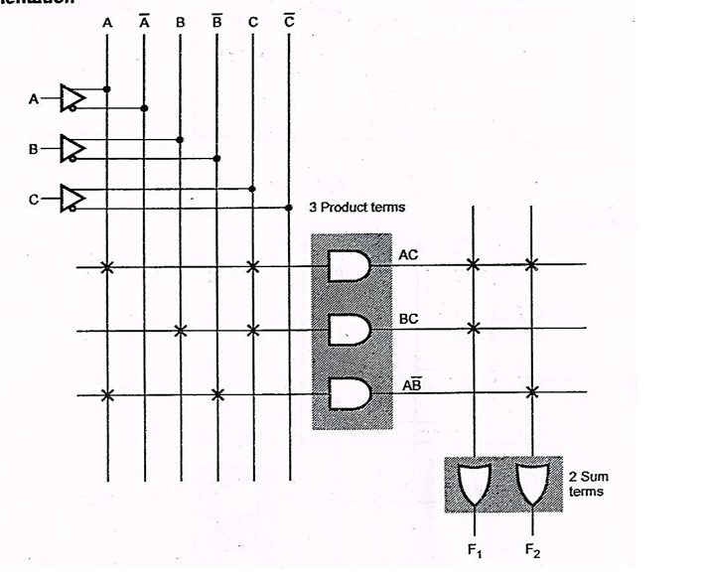
Implement boolean function with PLA-3
F1 = AC+ BC
F2= ?

