Slide 1
Multiple Pattern Matching (MPM) Problem
Goal: Given a set of patterns and a text, find all occurrences of any of patterns in text.
Input: k patterns p¹,…,p^{k}, and text of n characters t = t₁…t_{n}
Output: Positions 1 < i < n where the substring of text t starting at i matches one of the patterns p_{j} for 1 < j < k.
Suppose, the given text is ATCGATC
The patterns to be searched are G, T, C, TC, ATC, M
G will be found at position 4
A will be found at positions 1, 5
C will be found at positions 3, 7
TC will be found at positions 2, 6
ATC will be found at positions 1, 5
M will not be found at any position

Slide 2
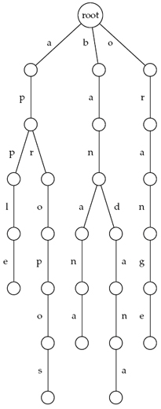
Keyword Trees: Properties
Stores a set of keywords in a rooted labeled tree.
Each edge is labeled with a letter from an alphabet.
Any two edges coming out of the same vertex have distinct labels.
Every keyword stored can be spelled on a path from root to some leaf.
Furthermore, every path from root to leaf gives a keyword.

Slide 3
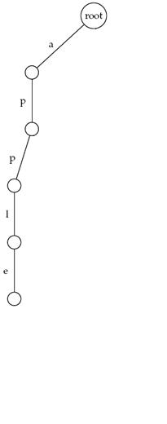
Keyword Trees: Example
Keyword tree:
Apple

Slide 4
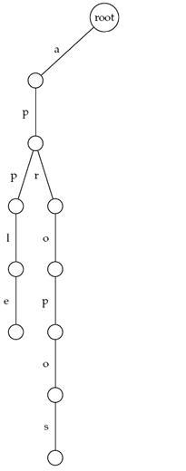
Keyword Trees: Example
Keyword tree:
Apple
Apropos

Slide 5
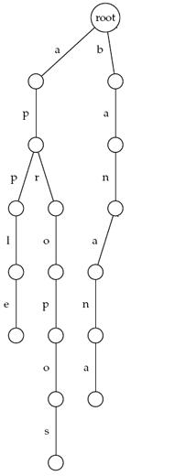
Keyword Trees: Example
Keyword tree:
Apple
Apropos
Banana

Slide 6
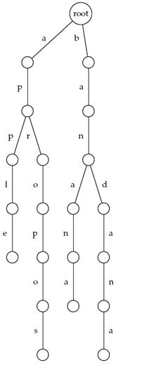
Keyword Trees: Example
Keyword tree:
Apple
Apropos
Banana
Bandana

Slide 7
Keyword Trees: Example
Keyword tree:
Apple
Apropos
Banana
Bandana
Orange

Slide 8
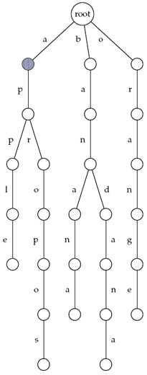
Keyword Trees: Threading
Thread “appeal”
appeal

Slide 9
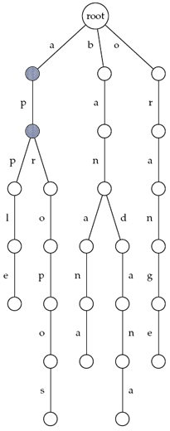
Keyword Trees: Threading
Thread “appeal”
appeal

Slide 10
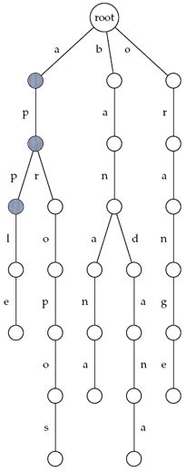
Keyword Trees: Threading
Thread “appeal”
appeal

Slide 11
Keyword Trees: Threading
Thread “appeal”
appeal

Slide 12
Keyword Trees: Threading
Thread “apple”
apple

Slide 13
Keyword Trees: Threading
Thread “apple”
apple

Slide 14
Keyword Trees: Threading
Thread “apple”
apple

Slide 15
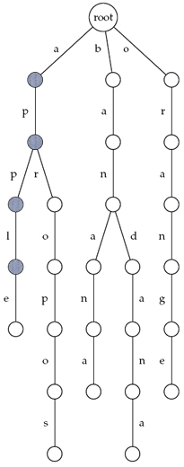
Keyword Trees: Threading
Thread “apple”
apple

Slide 16
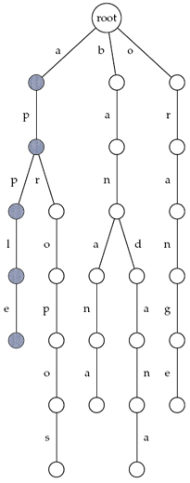
Keyword Trees: Threading
Thread “apple”
apple

Slide 17
Suffix Trees = Collapsed Keyword Trees
Suffix Tree: Similar to keyword tree,
Suffixes of the text are keywords
Edges that form paths are collapsed
Each edge is labeled with a substring of the text
All internal nodes have at least two outgoing edges.
Leaves are labeled by the index of the pattern.

Slide 18
Suffix Tree of a Text
The suffix trees of a text is constructed for all its suffixes.
Example: Suffix tree of ATCATG:
ATCATG
TCATG
CATG
ATG
TG
G
Keyword Tree
Suffix Tree

Slide 19
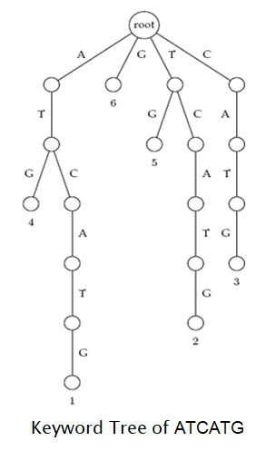
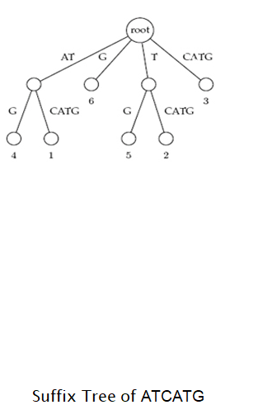
Suffix Tree of a Text
1
2
3
4
5
6
A T C A T G
Suffixes of the text
A T C A T G
1
ATCATG
TCATG
CATG
ATG
TG
G
2
3
4
5
6

Slide 20
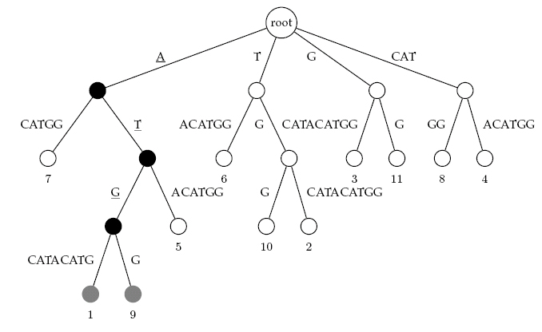
Suffix Trees: Example
Example: Suffix tree of
1
2
3
4
5
6
7
8
9
10
11
12
ATGCATACATGG

Slide 21
Pattern Matching with Suffix Trees
To find any pattern in a text:
Build suffix tree for text of length n
Thread the pattern of length m through the suffix tree of the text

Slide 22
Pattern Matching with Suffix Trees
SuffixTreePatternMatching(p,t)
Build suffix tree for text t
Thread pattern p through suffix tree
if threading is complete
output positions of all p-matching leaves in the tree
else
output “Pattern does not appear in text”

Slide 23
Threading through a Suffix Tree
ATGCATACATGG
Find the pattern ATG!
Found at position 1 and 9!
Suffix Tree of ATGCATACATGG

Slide 24
Suffix Trees: Runtime
Say the length of the text is n.
Construction of the keyword tree takes O(n²) time.
Constructing the suffix tree takes O(n) time.
So our method takes O(n² + n) = O(n²) time.
However, there exists a method of calculating the suffix tree in O(n) time without needing the keyword tree for the suffixes.
ATCATG TCATG CATG ATG TG G
Keyword Tree
Suffix Tree

Slide 25
Suffix Trees: Runtime
Say the length of the text is n.
Construction of the keyword tree takes O(n²) time.
Constructing the suffix tree takes O(n) time.
So our method takes O(n² + n) = O(n²) time.
However, there exists a method of calculating the suffix tree in O(n) time without needing the keyword tree for the suffixes.
ATCATG TCATG CATG ATG TG G
Keyword Tree
Suffix Tree

Slide 26
Pattern Matching with Suffix Trees
To find any pattern in a text:
Build suffix tree for text of length n—O(n) time
Thread the pattern of length m through the suffix tree of the text—O(m) time.
Therefore the runtime of the Pattern Matching Problem is only O(m + n)!

