Slide 1
Embedded systems (Introduction )

Slide 2
Definition
What is embedded system?
An embedded system is a combination of computer hardware and software designed for a specific function.
It may also function within a larger system.
The systems can be programmable or a fixed functionality.

Slide 3
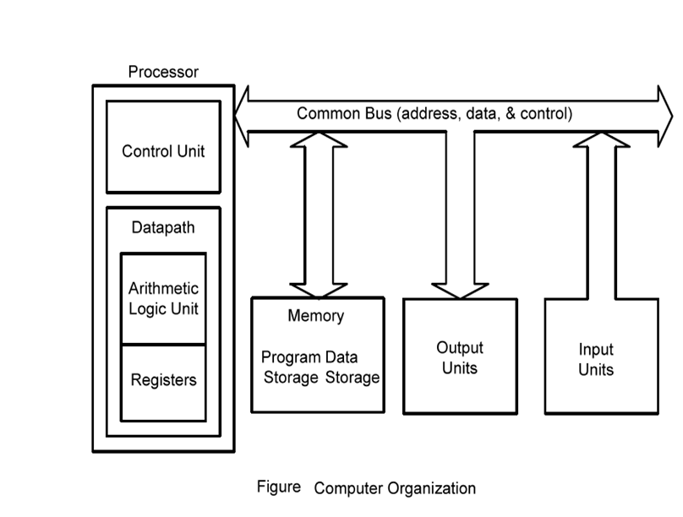
Computer Hardware Organization

Slide 4

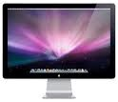
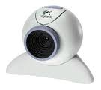


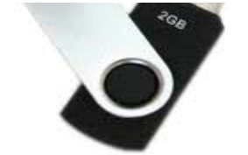
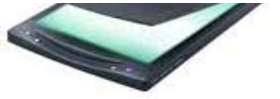

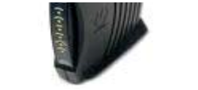


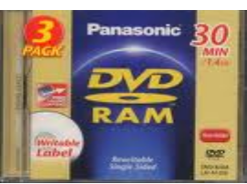
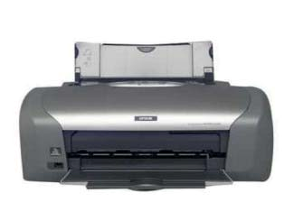
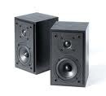


Computer Systems
R
A
Processor
M
Computer Systems
Internal (processor + memory (RAM)
Peripheral (Disk, Display, Audio, Eth,..)

Slide 5


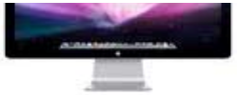
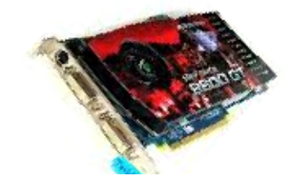


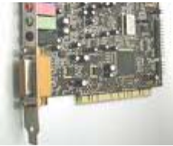
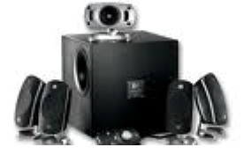
I
ntroduction
R
Processor
A
M
Peripherals : HD monitor, 5.1 speaker
Interfaces : Intermediate Hardware
Nvidia GPU card, Creative Sound Blaster card
Interfaces : Intermediate Software/Program
Nvidia GPU driver , Sound Blaster Driver software

Slide 6
Peripheral
A peripheral is a device that is connected to a host computer, but not part of it. It expands the host's capabilities but does not form part of the core computer architecture. It is often, but not always, partially or completely dependent on the host.
Types:
Input, used to interact with, or send data to the computer
Output, which provides output to the user from the computer
Storage, which stores data processed by the computer

Slide 7
Interfacing
The technique by which we can add additional devices with the main processor called interfacing.

Slide 8
Interface
An interface is the point of interaction with software, or computer hardware, or with peripheral devices.
Types
Hardware interfaces
Software interfaces

Slide 9
Hardware interfaces
Hardware interfaces exist in computing systems between many of the components such as the various buses, storage devices, other I/O devices.
Types:
Parallel Interface
Serial Interface

Slide 10
Software Interfaces
Software interfaces (programming interfaces) are the languages, codes and messages that programs use to communicate with each other and to the hardware. Examples are the Windows, Mac and Linux operating systems, SMTP email, IP network protocols and the software drivers that activate the peripheral devices.

Slide 11
Example
Suppose, you have a document open in a word processor, when you click to save the document the word processor will communicate with the operating system (software-software interface). The operating system would then use a software-hardware interface to communicate with the hard drive (or other storage device) and carry out the task.

Slide 12
Bus
A bus is a communication system that transfers data between components inside a computer, or between computers.
This expression covers all related hardware components (wire, optical fiber, etc.) and software, including communication protocol.
Types:
Internal bus
External bus

Slide 13
Internal Bus
The internal bus, also known as internal data bus, memory bus, system bus or Front-Side-Bus, connects all the internal components of a computer, such as CPU and memory, to the motherboard.
Internal data buses are also referred to as a local bus, because they are intended to connect to local devices.

Slide 14
External Bus
The external bus, or expansion bus, is made up of the electronic pathways that connect the different external devices, such as printer etc., to the computer.

Slide 15
References….
Microprocessors Principles and Applications by Ajit Pal
Microcomputer Systems: The 8086/8088 Family Architecture, Programming and Design. Youzheng Liu, Glenn A. Gibson
Intel Microprocessors 8086/8088, 80186/80188, 80286, 80386, 80486, Pentium, Pentium Processor, Pentium II, III, 4 By Barry B. Brey
Microprocessors, PC Hardware and Interfacing By – N. Mathivanan
Advanced Microprocessors and Interfacing By – Badri Ram
Microprocessor 8085 by Ramesh Gaonkar

