Slide 1
Multiprocessor System
Advantages & Disadvantages
Basic configurations
Microcomputer Systems; The 8086/8088 family
-Gibson
( Chapter 11)

Slide 2
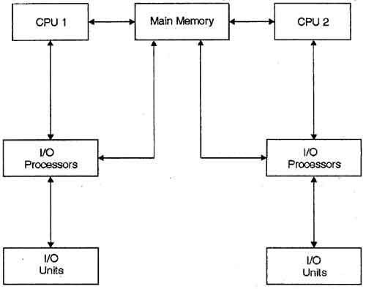
Multiprocessor System
Multiprocessor system is a type of parallel system in which two or more processors work together to process more than one program simultaneously.

Slide 3
Advantages
Reduced Cost: Multiple processors share the same resources. Separate power supply or mother board for each chip is not required. This reduces the cost.
Increased Reliability: The reliability of system is also increased. The failure of one processor does not affect the other processors though it will slow down the machine.

Slide 4
Advantages(Contd.)
Increased Throughput: An increase in the number of processes completes the work in less time.
Easy to add more processor as need arises.
Task are divided among modules, so if any failure occurs, so it is easier and cheaper to find and replace.

Slide 5
Disadvantages
Bus contention
Bus contention is an undesirable state of the bus in which more than one device on the bus attempts to place values on the bus at the same time. Most bus architectures require their devices to follow an arbitration protocol carefully designed to make the likelihood of contention negligible.
Inter processor Communication
Inter process communication (IPC) is a mechanism which allows processes to communicate each other and synchronize their actions. The communication between these processes can be seen as a method of co-operation between them.

Slide 6
Three basic configurations -
Coprocessor Configuration
Closely Coupled Configuration
Loosely Coupled Configuration

Slide 7
Coprocessor configuration
The configuration in which coprocessor is connected with the main processor is called coprocessor configuration.
Main processor and coprocessor work parallel in the system.
For example, 8087 is a coprocessor for the 8086 processor
Coprocessor mainly used for numeric calculation.
After calculation it supplies its result to the main processor .
Then main processor work with the result supplied by the coprocessor.

Slide 8
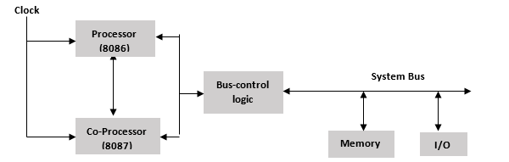
Coprocessor configuration

Slide 9
Closely Coupled Configuration
Main processor connected with the independent processor.
Independent processor execute its own instruction set.
This configuration minimize cost.
Share same clock and bus control logic.
For instruction fetching and data references, independent processor accesses the bus through the CPU’s RQ/GT lines.
Coprocessor cannot take control of the bus, it does everything through the CPU
Closely Coupled processor may take control of the bus independently

Slide 10
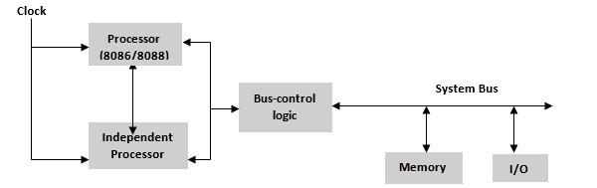
Closely Coupled Configuration

Slide 11
Loosely Coupled Configuration
Loosely Coupled Configuration
More than one main processor is used in this configuration.
Several modules may share the system resources and system bus control logic resolve the bus contention problem.
Coprocessor and Independent processor are connected with the main processor.
Several bus control logic, clock generator are used.
Several system bus is used in this system .

Slide 12
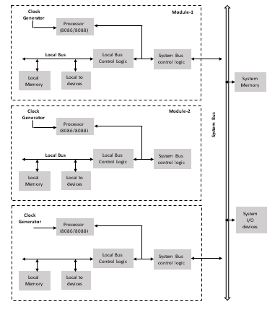

Slide 13
Coprocessor Configuration
Introduction
Characteristics
Interaction between CPU & Coprocessor

Slide 14
Introduction
8086 and 8088 are powerful single-chip microprocessors.
But, their instruction is not sufficient for some complex applications.
For example, the 8086/8088 has no instructions for performing floating point arithmetic.
Coprocessor 8087 can help as a numeric data processor here.
Hence, 8086/8088 are used as the dominant processors in multiprocessing systems.
Both the dominant processor and coprocessor uses same clock generator.
Dominant processor and coprocessor communicates with some specific instructions.
Main processor and the coprocessor shares the bus control logic.
The host CPU fetch instructions, but coprocessor also receives all instructions and monitor them.
An instruction to be executed by the coprocessor is indicated when an escape (ESC) instruction appears.
This ESC instruction contains an external operation code.
Both processor and coprocessor decodes it but coprocessor executes the instruction.

Slide 15
Interaction between CPU & Coprocessor (Contd.)
At this point, the host may simply go on the next instruction or it may fetch the first word.
While coprocessor executes an instruction, it sends a busy high) signal to host’s TEST pin.
As the host continues processing instruction stream, the coprocessor will perform operation indicated by the code in ESC instruction.
If the host needs result of coprocessor it executes WAIT instruction and stop parallel operation.
The host has to wait until the coprocessor deactivates the TEST pin of host.
The WAIT instruction repeatedly checks the test pin to check activation status of host.
When coprocessor completes its operation, it activates the TEST pin.
When the TEST pin is activated. The host executes the next instruction in sequence.

Slide 16
Synchronization between 8086 and its coprocessor
8086 Coprocessor
Wake up the
Coprocessor
Wake up the
8086 or
8088
ESC
Monitor the 8086 or 8088
Execute the 8086 instructions
Deactivate the host’s TEST pin & execute the specified operation.
WAIT
Activate the TEST pin

