Slide 1
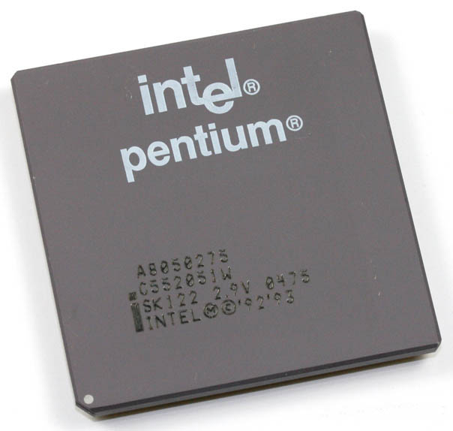
Loosely Coupled Configurations
Introduction, advantages &
bus allocations schemes

Slide 2
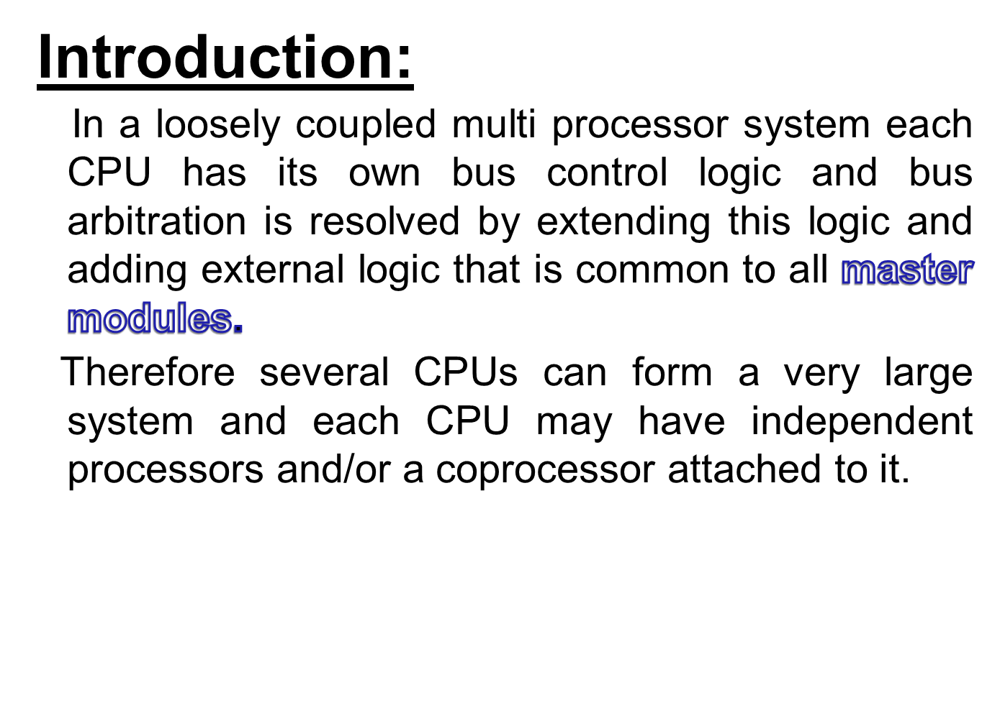

Slide 3
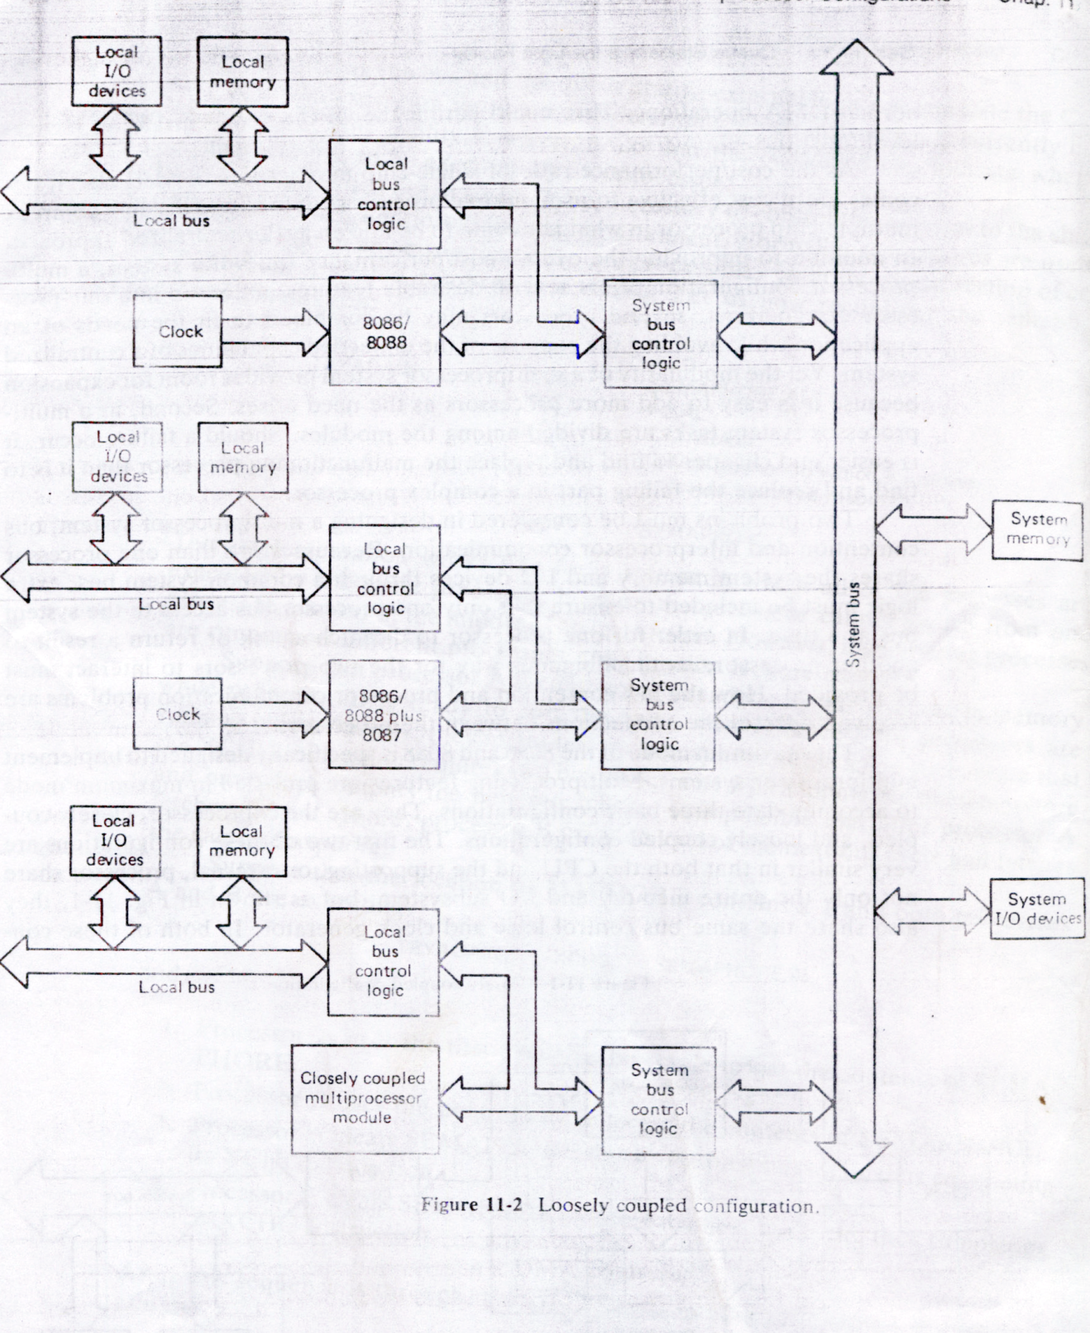

Slide 4

High system throughput can be achieved by having more than one CPU.
A failure in one module normally does not cause a breakdown of the entire system and the faulty module can be easily detected and replaced.
Each bus master may have a local bus to access dedicated memory or I/O devices so that a greater degree of parallel processing can be achieved.
The system can be expanded in a modular from. A bus master module can be added or removed without affecting the other modules in the system.
Advantages
Having more than one processor results in increased efficiency.
Each of the processors have their own local bus to access the local memory/I/O devices. This makes it easy to achieve parallel processing.
The system structure is flexible, i.e. the failure of one module doesn’t affect the whole system failure; faulty module can be replaced later.

Slide 5
Bus arbitration problem
Definition
  When more than one bus master module may have access to the shared bus. This problem is called bus arbitration problem.
Solution of bus master problem
    By providing extra bus logic, this problem can be resolved. This extra bus logic is called bus access logic.
    The responsibility of this logic is to ensure that only one bus master at a time control the bus.

Slide 6

There are three schemes for establishing priority:
Daisy Chaining
Polling
Independent requesting

Slide 7
Polling Method:
The polling scheme uses a set of lines sufficient to address each module .
In response to bus request , the controller generates a sequence of module addresses .
When a requesting module recognizes its address , it activates the busy line and the major advantages of polling is that the priority can be changed dynamically by alternating the polling sequence stored in the controller.

Slide 8

master1
master2
master N
Bus access logic
Bus access logic
Bus access logic
Module address
Bus Grant
Controller
Bus request
Bus busy

Slide 9
Polling Method
Advantages
  The priority can be dynamically change by altering the polling sequence stored in the controller.
  If one module is failed the whole system will not fail.

Slide 10

Independent request scheme:
The independent requests scheme resolves priority in a parallel fashion .
Each module has a separate pair of bus request and bus grant lines and each pair has a priority assigned to it .
The controller includes a priority decoder , which selects the request with the highest priority and returns the corresponding bus grant signal.
Compared to the other methods the independent requests design is fastest. It requires more bus request and grant lines.
Dis. Advan : COST

Slide 11
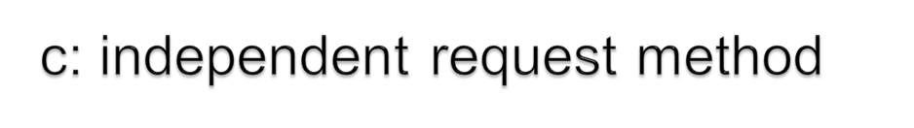
master1
master2
master N
Bus access logic
Bus access logic
Bus access logic
Controller
Bus grant 1
Bus request 1
Bus grant 2
Bus request 2
Bus grant N
Bus request N
Bus busy

