Slide 1
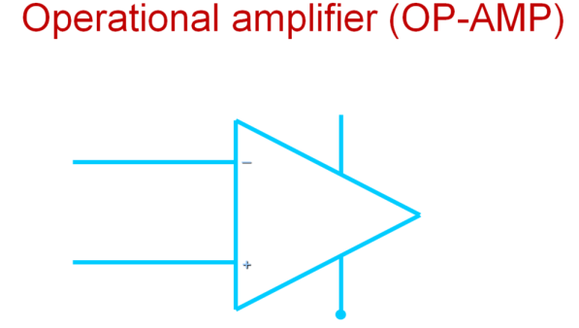
The Operational Amplifier
Usually Called Op Amps
An amplifier is a device that accepts a varying input signal and produces a similar output signal with a larger amplitude.
Usually connected so part of the output is fed back to the input. (Feedback Loop)
Most Op Amps behave like voltage amplifiers.
They are the basic components used to build analog circuits.
Integrated circuit fabrication techniques have made high-performance operational amplifiers very inexpensive in comparison to older discrete devices.

Slide 2
The Operational Amplifier
+V_{S}
_
i₍₋₎
Inverting
R_{O}
v_{id}
A
Output
R_{i}
v_{O} = A_{d}v_{id}
Noninverting
i₍₊₎
+
-V_{S}
i₍₋₎, i₍₊₎ : Currents into the amplifier on the inverting and noninverting lines respectively
v_{id} : The input voltage from inverting to non-inverting inputs
+V_{S} , -V_{S} : DC source voltages, usually +15V and –15V
R_{i} : The input resistance, ideally infinity
A : The gain of the amplifier. Ideally very high, in the 1x10¹⁰ range.
R_{O}: The output resistance, ideally zero
v_{O}: The output voltage; v_{O} = A_{OL}v_{id} where A_{OL} is the open-loop voltage gain

Slide 3
Op-amp characteristics
Nearly ideal
Op-amp has a very high input impedance and high output gain.
Op-amp is modeled as voltage controlled voltage source
Very low output impedance.
Op-amps can perform some mathematical operation
Two basic configuration of op-amp
Inverting configuration
2) Non-inverting configuration

Slide 4
Use of Op-Amp
Inverting amplifiers
Non-inverting amplifiers
Summing amplifiers
Deference amplifiers
Voltage follower
Integrating amplifier (integrator)
Differentiating amplifiers (differentiator)
Instrumentation amplifier
Active filters ( low pass and band pass filters)

Slide 5
Inverting configuration
i_{F}
R_{F}
i₁
R₁
_
+
+
+
v_{in}
v_{O}
_
R_{L}
-

Slide 6
Non-inverting configuration
i₍₊₎
+
i_{O}
i_{L}
v_{id}
_
i_{F}
+
+
+
+
v_{O}
v_{in}
i₍₋₎
v_{F}
R_{F}
R_{L}
v_{L}
-
_
_
_
+
v₁
R₁
_
i₁

Slide 7
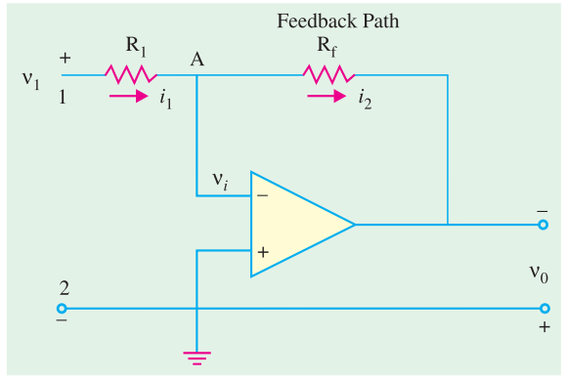
Virtual Ground and Summing Point

Slide 8
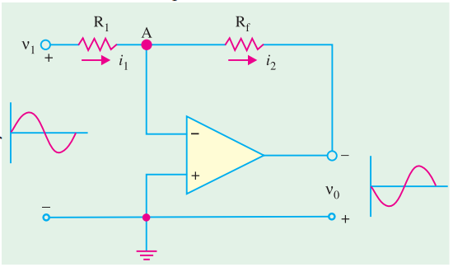
Negative Scaler

Slide 9
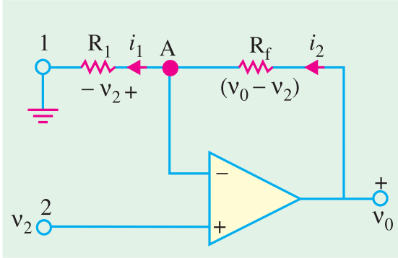
Positive Scaler

Slide 10
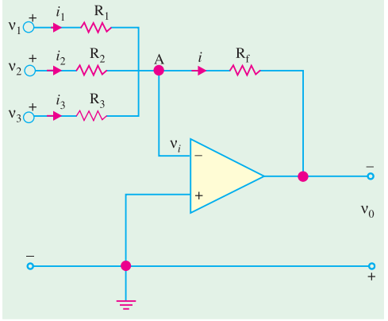
Adder or Summer

Slide 11
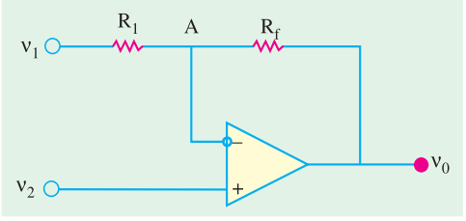
Subtractor

Slide 12
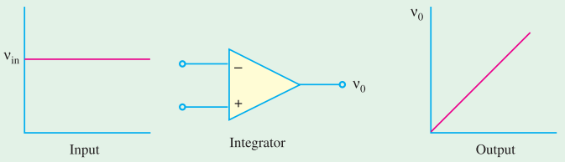
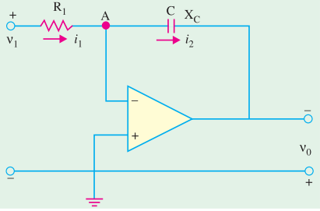
Integrator

Slide 13
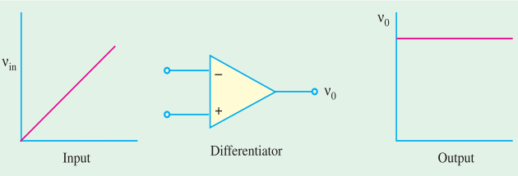
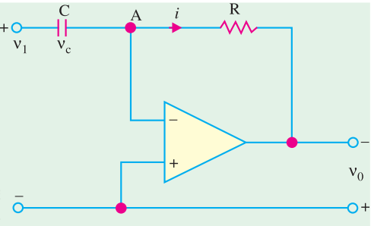
Differentiator

Slide 14
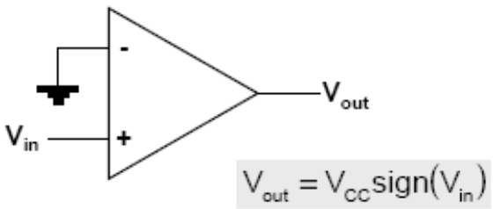
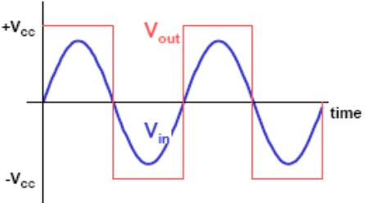
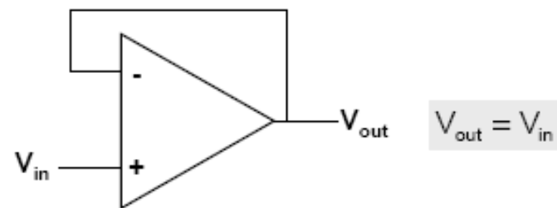
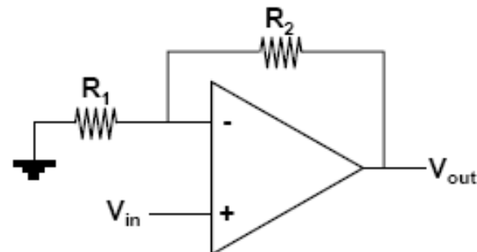
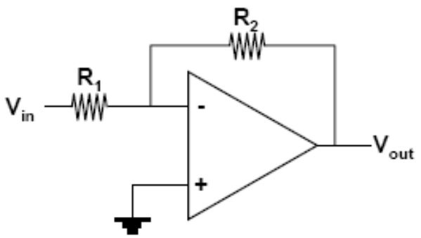
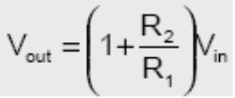
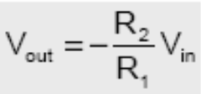
Basic Op-amp Configuration
Voltage Comparator
  digitize input
Voltage Follower
  buffer
Non-Inverting Amp
Inverting Amp

Slide 15
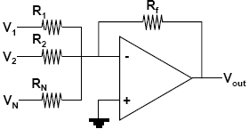
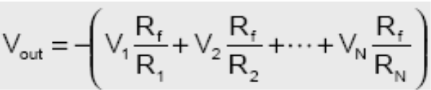
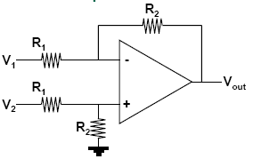
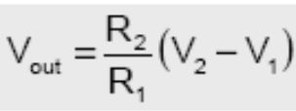
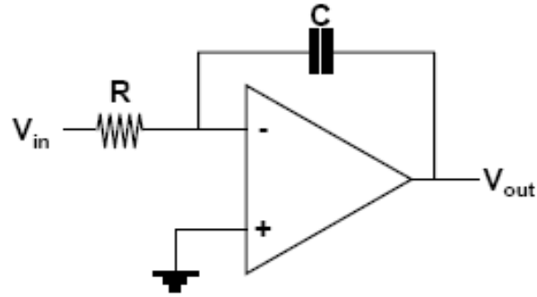
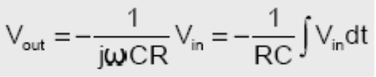
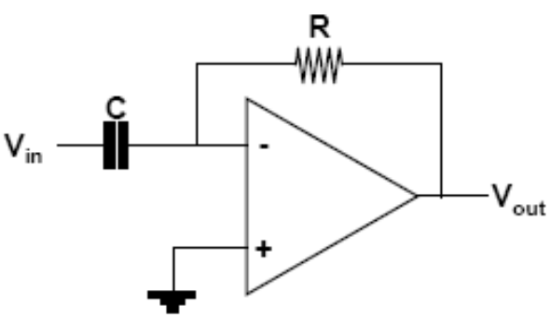
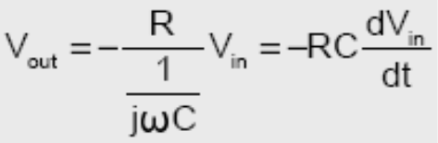
More Op-amp Configurations
Summing Amp
Differential Amp
Integrating Amp
Differentiating Amp

Slide 16
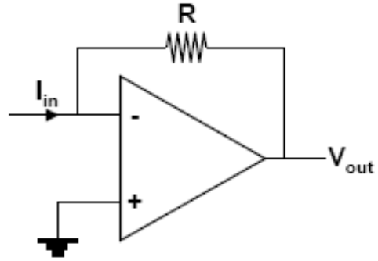

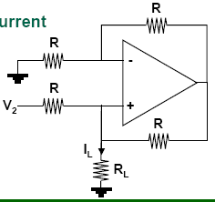
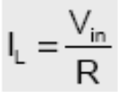
Converting Configuration
Current-to-Voltage
Voltage-to-Current

Slide 17
Optocouplers
Configuration
Functions
Applications
Drawbacks

Slide 18
Opto-couplers
Known as opto-isolator.
Provides optical isolation and coupling between two circuits.
Creating physically and electrically isolated signal coupling between them.
Assembled with traditional semiconductor packages contains-
LED and
Photosensitive semiconductor device in the same housing

Slide 19
Optocouplers
LED for emitter
Air as barrier for isolation
Phototransistor for detector
Transformer is similar, but only for AC
Optocoupler can be used for DC

Slide 20
Opto-couplers
Excellent isolating device because of their light coupling medium.
Allowing very large isolation voltage between circuits.
Commercial optocouplers use infrared light or laser beams as transmitting medium.

Slide 21
When to Use
There are many situations where signals and data need to be transferred from one subsystem to another within a
piece of electronics equipment, or from one piece of equipment to another, without making a direct electrical connection.
Often this is because the source and destination are at very different voltage levels, like a microprocessor which is operating from 5V DC but being used to control a triac which is switching 240V AC.
In such situations the link between the two must be an isolated one, to protect the microprocessor from overvoltage damage.

Slide 22
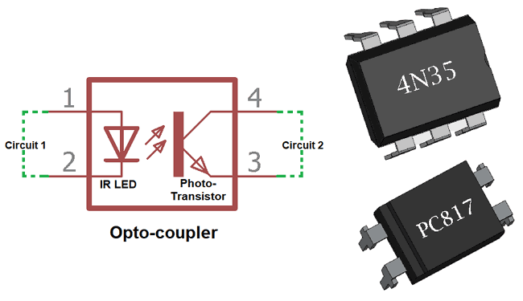
Typical Optocoupler Configurations

Slide 23


Typical Optocoupler Configurations
(a)
(b)

Slide 24
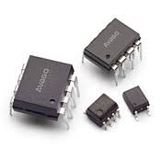
Typical Optocoupler ICs

Slide 25
Typical Optocoupler Configurations (cont.)
Configuration is divided into 2 parts.
Receiving Side
Transmitting Side
Both sides are encapsulated in a single 8-pin dual-in-line packages.

Slide 26
Typical Optocoupler Configurations (cont.)
In transmitting side LED can be made to emit light by passing specified amount of forward current.
In receiving side we can use three types devices
Photo diode
Photo Transistor
Photo Darlington-Pair

Slide 27
Typical Optocoupler Configurations (cont.)
Photo diode is used for-
High speed operation
Produce current by detecting light.
Photo Transistor provides-
moderate speed but higher output current.
Photo Darlington-pair is used for-
High transfer ratio but lower speed.

Slide 28
Block diagram of Optocouplers
Vin
Vout
LED
(Transmitter)
Photosensitive devices (receiver)

Slide 29
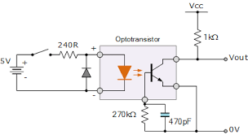
Typical Circuit

Slide 30
Functions of Optocouplers
LED and the photosensitive device are assembled in such a way that the light emitted by the LED would strike the photosensitive device and trigger it into conduction.
Emission travel through a transparent gap until it gets picked by the Photosensitive devices.
Output waveform is identical to the input waveform , although their amplitudes usually differ.

Slide 31
Applications of Optocouplers
Opto-isolation is important where ‘fragile’ digital circuits are at risk of being damaged by large transient voltage or spikes.
Common applications is in modem which allow the computer to connect with telephone line without risk of damage from the line transients.

Slide 32
Other Applications of Optocouplers
Isolated line receiver.
Computer peripheral Interfacing.
Digital Isolations between ADC’s and DAC’s.
Switching power supplies
Instrument input output isolation and
Ground loop elimination

Slide 33
Drawbacks of optocouplers
Fairly Expensive.
Bulkier and heavier than optical devices.
Create magnetic field and switching transients which may be a source of troublesome electrical noise.
Relay contacts may develop sparks , which are very undesirable in certain industrial situations.

Slide 34
Optocoupler (Types & Characteristics)

Slide 35
Types of Optocoupler
Slotted Optocoupler:
A slotted optocoupler has a slot moduled into the package between the LED light source and the phototransistor light sensor
The slot houses transparent windows, so that the LED light can normally freely reach the face of transistor , but can be interrupted or blocked via object placed within the slot.

Slide 36
Types of Optocoupler
- Application :
detecting applications, limit switching and liquid level detection.

Slide 37
Types of Optocoupler
Reflective Optocoupler:
Here the LED and phototransistor are optically screened from each other within the package, and both face outwards (in same direction) from the package.
The construction is such that an optocoupled link can be set up by a reflective object (such as metallic paint or tape, or even smoke particles) placed a short distance outside the package, in line with both the LED .

Slide 38
Types of Optocoupler
- Application :
tape-position detection, engine-shaft revolution counting or speed measurement or smoke or fog detection.

Slide 39
Characteristics of Optocoupler
Current Transfer Ration (CTR) :
- important parameter : optocoupling efficiency.
parameter is maximized by the LED and phototransistor
- Efficiency specified by output-to-input current transfer ratio (CRT)
CTR is simply the ratio between a current change in the output transistor and the current change in the input LED which produced it.
Typical values for CTR range from 10% to 50% for devices with an output phototransistor and up to 2000% or so for those with a Darlington transistor pair in the output.

Slide 40
Characteristics of Optocoupler
Input-to-Output Isolation Voltage (Viso):
- maximum potential difference exists between input & output terminals
- range 500V to 4kV

Slide 41
Characteristics of Optocoupler
Maximum Collector-Emitter Voltage, Vce(max):
- maximum allowable dc voltage can be applied across the output transistor
- vary from 20 to 80 volts.

Slide 42
Characeristics of Optocoupler
Bandwidth:
- maximum signal frequency
- fully passed through the optocoupler when the device is operated in its normal mode
- vary from 20 to 500 khz

Slide 43
Characteristics of Optocoupler
Response Time:
- Divided into rise time tr and fall time tf
- tr and tf are around 2 to 5 us

