Slide 1
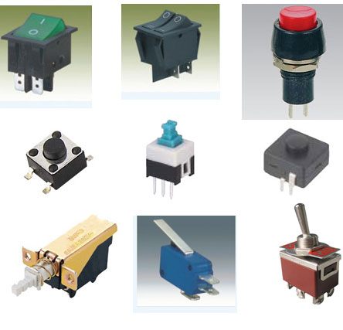
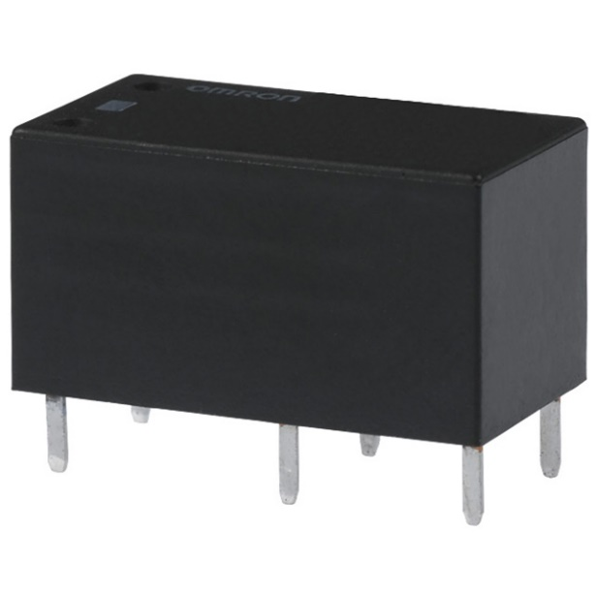
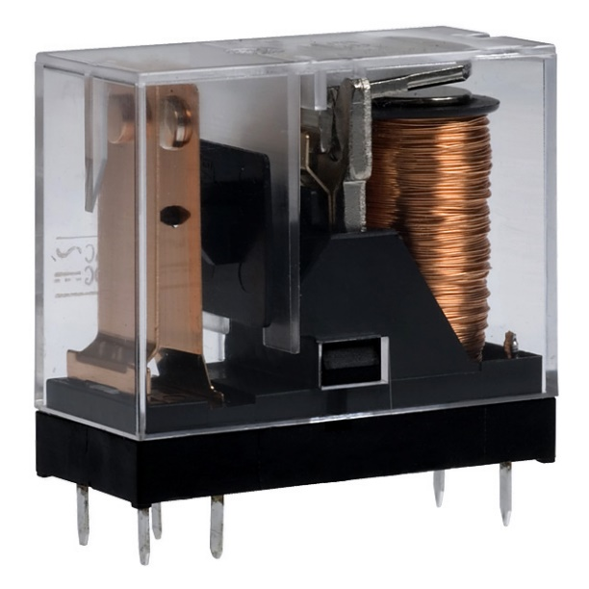


Slide 2
What is a Switch?
A switch is a device that allows you to stop the flow of current entirely. These are usually mechanical devices that separates two bits of metal (contacts). When the metal doesn't touch, current doesn't flow. When the metal touches, is called a closed circuit. When the metal doesn't touch, is called an open circuit. (closed = ON, open = OFF)
Basic Switch Schematic Symbol
S1

Slide 3
What is a Relay?
A Relay is an electromechanical switch, operated by passing current through a coil of wire wound around a steel core, which acts as an electromagnet, pulling the switch contact down to make or break a circuit.

Slide 4
Relay
Simple electromechanical switch
- made up of electromagnet and set of contacts
Two states : open & close
A contact either normally open or normally close

Slide 5
Relay
Relays are amazingly simple devices. There are four parts in every relay:
Electromagnet
Armature that can be attracted by the electromagnet
Spring
Set of electrical contacts

Slide 6
How to they work?
A small current is passed though the coil which generates a magnetic field.
This magnetic field pulls the armature down towards the coil. At the end of the armature is a contact.
When the armature moves its contact touches the contact of the controlled circuit. This creates a closed circuit. (this is not always the case as some relays are normally closed)

Slide 7
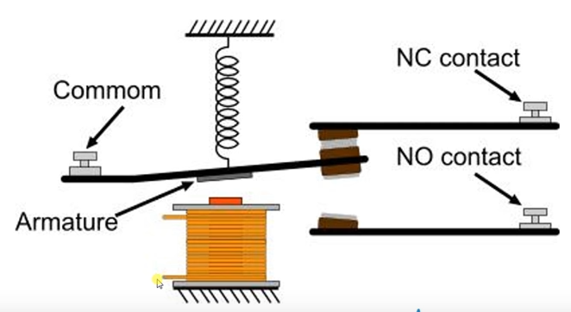
Relay Circuit

Slide 8
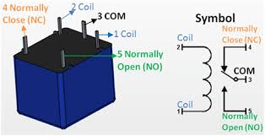
Relay Circuit

Slide 9
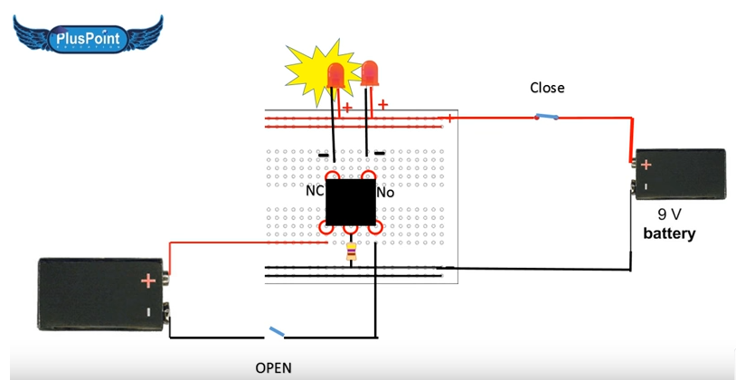
Relay Circuit

Slide 10
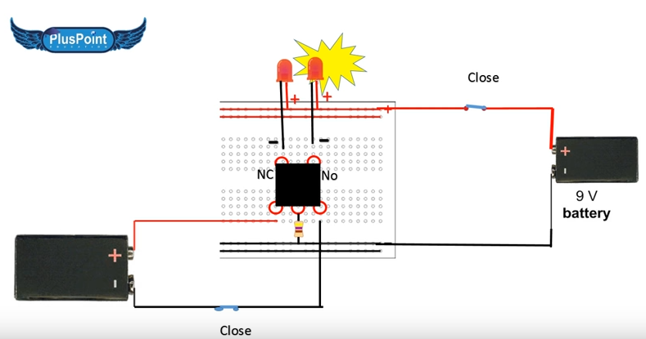
Relay Circuit

Slide 11
Relay Construction
The flow of current through an electrical conductor causes a magnetic field at right angles to the current flow direction.
If this conductor is wrapped to form a coil, then the magnetic field produced gets oriented along the length of the coil.
If the current flowing through the conductor increases, then the magnetic field strength also increase

Slide 12
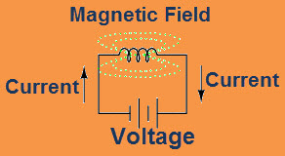
Fig 2: Relay construction
Magnetic field
current
current

Slide 13
Relay Construction
Electric current through a conductor will produce a magnetic field
The greater the current, the greater the magnetic field
Inductor reacts against changes in current
Most armature moved either dc or ac current

Slide 14
Relay Function
When power is applied
- the electromagnetic coil energized
The electromagnetic field pulls the armature
Contacts toward the electromagnet
Closing the contacts

Slide 15
Relay Function
Allows current flow through the contacts
When power removed
- spring tension pushes the armature away
Opening contacts

Slide 16
USEFULNESS OF RELAY
Extremely useful when we have a need to control a large amount of current and/or voltage with a small electrical signal.
A relay acts as binary (ON or OFF) amplifier.
It is quite likely that the current required to energize the relay coil will be hundreds of times less than the current rating of the contact.

Slide 17
Disadvantages of relay
Limited life time.
contact bounce
Slow speed of operation
Corrosion of contacts
Most of this problem can be overcome by using solid state relay (SSRs).

Slide 18
Solid state Relay (SSR)
Introduction
Types
Zero-cross Switching
Random Switching
Disadvantages of SSR
An Example
A typical Circuit of Heater Control
Notes:
‹#›
‹#›

Slide 19
Introduction
Solid State Relays overcomes problems like limited lifetime, corrosion of contacts, contact bounce, slow speed etc.
Relays of this type are only capable of controlling ac operated devices.
Solid state relays are commercially available in the industry for its merits and popularity.

Slide 20
Solid state relay (SSR)
A SSR basically comprises a TRIAC or silicon control rectifier triggered by an infrared light source.
SSRs are capable of controlling only AC operate devices like as motor or heater.
Here Infrared Emitting Diode is used to isolate the control circuit.
It also trigger silicon bilateral switch (SBS)

Slide 21
1 to 10 mA DC
40 Amp AC
IRED
SBS
Figure : Functional block diagram of a solid state relay.

Slide 22
Types
Basically, two types of SSRs are available.
The classification of SSR is dependent on the switching used in the circuitry.
They are :-
(1) Zero-cross Switching.
and (2) Random Switching.

Slide 23
Zero-Cross switching
Zero-cross switching relays do not switch-on initially.
When the first zero-crossing of the line voltage after the control signal is applied, the relay is switched on.

Slide 24
Random switching
Random switching relays switch on immediately after the receipt of the control signal.
A proper type of device should be selected, depending on the nature of the application.

Slide 25
Disadvantages OF SSR
The SSR are prone to failure to high voltage transients.
If proper protection is not taken, then the circuit may fail due to the reason.

Slide 26
An Example
To overcome the demerits of the SSR, special protection circuit is used.
An widely used example of such protection circuit is called the “Snubber Circuit”.
This protection circuit suppress the line transients.
E.G. The 100 Ω resistor and 0.1 ɥF capacitor constitute the snubber circuit.

Slide 27
Reference:
Microprocessor :Principles and Applications
-By Ajit Pal
Chapter 7

