Slide 1
Digital to analog Converter (DAC)

Slide 2
DAC performance
DAC are at the beginning of the analog signal chain , which makes them very important in system performance.
Most important Characteristics of DAC are:
Resolution
Maximum sampling Frequencies
Monotonicity
THD + N
Dynamic Range
2

Slide 3
DAC Performance(cont.)
Resolution:
Number of the possible output levels the DAC is designed to reproduce.
Usually stated as the number of bits it uses.
Number of bits is the base two logarithm of the number of levels.
Resolution is related to the effective number of bits (ENOB).
Example:
1 bit DAC is designed to produce 2 (2¹) levels.
8 bit DAC is designed for 256 (2⁸) levels.
3

Slide 4
DAC Performance(cont.)
Maximum Sampling Frequency :
Measurement of the maximum speed at which the DAC circuits operate and produce correct output.
As the Nyquist Shannon sampling theorem , a signal must be sampled at over twice the frequency of the desired signal.
Example:
To reproduce signals in all the audible spectrum , which includes frequencies of up to 20 KHz, it is necessary to use DACs that operate at over 40 KHz.
4

Slide 5
DAC Performance(Cont.)
Monotonicity:
Refers to the ability of a DAC’s analog output to move only in the direction of digital input moves.
THD +N:
This is the measurement of distortion and noise introduced to the signal by the DAC.
*****Important for dynamic and small signal DAC applications.*****
Dynamic Range :
Measurement of difference between the largest and smallest signals DAC can reproduce.
5

Slide 6
APPLICATIONS
Consider a typical long-distance telephone call. The caller's voice is converted into an analog electrical signal by a microphone, then the analog signal is converted to a digital stream by an ADC.
The digital stream is then divided into network packets where it may be sent along with other digital data, not necessarily audio. The packets are then received at the destination, but each packet may take a completely different route and may not even arrive at the destination in the correct time order.
The digital voice data is then extracted from the packets and assembled into a digital data stream. A DAC converts this back into an analog electrical signal, which drives an audio amplifier, which in turn drives a loudspeaker, which finally produces sound.

Slide 7
DIGITAL TO ANALOG CONVERTER
Converting digital code to analog signal
- binary to current, voltage or electric charges.
Generates analog signal A corresponding to a digital data D
A=KD and D=a₁.2⁻¹+a₂.2⁻²+….+a_{N}.2^{-N}
Here K = constant
a₁,a₂,a₃,…,a_{n} are binary bits of D

Slide 8
OPERATING PRINCIPLE
When data is in binary form
- 0 valued to <2 volts
- 1 valued to 2 to 5 volts
This form can be converted to analog form
- using summing amplifier

Slide 9
FUNCTIONAL PARTS OF DAC
Consists three parts:
A resistor network
A set of analog switches
A summing amplifier

Slide 10
FUNCTIONAL PARTS OF DAC
V_{ref}
am
Function block diagram of DAC
Resistor network
Analog switches

Slide 11
RESISTOR NETWORK
A resistor network can be one of the following:
Weighted –resistor network
Ladder network

Slide 12
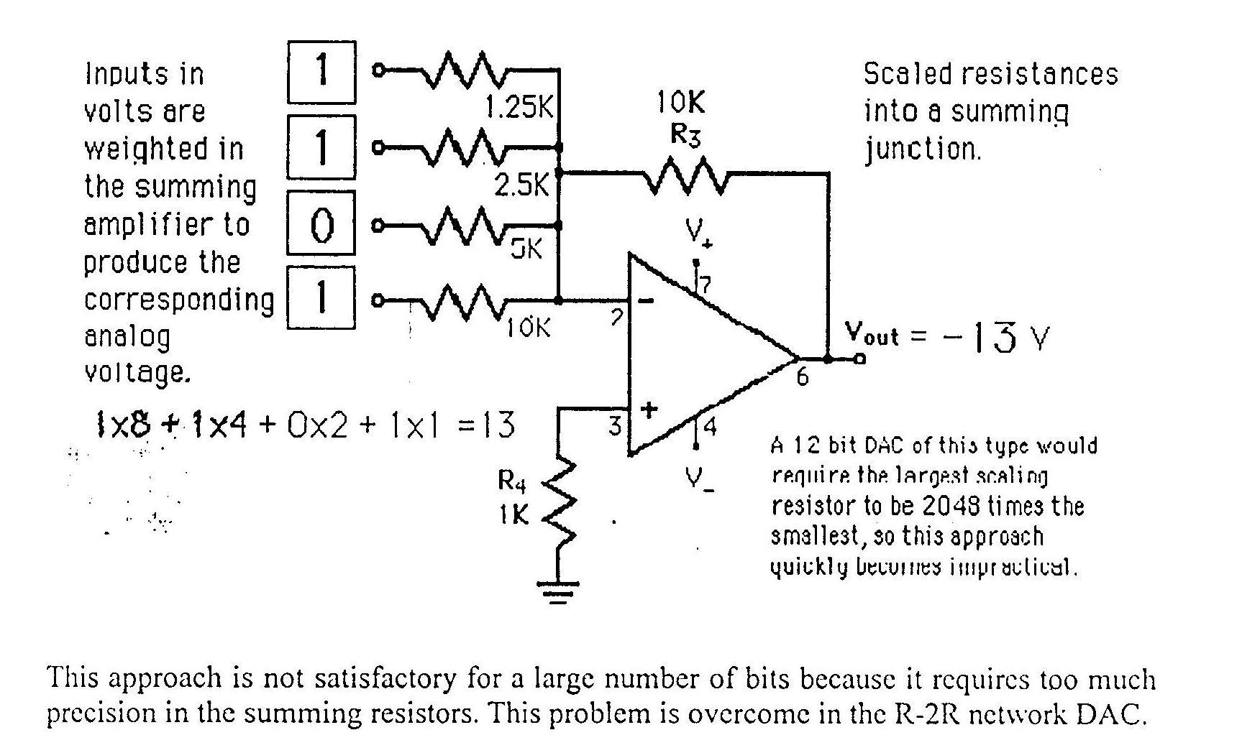
FOUR-BIT D/A CONVERTER

Slide 13
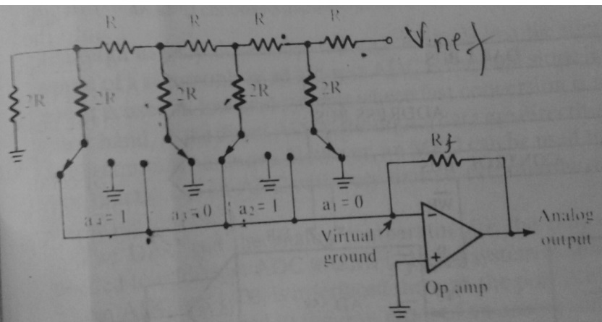
FOUR-BIT D/A CONVERTER USING R-2R LADER NETWORK

Slide 14
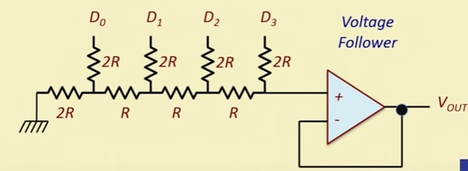
FOUR-BIT D/A CONVERTER USING R-2R LADER NETWORK

Slide 15
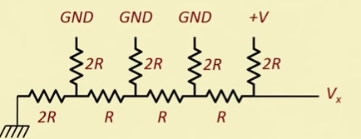
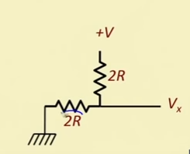
FOUR-BIT D/A CONVERTER USING R-2R LADER NETWORK

Slide 16
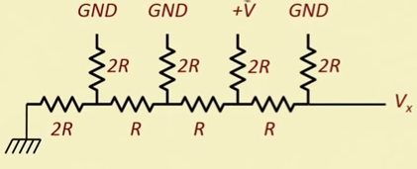
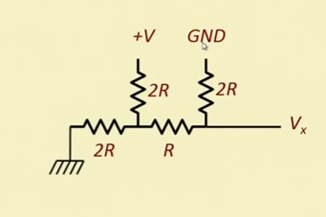
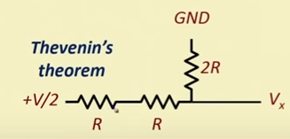
FOUR-BIT D/A CONVERTER USING R-2R LADER NETWORK

Slide 17
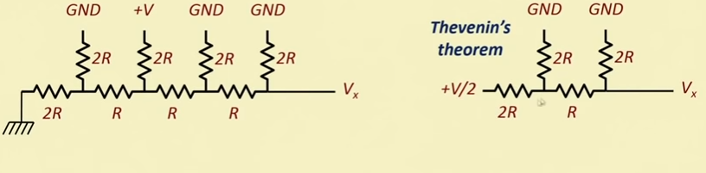
FOUR-BIT D/A CONVERTER USING R-2R LADER NETWORK

Slide 18
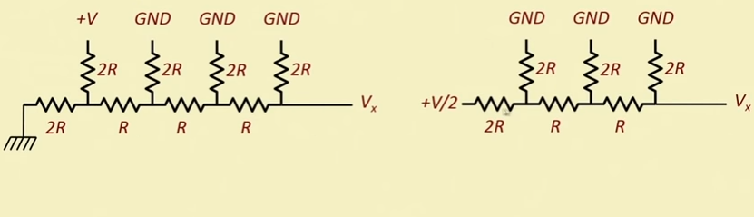
FOUR-BIT D/A CONVERTER USING R-2R LADER NETWORK

Slide 19
Reference:
Microprocessor :Principles and Applications
-By Ajit Pal
Chapter 7

