Slide 1
Information System and Software Engineering

Slide 2
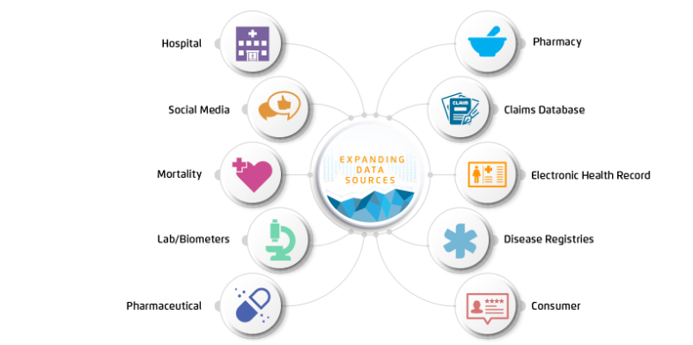
Data and Information
The term data is simply defined as “facts and figures”
Each piece of data is a little fact that does not mean much
Information is defined as “news or knowledge received or given”
It is what results when we have processed, interpreted and organized facts.

Slide 3
Fact/ data collection methods
Surveys : Surveys are physical or digital questionnaires that gather both qualitative and quantitative data from subjects. One situation in which you might conduct a survey is gathering attendee feedback after an event.
2. Transactional Tracking : Each time your customers make a purchase, tracking that data can allow you to make decisions about targeted marketing efforts and understand your customer base better.
3. Interviews and Focus Groups : Interviews and focus groups consist of talking to subjects face-to-face about a specific topic or issue.
4. Observation : Observing people interacting with your website or product can be useful for data collection because of the candor it offers.
5. Social Media Monitoring : Monitoring your company’s social media channels for follower engagement is an accessible way to track data about your audience’s interests and motivations. Many social media platforms have analytics built in, but there are also third-party social platforms that give more detailed, organized insights pulled from multiple channels.

Slide 4
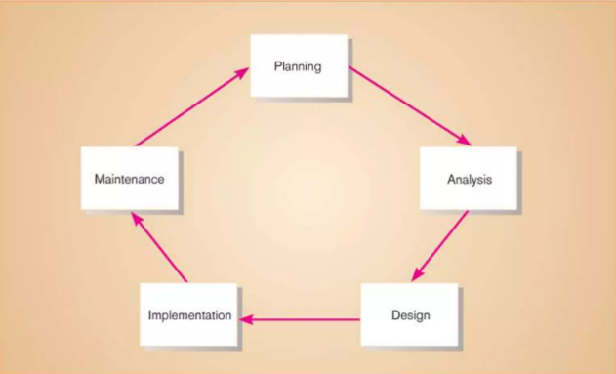
Software Engineering

Slide 5
Software Engineering
Planning: identify, analyze, prioritize and arrange IS needs and requirements . Requires customer involvement
Analysis: Breaking down of system nature and functions to understand the logical point of view by detailing it’s functionality.
Design: to make preliminary sketches, patterns or outline that gives us a blueprint of the actual system
Implementation: Software development and testing phase
Maintenance: the process of changing, modifying, and updating software to keep up with customer needs

Slide 6
Software development life cycle models
Waterfall
Agile
Spiral
V model

Slide 7
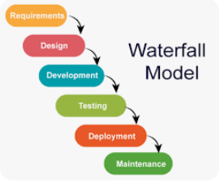
Waterfall model
linear-sequential life cycle model

Slide 8
Agile Model
- Based on iterative development
- Requirements are divided into smaller increments and in each increment, we follow the steps of s/w engineering.

Slide 9
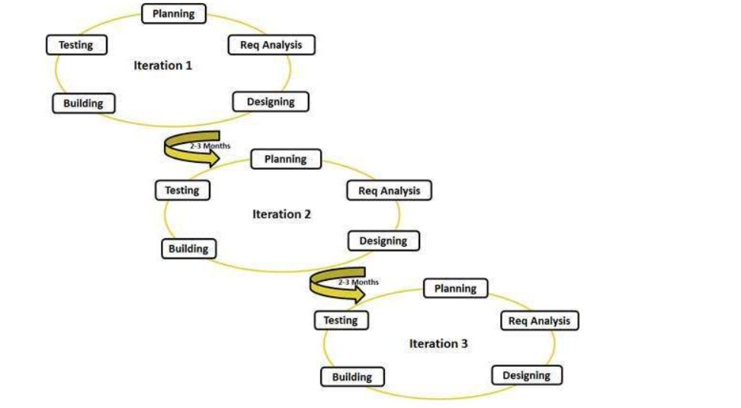

Slide 10
When to use agile / waterfall
If your major project constraints are well understood and documented, Waterfall is likely the best approach. The Agile methodology was created for projects where the significant constraints are not well understood.

Slide 11
What are requirements?
Specifies business needs and what we need to develop/ implement
It may range from a high-level abstract statement of a service or of a system constraint to a detailed mathematical functional specification
Common way of getting requirements are from USER STORIES

Slide 12
Functional requirements :
define what a product must do, what its features and functions are.
For example: The system sends a confirmation email when a new user account is created.
Non-functional requirements :
Not related to the system functionality, rather define how the system should perform
For example: The system should be able to handle 20 million users without performance deterioration.
Domain requirements:
Constraints on the system from the domain of operation
From example: extra layer of security for sensitive information related requirements

Slide 13
UML
UML (Unified Modeling Language) is a standard language for specifying and visualizing the artifacts or components of software systems.
Structural : depicts the elements of a system that are independent of time. Means more static representation of a system components.
Classes diagrams
Objects diagrams
Deployment diagrams
Behavioral: visualizes how individual aspects of a system changes at run time. Means more dynamic representation of system components.
Activity diagrams
State chart diagrams
Use case diagrams

Slide 14
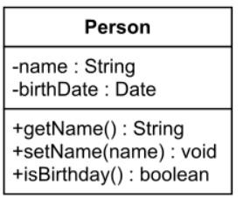
UML class diagram
UML (Unified Modeling Language) is a graphical language for modeling the structure and behavior of object-oriented systems. UML is widely used in industry to design, develop and document complex software.
Classes:
A class diagram contains a rectangle for each class.
It is divided into three parts.
The name of the class.
The names and types of the fields.
The names, return types, and parameters of the methods.

Slide 15
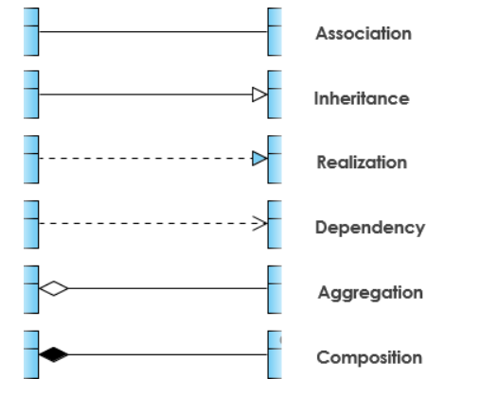
Relationships
UML class diagrams include the following types of use-relationships, in order from weakest to strongest.

Slide 16
1. Associations: They are represented by a solid line between classes. Associations are typically named using a verb or verb phrase which reflects the real-world problem domain.
2. Aggregation: A special type of association. It represents a "part of" relationship.
Class2 is part of Class1.
3. Composition : A special type of aggregation where parts are destroyed when the whole is destroyed. Objects of Class2 live and die with Class1.Class2 cannot stand by itself.
4. Dependency: An object of one class might use an object of another class in the code of a method. If the object is not stored in any field, then this is modeled as a dependency relationship.

Slide 17
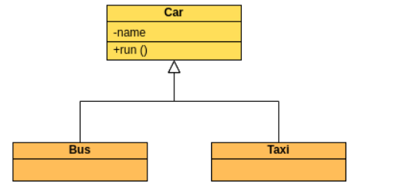
Inheritance relationship
Generalization: A class extends another class. Represents an "is-a" relationship.

Slide 18
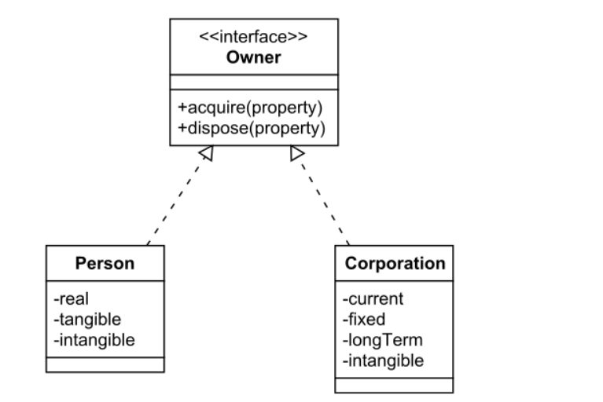
Realization/ implementation:
Implementation (Implementation) is mainly used to specify the relationship between interfaces and implementation classes .
An interface (including an abstract class ) is a collection of methods. In an implementation relationship, a class implements an interface, and methods in the class implement all methods of the interface declaration.

