Slide 1
Software Project management

Slide 2
Software project management
Software project management is a discipline that involves planning, organizing, and overseeing the development and implementation of software projects. It encompasses a range of activities and processes aimed at ensuring that software projects are completed on time, within budget, and according to the specified quality standards. Effective software project management is essential for delivering successful software products that meet the needs of stakeholders.
Key components of software project management include:
Project Planning: This involves defining project goals, objectives, scope, and requirements. Project managers create a detailed project plan that outlines tasks, schedules, resource allocation, and budget estimates.
Risk Management: Identifying potential risks and developing strategies to mitigate them is a crucial aspect of project management. This includes assessing technical, financial, and operational risks and planning for contingencies.

Slide 3
3. Resource Management: Allocating and managing the necessary resources, including human resources, tools, and equipment, is vital to ensure that the project progresses smoothly.
4. Scheduling: Creating a project schedule that includes task dependencies, milestones, and deadlines helps in tracking progress and ensuring that the project stays on track.
5. Quality Assurance: Establishing quality standards and processes to ensure that the software being developed meets the desired level of quality and reliability.
6. Communication: Effective communication is key to keeping stakeholders informed about project progress, issues, and changes. Project managers often act as intermediaries between different teams and stakeholders.
7. Budgeting and Cost Control: Managing project budgets, tracking expenses, and ensuring that the project stays within budget is essential to the financial success of the project.
8. Change Management: Handling changes to project scope, requirements, or other aspects while minimizing disruptions to the project's progress.
9. Team Leadership: Leading and motivating the project team to achieve their goals, resolving conflicts, and ensuring that team members have the necessary resources and support.

Slide 4
10. Monitoring and Reporting: Continuously monitoring project progress, performance, and key performance indicators (KPIs) to assess whether the project is on track and delivering value. Regular reporting to stakeholders is essential.
11. Closure: Concluding the project, including delivering the final product, conducting post-project reviews to identify lessons learned, and ensuring that all project-related documentation and assets are properly archived.
Effective software project management involves balancing these aspects to achieve project goals while considering constraints such as time, cost, and quality. The specific emphasis on each aspect may vary depending on the project's nature, complexity, and the chosen project management methodology.

Slide 5
Development mode
1. Organic – A software project is said to be an organic type if the team size required is adequately small, the problem is well understood and has been solved in the past and also the team members have a nominal experience regarding the problem.
2. Semi-detached – A software project is said to be a Semi-detached type if the vital characteristics such as team size, experience, and knowledge of the various programming environment lie in between that of organic and Embedded.
3. Embedded – A software project requiring the highest level of complexity, creativity, and experience requirement fall under this category. Such software requires a larger team size than the other two models and also the developers need to be sufficiently experienced and creative to develop such complex models.

Slide 6
Effort
In software project management, "effort" refers to the amount of human work, typically measured in person-hours or person-months, required to complete a specific task, phase, or the entire project.

Slide 7
Effort estimation can be challenging because it involves considering various factors, including the complexity of the task, the skills and experience of the team members, the tools and technologies used, and any potential risks or uncertainties. Different estimation techniques, such as expert judgment, historical data analysis, and software estimation models like COCOMO, are used to arrive at accurate effort estimates in software project management.

Slide 8
COCOMO
The COCOMO (COnstructive COst MOdel) is a method used in software engineering to estimate how much time and effort it will take to develop a software project. It helps project managers and developers understand the resources needed for a software project
Basic COCOMO: This is like a quick estimate based on the size of the software. It's similar to estimating the cost of building a house based on the number of rooms. You use historical data and some simple formulas to make this estimate.
Intermediate COCOMO: This takes into account more factors, like the complexity of the software and the experience of the development team. It's like considering not only the size of the house but also the materials used and the skills of the builders.
Detailed COCOMO: This is the most precise estimate. It considers a lot of factors, such as the specific tools and technologies you'll use and the individual abilities of team members. It's like creating a detailed plan for the house, specifying every detail.

Slide 9
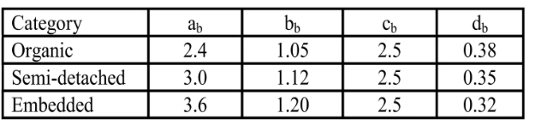
Basic cocomo - Constant values

Slide 10
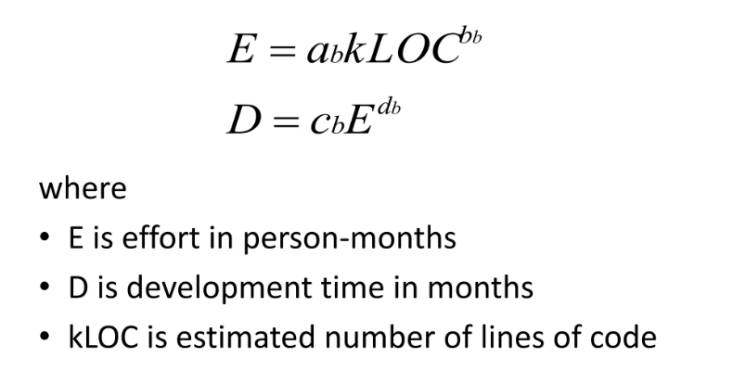
Basic cocomo

Slide 11
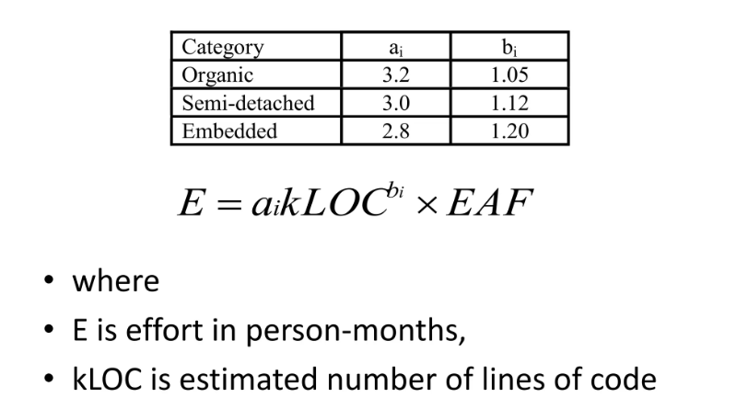
Intermediate cocomo

Slide 12
PERT chart
PERT (Program Evaluation and Review Technique): PERT is a probabilistic project management technique that focuses on estimating the time it will take to complete individual project tasks while considering the uncertainty and variability in those estimates. PERT uses three time estimates for each task:
Optimistic Time (O): The shortest possible time to complete the task, assuming everything goes exceptionally well.
Most Likely Time (M): The best estimate of the time required based on realistic conditions.
Pessimistic Time (P): The longest possible time to complete the task, assuming everything goes wrong or experiences delays.
From these three estimates, PERT calculates an expected or "weighted average" time for each task using the formula:
ExpectedTime(TE)=(O+4M+P)/6

Slide 13
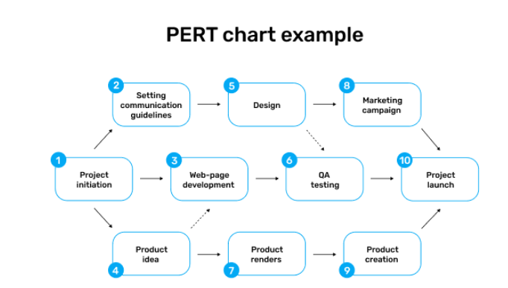

Slide 14
CPM – Critical Path Method
CPM, like PERT, is used for project scheduling and management. However, CPM is deterministic and focuses on identifying the critical path—the sequence of activities that, if delayed, would extend the project's duration. CPM assumes that task durations are fixed and known with certainty, making it suitable for projects with well-defined and predictable activities.

Slide 15
PERT VS CPM
PERT and CPM are project management techniques that help in planning, scheduling, and managing projects. PERT is probabilistic and suitable for projects with uncertainty, while CPM is deterministic and suited for projects with known and fixed task durations. Both methods help project managers make informed decisions about resource allocation, project timelines, and critical activities.

