Slide 1
Information System and Software Engineering

Slide 2
Design Patterns
Design patterns are description of communicating objects and classes that are customized to solve a general design problem in a particular context.
A design pattern is a general reusable solution to a commonly occurring problem in software design. It is description and template for how to solve a problem that can be used in many different situations. It is like a description on how to tackle these problems and design a solution.

Slide 3
Why should we know design patterns?
Design Patterns provide easy to recognize and use OOP solutions to common problems. They aim to address common challenges in software development, such as code complexity, flexibility, extensibility, and maintainability. It makes code reusable, bug-free, and clean.it makes life easier by not reinventing the wheel. It also improves communication among developers.

Slide 4
Pattern elements
Name
Problem description / when to apply
Solution description
Advantages/disadvantages

Slide 5
Types of Design Patterns
Creational pattern: Creating a collection of objects in most efficient way.
Structural pattern: These patterns are designed with regard to a class's structure and composition. The main goal of most of these patterns is to increase the functionality of the class(es) involved, without changing much of its composition.
Behavioral pattern : These patterns are designed depending on how one class communicates with others.

Slide 6
Creational Design Patterns

Slide 7
Singleton Pattern
The singleton pattern is a design pattern that restricts the instantiation of a class to one object. Ensure a class only has one instance, and provide a global point of access to it.

Slide 8
Singleton Pattern
When to use:
Control object creation
Limit instantiation
preventing multiple instances from conflicting with each other or creating unexpected behavior.
Most common scenarios: one file system, single DB connectivity , one Test engine
You can use a Singleton to create and reuse one instance of these resources.

Slide 9
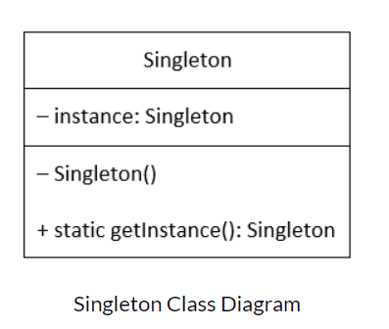
Applying Singleton Pattern
A private static variable, holding the only instance of the class.
A private constructor, so it cannot be instantiated anywhere else.
A public static method, to return the single instance of the class.

Slide 10
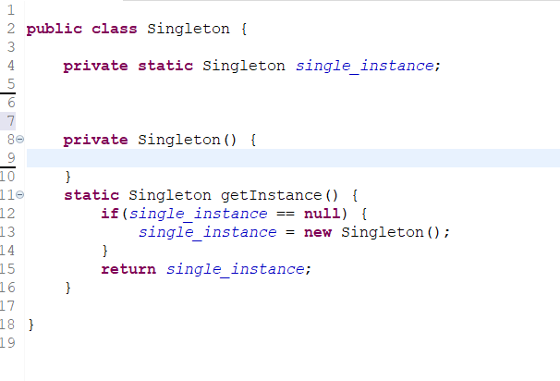
Singleton x = Singleton.getInstance();

Slide 11
“lazy-initialization”
Here we have declared getInstance() static so that we can call it without instantiating the class. The first time getInstance() is called it creates a new singleton object and after that, it just returns the same object. Note that Singleton object is not created until we need it and call the getInstance() method. This is called lazy instantiation.

Slide 12
“Early initialization”
We create the instance of the class at the time of declaring the static data member, so instance of the class is created at the time of classloading. JVM executes a static initializer when the class is loaded
class A{
private static A obj=new A();//Early, instance will be created at load time
private A(){}
public static A getA(){
return obj;
}
}

Slide 13
Early vs lazy initialization
Early Instantiation: creation of instance at load time.
Lazy Instantiation: creation of instance when required.

Slide 14
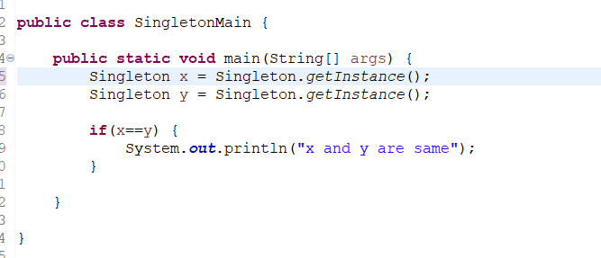
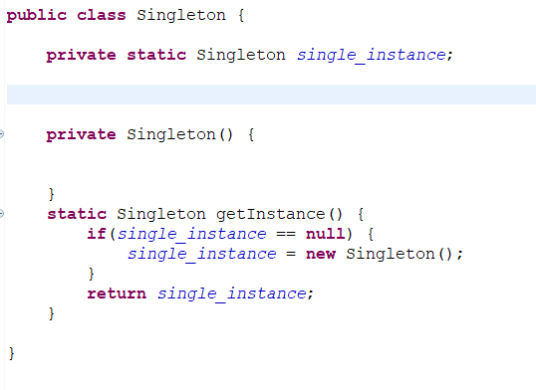
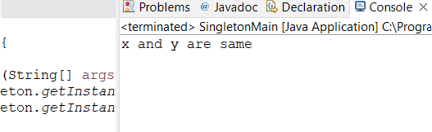
Pointing to the same reference

Slide 15
What if two different clients access the Singleton class at the same time, right to the millisecond? they will check if the instance is null at the same time, and will find it
true, and so will create two instances of the class for each request by the two clients.
To fix this, Thread Safe instantiation is to be implemented. synchronized is used on methods or objects to implement thread safety, so that only one thread will access a particular resource at one time.

Slide 16
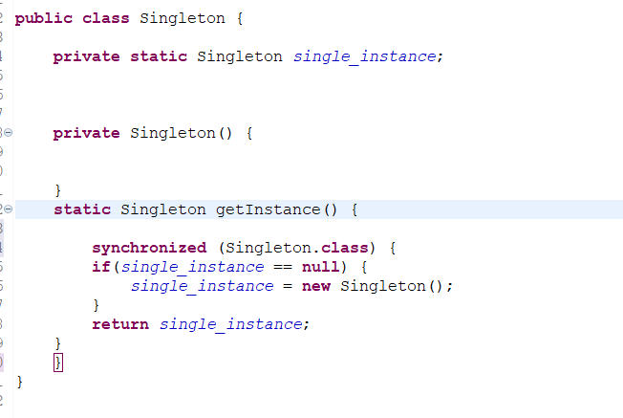

Slide 17
Drawbacks
The Singleton pattern can introduce tight coupling between different components of an application, as they all depend on the same global instance. This can make it difficult to test and maintain the application.

Slide 18
Structural Patterns

Slide 19
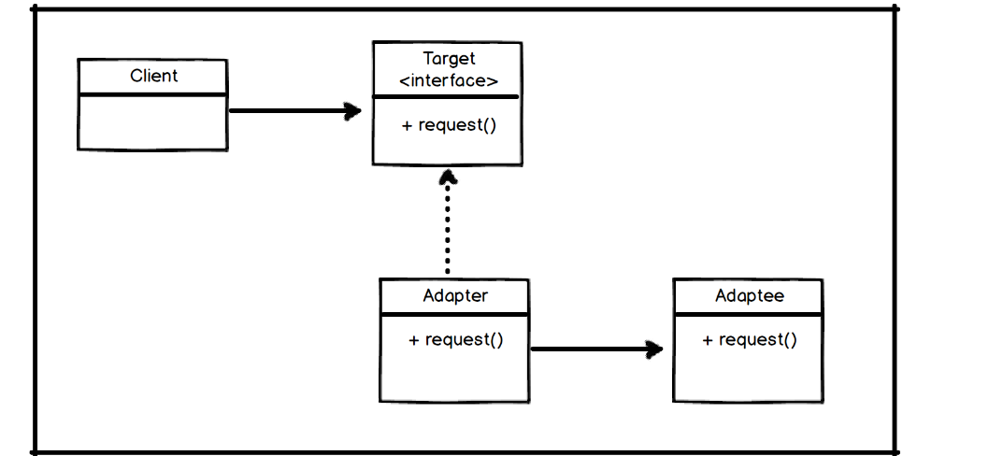
Adapter Design pattern
An Adapter pattern acts as a connector between two incompatible interfaces that otherwise cannot be connected directly. The main goal for this pattern is to convert an existing interface into another one the client expects. (like USB)
Implements
Extends

Slide 20
Classes:
Target interface – Desired interface used by client
Adapter class- Implements the target interface and modifies the specific req available from adapter class
Adaptee class – Has functionality that adapter class can use and modify

Slide 21
public class Student { //adaptee
int rollNumber;
String name;
Date dob;
.. getter and setter ...
}
public class Employee{
int employeeId;
String name;
Date dateOfBirth;
public Employee(int employeeId, String name, Date dateOfBirth) {
this.employeeId = employeeId;
this.name = name;
this.dateOfBirth = dateOfBirth;
}
.. getter and setter ...
}
public class EmployeeService{
public void getEmployee(Employee e){
.. code to create employee record
}
}
public class EmployeeAdapter{
public static Employee getEmployee(Student s){
return new Employee(s.getRollNumber(),s.name,s.getDob()); //object
}
}

Slide 22
we have created another class called EmployeeAdapter.java. As we have Student.java class and we can only pass employee data to saveEmployee() function. Therefore, we needed another code which can do the magic of converting student to employee. In the adapter class, we pass the student information(object) that converts that info into an Employee information (object).

Slide 23
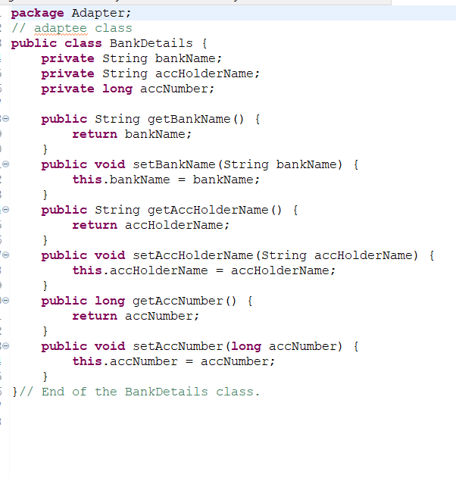
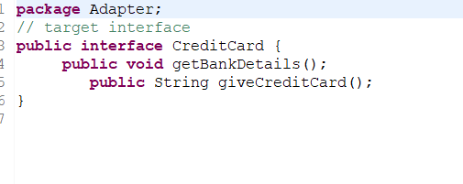
Another example

Slide 24
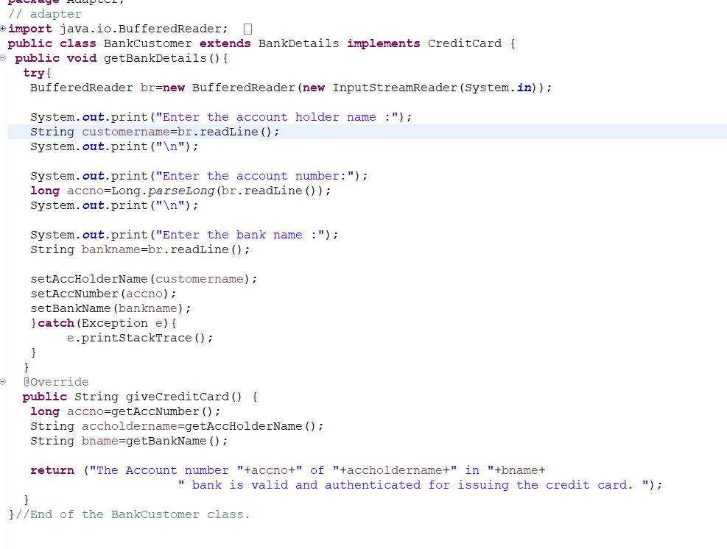

Slide 25
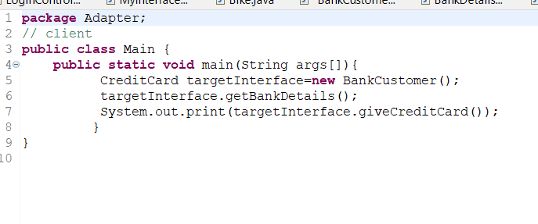
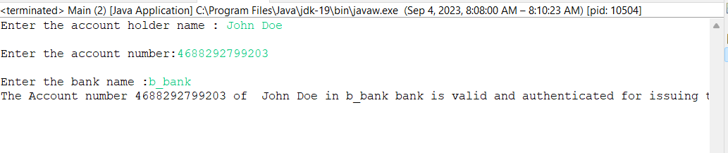
Customer uses credit card through which system gets the bankdetails.
Credit card – interface
Bank details class – has basic code to get details of a customer / adaptee
bankCustomer class – uses bank details class as necessary and gets the customer their credit card / adapter

Slide 26
Types of adapter
Class adapter: uses adaptee class by extension (bank example)
Object adapter: adapter class holds an instance of adaptee (student example)

Slide 27
Behavioral Design Patterns

Slide 28
Iterator
Iterator is a behavioral design pattern that lets you traverse elements of a collection without exposing its underlying representation (list, stack, tree, etc.).
Most collections store their elements in simple lists. However, some of them are based on stacks, trees, graphs and other complex data structures.
But no matter how a collection is structured, it must provide some way of accessing its elements so that other code can use these elements. There should be a way to go through each element of the collection without accessing the same elements over and over. It helps us to traverse elements independent of its type

