Slide 1
ROKTO LAGBE?
Minhaz Rahman 1605093
Pronob Das 1605098
Abir Mohammad Turza 1605104
Sifat Ibna Amin 1605112
Pijush Chakma 1605120

Slide 2
Motivations
.99% of the 500 000 women who die each year
during pregnancy and childbirth live in developing countries, with haemorrhage—which invariably requires blood transfusion
.In every 3 seconds someone needs Blood
.Around 362,000 units of blood were collected in Bangladesh in 2009, of which only 29% were from voluntary donors.

Slide 3
Features
.Donor History
.Availability List
.Search For Blood
.Request for Blood
.Map
.Working as a Third Party
.Nearby Hospitals

Slide 4
Challenges
.Collecting Data
.Real Time Location
.Managing Blood Banks
.Managing Hospitals
.Client Health Tips
.Real Time Services

Slide 5
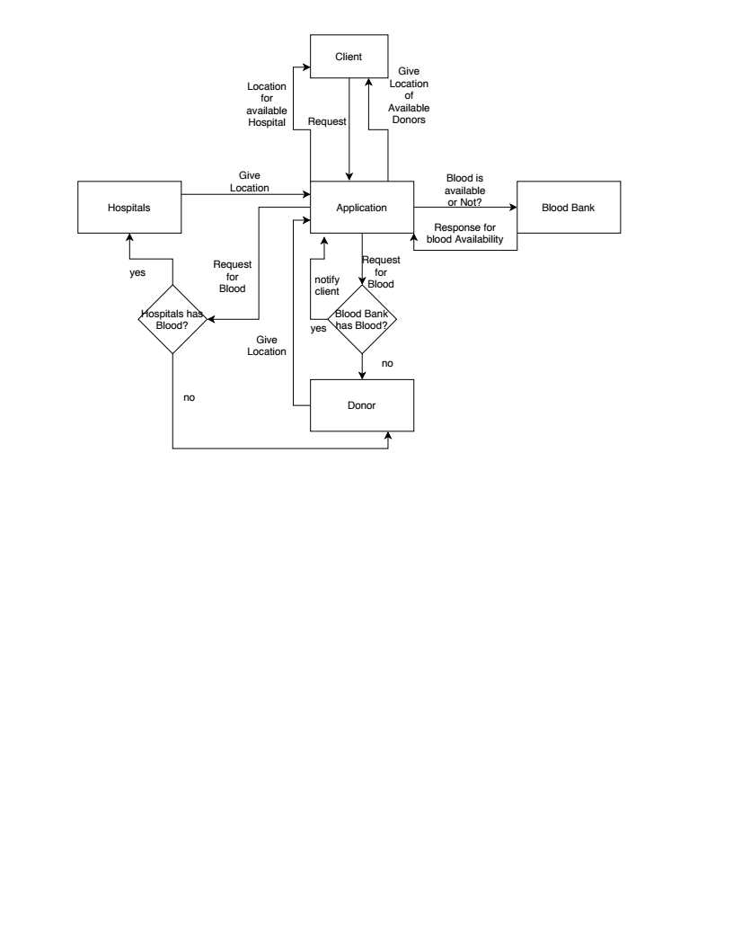
Block Diagram

Slide 6
Source
.https://www.who.int/worldblooddonorday/campaignkit/WBDD_GlobalNeed_English.pdf

