Slide 1
Knowledge sharing paper presentaion
Cloud Computing

Slide 2
Energy Efficiency in Cloud Computing Data Centers
A Survey on Software Technologies
F. M. Shefat Hossain Niloy- 0122310011 Alamin Refat- 0122420003
Jamil Uddin Bhuiyan- 0122410061 Md. Harun-Ur-Rashid- 0122310047

Slide 3
📖 Paper Title: Energy Efficiency in Cloud Computing Data Centers: A Survey on Software Technologies
✍️ Authors: - Avita Katal (Research Scholar, School of Computer Science, University of Petroleum and Energy Studies, Dehradun, India) - Susheela Dahiya (School of Computer Science, University of Petroleum and Energy Studies, Dehradun, India) - Tanupriya Choudhury (School of Computer Science, University of Petroleum and Energy Studies, Dehradun, India) 📅 Published: 30 August 2022 🔗 DOI: https://doi.org/10.1007/s10586-022-03713-0

Slide 4
Introduction
🔍 Cloud computing is a growing IT paradigm with high energy demands.
⚡ Data centers consume a lot of electricity and generate heat.
💡 This research explores software-based solutions to optimize energy use in cloud environments.

Slide 5
Problem Definition
❗ The Problem: Data Centers Consume Excessive Energy
🌍 Rising Energy Demands - By 2030, data center energy usage will reach 2967 TWh!
💨 Environmental Impact - High power consumption leads to increased CO₂ emissions.
💸 High Operational Costs - More energy use means higher financial expenses for cloud providers.

Slide 6
Motivation
💡 Why Solve This Problem?
🔹 Energy Consumption is Growing Rapidly!
🔹 High Energy Usage = More Pollution (CO₂ Emissions)
🔹 Need for Sustainable Cloud Computing to Reduce Environmental Harm

Slide 7
Solution Approach
🔬 How Can We Solve This?
⚡ Optimizing Software-based Technologies
✅ Operating System-Level Solutions - Energy-aware scheduling & power management.
✅ Virtualization & Containers - Reduce redundant hardware usage and improve efficiency.
✅ Application-Level Strategies - Load balancing, workload management, and AI-powered optimizations.

Slide 8
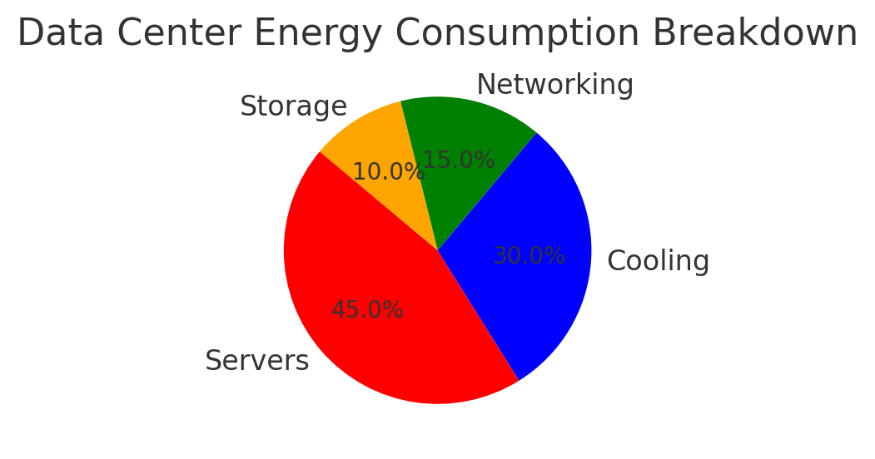
Energy Usage in Data Centers
Data centers consume energy for:
⚙️ Servers (45%)
❄️ Cooling Systems (30%)
🌐 Networking & Storage (25%)

Slide 9
Power Usage Effectiveness (PUE)
PUE measures how efficiently a data center uses power.
🔹 Ideal PUE = 1.0 (100% efficient, no wasted energy).
🔹 Industry Average = 1.57 (some energy wasted on cooling, etc.).

Slide 10
Software-Level Solutions for Energy Efficiency
🔹 Operating System Optimizations (Power Management, Energy-efficient Scheduling)
🔹 Virtualization & Containers (Dynamic VM Placement, Load Balancing, Docker)
🔹 Application-Level Improvements (Optimized SaaS, Workload Reduction)

Slide 11
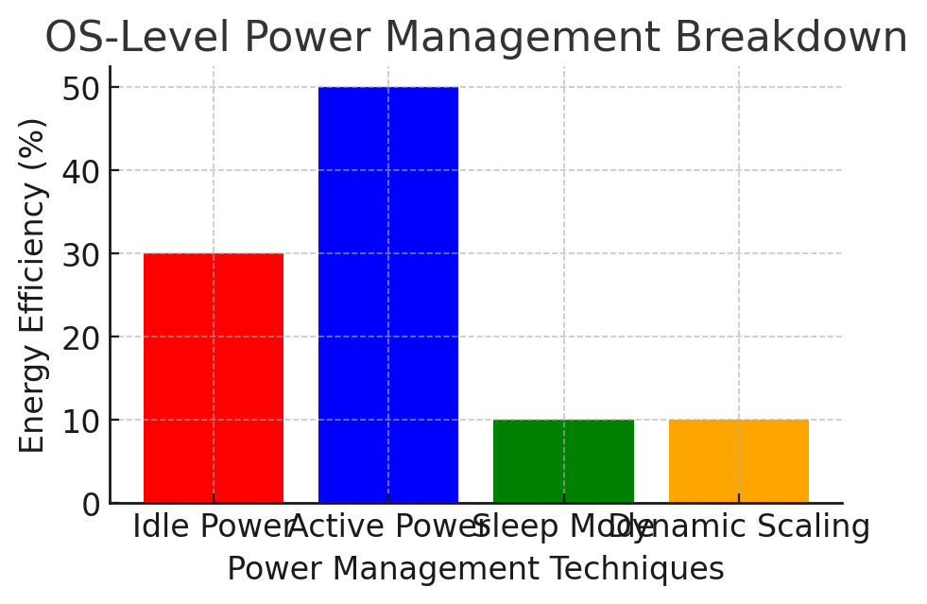
Operating System Level Optimization
🖥️ The Operating System (OS) plays a crucial role in managing power usage efficiently.

Slide 12
⚙️ Techniques for OS-Level Energy Optimization: 🔹 Dynamic Voltage & Frequency Scaling (DVFS): Adjusts CPU power dynamically based on workload to reduce energy waste. 🔹 OS-Directed Power Management (OSPM): Allows the OS to transition between different power states for optimal efficiency. 🔹 Energy-Aware Scheduling: Allocates system resources intelligently to balance performance and power consumption.

Slide 13
Virtualization & Containers
🖥️ Virtualization allows multiple virtual machines (VMs) to share the same physical hardware.
⚙️ How Virtualization Helps Energy Efficiency?
🔹 Reduces the number of physical servers needed, lowering energy consumption.
🔹 Allows better resource utilization by dynamically allocating computing power.
🔹 Enables Live Migration of VMs to balance workload and optimize power usage.

Slide 14
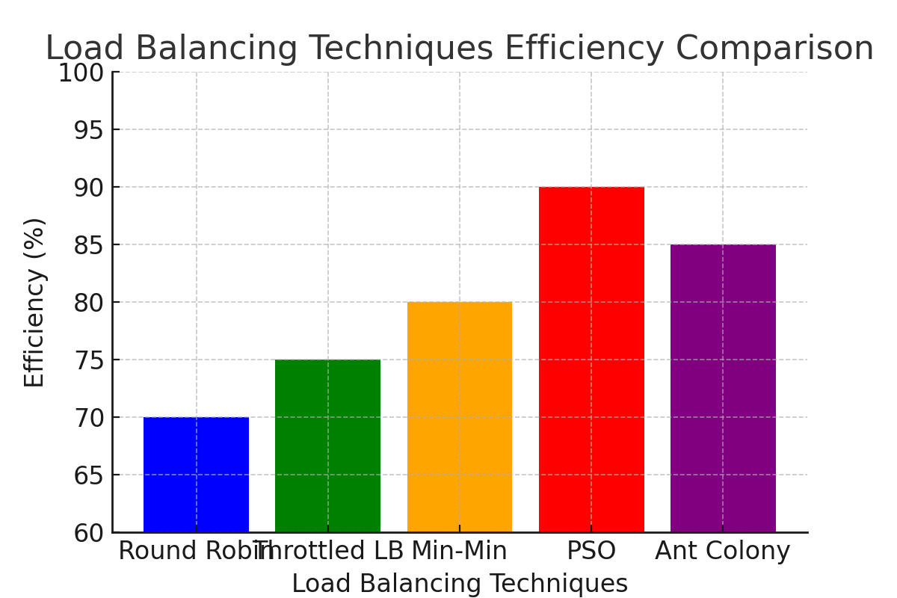
Load Balancing Techniques
Even distribution of workload across servers prevents overheating and reduces power waste. Methods include Round Robin, Min-Min, and AI-driven solutions.

Slide 15
1. Round Robin: Distributes requests sequentially across available servers. 2. Throttled Load Balancing: Allocates resources based on threshold limits. 3. Min-Min Algorithm: Assigns shortest tasks to the fastest available resources first. 4. Particle Swarm Optimization: AI-based method optimizing task scheduling and resource allocation. 5. Ant Colony Optimization: Bio-inspired algorithm for efficient workload distribution.

Slide 16
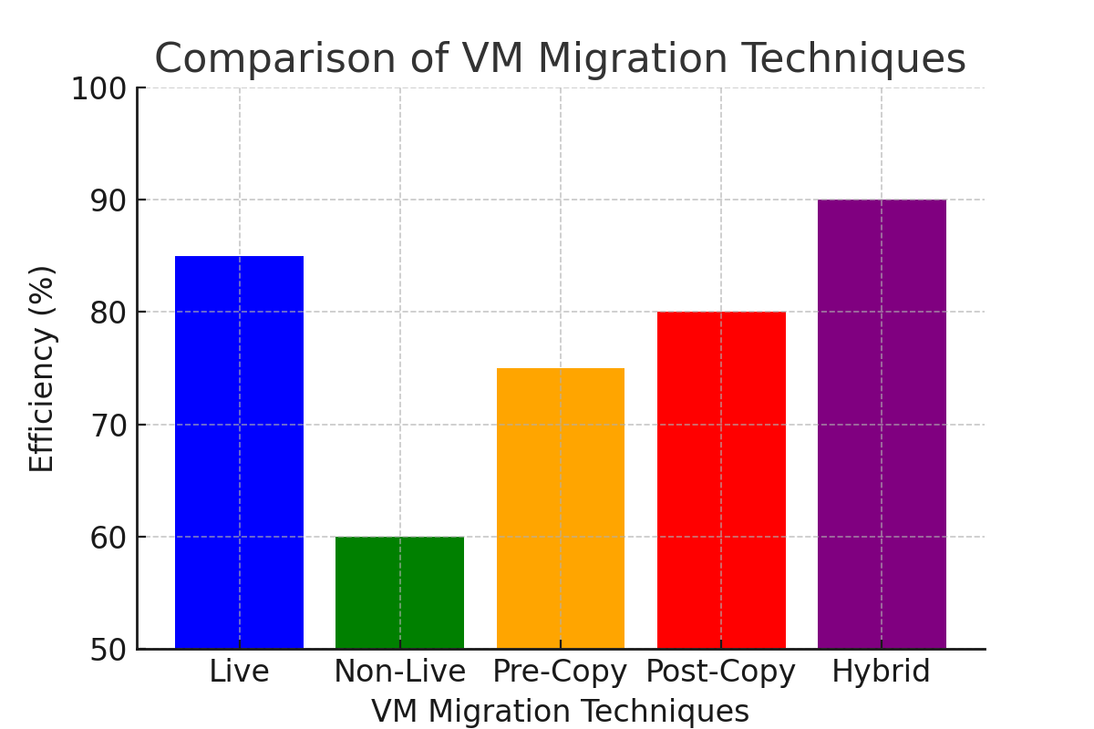
Virtual Machine Migration
VM Migration allows seamless movement of virtual machines across physical servers to optimize resource usage, reduce energy consumption, and balance workloads.

Slide 17
🏁 Conclusion
If we reduce energy use in data centers, we can:
🌱 Protect the environment
💰 Save money on electricity
⚡ Make cloud services faster and more efficient
This research is important because it helps big tech companies like Google, Amazon, and Microsoft build eco-friendly data centers that use less power while still providing fast services.

