Slide 1

CSE 604 Artificial Intelligence
Chapter 1: Introduction
Dr. Ahmedul Kabir
Adapted from slides available in Russell & Norvig’s textbook webpage

Slide 2
Objectives
To define what Artificial Intelligence (AI) is
To give an overview of topics to be covered in this course
To look at some applications of AI
To get an idea about the state of the art in AI

Slide 3
What is AI?
• AI is a relatively new field - started at the end of the 1940s
• The name “Artificial Intelligence” was coined by John McCarthy in 1956
• Two of the many definitions of Artificial Intelligence are:
What is an “intelligent entity” or what does it mean to “behave intelligently”?
My favorite definition of AI
“AI is an attempt to understand intelligent entities and to build them” (Russell and Norvig, 1995)
“AI is the design and study of computer programs that behave intelligently”
(Dean, Allen, and Aloimonos,1995)
“The aggregate or global capacity to act purposefully, to think rationally, and to deal effectively with its environment” (Wechsler, 1958)
“The study of how to make computers do things at which, at the moment, humans are better” (Rich and Knight, 1991)

Slide 4
What is AI? (cont.)
AI can be seen as an ensemble of ideas & techniques for:
representing knowledge
using knowledge to solve problems
with two goals:
Engineering Goal:
To solve real-world problems using AI
Scientific Goal:
To explain various sorts of intelligence

Slide 5
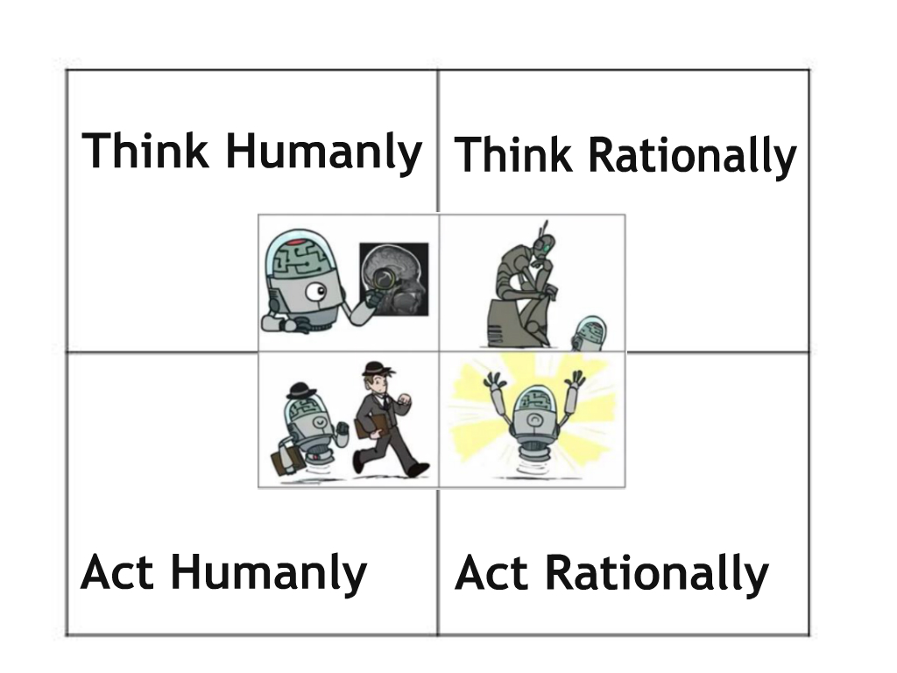
What is AI? (cont.)
Views of AI fall into four categories:
https://kartikkukreja.wordpress.com/2015/05/17/what-is-ai-and-what-can-we-do-with-it-today/

Slide 6

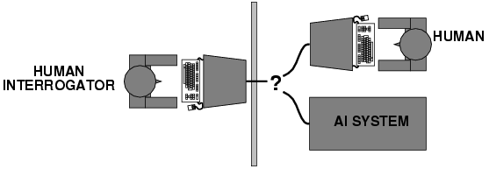
Acting humanly: Turing Test
Alan Turing (1950) "Computing machinery and intelligence":
"Can machines think?" → "Can machines behave intelligently?“
Operational test for intelligent behavior: the Imitation Game
The test: A computer is interrogated by a human through a terminal and passes the test if the interrogator cannot tell if there is a computer or a human at the other end.

Slide 7
Acting humanly: Turing Test (cont.)
To pass the Turing test a machine will need to:
represent knowledge
reason automatically
learn
process natural language
For the TOTAL Turing test (which includes also a video signal so that the interrogator can test the subject’s perceptual abilities) the machine will also need to:
5. “see” (computer vision)
6. “move” (robotics)
In 2014, a chatbot named “Eugene Goostman” claimed to have passed the Turing test, but was later dismissed by critics.

Slide 8
Thinking humanly: cognitive modeling
Requires scientific theories of internal activities of the brain
Three ways to do this
Introspection – catching one’s own thoughts
Psychological experiments - predicting and testing behavior of human subjects
Direct identification - from brain imaging and neurological data
Cognitive Science brings together computer models form AI and techniques from psychology
Problem:
We know very little about how human brain works!
Experimenting on humans is costly and imprecise

Slide 9
Thinking rationally: "laws of thought"
Aristotle: what are “the right” arguments/thought processes?
Syllogisms provide patterns for argument: always yield correct conclusions when correct premises are given.
“Socrates is a man. All men are mortal.
Therefore, Socrates is mortal”
Logicians in the 19th century developed a notation for statements about all kinds of objects in the real world.
Problems:
Not all intelligent behavior is mediated by logical deliberation
Difference between solving problems “in principle”, and solving them in practice

Slide 10
Acting rationally: rational agent
Rational behavior: doing the right thing
The right thing: that which is expected to maximize goal achievement, given the available information
Doesn't necessarily involve thinking – e.g., blinking reflex – but thinking should be in the service of rational action Advantages:
More general than the “laws of thought” approach
More amenable to scientific development than approaches based on human behavior or human thought
This course will focus on building rational agents

Slide 11
The Foundations of AI
Philosophy Methods of reasoning, mind as a physical system, foundations of knowledge and learning
Mathematics Formal representation and proof, algorithms, computation, (un)decidability, (in)tractability, probability
Economics Formal theory of rational decisions
Neuroscience Physical substrate for mental activity
Psychology Experimental techniques on human and animal behavior
Computer Building fast and efficient computers engineering
Linguistics Knowledge representation, human interaction

Slide 12
Overview of Topics in this Course
Introduction, Intelligent Agents
Problem-solving techniques:
Blind Search, Heuristic Search, Optimal search, Adversarial Search (Game Playing), Constraint Satisfaction
Knowledge representation and Logical reasoning
Machine Learning
Applications of AI
Computer vision, Natural language processing, Robotics

Slide 13



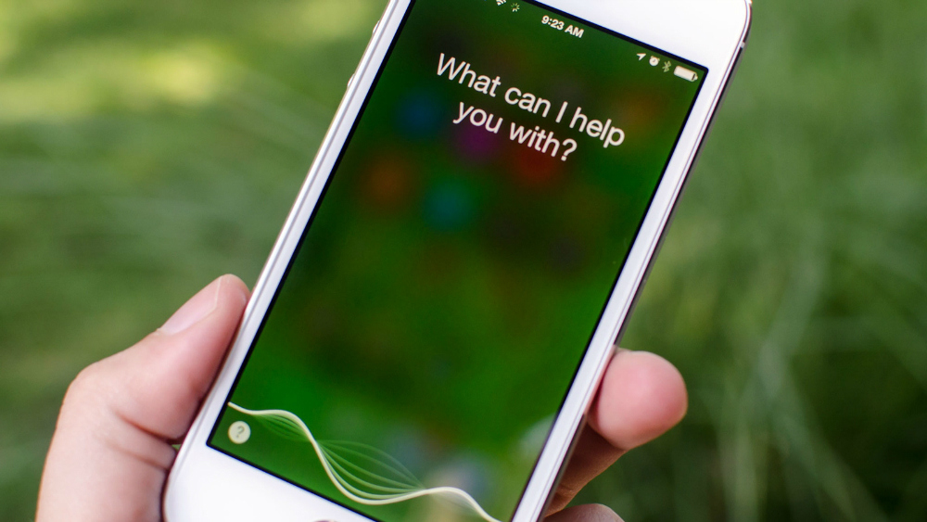


AI in everyday life
Personal assistants
Recommendation Systems
Bgr.com/tag/siri

Slide 14


AI in everyday life (cont.)
Email categorization,
Spam filtering
Fraud prevention,
Credit decisions
https://www.cafecredit.com/free-credit-score
https://sendpulse.com/support/spam-filter

Slide 15

AI in everyday life (cont.)
Face and Object recognition
Facebook, Pinterest
https://www.classaction.org/blog/facebook-sued-over-face-recognition-feature

Slide 16
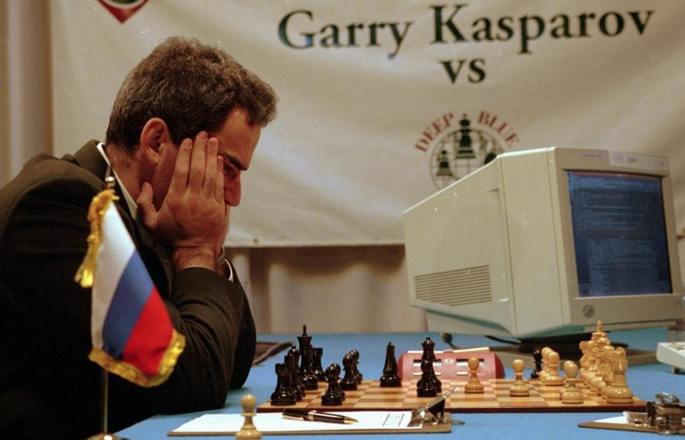
AI Success stories
Game Playing
DeepBlue beats Gary Kasparov (1997)

Slide 17
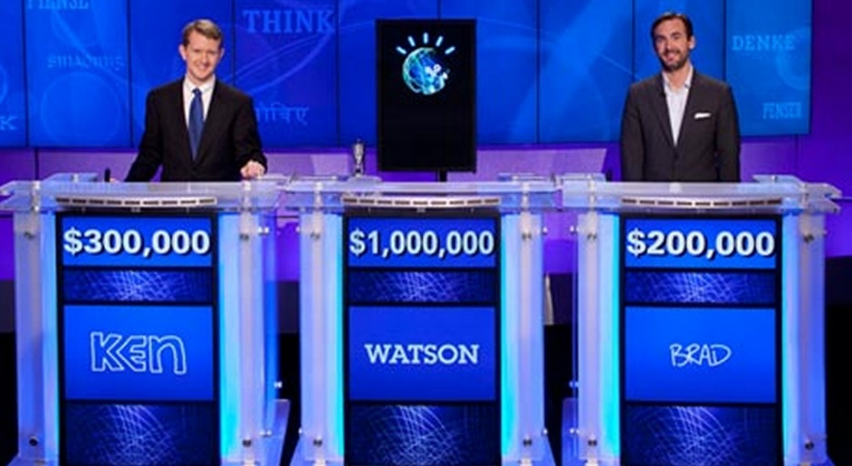
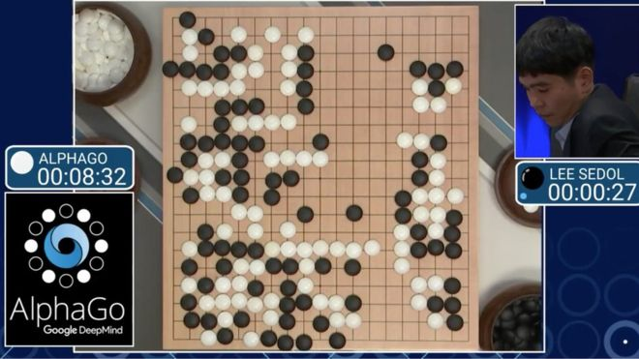
AI Success stories (cont.)
Game Playing
IBM Watson wins Jeopardy! (2011)
AlphaGo beats world champion Go player (2016)
https://www.technobuffalo.com/2013/05/21/ibm-watson-smartphone-ap/
http://www.bbc.com/news/technology-35785875

Slide 18
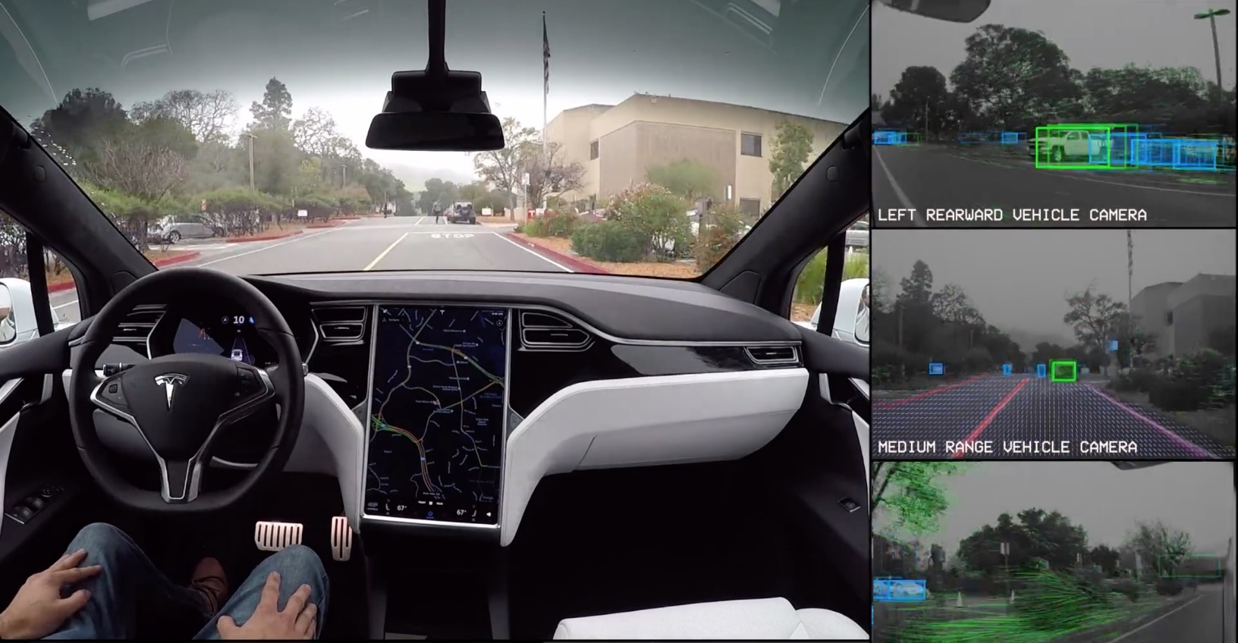
AI Success stories (cont.)
Autonomous vehicles
Google self-driving car, Tesla autopilot
https://www.tesla.com/videos/autopilot-self-driving-hardware-neighborhood-long

Slide 19
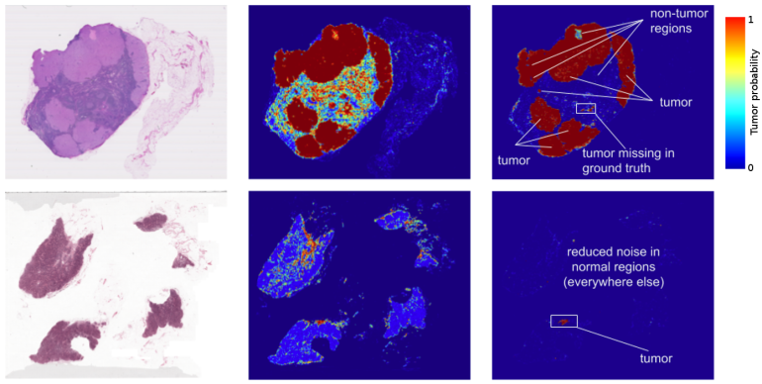
AI Success stories (cont.)
Theorem Proving
Proved a mathematical conjecture (Robbins conjecture) unsolved for decades
Medical diagnosis
AI systems outperformed human experts in blood infection diagnosis and lung cancer diagnosis
http://wnep.com/2017/03/03/google-uses-ai-to-help-diagnose-breast-cancer/

Slide 20
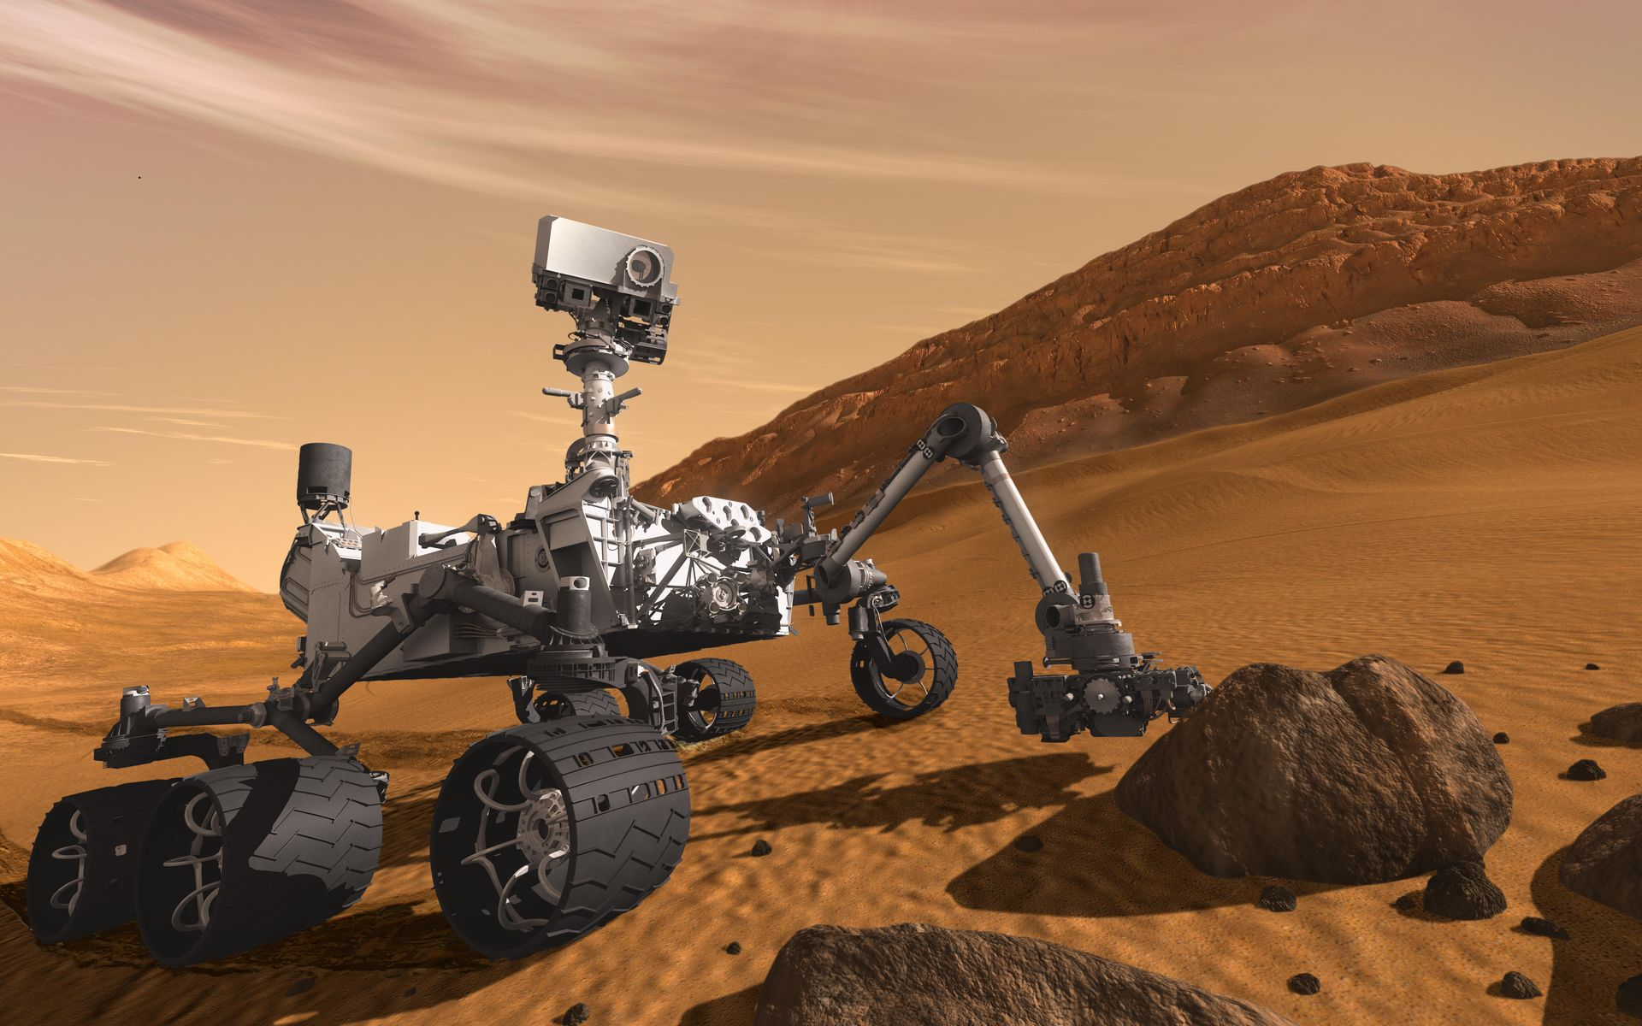
AI Success stories (cont.)
Robot explorers
Mars exploration rovers designed at the NASA Jet Propulsions Laboratory.
In 2016, NASA installed a new AI system called AEGIS in the Curiosity rover, enabling it to choose targets autonomously.
https://www.jpl.nasa.gov/missions/mars-science-laboratory-curiosity-rover-msl//

Slide 21
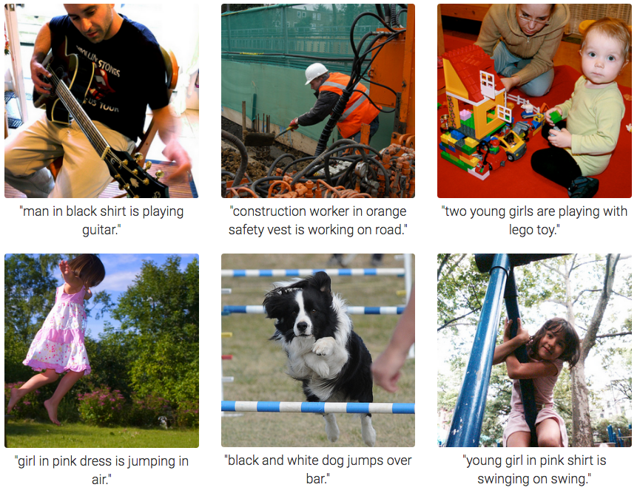
AI Success stories (cont.)
Image processing
Using deep neural networks, possible to identify and categorize objects in images
https://machinelearningmastery.com/inspirational-applications-deep-learning/

Slide 22



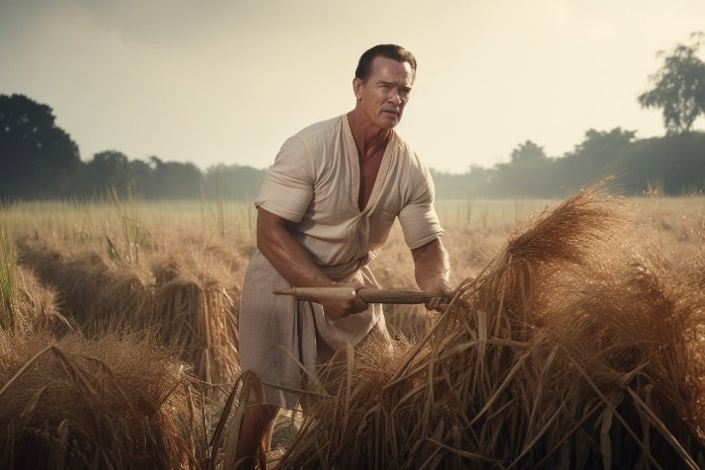
AI Success stories (cont.)
AI generated images
Using prompts, AI can synthesize never-before-seen images
Created by MidJourney AI

Slide 23
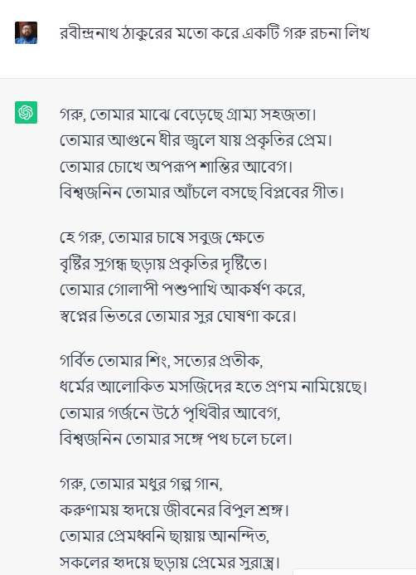
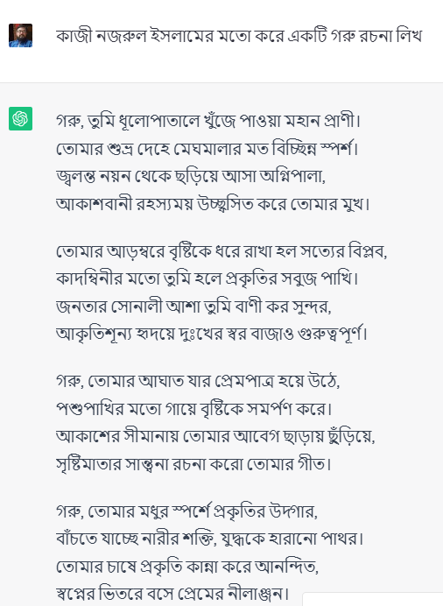
AI Success stories (cont.)
Language synthesis
Generated by ChatGPT

Slide 24
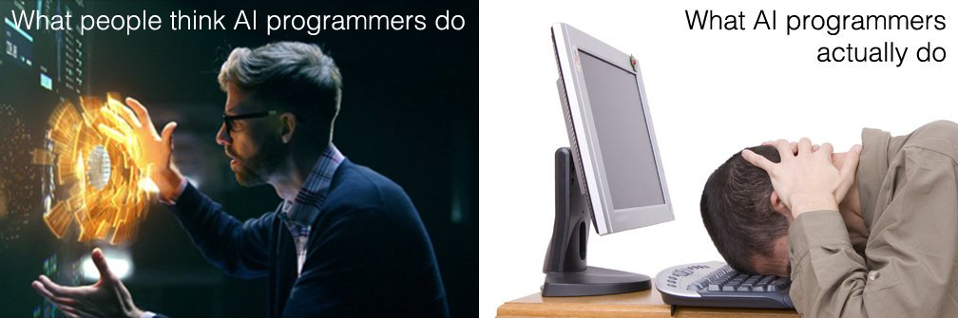
Final remarks
https://twitter.com/mark_riedl/status/837879984375091200

