Slide 1

CSE 604 Artificial Intelligence
Chapter 5: Adversarial Search
Dr. Ahmedul Kabir
Adapted from slides available in Russell & Norvig’s textbook webpage

Slide 2
Outline
Optimal decisions
α-β pruning
Imperfect, real-time decisions

Slide 3
Games vs. search problems
"Unpredictable" opponent → specifying a move for every possible opponent reply
Time limits → unlikely to find goal, must approximate

Slide 4
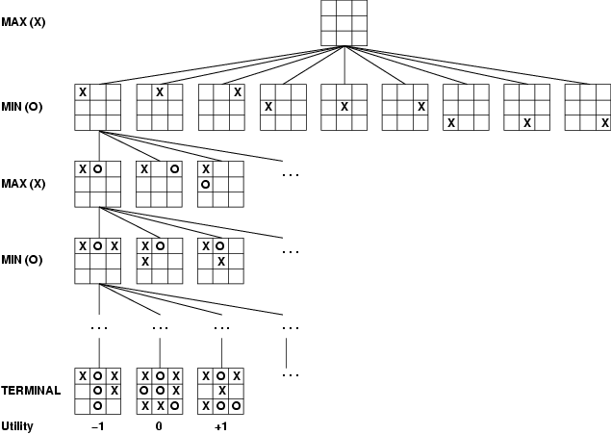
Game tree (2-player, deterministic, turns)

Slide 5
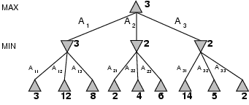
Minimax
Perfect play for deterministic games
Idea: choose move to position with highest minimax value = best achievable payoff against best play
E.g., 2-ply game:

Slide 6
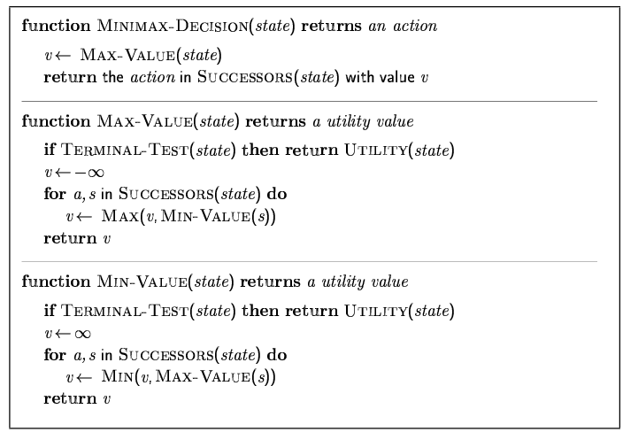
Minimax algorithm

Slide 7
Properties of minimax
Complete? Yes (if tree is finite)
Optimal? Yes (against an optimal opponent)
Time complexity? O(b^{m})
Space complexity? O(bm) (depth-first exploration)
For chess, b ≈ 35, m ≈100 for "reasonable" games → exact solution completely infeasible

Slide 8
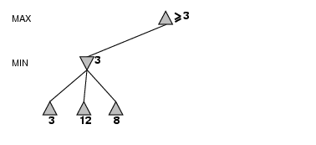
α-β pruning example

Slide 9
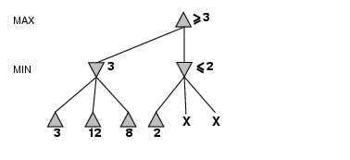
α-β pruning example

Slide 10
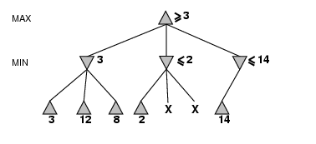
α-β pruning example

Slide 11
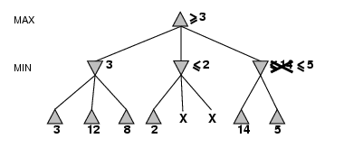
α-β pruning example

Slide 12
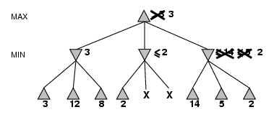
α-β pruning example

Slide 13
Properties of α-β
Pruning does not affect final result
Good move ordering improves effectiveness of pruning
Try the moves that are “likely to be best” first
E.g., in chess, try captures, threats, forward moves, backward moves in that order
With "perfect ordering," time complexity ≈ O(b^{m/2})
→ doubles depth of search
A simple example of the value of reasoning about which computations are relevant (a form of metareasoning)

Slide 14
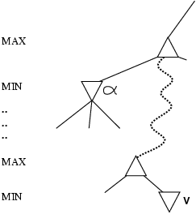
Why is it called α-β?
α is the value of the best (i.e., highest-value) choice found so far at any choice point along the path for max
If v is worse than α, max will avoid it
→ prune that branch
Define β similarly for min

Slide 15
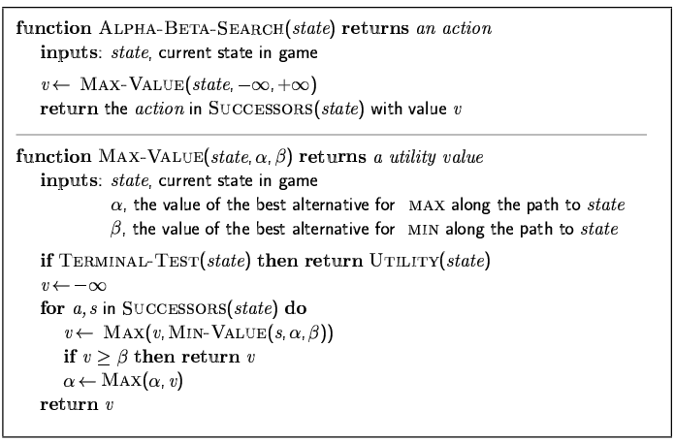
The α-β algorithm

Slide 16
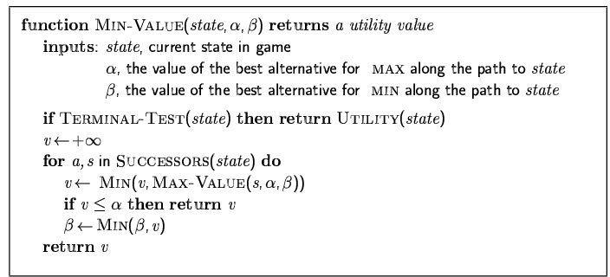
The α-β algorithm

Slide 17
Imperfect Real Time Decisions
Even with alpha-beta pruning, it is infeasible to grow the whole game tree!
Standard approach:
evaluation function
= estimated desirability of position
cut off search
e.g., depth limit or iterative deepening
forward pruning
e.g., Beam search

Slide 18
Evaluation functions
For chess, typically linear weighted sum of features
Eval(s) = w₁ f₁(s) + w₂ f₂(s) + … + w_{n} f_{n}(s)
e.g., w₁ = 9 with
f₁(s) = (number of white queens) – (number of black queens),
w₂ = 5 with
f₂(s) = (number of white rooks) – (number of black rooks),
etc.

Slide 19
Cutting off search
We can use a modified algorithm MinimaxCutoff
MinimaxCutoff is identical to MinimaxValue except
Terminal? is replaced by Cutoff?
Utility is replaced by Eval
Does it work in practice?
Suppose we have 100 secs, explore 10⁴ nodes/sec → 10⁶ nodes per move
b^{m} = 10⁶, b=35 → m=4
4-ply lookahead is a hopeless chess player!
4-ply ≈ human novice
8-ply ≈ typical PC, human master
12-ply ≈ Deep Blue, Kasparov

Slide 20
Deterministic games in practice
Checkers: Chinook ended 40-year-reign of human world champion Marion Tinsley in 1994.
Chess: Deep Blue defeated human world champion Garry Kasparov in a six-game match in 1997. Deep Blue searches 200 million positions per second, uses very sophisticated evaluation, and undisclosed methods for extending some lines of search up to 40 ply.
Othello: human champions refuse to compete against computers, who are too good.
Go: Until recently, human champions refused to compete against computers, who were too bad (in Go, b > 300).
But in 2016, Google’s AlphaGo defeated human world champion Lee Sedol.
In 2017, AlphaGo Zero defeated the previous version of AlphaGo 100-0

