Slide 1


CSE366 Artificial Intelligence East West University
Md Al-Imran
Lecturer
Department of CSE

Slide 2
Problem Solving Agents
A problem can be considered to consist of a goal and a set of actions that can be taken to lead to the goal. At any given time, we consider the state of the search space to represent where we have reached as a result of the actions we have applied so far. For example, consider the problem of looking for a contact lens on a football field. The initial state is how we start out, which is to say we know that the lens is somewhere on the field, but we don’t know where. If we use the representation where we examine the field in units of one square foot, then our first action might be to examine the square in the top-left corner of the field. If we do not find the lens there, we could consider the state now to be that we have examined the top-left square and have not found the lens. After a number of actions, the state might be that we have examined 500 squares, and we have now just found the lens in the last square we examined. This is a goal state because it satisfies the goal that we had of finding a contact lens.

Slide 3
Goal Formulation
Imagine an agent in the city of Arad, Romania, enjoying a touring holiday. The agent’s performance measure contains many factors: it wants to improve its suntan, improve its Romanian, take in the sights, enjoy the nightlife (such as it is), avoid hangovers, and so on. The decision problem is a complex one involving many tradeoffs and careful reading of guidebooks. Now, suppose the agent has a nonrefundable ticket to fly out of Bucharest the following day. In that case, it makes sense for the agent to adopt the goal of getting to Bucharest. Courses of action that don’t reach Bucharest on time can be rejected without further consideration and the agent’s decision problem is greatly simplified. Goals help organize behavior by limiting the objectives that the agent is trying to achieve and hence the actions it needs to consider. Goal formulation, based on the current situation and the agent’s performance measure, is the first step in problem solving.

Slide 4
Problem Formulation
Problem formulation is the process of deciding what actions and states to consider, given a goal. We discuss this process in more detail later. For now, let us assume that the agent will consider actions at the level of driving from one major town to another. Each state therefore corresponds to being in a particular town.

Slide 5
Search and Execution
The process of looking for a sequence of actions that reaches the goal is called search.
A search algorithm takes a problem as input and returns a solution in the form of an action sequence. Once a solution is found, the actions it recommends can be carried out.

Slide 6
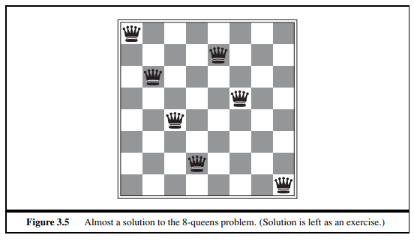
Search in a Physical space

Slide 7
Real-world problems
Route Finding Problem
States: Each state obviously includes a location (e.g., an airport) and the current time. Furthermore, because the cost of an action (a flight segment) may depend on previous segments, their fare bases, and their status as domestic or international, the state must record extra information about these “historical” aspects.
• Initial state: This is specified by the user’s query.
• Actions: Take any flight from the current location, in any seat class, leaving after the current time, leaving enough time for within-airport transfer if needed.
• Transition model: The state resulting from taking a flight will have the flight’s destination as the current location and the flight’s arrival time as the current time. • Goal test: Are we at the final destination specified by the user?
• Path cost: This depends on monetary cost, waiting time, flight time, customs and immigration procedures, seat quality, time of day, type of airplane, frequent-flyer mileage awards, and so on.

Slide 8
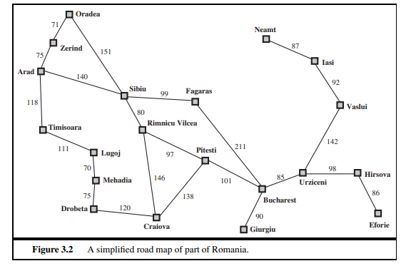
Real-world problems

Slide 9
Uninformed Search vs Informed Search
Uninformed:
Also called blind, exhaustive or brute-force search, uses no information about the problem to guide the search and therefore may not be very efficient.
Informed:
Also called heuristic or intelligent search, uses information about the problem to guide the search, usually guesses the distance to a goal state and therefore efficient, but the search may not be always possible

Slide 10
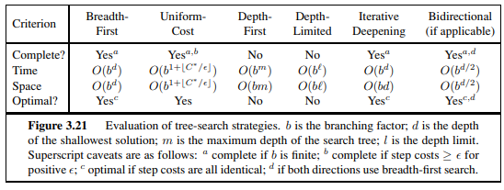
Evaluation metrics

Slide 11
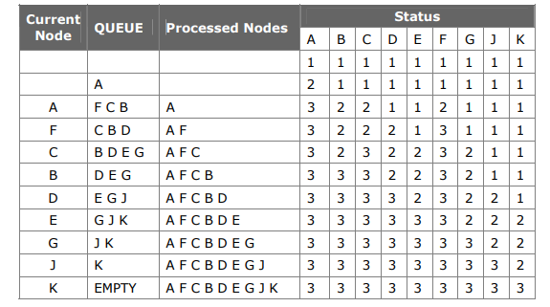
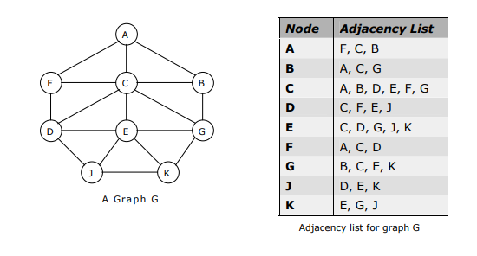
BFS

Slide 12
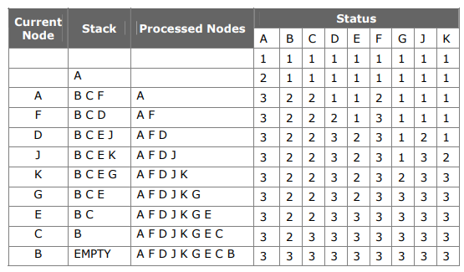
DFS

Slide 13
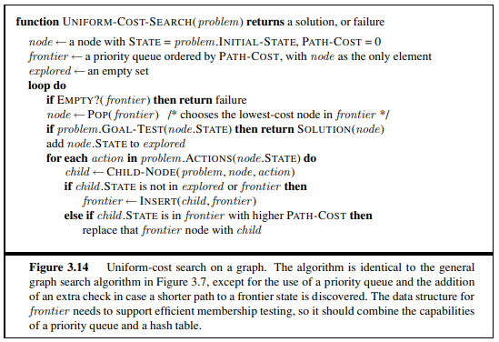
UCS

Slide 14
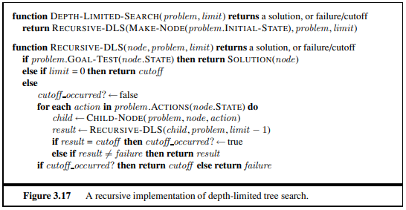
DLS
The embarrassing failure of depth-first search in infinite state spaces can be alleviated by supplying depth-first search with a predetermined depth limit . That is, nodes at depth are treated as if they have no successors.
This approach is called depth-limited search. The depth limit solves the infinite-path problem.

Slide 15
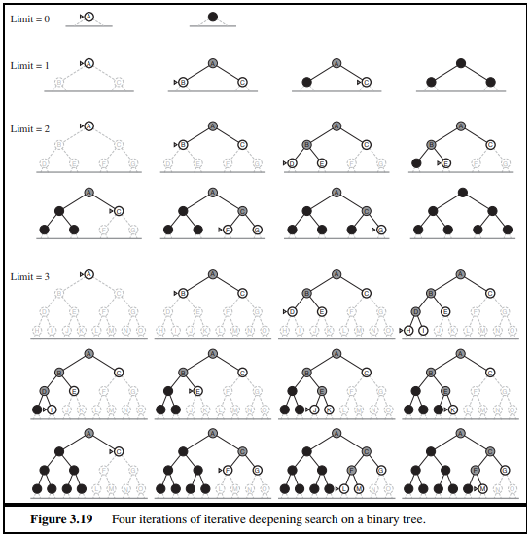
IDS

Slide 16
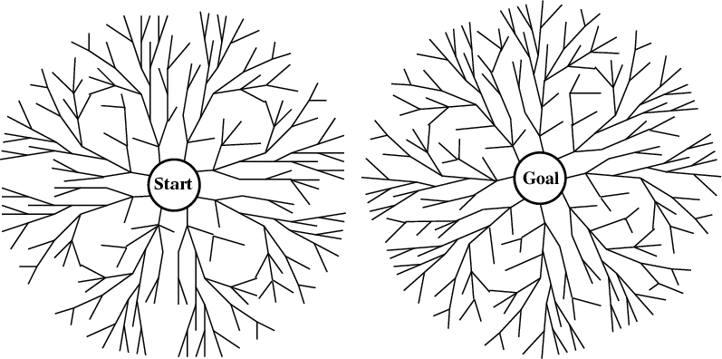
Bi-directional search
Alternate searching from the start state toward the goal and from the goal state toward the start.
Stop when the frontiers intersect.
Works well only when there are unique start and goal states.
Requires the ability to generate “predecessor” states.
Can (sometimes) lead to finding a solution more quickly.
Time complexity: O(b^{d/2}). Space complexity: O(b^{d/2}).

Slide 17


