Slide 1


CSE365(1) and CSE366(2) Artificial Intelligence Summer 2021 East West University
Md Al-Imran
Lecturer
Department of CSE

Slide 2
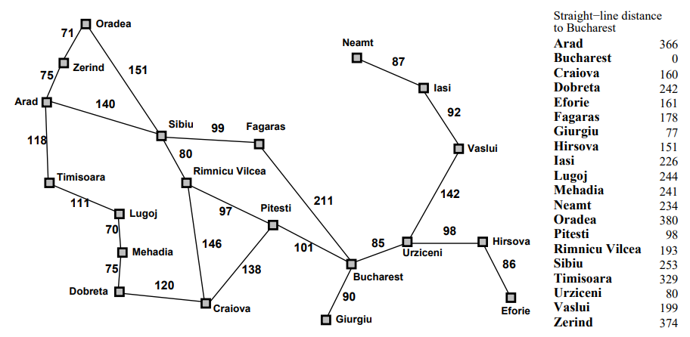
Best First Search
Idea: use an evaluation function for each node – estimate of “desirability”
Figure: Romania with step costs in KM

Slide 3

Greedy Best First Search
Evaluation function h(n) ( heuristic) = estimate of cost from n to the closest goal. E.g., straight-line distance from n to Bucharest
Greedy search expands the node that appears to be closest to goal

Slide 4
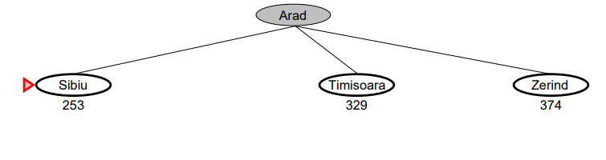
Greedy Best First Search

Slide 5
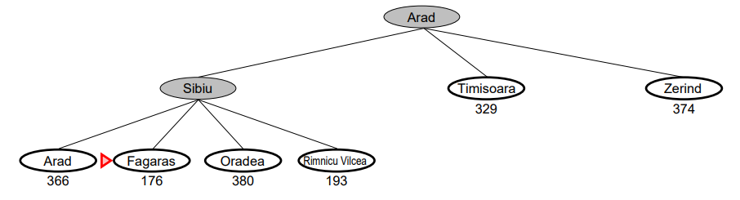
Greedy Best First Search

Slide 6
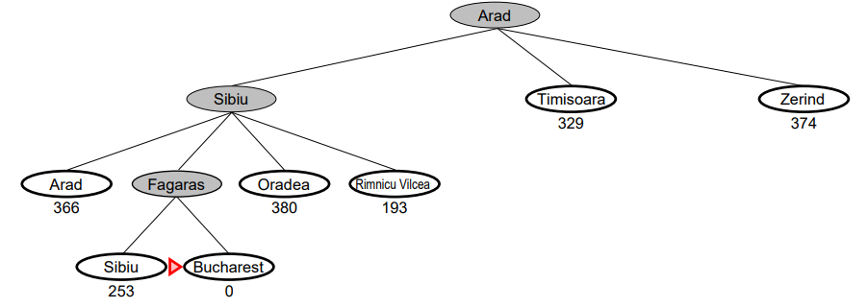
Greedy Best First Search

Slide 7
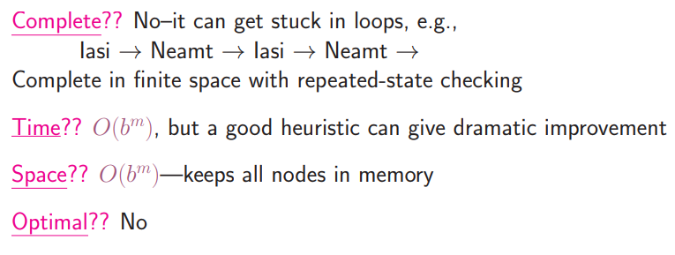
Properties of greedy search

Slide 8
A* Search
Evaluation Function f(n) = g(n) + h(n)
g(n) = cost so far to reach n
h(n) = estimated cost to goal from n
f(n) = estimated total cost of path through n to goal

Slide 9
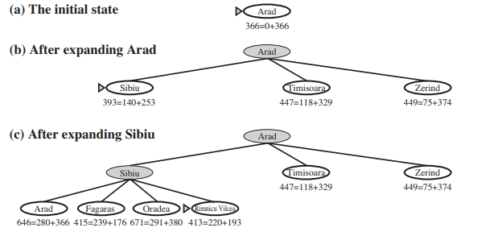
A* Search

Slide 10
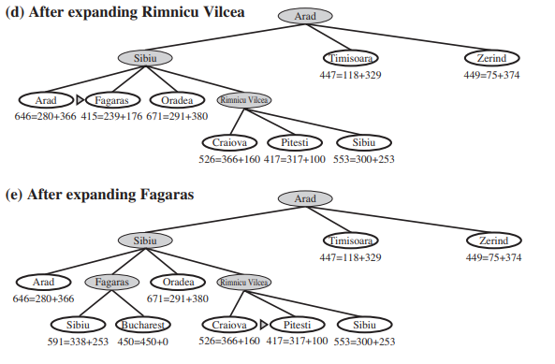
A* Search

Slide 11
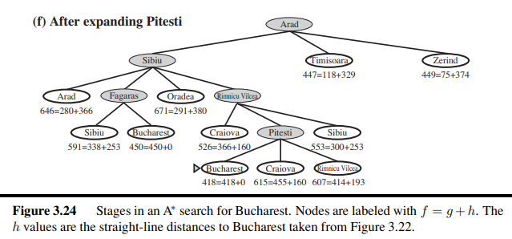
A* Search

Slide 12
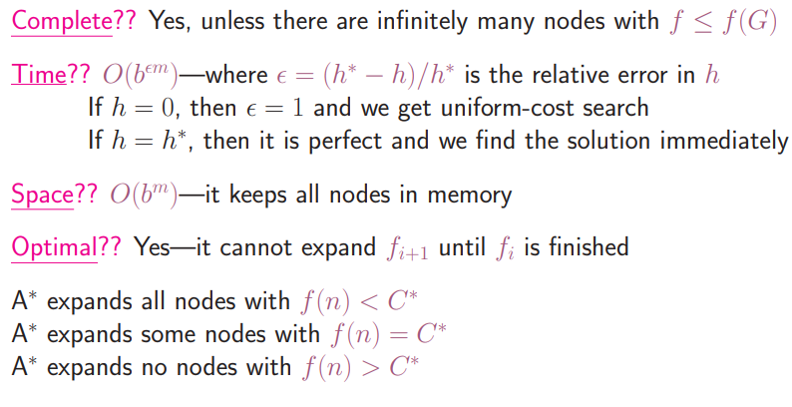
A* Search properties

Slide 13
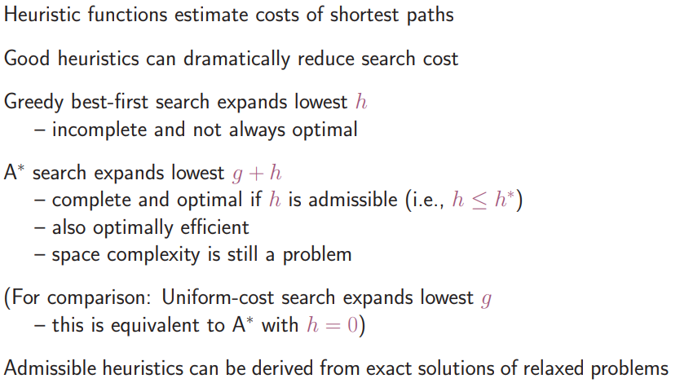
Summary

Slide 14
IDA*
• Solves minimum cost-path problems with heuristics
• Iterative deepening version of A*
Idea:
• Performs limited-cost depth-first search for the current evaluation function limit – Keeps expanding nodes in the depth-first manner up to the evaluation function limit
• Progressively increases the evaluation function limit (instead of the depth limit) Problem: the amount by which the evaluation limit should be progressively increased

Slide 15
IDA*
Pros:
It will always find the optimal solution provided that it exist’s and that if a heuristic is supplied it must be admissible.
Heuristic is not necessary, it is used to speed up the process.
Various heuristics can be integrated to the algorithm without changing the basic code.
The cost of each move can be tweaked into the algorithms as easily as the heuristic
Uses a lot less memory which increases linearly as it doesn’t store and forgets after it reaches a certain depth and start over again.
Cons:
Doesn’t keep track of visited nodes and thus explores already explored nodes again.
Slower due to repeating the exploring of explored nodes.
Requires more processing power and time than A*.

Slide 16
IDA*

Slide 17
Hill Climbing Algorithms
A hill-climbing algorithm is a local search algorithm that moves continuously upward (increasing) until the best solution is attained. This algorithm comes to an end when the peak is reached.
This algorithm has a node that comprises two parts: state and value. It begins with a non-optimal state (the hill’s base) and upgrades this state until a certain precondition is met. The heuristic function is used as the basis for this precondition. The process of continuous improvement of the current state of iteration can be termed as climbing. This explains why the algorithm is termed as a hill-climbing algorithm.
A hill-climbing algorithm’s objective is to attain an optimal state that is an upgrade of the existing state. When the current state is improved, the algorithm will perform further incremental changes to the improved state. This process will continue until a peak solution is achieved. The peak state cannot undergo further improvements.

Slide 18
Features of hill climbing algorithm
It employs a greedy approach: This means that it moves in a direction in which the cost function is optimized. The greedy approach enables the algorithm to establish local maxima or minima.
No Backtracking: A hill-climbing algorithm only works on the current state and succeeding states (future). It does not look at the previous states.
Feedback mechanism: The algorithm has a feedback mechanism that helps it decide on the direction of movement (whether up or down the hill). The feedback mechanism is enhanced through the generate-and-test technique.
Incremental change: The algorithm improves the current solution by incremental changes.

Slide 19
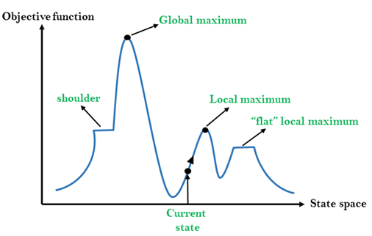
State Space analysis Hill Climbing

Slide 20
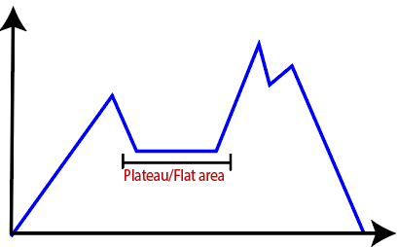
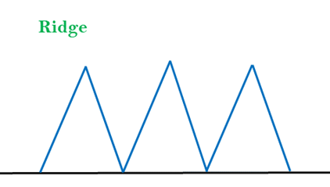
Problems of Hill Climbing
Prone to Local Maxima
Flat Area:
challenge can be overcome by taking a huge jump that will lead you to a non-plateau space.
Ridge:
The hill-climbing algorithm may terminate itself when it reaches a ridge. This is because the peak of the ridge is followed by downward movement rather than upward movement. This impediment can be solved by going in different directions at once.

Slide 21
Variations of Hill Climbing
Simple Hill Climbing
Steepest Ascent Hill Climbing
Stochastic Hill Climbing

Slide 22


