Slide 1

Artificial Intelligence CSE 366
Md Al-Imran Senior Lecturer
Department of CSE

Slide 2
Outline
Introduction
Minimax
Alpha Beta Pruning
In which we examine the problems that arise when we try to plan ahead in a world where other agents are planning against us.

Slide 3
Introduction
Adversarial Search
Multi-agent environment:
any given agent needs to consider the actions of other agents and how they affect its own welfare
Introduce possible contingencies into the agent’s problem-solving process
In this chapter we cover competitive environments, in which the agents’ goals are in conflict, giving rise to adversarial search problems—often known as games.
Mathematical game theory, a branch of economics, views any multiagent environment as a game, provided that the impact of each agent on the others is “significant,” regardless of whether the agents are cooperative or competitive.

Slide 4
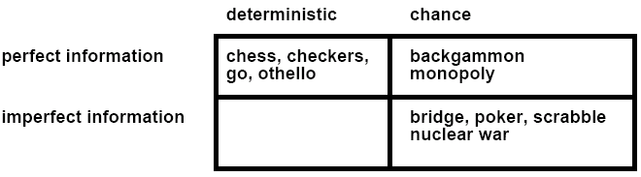
Types of Games
battleship
Kriegspiel
Not Considered: Physical games like tennis, croquet, ice hockey, etc.
(but see “robot soccer” http://www.robocup.org/)

Slide 5
Assumptions
The game state is fully observable.
The outcome of each move is deterministic.
Game states discrete, finite number of possible moves and game states.
There are no infinite runs of the game: a terminal state is always reached after a finite number of steps.
Two-player zero-sum game: two players, terminal states have utility with utility(player1) = −utility(player2).
Our formulation (equivalent): single utility function u, players Max vs. Min trying to maximize vs. minimize u.
Turn-taking: Players move alternatingly. Max begins.
Compare to, e.g., “Prisoner’s Dilemma”
“Deterministic, Non-turn-taking, Non-Zero-sum game of Imperfect information”

Slide 6
Game vs Search Problems
Search – no adversary
Solution is (heuristic) method for finding goal
Heuristics and CSP techniques can find optimal solution
Evaluation function: estimate of cost from start to goal through given node
Examples: path planning, scheduling activities
Games – adversary
Solution is strategy
strategy specifies move for every possible opponent reply.
Time limits force an approximate solution
Evaluation function: evaluate “goodness” of game position
Examples: chess, checkers, backgammon

Slide 7
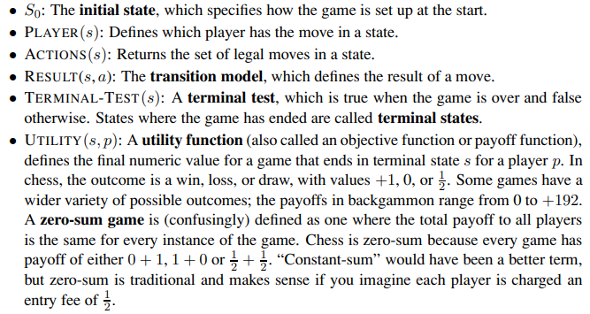
Game Problem Formulation

Slide 8
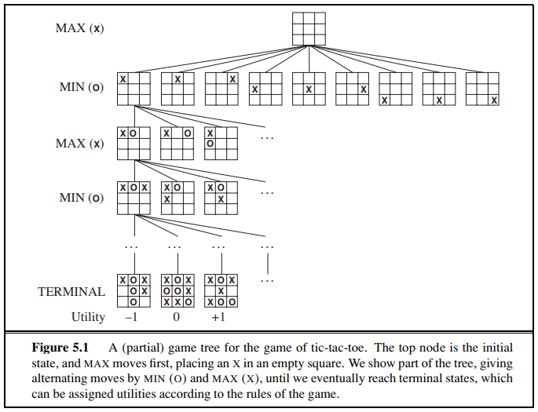
Game tree (2-player, deterministic, turns)
How do we search this tree
to find the optimal move?

Slide 9
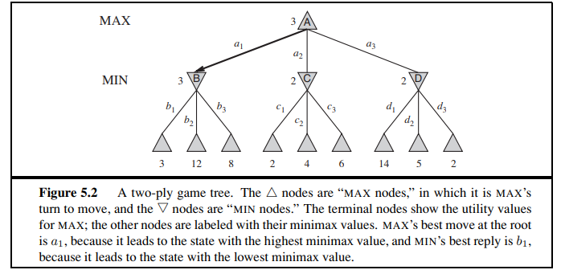
Minimax Strategy

Slide 10
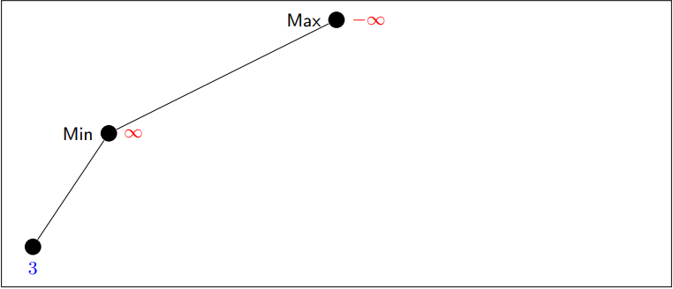
Minimax Details

Slide 11
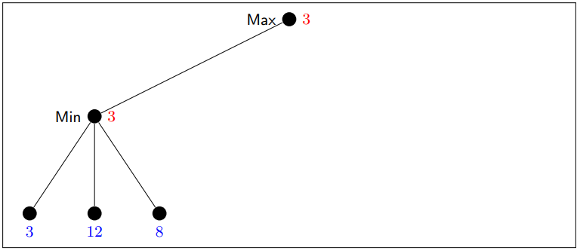
Minimax Details

Slide 12
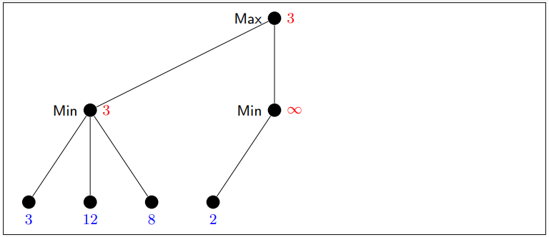
Minimax Details

Slide 13
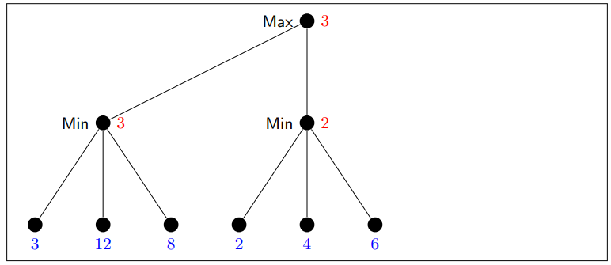
Minimax Details

Slide 14
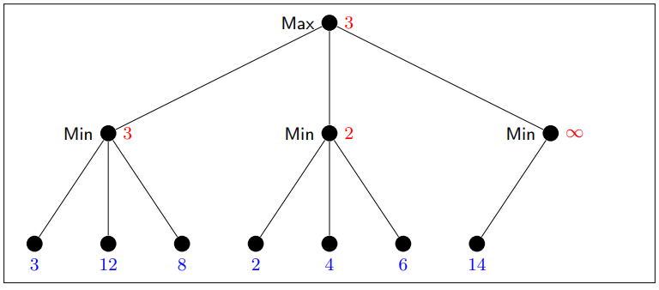
Minimax Details

Slide 15
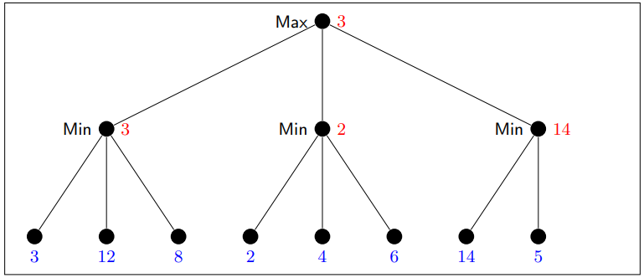
Minimax Details

Slide 16
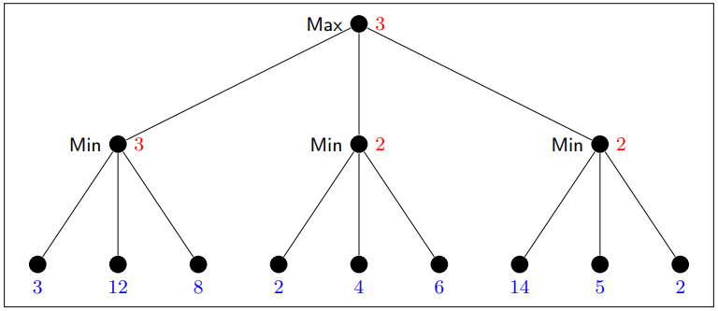
Minimax Details
→ So which action for Max is returned? Leftmost branch. Note: The maximal possible pay-off is higher for the rightmost branch, but assuming perfect play of Min, it’s better to go left. (Going right would be “relying on your opponent to do something stupid”.)

Slide 17
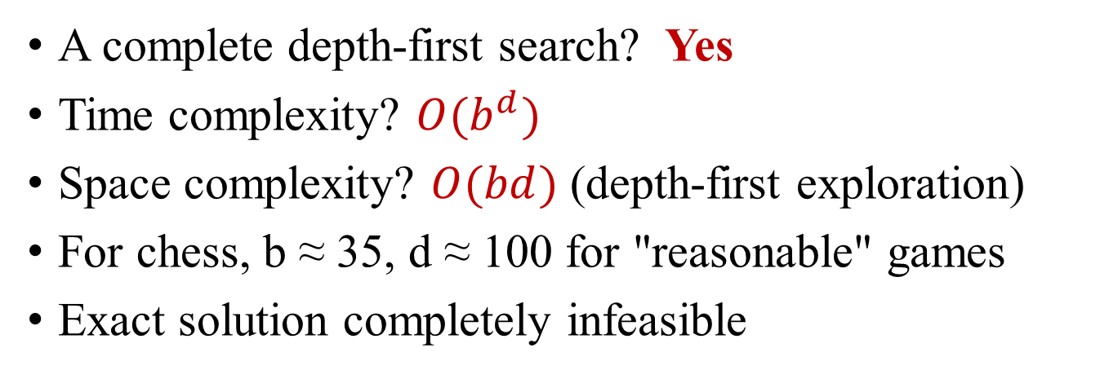
Analysis

Slide 18

Alpha-Beta Pruning

Slide 19

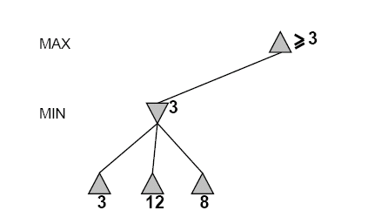
Do DFS until first leaf
Range of possible values
(−∞,+∞)
(−∞, +∞)

Slide 20
(−∞,+∞)
(−∞,3]

Slide 21
(−∞,+∞)
(−∞,3]

Slide 22
[3,+∞)
[3,3]

Slide 23
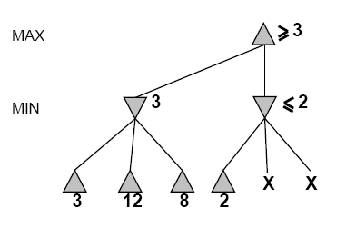
[3,+∞)
This node is
worse for MAX
[3,3]
(−∞,2]

Slide 24
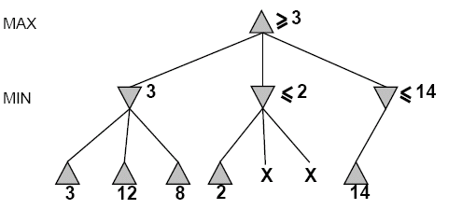
[3,14]
,
[3,3]
(−∞,2]
(−∞,14]

Slide 25
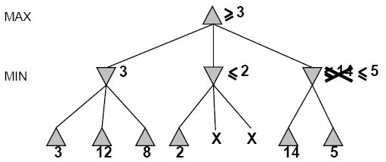

[3,5]
,
[3,3]
(−∞,2]
(−∞,5]

Slide 26
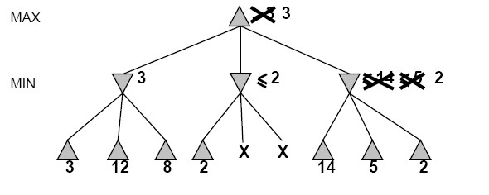
[3,3]
[3,3]
(−∞,2]
[2,2]

Slide 27
[3,3]
[3,3]
(−∞,2]
[2,2]

Slide 28
Alpha-beta Algorithm
Depth first search
only considers nodes along a single path from root at any time
α = highest-value choice found at any choice point of path for MAX
(initially, α = −infinity)
β = lowest-value choice found at any choice point of path for MIN
(initially, β = +infinity)
Pass current values of α and β down to child nodes during search.
Update values of α and β during search:
MAX updates α at MAX nodes
MIN updates β at MIN nodes
Prune remaining branches at a node when α ≥ β

Slide 29
When to Prune
Prune whenever α ≥ β.
Prune below a Max node whose alpha value becomes greater than or equal to the beta value of its ancestors.
Max nodes update alpha based on children’s returned values.
Prune below a Min node whose beta value becomes less than or equal to the alpha value of its ancestors.
Min nodes update beta based on children’s returned values.

Slide 30
Alpha-Beta Example Revisited
Do DF-search until first leaf
α, β, initial values
α=−∞
β =+∞
α, β, passed to kids
α=−∞
β =+∞

Slide 31
Alpha-Beta Example Revisited
α=−∞
β =+∞
α=−∞
β =3
MIN updates β, based on kids

Slide 32
Alpha-Beta Example Revisited
α=−∞
β =+∞
α=−∞
β =3
MIN updates β, based on kids.
No change.

Slide 33
Alpha-Beta Example Revisited
MAX updates α, based on kids.
α=3
β =+∞
3 is returned as node value.

Slide 34
Alpha-Beta Example Revisited
α=3
β =+∞
α, β, passed to kids
α=3
β =+∞

Slide 35
Alpha-Beta Example Revisited
α=3
β =+∞
MIN updates β, based on kids.
α=3
β =2

Slide 36
Alpha-Beta Example Revisited
α=3
β =+∞
α=3
β =2
α ≥ β, so prune.

Slide 37
Alpha-Beta Example (continued)
MAX updates α, based on kids.
No change.
α=3
β =+∞
2 is returned
as node value.

Slide 38
Alpha-Beta Example Revisited
α=3
β =+∞
,
α, β, passed to kids
α=3
β =+∞

Slide 39
Alpha-Beta Example Revisited
α=3
β =+∞
,
MIN updates β,
based on kids.
α=3
β =14

Slide 40
Alpha-Beta Example Revisited
α=3
β =+∞
,
MIN updates β,
based on kids.
α=3
β =5

Slide 41
Alpha-Beta Example Revisited
α=3
β =+∞
2 is returned
as node value.
2

Slide 42
Alpha-Beta Example Revisited
Max calculates the same node value, and makes the same move!
2

Slide 43
Analysis
Worst-Case
branches are ordered so that no pruning takes place. In this case alpha-beta gives no improvement over exhaustive search
Best-Case
each player’s best move is the left-most child (i.e., evaluated first)
in practice, performance is closer to best rather than worst-case
E.g., sort moves by the remembered move values found last time.
E.g., expand captures first, then threats, then forward moves, etc.
E.g., run Iterative Deepening search, sort by value last iteration.
In practice often get O(b^{(d/2)}) rather than O(b^{d})

Slide 44
Final Comments about Alpha-Beta Pruning
Pruning does not affect final results
Entire subtrees can be pruned.
Good move ordering improves effectiveness of pruning
Repeated states are again possible.
Store them in memory = transposition table

Slide 45
Practice Problem
-which nodes can be pruned?
5
6
3
4
1
2
7
8

Slide 46


