Slide 1

Artificial Intelligence CSE 366
Md Al-Imran Senior Lecturer
Department of CSE

Slide 2
Outline
Introduction
CS Problem
Algorithms

Slide 3
Constraint Satisfaction Problems (CSP)
Standard search problem: state is a "black box“ – any data structure that supports successor function and goal test CSP:
state is defined by variables X_{i} with values from domain D_{i}
goal test is a set of constraints specifying allowable combinations of values for subsets of variables
Simple example of a formal representation language
Allows useful general-purpose algorithms with more power than standard search algorithms

Slide 4
CSP Formal Definitions
What is a CSP?
Finite set of variables X₁, X₂, …, X_{n}
Nonempty domain of possible values for each variable D₁, D₂, …, D_{n}
Finite set of constraints C₁, C₂, …, C_{m}
Each constraint C_{i} limits the values that variables can take,
e.g., X₁ ≠ X₂
Each constraint C_{i} is a pair <scope, relation>
Scope = Tuple of variables that participate in the constraint.
Relation = List of allowed combinations of variable values.
May be an explicit list of allowed combinations.
May be an abstract relation allowing membership testing and listing.

Slide 5
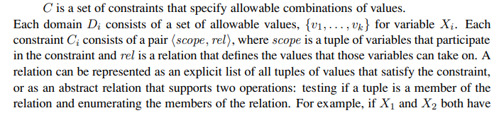
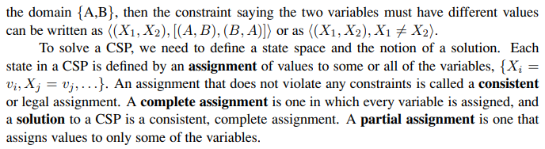
CSP

Slide 6
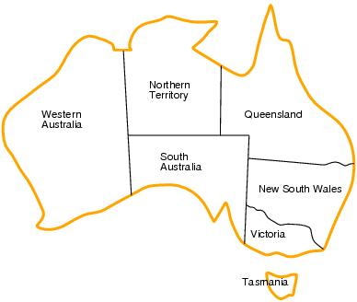
CSP example: map coloring
Variables: {WA, NT, Q, NSW, V, SA, T}
Domains: D_{i}={red, green, blue}
Constraints: adjacent regions must have different colors.
E.g. WA ≠ NT

Slide 7
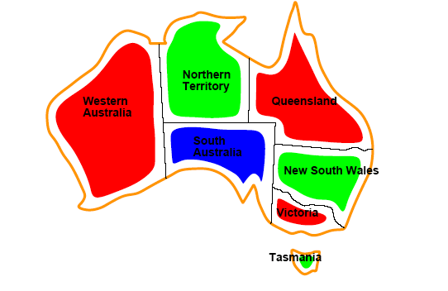
CSP example: map coloring
Solutions are assignments satisfying all constraints, e.g.
{WA=red, NT=green, Q=red, NSW=green, V=red, SA=blue, T=green}

Slide 8
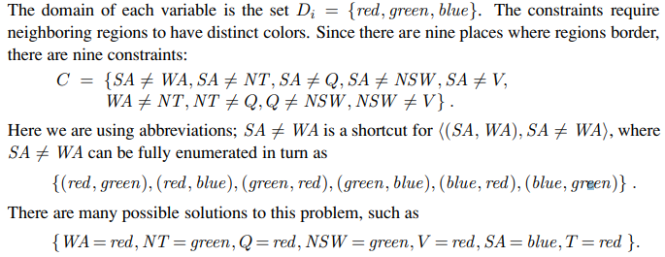
CSP example: map coloring

Slide 9
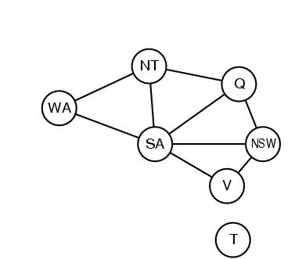
Constraint graphs
Constraint graph:
nodes are variables
arcs are binary constraints
Graph can be used to simplify search
e.g. Tasmania is an independent subproblem

Slide 10
Varieties of constraints
Unary constraints involve a single variable.
e.g. SA ≠ green
Binary constraints involve pairs of variables.
e.g. SA ≠ WA
Higher-order constraints involve 3 or more variables.
Professors A, B, and C cannot be on a committee together
Can always be represented by multiple binary constraints
Preference (soft constraints)
e.g. red is better than green often can be represented by a cost for each variable assignment
combination of optimization with CSPs

Slide 11
CSP as a standard search problem
A CSP can easily be expressed as a standard search problem.
Incremental formulation
Initial State: the empty assignment {}
Successor function: Assign a value to an unassigned variable provided that it does not violate a constraint
Goal test: the current assignment is complete
(by construction it is consistent)
Path cost: constant cost for every step (not really relevant)
Can also use complete-state formulation
Local search techniques (Chapter 4)

Slide 12
Commutativity
CSPs are commutative.
The order of any given set of actions has no effect on the outcome.
Another Example: choose colors for Australian territories one at a time
[WA=red then NT=green] same as [NT=green then WA=red]
All CSP search algorithms can generate successors by considering assignments for only a single variable on each level
⇒ there are d^{n} leaves

Slide 13
Backtracking search
Depth-first search in the context of CSP is also called “backtracking”
Chooses values for one variable at a time and backtracks when a variable has no legal values left to assign.
Nice: we have a standard representation. No need for a domain-specific initial state, successor function, or goal test.

Slide 14
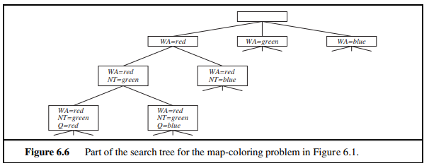
Backtracking

Slide 15
Backtracking search
function BACKTRACKING-SEARCH(csp) return a solution or failure
return BACKTRACK({} , csp)
function BACKTRACK(assignment, csp) return a solution or failure
if assignment is complete then return assignment
var ← SELECT-UNASSIGNED-VARIABLE(csp,assignment)
for each value in ORDER-DOMAIN-VALUES(var, assignment, csp) do
if value is consistent with assignment then
add {var=value} to assignment
inferences ← INFERENCE(csp,assignment)
if inferences != failure
add inferences to assignment
result ← BACTRACK(assignment, csp)
if result ≠ failure then return result
remove {var=value} and inferences from assignment (if you added it)
return failure

Slide 16
Improving CSP efficiency
Previous improvements on uninformed search
→ introduce heuristics
For CSPS, general-purpose methods can give large gains in speed, e.g.,
Which variable should be assigned next?
In what order should its values be tried?
Can we detect inevitable failure early?

Slide 17
Backtracking search
SELECT-UNASSIGNED-VARIABLE
Minimum Remaining Values (MRV)
Most constrained variable
Most likely to fail soon (so prunes pointless searches)
If a tie (such as choosing the start state), choose the variable involved in the most constraints (degree heuristic) E.g., in the map example, SA adjacent to the most states.
Reduces branching factor, since fewer legal successors of that node

Slide 18
CSP example: map coloring
Solutions are assignments satisfying all constraints, e.g.
{WA=red,NT=green,Q=red,NSW=green,V=red,SA=blue,T=green}

Slide 19
Backtracking search
ORDER-DOMAIN-VALUES
Least Constraining Value
Rules out the fewest choices for the variables it is in constraints with
Leave the maximum flexibility
You’ve chosen the variable, now let’s make the most of it

Slide 20

Minimum remaining values (MRV)
var ← SELECT-UNASSIGNED-VARIABLE(assignment,csp)
Before the assignment to the rightmost state: one region has one remaining; one region has two; three regions have three. Choose the region with only one remaining

Slide 21

Degree heuristic
Degree heuristic can be useful as a tie breaker.
Before the assignment to the rightmost state, WA and Q have the same number of remaining values ({R}). So, choose the one adjacent to the most states. This will cut down on the number of legal successor states to it.

Slide 22
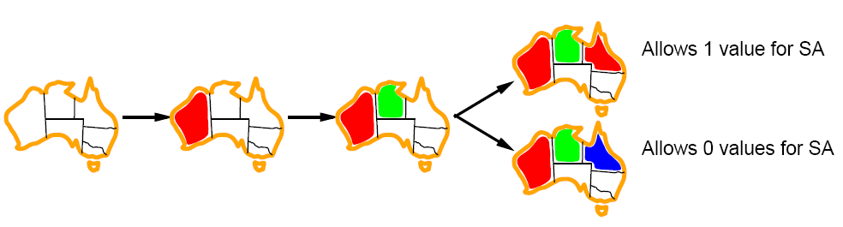
Least constraining value for value-ordering
Least constraining value heuristic
Heuristic Rule: given a variable choose the least constraining value
leaves the maximum flexibility for subsequent variable assignments

Slide 23
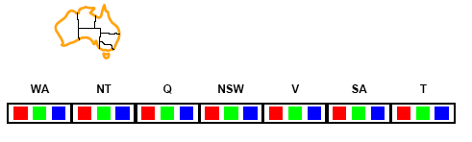
Forward checking (INFERENCE)
Can we detect inevitable failure early?
And avoid it later?
Forward checking idea: keep track of remaining legal values for unassigned variables.
Terminate search when any variable has no legal values.

Slide 24
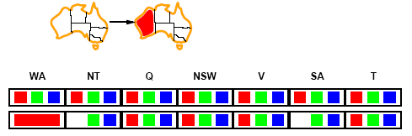
Forward checking
Assign {WA=red}
Effects on other variables connected by constraints to WA
NT can no longer be red
SA can no longer be red
Note: this example is not using MRV; if it were, we would choose NT or SA next. But, we will choose Q next. This example is from the text. It shows the example here, then talks through what would happen if we had used MRV.

Slide 25
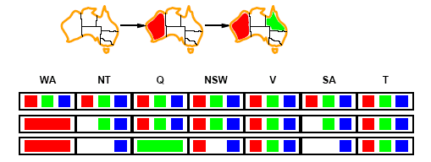
Forward checking
Assign {Q=green}
Effects on other variables connected by constraints with WA
NT can no longer be green
NSW can no longer be green
SA can no longer be green

Slide 26
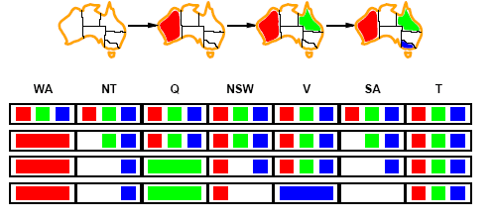
Forward checking
Assign {V=blue}
Effects on other variables connected by constraints with WA
NSW can no longer be blue
SA is empty
Forward Checking has detected that partial assignment is inconsistent with the constraints and backtracking can occur.

Slide 27
Backtracking search
function BACKTRACKING-SEARCH(csp) return a solution or failure
return BACKTRACK({} , csp)
function BACKTRACK(assignment, csp) return a solution or failure
if assignment is complete then return assignment
var ← SELECT-UNASSIGNED-VARIABLE(csp,assignment)
for each value in ORDER-DOMAIN-VALUES(var, assignment, csp) do
if value is consistent with assignment then
add {var=value} to assignment
inferences ← INFERENCE(csp,assignment)
if inferences != failure
add inferences to assignment
result ← BACTRACK(assignment, csp)
if result ≠ failure then return result
remove {var=value} and inferences from assignment (if you added it)
return failure

Slide 28
Example: 4-Queens Problem
X1
{1,2,3,4}
X2
{1,2,3,4}
1
2
3
4
1
2
3
4
X3
{1,2,3,4}
X4
{1,2,3,4}

Slide 29
Example: 4-Queens Problem
X1
{1,2,3,4}
X2
{1,2,3,4}
1
2
3
4
1
2
3
4
X3
{1,2,3,4}
X4
{1,2,3,4}

Slide 30
Example: 4-Queens Problem
X1
{1,2,3,4}
X2
{ , ,3,4}
1
2
3
4
1
2
3
4
X3
{ ,2, ,4}
X4
{ ,2,3, }

Slide 31
Example: 4-Queens Problem
X1
{1, , , }
X2
{ , ,3,4}
1
2
3
4
1
2
3
4
X3
{ , , , }
X4
{ ,2, , }

Slide 32
Example: 4-Queens Problem
X1
{1,2,3,4}
X2
{ , ,3,4}
1
2
3
4
1
2
3
4
X3
{ ,2, ,4}
X4
{ ,2,3, }

Slide 33
Example: 4-Queens Problem
X1
{1,2,3,4}
X2
{ , ,3,4}
1
2
3
4
1
2
3
4
X3
{ ,2, , }
X4
{ ,2,3, }

Slide 34
Example: 4-Queens Problem
X1
{1,2, , }
X2
{ , ,3,4}
1
2
3
4
1
2
3
4
X3
{ ,2, , }
X4
{ , ,3, }

Slide 35
Example: 4-Queens Problem
X1
{1,2, , }
X2
{ , ,3,4}
1
2
3
4
1
2
3
4
X3
{ ,2, , }
X4
{ , ,3, }

Slide 36
Example: 4-Queens Problem
X1
{1, , , }
X2
{ , , ,4}
1
2
3
4
1
2
3
4
X3
{ ,2, , }
X4
{ , , , }

Slide 37
Forward
Solving CSPs (backtrack) with combination of heuristics plus forward checking is more efficient than either approach alone
But Forward Checking does not see all inconsistencies
Consider our map coloring search, after we have assigned WA=red and Q=green

Slide 38
Forward checking
WA=Red; Q=green
Forward checking gives us the third row
At this point, we can see that this is inconsistent, since NT and SA are forced to be blue, yet they are adjacent. Forward checking doesn’t see this, and proceeds onward in the search from this state (as we saw earlier)

Slide 39
Constraint propagation
Forward checking (FC) is in effect eliminating parts of the search space
Constraint propagation goes further than FC by repeatedly enforcing constraints locally
Needs to be faster than actually searching to be effective
Arc-consistency (AC) is a systematic procedure for constraint propagation

Slide 40
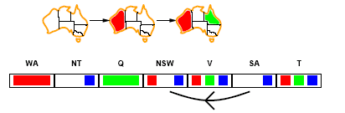
Arc consistency
An Arc X → Y is consistent if
for every value x of X there is some value y consistent with x
Consider state of search after WA and Q are assigned:
SA → NSW is consistent: if SA=blue NSW could be =red

Slide 41
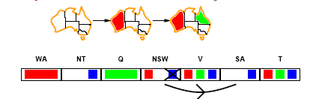
Arc consistency
X → Y is consistent if for every value x of X there is some value y consistent with x
We will try to make the arc consistent by deleting x’s for which there is no y (and then check to see if anything else has been affected – algorithm is in a few slides)
NSW → SA: if NSW=red SA could be =blue
But, if NSW=blue, there is no color for SA.
So, remove blue from the domain of NSW
Propagate the constraint: need to check Q 🡪 NSW SA 🡪 NSW V 🡪 NSW
If we remove values from any of Q, SA, or V’s domains, we will need to check THEIR neighbors

Slide 42
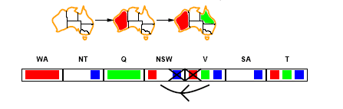
Arc consistency
After removing red from domain of V to make V 🡪 NSW arc consistent
SA 🡪 V, NSW 🡪 V check out; no changes
Check the remaining arcs: most check out, until we check SA 🡪 NT, NT 🡪 SA. Whichever is checked first will result in failure.

Slide 43
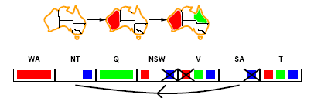
Arc consistency
SA → NT is not consistent
and cannot be made consistent
Arc consistency detects failure earlier than FC
This process was all in one call to the INFERENCE function right after we assigned Q=green. Forward checking proceeded in the search, assigning a value to V.

Slide 44
Arc consistency checking
AC must be run until no inconsistency remains
Trade-off
Requires some overhead to do, but generally more effective than direct search
In effect it can eliminate large (inconsistent) parts of the state space more effectively than search can
Need a systematic method for arc-checking
If X loses a value, neighbors of X need to be rechecked:
i.e. incoming arcs can become inconsistent again
(outgoing arcs will stay consistent).

Slide 45
Summary
CSPs
special kind of problem: states defined by values of a fixed set of variables, goal test defined by constraints on variable values
Backtracking=depth-first search with one variable assigned per level
Heuristics
Variable ordering and value selection heuristics help significantly
Constraint propagation does additional work to constrain values and detect inconsistencies
Works effectively when combined with heuristics

Slide 46


