Slide 1
East West University
CSE366, Section 1 and 2
Artificial Intelligence
Fall 2021
Introduction to Artificial Intelligence (AI): definition, history, applications. AI agent overview: definition of rational agent, agent environment, agent structure.

Slide 2

Md Al-Imran
Lecturer
Department of CSE

Slide 3
Introduction
Artificial Intelligence is concerned with the design of intelligence in an artificial device. The term was coined by John McCarthy in 1956.
Intelligence is the ability to acquire, understand and apply the knowledge to achieve goals in the world.
AI is the study of the mental faculties through the use of computational models
AI is the study of intellectual/mental processes as computational processes.

Slide 4
Introduction contd.
AI program will demonstrate a high level of intelligence to a degree that equals or exceeds the intelligence required of a human in performing some task.
AI is unique, sharing borders with Mathematics, Computer Science, Philosophy, Psychology, Biology, Cognitive Science and many others.
Although there is no clear definition of AI or even Intelligence, it can be described as an attempt to build machines that like humans can think and act, able to learn and use knowledge to solve problems on their own.

Slide 5
History of AI
Important research that laid the groundwork for AI:
In 1931, Goedel layed the foundation of Theoretical Computer Science1920-30s: He published the first universal formal language and showed that math itself is either flawed or allows for unprovable but true statements.
In 1936, Turing reformulated Goedel’s result and church’s extension thereof.
In 1956, John McCarthy coined the term "Artificial Intelligence" as the topic of the Dartmouth Conference, the first conference devoted to the subject.
In 1957, The General Problem Solver (GPS) demonstrated by Newell, Shaw & Simon
In 1958, John McCarthy (MIT) invented the Lisp language.

Slide 6
History of AI contd.
In 1959, Arthur Samuel (IBM) wrote the first game-playing program, for checkers, to achieve sufficient skill to challenge a world champion.
In 1963, Ivan Sutherland's MIT dissertation on Sketchpad introduced the idea of interactive graphics into computing.
In 1966, Ross Quillian (PhD dissertation, Carnegie Inst. of Technology; now CMU) demonstrated semantic nets
In 1967, Dendral program (Edward Feigenbaum, Joshua Lederberg, Bruce Buchanan, Georgia Sutherland at Stanford) demonstrated to interpret mass spectra on organic chemical compounds. First successful knowledge-based program for scientific reasoning.
In 1967, Doug Engelbart invented the mouse at SRI

Slide 7
History of AI contd.
In 1968, Marvin Minsky & Seymour Papert publish Perceptrons, demonstrating limits of simple neural nets.
In 1972, Prolog developed by Alain Colmerauer.
In Mid 80’s, Neural Networks become widely used with the Backpropagation algorithm (first described by Werbos in 1974).
1990, Major advances in all areas of AI, with significant demonstrations in machine learning, intelligent tutoring, case-based reasoning, multi-agent planning, scheduling, uncertain reasoning, data mining, natural language understanding and translation, vision, virtual reality, games, and other topics.
In 1997, Deep Blue beats the World Chess Champion Kasparov
In 2002,iRobot, founded by researchers at the MIT Artificial Intelligence Lab, introduced Roomba, a vacuum cleaning robot. By 2006, two million had been sold.

Slide 8
Foundations of AI
Philosophy e.g., foundational issues (can a machine think?), issues of knowledge and believe, mutual knowledge.
Psychology and Cognitive Science e.g., problem solving skills
Neuro-Science e.g., brain architecture
Computer Science and Engineering e.g., complexity theory, algorithms, logic and inference, programming languages, and system building.
Mathematics and Physics e.g., statistical modeling, continuous mathematics,
Statistical Physics, and Complex Systems.

Slide 9
Sub Areas of AI
Game Playing Deep Blue Chess program beat world champion Gary Kasparov
Speech Recognition PEGASUS spoken language interface to American Airlines' EAASY SABRE reseration system, which allows users to obtain flight information and make reservations over the telephone. The 1990s has seen significant advances in speech recognition so that limited systems are now successful.
Computer Vision Face recognition programs in use by banks, government, etc. The ALVINN system from CMU autonomously drove a van from Washington, D.C. to San Diego (all but 52 of 2,849 miles), averaging 63 mph day and night, and in all weather conditions. Handwriting recognition, electronics and manufacturing inspection, photo interpretation, baggage inspection, reverse engineering to automatically construct a 3D geometric model.

Slide 10
Sub Areas of AI contd.
4. Expert Systems Application-specific systems that rely on obtaining the knowledge of human experts in an area and programming that knowledge into a system.
Diagnostic Systems: MYCIN system for diagnosing bacterial infections of the blood and suggesting treatments. Intellipath pathology diagnosis system (AMA approved). Pathfinder medical diagnosis system, which suggests tests and makes diagnoses. Whirlpool customer assistance center.
System Configuration: DEC's XCON system for custom hardware configuration. Radiotherapy treatment planning.
Financial Decision Making: Credit card companies, mortgage companies, banks, and the U.S. government employ AI systems to detect fraud and expedite financial transactions. For example, AMEX credit check
Classification Systems: Put information into one of a fixed set of categories using several sources of information. E.g., financial decision making systems. NASA developed a system for classifying very faint areas in astronomical images into either stars or galaxies with very high accuracy by learning from human experts' classifications.

Slide 11
Sub Areas of AI contd.
5. Mathematical Theorem Proving Use inference methods to prove new theorems.
6.Natural Language Understanding AltaVista's translation of web pages. Translation of Catepillar Truck manuals into 20 languages.
7. Scheduling and Planning Automatic scheduling for manufacturing. DARPA's DART system used in Desert Storm and Desert Shield operations to plan logistics of people and supplies. American Airlines rerouting contingency planner. European space agency planning and scheduling of spacecraft assembly, integration and verification.
8. Artificial Neural Networks
9. Machine Learning

Slide 12
Application of AI
AI algorithms have attracted close attention of researchers and have also been applied successfully to solve problems in engineering. Nevertheless, for large and complex problems, AI algorithms consume considerable computation time due to stochastic feature of the search approaches
Business; financial strategies
Engineering: check design, offer suggestions to create new product, expert systems for all engineering problems
Manufacturing: assembly, inspection and maintenance
Medicine: monitoring, diagnosing
Education: in teaching
Fraud detection
Object identification
Information retrieval
Space shuttle scheduling

Slide 13
Building AI Systems
Perception Intelligent biological systems are physically embodied in the world and experience the world through their sensors (senses). For an autonomous vehicle, input might be images from a camera and range information from a rangefinder. For a medical diagnosis system, perception is the set of symptoms and test results that have been obtained and input to the system manually.
Reasoning Inference, decision-making, classification from what is sensed and what the internal "model" is of the world. Might be a neural network, logical deduction system, Hidden Markov Model induction, heuristic searching a problem space, Bayes Network inference, genetic algorithms, etc. Includes areas of knowledge representation, problem solving, decision theory, planning, game theory, machine learning, uncertainty reasoning, etc.
Action Biological systems interact within their environment by actuation, speech, etc. All behavior is centered around actions in the world. Examples include controlling the steering of a Mars rover or autonomous vehicle, or suggesting tests and making diagnoses for a medical diagnosis system. Includes areas of robot actuation, natural language generation, and speech synthesis.

Slide 14
Differences between strong AI and weak AI
Strong AI makes the bold claim that computers can be made to think on a level (at least) equal to humans.
Weak AI simply states that some "thinking-like" features can be added to computers to make them more useful tools... and this has already started to happen (witness expert systems, drive-by-wire cars and speech recognition software).
AI Problems: AI problems (speech recognition, NLP, vision, automatic programming, knowledge representation, etc.) can be paired with techniques (NN, search, Bayesian nets, production systems, etc.).

Slide 15
What’s involved in Intelligence?
Ability to interact with the world (speech, vision, motion, manipulation)
Ability to model the world and to reason about it
Ability to learn and to adapt
Perceive
Understand
Predict
Manipulate

Slide 16
Goals in AI
To build systems that exhibit intelligent behavior
To understand intelligence in order to model it

Slide 17
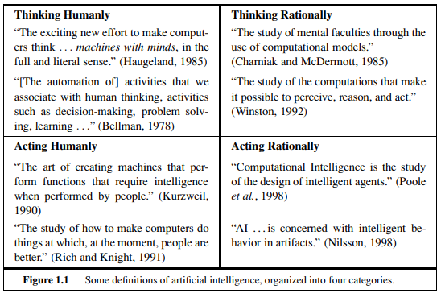
What is AI?
Hard Question?

Slide 18
What does modern AI do?
Acting Humanly: Turing Test, not much pursued outside Loebner prize
Aeronautics: building pigeons that can fly so much like real pigeons that they can fool pigeons
Not reproducible, not amenable to mathematical analysis
Thinking Humanly: Cognitive Science. How do humans think? How does the (human) brain work?
Neural networks are a (extremely simple so far) approximation
Thinking Rationally: Logics, Formalization of knowledge and inference
You know the basics, we do some more, fairly widespread in modern Al
Acting Rationally: How to make good action choices?
Contains Logics (one possible way to make intelligent decisions)
We are interested in making good choices in practice (e.g. in AlphaGo)

Slide 19
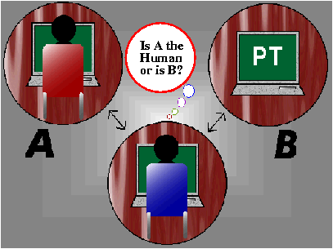
Acting Humanly
Turing test: ultimate test for acting humanly
Computer and human both interrogated by judge
Computer passes test if judge can’t tell the difference

Slide 20
Acting Humanly contd.
Agent must:
Have command of language
Have wide range of knowledge
Demonstrate human traits (humor, emotion)
Be able to reason
Be able to learn
Loebner prize competition is modern version of Turing Test
Example: Alice, Loebner prize winner for 2000 and 2001

Slide 21
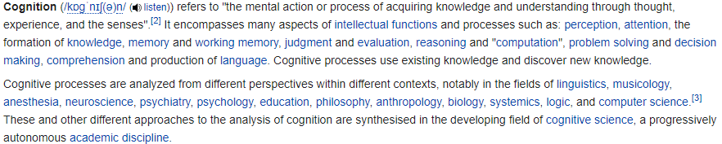
Wikipedia

Slide 22
Thinking Humanly: Cognitive Science
1960s "cognitive revolution": information-processing psychology replaced prevailing orthodoxy of behaviorism
Requires scientific theories of internal activities of the brain
What level of abstraction? "Knowledge" or "circuits"?
How to validate? Requires
(1) Predicting and testing behaviour of human subjects (top-down)
(2) Direct identification from neurological data (bottom-up)
Both approaches (roughly, Cognitive Science and Cognitive Neuroscience) are now distinct from Al

Slide 23
Thinking Rationally: laws of thought
What are correct arguments or thought processes?
Provided foundation of much of AI
Not all intelligent behavior controlled by logic
What is our goal? What is the purpose of thinking?
Normative (or prescriptive) rather than descriptive
Aristotle: What are correct arguments/thought processes?
Several Greek schools developed various forms of logic: notation and rules of derivation for thoughts; may not have proceeded to the idea of mechanization
Direct line through mathematics and philosophy to modern Al
Problems:
1) Not all intelligent behavior is mediated by logical deliberation
2) What is the purpose of thinking? What thoughts should I have out of all the thoughts (logical or otherwise) that I could have?

Slide 24
Acting Rationally
Rational behavior: doing the right thing
The right thing: that which is expected to maximize goal achievement,
given the available information
Doesn't necessarily involve thinking—e.g., blinking reflex—but
Thinking should be in the service of rational action
Aristotle (Nicomachean Ethics):
Every art and every inquiry, and similarly every
action and pursuit, is thought to aim at some good
Act to achieve goals, given set of beliefs
Rational behavior is doing the “right thing”
Thing which expects to maximize goal achievement

Slide 25
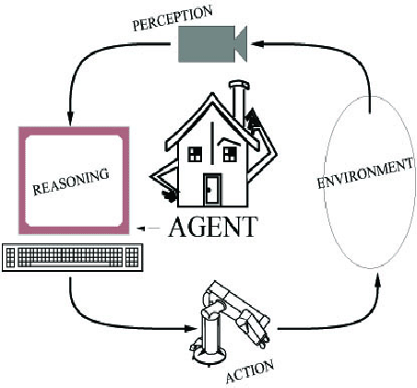
Components of an AI System
An agent perceives its environment
through sensors and acts on the
environment through actuators.
Human: sensors are eyes, ears,
actuators (effectors) are hands,
legs, mouth.
Robot: sensors are cameras, sonar,
lasers, ladar, bump, effectors are
grippers, manipulators, motors
The agent’s behavior is described by its
function that maps percept to action.
Notes:
LADAR is Laser Detection and Ranging
Light radar by uses light

Slide 26


An Agent
‘Anything’ that can gather information about its environment and take action based on that information.

Slide 27
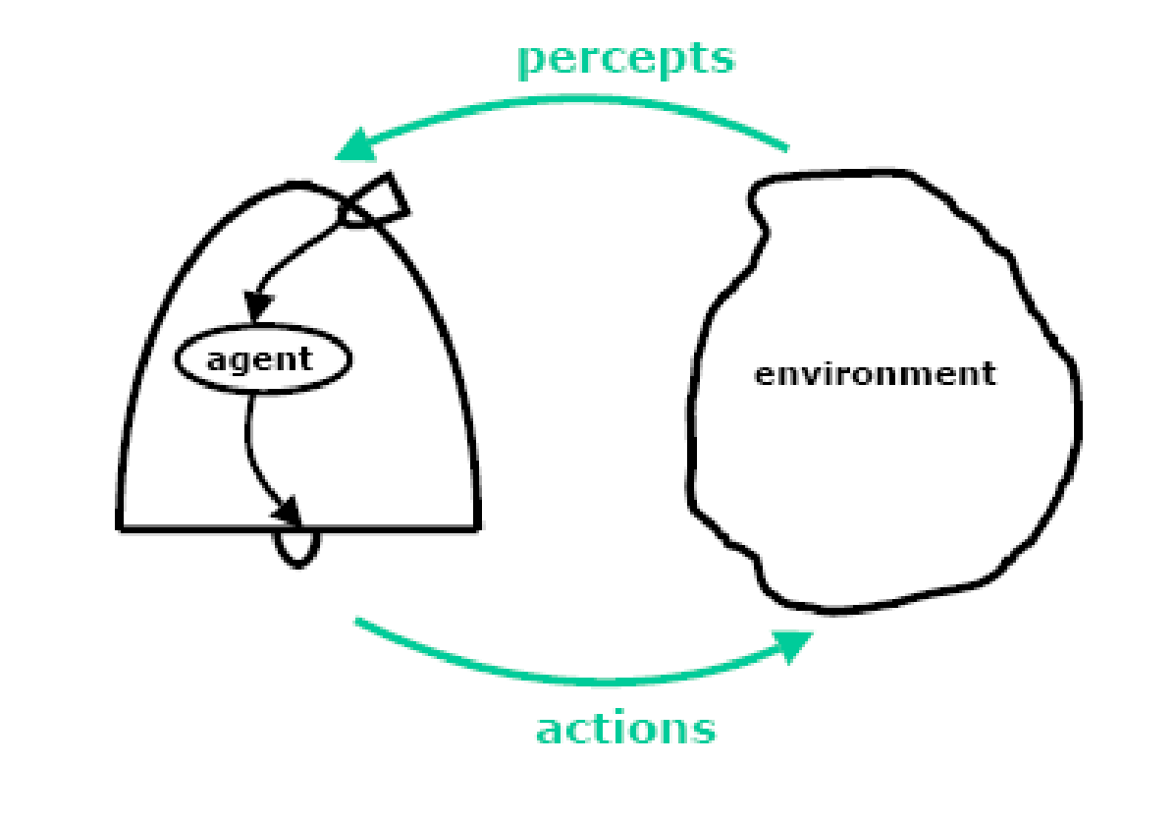
The Agent Environment
What all do we need to specify?
The action space
The percept space
The environment as a string of mappings from the action space to the percept space.
A rational agent acts in its environment, according to what is has perceived, in order to maximize its expected performance measure.

Slide 28
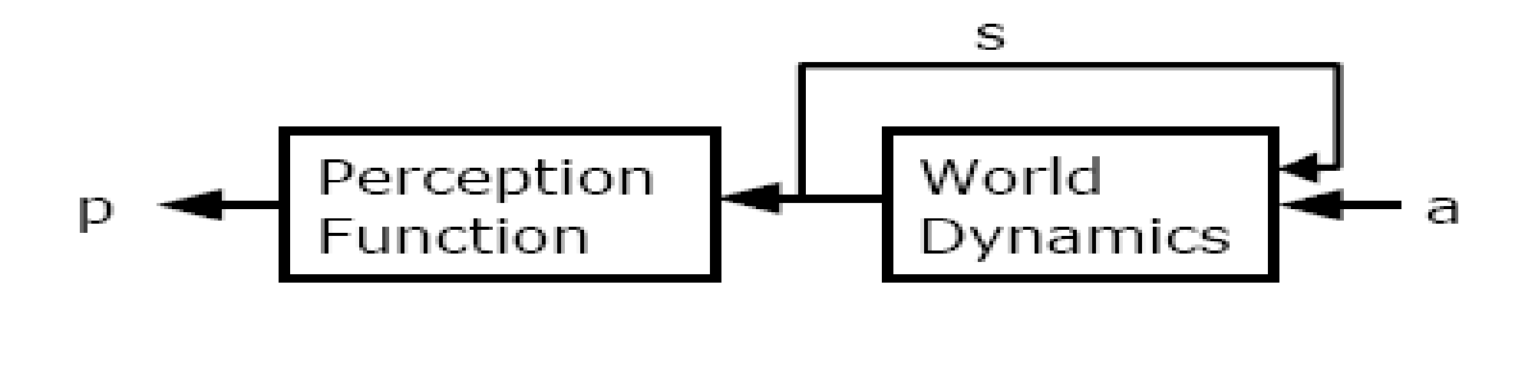
The World Model
Perception function
World dynamics / State transition function
Utility function- how does the agent know what constitutes “good” or “bad” behavior

Slide 29
Agent and Environment
Percept: We use the term percept to refer to the agent's perceptual inputs at any given instant.
Percept Sequence: An agent's percept sequence is the complete history of everything the agent has ever perceived.
Agent function: Mathematically speaking, we say that an agent's behavior is described by the agent function that maps any given percept sequence to an action.
Agent program: Internally, the agent function for an artificial agent will be implemented by an agent program. It is important to keep these two ideas distinct. The agent function is an abstract mathematical description; the agent program is a concrete implementation, running on the agent architecture.

Slide 30
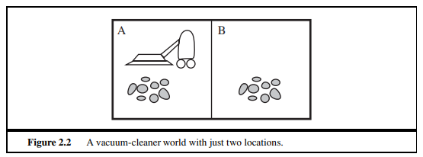
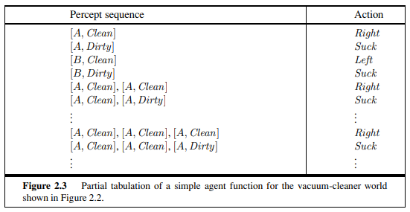
Example
(must go through books)

Slide 31
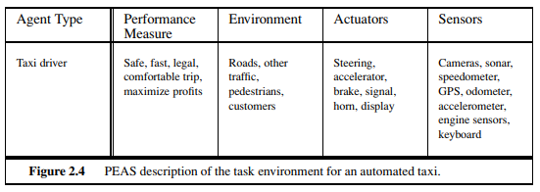
Task Environment
Use PEAS to describe task environment
Performance measure
Environment
Actuators
Sensors

Slide 32
Properties of Task Environments
Accessible/Inaccessible
Deterministic/Non-deterministic
Static/Dynamic
Discrete/Continuous
E.g. Driving a car, a game of Chinese-checkers
(must do homework on this section)

Slide 33
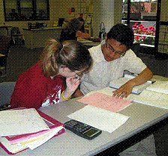
Environment Examples
Environment | Observable | Deterministic | Episodic | Static | Discrete | Agents
Chess with a clock | Fully | Strategic | Sequential | Semi | Discrete | Multi
Chess without a clock | Fully | Strategic | Sequential | Static | Discrete | Multi
Poker | Partial | Strategic | Sequential | Static | Discrete | Multi
Backgammon | Fully | Stochastic | Sequential | Static | Discrete | Multi
Taxi driving | Partial | Stochastic | Sequential | Dynamic | Continuous | Multi
Medical diagnosis | Partial | Stochastic | Episodic | Static | Continuous | Single
Image analysis | Fully | Deterministic | Episodic | Semi | Discrete | Single
Robot part picking | Fully | Deterministic | Episodic | Semi | Discrete | Single
Interactive English tutor | Partial | Stochastic | Sequential | Dynamic | Discrete | Multi
Fully observable vs. partially observable
Deterministic vs. stochastic / strategic
Episodic vs. sequential
Static vs. dynamic
Discrete vs. continuous
Single agent vs. multi agent

Slide 34
Agent Types
Types of agents (increasing in generality and ability to handle complex environments)
Simple reflex agents
Reflex agents with state
Goal-based agents
Utility-based agents
Learning agent

Slide 35
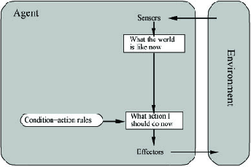
Simple Reflex Agent
Use simple “if then” rules
Can be short sighted
SimpleReflexAgent(percept)
state = InterpretInput(percept)
rule = RuleMatch(state, rules)
action = RuleAction(rule)
Return action

Slide 36
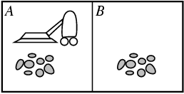
Example: Vacuum Agent
Performance?
1 point for each square cleaned in time T?
#clean squares per time step - #moves per time step?
Environment: vacuum, dirt, multiple areas defined by square regions
Actions: left, right, suck, idle
Sensors: location and contents
[A, dirty]
Rational is not omniscient
Environment may be partially observable
Rational is not clairvoyant
Environment may be stochastic
Thus Rational is not always successful

Slide 37
Reflex Vacuum Agent
If status=Dirty then return Suck
else if location=A then return Right
else if location=B then right Left

Slide 38
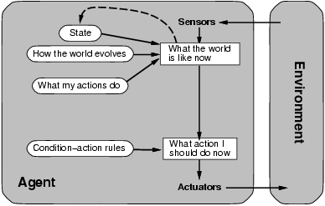
Reflex Agent With State
Store previously-observed information
Can reason about unobserved aspects of current state
ReflexAgentWithState(percept)
state = UpdateDate(state,action,percept)
rule = RuleMatch(state, rules)
action = RuleAction(rule)
Return action

Slide 39
Reflex Vacuum Agent
If status=Dirty then Suck
else if have not visited other square in >3 time units, go there

Slide 40
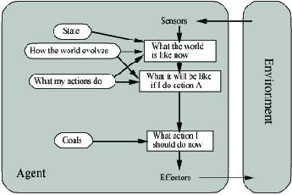
Goal-Based Agents
Goal reflects desires of agents
May project actions to see if consistent with goals
Takes time, world may change during reasoning

Slide 41
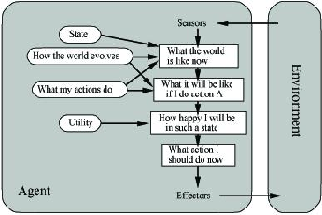
Utility-Based Agents
Evaluation function to measure utility f(state) -> value
Useful for evaluating competing goals

Slide 42
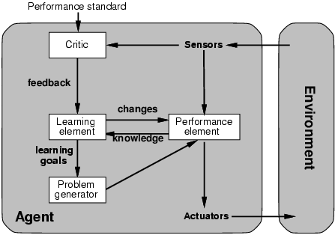
Learning Agents

Slide 43


