Slide 1
Artificial Intelligence
Informed Search Algorithms

Slide 2
Search Algorithms
Blind/Uninformed search – BFS, DFS, uniform cost
no notion concept of the “right direction”
can only recognize goal once it’s achieved
Informed search – we have rough idea of how good various states are, and use this knowledge to guide our search

Slide 3
Informed methods add domain-specific information
Add domain-specific information to select the best path along which to continue searching
Define a heuristic function, h(n), that estimates the “goodness” of a node n.
Specifically, h(n) = estimated cost (or distance) of n to a goal state.
The heuristic function is an estimate, based on domain-specific information that is computable from the current state description, of how close we are to a goal

Slide 4
Best-first search
Idea: use an evaluation function f(n) for each node n
- estimate of "desirability"
- Expand most desirable unexpanded node
Implementation:
Order the nodes in queue in decreasing order of desirability
Special cases:
greedy best-first search
A* search

Slide 5
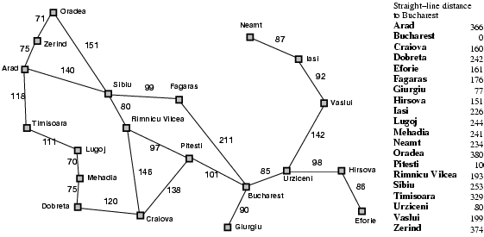
An example graph containing straight line distances to Bucharest from other cities/nodes

Slide 6
Greedy best-first search
Evaluation function, f(n) = h(n) (heuristic) = estimate of cost from n to goal
Example: h_{SLD}(n) = straight-line distance from a city n to Bucharest
Greedy best-first search expands the node that appears to be the closest to goal

Slide 7

Greedy best-first search example: Route Finding Arad <-> Bucharest
From each city, we will choose the following city considering which one has the least SLD to Bucharest

Slide 8
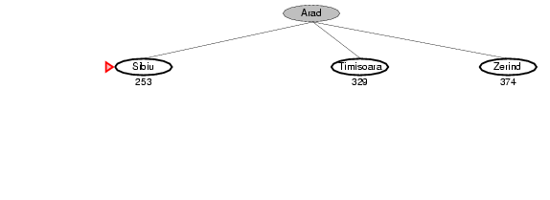
Greedy best-first search example: Route Finding Arad <-> Bucharest
From each city, we will choose the following city considering which one has the least SLD to Bucharest

Slide 9
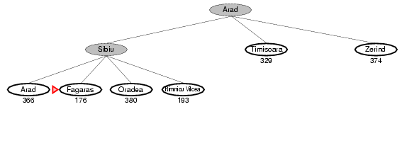
Greedy best-first search example: Route Finding Arad <-> Bucharest
From each city, we will choose the following city considering which one has the least SLD to Bucharest

Slide 10
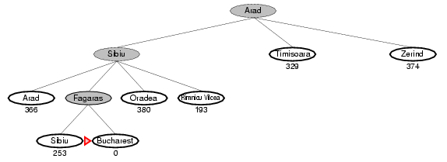
Greedy best-first search example: Route Finding Arad <-> Bucharest
From each city, we will choose the following city considering which one has the least SLD to Bucharest

Slide 11
Example: Robot Navigation
f(N) = h(N), with h(N) = Manhattan distance to the goal
Goat state
Start state
8 | 7 | 6 | 5 | 4 | 3 | 2 | 3 | 4 | 5 | 6
7 |  | 5 | 4 | 3 |  |  |  |  |  | 5
6 |  |  | 3 | 2 | 1 |  | 1 | 2 |  | 4
7 | 6 |  |  |  |  |  |  |  |  | 5
8 | 7 | 6 | 5 | 4 | 3 | 2 | 3 | 4 | 5 | 6

Slide 12
Example: Robot Navigation
f(N) = h(N), with h(N) = Manhattan distance to the goal
A possible path using Greedy Best-First
Goat state
Start state
8 | 7 | 6 | 5 | 4 | 3 | 2 | 3 | 4 | 5 | 6
7 |  | 5 | 4 | 3 |  |  |  |  |  | 5
6 |  |  | 3 | 2 | 1 |  | 1 | 2 |  | 4
7 | 6 |  |  |  |  |  |  |  |  | 5
8 | 7 | 6 | 5 | 4 | 3 | 2 | 3 | 4 | 5 | 6

Slide 13
Example: Robot Navigation
f(N) = h(N), with h(N) = Manhattan distance to the goal
Another possible path using Greedy Best-First
Goat state
Start state
8 | 7 | 6 | 5 | 4 | 3 | 2 | 3 | 4 | 5 | 6
7 |  | 5 | 4 | 3 |  |  |  |  |  | 5
6 |  |  | 3 | 2 | 1 |  | 1 | 2 |  | 4
7 | 6 |  |  |  |  |  |  |  |  | 5
8 | 7 | 6 | 5 | 4 | 3 | 2 | 3 | 4 | 5 | 6

Slide 14
Example: Robot Navigation, Multiple Possibilities
8 | 7 | 6 | 5 | 4 | 3 | 2 | 3 | 4 | 5 | 6
7 |  | 5 | 4 | 3 |  |  |  |  |  | 5
6 |  |  | 3 | 2 | 1 |  | 1 | 2 |  | 4
7 | 6 |  |  |  |  |  |  |  |  | 5
8 | 7 | 6 | 5 | 4 | 3 | 2 | 3 | 4 | 5 | 6
Which one is best ?
First One
This search strategy is not optimal.
8 | 7 | 6 | 5 | 4 | 3 | 2 | 3 | 4 | 5 | 6
7 |  | 5 | 4 | 3 |  |  |  |  |  | 5
6 |  |  | 3 | 2 | 1 |  | 1 | 2 |  | 4
7 | 6 |  |  |  |  |  |  |  |  | 5
8 | 7 | 6 | 5 | 4 | 3 | 2 | 3 | 4 | 5 | 6

Slide 15
Issues of Greedy Best-First Search
What happens when the search faces a dead end ?
It backtracks like dfs and starts with next best possible choice
What happens if state repetition occurs ?
We need to track the states which are visited otherwise we might fall into infinite same state searching

Slide 16
Greedy Best-First Search: Pseudocode
g[ ]: distance from source to a node,
visited [ ]: which nodes are visited/explored/expanded to reach goal state
function Greedy-Best-First(node n, visited={}) {
if (goal is reached) return 0
next = { }
for v ∈ adj[n] {
if (v is not visited) next = next U {v}, g[v]=g[n]+edge(n,v)
}
sort next over h(n) for each node // greedy choice set up
while(next is not empty) {
u = next.top(), visited = visited U {u}
rem_cost = Greedy-Best-First(u, visited)
If (rem_cost is not ∞) return g(u)+rem_cost
}
return ∞
Greedy Best-First Search is actually DFS with greedy choice move

Slide 17
Properties of greedy best-first search
Complete? Generally yes. But it bears the same effects as DFS, it might fall into infinite-path due to heuristic function. Also need to track the visited states in the case of cycles.
Time? O(b^{m}), but a good heuristic can give dramatic improvement
Space? O(b^{m}) - keeps all nodes in memory, otherwise repetition search, need to handle carefully
Optimal? No - No guarantees about the cost

Slide 18
A* Search: Minimizing the total estimated solution Cost
We kept looking at nodes closer and closer to the goal, but were accumulating costs as we got further from the initial state
Our goal is not to minimize the distance from the current head of our path to the goal, we want to minimize the overall length of the path to the goal!
Let g(N) be the cost of the best path found so far between the initial node and N
f(N) = g(N) + h(N)

Slide 19
Problem of Greedy Best-First Search
s
But it increases overall cost, greedy choice did not provide optimal results.
g(n1)=1
g(n2)=300
Greedy Best-First Search chooses n2 because of better h(n)
n1
n2
h(n1)=200
h(n2)=100
g
A* searches focuses on both h(n) and g(n) to make decisions

Slide 20
Admissible Heuristic
Let h*(N) be the true cost of the optimal path from N to a goal node
Heuristic h(N) is admissible if: 0 ≤ h(N) ≤ h*(N)
An admissible heuristic is always optimistic (never over approximate results)
f(n) = g(n) + h(n) <= actual cost
Due to admissible heuristics, f(n) is never over approximated.

Slide 21
A* search
Idea: avoid expanding paths that are already expensive
Evaluation function f(n) = g(n) + h(n)
g(n) = cost so far to reach n
h(n) = estimated cost from n to goal (admissible heuristic)
f(n) = estimated total cost of path through n to goal
Then, best-first search with this evaluation function is called A* search

Slide 22

A* search example

Slide 23
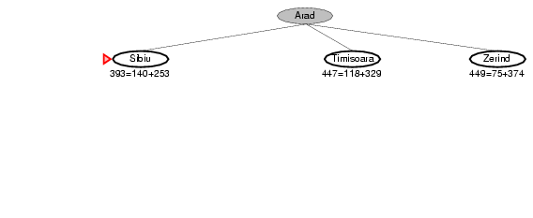
A* search example
140
75
118

Slide 24
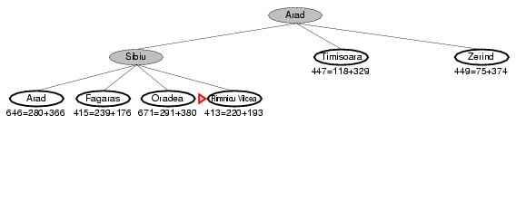
A* search example
140
75
118
140
80
99
151

Slide 25
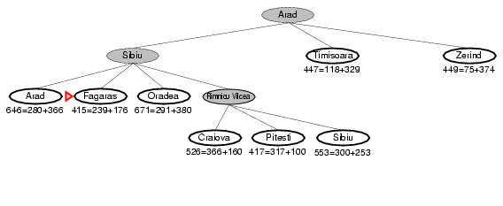
A* search example
140
75
118
140
80
99
151
80
146
97

Slide 26
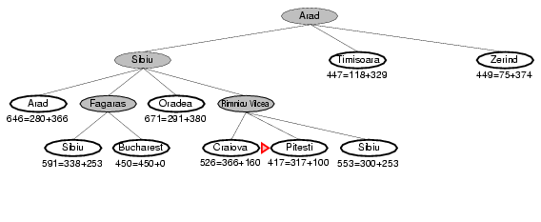
A* search example
140
75
118
140
80
99
151
80
99
211
146
97

Slide 27
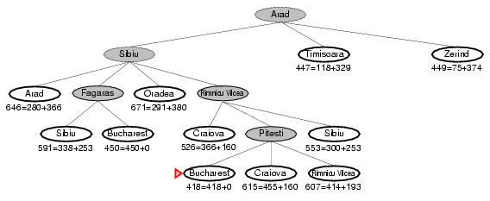
A* search example
140
75
118
140
80
99
151
80
99
211
146
97
101
138
97

Slide 28
Example: Robot Navigation
h(N) = Manhattan distance to the goal,
g(N)=distance from start state by a path, f(N) = g(N)+h(N)
In runtime we will calculate g(N)
Goat state
Start state
3+8 | ..+7 | ..+6 | ..+5 | ..+4 | ..+3 | ..+2 | ..+3 | ..+4 | 5 | 6
2+7 |  | 5 | 4 | 3 |  |  |  |  |  | 5
1+6 |  |  | 3 | 2 | 1 |  | 1 | 2 |  | 4
7 | 1+6 |  |  |  |  |  |  |  |  | 5
2+8 | 2+7 | 3+6 | 4+5 | 5+4 | 6+3 | 7+2 | 8+3 | ..+4 | ..+5 | ..+6

Slide 29
Example: Robot Navigation(contd.)
Superscript denotes the order when it was popped from MIN_QUEUE and expanded
1+6
7⁽⁰⁾ | 1+6
1+8

Slide 30
Example: Robot Navigation(contd.)
Superscript denotes the order when it was popped from MIN_QUEUE and expanded
1+6
7⁽⁰⁾ | 1+6⁽¹⁾
1+8 | 2+7

Slide 31
Example: Robot Navigation(contd.)
Superscript denotes the order when it was popped from MIN_QUEUE and expanded
2+7
1+6⁽²⁾
7⁽⁰⁾ | 1+6⁽¹⁾
1+8 | 2+7

Slide 32
Example: Robot Navigation(contd.)
Superscript denotes the order when it was popped from MIN_QUEUE and expanded
3+8
2+7⁽³⁾
1+6⁽²⁾
7⁽⁰⁾ | 1+6⁽¹⁾
1+8 | 2+7

Slide 33
Example: Robot Navigation(contd.)
Superscript denotes the order when it was popped from MIN_QUEUE and expanded
3+8
2+7⁽³⁾
1+6⁽²⁾
7⁽⁰⁾ | 1+6⁽¹⁾
1+8 | 2+7⁽⁴⁾ | 3+6

Slide 34
Example: Robot Navigation(contd.)
Superscript denotes the order when it was popped from MIN_QUEUE and expanded
3+8
2+7⁽³⁾
1+6⁽²⁾
7⁽⁰⁾ | 1+6⁽¹⁾
1+8 | 2+7⁽⁴⁾ | 3+6⁽⁵⁾ | 4+5

Slide 35
Example: Robot Navigation(contd.)
Superscript denotes the order when it was popped from MIN_QUEUE and expanded
3+8
2+7⁽³⁾
1+6⁽²⁾
7⁽⁰⁾ | 1+6⁽¹⁾
1+8 | 2+7⁽⁴⁾ | 3+6⁽⁵⁾ | 4+5⁽⁶⁾ | 5+4

Slide 36
Example: Robot Navigation(contd.)
Superscript denotes the order when it was popped from MIN_QUEUE and expanded
3+8
2+7⁽³⁾
1+6⁽²⁾
7⁽⁰⁾ | 1+6⁽¹⁾
1+8 | 2+7⁽⁴⁾ | 3+6⁽⁵⁾ | 4+5⁽⁶⁾ | 5+4⁽⁷⁾ | 6+3

Slide 37
Example: Robot Navigation(contd.)
Superscript denotes the order when it was popped from MIN_QUEUE and expanded
3+8
2+7⁽³⁾
1+6⁽²⁾
7⁽⁰⁾ | 1+6⁽¹⁾
1+8 | 2+7⁽⁴⁾ | 3+6⁽⁵⁾ | 4+5⁽⁶⁾ | 5+4⁽⁷⁾ | 6+3⁽⁸⁾ | 7+2

Slide 38
Example: Robot Navigation(contd.)
Superscript denotes the order when it was popped from MIN_QUEUE and expanded
3+8
2+7⁽³⁾
1+6⁽²⁾
7⁽⁰⁾ | 1+6⁽¹⁾
1+8 | 2+7⁽⁴⁾ | 3+6⁽⁵⁾ | 4+5⁽⁶⁾ | 5+4⁽⁷⁾ | 6+3⁽⁸⁾ | 7+2⁽⁹⁾ | 8+3

Slide 39
Example: Robot Navigation(contd.)
Superscript denotes the order when it was popped from MIN_QUEUE and expanded
3+8
2+7⁽³⁾
1+6⁽²⁾
7⁽⁰⁾ | 1+6⁽¹⁾
1+8⁽¹⁰⁾ | 2+7⁽⁴⁾ | 3+6⁽⁵⁾ | 4+5⁽⁶⁾ | 5+4⁽⁷⁾ | 6+3⁽⁸⁾ | 7+2⁽⁹⁾ | 8+3

Slide 40
Example: Robot Navigation(contd.)
Superscript denotes the order when it was popped from MIN_QUEUE and expanded
3+8
2+7⁽³⁾
1+6⁽²⁾
7⁽⁰⁾ | 1+6⁽¹⁾
1+8⁽¹⁰⁾ | 2+7⁽⁴⁾ | 3+6⁽⁵⁾ | 4+5⁽⁶⁾ | 5+4⁽⁷⁾ | 6+3⁽⁸⁾ | 7+2⁽⁹⁾ | 8+3⁽¹¹⁾ | 9+4

Slide 41
Example: Robot Navigation(contd.)
Superscript denotes the order when it was popped from MIN_QUEUE and expanded
3+8⁽¹²⁾ | 4+7
2+7⁽³⁾
1+6⁽²⁾
7⁽⁰⁾ | 1+6⁽¹⁾
1+8⁽¹⁰⁾ | 2+7⁽⁴⁾ | 3+6⁽⁵⁾ | 4+5⁽⁶⁾ | 5+4⁽⁷⁾ | 6+3⁽⁸⁾ | 7+2⁽⁹⁾ | 8+3⁽¹¹⁾ | 9+4

Slide 42
Example: Robot Navigation(contd.)
Superscript denotes the order when it was popped from MIN_QUEUE and expanded
3+8⁽¹²⁾ | 4+7⁽¹³⁾ | 5+6
2+7⁽³⁾
1+6⁽²⁾
7⁽⁰⁾ | 1+6⁽¹⁾
1+8⁽¹⁰⁾ | 2+7⁽⁴⁾ | 3+6⁽⁵⁾ | 4+5⁽⁶⁾ | 5+4⁽⁷⁾ | 6+3⁽⁸⁾ | 7+2⁽⁹⁾ | 8+3⁽¹¹⁾ | 9+4

Slide 43
Example: Robot Navigation(contd.)
Superscript denotes the order when it was popped from MIN_QUEUE and expanded
3+8⁽¹²⁾ | 4+7⁽¹³⁾ | 5+6⁽¹⁴⁾ | 6+5
2+7⁽³⁾ |  | 6+5
1+6⁽²⁾
7⁽⁰⁾ | 1+6⁽¹⁾
1+8⁽¹⁰⁾ | 2+7⁽⁴⁾ | 3+6⁽⁵⁾ | 4+5⁽⁶⁾ | 5+4⁽⁷⁾ | 6+3⁽⁸⁾ | 7+2⁽⁹⁾ | 8+3⁽¹¹⁾ | 9+4

Slide 44
Example: Robot Navigation(contd.)
Superscript denotes the order when it was popped from MIN_QUEUE and expanded
3+8⁽¹²⁾ | 4+7⁽¹³⁾ | 5+6⁽¹⁴⁾ | 6+5⁽¹⁵⁾ | 7+4
2+7⁽³⁾ |  | 6+5 | 7+4
1+6⁽²⁾
7⁽⁰⁾ | 1+6⁽¹⁾
1+8⁽¹⁰⁾ | 2+7⁽⁴⁾ | 3+6⁽⁵⁾ | 4+5⁽⁶⁾ | 5+4⁽⁷⁾ | 6+3⁽⁸⁾ | 7+2⁽⁹⁾ | 8+3⁽¹¹⁾ | 9+4

Slide 45
Example: Robot Navigation(contd.)
Superscript denotes the order when it was popped from MIN_QUEUE and expanded
3+8⁽¹²⁾ | 4+7⁽¹³⁾ | 5+6⁽¹⁴⁾ | 6+5⁽¹⁵⁾ | 7+4⁽¹⁶⁾ | 8+3
2+7⁽³⁾ |  | 6+5 | 7+4 | 8+3
1+6⁽²⁾
7⁽⁰⁾ | 1+6⁽¹⁾
1+8⁽¹⁰⁾ | 2+7⁽⁴⁾ | 3+6⁽⁵⁾ | 4+5⁽⁶⁾ | 5+4⁽⁷⁾ | 6+3⁽⁸⁾ | 7+2⁽⁹⁾ | 8+3⁽¹¹⁾ | 9+4

Slide 46
Example: Robot Navigation(contd.)
Superscript denotes the order when it was popped from MIN_QUEUE and expanded
3+8⁽¹²⁾ | 4+7⁽¹³⁾ | 5+6⁽¹⁴⁾ | 6+5⁽¹⁵⁾ | 7+4⁽¹⁶⁾ | 8+3⁽¹⁷⁾ | 9+2
2+7⁽³⁾ |  | 6+5 | 7+4 | 8+3
1+6⁽²⁾
7⁽⁰⁾ | 1+6⁽¹⁾
1+8⁽¹⁰⁾ | 2+7⁽⁴⁾ | 3+6⁽⁵⁾ | 4+5⁽⁶⁾ | 5+4⁽⁷⁾ | 6+3⁽⁸⁾ | 7+2⁽⁹⁾ | 8+3⁽¹¹⁾ | 9+4

Slide 47
Example: Robot Navigation(contd.)
Superscript denotes the order when it was popped from MIN_QUEUE and expanded
3+8⁽¹²⁾ | 4+7⁽¹³⁾ | 5+6⁽¹⁴⁾ | 6+5⁽¹⁵⁾ | 7+4⁽¹⁶⁾ | 8+3⁽¹⁷⁾ | 9+2⁽¹⁸⁾ | 10+3
2+7⁽³⁾ |  | 6+5 | 7+4 | 8+3
1+6⁽²⁾
7⁽⁰⁾ | 1+6⁽¹⁾
1+8⁽¹⁰⁾ | 2+7⁽⁴⁾ | 3+6⁽⁵⁾ | 4+5⁽⁶⁾ | 5+4⁽⁷⁾ | 6+3⁽⁸⁾ | 7+2⁽⁹⁾ | 8+3⁽¹¹⁾ | 9+4

Slide 48
Example: Robot Navigation(contd.)
Superscript denotes the order when it was popped from MIN_QUEUE and expanded
3+8⁽¹²⁾ | 4+7⁽¹³⁾ | 5+6⁽¹⁴⁾ | 6+5⁽¹⁵⁾ | 7+4⁽¹⁶⁾ | 8+3⁽¹⁷⁾ | 9+2⁽¹⁸⁾ | 10+3
2+7⁽³⁾ |  | 6+5 | 7+4 | 8+3⁽¹⁹⁾
1+6⁽²⁾ |  |  |  | 9+2
7⁽⁰⁾ | 1+6⁽¹⁾
1+8⁽¹⁰⁾ | 2+7⁽⁴⁾ | 3+6⁽⁵⁾ | 4+5⁽⁶⁾ | 5+4⁽⁷⁾ | 6+3⁽⁸⁾ | 7+2⁽⁹⁾ | 8+3⁽¹¹⁾ | 9+4

Slide 49
Example: Robot Navigation(contd.)
Superscript denotes the order when it was popped from MIN_QUEUE and expanded
3+8⁽¹²⁾ | 4+7⁽¹³⁾ | 5+6⁽¹⁴⁾ | 6+5⁽¹⁵⁾ | 7+4⁽¹⁶⁾ | 8+3⁽¹⁷⁾ | 9+2⁽¹⁸⁾ | 10+3
2+7⁽³⁾ |  | 6+5 | 7+4 | 8+3⁽¹⁹⁾
1+6⁽²⁾ |  |  | 10+3 | 9+2⁽²⁰⁾ | 10+1
7⁽⁰⁾ | 1+6⁽¹⁾
1+8⁽¹⁰⁾ | 2+7⁽⁴⁾ | 3+6⁽⁵⁾ | 4+5⁽⁶⁾ | 5+4⁽⁷⁾ | 6+3⁽⁸⁾ | 7+2⁽⁹⁾ | 8+3⁽¹¹⁾ | 9+4

Slide 50
Example: Robot Navigation(contd.)
Superscript denotes the order when it was popped from MIN_QUEUE and expanded
3+8⁽¹²⁾ | 4+7⁽¹³⁾ | 5+6⁽¹⁴⁾ | 6+5⁽¹⁵⁾ | 7+4⁽¹⁶⁾ | 8+3⁽¹⁷⁾ | 9+2⁽¹⁸⁾ | 10+3
2+7⁽³⁾ |  | 6+5 | 7+4 | 8+3⁽¹⁹⁾
1+6⁽²⁾ |  |  | 10+3 | 9+2⁽²⁰⁾ | 10+1⁽²¹⁾
7⁽⁰⁾ | 1+6⁽¹⁾
1+8⁽¹⁰⁾ | 2+7⁽⁴⁾ | 3+6⁽⁵⁾ | 4+5⁽⁶⁾ | 5+4⁽⁷⁾ | 6+3⁽⁸⁾ | 7+2⁽⁹⁾ | 8+3⁽¹¹⁾ | 9+4

Slide 51
A* (A star) Search: Pseudocode
Q is a min priority queue sorted on g(n)+h(n).
A*Search(start, goal, cost){
Q = init_queue(), g[ ] = all are ∞initially
push (Q, {start,0, h(start)} )
while (! empty(Q))
U, g_val, h_val = pop_min(Q)
if (U is goal)
return
for each child in children(u)
push (Q, {child, g_val+cost(u,v), h(child)})

Slide 52
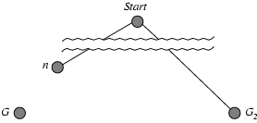
Optimality of A* (proof)
Suppose some suboptimal goal G₂ has been generated and is in the fringe. Let n be an unexpanded node in the fringe such that n is on a shortest path to an optimal goal G.
f(G₂) = g(G₂) since h(G₂) = 0, suboptimal goal
g(G₂) > g(G) since G₂ is suboptimal
f(G) = g(G) since h(G) = 0, goal
f(G₂) > f(G) since g(G₂) > g(G)
h(n) ≤ h*(n) since h is admissible
g(n) + h(n) ≤ g(n) + h*(n) [g(n)+h*(n) actual distance to reach G from start through n and as f(G) = g(G)+0 it also represents same]
f(n) ≤ f(G) < f(G2)
So, A* will always try to expand n before reaching G2.
A* is a sort of dijkstra with an additional heuristic that which node is closer to goal, expand that first, maintaining a tradeoff between g(n) and h(n) as g(n)+h(n)

Slide 53
Completeness of A*
state to a goal node, A* will find it.
Let g be the cost of a best path to a goal node
No path in search tree can get longer than g, before the goal node is expanded [because of MIN QUEUE]

Slide 54
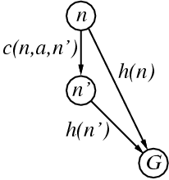
Consistent heuristics
A heuristic is consistent if for every node n, every successor n' of n generated by any action a,
h(n) ≤ c(n,a,n') + h(n')
If h is consistent, we have
f(n') = g(n') + h(n')
= g(n) + c(n,a,n') + h(n')
≥ g(n) + h(n)
= f(n)
i.e., f(n) is non-decreasing along any path.
Theorem: If h(n) is consistent, A* using GRAPH-SEARCH is optimal
For closer node (n') heuristic value is lesser than further node (n)

Slide 55
Properties of A*
Complete?
Yes, (assuming that f(n) is always increasing).
Optimal?
Yes, The cost of a path always increases as we go along the path. Therefore the first goal node selected for expansion is the optimal solution [condition h(n) is admissible]
Time?
O(b^{⌈C*/e⌉} ) where, C* : cost of optimal solution (≈O(b^{d}) approx. with level)
Space?
O(b^{⌈C*/e⌉} )

Slide 56
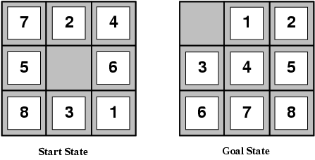
Example: Admissible heuristics
E.g., for the 8-puzzle:
h₁(n) = number of misplaced tiles
h₂(n) = total Manhattan distance
(i.e., no. of squares from desired location of each tile)
h₁(S) = 8?
h₂(S) = 3+1+2+2+2+3+3+2 = 18?

Slide 57
Dominance
If h₂(n) ≥ h₁(n) for all n (both admissible)
then h₂ dominates h₁
∀n, h₂(n) ≥ h₁(n)
h₂ is better for search
h2 is more informed than h1 -> h2 is a better heuristic to use

Slide 58
IDA*: Iterative Deepening A*
Inherits the properties of IDS (Iterative Deepening Search): Depth first traversal, gradual increase based on a threshold f
Inherits the properties of A* : Inherits the threshold f calculation, f(n) = g(n)+h(n)
Bullet Points
We will do DFS in iterative deepening style with a gradually increased threshold f
After each DFS, we will get a set of nodes which were not extended due to threshold constraint violation
Among them we will chose the minimum threshold and update f with this value for the next level iterative DFS

Slide 59
IDA*: Pseudocode
function search(n, cost, f) {
if( n is goal) return true // goal reached
if (cost+h(n) > f) return cost+h(n) // threshold failure
updated_f = ∞
found = false
for v ∊ child of n {
path.append(v)
found = search(v, g(v)+cost, f)
if(found is true) return true
updated_f = min(updated_f, found)
path.pop( )
}
return found
}
start and goal are global
path [ ] a global list
function IDA*(){
f = 0
while(true) {
found = search(start, 0, f)
if (found is true) break
f = found
}
}
Reference

Slide 60
IDA*: Simulation
arad
366=0+366
f limit = 0

Slide 61
IDA*: Simulation
arad
366=0+366
f limit = 366
zerind
449=75+374
sibiu
339=140+253
timișoara
447=118+329

Slide 62
IDA*: Simulation
arad
366=0+366
f limit = 366
zerind
449=75+374
sibiu
339=140+253
timișoara
447=118+329
arad
646=280+366
fagaras
415=239+176
Rimnicu vilcea
413=220+193

Slide 63
IDA*: Simulation
arad
366=0+366
f limit = 413
zerind
449=75+374
sibiu
339=140+253
timișoara
447=118+329
arad
646=280+366
fagaras
415=239+176
rimnicu vilcea
413=220+193
craiova
528=368+160
pitesti
327=10+317
sibiu
553=300+253

Slide 64
IDA*: Simulation
arad
366=0+366
f limit = 413
zerind
449=75+374
sibiu
339=140+253
timișoara
447=118+329
arad
646=280+366
fagaras
415=239+176
rimnicu vilcea
413=220+193
craiova
528=368+160
pitesti
327=10+317
sibiu
553=300+253
bucharest
418=0+418
craiova
615=455+160
rimnicu vilcea
607=193+160

Slide 65
IDA*: Simulation
arad
366=0+366
f limit = 415
zerind
449=75+374
sibiu
339=140+253
timișoara
447=118+329
arad
646=280+366
fagaras
415=239+176
rimnicu vilcea
413=220+193
bucharest
450=450+0
sibiu
591=338+253
craiova
528=368+160
pitesti
327=10+317
sibiu
553=300+253
bucharest
418=0+418
craiova
615=455+160
rimnicu vilcea
607=193+160

Slide 66
IDA*: Simulation
f limit = 418
arad
366=0+366
zerind
449=75+374
sibiu
339=140+253
timișoara
447=118+329
arad
646=280+366
fagaras
415=239+176
rimnicu vilcea
413=220+193
bucharest
450=450+0
sibiu
591=338+253
craiova
528=368+160
pitesti
327=10+317
sibiu
553=300+253
bucharest
418=0+418
craiova
615=455+160
rimnicu vilcea
607=193+160
Algorithm stops

Slide 67
Properties of IDA*
Complete?
Yes, (assuming that f(n) is always increasing).
Optimal?
Yes, The cost of a path always increases as we go along the path. Therefore the first goal node selected for expansion is the optimal solution [condition h(n) is admissible]
Time?
O(b^{⌈C*/e⌉} ) where, C* : cost of optimal solution (≈O(b^{d}) approx. with level). But the actual complexity is pretty high compared to A* due to iterative deepening nature and same nodes’ multiple times revisit
Space?
Much less than O(b^{⌈C*/e⌉} ), the main improvement over A* Search

Slide 68
Metaheuristic vs Heuristic
Metaheuristic is a common/generalized solving method.
Heuristic is a problem specific guiding strategy of a solution to solve a problem.

Slide 69
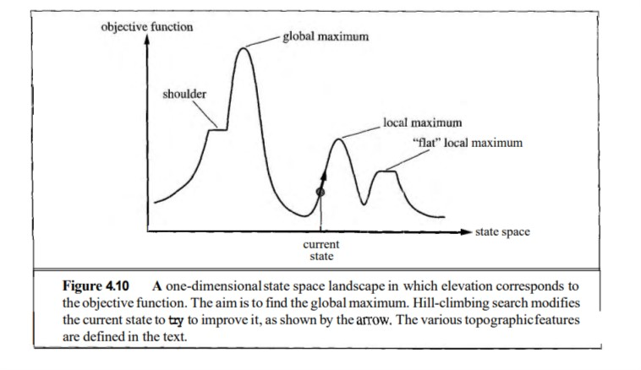
Metaheuristic Algorithms: Hill Climbing Search

Slide 70
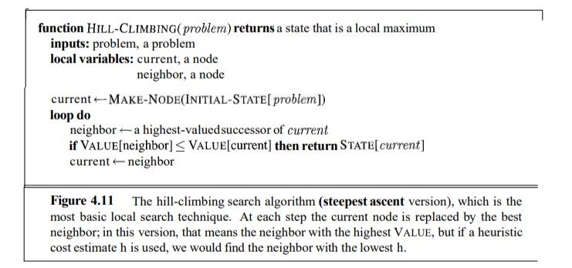
Hill Climbing Search: Pseudocode (steepest ascent version)

Slide 71
Hill Climbing Search: steepest ascent/greedy local search
From each state S, generate the next possible states S₁,S₂,S₃,..,S_{K}
Calculate the heuristic cost estimation h_{i} for each S_{i}
Choose the S_{x} having the optimal h_{x} compared to others [greedy choice]
If h_{x} is better than h (heuristic value of S), then S_{x} is next state to work with. But If h_{x} is worse, then the algorithm stops.
If there are multiple h_{x} randomly any S_{x} can be considered for the next possible state.

Slide 72
Hill Climbing Search Example: 8 Puzzle
h(state) = total Manhattan distance calculated from each tiles

Slide 73
7 | 2
5 | 3 | 4
8 | 1 | 6
7 | 3 | 2
5 |  | 4
8 | 1 | 6
7 | 2 | 4
 | 5 | 6
8 | 3 | 1
7 | 2 | 4
5 | 3 | 6
 | 8 | 1
7 | 2 | 4
5 | 3 | 6
8 | 1
17
16
Stuck in local maxima
14
14
17
7 |  | 2
5 | 3 | 4
8 | 1 | 6
 | 7 | 2
5 | 3 | 4
8 | 1 | 6
7 | 2 | 4
5 |  | 6
8 | 3 | 1
13
7 |  | 2
5 | 3 | 4
8 | 1 | 6
7 | 2 | 4
5 | 3 | 6
8 |  | 1
7 | 2 | 4
5 | 3 | 6
8 | 1
17
16
12
18
14
13
15
7 |  | 4
5 | 2 | 6
8 | 3 | 1
13
5 | 7 | 2
 | 3 | 4
8 | 1 | 6
7 | 2 | 4
5 |  | 6
8 | 3 | 1
7 | 2 | 4
5 | 3
8 | 1 | 6
7 | 2
5 | 3 | 4
8 | 1 | 6
19
18
17
7 | 2 | 4
5 | 6
8 | 3 | 1
16
15
Hill Climbing Search: Greedy Best Choice, Randomized at per step over optimal improved choices
16
7 | 2 | 4
5 |  | 3
8 | 1 | 6
7 | 2 | 4
5 | 3 | 6
8 | 1
7 | 2 | 4
5 | 3
8 | 1 | 6

Slide 74
Hill Climbing Search Issues
Number of nodes’/states’ expansion is very few
But often fails to reach the goal state
Very flexible with lots of variations
Can stuck in
Local maxima: suboptimal result
Ridges: Creating a sequence of local maxima that are not directly connected to each other. A special kind of local maxima, higher than its neighbours but its a slope.
Plateaux: (shoulder/flat local maxima)

Slide 75
Hill Climbing Search: Local Maxima and Plateaux Example
h(n)=0
h(n)=-12
S(n1)=S(n2)=-10
S(n1)=S(n2)=-17

Slide 76
Hill Climbing Search Variations
Let we are in state S having heuristic value h, from this state we can move to two new states S₁ and S₂, having heuristic values as h₁ and h₂ respectively.
Greedy Local Search: Choose the state S_{i} with better h_{i} compared to h. If can’t move, we stop. Reached local maxima/global maxima.
Stochastic Hill Climbing: Choose any state S_{i} having better h_{i} compared to h. Start from that state for the next iterations.
First choice Hill climbing: Start generating states randomly. During generation if any state S_{i} is found to have better h_{i} compared to h of S. Stop generating states, start with S_{i} for the next iteration. Main difference between 2 and 3 is, 2 generates all the states first.

Slide 77
Hill Climbing Search Variations (Contd.)
Random Restart Hill Climbing: For the initial state, randomly choose a next possible state from the valid moves, and then follow any hill climbing approach.
7 | 2 | 4
 | 5 | 6
8 | 3 | 1
7 | 2 | 4
5 |  | 6
8 | 3 | 1
Randomly choose any move ignoring the value of heuristic suggestion and then follow the node expansion strategy
7 |  | 4
5 | 2 | 6
8 | 3 | 1
7 | 2 | 4
5 | 3 | 6
8 |  | 1
7 | 2 | 4
5 | 6
8 | 3 | 1

Slide 78
Plateaux Moves
Let we are in state S having heuristic value h, from this state we can move to two new states S₁ and S₂, having heuristic values as h₁ and h₂ respectively. And h₁ = h₂ = h. Two possibilities -
Stuck into shoulder
Stuck into flat local maxima
Solution: Continue with any state S_{i} with a bound B that denotes how many consecutive similar value moves are allowed (e.g, B=100).
B is fixed so that, the searching does not get stuck into infinite loop (flat local maxima)
Some S_{i} will eventually improve h
No S_{i} will eventually improve h

Slide 79
Metaheuristic Algorithm: Simulated Annealing
Issues in hill climbing approaches (greedy, stochastic, first-choice, etc.)
Pros: Fast
Cons: Incomplete, often gets stuck in the local maxima/minima/optimal solution
Issues in Random Walk (Random move)
Pros: Eventually always finds the global optimal solution
Cons: Extremely slow
Better Approach will be merging both (Simulated Annealing)
Greedy choices of hill climbing (to bring efficiency/faster solution)
Some random moves with probability function (to bring completeness by reaching global maxima)

Slide 80
Simulated Annealing
“ In metallurgy, annealing is the process used to temper or harden metals and glass by heating them to a high temperature and then gradually cooling them, thus allowing the material to coalesce into a low-energy crystalline state. “
In this algorithm,
when we can give good move (giving better heuristic value), we will give that
But when we do not have a good move, we give some bad ones with a probabilistic approach mapped with the temperature
Initially, we start by shaking hard (at a high temperature) / can give a lot of bad moves
But slowly, we reduce the intensity of the shaking (lower temperature) / the number of bad moves get reduced.

Slide 81
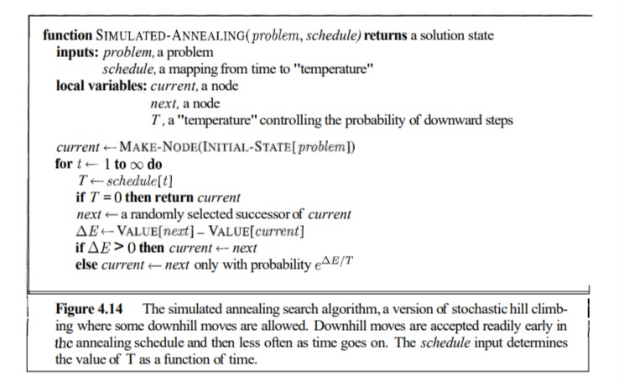
Simulated Annealing
ΔE < 0 and with decrease in ΔE , probability reduces
With decreased, T, probability also reduces and T always gets reduced with time

Slide 82
Simulated Annealing (SA)
A “bad” move from A to B is accepted with a probability
(f(B)-f(A)/T)
e
The higher the temperature, the more likely it is that a bad move can be made. E.g, e^{(-15+12)/10} > e^{(-15+12)/3} (-15 is worse than -12 in 8 puzzle, initially high probability, slowly low probability to choose)
As T tends to zero, this probability tends to zero, and SA becomes more like hill climbing (getting stuck 1/e∞ ≈ 0)
If T is lowered slowly enough (high probability for bad moves), SA is complete and admissible.

Slide 83
Genetic Algorithm(GA)
To understand the adaptive processes of natural systems
To design an artificial systems software that retains the robustness of natural systems
Provide efficient, effective techniques for optimization and machine learning applications

Slide 84
Main Idea
Take a population of candidate solutions to a given problem.
Use operators inspired by the mechanisms of natural genetic variation.
Apply selective pressure towards certain properties
Evolve a more fit solution

Slide 85
GA Terminology
Abstractions imported from biology
Chromosomes, Genes, Alleles (Representation of candidates)
Fitness, Selection (Evolution)
Crossover, Mutation (operators)

Slide 86
GA Terminology
In the spirit – but not the letter – of biology
GA chromosomes are strings of genes
Each gene has a number of alleles; i.e., settings
Each chromosome is an encoding of a solution to a problem
A population of such chromosomes is operated on by a GA

Slide 87
Encoding
A data structure for representing candidate solutions
Often takes the form of a bit string
Usually has internal structure; i.e., different parts of the string represent different aspects of the solution.

Slide 88
Crossover
Mimics biological recombination
Some portion of genetic material is swapped between chromosomes
Typically the swapping produces an offspring
Mechanism for the dissemination of “building blocks” (schemas)

Slide 89
Mutation
Selects a random locus – gene location – with some probability and alters the allele at that locus
The intuitive mechanism for the preservation of variety in the population

Slide 90
Fitness
A measure of the goodness of the organism
Expressed as the probability that the organism will live another cycle (generation)
Basis for the natural selection simulation
Organisms are selected to mate with probabilities proportional to their fitness
Probabilistically better solutions have a better chance of conferring their building blocks to the next generation (cycle)

Slide 91
The GA cycle
reproduction
children
modification
modified
children
parents
population
evaluation
evaluated children
deleted
members
discard

Slide 92
The GA cycle
Randomly generated initial
population
Evaluate
All
individual
Stop ?
Best
individual
Y
N
Start
Crossing Over
Result
Generation Cycle
Mutation

Slide 93
Population
Chromosomes could be:
Bit strings (0101 ... 1100)
Real numbers (43.2 -33.1 ... 0.0 89.2)
Permutations of element (E11 E3 E7 ... E1 E15)
Lists of rules (R1 R2 R3 ... R22 R23)
... any data structure ...
population
All are candidates for different problems, representing a possible solution

Slide 94
Reproduction
children
reproduction
parents
population
Parents are selected at random with selection chances biased in relation to chromosome evaluations.

Slide 95
Modification
Modifications are stochastically triggered
Operator types are:
Mutation
Crossover (recombination)
Modifications
Children
Modified Children

Slide 96
Evaluation
The evaluator decodes a chromosome and assigns it a fitness measure
The evaluator is the only link between a classical GA and the problem it is solving
modified
children
evaluated
children
evaluation

Slide 97
Deletion
Generational GA: entire populations replaced with each iteration
Steady-state GA: a few members replaced at each generation
population
discarded members
discard

Slide 98
Example: the MAXONE problem
Suppose we want to maximize the number of ones in a string of l binary digits.

Slide 99
Example (cont)
An individual is encoded (naturally) as a string of l binary digits
The fitness f of a candidate solution to the MAXONE problem is the number of ones in its genetic code
We start with a population of n random strings. Suppose that l = 10 and
n = 6

Slide 100
Example (initialization)
We toss a fair coin 60 times and get the following initial population:
S₁ | = | 1 | 1 | 1 | 1 | 0 | 1 | 0 | 1 | 0 | 1 | f(S₁ ) | = | 7
S₂ | = | 0 | 1 | 1 | 1 | 0 | 0 | 0 | 1 | 0 | 1 | f(S₂ ) | = | 5
S₃ | = | 1 | 1 | 1 | 0 | 1 | 1 | 0 | 1 | 0 | 1 | f(S₃ ) | = | 7
S₄ | = | 0 | 1 | 0 | 0 | 0 | 1 | 0 | 0 | 1 | 1 | f(S₄ ) | = | 4
S₅ | = | 1 | 1 | 1 | 0 | 1 | 1 | 1 | 1 | 0 | 1 | f(S₅ ) | = | 8
S₆ | = | 0 | 1 | 0 | 0 | 1 | 1 | 0 | 0 | 0 | 0 | f(S₆ ) | = | 3
Fitness |  |  |  |  |  |  |  |  |  |  |  |  | = | 34

Slide 101
Example (selection)
Suppose that, after performing selection, we get the following population:
S₁’ | = | 1 | 1 | 1 | 1 | 0 | 1 | 0 | 1 | 0 | 1 | (S₁ ) | = | 7
S₂’ | = | 1 | 1 | 1 | 0 | 1 | 1 | 0 | 1 | 0 | 1 | (S₃ ) | = | 7
S₃’ | = | 1 | 1 | 1 | 0 | 1 | 1 | 1 | 1 | 0 | 1 | (S₅ ) | = | 8
S₄’ | = | 0 | 1 | 1 | 1 | 0 | 0 | 0 | 1 | 0 | 1 | (S₂ ) | = | 5
S₅’ | = | 0 | 1 | 0 | 0 | 0 | 1 | 0 | 0 | 1 | 1 | (S₄ ) | = | 4
S₆’ | = | 0 | 1 | 0 | 0 | 1 | 1 | 0 | 0 | 0 | 0 | (S₆ ) | = | 3
Fitness |  |  |  |  |  |  |  |  |  |  |  |  | = | 34

Slide 102
Example (crossover)
Next we mate strings for crossover. For each couple we decide according to crossover probability (for instance 0.6) whether to actually perform crossover or not
Suppose that we decide to actually perform crossover only for couples (s₁`, s₂`) and (s₅`, s₆`). For each couple, we randomly extract a crossover point, for instance 2 for the first and 5 for the second.

Slide 103
Example (crossover)
Before crossover
S₁’ | = | 1 | 1 | 1 | 1 | 0 | 1 | 0 | 1 | 0 | 1
S₂’ | = | 1 | 1 | 1 | 0 | 1 | 1 | 0 | 1 | 0 | 1
S₅’ | = | 0 | 1 | 0 | 0 | 0 | 1 | 0 | 0 | 1 | 1
S₆’ | = | 0 | 1 | 0 | 0 | 1 | 1 | 0 | 0 | 0 | 0
After crossover
S₁’’ | = | 1 | 1 | 1 | 0 | 1 | 1 | 0 | 1 | 0 | 1
S₂’’ | = | 1 | 1 | 1 | 1 | 0 | 1 | 0 | 1 | 0 | 1
S₅’’ | = | 0 | 1 | 0 | 0 | 0 | 1 | 0 | 0 | 0 | 0
S₆’’ | = | 0 | 1 | 0 | 0 | 1 | 1 | 0 | 0 | 1 | 1

Slide 104
Example (mutation)
The final step is to apply random mutation: for each bit that we are to copy to the new population we allow a small probability of error (for instance 0.1)
Before applying mutation:
S₁’’ | = | 1 | 1 | 1 | 0 | 1 | 1 | 0 | 1 | 0 | 1
S₂’’ | = | 1 | 1 | 1 | 1 | 0 | 1 | 0 | 1 | 0 | 1
S₃’’ | = | 1 | 1 | 1 | 0 | 1 | 1 | 1 | 1 | 0 | 1
S₄’’ | = | 0 | 1 | 1 | 1 | 0 | 0 | 0 | 1 | 0 | 1
S₅’’ | = | 0 | 1 | 0 | 0 | 0 | 1 | 0 | 0 | 0 | 0
S₆’’ | = | 0 | 1 | 0 | 0 | 1 | 1 | 0 | 0 | 1 | 1

Slide 105
Example (mutation)
After applying mutation:
S₁’’’ | = | 1 | 1 | 1 | 0 | 1 | 1 | 1 | 1 | 0 | 1 | f(S₁’’’) | = | 8
S₂’’’ | = | 1 | 1 | 1 | 1 | 1 | 1 | 0 | 1 | 0 | 0 | f(S₂’’’) | = | 7
S₃’’’ | = | 1 | 1 | 1 | 0 | 1 | 1 | 1 | 1 | 1 | 1 | f(S₃’’’) | = | 9
S₄’’’ | = | 0 | 1 | 1 | 1 | 0 | 0 | 0 | 1 | 0 | 1 | f(S₄’’’) | = | 5
S₅’’’ | = | 0 | 1 | 0 | 0 | 0 | 1 | 0 | 0 | 0 | 1 | f(S₅’’’) | = | 3
S₆’’’ | = | 0 | 1 | 0 | 0 | 1 | 1 | 0 | 1 | 1 | 1 | F(S₆’’’) | = | 5
Fitness |  |  |  |  |  |  |  |  |  |  |  |  | = | 37

Slide 106
Example
In one generation, the total population fitness changed from 34 to 37, thus improved by ~9%
At this point, we go through the same process all over again, until a stopping criterion is met

Slide 107
Example 2: 8-queen problem
Encoding: integer number from 0 -63 (8x8 board)
21 | 52 | 37 | 22 | 38 | 62 | 11 | 1
 | 1
 |  |  | 11
 |  |  |  |  | 21 | 22
 |  |  |  |  | 37 | 38
 |  |  |  | 52
 |  |  |  |  |  | 62
 | ■
 |  |  | ■
 |  |  |  |  | ■ | ■
 |  |  |  |  | ■ | ■
 |  |  |  | ■
 |  |  |  |  |  | ■
Fitness: Number of queens under attack(by 2) and target 0 [-9]

Slide 108
Crossover
 | ■
 |  |  | ■
 |  |  |  |  | ■ | ■
 |  |  |  |  | ■ | ■
 |  |  |  | ■
 |  |  |  |  |  | ■
 |  | ■ | ■
■
 |  | ■
 |  |  |  | ■
 |  |  |  |  |  |  | ■
 |  |  |  |  | ■ |  | ■
One to the right shift
Bring the next free one from the other side
21 | 52 | 37 | 22 | 38 | 62 | 11 | 1
53 | 11 | 16 | 26 | 47 | 55 | 10 | 36
21 | 53 | 52 | 11 | 37 | 16 | 22 | 26 | 38 | 47 | 62 | 55 | 11 | 10 | 1 | 36
21 | 53 | 52 | 11 | 37 | 16 | 22 | 26
38 | 47 | 62 | 55 | 11 | 10 | 1 | 36
 |  |  | ■
■ |  |  |  |  | ■ | ■
 |  | ■
 |  |  |  |  | ■
 |  |  |  | ■ | ■
 | ■
 |  | ■ | ■
 |  |  |  | ■ |  | ■
 |  |  |  |  |  |  | ■
 |  |  |  |  |  |  | ■
 |  |  |  |  |  | ■

Slide 109
Example 2: 8-queen problem
Mutation: at any locus randomly
21 | 53 | 52 | 11 | 37 | 16 | 22 | 26
21 | 53 | 52 | 11 | 37 | 9 | 22 | 26
 | ■ |  | ■
■ |  |  |  |  | ■ | ■
 |  | ■
 |  |  |  |  | ■
 |  |  |  | ■ | ■
Fitness: - 7
22 % improvement

Slide 110
GA for TSP
Dhaka | 1
Barisal | 2
Cox Bazar | 3
Sylhet | 4
Rangpur | 5
Jessore | 6
 | 1 | 2 | 3 | 4 | 5 | 6
1 | 0 | 169 | 391 | 241 | 304 | 164
2 |  | 0 | 465 | 405 | 471 | 168
3 |  |  | 0 | 518 | 692 | 550
4 |  |  |  | 0 | 513 | 400
5 |  |  |  |  | 0 | 340
6 |  |  |  |  |  | 0

Slide 111
Initial Population for TSP
 | 1 | 2 | 3 | 4 | 5 | 6
1 | 0 | 169 | 391 | 241 | 304 | 164
2 |  | 0 | 465 | 405 | 471 | 168
3 |  |  | 0 | 518 | 692 | 550
4 |  |  |  | 0 | 513 | 400
5 |  |  |  |  | 0 | 340
6 |  |  |  |  |  | 0
S₁ | (5,3,4,6,1,2) | 692+518+400+164+169 | 1943
S₂ | (2,4,6,1,3,5) | 405+400+164+391+692 | 2052
S₃ | (4,3,6,2,5,1) | 518+550+168+471+304 | 2011
S₄ | (2,3,1,4,6,5) | 465+391+241+400+340 | 1837
S₅ | (4,5,3,6,1,2) | 513+692+550+164+169 | 2088
S₆ | (3,1,4,5,2,6) | 391+241+513+471+168 | 1784
S₇ | (3,5,4,1,6,2) | 692+513+241+164+168 | 1778
S₈ | (4,5,1,3,6,2) | 513+304+391+550+168 | 1926
S₉ | (5,4,2,1,3,6) | 513+405+169+391+550 | 2028
S₁₀ | (1,4,6,3,2,5) | 241+400+550+405+471 | 2067
S₁₁ | (3,4,1,2,6,5) | 518+241+169+168+340 | 1436
S₁₂ | (3,1,6,5,2,4) | 391+164+340+471+405 | 1771

Slide 112
Fitness of Population
S₁ | (3,4,1,2,6,5) | 1436 | S₁₁
S₂ | (3,1,6,5,2,4) | 1771 | S₁₂
S₃ | (3,5,4,1,6,2) | 1778 | S₇
S₄ | (3,1,4,5,2,6) | 1784 | S₆
S₅ | (2,3,1,4,6,5) | 1837 | S₄
S₆ | (4,5,1,3,6,2) | 1926 | S₈
S₇ | (5,3,4,6,1,2) | 1943 | S₁
S₈ | (4,3,6,2,5,1) | 2011 | S₃
S₉ | (5,4,2,1,3,6) | 2028 | S₉
S₁₀ | (2,4,6,1,3,5) | 2052 | S₂
S₁₁ | (1,4,6,3,2,5) | 2067 | S₁₀
S₁₂ | (4,5,3,6,1,2) | 2088 | S₅

Slide 113
Parent selection
S₁ | (3,4,1,2,6,5) | 1436 | S₁₁
S₂ | (3,1,6,5,2,4) | 1771 | S₁₂
S₃ | (3,5,4,1,6,2) | 1778 | S₇
S₄ | (3,1,4,5,2,6) | 1784 | S₆
S₅ | (2,3,1,4,6,5) | 1837 | S₄
S₆ | (4,5,1,3,6,2) | 1926 | S₈
S₇ | (5,3,4,6,1,2) | 1943 | S₁
S₈ | (4,3,6,2,5,1) | 2011 | S₃
S₉ | (5,4,2,1,3,6) | 2028 | S₉
S₁₀ | (2,4,6,1,3,5) | 2052 | S₂
S₁₁ | (1,4,6,3,2,5) | 2067 | S₁₀
S₁₂ | (4,5,3,6,1,2) | 2088 | S₅

Slide 114
Crossover
S₁ | (3,4,1,2,6,5) | 1436 | S₁₁
S₂ | (3,1,6,5,2,4) | 1771 | S₁₂
S₃ | (3,5,4,1,6,2) | 1778 | S₇
S₄ | (3,1,4,5,2,6) | 1784 | S₆
S₅ | (2,3,1,4,6,5) | 1837 | S₄
S₆ | (4,5,1,3,6,2) | 1926 | S₈
S₇ | (5,3,4,6,1,2) | 1943 | S₁
S₈ | (4,3,6,2,5,1) | 2011 | S₃
S₉ | (5,4,2,1,3,6) | 2028 | S₉
S₁₀ | (2,4,6,1,3,5) | 2052 | S₂
S₁₁ | (1,4,6,3,2,5) | 2067 | S₁₀
S₁₂ | (4,5,3,6,1,2) | 2088 | S₅
S₁S₂ | (6,5,3,1,2,4)
S₃S₄ | (3,1,4,5,6,2)

Slide 115
Mutation
S₁ | (3,4,1,2,6,5) | 1436 | S₁₁
S₂ | (3,1,6,5,2,4) | 1771 | S₁₂
S₃ | (3,5,4,1,6,2) | 1778 | S₇
S₄ | (3,1,4,5,2,6) | 1784 | S₆
S₅ | (2,3,1,4,6,5) | 1837 | S₄
S₆ | (4,5,1,3,6,2) | 1926 | S₈
S₇ | (5,3,4,6,1,2) | 1943 | S₁
S₈ | (4,3,6,2,5,1) | 2011 | S₃
S₉ | (5,4,2,1,3,6) | 2028 | S₉
S₁₀ | (2,4,6,1,3,5) | 2052 | S₂
S₁₁ | (1,4,6,3,2,5) | 2067 | S₁₀
S₁₂ | (4,5,3,6,1,2) | 2088 | S₅
S₁S₂ | (6,5,3,1,2,4)
S₃S₄ | (3,1,4,5,6,2)

Slide 116
Mutation
S₁ | (3,4,1,2,6,5) | 1436 | S₁₁
S₂ | (3,1,6,5,2,4) | 1771 | S₁₂
S₃ | (3,5,4,1,6,2) | 1778 | S₇
S₄ | (3,1,4,5,2,6) | 1784 | S₆
S₅ | (2,3,1,4,6,5) | 1837 | S₄
S₆ | (4,5,1,3,6,2) | 1926 | S₈
S₇ | (5,3,4,6,1,2) | 1943 | S₁
S₈ | (4,3,6,2,5,1) | 2011 | S₃
S₉ | (5,4,2,1,3,6) | 2028 | S₉
S₁₀ | (2,4,6,1,3,5) | 2052 | S₂
S₁₁ | (1,4,6,3,2,5) | 2067 | S₁₀
S₁₂ | (4,5,3,6,1,2) | 2088 | S₅
S₁S₂ | (6,2,3,1,5,4) | 1701
S₃S₄ | (3,1,2,5,6,4) | 1771

Slide 117
New Population
S₁ | (3,4,1,2,6,5) | 1436 | S₁₁
S₂ | (3,1,6,5,2,4) | 1771 | S₁₂
S₃ | (3,5,4,1,6,2) | 1778 | S₇
S₄ | (3,1,4,5,2,6) | 1784 | S₆
S₅ | (2,3,1,4,6,5) | 1837 | S₄
S₆ | (4,5,1,3,6,2) | 1926 | S₈
S₇ | (5,3,4,6,1,2) | 1943 | S₁
S₈ | (4,3,6,2,5,1) | 2011 | S₃
S₉ | (5,4,2,1,3,6) | 2028 | S₉
S₁₀ | (2,4,6,1,3,5) | 2052 | S₂
S₁₁ | (1,4,6,3,2,5) | 2067 | S₁₀
S₁₂ | (4,5,3,6,1,2) | 2088 | S₅
S₁S₂ | (6,2,3,1,5,4) | 1701
S₃S₄ | (3,1,2,5,6,4) | 1771

Slide 118
New Population
S₁ | (3,4,1,2,6,5) | 1436 | S₁₁
S₂ | (6,2,3,1,5,4) | 1701 | C₁
S₃ | (3,1,2,5,6,4) | 1771 | C₂
S₄ | (3,1,6,5,2,4) | 1771 | S₁₂
S₅ | (3,5,4,1,6,2) | 1778 | S₇
S₆ | (3,1,4,5,2,6) | 1784 | S₆
S₇ | (2,3,1,4,6,5) | 1837 | S₄
S₈ | (4,5,1,3,6,2) | 1926 | S₈
S₉ | (5,3,4,6,1,2) | 1943 | S₁
S₁₀ | (4,3,6,2,5,1) | 2011 | S₃
S₁₁ | (5,4,2,1,3,6) | 2028 | S₉
S₁₂ | (2,4,6,1,3,5) | 2052 | S₂

Slide 119
After One Iteration
S₁ | (3,4,1,2,6,5) | 1436 | S₁₁
S₂ | (6,2,3,1,5,4) | 1701 | C₁
S₃ | (3,1,2,5,6,4) | 1771 | C₂
S₄ | (3,1,6,5,2,4) | 1771 | S₁₂
S₅ | (3,5,4,1,6,2) | 1778 | S₇
S₆ | (3,1,4,5,2,6) | 1784 | S₆
S₇ | (2,3,1,4,6,5) | 1837 | S₄
S₈ | (4,5,1,3,6,2) | 1926 | S₈
S₉ | (5,3,4,6,1,2) | 1943 | S₁
S₁₀ | (4,3,6,2,5,1) | 2011 | S₃
S₁₁ | (5,4,2,1,3,6) | 2028 | S₉
S₁₂ | (2,4,6,1,3,5) | 2052 | S₂

Slide 120
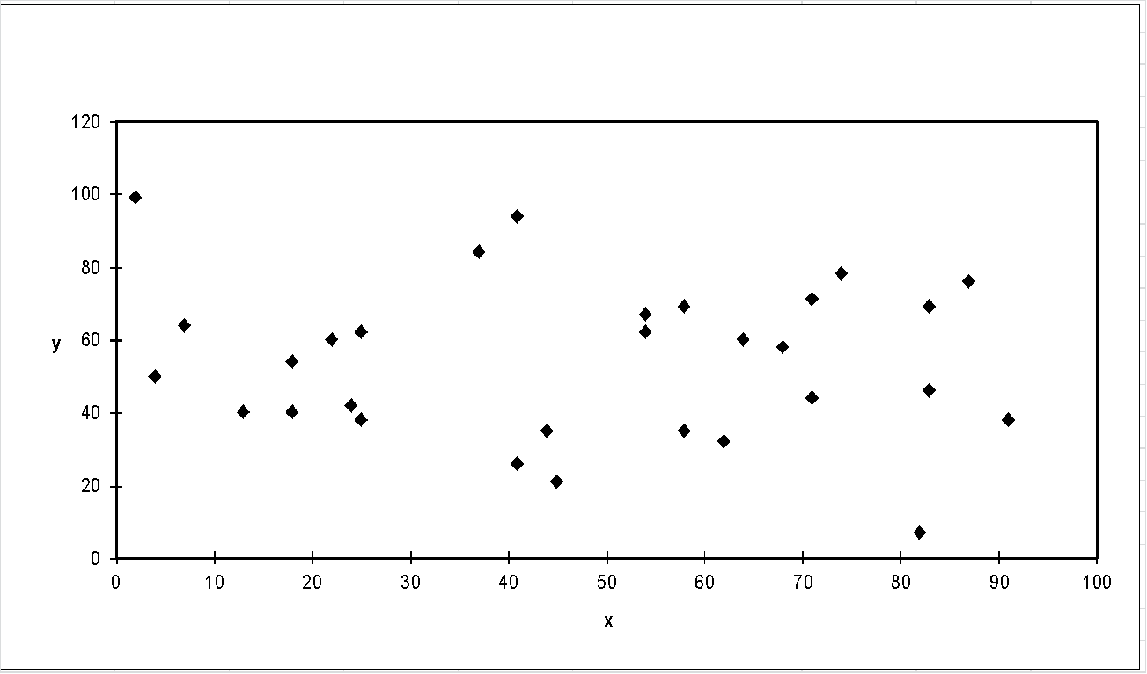
TSP Example: 30 Cities

Slide 121
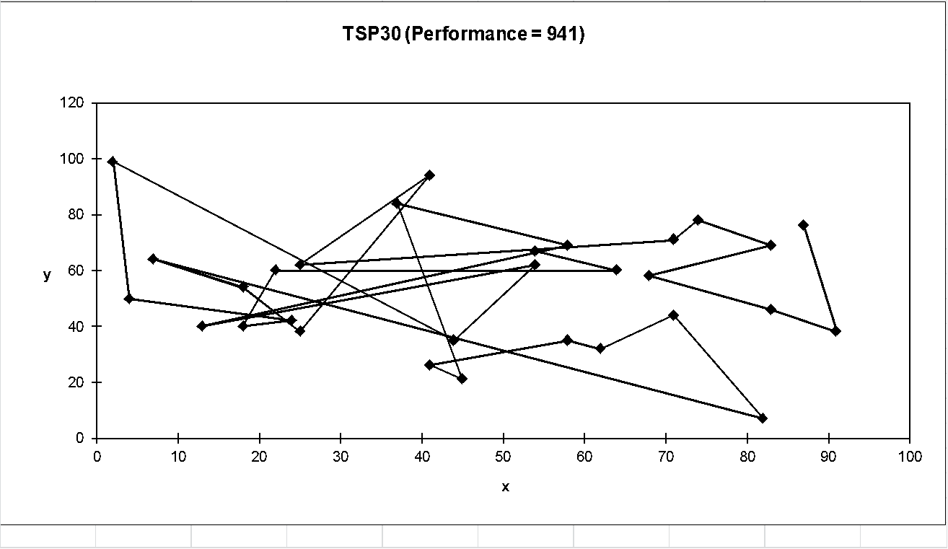
Solution _{i} (Distance = 941)

Slide 122
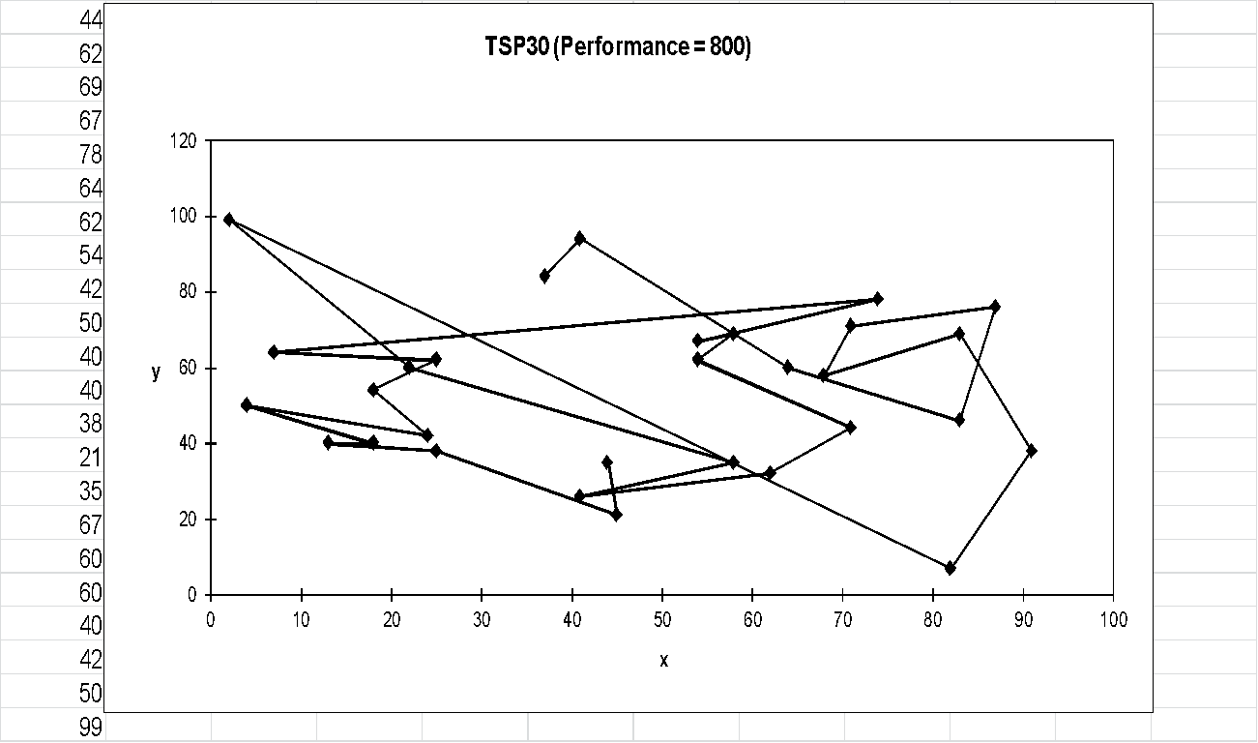
Solution _{j}(Distance = 800)

Slide 123
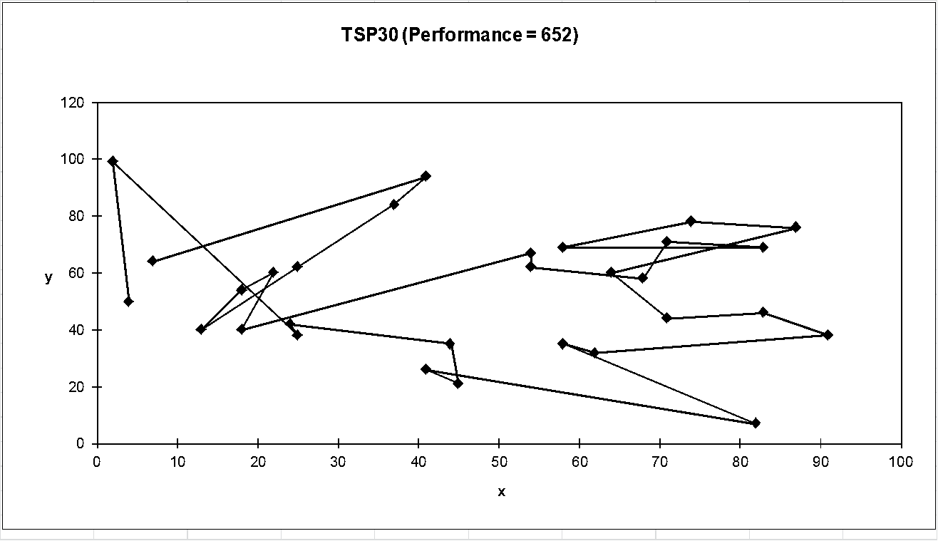
Solution _{k}(Distance = 652)

Slide 124
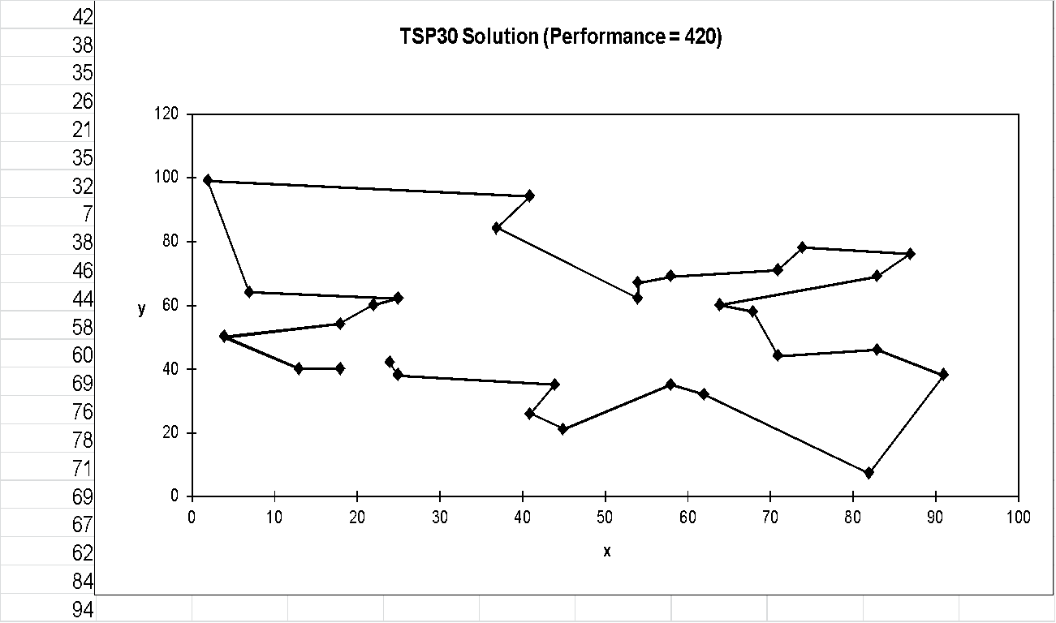
Best Solution (Distance = 420)

Slide 125
Representation
Usual : bit string
Other : array, tree, linked list
Any other data structure

Slide 126
Population size
Population size: small population run the risk of seriously under-covering the solution space, while large populations will require computational resources.
Empirical results suggest that population sizes around 30 are adequate in many cases, but 50-100 are more common.

Slide 127
Population Module
Delete-All : Deletes all the members of the current population and replaces them with the same number of chromosomes that have just been created
Steady-State : Deletes n old members and replaces them with n new members; n is a parameter But do you delete the worst individuals or pick them at random or delete the chromosomes that you used as parents?
Steady-State-No-Duplicates : Same as steady-state but checks that no duplicate chromosomes are added to the population. This adds to the computational overhead but can mean that more of the search space is explored

Slide 128
Elitism
Generation Gap: The fraction of the population that is replaced each cycle. A generation gap of 1.0 means that the whole population is replaced by the offspring. A generation gap of 0.01 (given a population size of 100) means one will be replaced in each iteration.
Elitism: The fraction of the population that is guaranteed to survive to the next cycle. An elitism rate of 0.99 (given a population size of 100) means 1 will be replaced and an elitism rate of 0.01 means 99 will be replaced.

Slide 129
Crossover and Mutation
Decade long debate: which one is better / necessary / main-background
Answer (at least, rather wide agreement):
it depends on the problem, but
in general, it is good to have both
both have different role
mutation-only-EA is possible, crossover-only-EA would not work (new component will not generate otherwise)

Slide 130
Issues with GA
Choosing basic implementation issues:
representation
population size, mutation rate,
selection, deletion policies
crossover, mutation operators
Termination Criteria (when to stop, feasible, complete, optimal, etc.)
Solution is only as good as the evaluation function (often hardest part). If the evaluation function is not good, solution will fail.

Slide 131
Benefits of GA
Concept is easy to understand
Modular, separate from application
Good for “noisy” environments
Always an answer; answer gets better with time
Inherently parallel; easily distributable

Slide 132
When to use GA
Alternate solutions are too slow or overly complicated
Need an exploratory tool to examine new approaches
Problem is similar to one that has already been successfully solved by using a GA
Want to hybridize with an existing solution

Slide 133
Acknowledgement
Prof. Dr. Saifuddin Md. Tareeq
Professor
Department of Computer Science & Engineering, University of Dhaka
Dr. Md. Hasanuzzaman
Professor
Department of Computer Science & Engineering, University of Dhaka

Slide 134
Recommended Textbooks
[Negnevitsky, 2001] M. Negnevitsky “ Artificial Intelligence: A guide to Intelligent Systems”, Pearson Education Limited, England, 2002.
[Russel, 2003] S. Russell and P. Norvig Artificial Intelligence: A Modern Approach Prentice Hall, 2003, Second Edition (Informed Searching)
[Patterson, 1990] D. W. Patterson, “Introduction to Artificial Intelligence and Expert Systems”, Prentice-Hall Inc., Englewood Cliffs, N.J, USA, 1990.
[Minsky, 1974] M. Minsky “A Framework for Representing Knowledge”, MIT-AI Laboratory Memo 306, 1974.
[Hubel, 1995] David H. Hubel, “Eye, Brain, and Vision”
[Ballard, 1982] D. H. Ballard and C. M. Brown, “Computer Vision”, Prentice Hall, 1982.

