Slide 1
ONLINE FOOD DELIVERY SYSTEM LAB 04
GROUP - 01
Presented By
Arun Jyoti Mondal - 2020-3-60-064
Md Sifatullah Sheikh - 2022-1-60-029
Nuzath Tabassum Arthi - 2022-1-60-185
Urmi Kirtonia - 2022-1-60-184
Presented To
Dr. Shamim H. Ripon
Professor
East West University

Slide 2
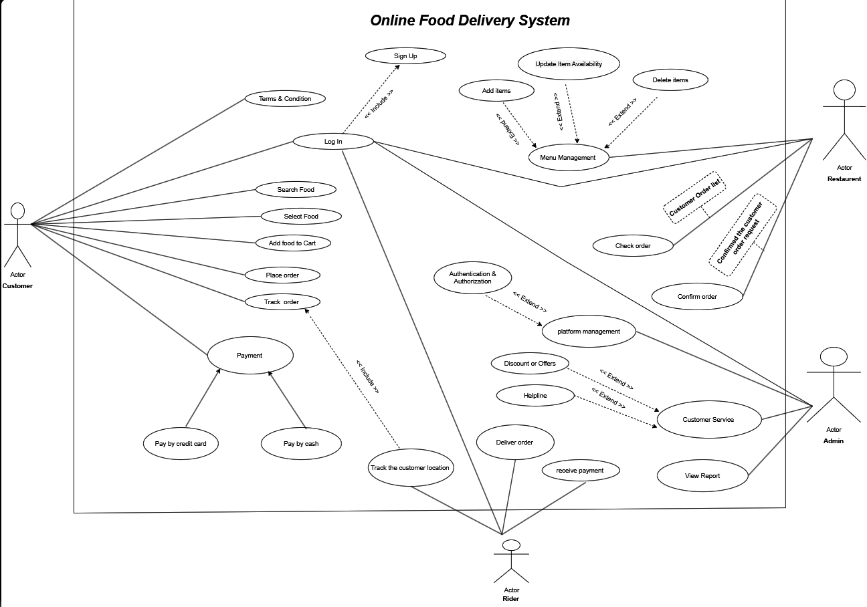
Use Case Diagram

Slide 3
Importance of the Use Case Diagram for Online Food Delivery Management System : Visual Clarity: Depicts core processes, including ordering, payment, and delivery. Stakeholder Communication: It helps developers, clients, and users understand the system. Role Identification: Lists the responsibilities of a customer, delivery agent, restaurant, and admins. Requirement Analysis: Simplifies the system requirements and their relationships. Efficient Design: Helps in the development of a well-organized and user-centered system.
Use Case Importance

Slide 4
Thank You

